Slide 1
MODULE 4 · VIDEO 4.1
4.1
Four questions decided once for every screen
How officers pick, find, move and act is settled for the whole application in one document you accept.
standalone video · voice-over on text slides
Notes:
Title card — the cold open. The hosts name the module, the video number, the title and the single message on this slide; no scripted narration. Hold until the opener begins; the opener is narrated on the next slide.

Slide 2
WHERE WE START
Four questions cross every screen, and none of them is settled yet.
The screens of each goal were agreed one goal at a time.
Leave the four questions open, and the program that builds the application settles them for you.
4.1 · Four questions decided once for every screen
www.itu.int
Notes:
VO: Your officials have agreed the screens of each goal, one goal at a time. Four questions are still open, because each crosses many screens. If you do not settle them in one document, the program that builds the application settles them for you.

Slide 3
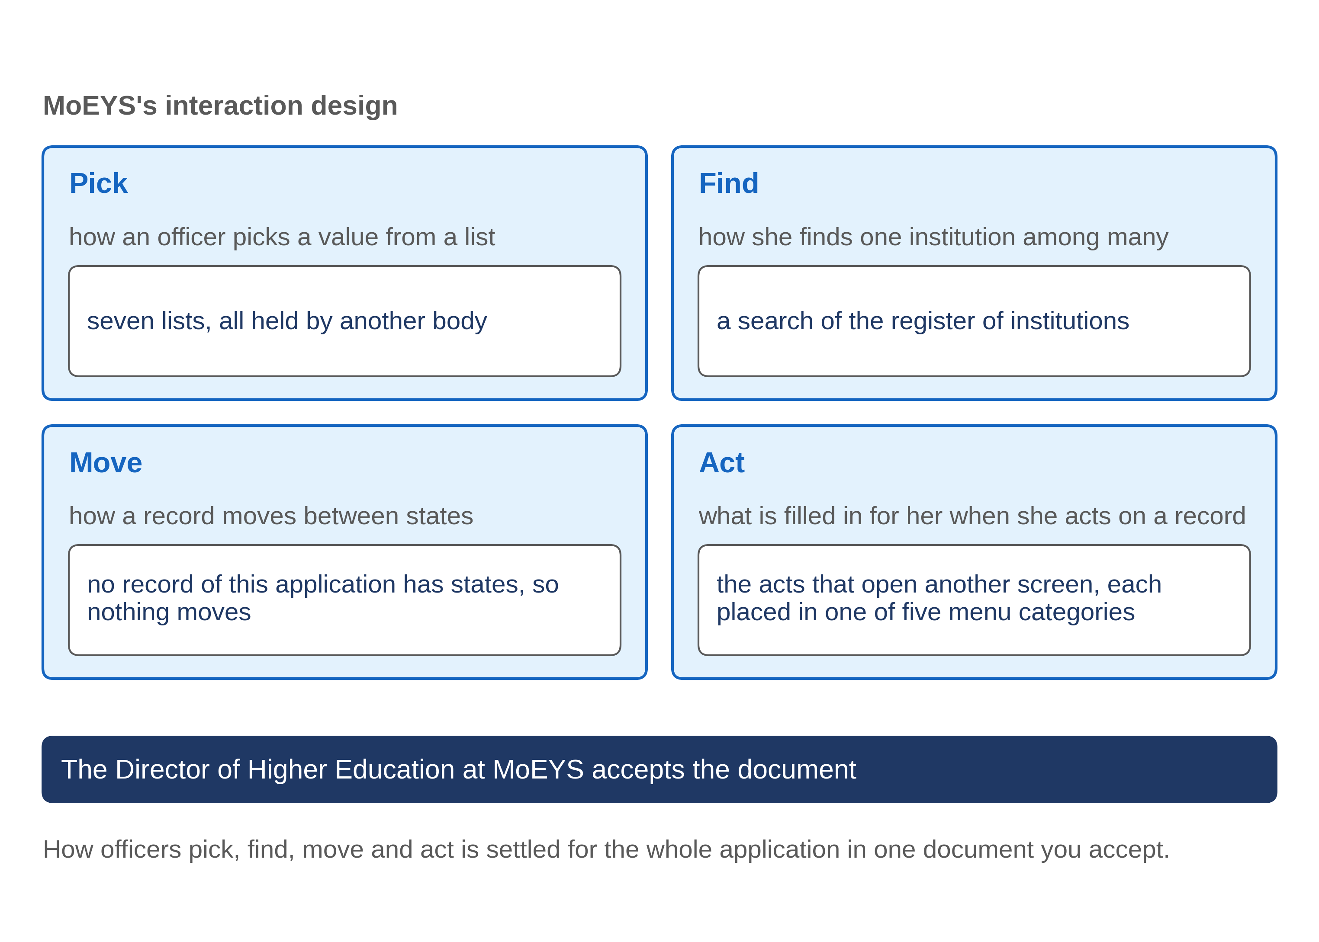
Four questions no single goal can answer
4.1 · Four questions decided once for every screen
Notes:
VO: The first question is how an officer picks a value from a list, such as the kind of licence. The second is how she finds one record among many, such as one institution among hundreds. The third is how a case moves from one state to the next, and who may move it. The fourth is what happens when she acts on a record: which screen opens, and what is already filled in. No single goal can answer these. One list serves many goals, and one case is moved by the acts of several goals.

Slide 4
One document, settled once
Each goal's screens were agreed on their own.
Left open, the four questions are settled by default, screen by screen.
The interaction design settles them once; you accept it before the application is described for the machine.
4.1 · Four questions decided once for every screen
Notes:
VO: Each goal's screens were agreed on their own, so nobody has yet looked across them. Left open, the four questions get answered by default while the application is built, and often differently on different screens. The method closes that gap with one document, the interaction design. One analyst writes it from the agreed screens of every goal. You, or the person you name, accept it. Only then is the application described for the machine. A decision settled once is re-used by every screen that needs it.

Slide 5
MoEYS: pick and find
Pick
seven lists. Each is fixed by Progressa's Higher Education Regulations. MoEYS keeps none.
Find
an institution is found by a search of PHEQA's register, never from a list of every institution.
Most often
a list of what waits for the officer; she picks a row.
4.1 · Four questions decided once for every screen
Notes:
VO: Here is how MoEYS, Progressa's ministry of education, answered the first two questions for its application. To pick a value, an officer uses seven lists. Each is held elsewhere, fixed by Progressa's Higher Education Regulations. MoEYS keeps none, so no screen of its application changes a list. To find an institution, she searches PHEQA's register by name or register number. She never scrolls a list of every institution. Most of the time she does not search at all: she opens the list of what waits for her, and picks a row.

Slide 6
MoEYS: move and act
Move
no record of this application has states. A decision is written once; a correction is a new version.
Act
the record she acts on is carried into the screen that opens, filled in and locked.
Menu
every entry sits in one of five categories: Licences; Names, the list and reviews; Suspension and cancellation; The Gazette; Requests for review.
4.1 · Four questions decided once for every screen
Notes:
VO: The third answer is short. No record of this application has states. A decision is written once, and a correction is a new version, so nothing moves. An institution's standing is shown as PHEQA's register gives it, and is never changed here. The fourth answer covers every act that opens another screen. The record she acted on is carried into that screen, filled in and locked, so she never types it again. Every menu entry sits in one of five categories, from Licences to Requests for review.

Slide 7
Who accepts it, and what she reads
Written by
one analyst of the supplier.
Read by the owner
a short answer, a table for each question, and sample pages to click.
Accepted by
the Director of Higher Education at MoEYS, with her name and the date.
4.1 · Four questions decided once for every screen
Notes:
VO: The Director of Higher Education at MoEYS accepts the document. She reads a short answer, a table for each question, and a few sample pages that show each answer working. She does not read every screen again. Where the goals were silent, the analyst writes a recommended answer, and she agrees it or changes it. Her acceptance is written into the document with her name and the date. Everything described for the machine afterwards is measured against what she accepted.

Slide 8
IN ONE SENTENCE
How officers pick, find, move and act is settled for the whole application in one document you accept.
Do this on your own sector. Find where the four questions are still open.
The prompt in the companion material gives you a table of the places where pick, find, move or act is still open. Before the next video.
4.1 · Four questions decided once for every screen
www.itu.int
Notes:
PRACTICE BOX (on-screen only — never read it, never paraphrase it, never point at it). It replaces the narrated handoff: this video ends on its recap.
VO: Before the application is described for the machine, ask for the one document that settles pick, find, move and act. Click its pages, then accept it in writing.

Slide 9
Sources
• The specification-driven development (SDD) method: the interaction design. No external source is cited.
4.1 · Four questions decided once for every screen
Notes:
Sources slide, held ~5 seconds at the end of the video. No external source is cited; no narration.

