Slide 1
MODULE 4 · VIDEO 4.3
4.3
The service workflow: states, moves and who may make each
Every state a case can be in, every move between states, and who may make each move, written once.
standalone video · voice-over on text slides
Notes:
Title card — the cold open. The hosts name the module, the video number, the title and the single message on this slide; no scripted narration. Hold until the opener begins; the opener is narrated on the next slide.

Slide 2
WHERE WE START
A licence, an application, an appeal: each case passes through stages.
Write the stages down once.
Otherwise every screen invents its own, and the law is enforced on some screens and not on others.
4.3 · The service workflow: states, moves and who may make each
www.itu.int
Notes:
VO: A licence, an application, an appeal: each is a case that passes through stages. If nobody writes those stages down once, every screen invents its own, and the law ends up enforced on some screens and not on others.

Slide 3
Three things, written once
States
every stage a case can be in.
Moves
every step from one state to another.
Who
the person who may make each move, and on what decision.
4.3 · The service workflow: states, moves and who may make each
Notes:
VO: The service workflow is three things, written once for the whole application. The states are every stage a case can be in. The moves are every step from one state to another; a move that is not written down cannot happen. And for each move, the workflow names who may make it, and on what decision. Every screen then offers only the moves the workflow allows, and only to the people it names.

Slide 4
What the published specifications say
A process
linked activities, each a step done by a person or a machine.
A workflow block runs the process
started by another system, by a click, or by the passage of time.
An officer decides on an application
approve, reject, or send back for correction.
GovStack Workflow and Registration specifications.
4.3 · The service workflow: states, moves and who may make each
Notes:
VO: The GovStack specifications give the same picture. The Workflow specification describes a process as a set of linked activities, each a step done by a person or by a machine. It asks a workflow block to run a process, not only to draw it: started by another system, by a person's click, or by the passage of time. The Registration specification gives an officer three decisions on an application: approve it, reject it, or send it back for correction. Its interface lets officers list the tasks that wait for them and complete each one. Find the link in the description.

Slide 5
PHEQA: the states of a licence
Granted
the institution may operate.
Suspended
it may not admit new students until the suspension ends.
Cancelled
it may no longer operate under this licence.
4.3 · The service workflow: states, moves and who may make each
Notes:
VO: Here is the one case in Progressa's example that has states: an institution's licence at PHEQA, the quality authority. It has three. Granted: the institution may operate. Suspended: it may not admit new students until the suspension ends. Cancelled: it may no longer operate under this licence. These three are written once, in the groundwork every goal shares, and every goal that touches a licence reads them from there.

Slide 6
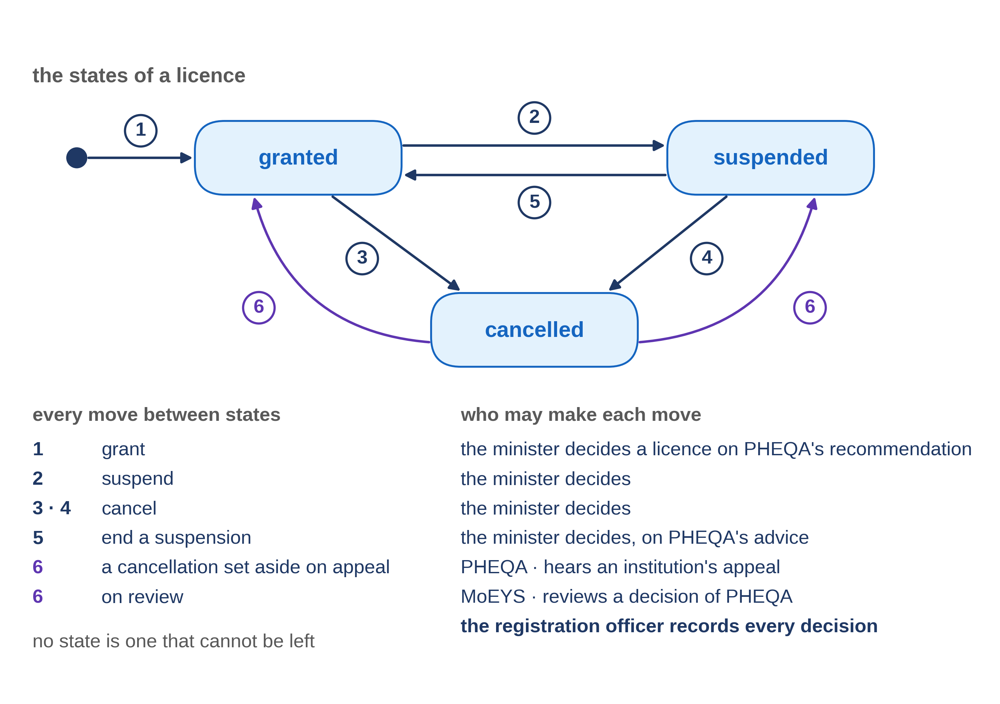
The moves, and who may make each
4.3 · The service workflow: states, moves and who may make each
Notes:
VO: Now the moves. A licence is granted when the minister decides to grant it, as Progressa's Higher Education Regulations provide, and the registration officer records the decision. It is suspended or cancelled on the minister's decision, recorded the same way, and a suspension is ended the same way, on PHEQA's advice. A cancellation is undone only by a decision on appeal or on review that sets it aside. Nobody moves a licence because a screen allows it. Every move rests on a decision someone is entitled to make.
Retrieval prompt — ask before playing on: of granted, suspended and cancelled, which state looks like a dead end, and is it one? Answer on the next slide.

Slide 7
The check: can every state be left?
A state that cannot be left is a dead end.
Cancelled looks like one.
But a cancellation set aside on appeal or on review returns the licence to the state it held before: no state is a dead end.
4.3 · The service workflow: states, moves and who may make each
Notes:
VO: One check is worth asking for: can every state be left? A state that cannot be left is a dead end, and sometimes that is intended. Cancelled looks like one. But an institution may appeal, and a person may ask the minister to review a decision. If the cancellation is set aside, the licence returns to the state it held before. So no state is a dead end, and the drawn workflow shows the way out.

Slide 8
IN ONE SENTENCE
Every state a case can be in, every move between states, and who may make each move, written once.
Do this on your own sector. Draft the states and moves of a case.
The prompt in the companion material gives you a table of states and moves, each move with who may make it and its source. Before the next video.
4.3 · The service workflow: states, moves and who may make each
www.itu.int
Notes:
PRACTICE BOX (on-screen only — never read it, never paraphrase it, never point at it). It replaces the narrated handoff: this video ends on its recap.
VO: Ask for the service workflow on one page: every state, every move, and who may make each move. Check each move against the law, and look for dead ends.

Slide 9
Sources
• GovStack Workflow Building Block specification (23Q4 edition), sections 3 and 4.2
• GovStack Registration Building Block specification (23Q4 edition), sections 6.2.3 and 8.2
Find the link in the description.
4.3 · The service workflow: states, moves and who may make each
Notes:
Sources slide, held ~5 seconds at the end of the video. Links are compiled into the YouTube description per ITU convention; no URLs read aloud.

