Slide 1
MODULE 4 · VIDEO 4.4
4.4
One file a program reads: the application model
Everything agreed is carried into one file, from which the application is generated.
standalone video · voice-over on text slides
Notes:
Title card — the cold open. The hosts name the module, the video number, the title and the single message on this slide; no scripted narration. Hold until the opener begins; the opener is narrated on the next slide.

Slide 2
WHERE WE START
Everything agreed must reach the platform without anyone retyping it.
The stories, the screens, the lists and the workflow are agreed.
The method carries all of it into one file, and a program builds the application from that file.
4.4 · One file a program reads: the application model
www.itu.int
Notes:
VO: Your officials have agreed the stories, the screens, the lists and the workflow. All of it now has to reach the platform without anyone retyping it. The method carries it into one file, and a program builds the application from that file.

Slide 3
What a low-code platform is made of
Forms
the screens where people enter and read values.
Lists
the tables of records people search and open.
Menus
the user interface that leads to each form and list.
Processes
the steps of the work.
4.4 · One file a program reads: the application model
Notes:
VO: A low-code platform builds an application from four kinds of part. Forms are the screens where people enter and read values. Lists are the tables of records that people search and open. The user interface, with its menus, leads to each form and list. Processes are the steps of the work. The platform's own documentation describes a builder for each of the four. Find the link in the description.

Slide 4
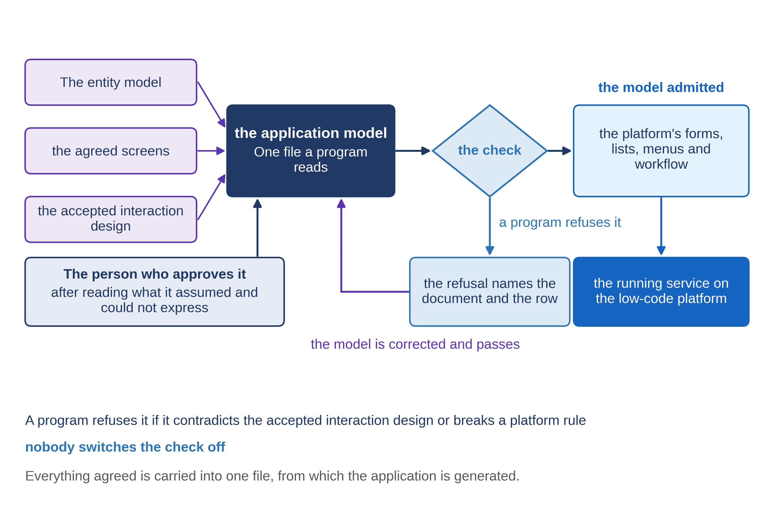
One file instead of a thousand clicks
4.4 · One file a program reads: the application model
Notes:
VO: The usual way is for a builder to click each part together, working from the documents. Every click is a chance to drift from what was agreed. The method does it differently. One file, the application model, holds everything agreed: the records, the lists, the screens, the menus, the workflow, who may do what, and the tests. A program reads the file and generates the parts from it. If something is wrong, the file is corrected, never the parts.

Slide 5
Nothing in the file is new
Stories and screens → forms and lists.
The interaction design → how lists, searches, moves and acts behave; the file names it.
The service workflow → states and moves.
What cannot be placed → written down for a person to rule on.
4.4 · One file a program reads: the application model
Notes:
VO: Nothing in the file is new. Each goal's story and its screens become forms and lists. The interaction design you accepted decides how lists, searches, moves and acts behave, and the file names that document. The service workflow becomes the states and moves. The file is written by an AI assistant that must refuse to guess. When something cannot be placed cleanly, it is written down for a person to rule on, not quietly decided.

Slide 6
MoEYS: one section, in plain sentences
Goal
approve a change of an institution's name.
Starts from
PHEQA's advice on changes of name that waits for the minister.
Shows
the institution's present name, read from PHEQA's register across Linkup; the new name asked for; PHEQA's advice.
Decision
approve or do not approve, chosen, not typed.
Records
the approval, sent to PHEQA across Linkup; officers of MoEYS see it in the list of approvals.
4.4 · One file a program reads: the application model
Notes:
VO: Here is one section of MoEYS's file, for the goal 'approve a change of an institution's name', read in plain sentences. The minister opens the list of PHEQA's advice on changes of name that waits for a decision. On the screen, the institution's present name is read from PHEQA's register across Linkup, the data exchange, and never copied. The new name and PHEQA's advice come as PHEQA sent them. The decision is chosen, approve or do not approve, never typed. Recording it sends the approval to PHEQA, and officers of MoEYS see it in their list of approvals.

Slide 7
Ask for it in plain sentences
The file is written for a program.
Ask for a plain-sentence reading of each section beside it.
Your officials check the reading against the screens they agreed.
Where the two differ, the file is what gets built.
4.4 · One file a program reads: the application model
Notes:
VO: The file is written for a program, not for you. So ask the supplier for a plain-sentence reading of each section, beside the file. Your officials check the reading against the screens they agreed. Then the business side and the builder read the same thing, and a decision means the same in both rooms. Keep one thing in mind: where the reading and the file differ, the file is what gets built. Raise every difference before the file is approved.

Slide 8
IN ONE SENTENCE
Everything agreed is carried into one file, from which the application is generated.
Do this on your own sector. Read one section of the model in plain sentences.
The prompt in the companion material gives you a plain-sentence reading of one section, with anything not agreed marked. Before the next video.
4.4 · One file a program reads: the application model
www.itu.int
Notes:
PRACTICE BOX (on-screen only — never read it, never paraphrase it, never point at it). It replaces the narrated handoff: this video ends on its recap.
VO: Ask for the one file the application is generated from, and a plain-sentence reading of it. Check the reading against what your officials agreed.

Slide 9
Sources
• Joget DX 9 Knowledge Base, the pages Form Builder, List Builder, UI Builder and Process Builder
Find the link in the description.
4.4 · One file a program reads: the application model
Notes:
Sources slide, held ~5 seconds at the end of the video. Links are compiled into the YouTube description per ITU convention; no URLs read aloud.

