Slide 1


FROM AGREED SCREENS TO ONE FILE
Settle the whole application once,
then describe it for the machine
Pick, find, move, act — once
No list longer than nine
Designing Digital Government Services · Module 4
Six standalone videos for the team that has the service specified: the four questions settled once for every screen, long lists chosen by category, the service workflow, the one file a program reads, its review, and the check that refuses a file which contradicts what you accepted.
States, moves and who
One file a program reads
Every assumption ruled on
Length: ~30 mins across 6 videos (4.1 – 4.6)
Target audience: Head of a ministry ICT unit · service owner's project lead · counterpart to the supplier
Refused, not worked around
1 document accepted · 1 file · 1 check nobody switches off
Notes:
Cover for the combined Module 4 deck. Each section that follows is one standalone ~5 minute video, for the team that has the service specified and built: the head of a ministry ICT unit, the service owner's project lead, the counterpart to the supplier.

Slide 2
Module 4 — six videos
4.1 Four questions decided once for every screen ~5 min
4.2 No list longer than nine: choose by category ~5 min
4.3 The service workflow: states, moves and who may make each ~5 min
4.4 One file a program reads: the application model ~5 min
4.5 Reviewing the model: what it assumed, and what it could not express ~5 min
4.6 Refused, not worked around ~5 min
Settle how officers pick, find, move and act once, for the whole application, and accept it in writing.
Then carry everything agreed into one file, have every assumption ruled on, and let a program refuse what contradicts it.
Notes:
Navigation slide for the combined deck; the videos ship standalone. 4.1 to 4.3 settle the application once; 4.4 to 4.6 carry it into the one file, review it, and show the check that refuses it.

Slide 3
MODULE 4 · VIDEO 4.1
4.1
Four questions decided once for every screen
How officers pick, find, move and act is settled for the whole application in one document you accept.
standalone video · voice-over on text slides
Notes:
Title card — the cold open. The hosts name the module, the video number, the title and the single message on this slide; no scripted narration. Hold until the opener begins; the opener is narrated on the next slide.

Slide 4
WHERE WE START
Four questions cross every screen, and none of them is settled yet.
The screens of each goal were agreed one goal at a time.
Leave the four questions open, and the program that builds the application settles them for you.
4.1 · Four questions decided once for every screen
www.itu.int
Notes:
VO: Your officials have agreed the screens of each goal, one goal at a time. Four questions are still open, because each crosses many screens. If you do not settle them in one document, the program that builds the application settles them for you.

Slide 5
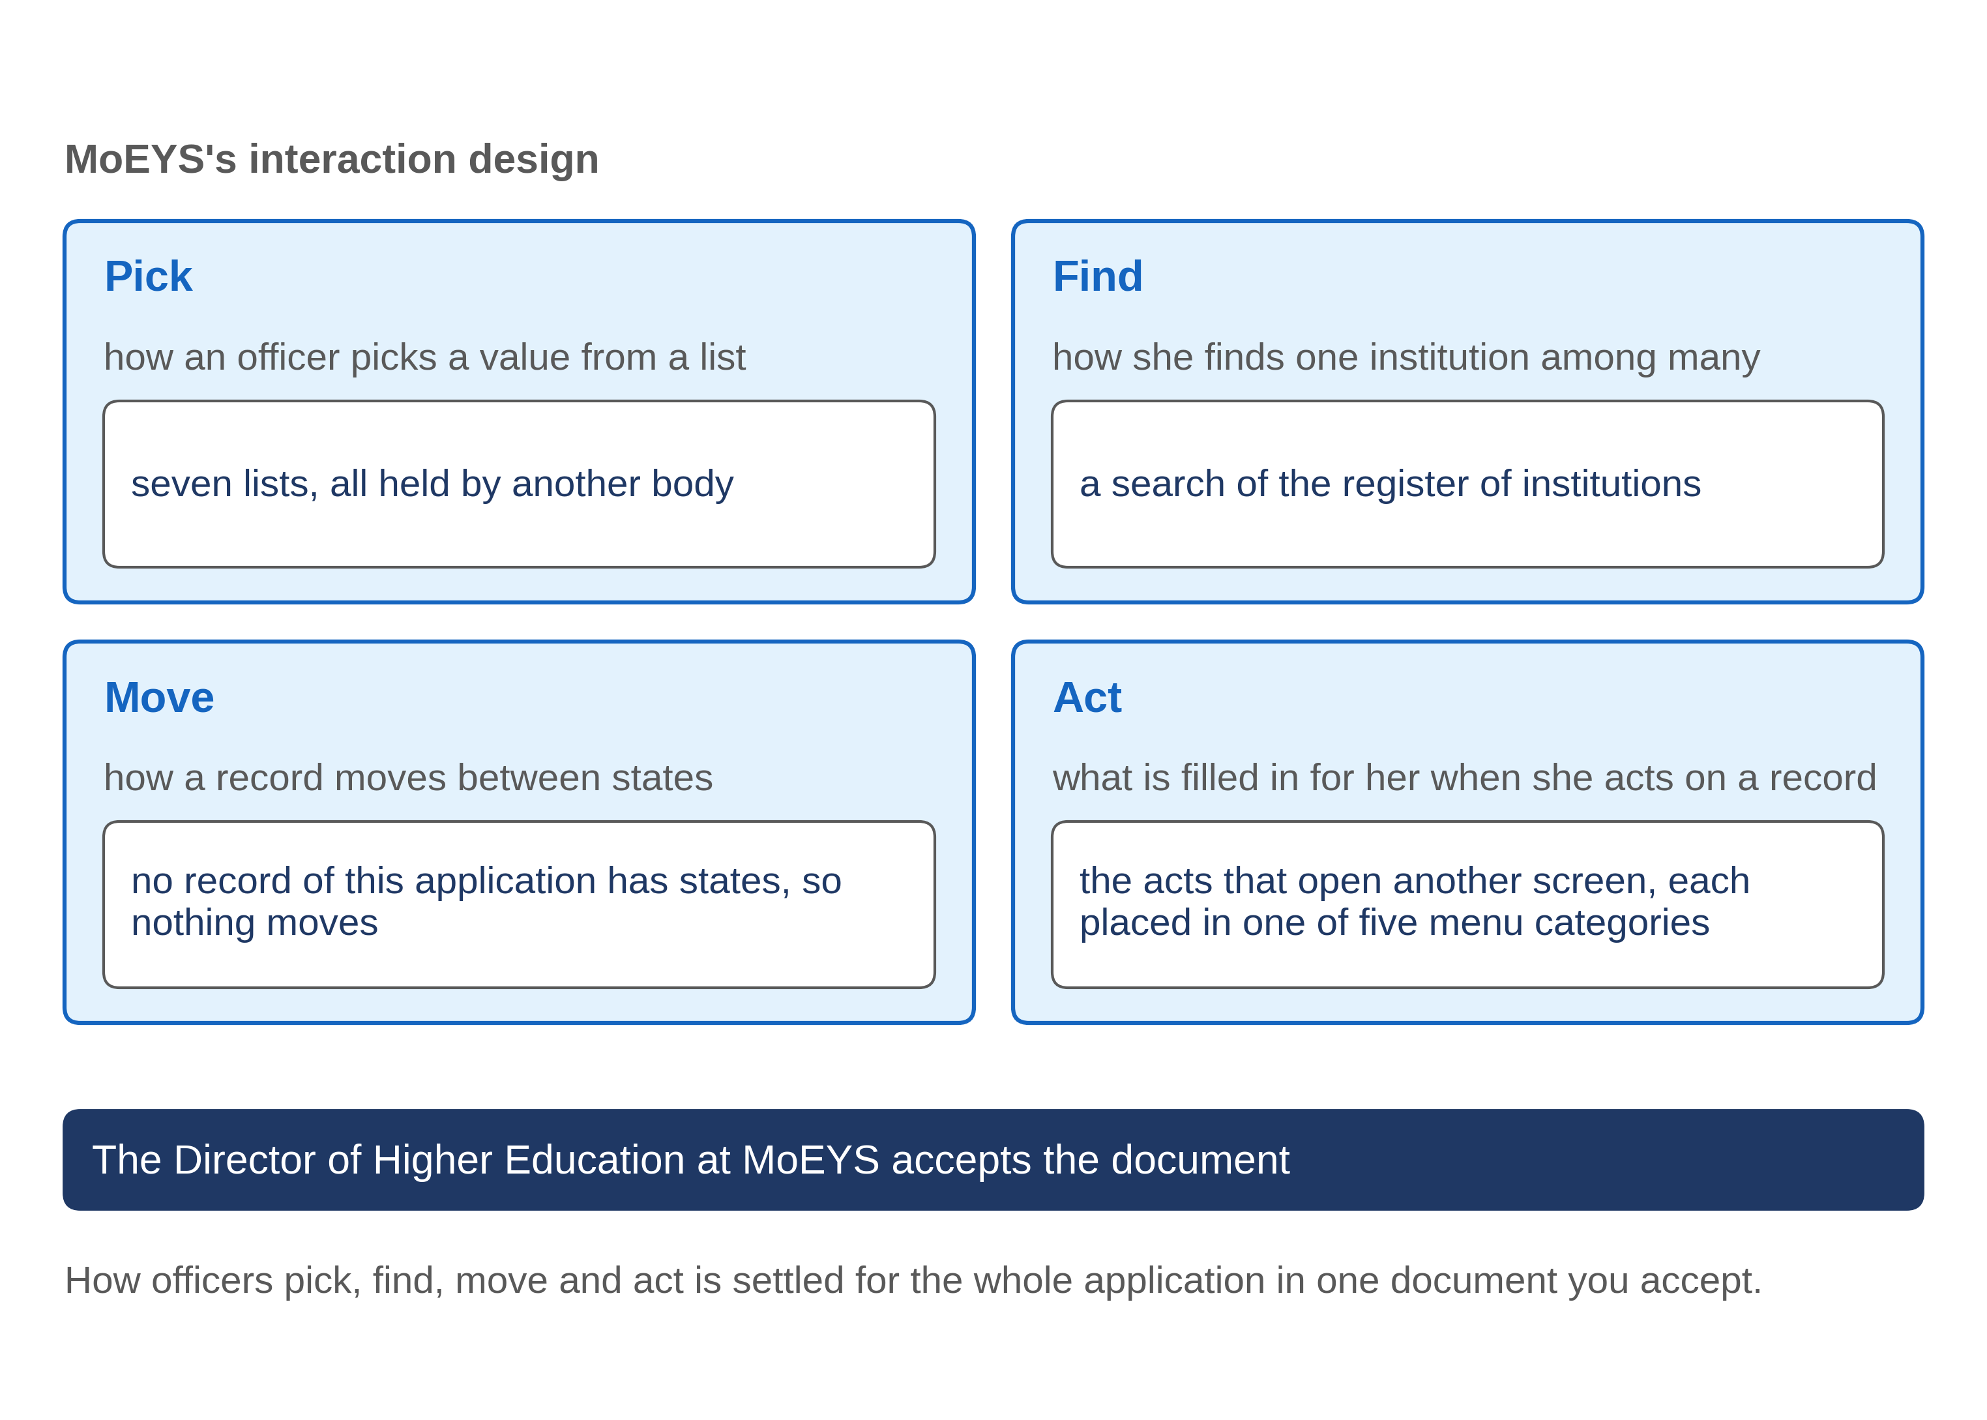
Four questions no single goal can answer
4.1 · Four questions decided once for every screen
Notes:
VO: The first question is how an officer picks a value from a list, such as the kind of licence. The second is how she finds one record among many, such as one institution among hundreds. The third is how a case moves from one state to the next, and who may move it. The fourth is what happens when she acts on a record: which screen opens, and what is already filled in. No single goal can answer these. One list serves many goals, and one case is moved by the acts of several goals.

Slide 6
One document, settled once
Each goal's screens were agreed on their own.
Left open, the four questions are settled by default, screen by screen.
The interaction design settles them once; you accept it before the application is described for the machine.
4.1 · Four questions decided once for every screen
Notes:
VO: Each goal's screens were agreed on their own, so nobody has yet looked across them. Left open, the four questions get answered by default while the application is built, and often differently on different screens. The method closes that gap with one document, the interaction design. One analyst writes it from the agreed screens of every goal. You, or the person you name, accept it. Only then is the application described for the machine. A decision settled once is re-used by every screen that needs it.

Slide 7
MoEYS: pick and find
Pick
seven lists. Each is fixed by Progressa's Higher Education Regulations. MoEYS keeps none.
Find
an institution is found by a search of PHEQA's register, never from a list of every institution.
Most often
a list of what waits for the officer; she picks a row.
4.1 · Four questions decided once for every screen
Notes:
VO: Here is how MoEYS, Progressa's ministry of education, answered the first two questions for its application. To pick a value, an officer uses seven lists. Each is held elsewhere, fixed by Progressa's Higher Education Regulations. MoEYS keeps none, so no screen of its application changes a list. To find an institution, she searches PHEQA's register by name or register number. She never scrolls a list of every institution. Most of the time she does not search at all: she opens the list of what waits for her, and picks a row.

Slide 8
MoEYS: move and act
Move
no record of this application has states. A decision is written once; a correction is a new version.
Act
the record she acts on is carried into the screen that opens, filled in and locked.
Menu
every entry sits in one of five categories: Licences; Names, the list and reviews; Suspension and cancellation; The Gazette; Requests for review.
4.1 · Four questions decided once for every screen
Notes:
VO: The third answer is short. No record of this application has states. A decision is written once, and a correction is a new version, so nothing moves. An institution's standing is shown as PHEQA's register gives it, and is never changed here. The fourth answer covers every act that opens another screen. The record she acted on is carried into that screen, filled in and locked, so she never types it again. Every menu entry sits in one of five categories, from Licences to Requests for review.

Slide 9
Who accepts it, and what she reads
Written by
one analyst of the supplier.
Read by the owner
a short answer, a table for each question, and sample pages to click.
Accepted by
the Director of Higher Education at MoEYS, with her name and the date.
4.1 · Four questions decided once for every screen
Notes:
VO: The Director of Higher Education at MoEYS accepts the document. She reads a short answer, a table for each question, and a few sample pages that show each answer working. She does not read every screen again. Where the goals were silent, the analyst writes a recommended answer, and she agrees it or changes it. Her acceptance is written into the document with her name and the date. Everything described for the machine afterwards is measured against what she accepted.

Slide 10
IN ONE SENTENCE
How officers pick, find, move and act is settled for the whole application in one document you accept.
Do this on your own sector. Find where the four questions are still open.
The prompt in the companion material gives you a table of the places where pick, find, move or act is still open. Before the next video.
4.1 · Four questions decided once for every screen
www.itu.int
Notes:
PRACTICE BOX (on-screen only — never read it, never paraphrase it, never point at it). It replaces the narrated handoff: this video ends on its recap.
VO: Before the application is described for the machine, ask for the one document that settles pick, find, move and act. Click its pages, then accept it in writing.

Slide 11
Sources
• The specification-driven development (SDD) method: the interaction design. No external source is cited.
4.1 · Four questions decided once for every screen
Notes:
Sources slide, held ~5 seconds at the end of the video. No external source is cited; no narration.

Slide 12
MODULE 4 · VIDEO 4.2
4.2
No list longer than nine: choose by category
A long list is divided into categories, and the officer picks the category first.
standalone video · voice-over on text slides
Notes:
Title card — the cold open. The hosts name the module, the video number, the title and the single message on this slide; no scripted narration. Hold until the opener begins; the opener is narrated on the next slide.

Slide 13
WHERE WE START
A list of twenty: she scrolls, reads, and sometimes picks the neighbour.
The method has a plain rule for long lists.
It costs nothing to apply while the application is designed.
4.2 · No list longer than nine: choose by category
www.itu.int
Notes:
VO: Ask an officer to pick one value from a list of twenty, and she scrolls, reads, and sometimes picks the neighbour. The method has a plain rule for this, and it costs nothing to apply while the application is designed.

Slide 14
The rule
No step of a choice offers more than nine values. Seven is the aim.
A longer list is divided into categories of no more than nine.
The officer picks the category first, then the value.
More than nine categories
add a level above them.
4.2 · No list longer than nine: choose by category
Notes:
VO: No step of a choice offers more than nine values, and seven is the aim. A longer list is divided into categories, each holding no more than nine values. The officer picks the category first, then the value inside it. If a list ever needs more than nine categories, another level is added above them. The categories are a list like any other: they have names, someone keeps them, and each new value is placed in one of them when it is added.

Slide 15
Why nine
A short list is read at a glance.
A long list is scrolled, and the wrong value is one line away.
Two short choices are faster and safer than one long one.
4.2 · No list longer than nine: choose by category
Notes:
VO: Why should this matter to you? An officer reads a short list at a glance and finds her value. A long list must be scrolled, and the wrong value is always one line away. A wrong value chosen on a busy day sends a file to the wrong desk, and nobody notices until someone asks where it went. Two short choices are faster and safer than one long one, and the officers who use the screens every day will tell you so.

Slide 16
Who decides the categories
Not a program
it cannot know how your officers think about a list.
Written once, in the interaction design, for the whole application.
Confirmed by the officers who use the list.
4.2 · No list longer than nine: choose by category
Notes:
VO: Who decides the categories? Not a program. A program can count the values, but it cannot know how your officers think about them. So the categories of each long list are decided once, in the interaction design, the one document that settles how officers use the whole application. The analyst proposes them, and the officers who use the list confirm that each value sits where they would look for it. After that, the program that checks the application's description refuses a long list with no categories.

Slide 17
Progressa: the matters PHEQA advises on
Licences
8 matters, such as a provisional licence for a university.
Suspension and cancellation
7 matters, such as suspending a full licence.
Other matters
5 matters, such as a change of an institution's name.
20 matters, 3 categories, no step longer than 8.
4.2 · No list longer than nine: choose by category
Notes:
VO: Here is the one long list in the application of MoEYS, Progressa's ministry of education. PHEQA, the quality authority, advises the minister on twenty kinds of matter, from a provisional licence for a university to a change of an institution's name. Twenty is too many for one step. So the list has three categories: licences, with eight matters; suspension and cancellation, with seven; and other matters, with five. No category holds more than nine, and each name is one the officers of MoEYS already use.

Slide 18
Two steps on the screen
Step 1
on the list of PHEQA's advice that waits for the minister, the officer picks the category: Suspension and cancellation.
Step 2
seven matters appear; she picks: suspending a full licence.
The list now shows only the advice on that matter.
4.2 · No list longer than nine: choose by category
Notes:
VO: Here is where the officer meets it. She opens the list of PHEQA's advice that waits for the minister's decision, and she wants only the advice on suspending a full licence. First she picks the category, suspension and cancellation. Seven matters appear, and she picks the one she wants. The list now shows only that advice. She never saw all twenty at once, and she never scrolled past a value she did not need.

Slide 19
IN ONE SENTENCE
A long list is divided into categories, and the officer picks the category first.
Do this on your own sector. Divide a long list into categories.
The prompt in the companion material gives you a list of categories, none holding more than nine values, each with a plain name. Before the next video.
4.2 · No list longer than nine: choose by category
www.itu.int
Notes:
PRACTICE BOX (on-screen only — never read it, never paraphrase it, never point at it). It replaces the narrated handoff: this video ends on its recap.
VO: When a screen offers a long list, ask how it is divided. No step should offer more than nine values, and the officers who use it should agree the categories.

Slide 20
Sources
• The specification-driven development (SDD) method: the rule that a long list is chosen by category. No external source is cited.
4.2 · No list longer than nine: choose by category
Notes:
Sources slide, held ~5 seconds at the end of the video. No external source is cited; no narration.

Slide 21
MODULE 4 · VIDEO 4.3
4.3
The service workflow: states, moves and who may make each
Every state a case can be in, every move between states, and who may make each move, written once.
standalone video · voice-over on text slides
Notes:
Title card — the cold open. The hosts name the module, the video number, the title and the single message on this slide; no scripted narration. Hold until the opener begins; the opener is narrated on the next slide.

Slide 22
WHERE WE START
A licence, an application, an appeal: each case passes through stages.
Write the stages down once.
Otherwise every screen invents its own, and the law is enforced on some screens and not on others.
4.3 · The service workflow: states, moves and who may make each
www.itu.int
Notes:
VO: A licence, an application, an appeal: each is a case that passes through stages. If nobody writes those stages down once, every screen invents its own, and the law ends up enforced on some screens and not on others.

Slide 23
Three things, written once
States
every stage a case can be in.
Moves
every step from one state to another.
Who
the person who may make each move, and on what decision.
4.3 · The service workflow: states, moves and who may make each
Notes:
VO: The service workflow is three things, written once for the whole application. The states are every stage a case can be in. The moves are every step from one state to another; a move that is not written down cannot happen. And for each move, the workflow names who may make it, and on what decision. Every screen then offers only the moves the workflow allows, and only to the people it names.

Slide 24
What the published specifications say
A process
linked activities, each a step done by a person or a machine.
A workflow block runs the process
started by another system, by a click, or by the passage of time.
An officer decides on an application
approve, reject, or send back for correction.
GovStack Workflow and Registration specifications.
4.3 · The service workflow: states, moves and who may make each
Notes:
VO: The GovStack specifications give the same picture. The Workflow specification describes a process as a set of linked activities, each a step done by a person or by a machine. It asks a workflow block to run a process, not only to draw it: started by another system, by a person's click, or by the passage of time. The Registration specification gives an officer three decisions on an application: approve it, reject it, or send it back for correction. Its interface lets officers list the tasks that wait for them and complete each one. Find the link in the description.

Slide 25
PHEQA: the states of a licence
Granted
the institution may operate.
Suspended
it may not admit new students until the suspension ends.
Cancelled
it may no longer operate under this licence.
4.3 · The service workflow: states, moves and who may make each
Notes:
VO: Here is the one case in Progressa's example that has states: an institution's licence at PHEQA, the quality authority. It has three. Granted: the institution may operate. Suspended: it may not admit new students until the suspension ends. Cancelled: it may no longer operate under this licence. These three are written once, in the groundwork every goal shares, and every goal that touches a licence reads them from there.

Slide 26
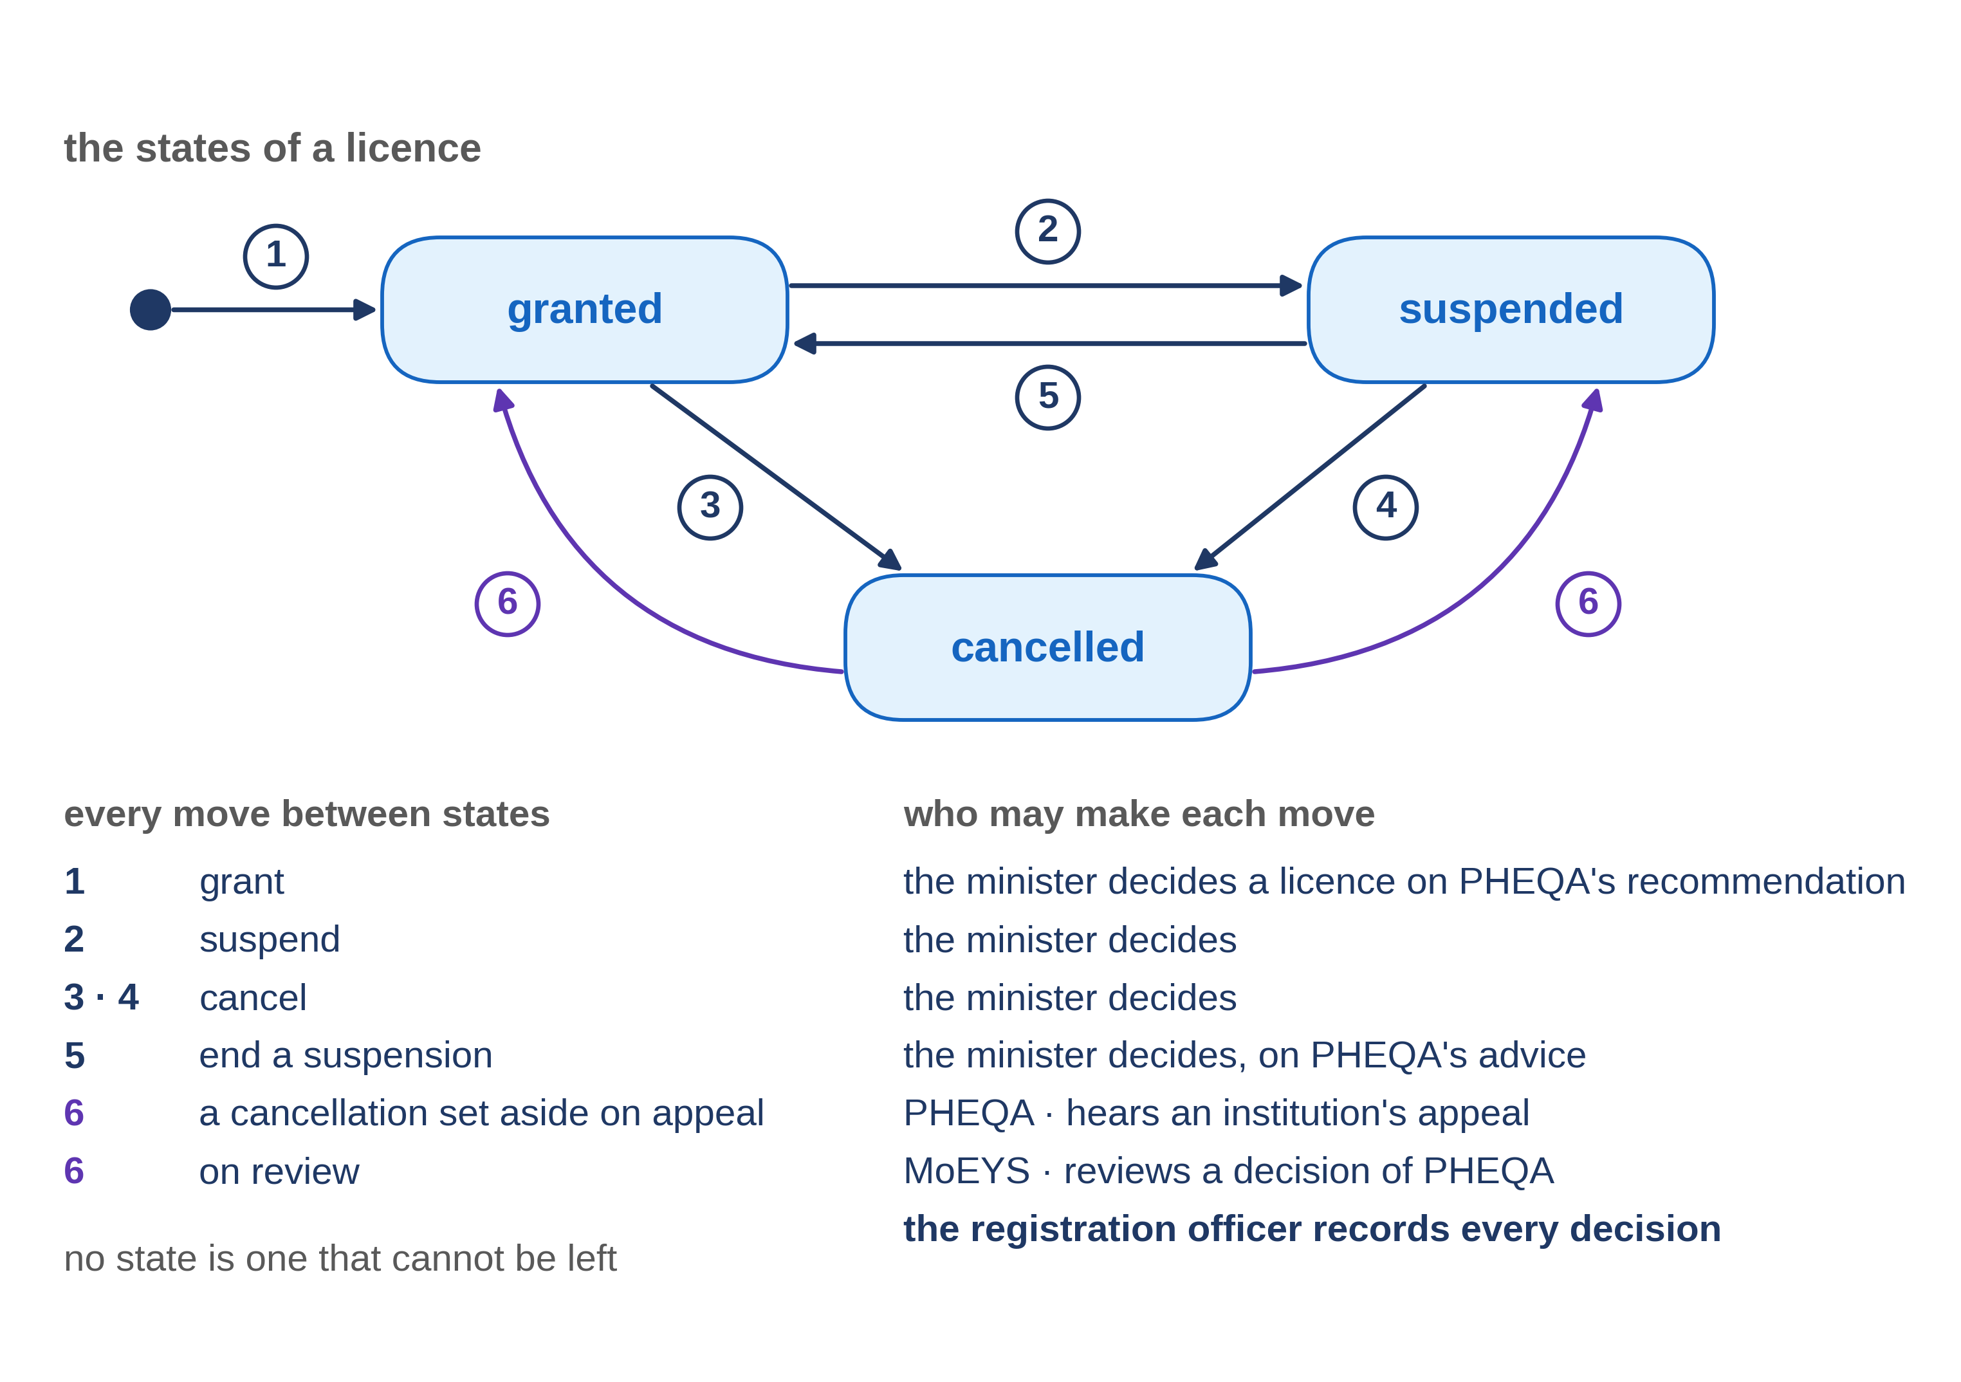
The moves, and who may make each
4.3 · The service workflow: states, moves and who may make each
Notes:
VO: Now the moves. A licence is granted when the minister decides to grant it, as Progressa's Higher Education Regulations provide, and the registration officer records the decision. It is suspended or cancelled on the minister's decision, recorded the same way, and a suspension is ended the same way, on PHEQA's advice. A cancellation is undone only by a decision on appeal or on review that sets it aside. Nobody moves a licence because a screen allows it. Every move rests on a decision someone is entitled to make.
Retrieval prompt — ask before playing on: of granted, suspended and cancelled, which state looks like a dead end, and is it one? Answer on the next slide.

Slide 27
The check: can every state be left?
A state that cannot be left is a dead end.
Cancelled looks like one.
But a cancellation set aside on appeal or on review returns the licence to the state it held before: no state is a dead end.
4.3 · The service workflow: states, moves and who may make each
Notes:
VO: One check is worth asking for: can every state be left? A state that cannot be left is a dead end, and sometimes that is intended. Cancelled looks like one. But an institution may appeal, and a person may ask the minister to review a decision. If the cancellation is set aside, the licence returns to the state it held before. So no state is a dead end, and the drawn workflow shows the way out.

Slide 28
IN ONE SENTENCE
Every state a case can be in, every move between states, and who may make each move, written once.
Do this on your own sector. Draft the states and moves of a case.
The prompt in the companion material gives you a table of states and moves, each move with who may make it and its source. Before the next video.
4.3 · The service workflow: states, moves and who may make each
www.itu.int
Notes:
PRACTICE BOX (on-screen only — never read it, never paraphrase it, never point at it). It replaces the narrated handoff: this video ends on its recap.
VO: Ask for the service workflow on one page: every state, every move, and who may make each move. Check each move against the law, and look for dead ends.

Slide 29
Sources
• GovStack Workflow Building Block specification (23Q4 edition), sections 3 and 4.2
• GovStack Registration Building Block specification (23Q4 edition), sections 6.2.3 and 8.2
Find the link in the description.
4.3 · The service workflow: states, moves and who may make each
Notes:
Sources slide, held ~5 seconds at the end of the video. Links are compiled into the YouTube description per ITU convention; no URLs read aloud.

Slide 30
MODULE 4 · VIDEO 4.4
4.4
One file a program reads: the application model
Everything agreed is carried into one file, from which the application is generated.
standalone video · voice-over on text slides
Notes:
Title card — the cold open. The hosts name the module, the video number, the title and the single message on this slide; no scripted narration. Hold until the opener begins; the opener is narrated on the next slide.

Slide 31
WHERE WE START
Everything agreed must reach the platform without anyone retyping it.
The stories, the screens, the lists and the workflow are agreed.
The method carries all of it into one file, and a program builds the application from that file.
4.4 · One file a program reads: the application model
www.itu.int
Notes:
VO: Your officials have agreed the stories, the screens, the lists and the workflow. All of it now has to reach the platform without anyone retyping it. The method carries it into one file, and a program builds the application from that file.

Slide 32
What a low-code platform is made of
Forms
the screens where people enter and read values.
Lists
the tables of records people search and open.
Menus
the user interface that leads to each form and list.
Processes
the steps of the work.
4.4 · One file a program reads: the application model
Notes:
VO: A low-code platform builds an application from four kinds of part. Forms are the screens where people enter and read values. Lists are the tables of records that people search and open. The user interface, with its menus, leads to each form and list. Processes are the steps of the work. The platform's own documentation describes a builder for each of the four. Find the link in the description.

Slide 33
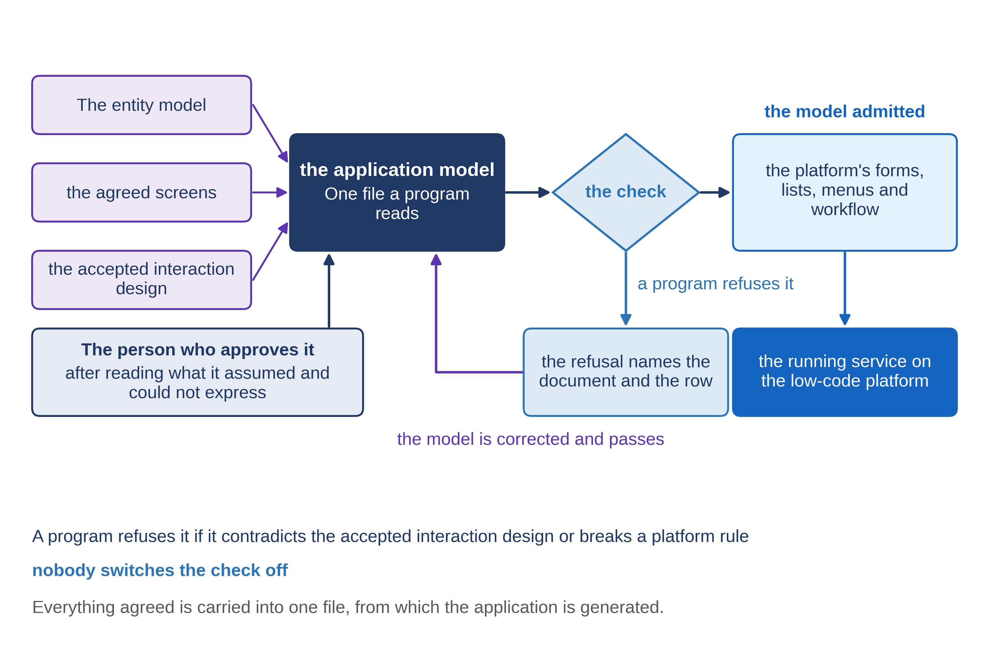
One file instead of a thousand clicks
4.4 · One file a program reads: the application model
Notes:
VO: The usual way is for a builder to click each part together, working from the documents. Every click is a chance to drift from what was agreed. The method does it differently. One file, the application model, holds everything agreed: the records, the lists, the screens, the menus, the workflow, who may do what, and the tests. A program reads the file and generates the parts from it. If something is wrong, the file is corrected, never the parts.

Slide 34
Nothing in the file is new
Stories and screens → forms and lists.
The interaction design → how lists, searches, moves and acts behave; the file names it.
The service workflow → states and moves.
What cannot be placed → written down for a person to rule on.
4.4 · One file a program reads: the application model
Notes:
VO: Nothing in the file is new. Each goal's story and its screens become forms and lists. The interaction design you accepted decides how lists, searches, moves and acts behave, and the file names that document. The service workflow becomes the states and moves. The file is written by an AI assistant that must refuse to guess. When something cannot be placed cleanly, it is written down for a person to rule on, not quietly decided.

Slide 35
MoEYS: one section, in plain sentences
Goal
approve a change of an institution's name.
Starts from
PHEQA's advice on changes of name that waits for the minister.
Shows
the institution's present name, read from PHEQA's register across Linkup; the new name asked for; PHEQA's advice.
Decision
approve or do not approve, chosen, not typed.
Records
the approval, sent to PHEQA across Linkup; officers of MoEYS see it in the list of approvals.
4.4 · One file a program reads: the application model
Notes:
VO: Here is one section of MoEYS's file, for the goal 'approve a change of an institution's name', read in plain sentences. The minister opens the list of PHEQA's advice on changes of name that waits for a decision. On the screen, the institution's present name is read from PHEQA's register across Linkup, the data exchange, and never copied. The new name and PHEQA's advice come as PHEQA sent them. The decision is chosen, approve or do not approve, never typed. Recording it sends the approval to PHEQA, and officers of MoEYS see it in their list of approvals.

Slide 36
Ask for it in plain sentences
The file is written for a program.
Ask for a plain-sentence reading of each section beside it.
Your officials check the reading against the screens they agreed.
Where the two differ, the file is what gets built.
4.4 · One file a program reads: the application model
Notes:
VO: The file is written for a program, not for you. So ask the supplier for a plain-sentence reading of each section, beside the file. Your officials check the reading against the screens they agreed. Then the business side and the builder read the same thing, and a decision means the same in both rooms. Keep one thing in mind: where the reading and the file differ, the file is what gets built. Raise every difference before the file is approved.

Slide 37
IN ONE SENTENCE
Everything agreed is carried into one file, from which the application is generated.
Do this on your own sector. Read one section of the model in plain sentences.
The prompt in the companion material gives you a plain-sentence reading of one section, with anything not agreed marked. Before the next video.
4.4 · One file a program reads: the application model
www.itu.int
Notes:
PRACTICE BOX (on-screen only — never read it, never paraphrase it, never point at it). It replaces the narrated handoff: this video ends on its recap.
VO: Ask for the one file the application is generated from, and a plain-sentence reading of it. Check the reading against what your officials agreed.

Slide 38
Sources
• Joget DX 9 Knowledge Base, the pages Form Builder, List Builder, UI Builder and Process Builder
Find the link in the description.
4.4 · One file a program reads: the application model
Notes:
Sources slide, held ~5 seconds at the end of the video. Links are compiled into the YouTube description per ITU convention; no URLs read aloud.

Slide 39
MODULE 4 · VIDEO 4.5
4.5
Reviewing the model: what it assumed, and what it could not express
Every assumption and every loss is named for a person to rule on.
standalone video · voice-over on text slides
Notes:
Title card — the cold open. The hosts name the module, the video number, the title and the single message on this slide; no scripted narration. Hold until the opener begins; the opener is narrated on the next slide.

Slide 40
WHERE WE START
Does the AI assistant tell you, or does it quietly decide?
It writes the file your application is generated from.
It will meet things nobody wrote down, and things the platform cannot do.
4.5 · Reviewing the model: what it assumed, and what it could not express
www.itu.int
Notes:
VO: An AI assistant writes the file your application is generated from. It will meet things nobody wrote down, and things the platform cannot do. The question for you is simple: does it tell you, or does it quietly decide?

Slide 41
Four ways a thing reaches the file
Placed directly
there is only one place it can go.
Placed by a judgement
written down as an assumption.
Cannot be placed
written down as a loss.
Stays in its own document
nothing is owed.
4.5 · Reviewing the model: what it assumed, and what it could not express
Notes:
VO: Everything agreed reaches the file in one of four ways. Most things are placed directly, because there is only one place they can go. Some need a judgement, and the judgement is written down as an assumption: what was decided, and on what ground. Some cannot be placed at all, because the platform has no way to express them. These are written down as losses. A few stay in their own document, and nothing is owed for them in the file.

Slide 42
An assumption, and a loss
Assumption
a decision the writer made where the documents were silent.
Loss
something agreed that the file cannot express, with what was done instead.
Never
a gap filled by invention, with nobody told.
4.5 · Reviewing the model: what it assumed, and what it could not express
Notes:
VO: An assumption is a decision the writer had to make because the documents were silent. A loss is something you agreed that the file cannot express, with what was done instead, if anything. Both are normal. What is not acceptable is a gap filled by invention, with nobody told. That is why the assistant must refuse to guess. A gap it names can be ruled on. A gap it fills in silently becomes a fault in the running service.

Slide 43
The cards the owner reads
One card for each assumption and each loss.
In plain words
what the application will do because of it.
The document it rests on.
The ruling
yes or no, with a name and a date.
4.5 · Reviewing the model: what it assumed, and what it could not express
Notes:
VO: You do not read the file. You read cards: one for each assumption and each loss. Each card says, in plain words, what the application will do because of it, and which document it rests on. The owner rules yes or no on each card, and the ruling is recorded with a name and a date. A 'no' is never typed into the file. It goes back to the document that owns the fact, and the file is written again from the corrected document.

Slide 44
MoEYS: two cards
Assumption
a change of name takes effect on the day the minister approves it. Ruling: yes.
Loss
the notice to the institution cannot be sent by the platform; it is kept as a task for an officer. Ruling: yes.
Ruled by the Director of Higher Education, with her name and the date.
4.5 · Reviewing the model: what it assumed, and what it could not express
Notes:
VO: Here are two cards from the review of the file of MoEYS, Progressa's ministry of education. The first is an assumption: a change of name takes effect on the day the minister approves it, because the goal's story did not say. The second is a loss: the story asks that the institution is told, and the platform cannot send that notice by itself, so it is kept as a task for an officer. The Director of Higher Education rules yes on both, and her rulings are recorded.

Slide 45
When the answer is no
'No' to an assumption → the goal's story is corrected.
The file is written again from the story.
The cards are read again.
Approval waits until every card carries a ruling.
4.5 · Reviewing the model: what it assumed, and what it could not express
Notes:
VO: Suppose she had said no to the first card, because a change of name should take effect only when it is published in the Gazette. Her answer would not be typed into the file. It would go back to the goal's story, the one document that owns that fact. The story is corrected, the file is written again, and the cards are read again. The head of the ICT unit approves the file only when every card carries a ruling.

Slide 46
IN ONE SENTENCE
Every assumption and every loss is named for a person to rule on.
Do this on your own sector. Turn the losses into yes-or-no questions.
The prompt in the companion material gives you a list of yes-or-no questions, one for each loss, in the loss's own words. Before the next video.
4.5 · Reviewing the model: what it assumed, and what it could not express
www.itu.int
Notes:
PRACTICE BOX (on-screen only — never read it, never paraphrase it, never point at it). It replaces the narrated handoff: this video ends on its recap.
VO: Before the file is approved, ask for every assumption and every loss as a card in plain words. Rule on each one, and record who ruled and when.

Slide 47
Sources
• The specification-driven development (SDD) method: the review of the application model. No external source is cited.
4.5 · Reviewing the model: what it assumed, and what it could not express
Notes:
Sources slide, held ~5 seconds at the end of the video. No external source is cited; no narration.

Slide 48
MODULE 4 · VIDEO 4.6
4.6
Refused, not worked around
A program refuses a description that contradicts what you accepted, and nobody switches the check off.
standalone video · voice-over on text slides
Notes:
Title card — the cold open. The hosts name the module, the video number, the title and the single message on this slide; no scripted narration. Hold until the opener begins; the opener is narrated on the next slide.

Slide 49
WHERE WE START
"Switch the check off, just this once."
Two days before a deadline, a program stops your supplier's build.
Your answer should already be written down, and it is no.
4.6 · Refused, not worked around
www.itu.int
Notes:
VO: Two days before a deadline, a program stops your supplier's build. The supplier asks for one favour: switch the check off, just this once. Your answer should already be written down, and it is no.

Slide 50
What the program checks first
Does the file name the interaction design you accepted?
Does that document say it was accepted, by a name, on a date?
Is it the same document, unchanged since then?
Does every list, search, move and act in the file match it?
4.6 · Refused, not worked around
Notes:
VO: Before anything is generated, built or installed, a program reads the file the application will be generated from, and asks four questions. Does the file name the interaction design you accepted? Does that document say it was accepted, by a name, on a date? Is it the same document, unchanged since it was accepted? And does every list, every search, every move and every act in the file match what the document decided? If any answer is no, the program refuses, and nothing is built.

Slide 51
Nothing switches it off
No setting.
No switch.
No exception for a deadline.
The check reads what the document says
your acceptance line is its evidence.
4.6 · Refused, not worked around
Notes:
VO: Nothing switches this check off. There is no setting, no switch, and no exception for a deadline. The check also cannot know that you accepted the document. It knows only that the document says so, and that the file agrees with it. That makes your acceptance line evidence. Write it exactly, with the name and the date, and never write it for a document nobody has read. A deadline does not change what was agreed; it changes only how soon the correction is needed.

Slide 52
Answered, not worked around
Either
correct the file to match what was accepted.
Or
if the decision should change, the owner accepts a revised interaction design, and the file names it.
Never
switch the check off, or edit what was built.
4.6 · Refused, not worked around
Notes:
VO: A refusal is answered, not worked around. There are two honest answers. Either the file is corrected to match what you accepted. Or, if the decision itself should change, the owner accepts a revised interaction design, and the file names that new version. Both leave a record of who decided what. Switching the check off leaves no record, and the same fault returns at the next build.

Slide 53
MoEYS: one list of twenty, refused
Accepted
the matters PHEQA advises on are chosen in three categories, of 8, 7 and 5.
The file
one list of twenty matters, no categories.
The program
refused. It names the interaction design and the row for that list.
Nothing is generated.
4.6 · Refused, not worked around
Notes:
VO: Here is how it looks for MoEYS, Progressa's ministry of education. The interaction design its director accepted says that the twenty matters PHEQA advises on are chosen in three categories, of eight, seven and five. A version of the file offers the officer all twenty in one list. The program refuses it before anything is built. The refusal names the document and the row it disagrees with, the row for that list, so the supplier knows exactly what to correct, and nobody has to guess.

Slide 54
Corrected, and admitted
First run: refused
the row for the matters PHEQA advises on.
Correction
the three categories, as accepted.
Second run
admitted.
Demonstration segment — a storyboard until it is recorded.
4.6 · Refused, not worked around
Notes:
VO: The correction is small. The list in the file is given the three categories the document decided, and the program reads the file again. This time it is admitted, and generation may begin. That is the whole demonstration: one run refused with the row named, one run admitted after the correction. Until it is recorded on a real application, this is a storyboard: the steps and what counts as a pass, written before anything is run.
Production cue: demonstration segment, a storyboard until it is recorded (in the bundle: section 4.8). The text-only stand-in holds the screen until the recording replaces this slide.

Slide 55
IN ONE SENTENCE
A program refuses a description that contradicts what you accepted, and nobody switches the check off.
Do this on your own sector. Explain a refusal in plain words.
The prompt in the companion material gives you a plain explanation of the refusal, naming the document to correct. Before the next video.
4.6 · Refused, not worked around
www.itu.int
Notes:
PRACTICE BOX (on-screen only — never read it, never paraphrase it, never point at it). It replaces the narrated handoff: this video ends on its recap.
VO: When the program refuses, do not ask who can switch it off. Ask which row it names, then correct the file or accept a revised decision.

Slide 56
Sources
• The specification-driven development (SDD) method: the check before generation. No external source is cited.
4.6 · Refused, not worked around
Notes:
Sources slide, held ~5 seconds at the end of the video. No external source is cited; no narration.

Slide 57
Notes:
Closing slide for the combined deck. Individual videos end on their recap or sources slide.

