Slide 1
MODULE 5 · VIDEO 5.1
5.1
From one file to a running application
The kit turns the model into the platform's forms, lists, menus and workflow, and installs them.
standalone video · voice-over on text slides
Notes:
Title card — the cold open. The hosts name the module, the video number, the title and the single message on this slide; no scripted narration. Hold until the opener begins; the opener is narrated on the next slide.

Slide 2
WHERE WE START
"The application is built." Built from what?
Before you accept the supplier's report, know what was built from what.
One file decides almost everything you will see.
5.1 · From one file to a running application
www.itu.int
Notes:
VO: Your supplier reports that the ministry's new application is built. Before you accept that report, you need to know what was built from what, and which questions to ask of the result. One file decides almost everything you will see.

Slide 3
One file, read by a program
The application model
the one file the application is generated from.
Written last, from documents your officials have already accepted.
Checked by a program before anything is built.
5.1 · From one file to a running application
Notes:
VO: In the SDD method, specification-driven development, each document a person writes is accepted before the next one begins. The last of them is the application model: one file, written for a program to read. It carries every record, screen, list, menu and step of the workflow, each taken from documents your officials have already accepted. Before anything is built, a program checks the file, and refuses it if it contradicts what was accepted.

Slide 4
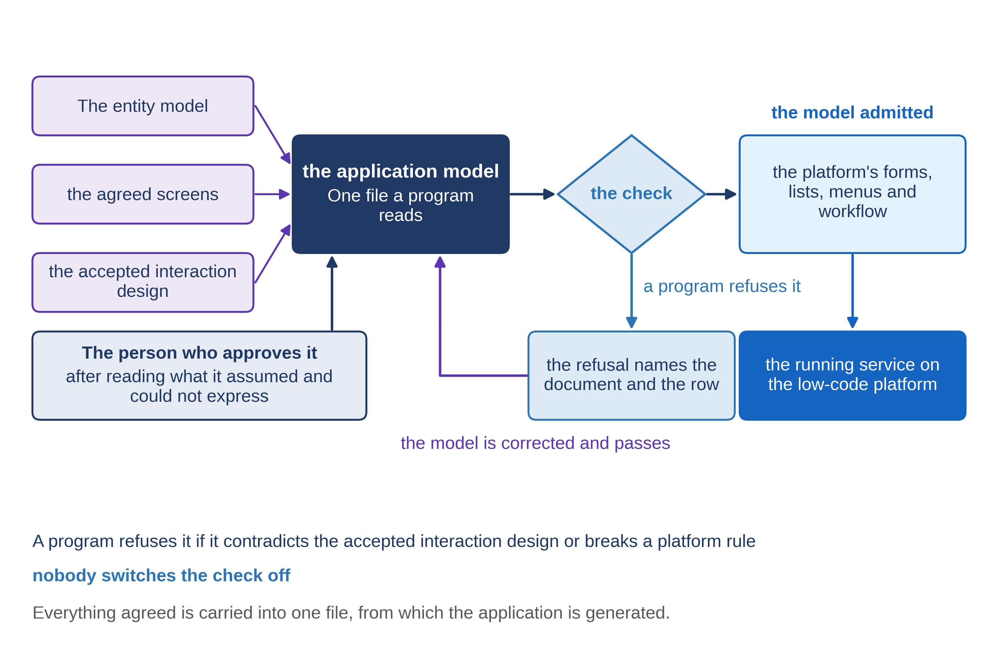
What the kit makes from it
5.1 · From one file to a running application
Notes:
VO: The kit is the method's set of programs, which the supplier runs. From the file it makes the four things a low-code platform is built from. Forms are the screens where an officer enters or reads a record. Lists are the worklists and registers. Menus are what each role sees after signing in, grouped in categories. The workflow is the order of steps, and who may take each one. The platform's own documentation has a builder for each of them, and the kit fills those builders from the file instead of by hand.

Slide 5
Installed, not rebuilt
The kit packs the application and installs it on the platform's server.
The same package can go to a test server first, then to the live one.
Nothing is rebuilt by hand in between.
5.1 · From one file to a running application
Notes:
VO: Then the kit installs what it built. It packs the application's design and puts it on the platform's server. The platform's documentation describes the same kind of move, of one application from one server to another, and by default only the design travels, not the data. So the same package can go to a test server, be checked there, and then go to the live server, with nothing rebuilt by hand in between.

Slide 6
Progressa: MoEYS's application
Generated from MoEYS's model, onto MoEYS's own installation.
Forms
the minister's decisions; the Gazette entries.
Lists
what awaits the minister's decision.
Menu in five categories
Licences · Names, the list and reviews · Suspension and cancellation · The Gazette · Requests for review.
5.1 · From one file to a running application
Notes:
VO: In Progressa, MoEYS's application is generated from its model onto MoEYS's own installation of the platform. The model asks for the forms on which the minister decides and an officer records the Gazette, for lists of what awaits the minister, and for a menu in five categories: licences; names, the list and reviews; suspension and cancellation; the Gazette; and requests for review. It asks for no table of institutions, because MoEYS reads PHEQA's register instead.

Slide 7
The questions you ask of the result
Each goal
where does it start, and who can start it?
Each menu category
present, and shown only to its role?
Each list
does it show only what awaits an act?
Any screen that no accepted document asked for?
5.1 · From one file to a running application
Notes:
VO: Acceptance starts from the model, not from the supplier's account. For each goal, ask where it starts and who can start it. Check that every menu category is there, for the right role and no other. Open each list and check that it shows only what waits for an act. Then ask whether any screen exists that no accepted document asked for. Each answer is read on the running application, not on a slide.

Slide 8
From the file to the menu
The file admitted by the check.
The application built and installed on MoEYS's installation.
The menu, one form and one list opened.
Pass
no error; the application listed; every menu category present.
Demonstration segment — a storyboard until it is recorded.
5.1 · From one file to a running application
Notes:
VO: The demonstration follows these steps. The check admits the file. The kit builds the application and installs it on MoEYS's installation. Then the menu, one form and one list are opened on the platform. It passes when the build ends without error, the application appears on the installation, and every menu category of the interaction design is there. Until MoEYS's application is generated, this is a storyboard: the steps and the pass, written before anything is recorded.
Production cue: demonstration segment, a storyboard until it is recorded (in the bundle: section 4.8). The text-only stand-in holds the screen until the recording replaces this slide.

Slide 9
IN ONE SENTENCE
The kit turns the model into the platform's forms, lists, menus and workflow, and installs them.
Do this on your own sector. Write the acceptance questions for a generated application.
The prompt in the companion material gives you a numbered list of acceptance questions, one for each goal, each with where on the running application to look. Before the next video.
5.1 · From one file to a running application
www.itu.int
Notes:
PRACTICE BOX (on-screen only — never read it, never paraphrase it, never point at it). It replaces the narrated handoff: this video ends on its recap.
VO: One accepted file, read by a program, becomes the forms, lists, menus and workflow on the platform. Ask your questions of the running result, one goal at a time.

Slide 10
Sources
• Joget DX 9 Knowledge Base, the platform's documentation, pages Form Builder, List Builder, UI Builder, Process Builder and Migrating a Single Joget App
Find the link in the description.
5.1 · From one file to a running application
Notes:
Sources slide, held ~5 seconds at the end of the video. Links are compiled into the YouTube description per ITU convention; no URLs read aloud.

