Slide 1
MODULE 5 · VIDEO 5.2
5.2
Nothing generated is edited by hand
A correction goes into the description and the application is generated again; a program shows any hand edit.
standalone video · voice-over on text slides
Notes:
Title card — the cold open. The hosts name the module, the video number, the title and the single message on this slide; no scripted narration. Hold until the opener begins; the opener is narrated on the next slide.

Slide 2
WHERE WE START
A wrong label, the evening before the demonstration.
The quickest fix is to change it on the platform.
Your contract should forbid that fix, and a program can show whether it was made.
5.2 · Nothing generated is edited by hand
www.itu.int
Notes:
VO: The evening before the minister's demonstration, someone notices a wrong label on a form. The quickest fix is to change it on the platform. That fix is the one your contract should forbid, and a program can show whether it was made.

Slide 3
Two versions of the truth
The accepted description says one thing.
The platform now shows another.
The next generation either overwrites the edit or is quietly stopped.
5.2 · Nothing generated is edited by hand
Notes:
VO: A hand edit creates two versions of the truth. The accepted description says one thing, and the platform now shows another. When the application is next generated from the description, one of two things happens. Either the edit is overwritten and the wrong label comes back. Or someone protects the edit by not generating again, and from then on nobody can say what the application is built from.
Retrieval prompt — ask before playing on: the label on the form is wrong; where does the correction go? Answer on the next slide.

Slide 4
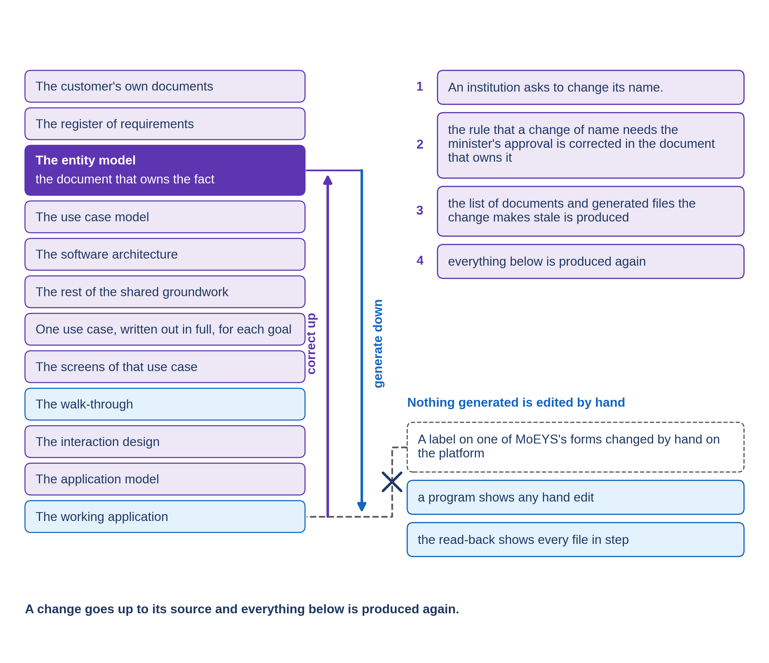
Correct up, generate down
Find the document that owns the fact.
Correct it there, and have the correction accepted.
Generate the application again.
5.2 · Nothing generated is edited by hand
Notes:
VO: The SDD method has one rule for this: nothing generated is edited by hand. A correction goes into the description that owns the fact, is accepted there, and the application is generated again. A label belongs to the screens of its goal, so it is corrected in those screens, carried into the model, and generated. It takes a little longer than a change on the platform. In exchange, the description and the platform never disagree.

Slide 5
The read-back
In step
the file is what the description generates.
Out of date
the description changed, and the file was not generated again.
Edited by hand
the file differs from what the description generates.
5.2 · Nothing generated is edited by hand
Notes:
VO: The method gives you a program to check this, the read-back. It compares each generated file on the platform with what the description would generate, and marks it in one of three ways: in step, out of date, or edited by hand. You do not need to read the files themselves. You read the program's list, and you ask about every line that is not in step.

Slide 6
Progressa: a label on MoEYS's form
The form on which the minister approves a new name.
A label changed by hand on the platform, the evening before a demonstration.
The read-back
this form, edited by hand.
The label corrected in the goal's screens and the model; generated again; read back again.
5.2 · Nothing generated is edited by hand
Notes:
VO: In Progressa, a builder changes a label on MoEYS's form for approving an institution's new name, directly on the platform, to meet the demonstration. The read-back lists that form as edited by hand. The head of MoEYS's ICT unit asks for the change to be made properly. The label is corrected in the goal's screens and in the model, the application is generated again, and the read-back is run once more. It passes only when every file shows in step.

Slide 7
A hand edit shown up
A label changed on the platform.
Read-back
the form, edited by hand.
The label corrected in the model; generated again.
Read-back
every file in step.
Demonstration segment — a storyboard until it is recorded.
5.2 · Nothing generated is edited by hand
Notes:
VO: The demonstration shows the same steps on a generated application. A label is changed by hand on the platform, the read-back runs and names the form, the correction is made in the model, and the read-back runs again. It passes when the first run names the edited file and the second shows every file in step. Until the application is generated, this is a storyboard.
Production cue: demonstration segment, a storyboard until it is recorded (in the bundle: section 4.9). The text-only stand-in holds the screen until the recording replaces this slide.

Slide 8
Write it into the contract
No generated file is edited by hand.
The read-back is run before every acceptance, and its list is handed over.
A file edited by hand is a defect, corrected in the description.
5.2 · Nothing generated is edited by hand
Notes:
VO: Put the rule into the supplier's contract, together with its evidence. No generated file may be edited by hand on the platform. The read-back is run before every acceptance, and its list is handed over with the delivery. A file marked as edited by hand is a defect, and it is corrected in the description, not argued about at the acceptance meeting.

Slide 9
IN ONE SENTENCE
A correction goes into the description and the application is generated again; a program shows any hand edit.
Do this on your own sector. Draft the contract clause that forbids hand edits.
The prompt in the companion material gives you one contract clause of four numbered parts, with the undefined terms listed after it. Before the next video.
5.2 · Nothing generated is edited by hand
www.itu.int
Notes:
PRACTICE BOX (on-screen only — never read it, never paraphrase it, never point at it). It replaces the narrated handoff: this video ends on its recap.
VO: Correct the accepted document, not the platform, and generate the application again. The read-back shows any file that someone changed by hand.

Slide 10
Sources
• This subtopic states the SDD method's own rule, that nothing generated is edited by hand, and its read-back, in plain words. It cites no external source.
5.2 · Nothing generated is edited by hand
Notes:
Sources slide, held ~5 seconds at the end of the video. No external source is cited; no narration.

