Slide 1
MODULE 5 · VIDEO 5.4
5.4
Identity and registries: use the block, do not rebuild it
The service takes a person's identity and an institution's record from the body that keeps them.
standalone video · voice-over on text slides
Notes:
Title card — the cold open. The hosts name the module, the video number, the title and the single message on this slide; no scripted narration. Hold until the opener begins; the opener is narrated on the next slide.

Slide 2
WHERE WE START
"We will add a table of users and a table of institutions."
It sounds helpful and quick.
It is the start of copies that will disagree, and of facts the ministry may have no reason to keep.
5.4 · Identity and registries: use the block, do not rebuild it
www.itu.int
Notes:
VO: A supplier offers to add a table of users and a table of institutions to the ministry's new application. It sounds helpful and quick. It is the start of copies that will disagree, and of facts the ministry may have no reason to keep.

Slide 3
Who someone is: the identity sign-in
The application sends the person to the identity block's own sign-in page.
The block asks which facts it may share; the person approves.
The application receives a code, exchanges it for a token, and reads the approved facts.
5.4 · Identity and registries: use the block, do not rebuild it
Notes:
VO: Identity comes from the body that keeps it. The GovStack Identity specification describes the sign-in step by step. The application sends the person to the identity block's own page. The person signs in there, and the block asks which facts it may share. The person approves. The application receives a code, exchanges it for a token that says who signed in, and then reads the facts that were approved. This follows OpenID Connect, an open standard for signing in.

Slide 4
Keep the identifier you are given
The identity block gives each service its own identifier for the person.
The same person has a different identifier in each service.
The application keeps that identifier, and never the national number.
5.4 · Identity and registries: use the block, do not rebuild it
Notes:
VO: What the application keeps matters as much. The token carries an identifier that the block gives this one service for this one person. The Identity specification asks that the same person have a different identifier in each service, to protect privacy. So the application keeps the identifier it is given, and never the national number. Where a design must check a person who is not present, the specification requires the block to verify a person from a known identifier; settle with the identity authority what it offers before the design relies on it.

Slide 5
What an institution is: the register
The specification
other systems work with a register's records through open interfaces, as the register authorises.
Progressa's design
only PHEQA's application writes the register of institutions.
A reader takes the record when it needs it, and keeps no copy.
5.4 · Identity and registries: use the block, do not rebuild it
Notes:
VO: An institution's record works the same way. The GovStack Digital Registries specification requires a register to let other systems search, read, create and update its records through open interfaces, and to authorise which systems and users may do so. Progressa's design authorises only PHEQA's application to write the register of institutions. Every other service reads the record when it needs it, and keeps no copy.

Slide 6
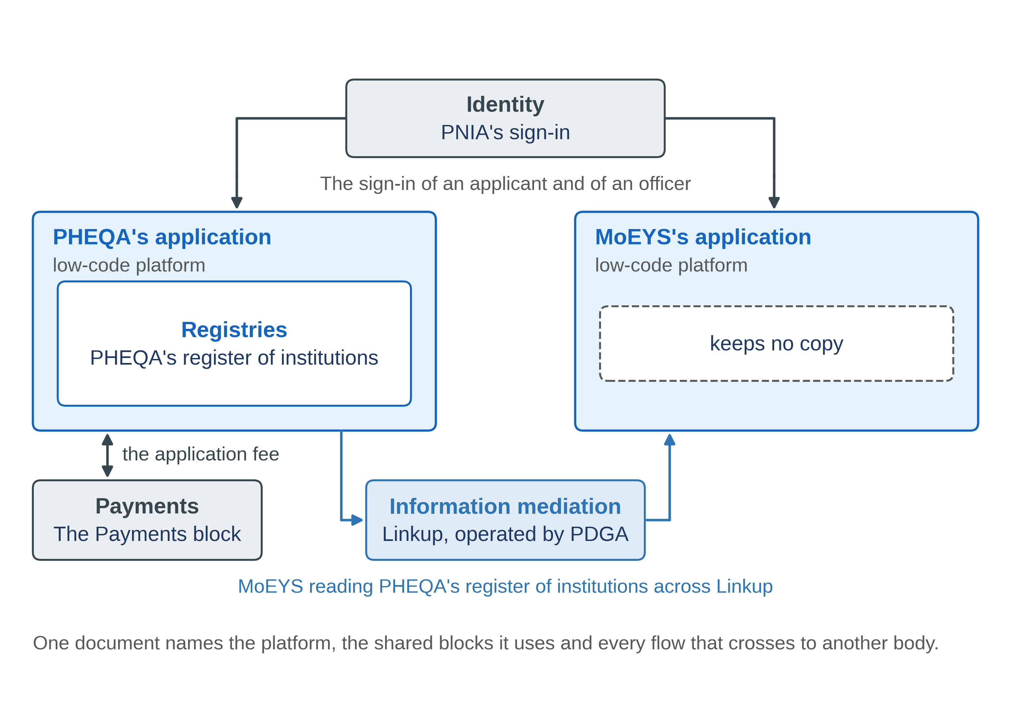
Progressa: one sign-in, one register, no copies
5.4 · Identity and registries: use the block, do not rebuild it
Notes:
VO: In Progressa, an officer of MoEYS signs in through PNIA, and MoEYS's application keeps the identifier PNIA gives it, not her national number. When she opens a case, the application reads Harbourview University College from PHEQA's register of institutions. Now picture the other design, with its own table of institutions inside MoEYS's application. One week PHEQA writes the college's new name into the register. MoEYS's copy keeps the old one, and the next week the minister signs a decision under a name the college no longer has.

Slide 7
A block used, not a copy kept
A block paid for once serves every service that needs it.
A copy is a second register that nobody planned and nobody keeps.
5.4 · Identity and registries: use the block, do not rebuild it
Notes:
VO: A block paid for once and used by many services is re-use that only someone planning for the whole sector can see. A copy is the opposite: a second register that nobody planned, nobody keeps and nobody corrects. The reference architecture PAERA puts the deeper point plainly: digital public infrastructure is not neutral, and it shapes what can be built on top of it. Build on the block, and the next service inherits the same identity and the same register.

Slide 8
Signed in, and read from the register
A test officer signs in through the identity sign-in.
The application shows the identifier it was given; no national number.
INS-00217 opened, as read from PHEQA's register.
Pass
sign-in complete; no national number; the record agrees with the register.
Demonstration segment — a storyboard until it is recorded.
5.4 · Identity and registries: use the block, do not rebuild it
Notes:
VO: The demonstration shows both on MoEYS's application. A test officer signs in through the identity sign-in. The application shows the identifier it was given and no national number. Then an institution's record is opened, read from PHEQA's register. It passes when the sign-in completes, no national number appears, and the record shown agrees with the register. Until both applications are generated, this is a storyboard.
Production cue: demonstration segment, a storyboard until it is recorded (in the bundle: section 4.10). The text-only stand-in holds the screen until the recording replaces this slide.

Slide 9
IN ONE SENTENCE
The service takes a person's identity and an institution's record from the body that keeps them.
Do this on your own sector. Find the copies of facts another body keeps.
The prompt in the companion material gives you a table of the copied facts, each with the body that keeps it and the block to use instead. Before the next video.
5.4 · Identity and registries: use the block, do not rebuild it
www.itu.int
Notes:
PRACTICE BOX (on-screen only — never read it, never paraphrase it, never point at it). It replaces the narrated handoff: this video ends on its recap.
VO: Take who someone is from the identity block, and what an institution is from its register. Keep the identifier you are given, and no copy.

Slide 10
Sources
• GovStack Identity 2.0, sections 9.1.1, 7.2.1 and 8, and requirement 6.2-r2
• OpenID Connect Core 1.0 incorporating errata set 2, sections 2 and 3.1
• GovStack Digital Registries 3.0-alpha, requirement DRS-33 and sections 8.1 and 8.2
• PAERA v1.0, section 2.6
Find the link in the description.
5.4 · Identity and registries: use the block, do not rebuild it
Notes:
Sources slide, held ~5 seconds at the end of the video. Links are compiled into the YouTube description per ITU convention; no URLs read aloud.

