Slide 1
MODULE 5 · VIDEO 5.5
5.5
The service's contract with the registration block, and its data interface
The contract another system reads is produced from the description, not written beside it.
standalone video · voice-over on text slides
Notes:
Title card — the cold open. The hosts name the module, the video number, the title and the single message on this slide; no scripted narration. Hold until the opener begins; the opener is narrated on the next slide.

Slide 2
WHERE WE START
Two applications rely on one contract: what may be asked, and what comes back.
Write that contract by hand beside the application, and the two drift apart.
5.5 · The service's contract with the registration block, and its data interface
www.itu.int
Notes:
VO: When the ministry's application asks the quality authority's application for an institution, both sides rely on a contract: what may be asked, and what comes back. If someone writes that contract by hand beside the application, the two will drift apart.

Slide 3
What a contract is
What another system may ask for.
What it must send, and what comes back.
Written in a published standard form, the OpenAPI Specification.
5.5 · The service's contract with the registration block, and its data interface
Notes:
VO: A contract, here, is the written promise one system makes to others. It says what they may ask for, what they must send, and what comes back. It is written in a published standard form, the OpenAPI Specification, so that a program on the other side can read it. The data exchange carries the call; the contract says what the call may be. Across the data exchange, each call names the service it is made to, and the exchange's own rules ask that each service be described in this standard form.

Slide 4
Produced from the description
The description already says what the register holds and what it publishes.
A program writes the contract from it.
When the description changes, the contract is produced again.
5.5 · The service's contract with the registration block, and its data interface
Notes:
VO: In the SDD method, nobody writes the contract beside the application. The accepted description already says what the register holds and what it publishes. A program produces the contract from that description, in the same way the application itself is produced. When the description changes, the contract is produced again, so the application and the promise it makes to others cannot say different things. It is the same rule as for the application itself: correct the description, never the copy.

Slide 5
The contract with the registration block
Published operations for applying online
the services and forms on offer, an application and its documents.
Published operations for processing
applications and officers' tasks.
For designing services and workflows
no interface specified yet.
The service's contract with the block is produced from the description.
5.5 · The service's contract with the registration block, and its data interface
Notes:
VO: The same holds for a registration service and the GovStack Registration block. Its specification publishes the operations of applying online: the services and forms on offer, and sending an application with its documents. It publishes operations for processing: the applications and the officers' tasks. For managing and designing services and workflows, it says no interface is specified yet. So the service's contract with the block is produced from the description, in the block's published terms.

Slide 6
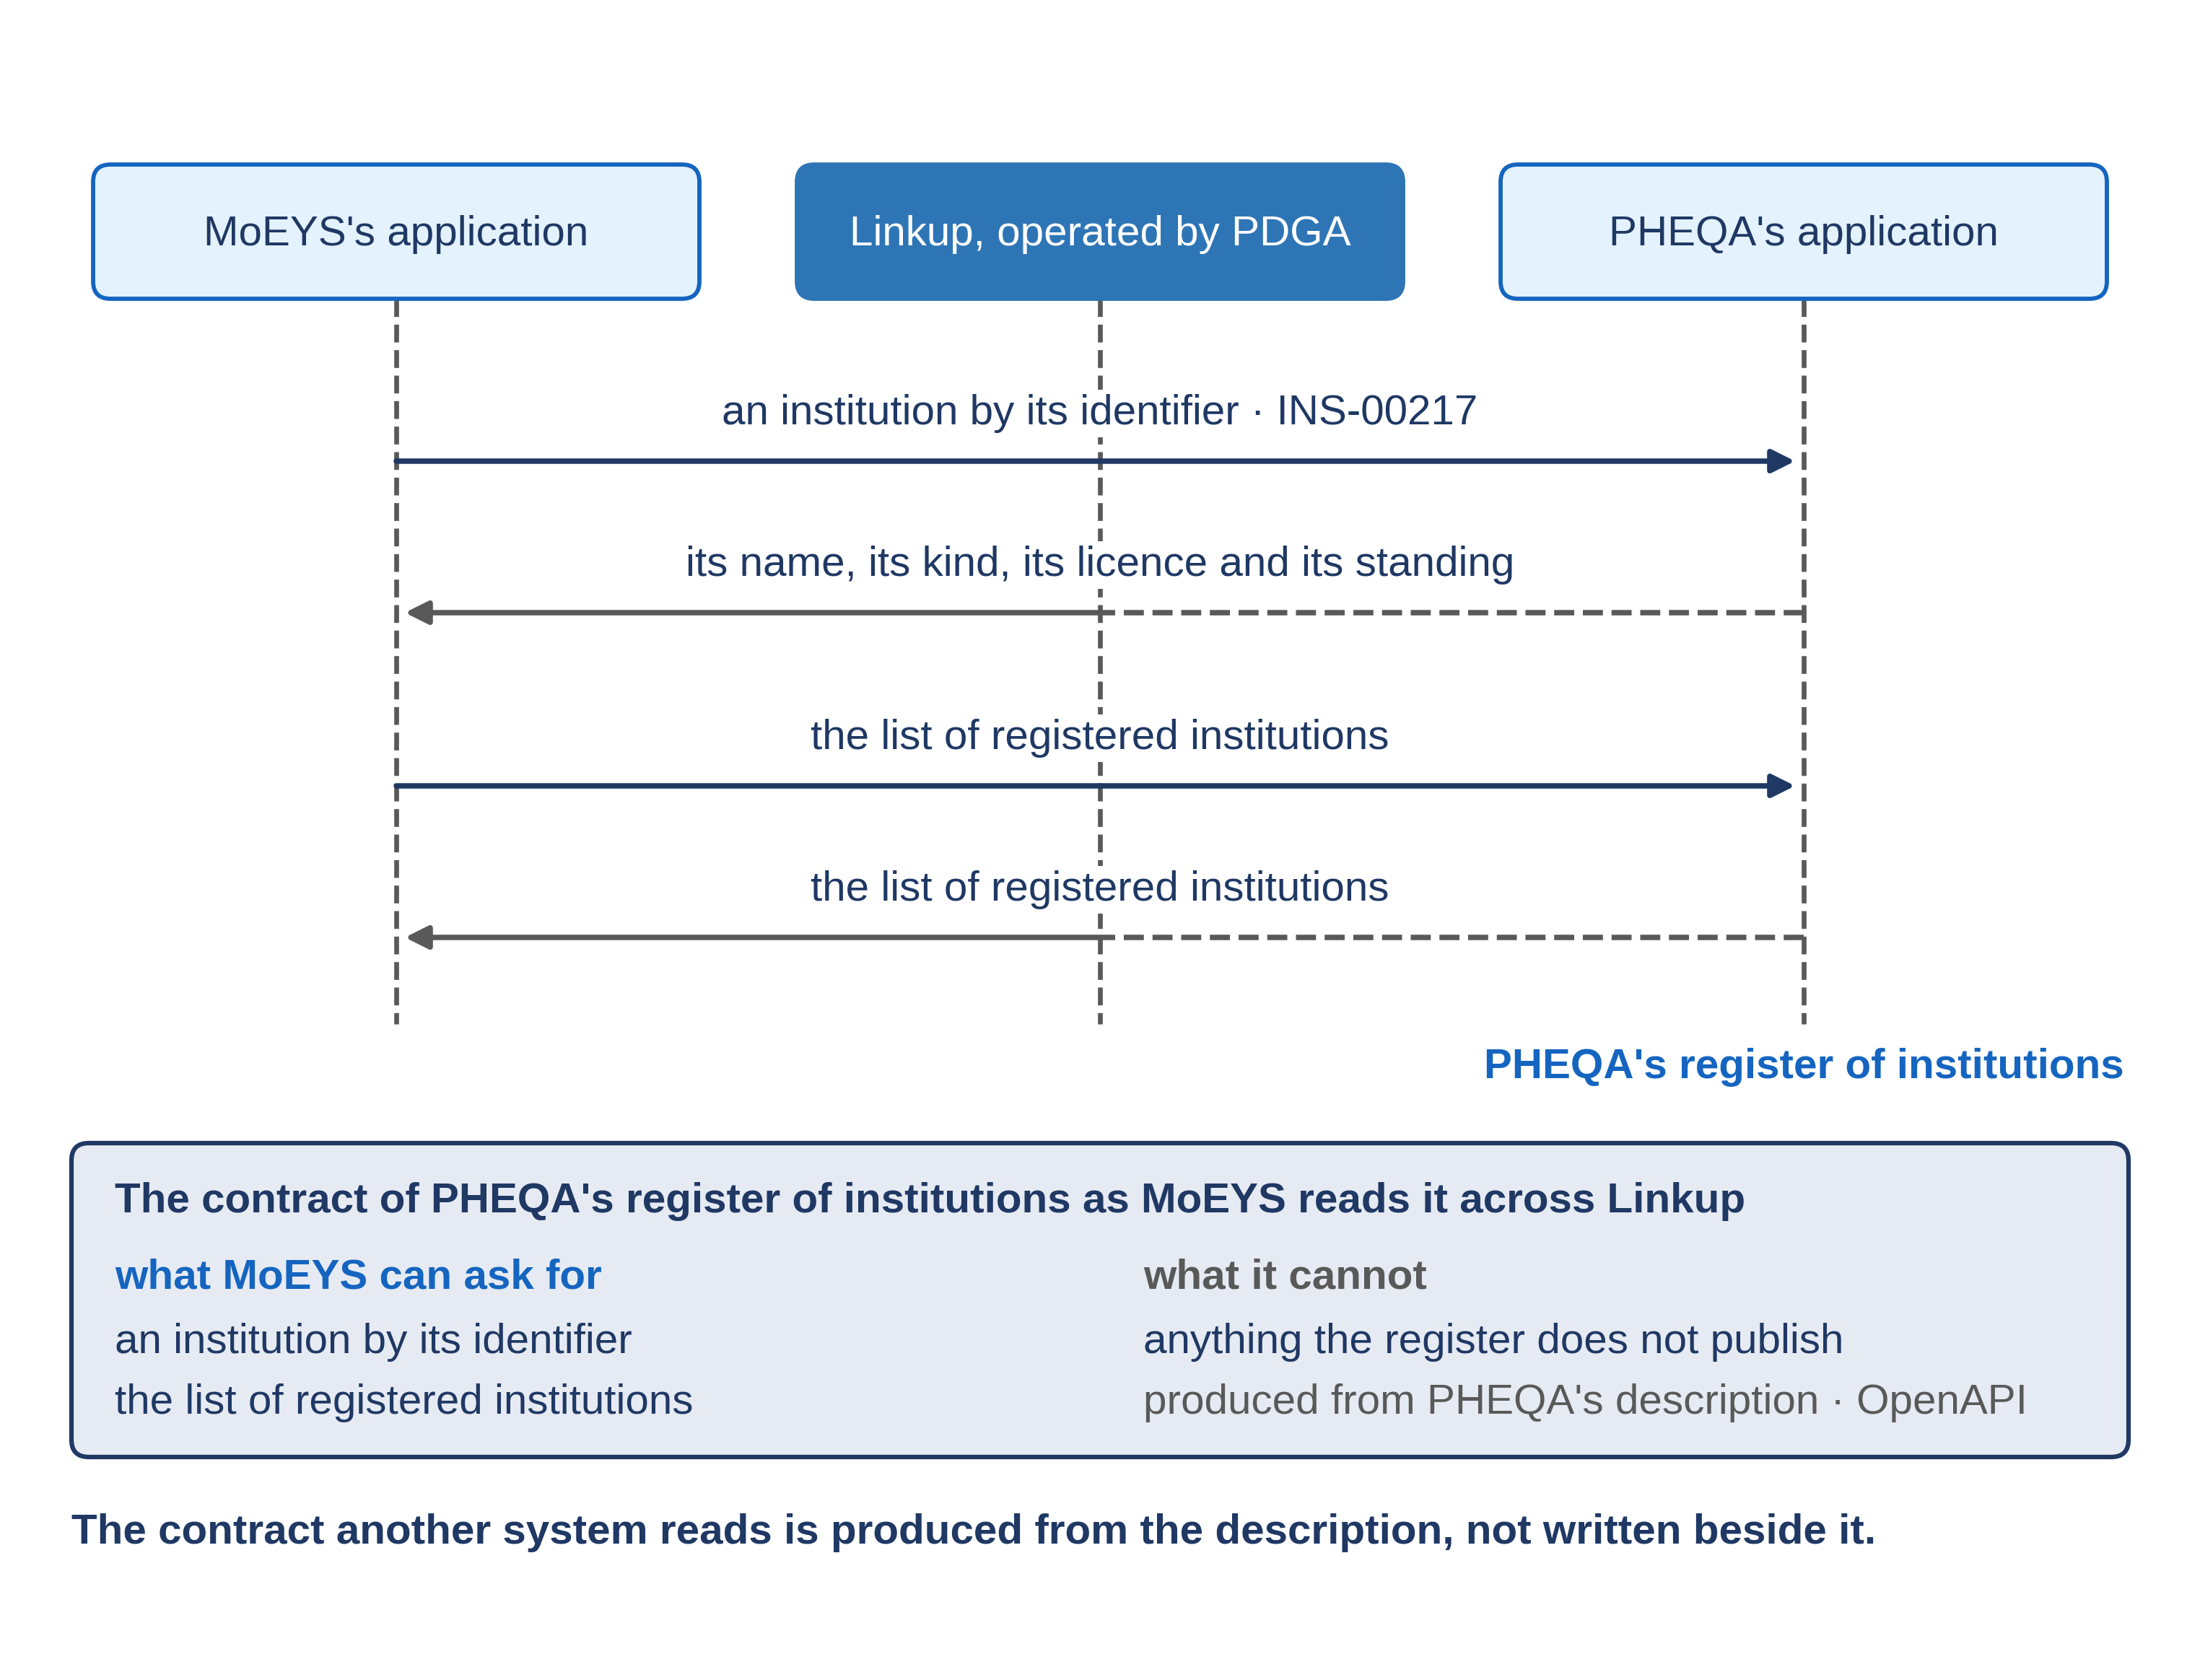
Progressa: PHEQA's register, as MoEYS reads it
5.5 · The service's contract with the registration block, and its data interface
Notes:
VO: Read as a list, the contract of PHEQA's register is short. MoEYS may ask for one institution by its register number, such as INS-00217, and receive its name, its kind, its licence and its standing. MoEYS may ask for the list of registered institutions. It cannot ask for applications, inspections, fees, or anything else the register does not publish. Every call goes through Linkup. The manager reads this list; the builder's program reads the same contract as a file. One document gives the business side and IT one shared language.

Slide 7
One institution, read across the exchange
MoEYS's application asks for INS-00217 across the data interface.
Beside the call
the contract it is read by.
Pass
the record agrees with PHEQA's register; the call is one the contract publishes.
Demonstration segment — a storyboard until it is recorded.
5.5 · The service's contract with the registration block, and its data interface
Notes:
VO: The demonstration reads one institution. MoEYS's application asks for it across the data interface, and the contract it is read by is shown beside the call. It passes when the record returned agrees with PHEQA's register, and the call is one that the contract publishes. Until both applications are generated, this is a storyboard: the steps and the pass, written before anything is recorded.
Production cue: demonstration segment, a storyboard until it is recorded (in the bundle: section 4.11). The text-only stand-in holds the screen until the recording replaces this slide.

Slide 8
IN ONE SENTENCE
The contract another system reads is produced from the description, not written beside it.
Do this on your own sector. Read an interface contract as a plain list.
The prompt in the companion material gives you two plain lists, what the other body can ask for and what it cannot. Before the next video.
5.5 · The service's contract with the registration block, and its data interface
www.itu.int
Notes:
PRACTICE BOX (on-screen only — never read it, never paraphrase it, never point at it). It replaces the narrated handoff: this video ends on its recap.
VO: A contract produced from the accepted documents cannot drift from them. Read it as a plain list of what may be asked, and what may not.

Slide 9
Sources
• GovStack Registration (default edition), sections 8.1, 8.2 and 8.3
• GovStack Information Mediator 1.1.1
• NIIS X-Road 7.7.0, Message Protocol for REST (PR-REST), sections 4.1 and 5.1
• OpenAPI Specification 3.0.3
Find the link in the description.
5.5 · The service's contract with the registration block, and its data interface
Notes:
Sources slide, held ~5 seconds at the end of the video. Links are compiled into the YouTube description per ITU convention; no URLs read aloud.

