Slide 1
MODULE 5 · VIDEO 5.6
5.6
Payments and information mediation as named crossings
A payment or a call across the data exchange is a crossing the architecture names, not a block the service rebuilds.
standalone video · voice-over on text slides
Notes:
Title card — the cold open. The hosts name the module, the video number, the title and the single message on this slide; no scripted narration. Hold until the opener begins; the opener is narrated on the next slide.

Slide 2
WHERE WE START
A fee, another body's register, a sign-in: each leaves the service and comes back.
Your architecture names every one of them before anyone builds anything.
5.6 · Payments and information mediation as named crossings
www.itu.int
Notes:
VO: A registration service takes a fee, reads another body's register and signs people in. Each of these leaves the service and comes back. Your architecture should name every one of them before anyone builds anything.

Slide 3
A crossing, named
What crosses, and in which direction.
The body on the other side.
The block it goes through.
Who on the other side has agreed to it.
5.6 · Payments and information mediation as named crossings
Notes:
VO: A crossing is any flow that leaves the service or enters it. The architecture names each one in a table: what crosses, in which direction, the body on the other side, and the block it passes through. The GovStack Registration specification expects all traffic into and out of a block to go through an Information Mediator or a secure gateway. A service that goes round the exchange builds a private road that nobody else can check.

Slide 4
The fee: through the Payments block
The service sends a payment request to the Payments block.
The request carries the payer, the payee, the amount, the currency, the policy and the service's own transaction number.
The block tracks the payment, and the confirmation comes back.
5.6 · Payments and information mediation as named crossings
Notes:
VO: Take the fee first. The registration service does not build its own payment screen or deal with banks. It sends a payment request to the government's Payments block. The GovStack Payments specification lists what such a request must carry at the least: who pays, who is paid, the amount, the currency, the policy, and the service's own transaction number. The block's payment portal tracks each payment's status and history, and the confirmation comes back to the service. The service keeps the confirmation, not the payment details.

Slide 5
When the block is not yet there
The applicant pays into the authority's bank account.
The finance officer records the evidence of the payment.
The table names this as a crossing still to move to the Payments block.
5.6 · Payments and information mediation as named crossings
Notes:
VO: The block may not be ready on the first day. Then the service does what many services do today: the applicant pays into the authority's bank account, and the finance officer records the evidence of the payment against the application: who paid, how much, and when. That is honest, and it works. The architecture still names it as a crossing, one still to move to the Payments block, so that the move is planned and budgeted, and not forgotten.

Slide 6
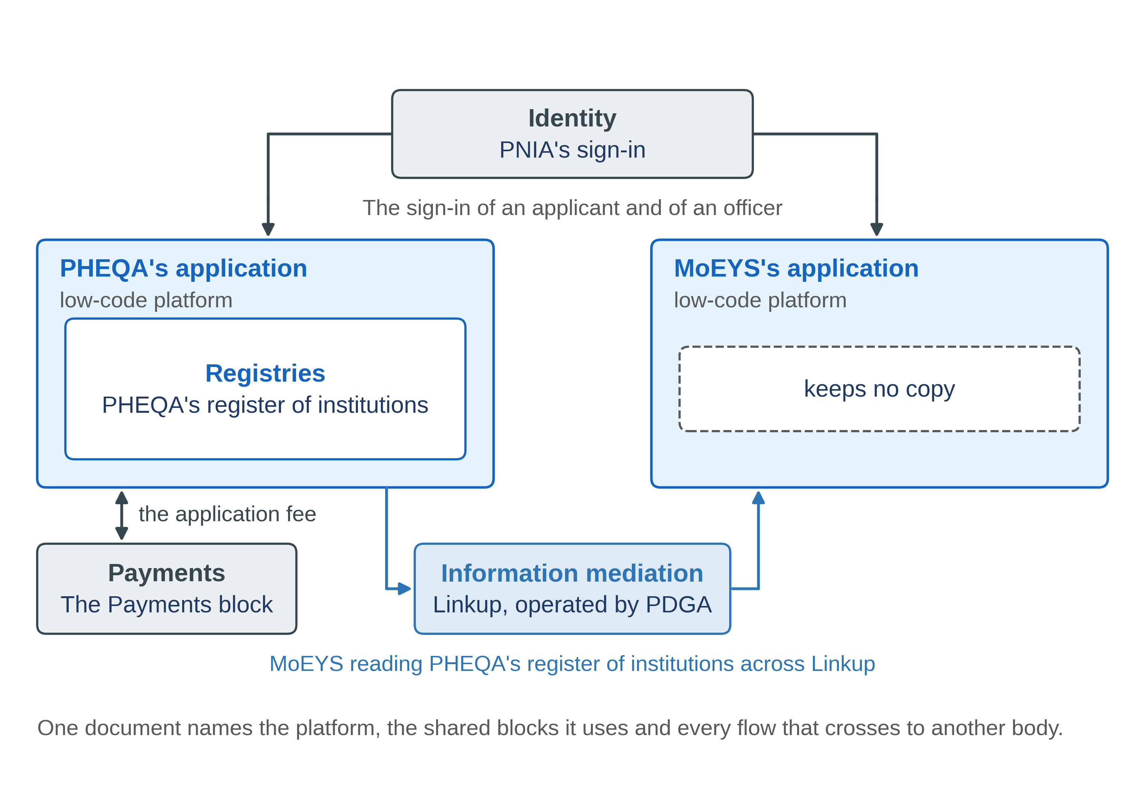
Progressa: the crossings of PHEQA's registration service
5.6 · Payments and information mediation as named crossings
Notes:
VO: Here is the table for PHEQA's registration service. The application fee goes out to the Payments block, and the confirmation comes back. An institution's record goes out to MoEYS when MoEYS asks for it, through Linkup, which PDGA operates. Who signs in comes in from PNIA. And one more crossing of the same kind lies ahead: a graduate's credential, issued by PDCA into the learner's digital wallet. Each row names a body that must agree to it.

Slide 7
Each row agreed by the other side
The operator of the Payments block
the fee.
PDGA
the use of Linkup.
PNIA
the sign-in.
MoEYS
what it reads from the register.
5.6 · Payments and information mediation as named crossings
Notes:
VO: A crossing is a promise made together with someone else, so each row needs that body's agreement. The operator of the Payments block confirms the fee crossing. PDGA confirms the use of Linkup. PNIA confirms the sign-in. MoEYS confirms what it will read from the register. Then the head of PHEQA's ICT unit accepts the table. A row that nobody on the other side has seen is a promise made on their behalf, and the first test will show it.

Slide 8
IN ONE SENTENCE
A payment or a call across the data exchange is a crossing the architecture names, not a block the service rebuilds.
Do this on your own sector. Draft the crossing table of a service.
The prompt in the companion material gives you a crossing table, one row for each crossing. Before the next video.
5.6 · Payments and information mediation as named crossings
www.itu.int
Notes:
PRACTICE BOX (on-screen only — never read it, never paraphrase it, never point at it). It replaces the narrated handoff: this video ends on its recap.
VO: Name every crossing, the body on the other side and the block it goes through. Never rebuild a block that a crossing can use.

Slide 9
Sources
• GovStack Payments 3.0, sections 6.4 and 6.6
• GovStack Information Mediator 1.1.1
• GovStack Registration (default edition), section 5.1.4
Find the link in the description.
5.6 · Payments and information mediation as named crossings
Notes:
Sources slide, held ~5 seconds at the end of the video. Links are compiled into the YouTube description per ITU convention; no URLs read aloud.

