Slide 1
MODULE 6 · VIDEO 6.1
6.1
What to require from a supplier
The twelve documents are deliverables you name in the contract, each accepted by a named person.
standalone video · voice-over on text slides
Notes:
Title card — the cold open. The hosts name the module, the video number, the title and the single message on this slide; no scripted narration. Hold until the opener begins; the opener is narrated on the next slide.

Slide 2
WHERE WE START
"A working system and its documentation." What will you receive?
Neither phrase says what you receive, or who on your side decides it is good enough.
Both can be settled in the contract, before any work begins.
6.1 · What to require from a supplier
www.itu.int
Notes:
VO: A supplier's offer often promises a working system and its documentation. Neither phrase says what you will receive, or who on your side decides that it is good enough. Both can be settled in the contract, before any work begins.
Retrieval prompt — ask before playing on: how many deliverables should the contract name? Answer on the next slide.

Slide 3
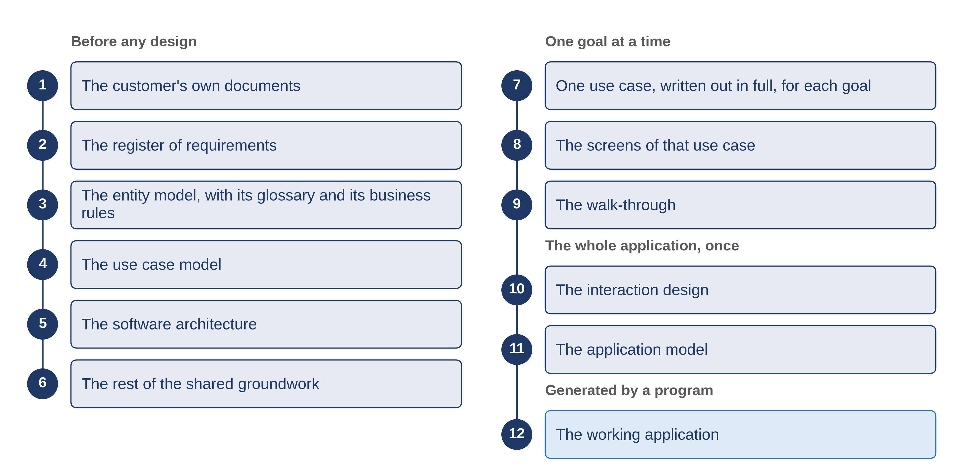
Twelve deliverables, not one system
6.1 · What to require from a supplier
Notes:
VO: The SDD method, short for specification-driven development, writes a service down in twelve documents, in a fixed order. The first is your own: the law, the mandate and the requests, handed over and never edited. Seven more are written before anything is built: what was asked, the records the service keeps, the goals, the architecture, the shared lists and settings, each goal written as a story, and its screens. Then come the walk-through your officials click, the decisions settled once for the whole application, and the one file a program reads. The twelfth is the working application itself. Each of the twelve can be named in the contract as a deliverable.

Slide 4
Three things for each deliverable
The form
the blank instrument it is written on.
The person
who in your organisation accepts it.
The check
what it must pass before it is accepted.
6.1 · What to require from a supplier
Notes:
VO: For each deliverable, the contract names three things. The first is the form, a blank instrument the document is written on, so that what arrives can be compared with what was ordered. The second is the person in your organisation who accepts it, named by role: the director who owns the service, or the head of the ICT unit for the technical documents. The supplier never accepts its own work. The third is the check the document must pass before it is accepted: its own checklist, a comparison with an earlier document, or a program. The next document is written only from what was accepted.

Slide 5
Two clauses that protect you
The application is generated from the accepted model, and nothing generated is edited by hand.
Every open question is delivered with an owner and a date.
6.1 · What to require from a supplier
Notes:
VO: Two clauses protect you most. The first says that the working application is generated from the accepted model, the one file a program reads, and that nothing generated is edited by hand. A supplier who patches the running system leaves your documents saying one thing while the system does another. The second clause says that every open question is delivered with an owner and a date. A question with a name on it is part of what you receive. A question the supplier answered with a guess is a fault in the delivery.

Slide 6
MoEYS's deliverables annex (illustrative)
The register of what was asked
accepted by the Director of Higher Education — its own checklist.
The screens of each goal
accepted at a review of three people — checked against the goal's story.
The file a program reads
approved by the head of the ICT unit — a program refuses it if it contradicts an accepted decision.
The working application
accepted when an officer has finished a real task on it.
6.1 · What to require from a supplier
Notes:
VO: Here is how Progressa's ministry of education, MoEYS, writes it, in an example built for this course. Its annex lists all twelve documents. The Director of Higher Education accepts the register of what was asked. The screens of each goal are accepted at a review of three people: their owner, the builder and the officer who will use them. The head of the ICT unit approves the file a program reads, once a program has checked it. And the working application is accepted only when an officer has finished a real task on it.

Slide 7
IN ONE SENTENCE
The twelve documents are deliverables you name in the contract, each accepted by a named person.
Do this on your own sector. Draft the deliverables annex of a terms of reference.
The prompt in the companion material gives you a deliverables annex with one row for each of the twelve documents. Before the next video.
6.1 · What to require from a supplier
www.itu.int
Notes:
PRACTICE BOX (on-screen only — never read it, never paraphrase it, never point at it). It replaces the narrated handoff: this video ends on its recap.
VO: Name the twelve documents as deliverables. For each one, name its form, the person on your side who accepts it, and the check it must pass.

