Slide 1
MODULE 6 · VIDEO 6.2
6.2
When something changes, correct the document that owns the fact
A change goes up to its source and everything below is produced again.
standalone video · voice-over on text slides
Notes:
Title card — the cold open. The hosts name the module, the video number, the title and the single message on this slide; no scripted narration. Hold until the opener begins; the opener is narrated on the next slide.

Slide 2
WHERE WE START
The quickest fix is the one that brings the problem back later.
A service is in use, and someone asks for a change.
The quickest fix changes the screen, or the running system, where the problem was seen.
6.2 · When something changes, correct the document that owns the fact
www.itu.int
Notes:
VO: A service is in use, and someone asks for a change. The quickest fix is to change the screen, or the running system, where the problem was seen. That fix is the one that brings the problem back later.

Slide 3
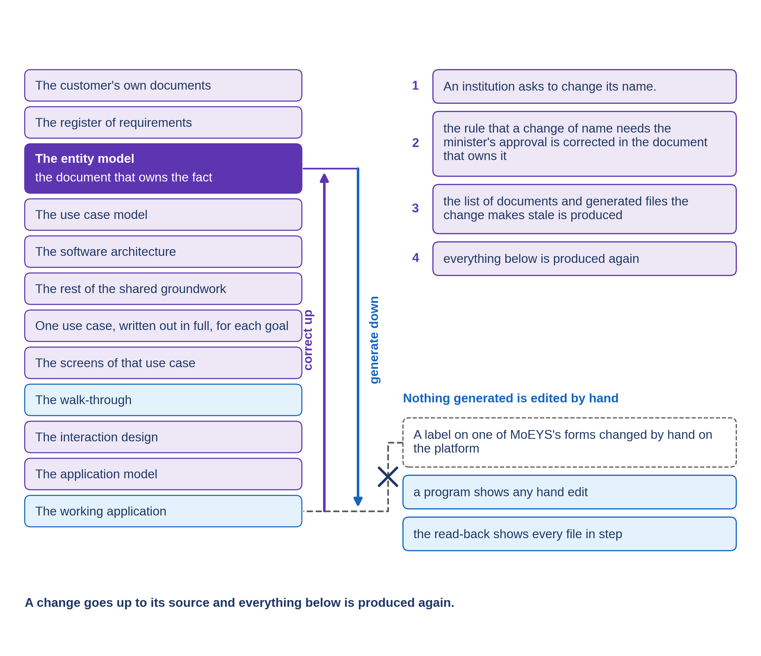
Up to the owner, then down again
Find the document that owns the fact.
Correct the fact there, and nowhere else.
Produce everything below it again.
6.2 · When something changes, correct the document that owns the fact
Notes:
VO: The SDD method has one rule for every change. The change goes up to the document that owns the fact. It is corrected there, and nowhere else. Then everything below that document is produced again from it. The reason is simple. If you correct a fact where you happened to notice it, the document that owns the fact still says the old thing. The next time anything is produced from that document, the old fault returns. One statement of each fact, with every copy made from it, is the only arrangement that stays true over the years.

Slide 4
When the behaviour itself changes
First the story of the goal, agreed.
Then the screens.
Then the walk-through.
Only then what was built.
6.2 · When something changes, correct the document that owns the fact
Notes:
VO: When the behaviour of the service itself must change, the order matters even more. The story of the goal changes first, and is agreed. Then the screens are brought into line. Then the walk-through is produced again. Only then does what was built change. People notice a screen first, so they ask for the screen to change first. Hold the order. A screen changed ahead of its story is a decision that nobody agreed, and the builder has no way to know it. Ask which story the change belongs to, before anything else is touched.

Slide 5
An institution asks to change its name (illustrative)
Harbourview University College asks PHEQA to change its name.
Followed through both bodies, the new name could be written before the minister approves.
The fact is owned by PHEQA's register of business rules.
Corrected there
no new name without the minister's approval.
6.2 · When something changes, correct the document that owns the fact
Notes:
VO: Here is an example built for Progressa. Harbourview University College asks the quality authority, PHEQA, to change its name. The request is followed through both bodies, PHEQA and the ministry of education, MoEYS. The head of the registration desk sees that an officer could write the new name into the register before the minister had approved it. The screen does not own that fact. PHEQA's register of business rules does. The rule is corrected there, to say that a new name is written only on the minister's approval, received from MoEYS. PHEQA's Registrar, who owns the rules, confirms the correction.

Slide 6
What the change makes stale
Corrected
the register of business rules.
Stale
the shared groundwork, two goals, their screens and walk-throughs, the interaction design, the model, the application.
Not stale
MoEYS's documents.
Pass
after generation, nothing is stale.
Demonstration segment — a storyboard until it is recorded.
6.2 · When something changes, correct the document that owns the fact
Notes:
VO: Then a program lists everything made from the old version of the rule: the shared states of a request, two of PHEQA's goals, their screens and walk-throughs, the decisions for the whole application, the file a program reads, and the application itself. Nothing on the list is reviewed, agreed or built from until it has been produced again. MoEYS's documents are not on the list, because none of them was made from PHEQA's rule. The recording of this segment will show the list, the application generated again, and the change on the running service. It passes when the list names everything the change reaches, and nothing is stale afterwards.
Production cue: demonstration segment, a storyboard until it is recorded (in the bundle: the storyboard of 6.2, after its worked example). The text-only stand-in holds the screen until the recording replaces this slide.

Slide 7
IN ONE SENTENCE
A change goes up to its source and everything below is produced again.
Do this on your own sector. Find the document that owns the fact a change touches.
The prompt in the companion material gives you the owning document with the reason, the list of documents to produce again, and any question with its owner. Before the next video.
6.2 · When something changes, correct the document that owns the fact
www.itu.int
Notes:
PRACTICE BOX (on-screen only — never read it, never paraphrase it, never point at it). It replaces the narrated handoff: this video ends on its recap.
VO: A change goes up to the document that owns the fact. Correct it there, then produce everything below it again.

