Slide 1
MODULE 6 · VIDEO 6.4
6.4
The AI assistant at every step, and the person who rules
The assistant drafts each document; a person rules on every proposal and every gap keeps its name.
standalone video · voice-over on text slides
Notes:
Title card — the cold open. The hosts name the module, the video number, the title and the single message on this slide; no scripted narration. Hold until the opener begins; the opener is narrated on the next slide.

Slide 2
WHERE WE START
A register of requirements, drafted by an AI assistant in an afternoon.
That speed is real.
Who decides what the draft says, and what happens to everything the assistant did not know?
6.4 · The AI assistant at every step, and the person who rules
www.itu.int
Notes:
VO: An AI assistant can draft a register of requirements in an afternoon. That speed is real. The question for a manager is who decides what the draft says, and what happens to everything the assistant did not know.

Slide 3
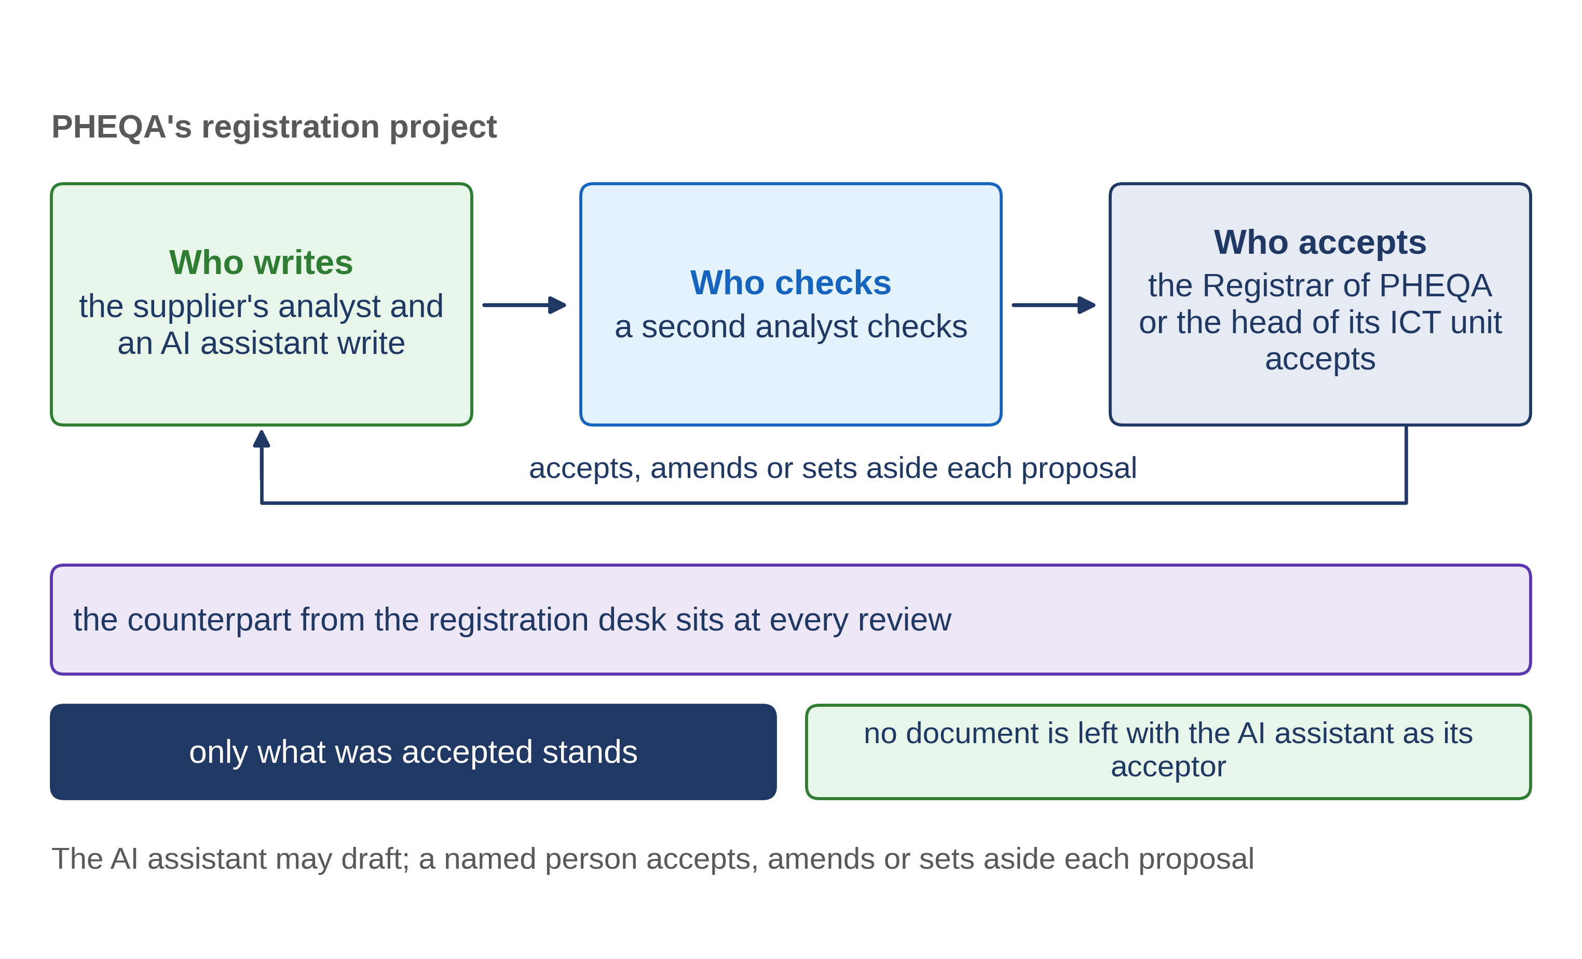
The assistant drafts; a person rules
6.4 · The AI assistant at every step, and the person who rules
Notes:
VO: The SDD method gives an assistant real work. It extracts the register of what was asked from your own documents. It drafts each goal as a story. It writes the one file a program reads. For each document a person writes, there is an assisting tool that walks that person through the document's standard, part by part. But no document is finished by an assistant alone. A named person reviews every proposal, and accepts it, amends it or sets it aside. Only what that person accepted stands in the document, with the person's name and the date.

Slide 4
Every gap keeps its name
The assistant does not fill a gap with a plausible answer.
It records a question, with the person who must answer it.
It never invents a figure to keep the work moving.
6.4 · The AI assistant at every step, and the person who rules
Notes:
VO: Inventing something plausible is what an assistant does best. That is why the method's most important rule binds it here. When your documents do not settle something, the assistant must not fill the gap. It records a question, with the name of the person who must answer it. It never invents a figure to keep the work moving, and it never quietly answers a decision that is still open. A draft that comes back with named questions is a good draft. A draft with no questions at all deserves a second, careful reading. Ask for the list of open questions with every draft.

Slide 5
MoEYS's rules of use (illustrative)
The assistant may draft the register, the stories and the model.
A named officer rules on every draft.
Every open question carries an owner.
No figure without its source.
The ministry's data stay within the tools the ministry allows.
6.4 · The AI assistant at every step, and the person who rules
Notes:
VO: Here is an example built for Progressa: the ministry of education's rules of use for an AI assistant, on one page. The assistant may draft the register, the stories and the model. A named officer rules on every draft, and the officer's name goes into the document. Every open question carries an owner. No figure enters a document without its source. And the ministry's data stay within the tools the ministry allows. The head of the ICT unit adopts the page, after it has been checked against the ministry's duties on personal data. It is short enough to keep beside every contract.

Slide 6
What you check in an assisted document
Whose name stands against each accepted part?
Which questions are open, and who owns each?
Is any figure without its source?
6.4 · The AI assistant at every step, and the person who rules
Notes:
VO: When an assisted document reaches you for acceptance, three questions are enough. Whose name stands against each part that was accepted? Which questions are still open, and who owns each one? And is there any figure without its source? If a part has no name against it, nobody in your organisation has ruled on it, and it is still only the assistant's proposal. The same holds for the one file a program reads: the person who approves it reads every assumption the assistant made, and sends each one back to the document it rests on.

Slide 7
IN ONE SENTENCE
The assistant drafts each document; a person rules on every proposal and every gap keeps its name.
Do this on your own sector. Draft the rules of use for an AI assistant in your specification work.
The prompt in the companion material gives you one page of rules of use, each rule with the paragraph of the policy it rests on. Before the next video.
6.4 · The AI assistant at every step, and the person who rules
www.itu.int
Notes:
PRACTICE BOX (on-screen only — never read it, never paraphrase it, never point at it). It replaces the narrated handoff: this video ends on its recap.
VO: Let the assistant draft each document. A named person rules on every proposal, and every gap stays a question with an owner.

