Slide 1
MODULE 6 · VIDEO 6.5
6.5
The next service on the same foundation
The second service, a digital credential, reuses what the first one built and proved.
standalone video · voice-over on text slides
Notes:
Title card — the cold open. The hosts name the module, the video number, the title and the single message on this slide; no scripted narration. Hold until the opener begins; the opener is narrated on the next slide.

Slide 2
WHERE WE START
The next request is already on the table.
Institutions register once with the quality authority, and the ministry reads that register.
Now graduates want proof of their degree that an employer can trust.
6.5 · The next service on the same foundation
www.itu.int
Notes:
VO: In Progressa, private institutions now register with the quality authority once, and the ministry reads that register instead of asking again. The next request is already on the table: graduates want proof of their degree that an employer can trust.

Slide 3
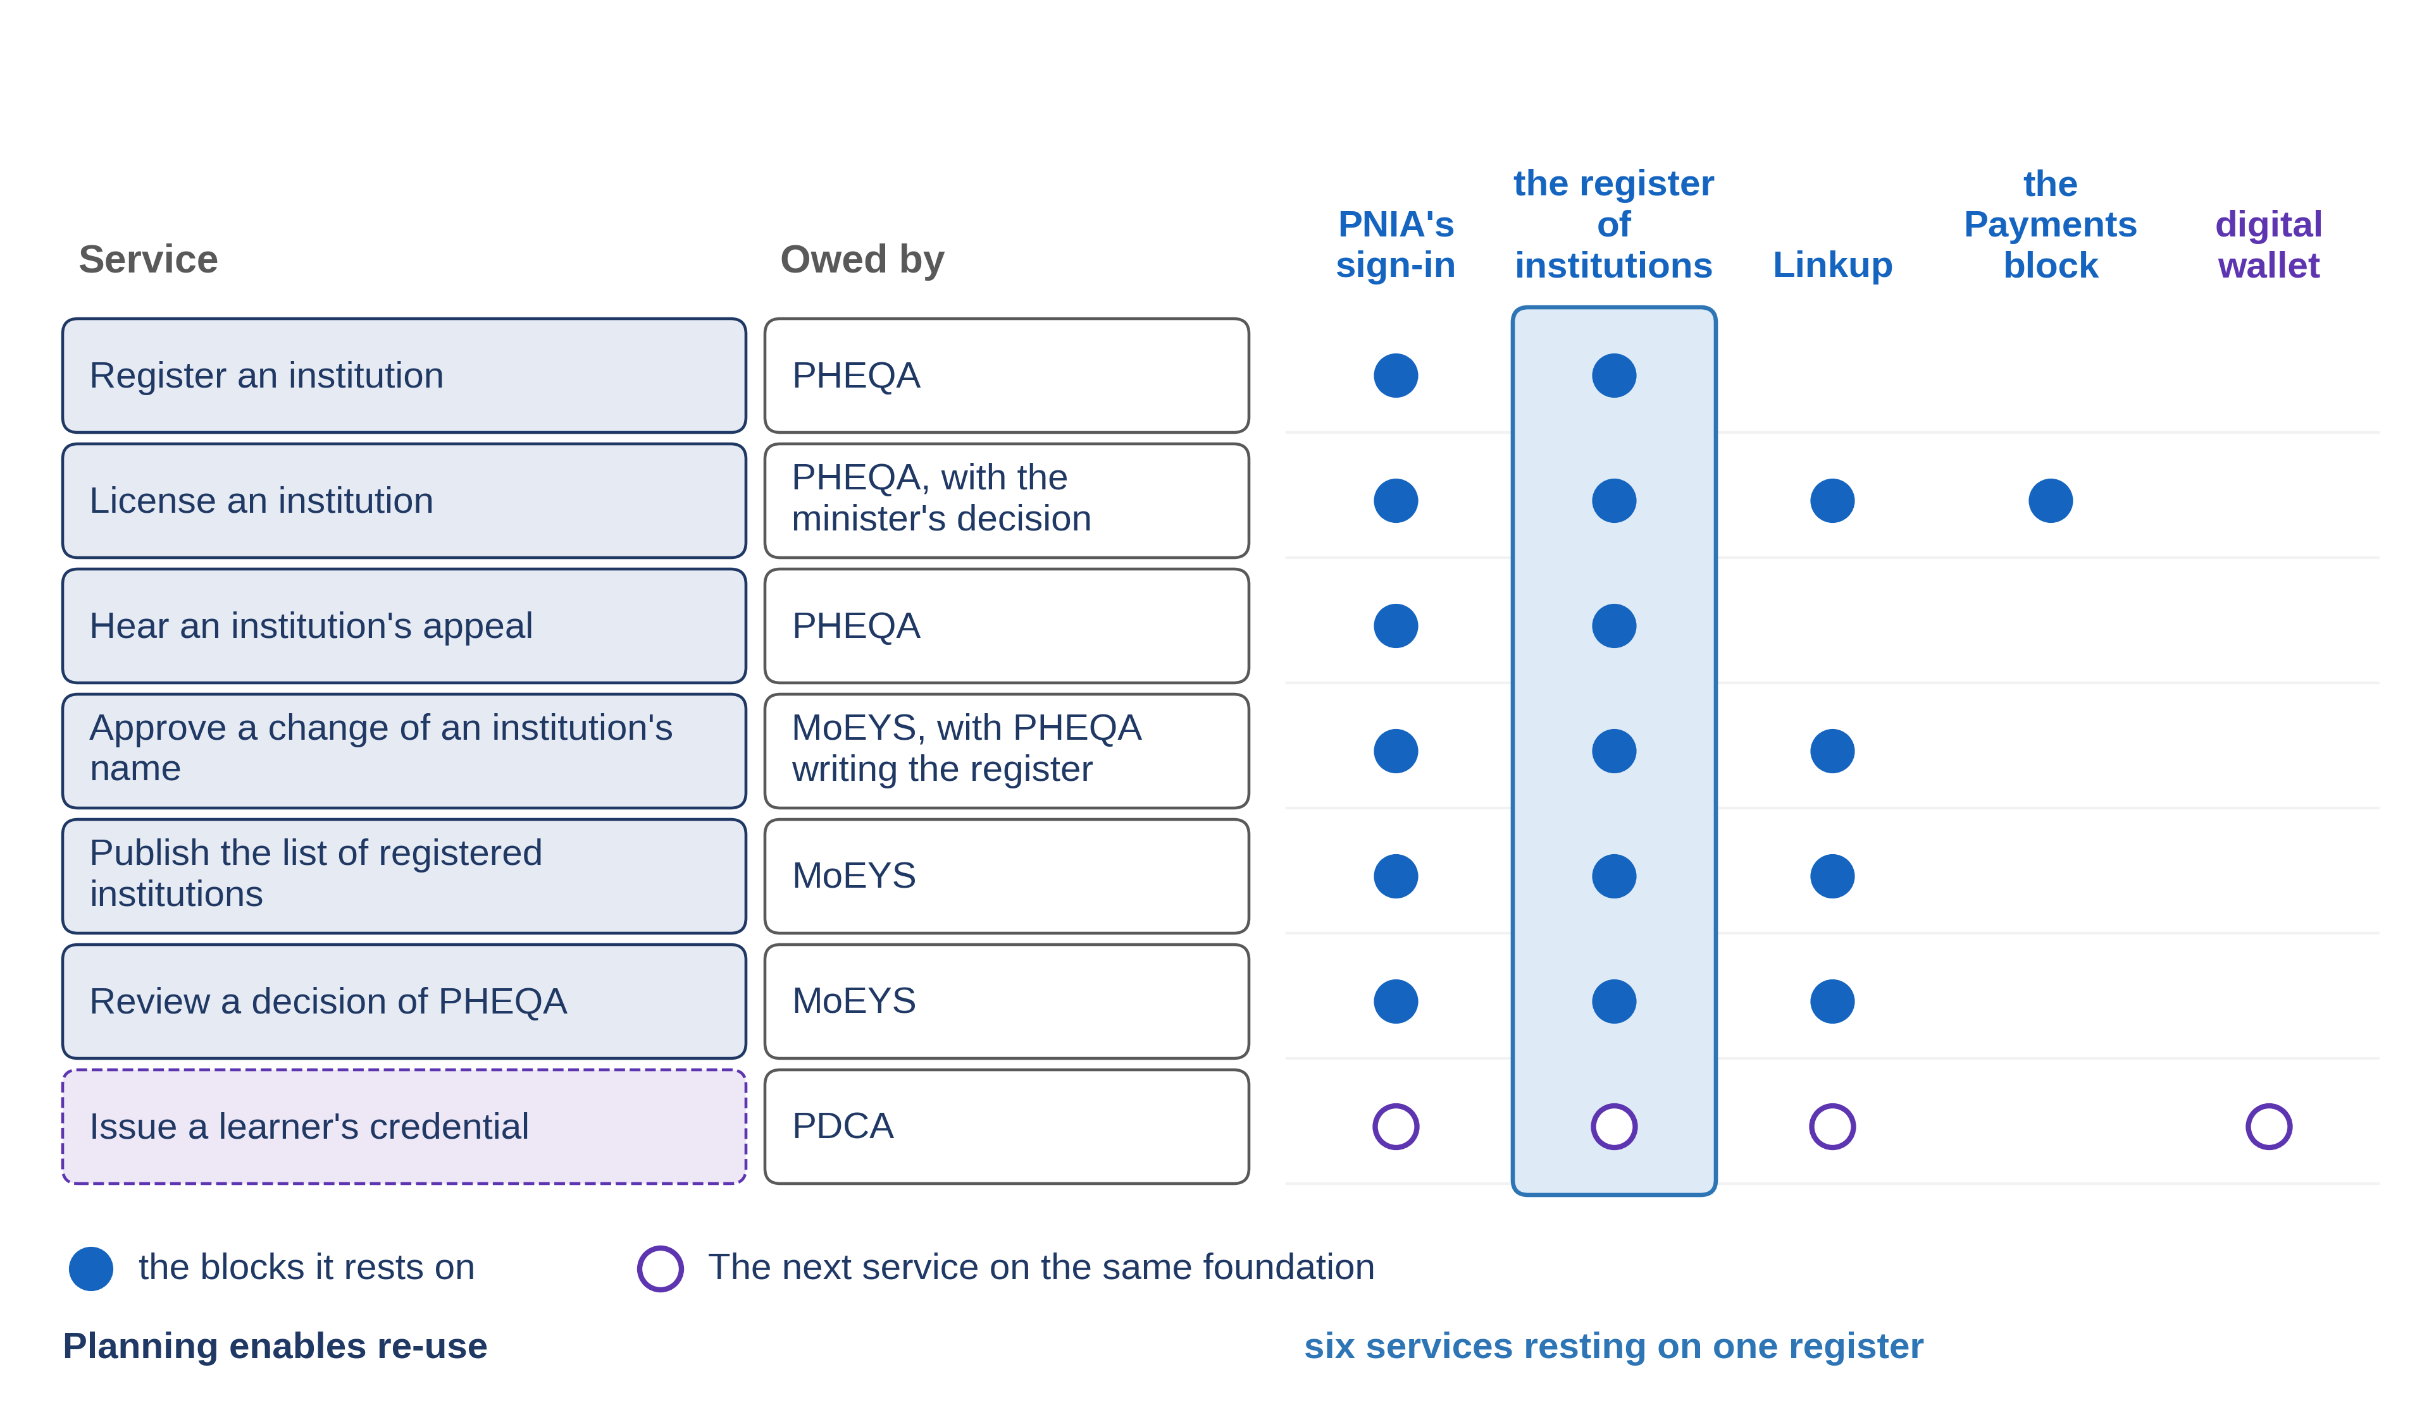
Planning enables re-use
6.5 · The next service on the same foundation
Notes:
VO: Inside one project, building your own list of institutions or your own sign-in always looks faster. That is what a project is paid to do. Procurement rules can make each contract cheaper, but only whole-of-government planning makes re-use possible. The sum that makes re-use worth it, one block paid for and many services carried, exists only at the level of the sector. UNDP describes digital public infrastructure as a set of shared digital systems. PAERA, the GovStack reference architecture, says that digital public infrastructure is not neutral and shapes what can be built on top of it. The first service chose the foundation; the second one builds on it.

Slide 4
The credential, one row of the catalogue
Issue a learner's credential
owed by PDCA.
Reuses
PNIA's sign-in.
Reuses
PHEQA's register of institutions, read across Linkup.
Adds
the credential, kept in the graduate's wallet.
6.5 · The next service on the same foundation
Notes:
VO: The second service is a digital credential for a graduate. It is already a row of Progressa's catalogue of services, owed by the digital credentials authority, PDCA, and the row shows what it rests on. The graduate signs in through the identity authority's sign-in, the same one the first service uses. PDCA reads the quality authority's register of institutions across Linkup, the data exchange, under the rules the register's keeper sets. One rule matters most: a credential is issued only for an institution whose licence is granted. PDCA keeps no copy of the register. None of these is built again.

Slide 5
Three of the roles in the W3C standard
The issuer gives the credential to the holder.
The holder keeps it, for example in a digital wallet.
The holder presents it, and the verifier checks it.
6.5 · The next service on the same foundation
Notes:
VO: The one new block is the credential itself. Of the roles the W3C standard for verifiable credentials names, three matter here. The issuer, here PDCA, gives the credential to the holder, the graduate. The holder stores it in what the standard calls a credential repository: for a person, usually a digital wallet. When an employer needs proof, the graduate presents the credential, in what the standard calls a verifiable presentation, and the employer, as the verifier, checks it. UNDP's compendium on digital public infrastructure counts verifiable credentials among the trust services that come with digital identity.

Slide 6
The same twelve documents, written once more
PDCA's own register of what was asked, records, goals and screens.
Most crossings already exist.
Each reuse confirmed with the body that keeps the block.
6.5 · The next service on the same foundation
Notes:
VO: The method does not change for the second service. PDCA's team writes the same twelve documents, in the same order, each accepted by a named person. What changes is the architecture. Most of its crossings already exist, and each one is confirmed with the body that keeps the block: the identity authority for the sign-in, the quality authority for the register. The second service pays for what it adds, the credential and the wallet, and not for the foundation the first one built. Each confirmation is written down before the plan is approved. For the minister, that is the argument in one line: the foundation is already paid for.

Slide 7
IN ONE SENTENCE
The second service, a digital credential, reuses what the first one built and proved.
Do this on your own sector. List what a new service can reuse, and what it must add.
The prompt in the companion material gives you a reuse list of blocks and records with their keepers. Before the next video.
6.5 · The next service on the same foundation
www.itu.int
Notes:
PRACTICE BOX (on-screen only — never read it, never paraphrase it, never point at it). It replaces the narrated handoff: this video ends on its recap.
VO: The second service reuses the sign-in, the register and the exchange that the first one built and proved. It adds only the credential.

Slide 8
Sources
• PAERA v1.0, section 2.6
• W3C, Verifiable Credentials Data Model v2.0, sections 1.2 and 4.13
• GovStack Identity specification, version 2.0
• GovStack Digital Registries specification, version 3.0-alpha
• UNDP, Accelerating the SDGs through Digital Public Infrastructure: A Compendium, 2023, pages 3 and 4
Find the link in the description.
6.5 · The next service on the same foundation
Notes:
Sources slide, held ~5 seconds at the end of the video. Links are compiled into the YouTube description per ITU convention; no URLs read aloud.

