Slide 1

Runkeeper
Naam : Remco Sannen
Malek Sediqi

Slide 2
Inhoud
Demo
Databinding
WinRT(Grafiek)
Mapcontrol
Linq
LocalStorage
Feature Geofencing

Slide 3
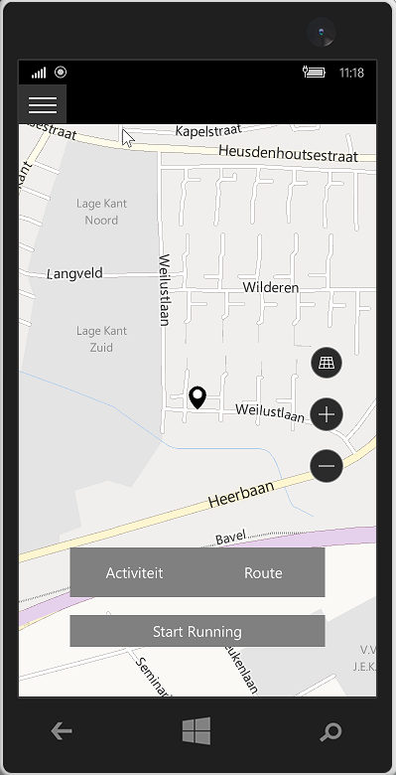
Demo-Runkeeper

Slide 4
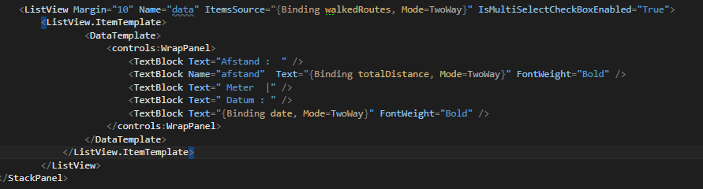
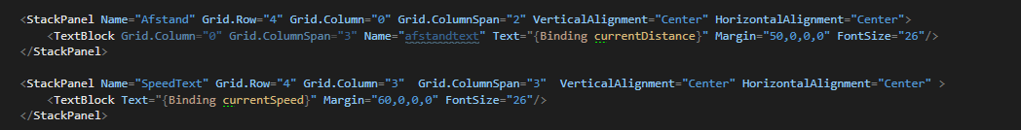
Databinding

Slide 5
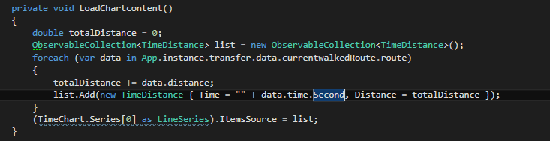
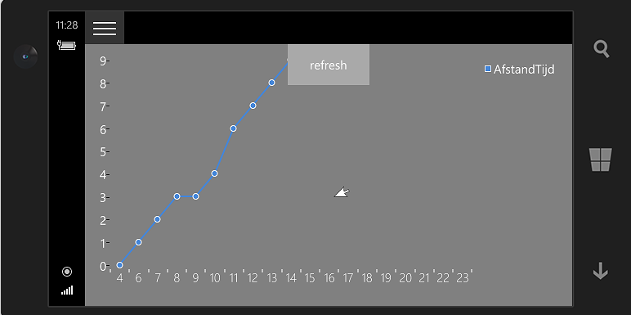
Grafiek

Slide 6
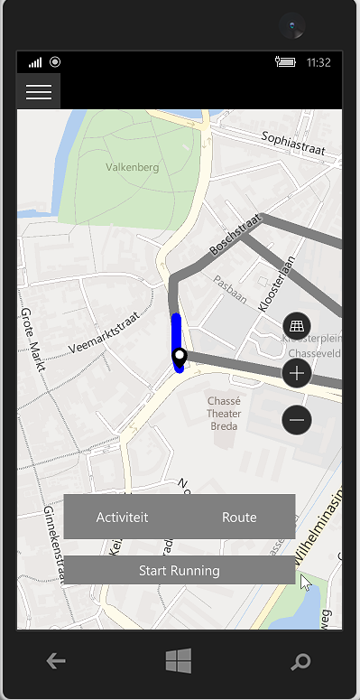
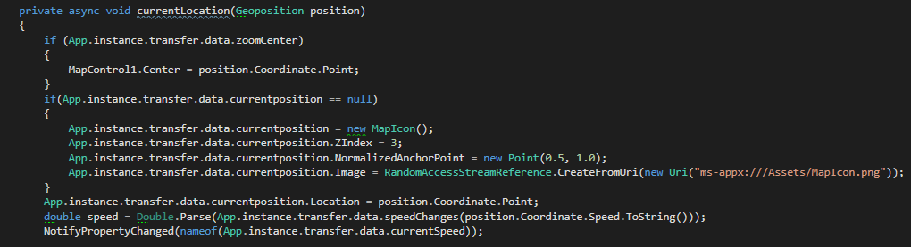
Mapcontrol

Slide 7
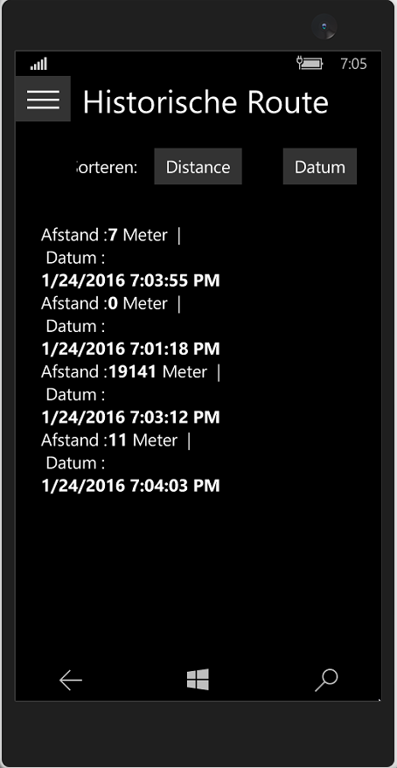
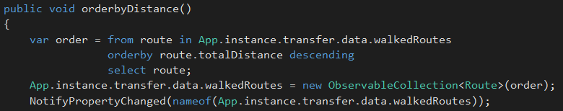
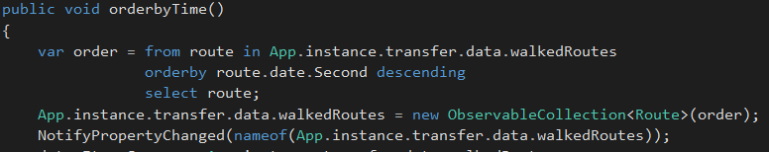
Linq

Slide 8
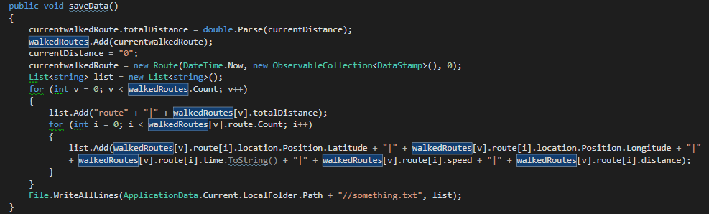
LocalStorage

Slide 9
Geofencing
Feature

Slide 10
Vragen
?

