Slide 1
Comparing M2T & M2M
Complementary Approaches
Hugo Bruneliere, Richard Paige & Goran Olsen
INRIA, York & SINTEF
- <number> -

Slide 2
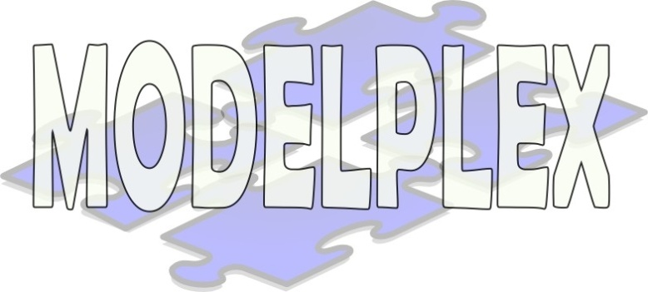

Context of this work
The present courseware has been elaborated in the context of the MODELPLEX European IST FP6 project (http://www.modelplex.org/).
Co-funded by the European Commission, the MODELPLEX project involves 21 partners from 8 different countries.
MODELPLEX aims at defining and developing a coherent infrastructure specifically for the application of MDE to the development and subsequent management of complex systems within a variety of industrial domains.
To achieve the goal of large-scale adoption of MDE, MODELPLEX promotes the idea of a collaborative development of courseware dedicated to this domain.
The MDE courseware provided here with the status of open-source software is produced under the EPL 1.0 license.
- <number> -

Slide 3
Outline
Presentation of model transformation
  Overview
  Other kinds of transformation (not model-based)
What is M2T?
  Principles
  Existing solutions (MOFScript & Epsilon EGL)
What is M2M?
  Principles
  Existing solutions (ATL & Epsilon ETL)
Differences between M2T & M2M
Combining both approaches in an MDE process
  Application on a concrete use case: UML2 to Java
  Advantages of such a solution
- <number> -

Slide 4
Presentation of model transformation
Overview
  Model-Driven Engineering (MDE) technique
  Consume/produce models as inputs/outputs
    Each model conforms to a given metamodel
  Two kinds of model transformation:
    Model-to-Text transformation (M2T)
    Model-to-Model transformation (M2M)
  Two different possible implementations:
    Use a model transformation Domain-Specific Language (DSL)
      ATL, MOFScript, Epsilon, etc.
    Use a General Purpose Language (GPL)
      Java, C#, etc.
- <number> -

Slide 5
Presentation of model transformation
Other kinds of transformations (not model-based)
  XSLT transformation
    XML document-to-XML document transformation
    Each XML document conforms to a given XML schema
    Directly translatable to the MDE paradigm
  Compilation transformation
    Text-to-Binary transformation
    Each source program conforms to a given grammar
    Each target compiled program conforms to a given binary format
    Also adaptable to the MDE paradigm
  Model transformation is a generic abstraction of all these techniques
- <number> -

Slide 6
What is M2T?
Principles
  To be completed (York & SINTEF)
- <number> -

Slide 7
What is M2T?
Existing solutions: MOFScript
  To be completed (SINTEF)
- <number> -

Slide 8
What is M2T?
Existing solutions: Epsilon EGL
  To be completed (York)
- <number> -

Slide 9
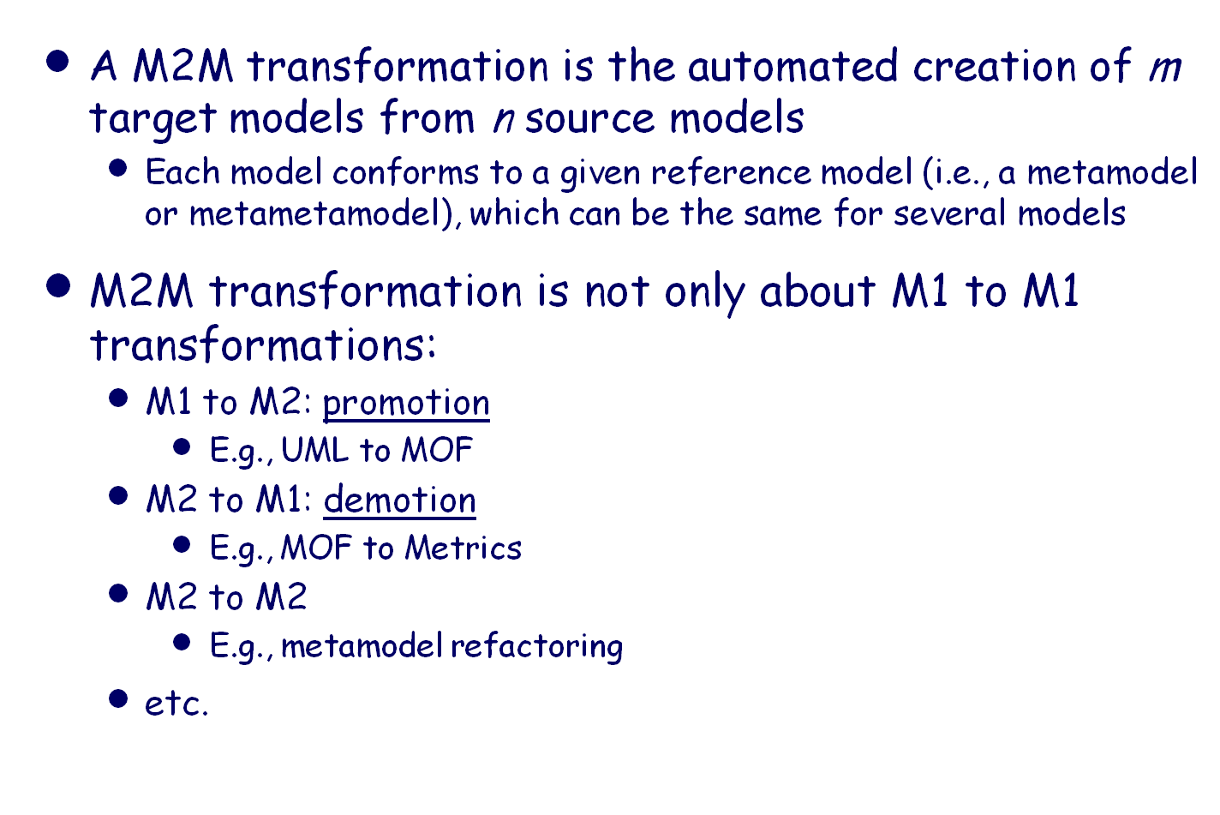
What is M2M?
Principles
M3
Metametamodel
M2
Metamodel
M1
Terminal Model
- <number> -

Slide 10
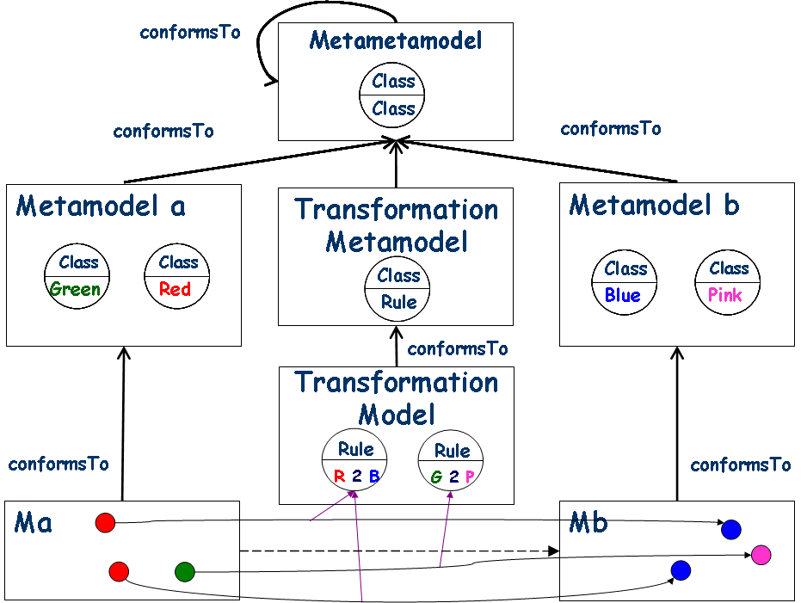
What is M2M?
Principles
- <number> -

Slide 11
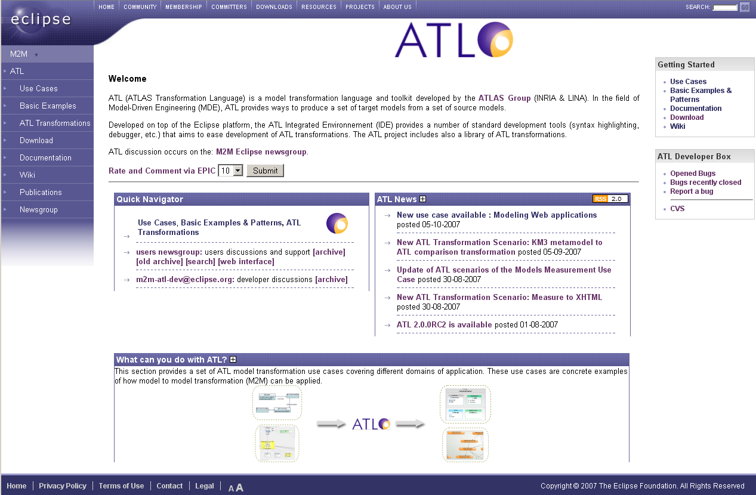
What is M2M?
Existing solutions: Eclipse-M2M ATL
  Website → http://www.eclipse.org/m2m/atl/
- <number> -

Slide 12
What is M2M?
Existing solutions: Eclipse-M2M ATL
  Available resources (1/2)
    Use cases → 24 complete transformation scenarios covering many different domains of application
    Basic examples → very first transformation examples which are interesting when starting with ATL (for beginners)
    ATL Transformations → ATL Transformation Zoo which gathers more than a hundred of various and varied transformations implemented using ATL
    Download → different binary builds of ATL available and also additional information for using the ATL update site
- <number> -

Slide 13
What is M2M?
Existing solutions: Eclipse-M2M ATL
  Available resources (2/2)
    Documentation → various kinds of ATL documents including a reference manual, a user manual, installation instructions, etc
    Publications → non-exhaustive list of papers presenting different works involving or using (directly or indirectly) ATL
    Wiki → an open section dedicated to ATL on the Eclipse Wiki which allows the community to consult or/and add information about ATL
    Newsgroup → a link to the Eclipse newsgroup dedicated to the M2M project components (posts concerning ATL are prefixed with the [ATL] tag)
- <number> -

Slide 14
What is M2M?
Existing solutions: Eclipse-M2M ATL
  How to get the plugins:
    Download the latest binary builds (frequently updated): http://www.eclipse.org/modeling/m2m/downloads/?project=atl
    Use the M2M update site (M2M ATL SDK): http://www.eclipse.org/modeling/m2m/updates/
    Install ATL sources from CVS (stable HEAD): http://wiki.eclipse.org/ATL/How_Install_ATL_From_CVS/
    Install ATL sources from CVS (development branch): http://wiki.eclipse.org/ATL/How_Install_ATL_(Dev)_From_CVS
- <number> -

Slide 15
What is M2M?
Existing solutions: Epsilon ETL
  To be completed (York)
- <number> -

Slide 16
Differences between M2T & M2M
M2T transformation bridges the MDE technical space with the Grammarware technical space
  Consumes/produces models to/from text files
  Requires both reference models (i.e., metamodels or metametamodels) and text formats (e.g., grammars)
  Handles both model elements and text
  → Heterogeneity
M2M transformation concerns only the MDE technical space
  Consumes/produces only models
  Requires only reference models (i.e., metamodels or metametamodels)
  Handles only model elements
  → Homogeneity
- <number> -

Slide 17
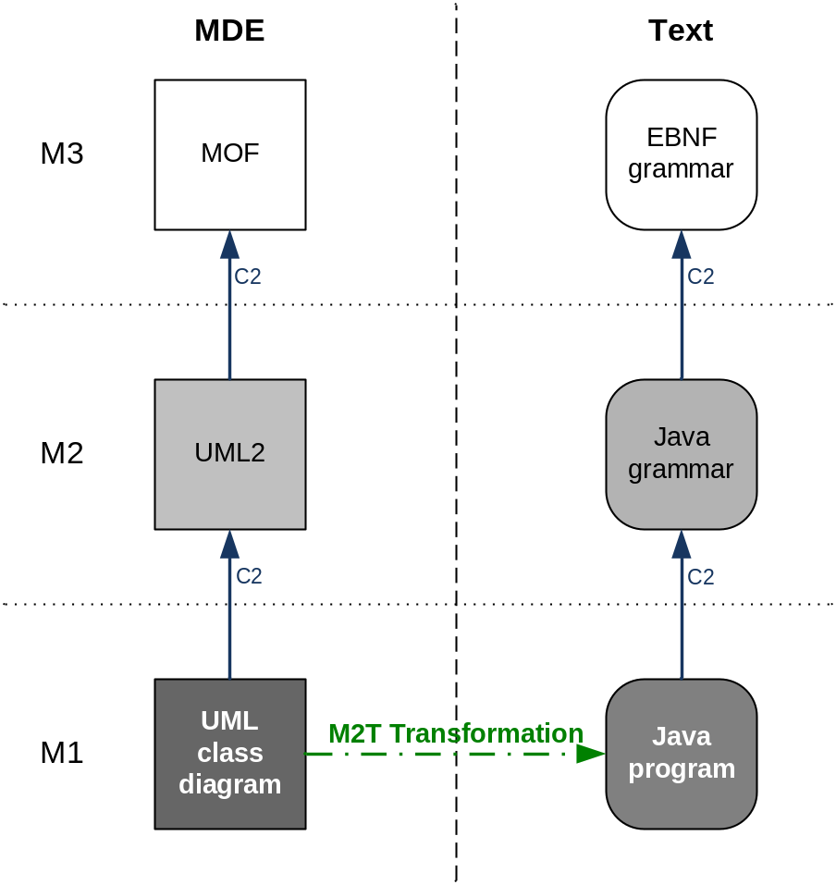
Combining both approaches in an MDE process
Application on a concrete use case: UML2 to Java
  An M2T solution
  A single transformation
  performing at the same time:
    Refactoring
    (e.g. delete of multiple
    inheritance)
    Mapping (UML2 concepts to
    Java concepts)
    Extraction to a concrete
    syntax (conforming to the
    Java grammar)
- <number> -

Slide 18
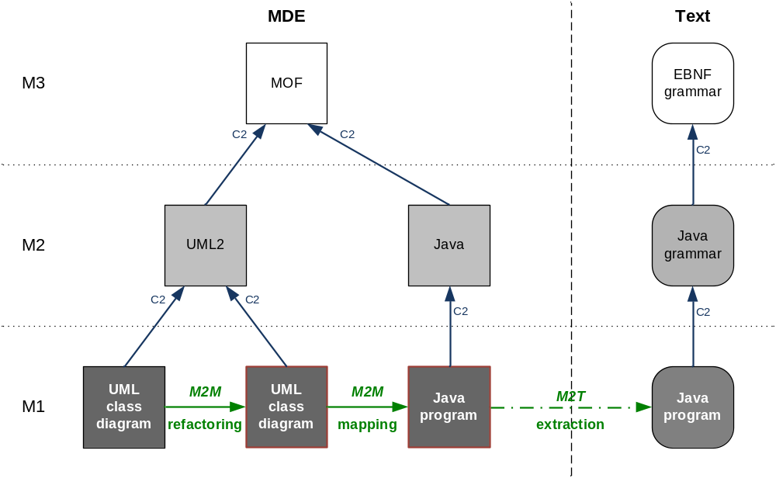
Combining both approaches in an MDE process
Application on a concrete use case: UML2 to Java
  Same case using an M2M+M2T solution
- <number> -

Slide 19
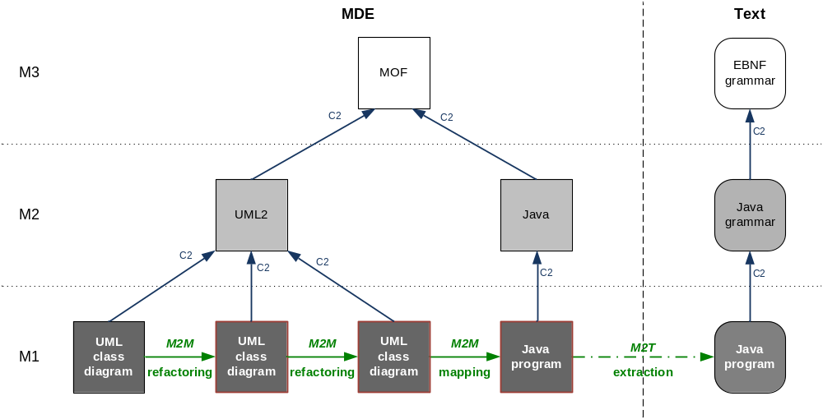
Combining both approaches in an MDE process
Application on a concrete use case: UML2 to Java
  Same case using an M2M+M2T solution + new refactoring
- <number> -

Slide 20
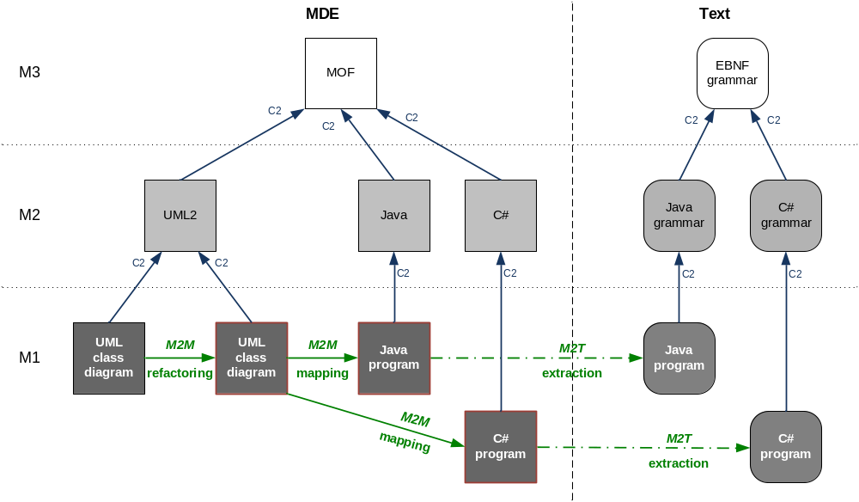
Combining both approaches in an MDE process
Application on a concrete use case: UML2 to Java
  Same case using an M2M+M2T solution + new mapping
- <number> -

Slide 21
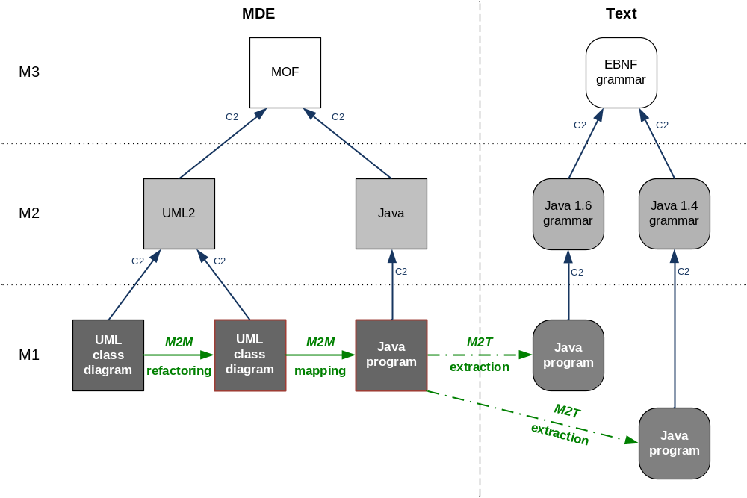
Combining both approaches in an MDE process
Application on a concrete use case: UML2 to Java
  Same case using an M2M+M2T solution + new extraction
- <number> -

Slide 22
Combining both approaches in an MDE process
Advantages of such a generic M2M+M2T solution
  Modularity
    Clearly separate the concerns (refactoring, mapping, extraction to a given syntax, etc)
  Extensibility
    Easily add new features (additional refactoring, different mapping, other extraction to a textual or graphical syntax, etc)
  Reusability
    Apply the same feature in different contexts (i.e., the same refactoring for targeting different languages)
  Homogeneity
    Handle mostly models (extraction is just the final step)
  Abstraction
    Focus is set only on the concepts (abstract syntax) and not on their various possible representations (concrete syntaxes)
- <number> -

