Slide 1
Internet-Controllable AGV
Alex Rich
Aaron Rosen

Slide 2
Deliverables (brief overview)
A vehicle that execute external commands communicated to it by a Raspberry Pi
A website containing a grid interface, where each grid cell is a location to where the vehicle can drive
Code that interprets current and target cells and converts the information into commands to be sent to the FPGA over Bluetooth

Slide 3
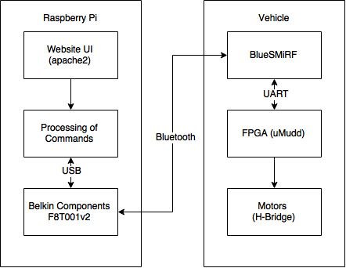
System Overview

Slide 4
Website: Front End

Slide 5
Website: Back End

Slide 6
FPGA: BlueSMiRF Interface (UART)

Slide 7
FPGA: Command Execution

Slide 8
Vehicle

