Slide 1
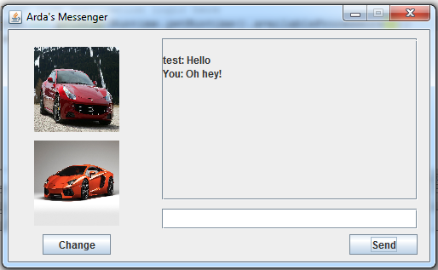
Chat Messenger
By Arda Aridici

Slide 2
Problem Statement
Solve the communication problem between two people who live far away by creating a medium for them to exchange messages

Slide 3
Solution
Create a chat client
User connects to the chat client, sends a message
Chat client communicates with a server
Other user’s chat client queries the server periodically
Server sends the messages to the other user’s chat client
Other user reads the message on his client

Slide 4
Arda’s Messenger
Enables 2 way communication between clients
Key aspects
Graphics – Extends JFrame
Images – By extending JComponent
Web communications – URL Connections
Multi threading – Threads and ExecutorService
Asynchronous method calls – ExecutorService
Buttons – ActionListeners
Keyboard – KeyListener
Warnings - JOptionPane

Slide 5
