Slide 1
Portfolio
Ahmad syamsul arifin
JAVASCRIPT
</>
</>
Email : aarie33ahmad@gmail.com
Github : github.com/aarie33
LinkedIn : linkedin.com/in/aarie33
…

Slide 2
Hello, I am Arie.
Full-Stack Web Developer specialized in building scalable web applications, robust APIs, and cloud infrastructure.
The projects listed here are sorted from older to newer

Slide 3
WEB STACKS
Backend
FRONTend
Laravel
NestJs
Java
Golang
Python
VueJs
ReactJs/ReactNative/NextJs
Typescript

Slide 4
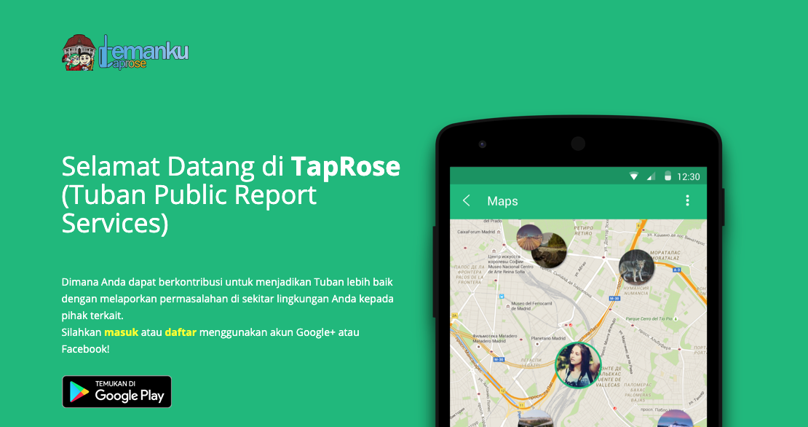
Taprose - pemkab tuban
Backend developer
(laravel)

Slide 5
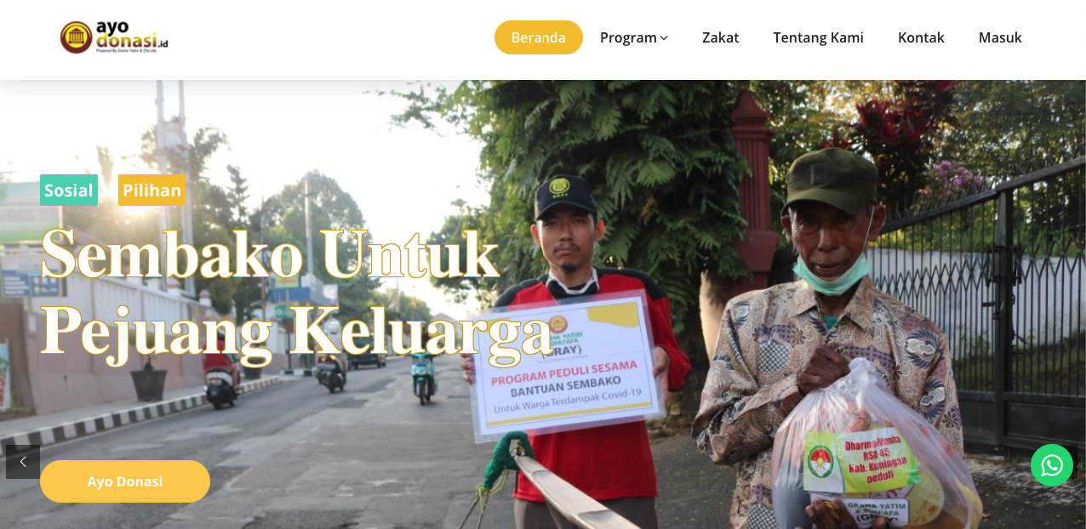
Ayo donasi
Dev lead
Backend developer
(hmvc codeigniter)

Slide 6
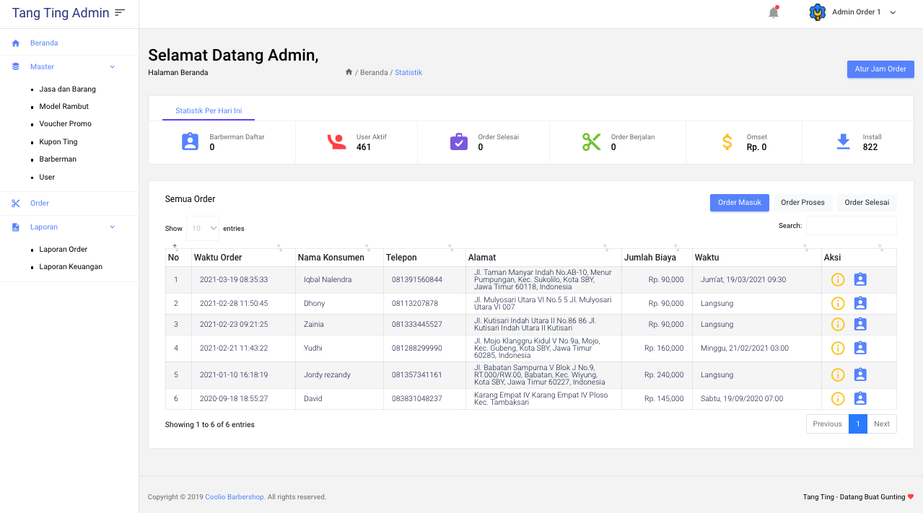
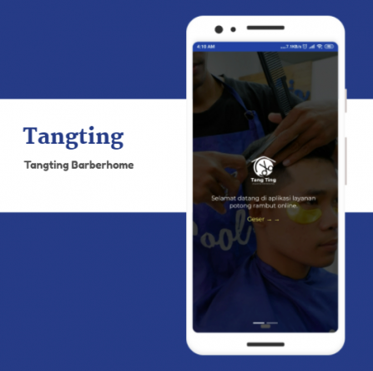
Tangting barberhome
Dev lead
Backend developer
(hmvc codeigniter, pwa)

Slide 7

Ahli gizi
Dev lead
fullstack developer
(codeigniter)

Slide 8
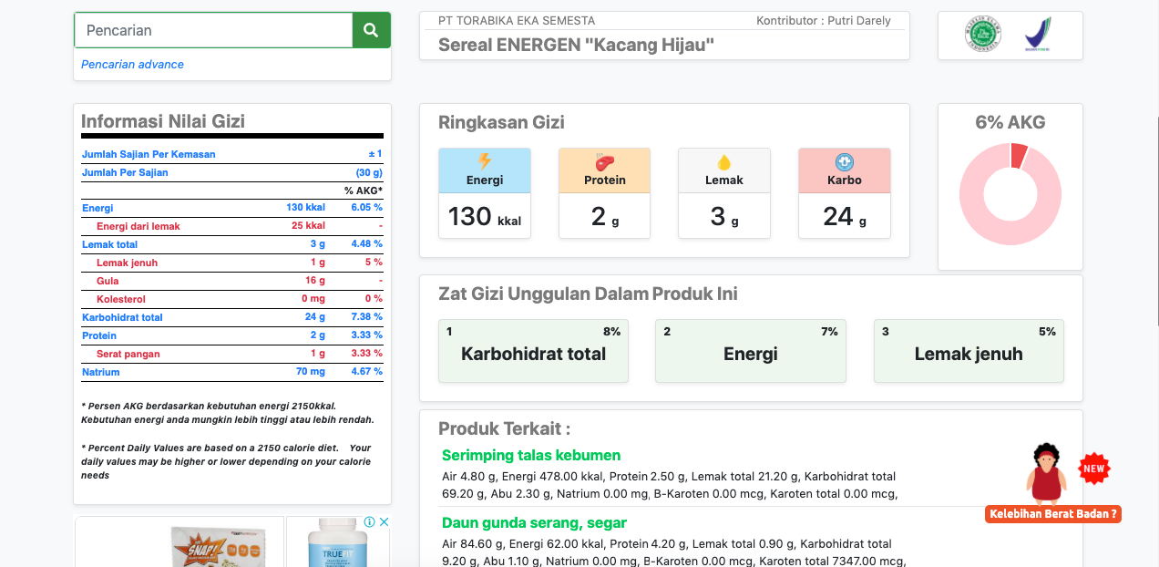
Nilai gizi
Dev lead
fullstack developer
(codeigniter)

Slide 9
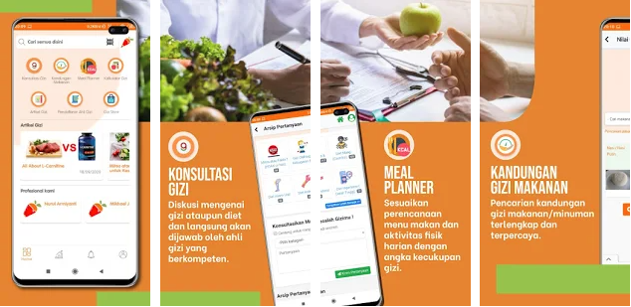
dietducate
DEV LEAD
FULLSTACk developer
(kotlin)

Slide 10
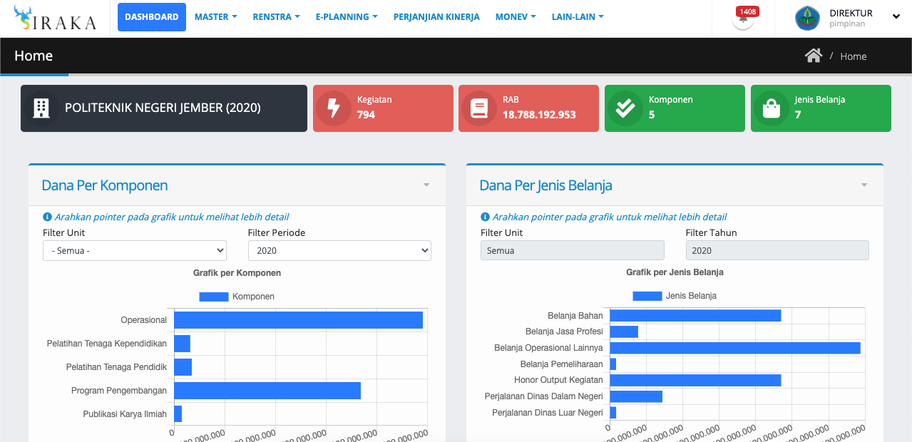
Siraka - politeknik negeri jember
Dev lead
fullstack developer
(codeigniter)

Slide 11
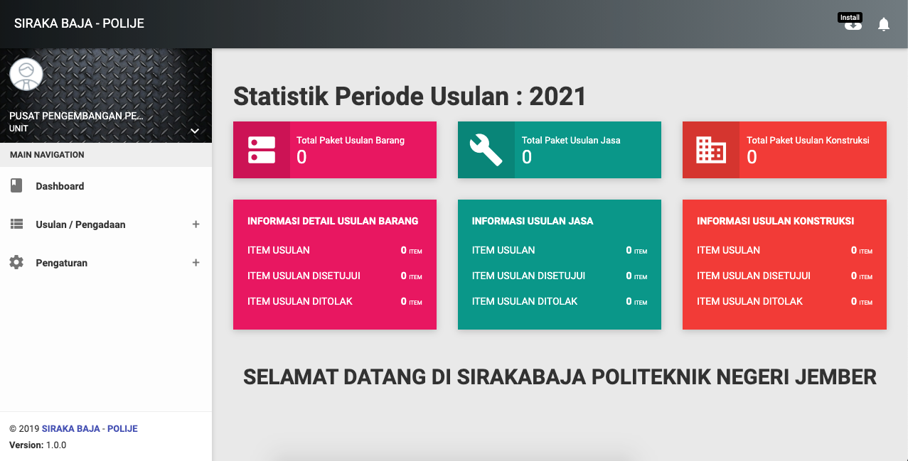
SirakaBaja - politeknik negeri jember
backend
Developer
(modular COdeigniter)

Slide 12
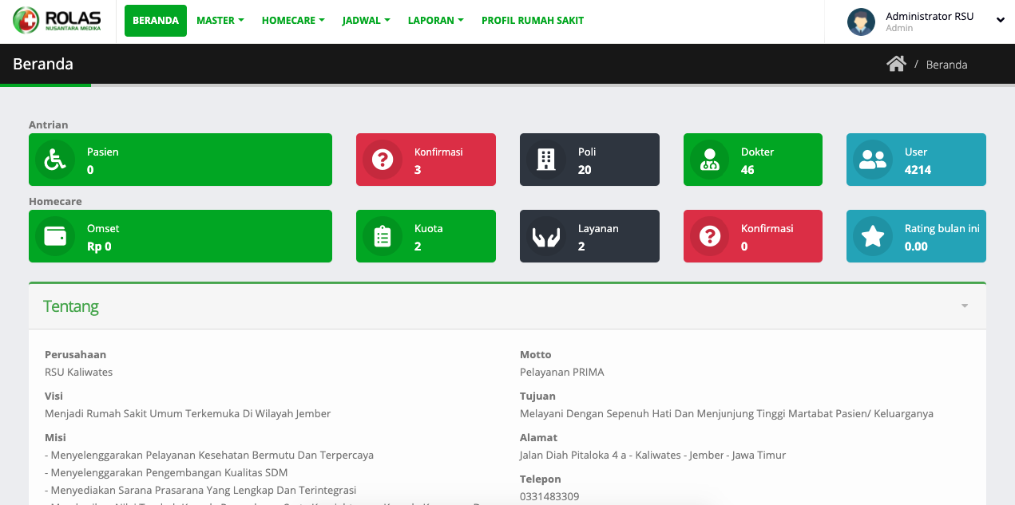
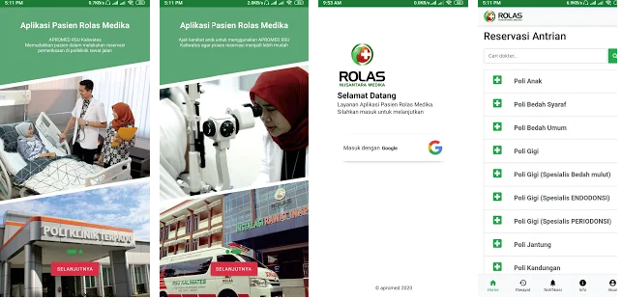
Apromed - rsu kaliwates jember
Dev lead
fullstack developer
(hmvc codeigniter, kotlin)

Slide 13
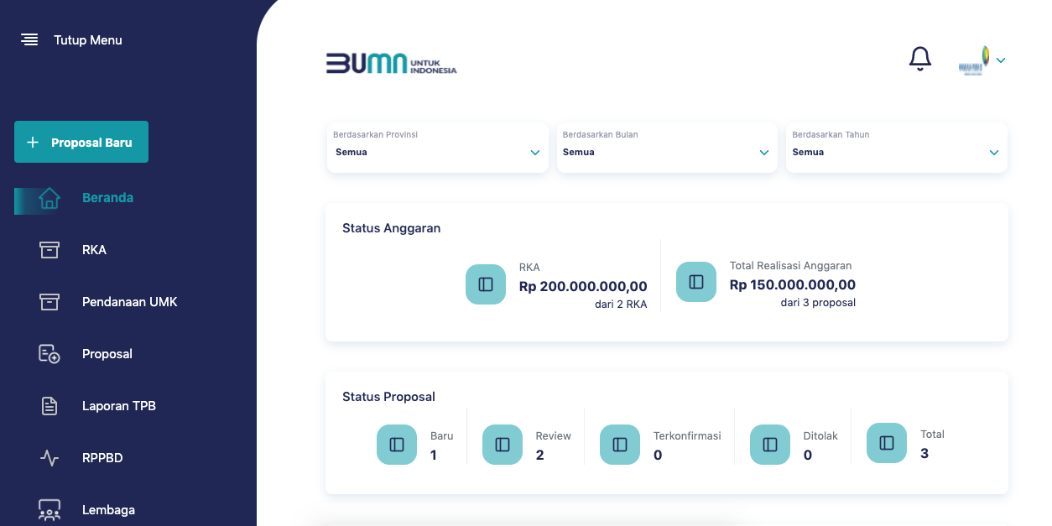
CSR - kementerian BUMN
BACKEND
developer
(laravel, vue)

Slide 14
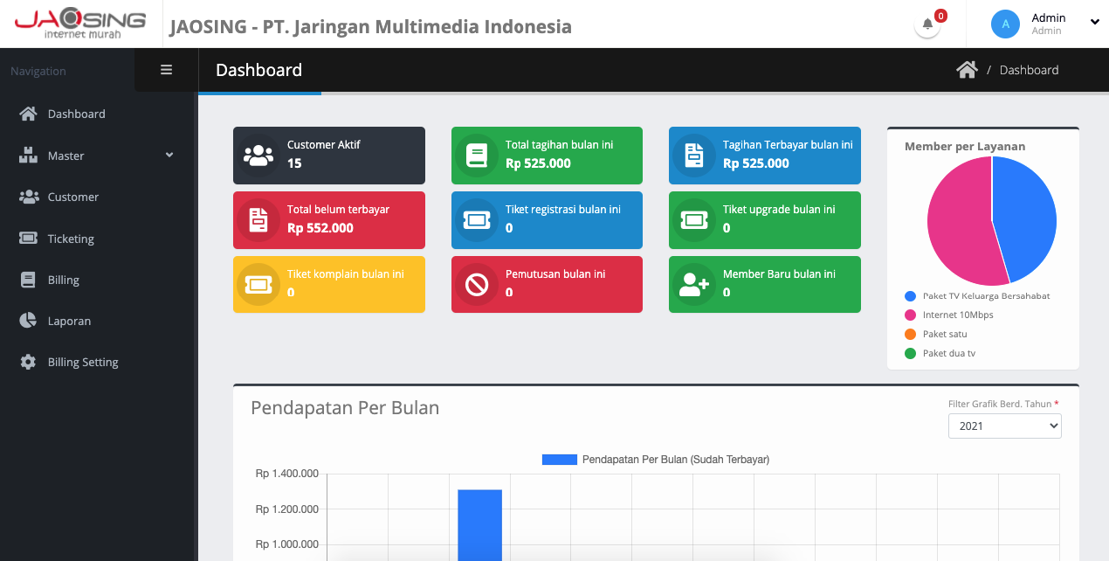
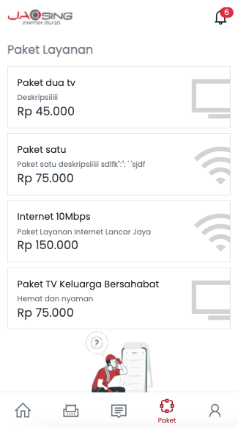
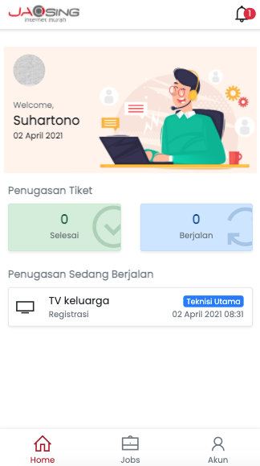
Jaosing - Jaringan multimedia banyuwangi
Dev lead
fullstack developer
(laravel, inertia, vue.js)

Slide 15
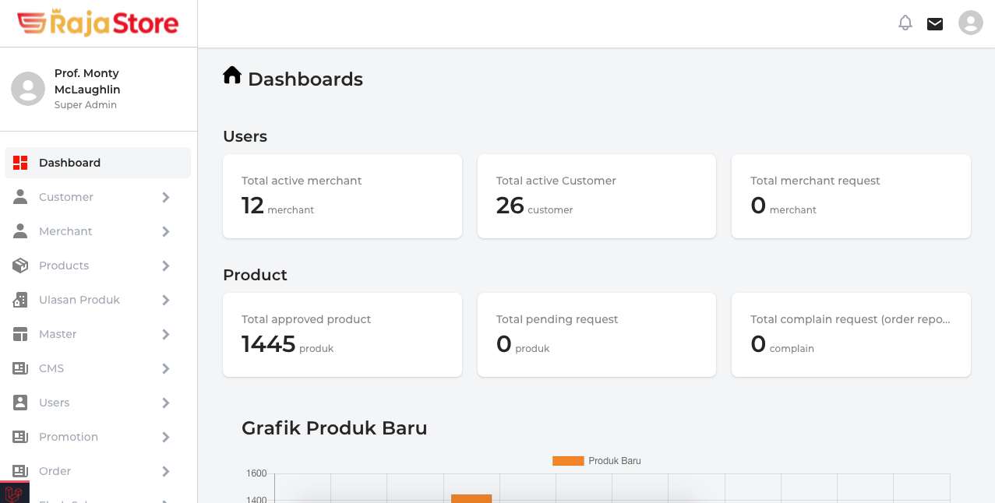
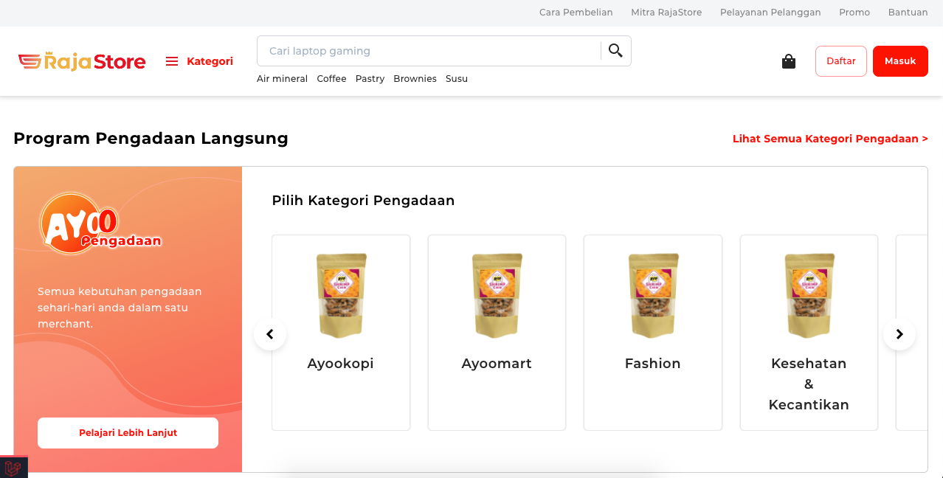
rajastore
backend developer
(laravel, inertia, vue.js)

Slide 16
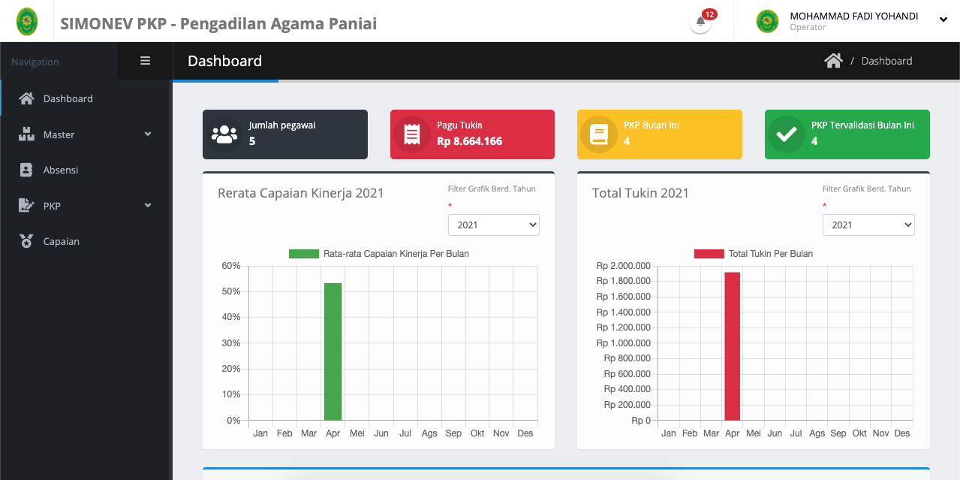
SiMonev - pengadilan agama paniai
DEV LEAD
FULLSTACk developer
(laravel, inertia, vue.js)

Slide 17
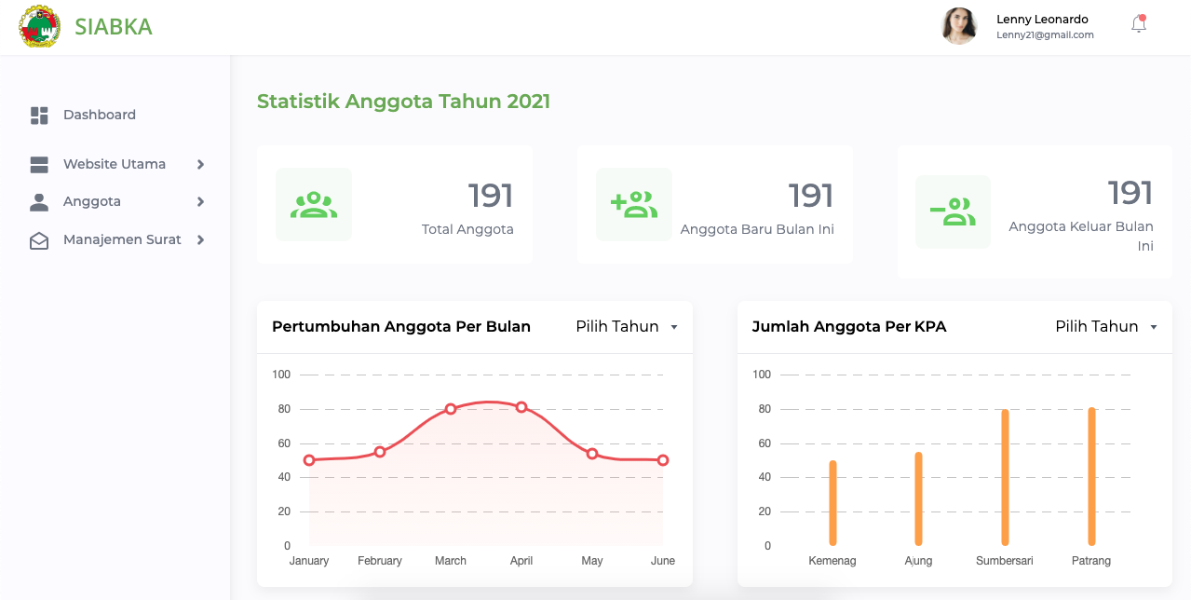
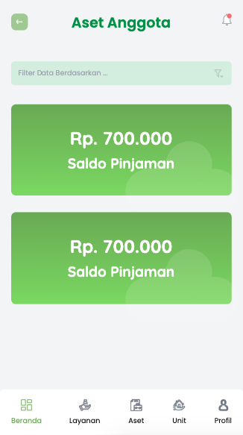
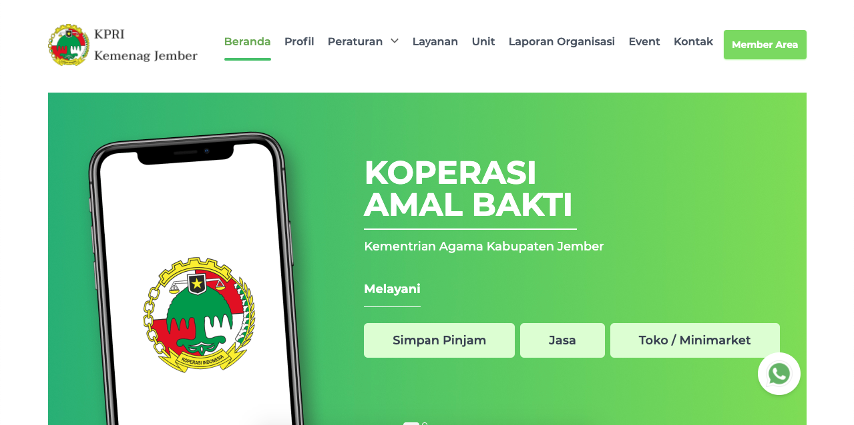
Siabka - kemenag jember
DEV LEAD
FULLSTACk
developer
(laravel, inertia, vue.js)

Slide 18
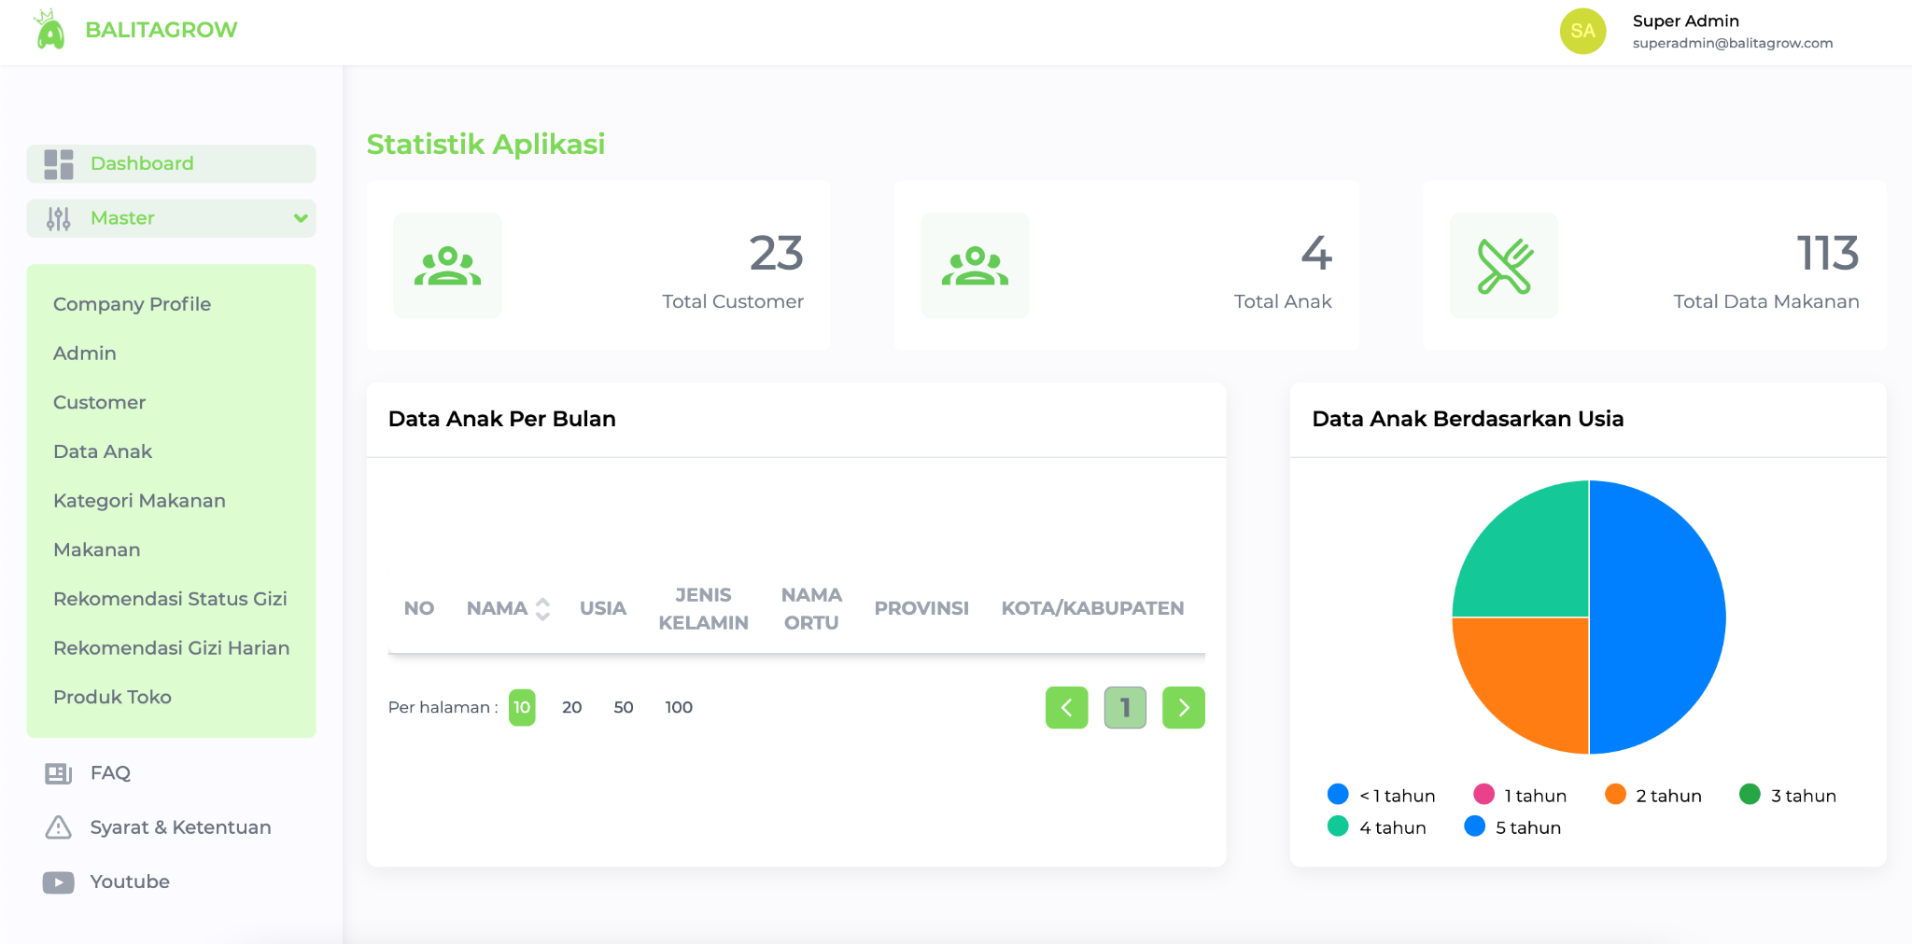
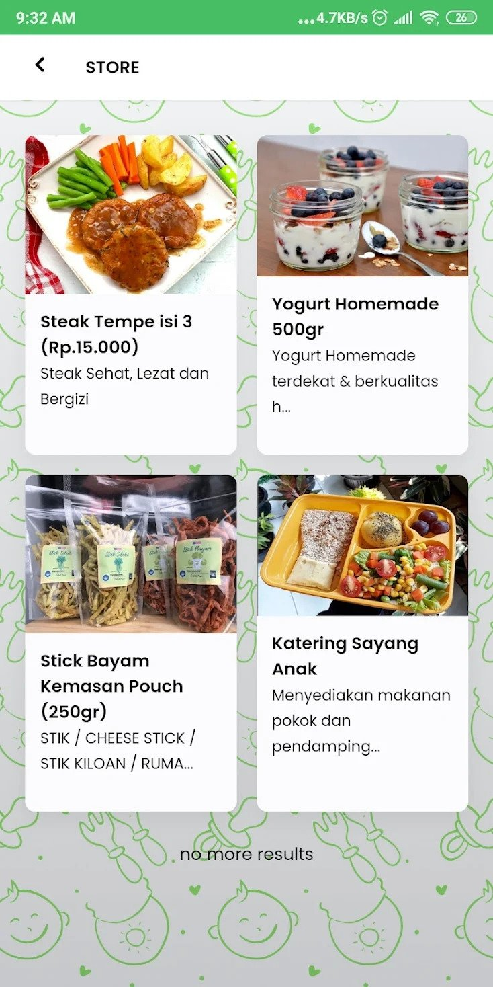
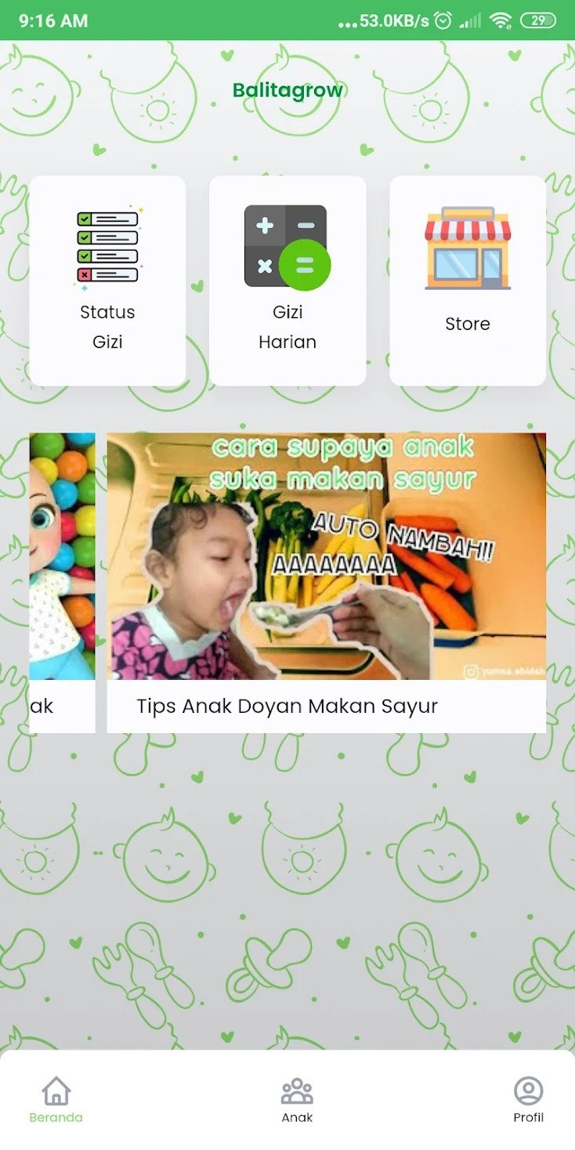
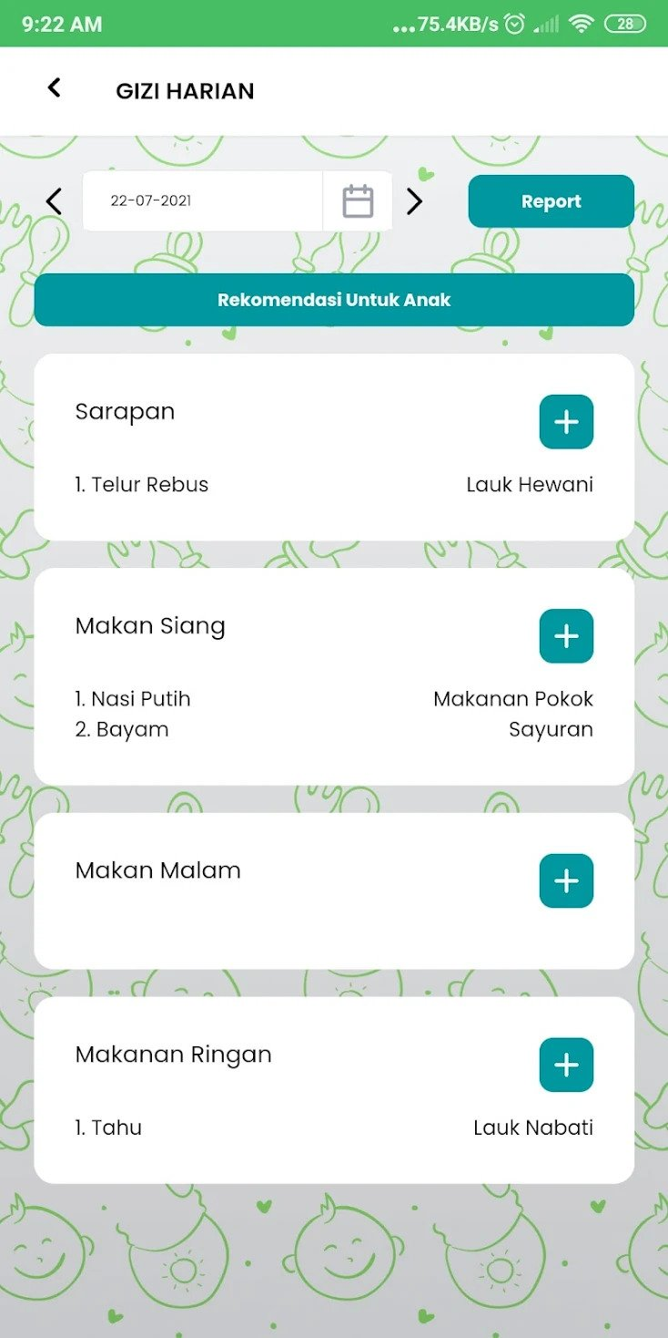
balitagrow
DEV LEAD
FULLSTACk
developer
(laravel, inertia, vue.js)

Slide 19
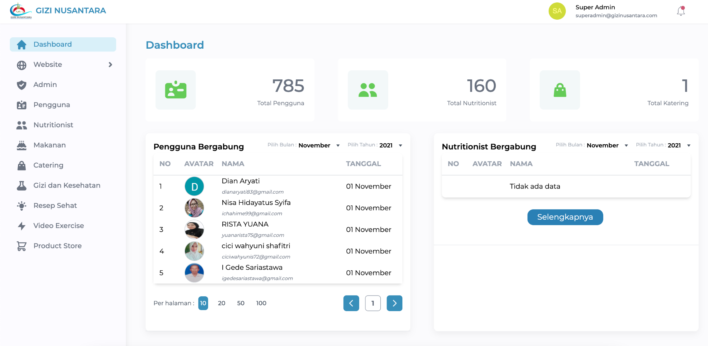

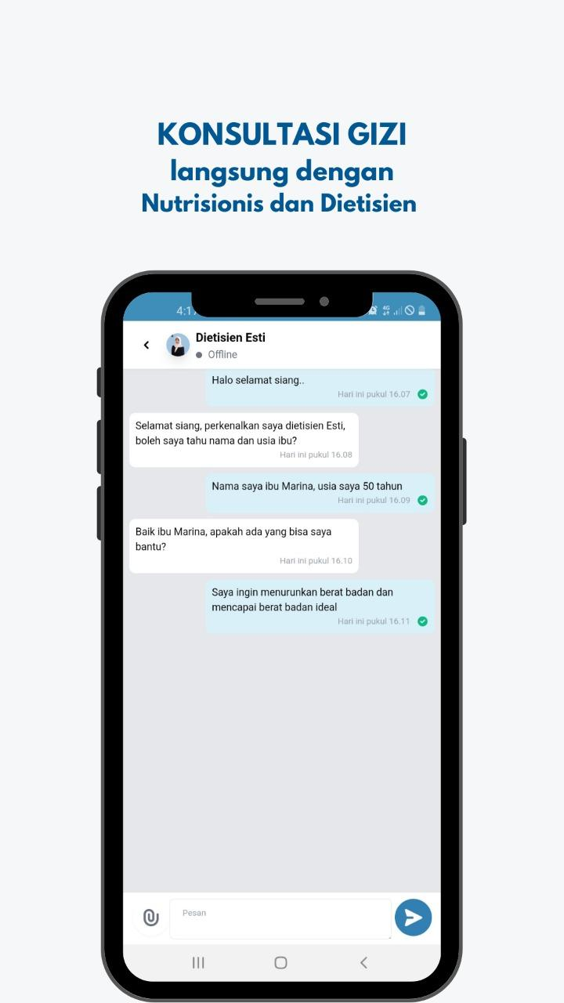
Gizi nusantara
DEV LEAD
FULLSTACk
developer
(laravel, inertia, vue.js)

Slide 20
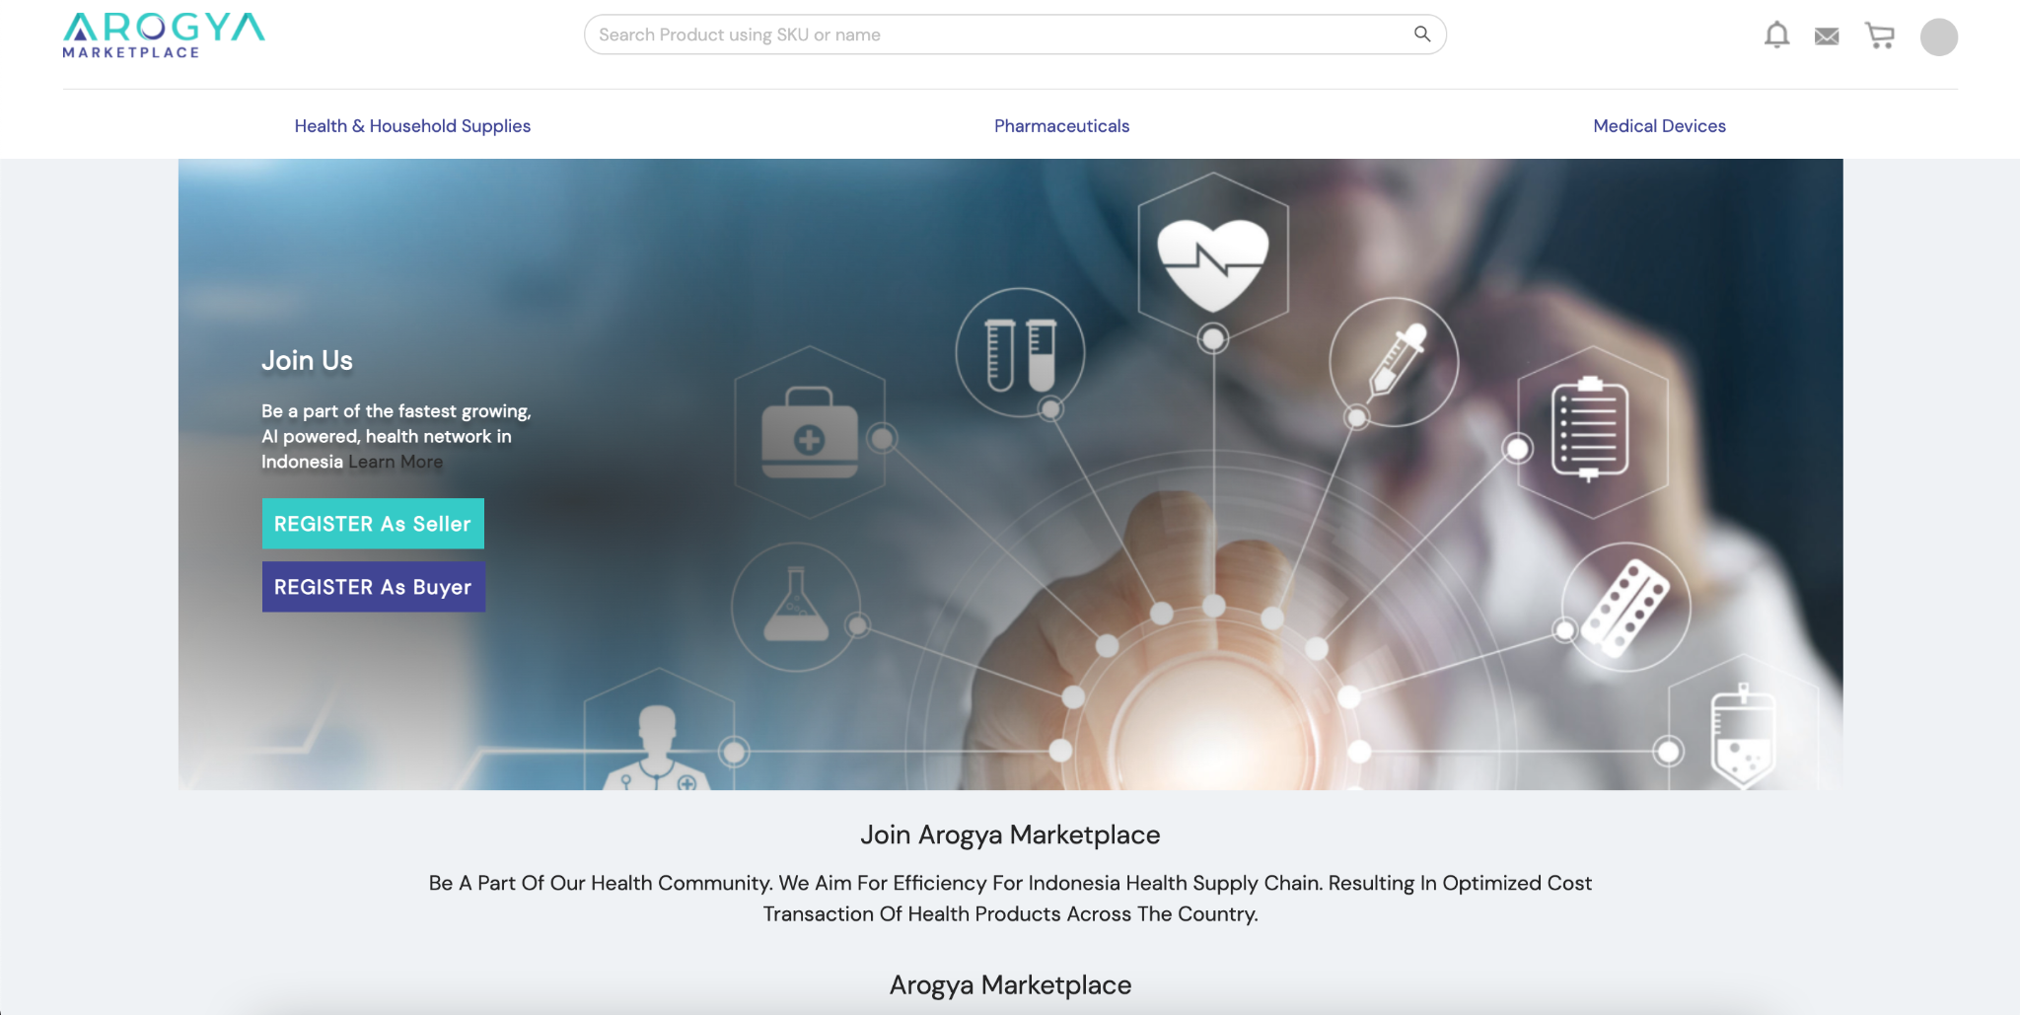
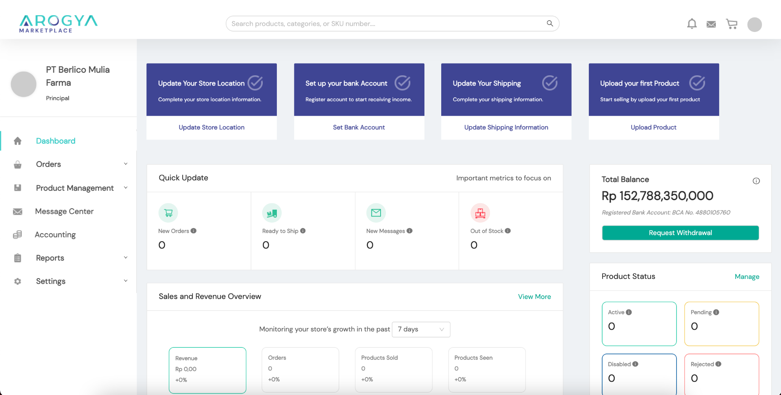
Arogya marketplace
Backend dev
(nest.js, typescript)

Slide 21
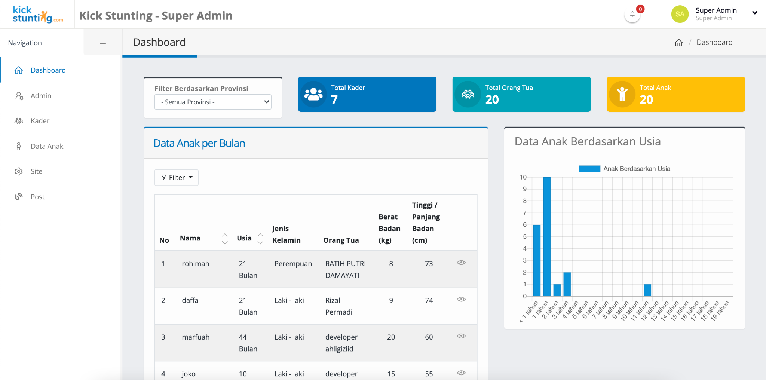
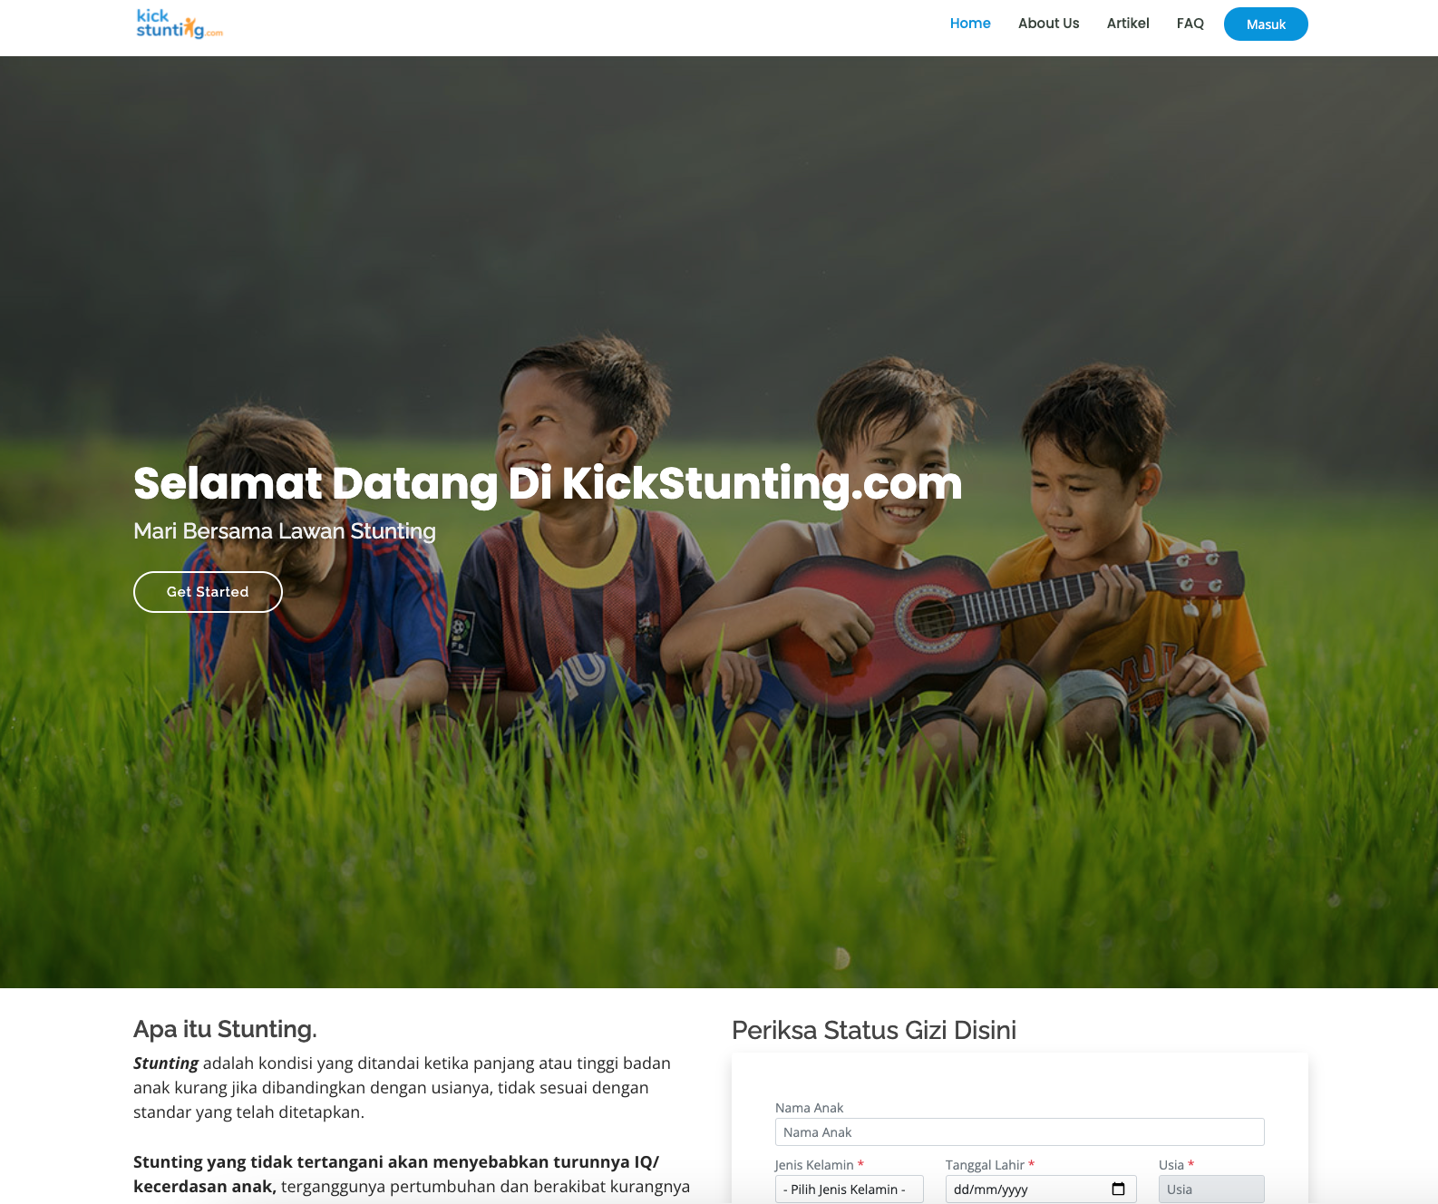
KICKSTUNting
DEV LEAD
FULLSTACk
developer
(laravel, inertia, vue.js)

Slide 22
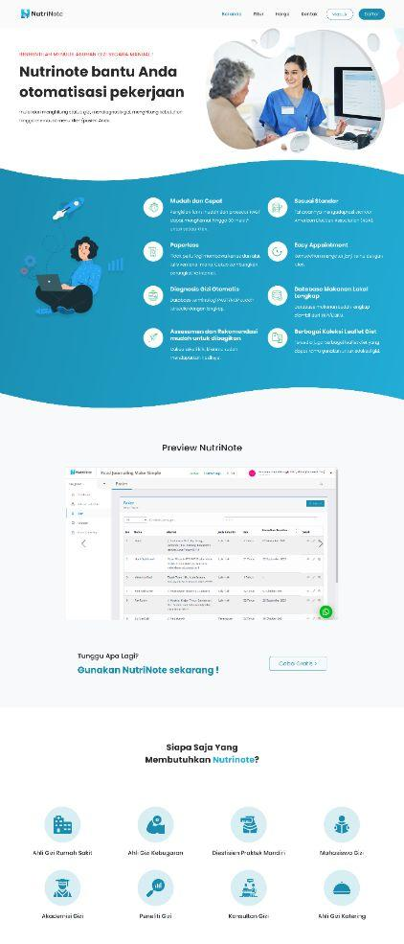
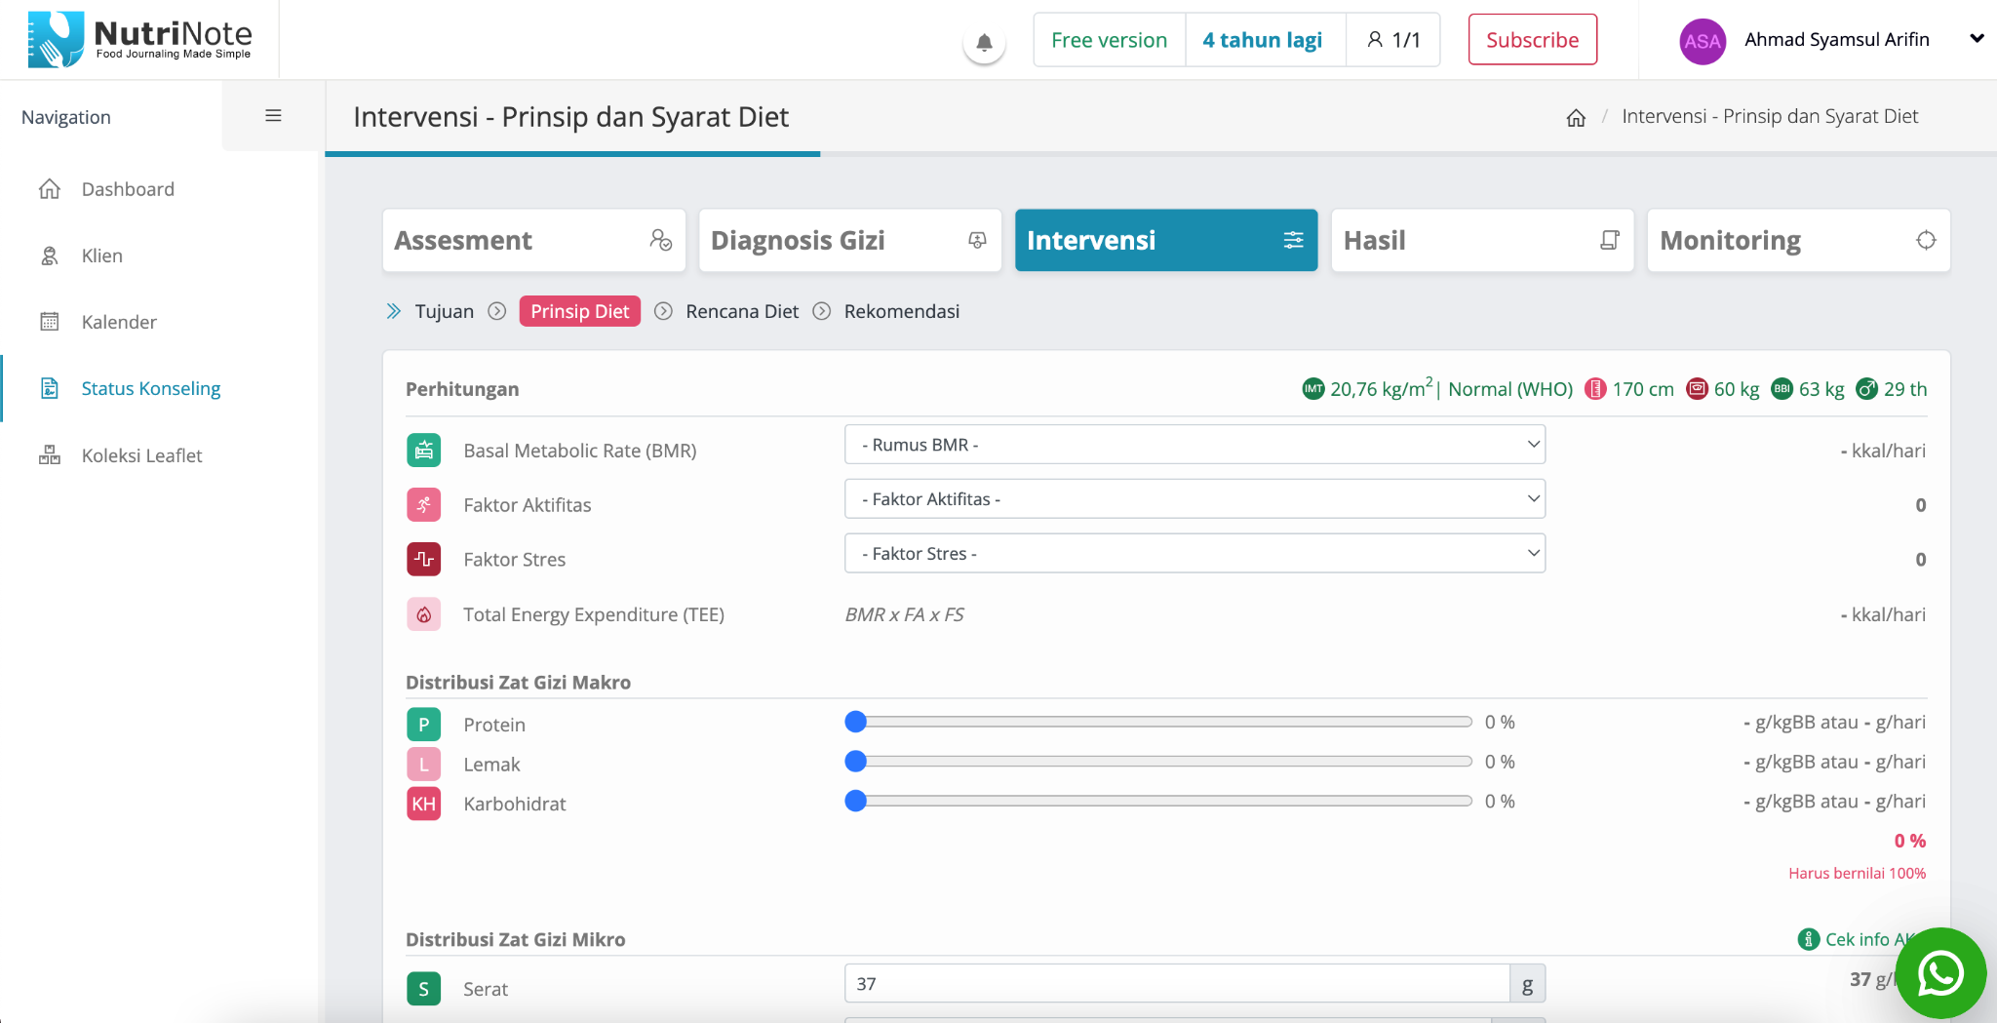
Nutrinote
DEV LEAD
FULLSTACk
developer
(laravel, inertia, vue.js)

Slide 23
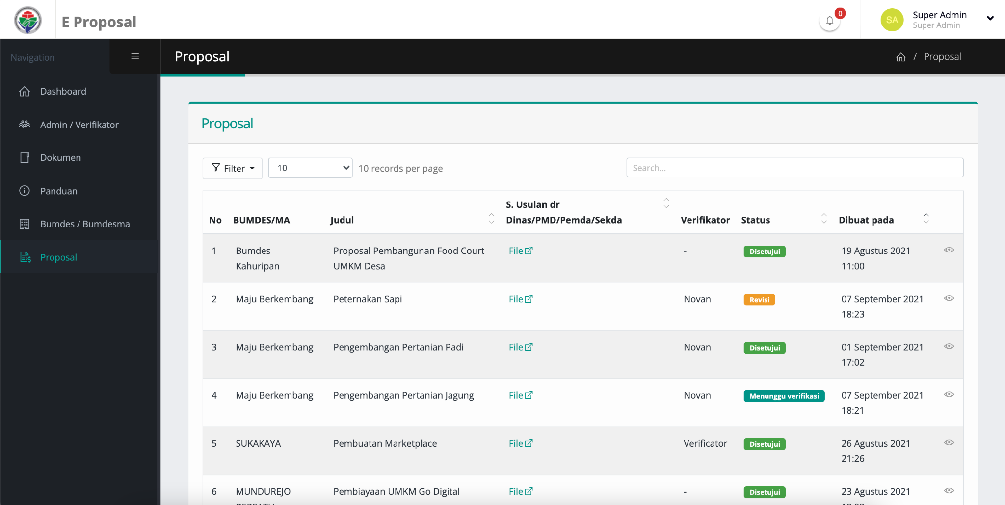
E-proposal
KEMENTERIAN DESA, PDT DAN TRANSMIGRASI
DEV LEAD
FULLSTACk
developer
(laravel, inertia, vue.js)

Slide 24
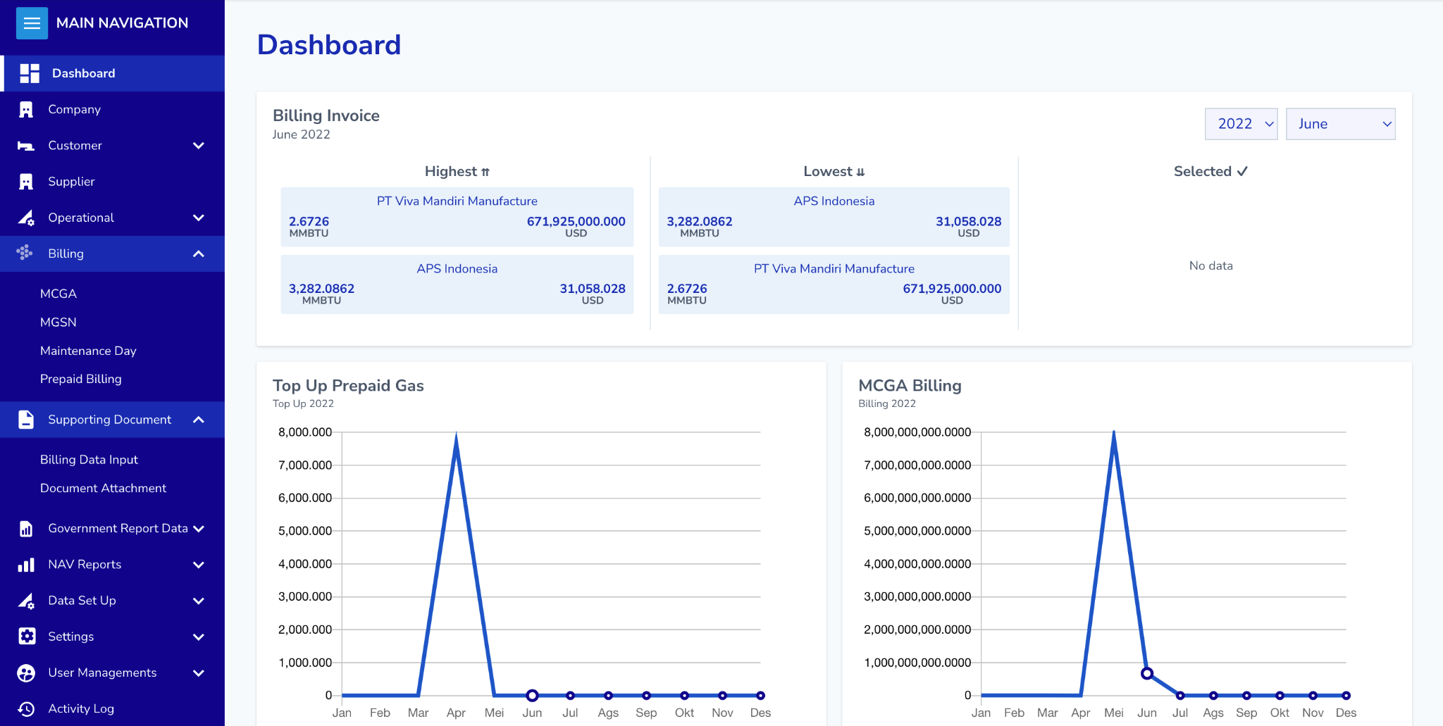
Billing App
energasindo heksa karya
FULLSTACk
developer
(laravel, inertia, vue.js)
Features :
Azure SSO
Billing calculation for natural gas usage
etc

Slide 25
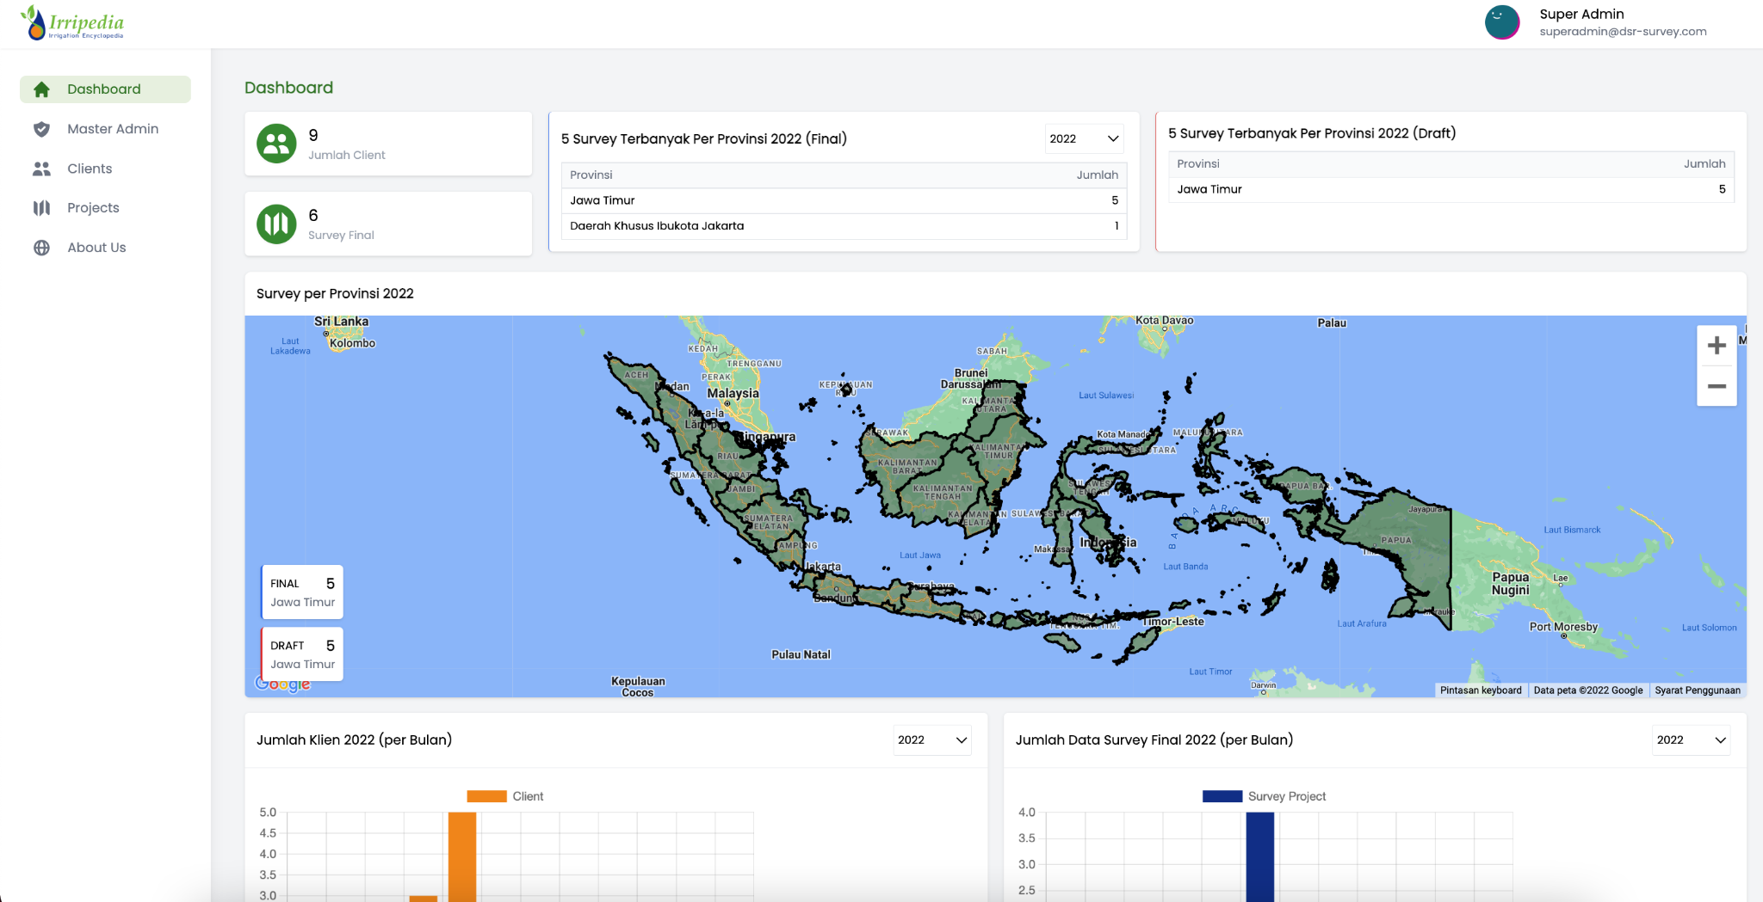
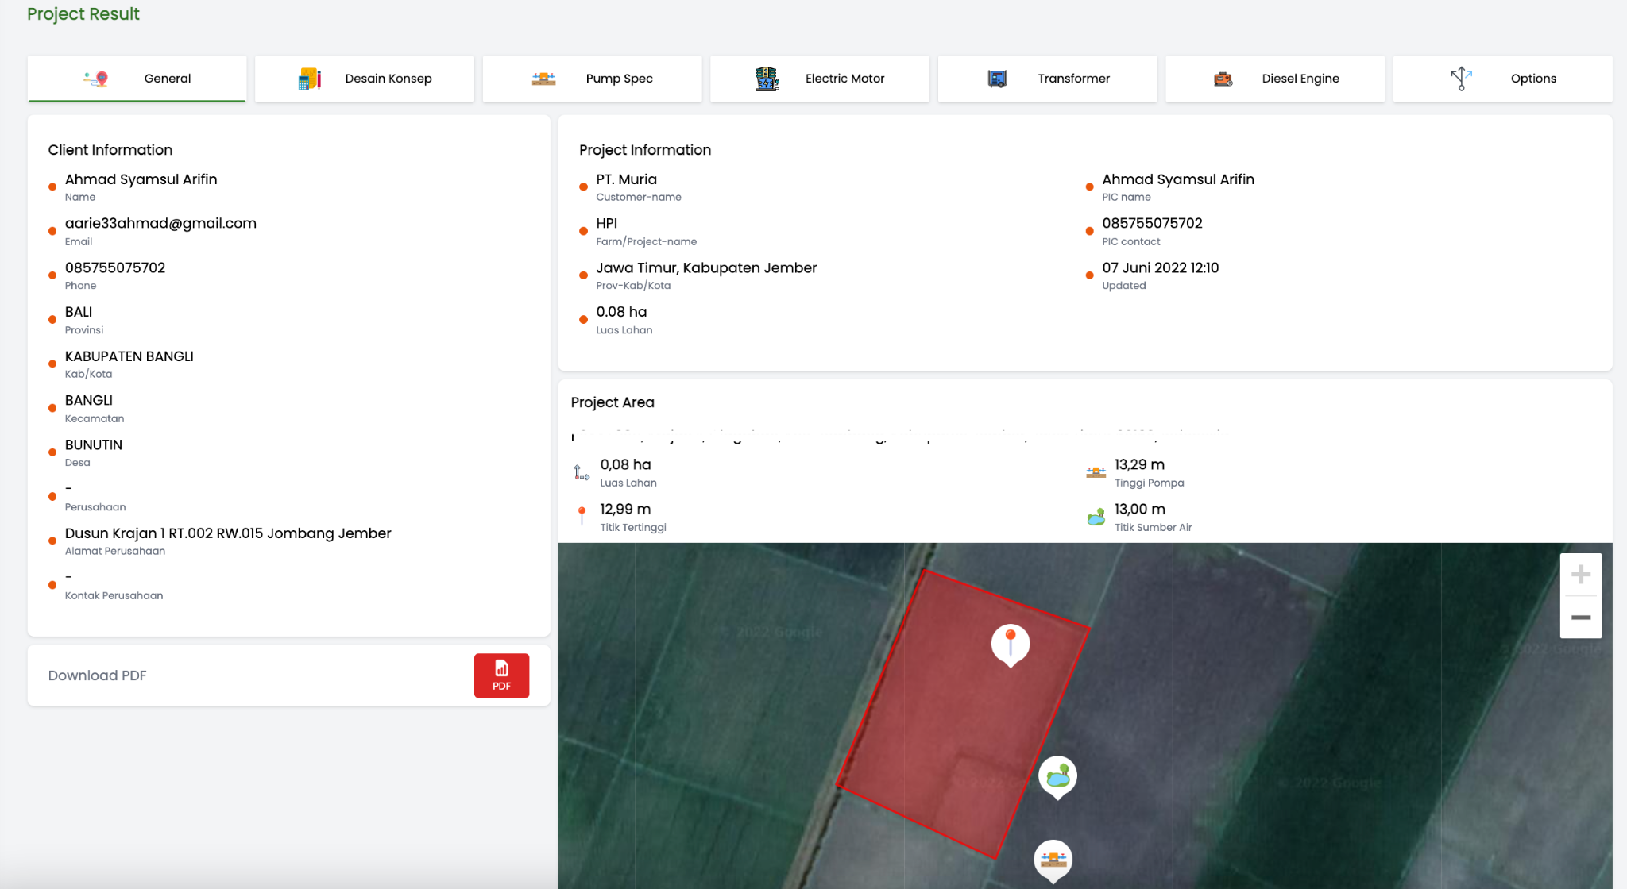
Irripedia - survey app
Daya Santosa Rekayasa
DEV LEAD
FULLSTACk developer
(laravel, inertia, vue3)
Features :
Survey lahan : marking lokasi, hitung luas area, ketinggian, input data.
Map view : Summary lokasi yang tersimpan.
etc

Slide 26
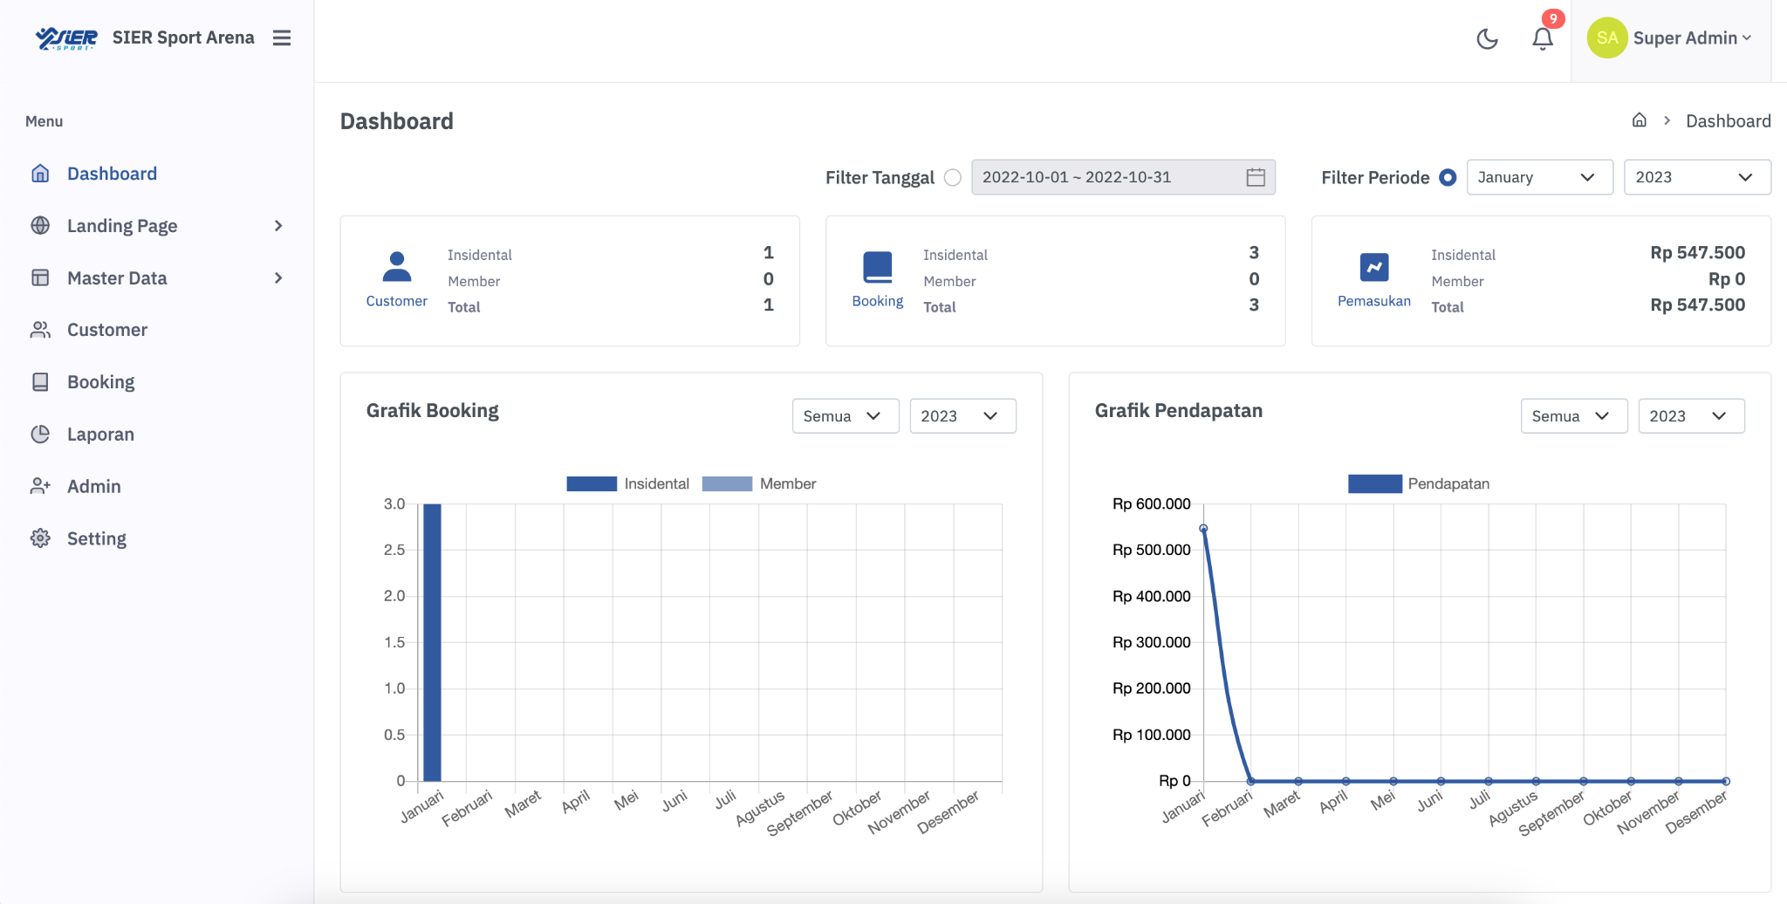
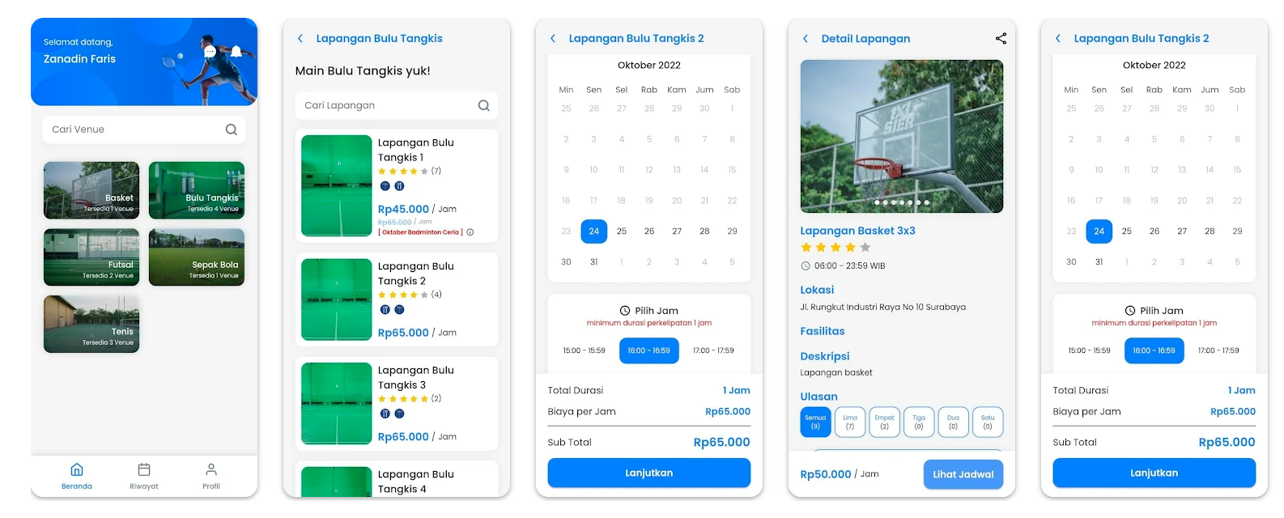
Sier sport arena - booking app
Pt. sier
DEV LEAD
FULLSTACk developer
(laravel, inertia, vue, flutter)
Features :
Management lapangan
Management jadwal lapangan
Booking lapangan
Chatroom
etc

Slide 27
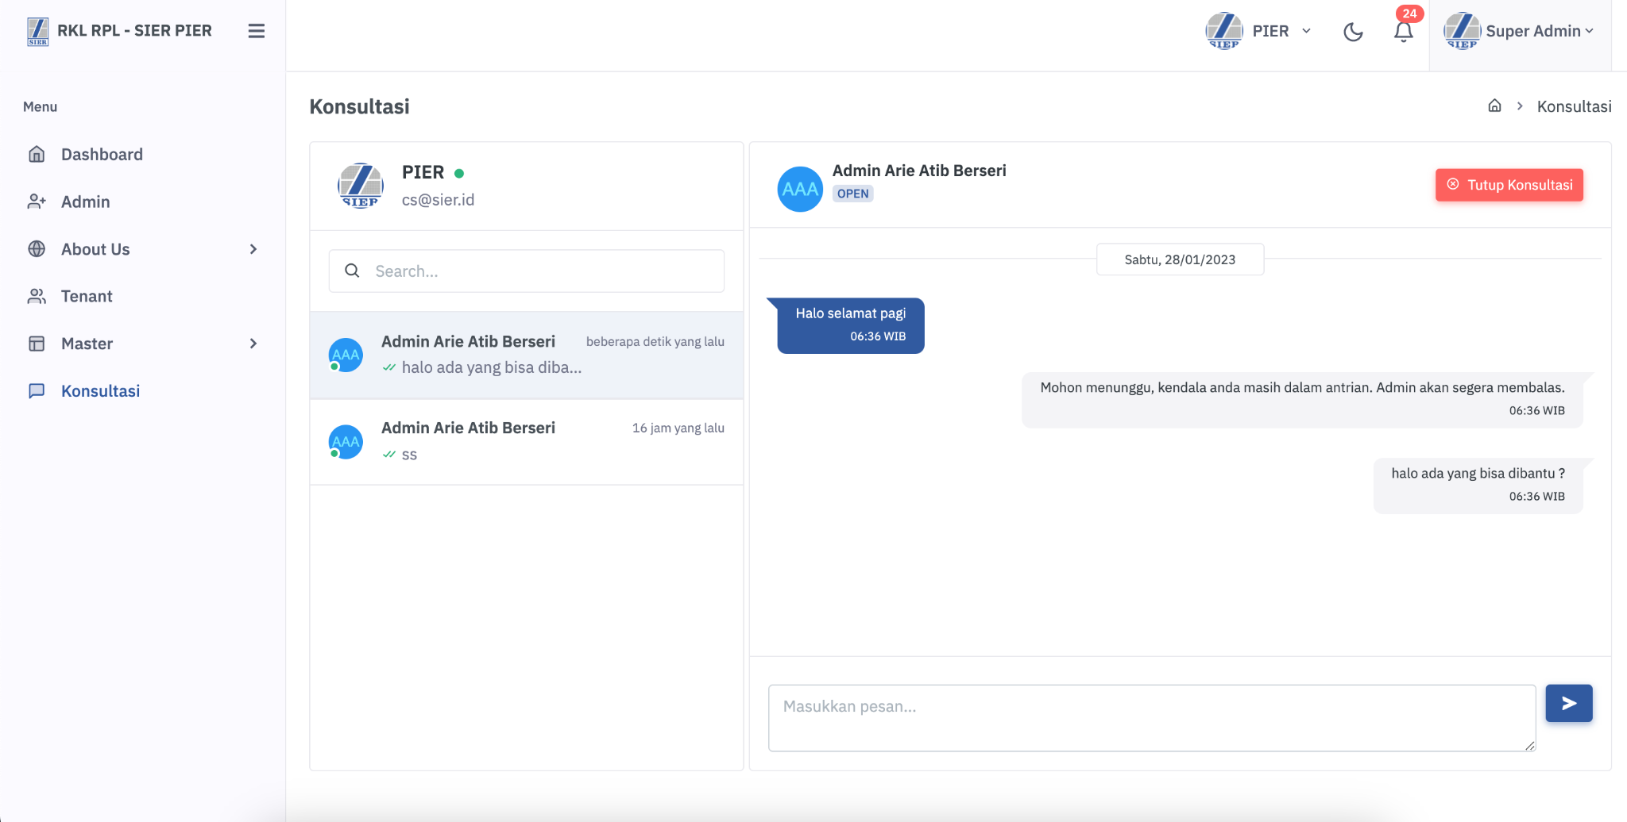
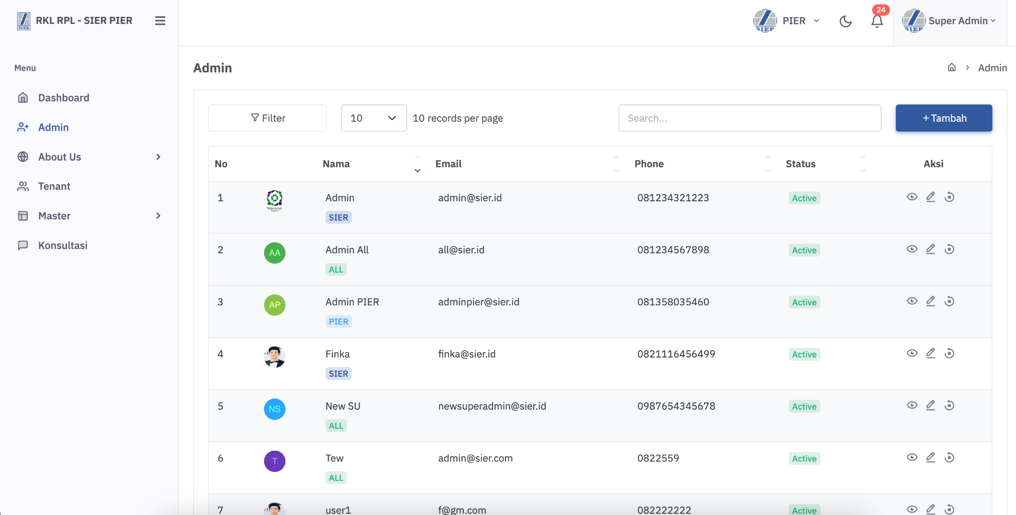
Rkl rpl (app pelaporan limbah)
Pt. sier
DEV LEAD
FULLSTACk developer
(laravel, inertia, vue, flutter)
Features :
Konsultasi : realtime chatroom
Report dan validasi dokumen limbah tiap bulan
etc

Slide 28
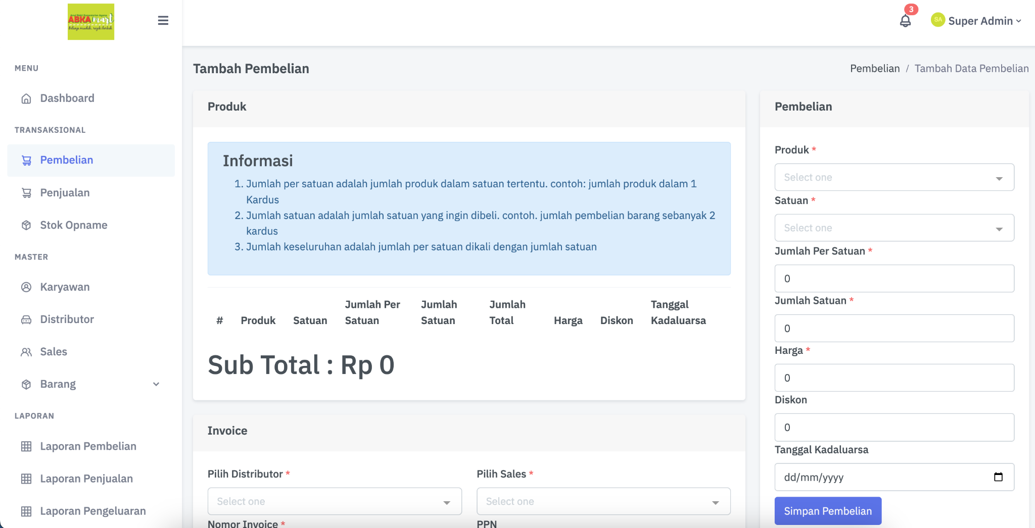
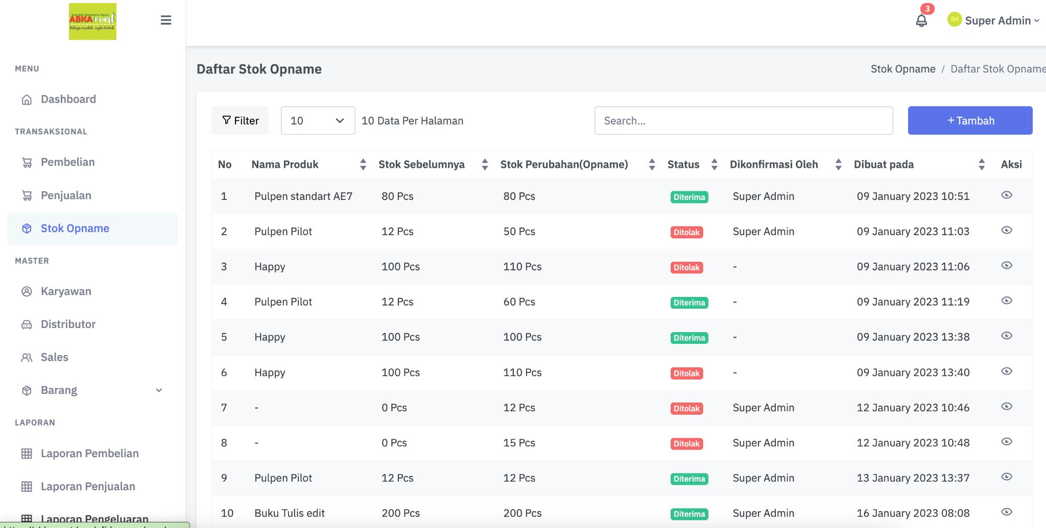
PoS App
Koperasi kemenag jember
DEV LEAD
(laravel, nuxtjs)
Features :
Management produk
Pembelian dan penjualan barang
Laporan
etc

Slide 29
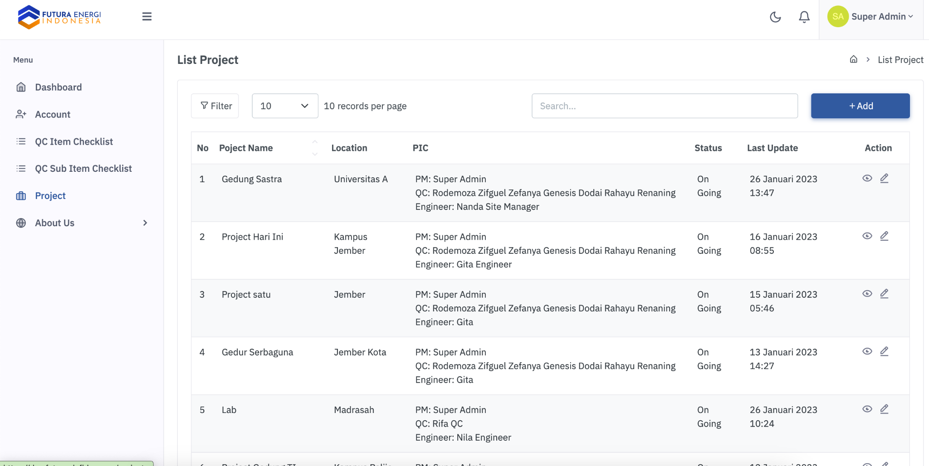
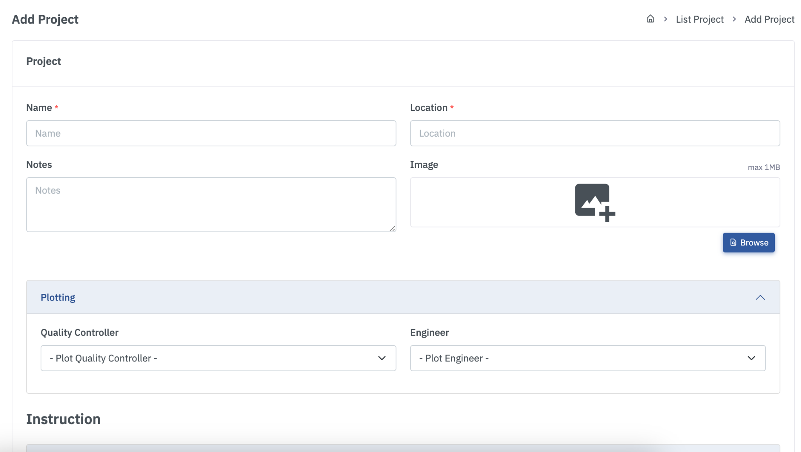
Project management App
Jember futura
DEV LEAD
(laravel, inertia, vuejs)
Features :
Management project
Pencatatan material project
Quality control project
etc

Slide 30
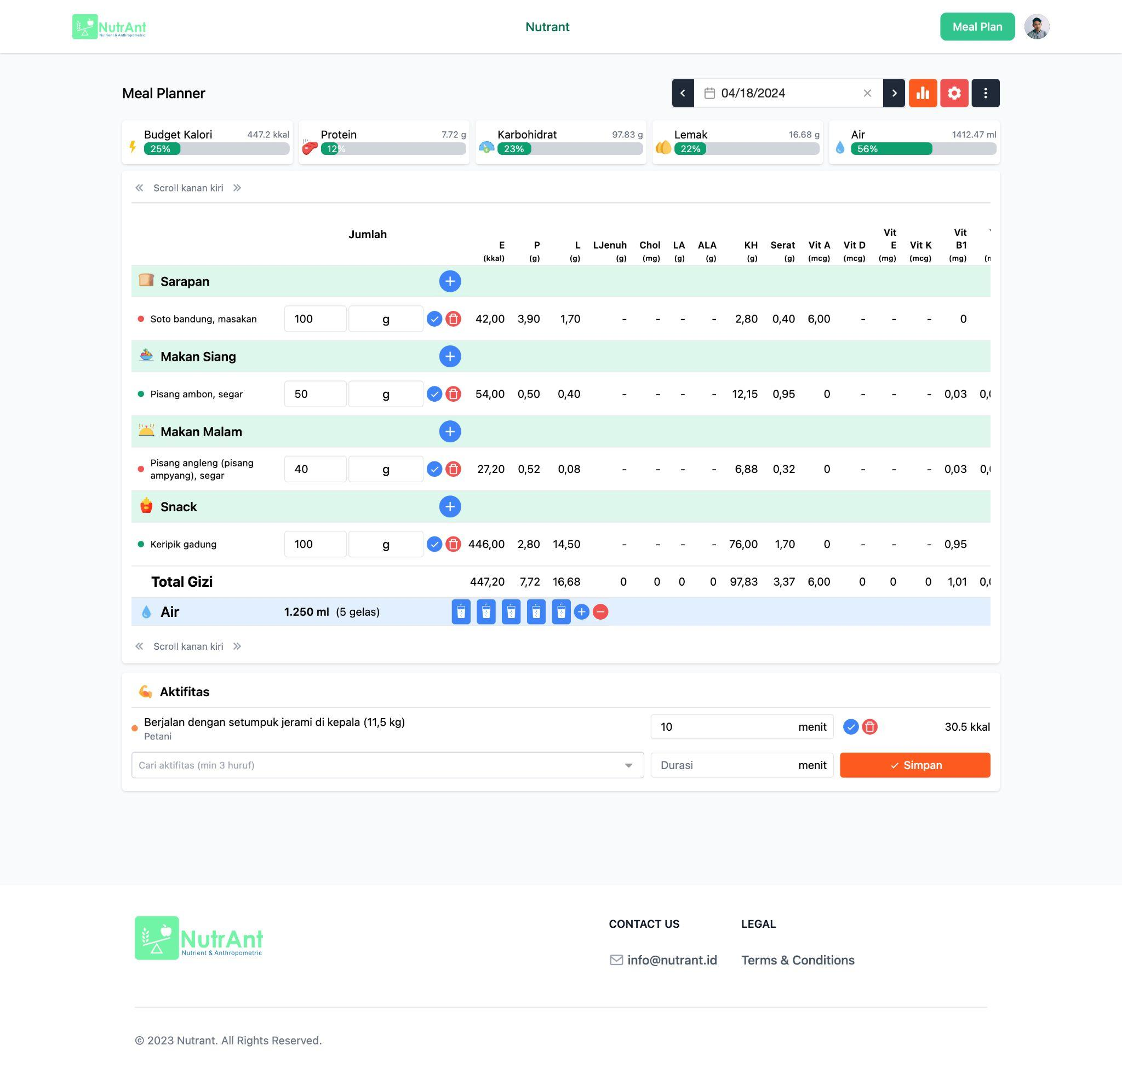
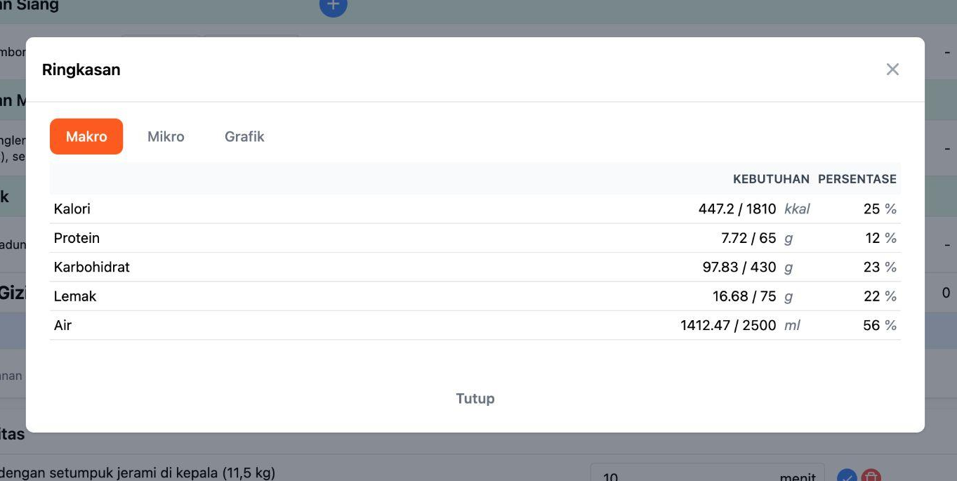
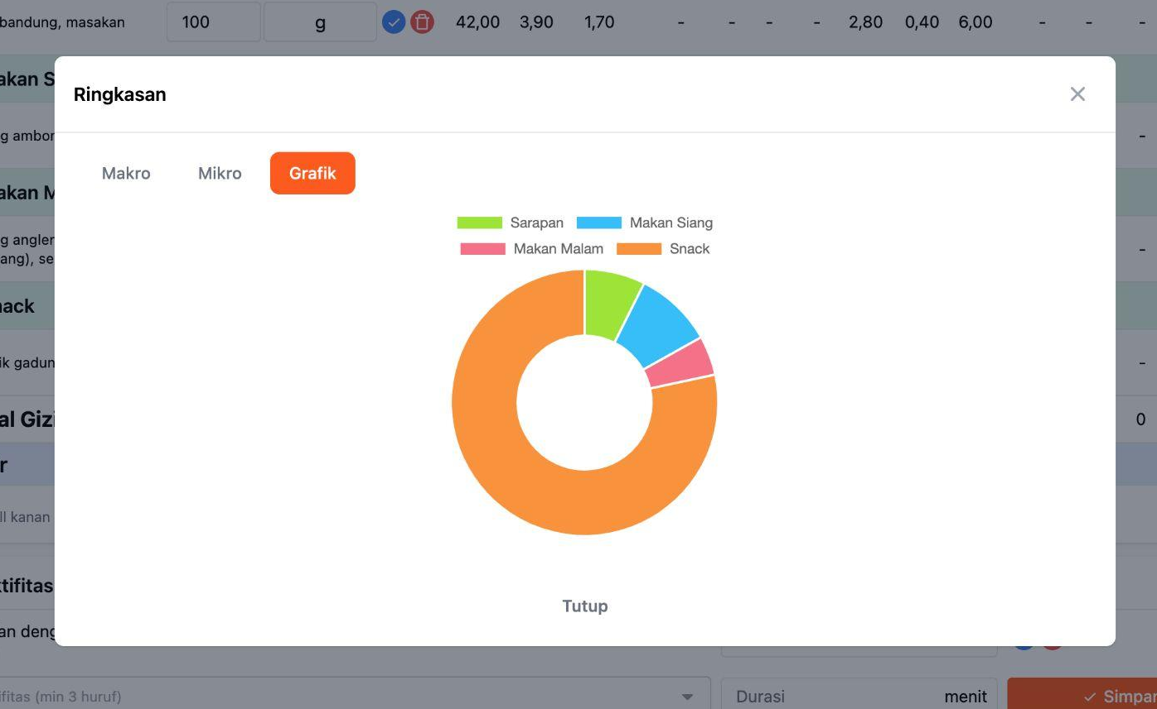
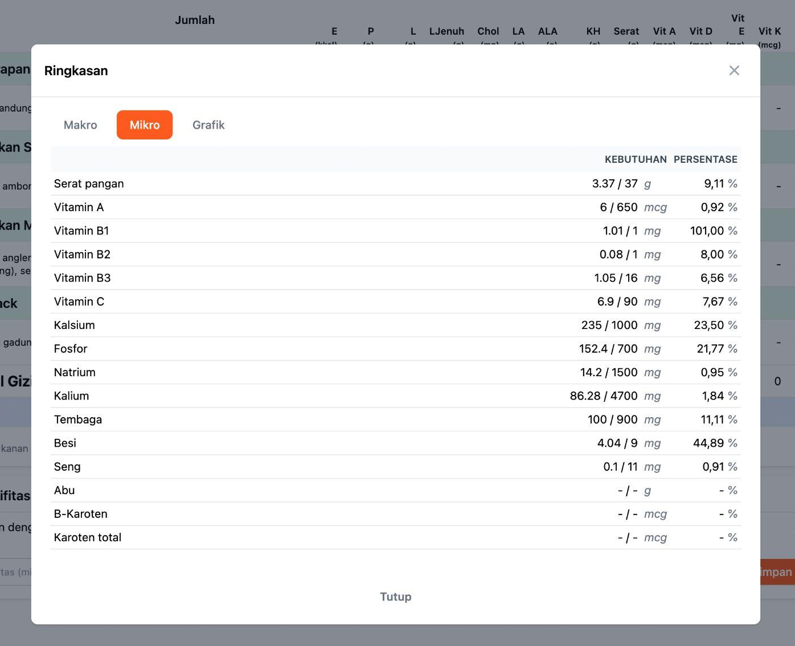
Nutrant
Food Nutrition App
DEV LEAD
(laravel, inertia, vuejs)
Features :
Record eating history
Calculate food nutrition
Report, export to PDF/Excel
etc

Slide 31
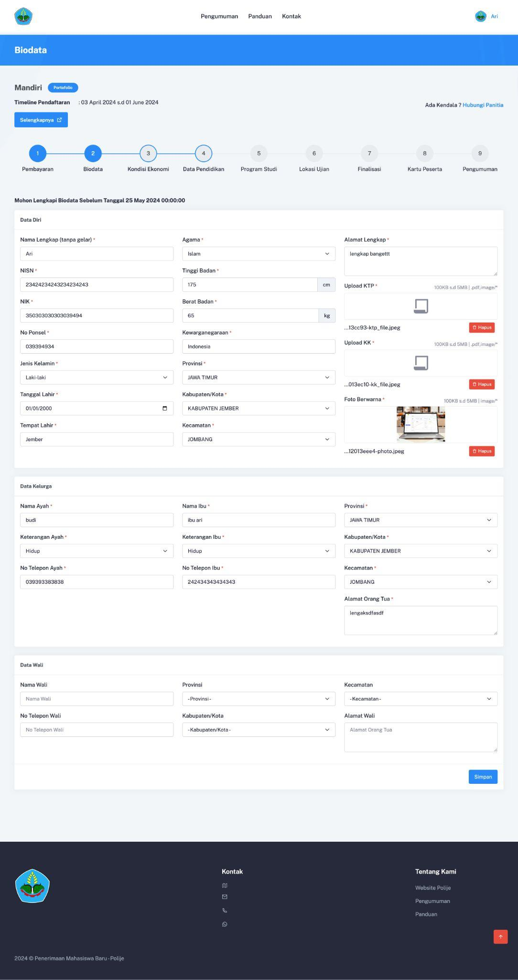
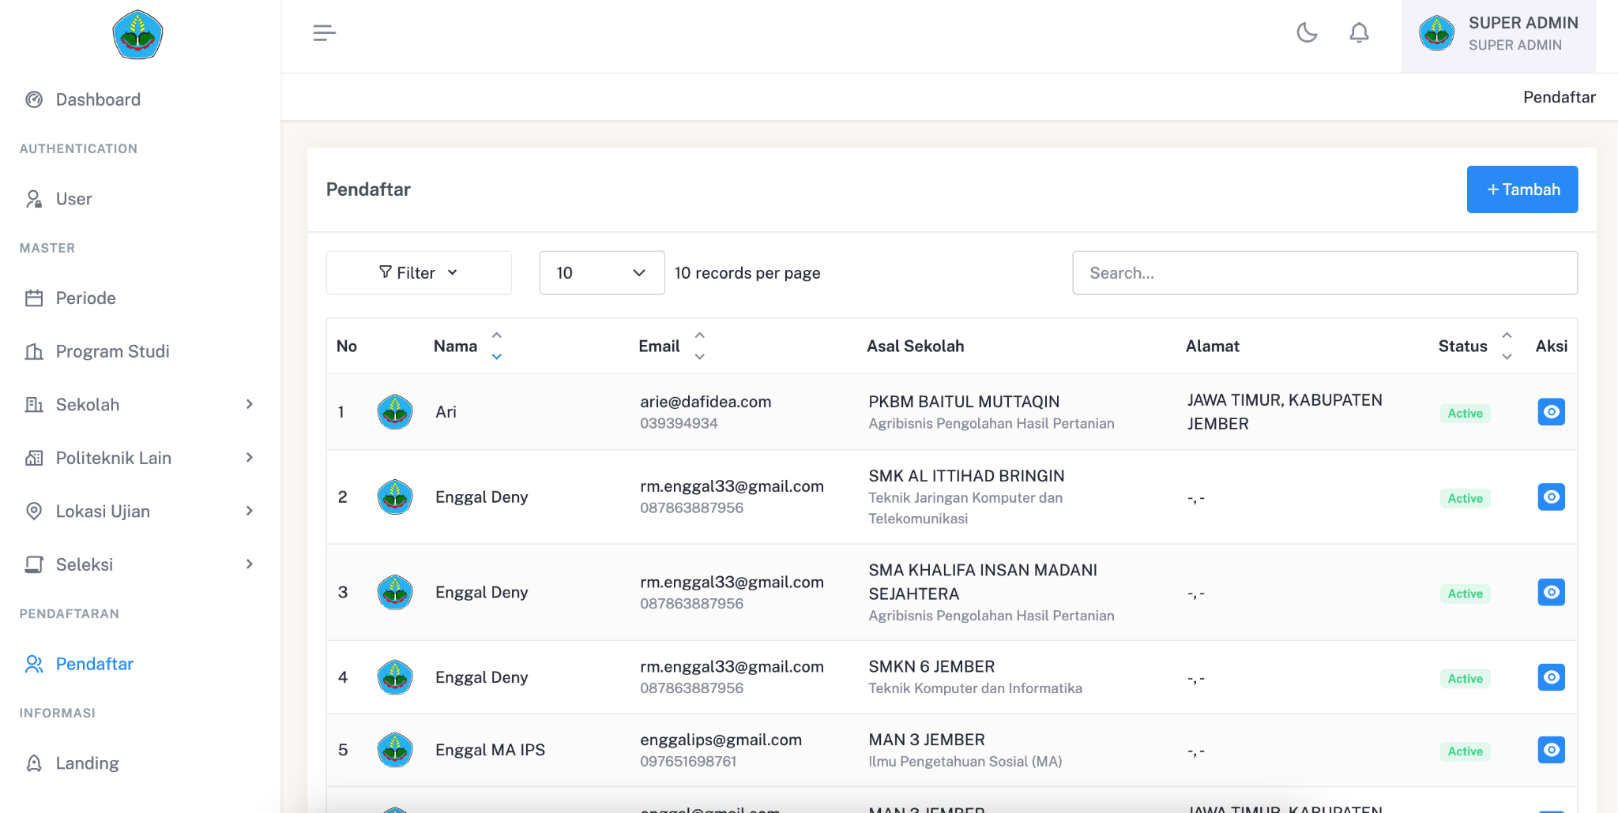
New student admission
Penerimaan mahasiswa baru
Politeknik Negeri jember
DEV LEAD
(laravel, inertia, vuejs)
Features :
Management student data
Registration for new student
etc

Slide 32


Booking Management
MUA BOOKING
(hongkong)
DEV LEAD
(laravel, inertia, vuejs)
Features :
(Admin) Booking management
(Admin) Schedule management
(Client) Create a new booking
(Client) Booking notification
etc

Slide 33


Insurance consultant
CRM System
(hongkong)
frontend Dev
(react js)
Features :
CRM
Quotation management
Claim
etc

Slide 34



fundraising
A drop of life
(hongkong)
DEV LEAD
(laravel, inertia, vuejs)
Features :
(Admin) Campaign management
(Admin) Fundraising management
(User) Make a donation
(User) Payment with paypal/stripe
etc

Slide 35





MONEY HERO app
CREDIT CARD Score app
(hongkong)
Mobile dev
(react native)
confidential information
Features :
Check credit score
Check reward
etc

Slide 36

DSC - Telkomsel
Digital smart care
telkomsel
An enterprise-grade application empowering GraPARI customer service agents with seamless integration, real-time information access, and AI-driven tools.
Tech Stack: ReactJS, NodeJS, AWS Cloud.
Core Features: AI-powered Knowledge Management System (KMS), AntreAja queue management, and automated transaction tools.
Impact: Reduced agent information-seeking steps by 50% and contributed to achieving an 89.25% NPS at GraPARI.

Slide 37

AntreAja - Telkomsel
Queue System, Customer Service
telkomsel
AntreAja (Digital Queue Management System)
A nationwide digital queue management system under the DSC ecosystem designed to optimize customer flow and operational efficiency at Telkomsel GraPARI outlets.
Tech Stack: ReactJS, NodeJS, Golang, AWS Cloud.
Core Capabilities: Online reservation, real-time queue notifications, and virtual queue tracking.
Key Solutions: Enables customers to locate the nearest outlet, book queue numbers in advance, and monitor service availability remotely.

Slide 38

Veronika - Telkomsel
Veronika (Omnichannel Chatbot) - Telkomsel
An enterprise-grade AI chatbot system serving millions of users across multiple digital touchpoints to automate customer queries and streamline support workflows.
Tech Stack: Java, NodeJS, Golang, AWS.
Kafka.Omnichannel Channels: WhatsApp, Telegram, Instagram, Facebook Messenger, MyTelkomsel App, and Standalone Web Chat.
Core Capabilities: Event-driven microservices architecture, real-time message orchestration, and seamless backend AI engine integration.
Key Contribution: Built and optimized backend integration services for high-throughput API communication between social channels and core internal infrastructure.

Slide 39
THANKS!
Do you have any questions?
aarie33ahmad@gmail.com
+6285-755-075-705
Please keep this slide for attribution

