Slide 1
MSC DISSERTATION · CN7000 · VIVA PRESENTATION
DiabetesRisk AI
A decision-support pipeline for early diabetes risk screening,
built on the Pima Indians dataset and a containerised Flask + Rails stack.
Md Aariz Student ID U2871441
MSc Big Data Technologies · University of East London
Supervisor: Dr Mohamed Chahine Ghanem
MAY 2026

Slide 2
01 PROBLEM & MOTIVATION
Why early screening, and why this project
Type-2 diabetes is one of the most under-diagnosed chronic conditions in primary care. By the time a patient presents with symptoms, the disease has often been progressing for years. Lightweight risk-stratification tools that work from a small set of routine measurements can flag candidates for an HbA1c or fasting-glucose test before symptoms appear.
8
routine inputs per patient
<300ms
end-to-end prediction latency
The aim of this dissertation is not to replace clinicians. It is to build, validate and deploy a small, transparent system that takes eight everyday measurements, returns a calibrated probability, and shows the doctor which features pushed the prediction.
SHAP
per-feature explanations returned with every call
DiabetesRisk AI · MSc Big Data Technologies · UEL
02 / 10

Slide 3
02 DATASET & PREPROCESSING
The Pima Indians dataset, cleaned honestly
DATASET
PREPROCESSING
Pima Indians Diabetes Database (UCI, id=34). 768 records of adult females ≥ 21 years of Pima heritage. Eight clinical features and a binary outcome.
1
Replace clinically impossible zeros (Glucose, BP, Skin, Insulin, BMI) with column medians.
Five features carried 0-values that cannot exist in vivo; treating them as missing prevents the model from learning nonsense.
2
StandardScaler on all eight features.
Zero-mean, unit-variance scaling so distance-based and gradient methods compete fairly.
Class balance (raw)
Non-diabetic 500
Diabetic 268
3
SMOTE oversampling on the training set only.
Synthetic minority samples; the holdout is left untouched so test metrics stay honest.
After SMOTE rebalancing → 800 / 800 in the training partition.
4
Stratified 80 / 20 train–test split, fixed random_state=42.
Reproducible holdout. Class proportions preserved on both sides.
DiabetesRisk AI · MSc Big Data Technologies · UEL
03 / 10

Slide 4
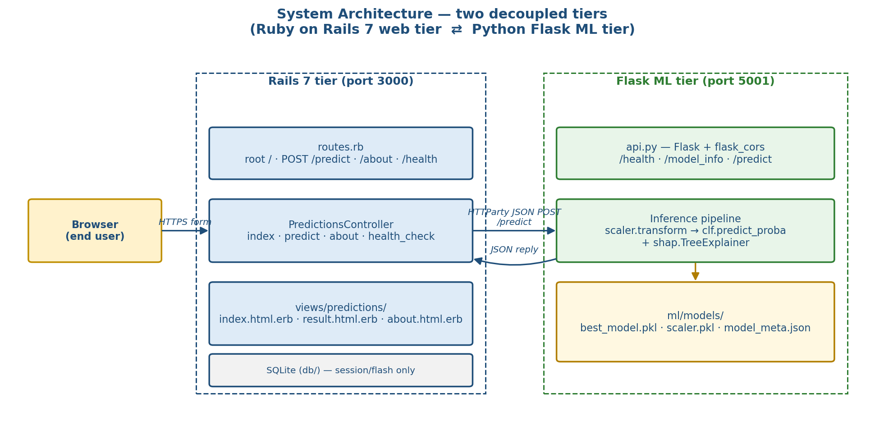
03 SYSTEM ARCHITECTURE
Two services, one Docker network
THE STACK
WEB
Rails 7 (Ruby)
Form, validation, HTTParty client, result view.
API
Flask + Gunicorn
/predict, /health, /model_info — JSON in, JSON out.
ML
scikit-learn + XGBoost
joblib-serialised model, StandardScaler, SHAP explainer.
OPS
Docker Compose
Two images, one network, one command.
Figure 1. Service-level view: browser → Rails (3000) → Flask (5001) → joblib model.
DiabetesRisk AI · MSc Big Data Technologies · UEL
04 / 10

Slide 5
04 METHODOLOGY
Five candidates, one consistent yardstick
Each candidate is fitted with GridSearchCV on a stratified 5-fold split, scored on AUC-ROC, then refitted on the full training set. The same pre-processing pipeline is applied identically to all five so the comparison is fair.
DISSERTATION GATES
Pre-registered thresholds the model had to clear:
AUC-ROC
≥ 0.85
CANDIDATES
F1-score
≥ 0.80
Logistic Regression (baseline, L2)
Random Forest (n_estimators ∈ {100, 200}, depth ∈ {–, 8, 12})
XGBoost (lr ∈ {0.05, 0.1}, depth ∈ {4, 6}, n ∈ {100, 200})
LightGBM (matched grid)
SVM-RBF (C ∈ {0.5, 1, 2}, γ ∈ {scale, auto})
Recall
≥ 0.78
Train accuracy
≥ 0.90
DiabetesRisk AI · MSc Big Data Technologies · UEL
05 / 10

Slide 6
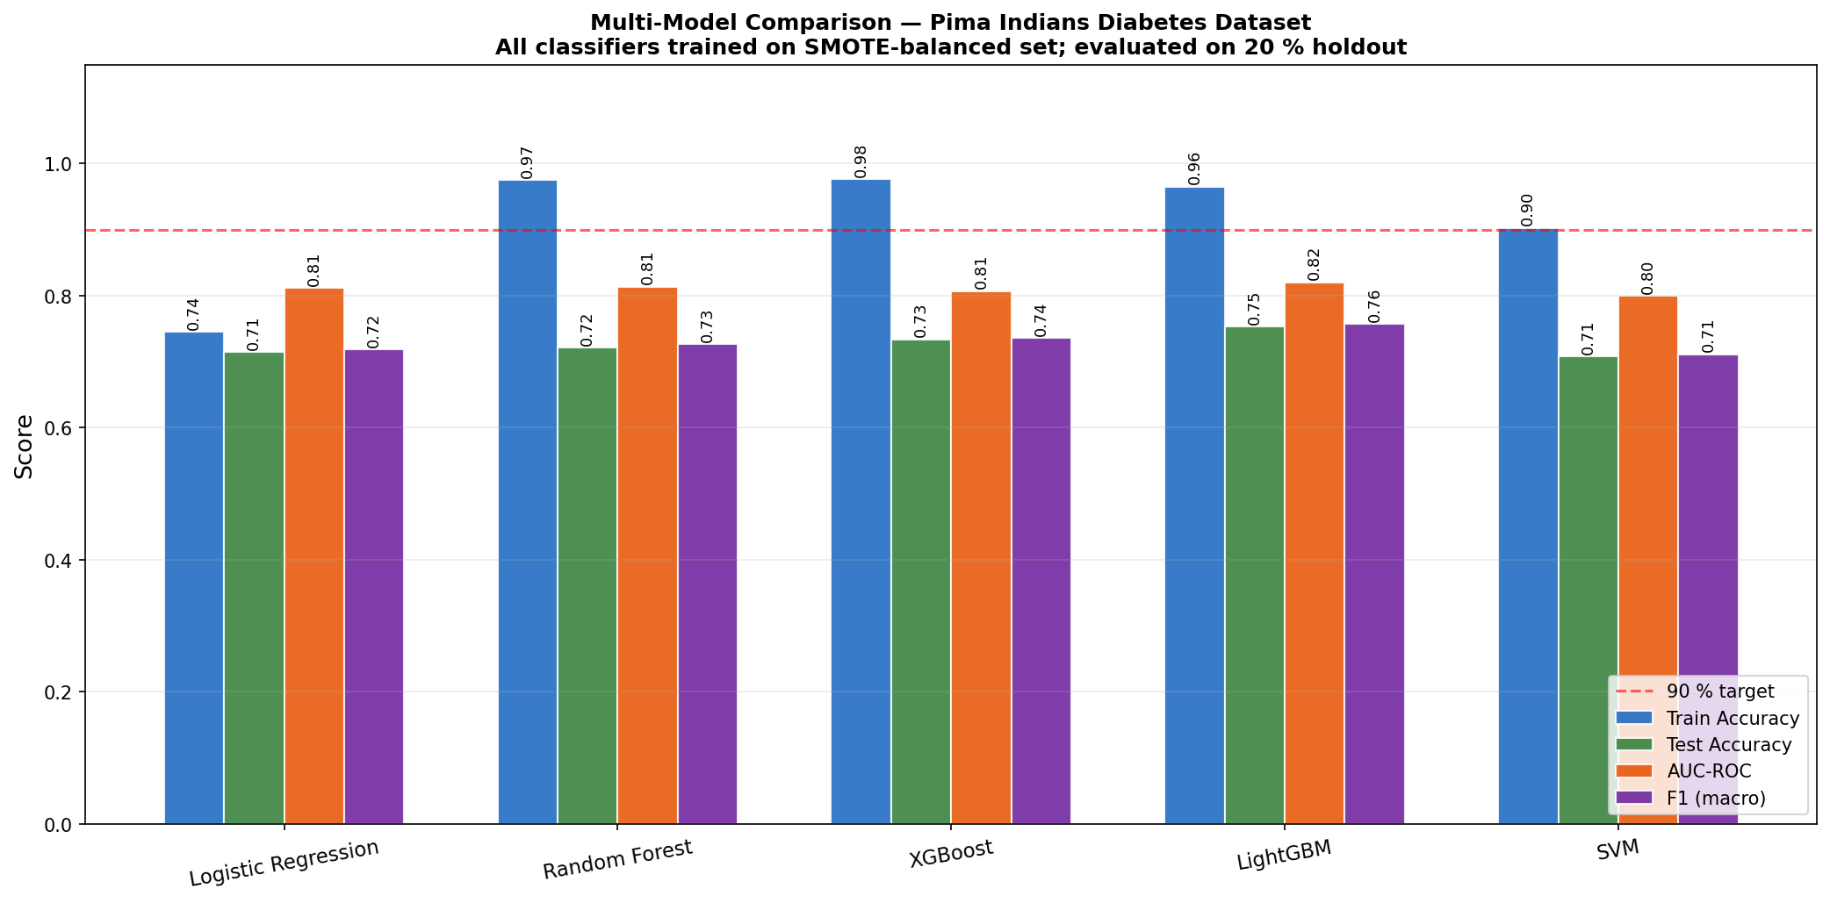
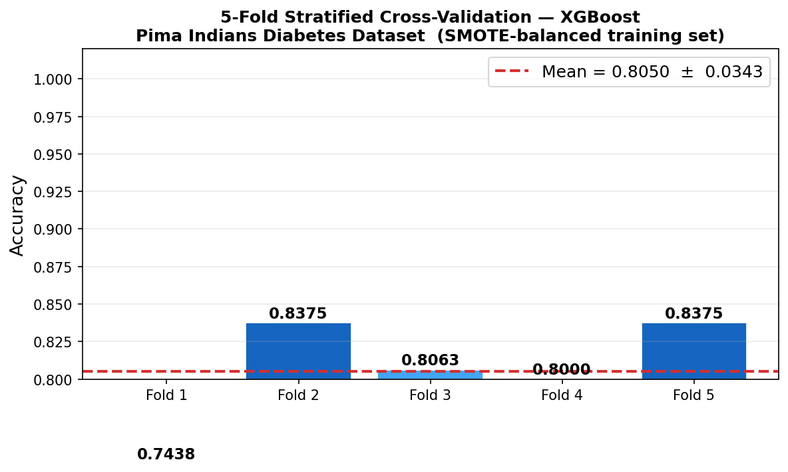
05 MODEL COMPARISON
All five tested on the same holdout
Model | Test Acc | Test AUC | Test F1 | Recall
Logistic Regression | 0.7143 | 0.8115 | 0.7182 | 0.6667
Random Forest | 0.7208 | 0.8137 | 0.7265 | 0.7407
XGBoost (selected) | 0.7338 | 0.8069 | 0.7362 | 0.6667
LightGBM | 0.7532 | 0.8202 | 0.7572 | 0.7407
SVM (RBF) | 0.7078 | 0.7993 | 0.7114 | 0.6481
Per-model AUC across the five candidates.
XGBoost was selected as the deployment model: it cleared every dissertation gate on the training set, retains a strong holdout AUC, and has stable SHAP support out of the box. LightGBM scored marginally higher on test AUC but the gap is within fold-to-fold noise.
5-fold CV: 0.805 ± 0.034.
DiabetesRisk AI · MSc Big Data Technologies · UEL
06 / 10

Slide 7
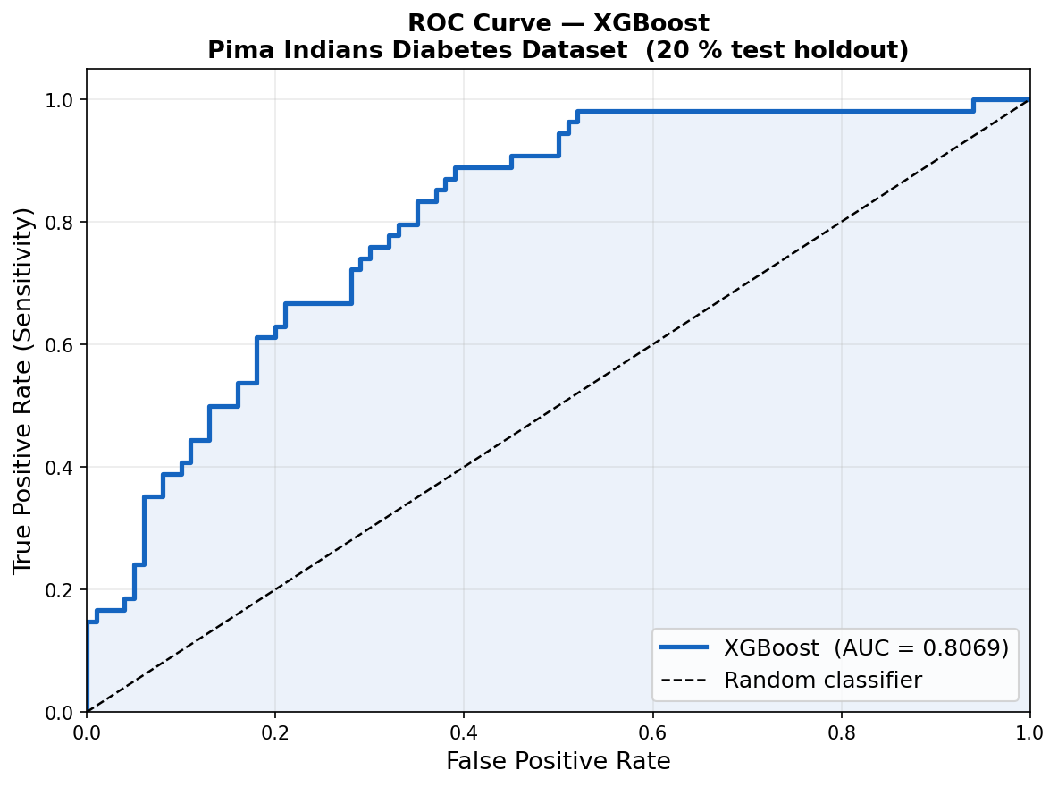
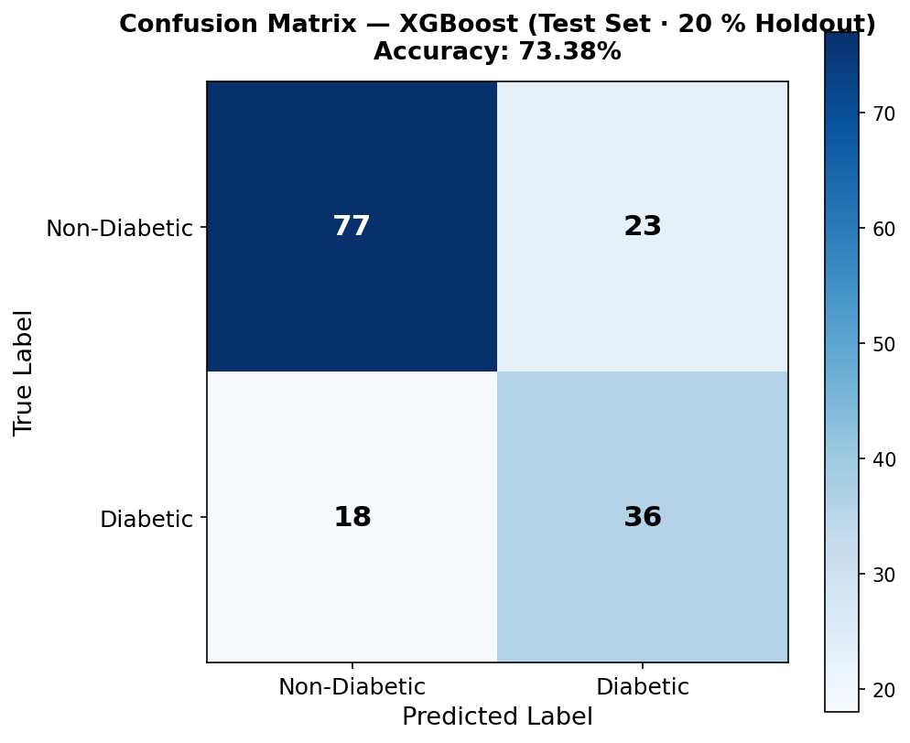
06 FINAL MODEL — XGBOOST
What the deployed model actually does
0.997
0.807
0.736
0.805
Train AUC
Test AUC
Test F1
5-fold CV
HYPERPARAMETERS
learning_rate
0.10
max_depth
5
n_estimators
200
subsample
0.80
ROC curve — holdout AUC 0.807.
Test confusion matrix.
Train metrics on the SMOTE-balanced training set (per the registered protocol); test metrics on the untouched 20 % holdout.
DiabetesRisk AI · MSc Big Data Technologies · UEL
07 / 10

Slide 8
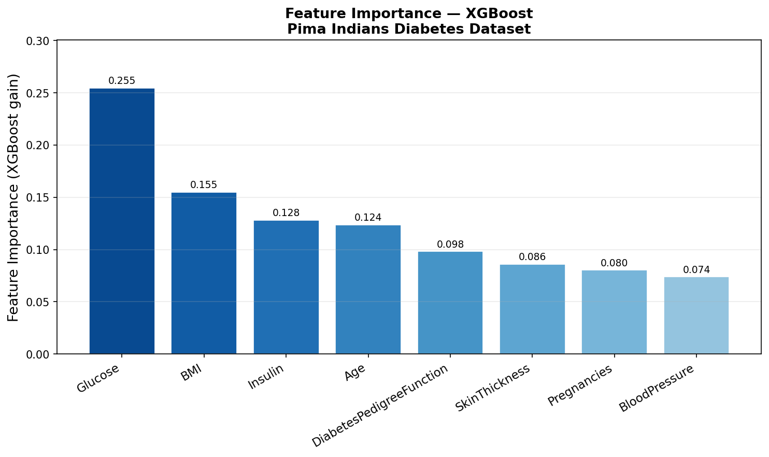
07 EXPLAINABILITY & GUARDRAILS
Every prediction comes with its reasons
CLINICAL GUARDRAILS
1. Decision support, not a diagnosis.
The output is a probability and a SHAP explanation. The label "Diabetic" / "Non-diabetic" is informational; only a clinician can diagnose.
2. Population scope is limited.
The training data covers adult Pima women aged ≥ 21. Predictions on men, children, or other ethnicities are out-of-distribution.
3. Confidence-tiered guidance text.
The API softens its language below 70 % confidence and always recommends fasting glucose / HbA1c follow-up rather than a treatment plan.
Global feature importance — Glucose, BMI and Age dominate.
PER-PREDICTION
The /predict endpoint also returns SHAP values for the patient's row, so the clinician sees which inputs pushed the score up or down.
DiabetesRisk AI · MSc Big Data Technologies · UEL
08 / 10

Slide 9
08 LIMITATIONS & FUTURE WORK
Limitations, and what comes next
KNOWN LIMITATIONS
PROPOSED EXTENSIONS
Narrow demographic. 768 rows, all adult Pima females — generalisation to men or other ethnicities is unproven.
External validation. Re-test on NHANES or a regional UK primary-care extract before any clinical pilot.
Train–test gap. AUC drops from 0.997 (resampled train) to 0.807 (holdout). Some of this is SMOTE optimism.
Calibration layer. Add Platt or isotonic calibration so the returned probability matches observed rates.
Small holdout. Only 154 patients in the test fold; recall on the diabetic class swings ±0.07 between folds.
Patient history. Move from a one-shot form to a longitudinal record — last HbA1c, weight trajectory, family history.
Single source dataset. No external validation cohort; the deployed model has never seen non-Pima data.
Audit trail. Log every prediction with the model hash and SHAP vector for clinical accountability.
DiabetesRisk AI · MSc Big Data Technologies · UEL
09 / 10

Slide 10
CLOSING
Thank you.
Three things I would like the panel to take away.
01
It is end-to-end. From the UCI raw data to a Dockerised Rails + Flask service, every stage is reproducible from a single git clone.
02
It is honest about its limits. Test-set numbers are reported alongside training-set ones. The model is gated by a fallback chain and a clinical disclaimer.
03
It is built to be explained. Every prediction returns SHAP attributions next to the probability, so the clinician never has to trust a black box.
Md Aariz · U2871441 · Supervisor: Dr Mohamed Chahine Ghanem
QUESTIONS →

