Slide 1




JAVA
MySQL
Connectivity
JAINIKA BISEN
1032222201
T.Y. PC - 41

Slide 2


What is JDBC?
JDBC (Java Database Connectivity) is a Java API that allows applications to interact with relational databases like MySQL, PostgreSQL.
It provides methods to connect to a database, execute queries, and process the results.
WHY JDBC?
Platform-Independent – Works on any system with a JVM
Supports Multiple Databases – Compatible with MySQL, PostgreSQL, Oracle, and more.
Secure & Efficient – Uses PreparedStatement to prevent SQL injection and optimize performance.

Slide 3


Steps in Java-MySQL Connectivity
1. Establish Connection:
Create a connection to the MySQL database using DriverManager.
Syntax:
Connection conn = DriverManager.getConnection(url, user, password)
2. Create Database and Schema in MySQL workbench
3. Create SQL queries and run using PreparedStatement:
Syntax:
PreparedStatement stmt = conn.prepareStatement(query));
4. Close connection:
conn.close();

Slide 4

Problem Statement
Develop a Java-based Student Registration System that connects to a MySQL database using JDBC, allowing users to insert student details using Swing GUI.
The student table should include:
ID
Name
Age
Enrollment status

Slide 5
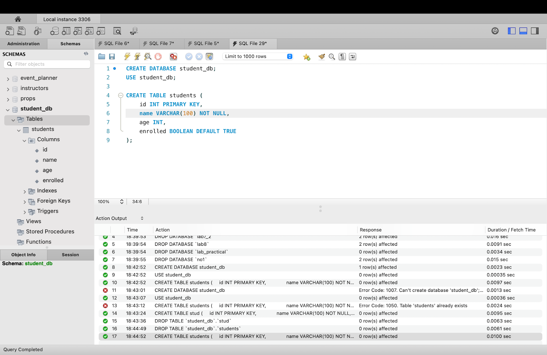
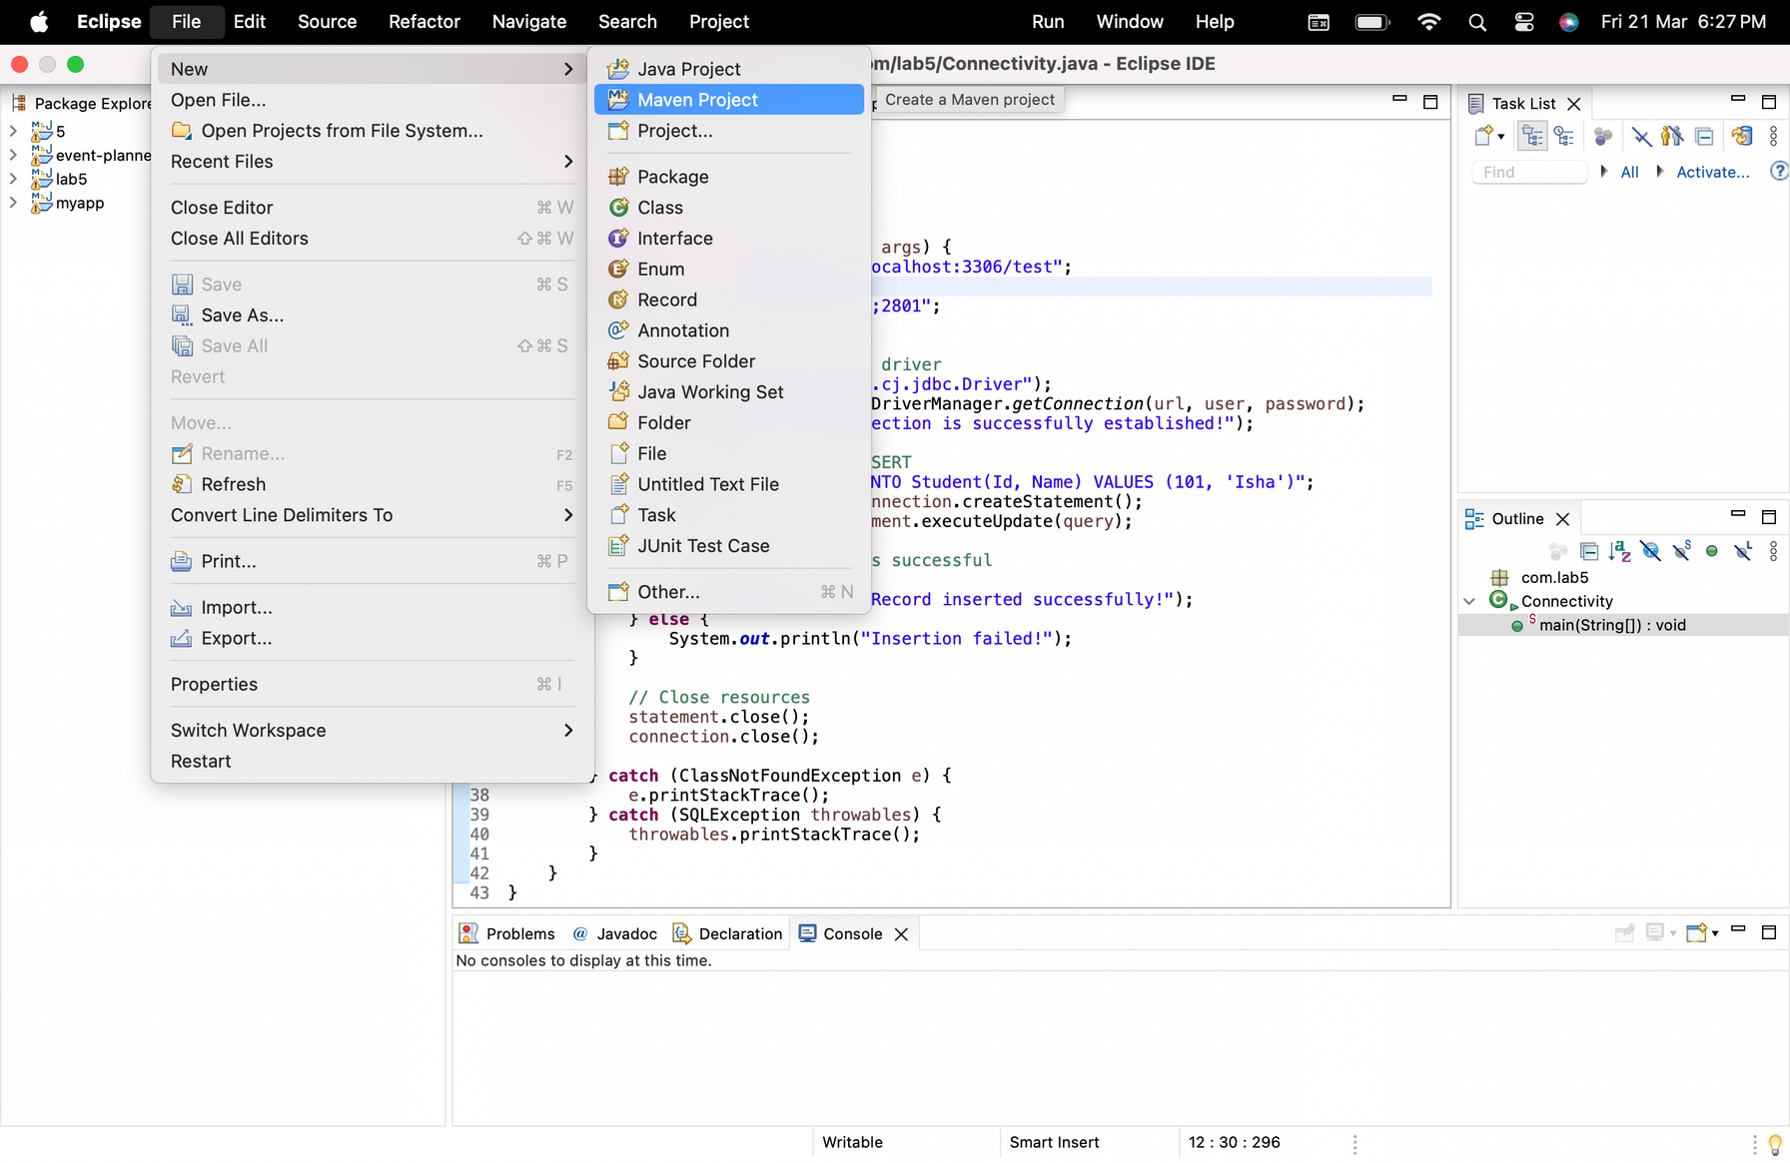
Demonstration
Create Schema in MySQL:
2. Create a new Maven Project:
Go to File -> New ->Maven Project
Select the option - ‘Create a simple project’

Slide 6
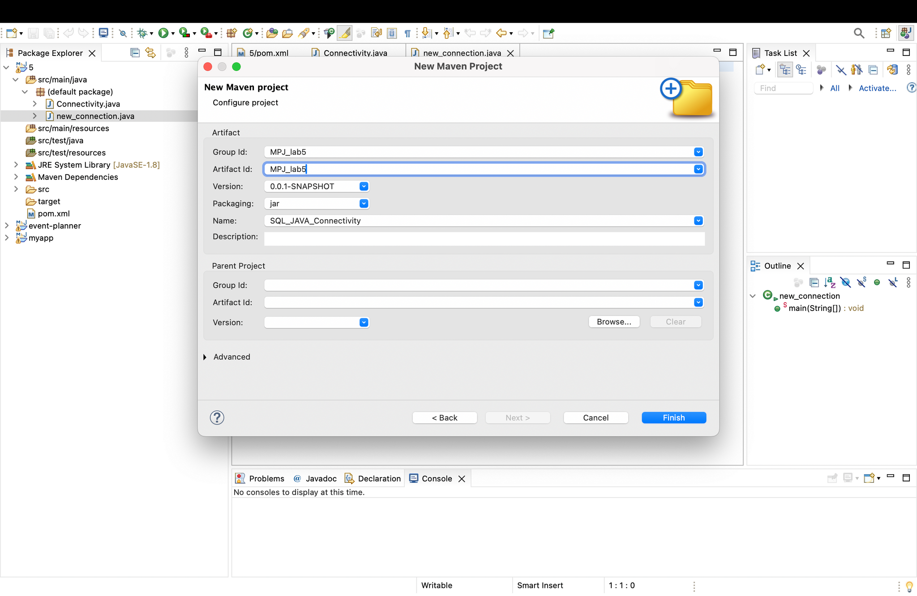
Demonstration
3. Enter the details:
Enter Group ID, Artifact ID and
Name.
ex:
GroupID: LAB5
ArtifactID: LAB5
Name: MPJ_Connectivity
Do not add any parent project
details
Click finish

Slide 7
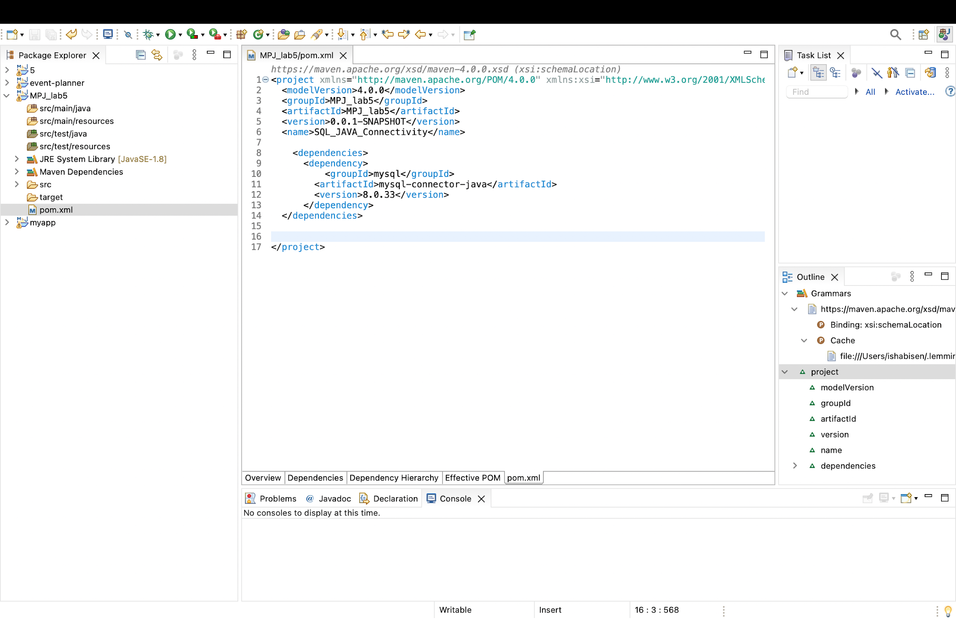
Demonstration
4. Add dependencies to pom.xml file
<dependencies>
<dependency>
<groupId>mysql</groupId>
<artifactId>mysql-connector-java</artifactId>
<version>8.0.33</version>
</dependency>
</dependencies>
The above dependencies add MySQL Connector, which is essential for Java applications to communicate with a MySQL database using JDBC.

Slide 8
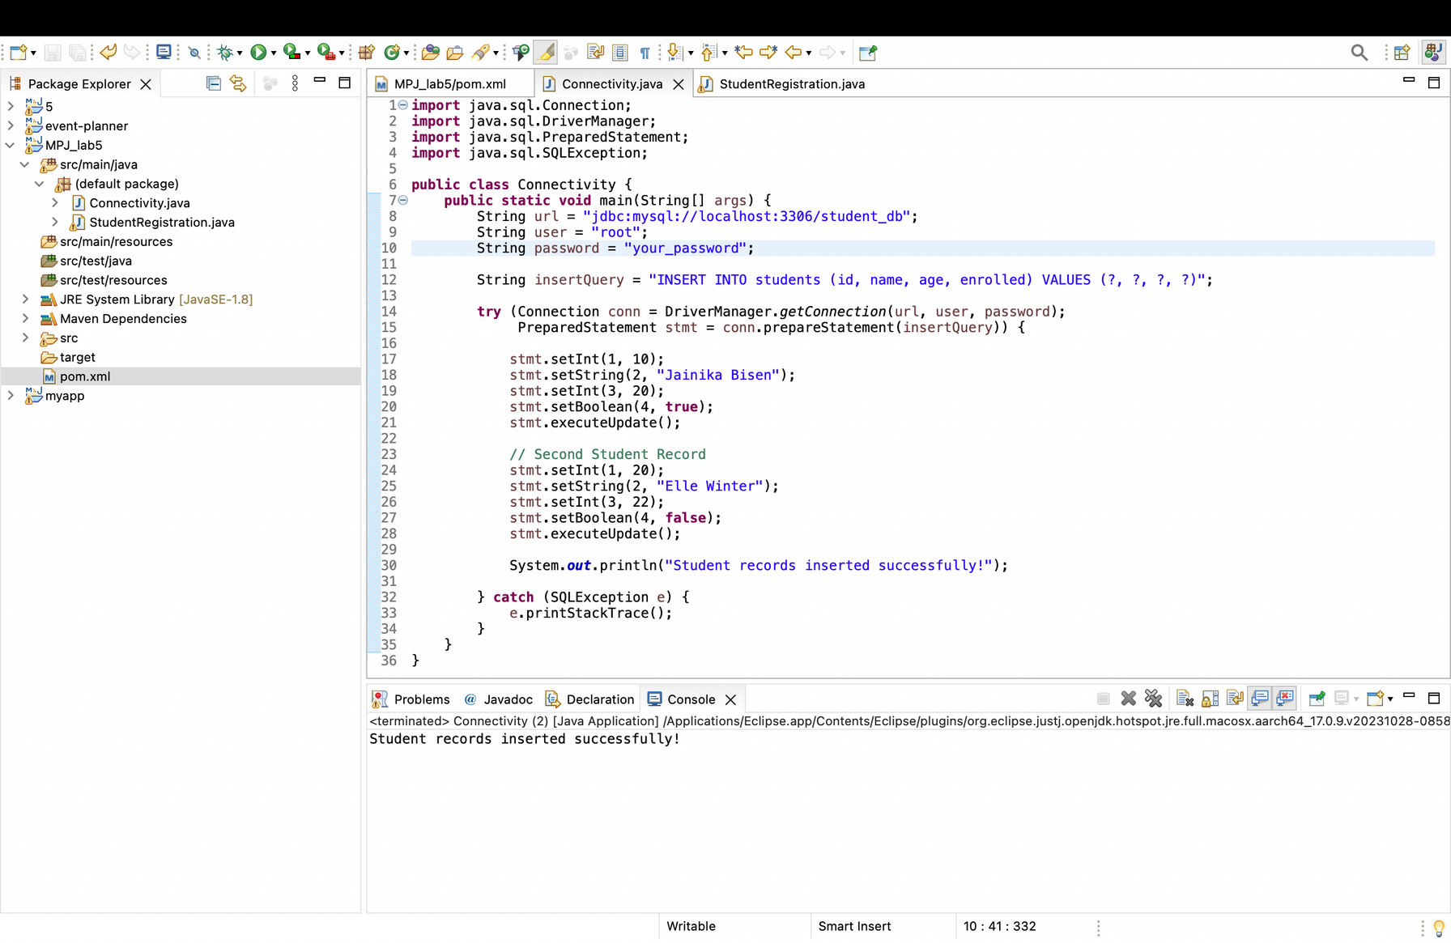
Demonstration
5. Write code for connecting java with MySQL
In src/main/java, create a file and name it with .java extension

Slide 9
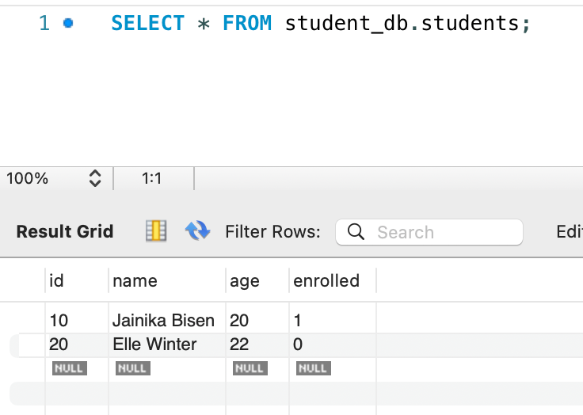
Demonstration
6. Run select query to check if data is inserted
7. Develop complete web application
Swing can be utilized to develop a GUI-based frontend, providing an interactive interface for users.
In a web application,
Servlets efficiently manage client requests and responses.
JSP facilitates the creation of dynamic web pages by integrating Java with HTML.

Slide 10
Thank You

