Slide 1
Hotel Data Early Reservations
Aaron Kohn
6/4/2021
DSC530, Bellevue University

Slide 2
Do people book earlier in busy season?
It would be assumed that people book earlier for seasons that have higher demand. It is expected that higher demand would lead to an increase in price. This study is designed to study these relationships.

Slide 3
Variable Selection
Lead Time = Time elapsed from data entry till arrival. This is the value used to assume initial reservation.
ADR = Average daily rate .
ArrivalDateWeekNumber = Week number in year of arrival date.
StaysInWeekendNights/StayInWeekNights = Number of weekend nights stayed / weeknights stayed. combined = StaysTotalNights
PreviousCancellations/PreviousBookingsNotCanceled = Previous bookings cancelled / not cancelled. Total = PreviousBooking?
DaysInWaitingList = Number of days from booking being entered to being confirmed to the customer.
WeekCount = Newly calculated variable used to measure number of entries for a given week.

Slide 4
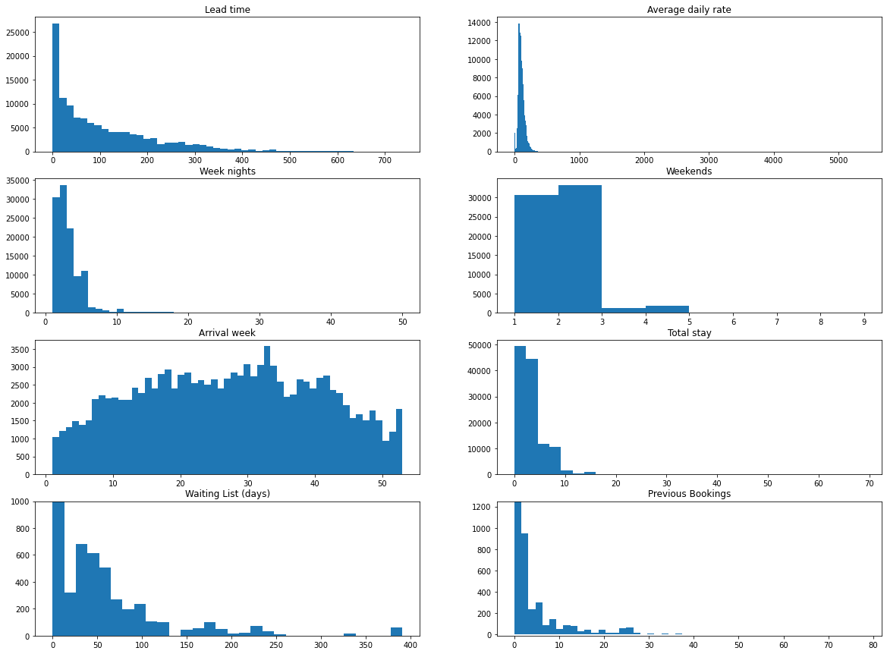
Histograms

Slide 5
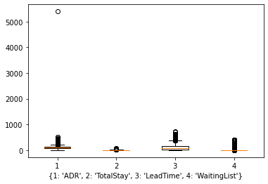
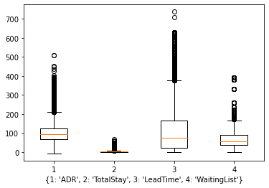
Outliers
The obvious outlier in ADR is at $5400 more than 10x the nearest value.
This may be an error or due to how the average daily rate is calculated. This instance was a nonrefundable payment that canceled. This will be removed.
Boxplot modeling the data with the outlier removed and without zeros for LeadTime and WaitingList.

Slide 6
Summary stats
 | LeadTime | ADR | DaysInWaitingList | StaysTotalNights
mean | 104.011994 | 101.786744 | 2.321169 | 3.427920
median | 69.000000 | 94.560000 | 0.000000 | 3.000000
skew | 1.346537 | 1.017731 | 11.944303 | 3.308778
std | 106.863358 | 48.153554 | 17.594793 | 2.557440
kurt | 1.696412 | 2.131745 | 186.791483 | 28.873823

Slide 7
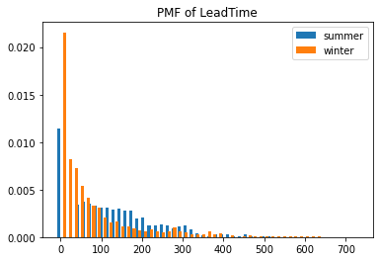
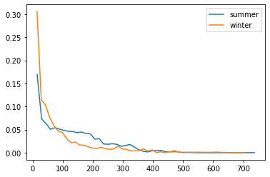
PMF

Slide 8
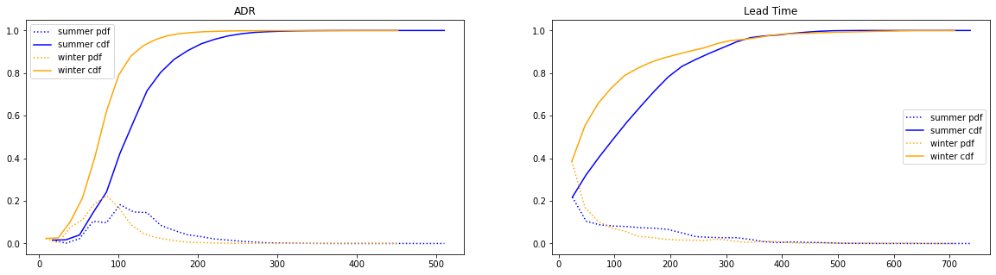
CDF

Slide 9
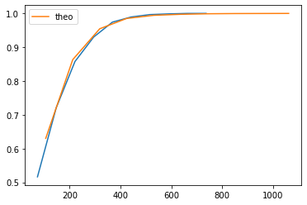
Analytic distribution LeadTime
Exponential distribution
KstestResult
statistic=0.8670171807177622, pvalue=0.0
It can be assumed that LeadTime follows an exponential distribution.

Slide 10
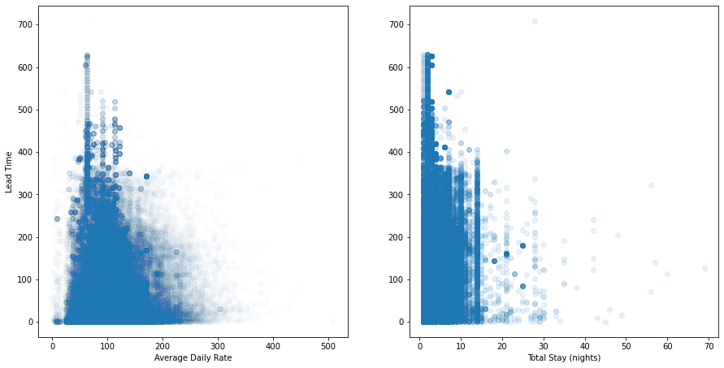
Scatter Plots For Lead Time
Pearson Correlation for LeadTime
WeekCount = 0.21758933249781223,
ADR = -0.06560260322568374,
StaysTotal = 0.15716270405368435.

Slide 11
Results and p-value
mean test LeadTime (summer vs winter)
Ttest_indResult(statistic=67.66613926932408, pvalue=0.0)
mean test ADR (summer vs winter)
Ttest_indResult(statistic=142.39896526421992, pvalue=0.0)
cor WeekCount, ADR
(0.3814843730420176, 0.0) SpearmanrResult(correlation=0.39587894978498966, pvalue=0.0)
cor WeekCount, LeadTime
(0.21758933249781226, 0.0) SpearmanrResult(correlation=0.2496423764173558, pvalue=0.0)
cor ADR, LeadTime
(-0.0656026032256837, 5.412110078115806e-114)

Slide 12
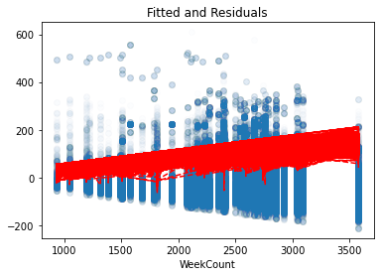
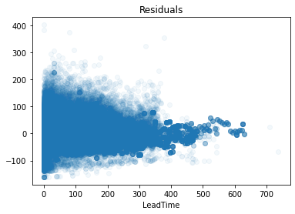
Regression Models
LeadTime ~ ADR + WeekCount
Using ADR and WeekCount to predict LeadTime results in an R² of 0.524 and a reduction in RMSE of 3.7%.
ADR ~ LeadTime + WeekCount
Using LeadTime and WeekCount to predict ADR results an R² of 0.847 and a reduction in RMSE of 8.4%.

