Slide 1
Physical Force in the
New York City Police Department
Bellevue University – DSC630
Aaron Kohn – October 2021

Slide 2
Background
Clearer points less words
Data retrieved from New York City’s stop and frisk data base.
Data includes details of stop including whether officer use physical force.
Knowing when an encounter is likely to result in the use of force can help prepare officers on response.

Slide 3
Problem Statement
Clearer points less words
Use the data collected in the stop and frisk program to create a model that will predict scenarios likely to end in the use of physical force.
Identify variables with highest effect on use of physical force.
Determine areas where further focus is warranted.

Slide 4
Ethical Considerations
Acknowledgment of Risks
This study does include variables such as race, sex, and neighborhood.
Limitations of Use
The findings do not include any predictions on the habits of civilians. The study is limited to the actions performed by the police officers.
Finding Bias
Not including the above factors may prevent discovering trends that need correction.

Slide 5
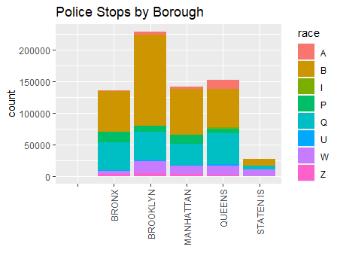
Ethical Concerns
Note race B’s high representation in all boroughs.

Slide 6
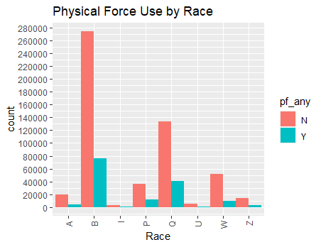
Ethical Concerns
Percent of stops resulting in the use of force is not higher for race- B

Slide 7
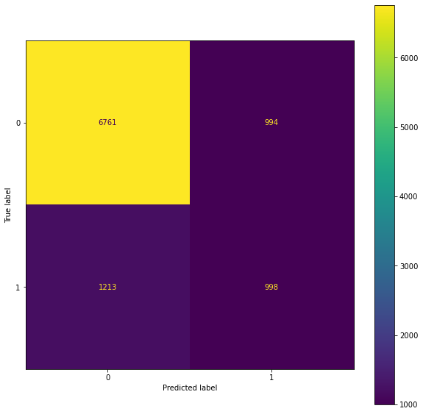
Initial Decision Tree
Number in sample = 50,000
Accuracy = 0.78
Recall = 0.45
F1 score = 0.47

Slide 8
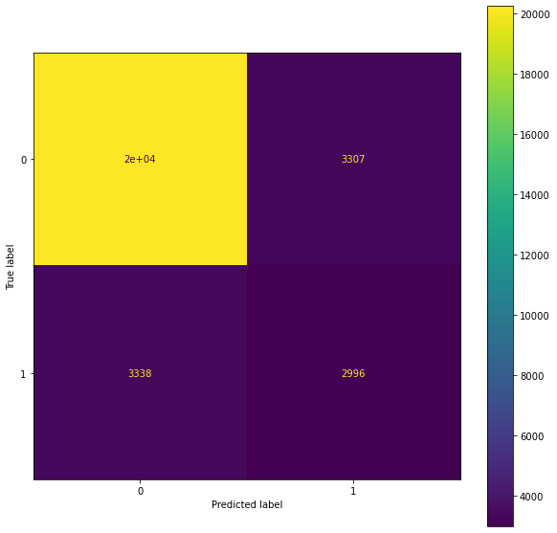
Initial Decision Tree
Larger Sample
Number in sample = 150,000
Accuracy = 0.78
Recall = 0.47
F1 score = 0.47

Slide 9
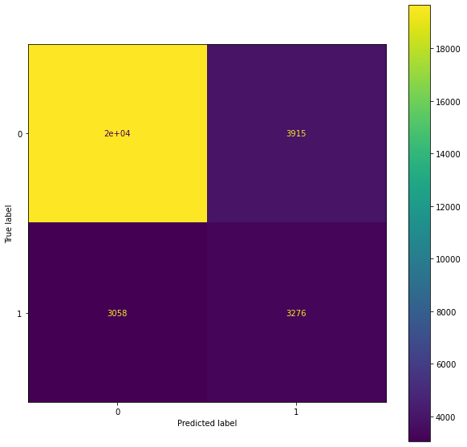
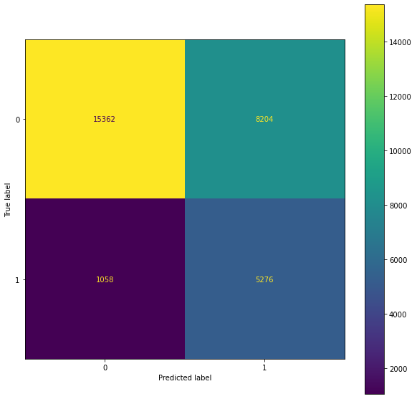
Best Decision Trees
“Balanced Target”
Depth = 60
Accuracy = 0.77
Recall = 0.52
F1 score = 0.48
Depth = 16
Accuracy = 0.69
Recall = 0.83
F1 score = 0.53

Slide 10
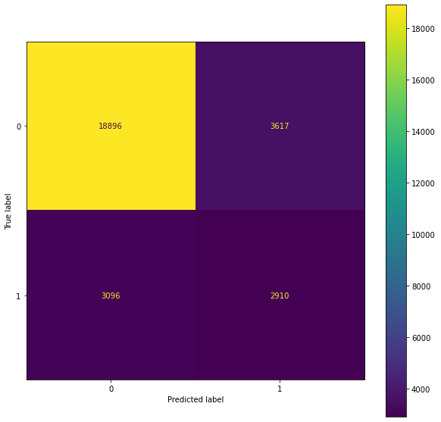
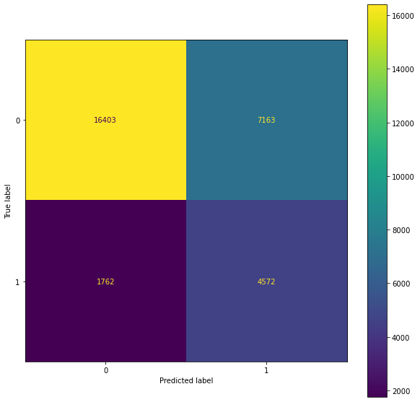
Other Models
Naïve Bayes
Logistic Regression
Accuracy = 0.76
Recall = 0.48
F1 score = 0.46
Accuracy = 0.70
Recall = 0.72
F1 score = 0.51

Slide 11
Modeling
Target value of class 0 present at 78%. Decision model accuracies do not exceed 78%.
Further study is needed to determine best model based on precision, recall or f1-score.

Slide 12
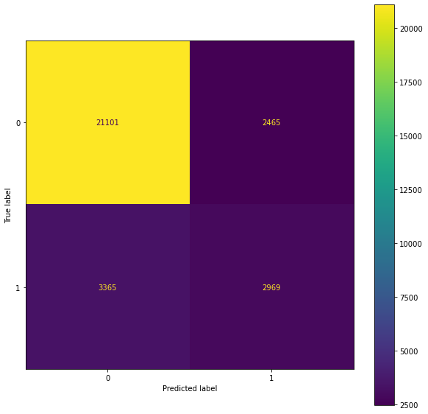
Gradient Boost Classifier
Number in sample = 150,000
Accuracy = 0.81
Recall = 0.47
F1 score = 0.50

Slide 13
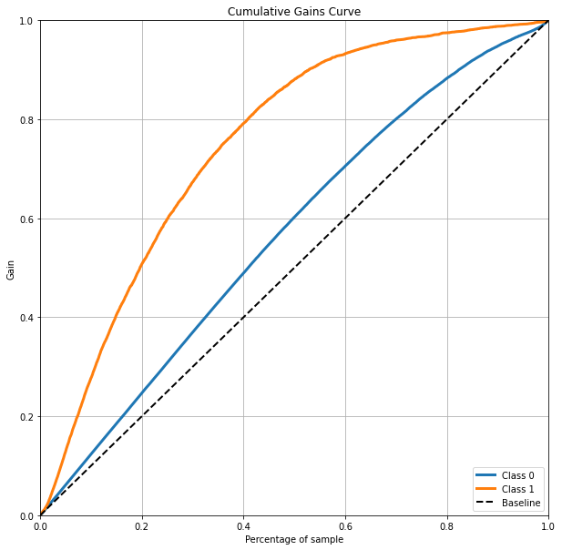
Gradient Boost Classifier

Slide 14
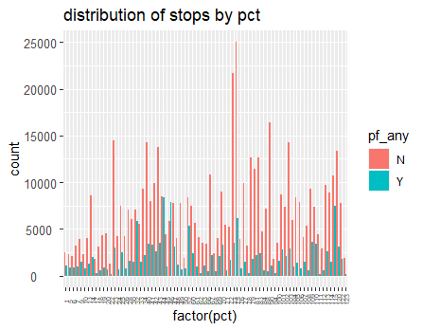
A look at some variables
pct 46

Slide 15
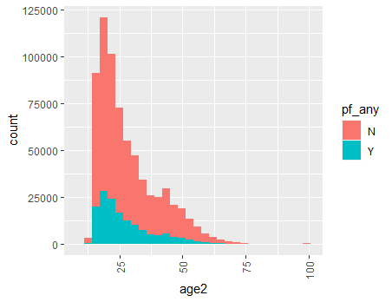
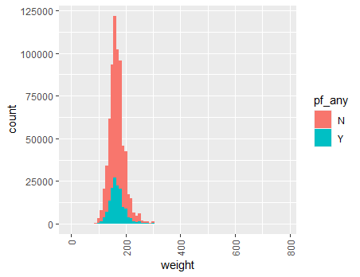
A look at some variables
Variables such as age and weight seem to have number of stops and use of force follow similar distributions.

Slide 16
Future Steps

Slide 17
By pct

Slide 18
References
Data retrieved from https://www1.nyc.gov/site/nypd/stats/reports-analysis/stopfrisk.page

