Slide 1
IBM University Engagement Project Submission
“Exploring the Power of Agentic AI with IBM Granite and LangFlow”

Slide 2

Project Tile – Course Content Simplification Agent
Domain of Project – Education
Student Name | Recent Passport Photo | Email ID | Mobile number [WhatsApp]
Aarna Neemkar |  | aarna9.neemkar@gmail.com | 7989193820
Recommended font style and size: Font Style: Arial Font Size (Heading): 28
Font Size (Content): 20

Slide 3
Problem Statement -
Problem Statement : Nutrition Agent
The Challenge
Educational content such as textbooks, lecture notes, and study materials often contains complex language and technical jargon. Students with different learning abilities and knowledge levels find it difficult to understand these materials. Existing educational resources rarely adapt explanations according to an individual learner's proficiency..
The Objective
Develop an AI-powered Course Content Simplification Agent that:
Simplifies educational content based on learner level.
Converts complex explanations into easy-to-understand language.
Generates concise summaries.
Highlights important concepts.
Creates flashcards for revision.
Generates quizzes for self-assessment.
Provides personalized learning support using IBM watsonx.ai.

Slide 4
Proposed Solution -
Proposed Solution: Course Content Simplification Agent
The proposed solution is an AI-powered Course Content Simplification Agent developed using IBM watsonx.ai Studio and IBM Foundation Models.
The application allows students to upload educational content in PDF, DOCX, TXT formats or paste text directly.
Based on the selected learner level (Beginner, Intermediate, High School, Undergraduate, Engineering Student, Expert), the AI:
Simplifies the content
Generates a concise summary
Extracts key points
Explains difficult terms
Creates flashcards
Generates multiple-choice quiz questions
The backend is built using FastAPI, while the frontend is developed using React.
IBM watsonx.ai powers the AI-based content generation through Foundation Models.

Slide 5
Technology Used
IBM watsonx.ai Studio : Used for accessing IBM Foundation Models to simplify educational content.
IBM Foundation Models : Used for: Content Simplification
Summary Generation
Flashcard Generation
Quiz Generation
FastAPI : Backend REST API development.
React.js : Responsive user interface.
Tailwind CSS : Modern frontend styling.
Python : Backend development.
PyMuPDF : Extracts text from PDF files.
python-docx : Reads DOCX documents.

Slide 6
Component Used -
IBM Components:
IBM watsonx.ai Studio
Used for AI model inference.
IBM Foundation Model
Example:
Meta Llama 3.3 70B Instruct
Used for:
Text Simplification
Summarization
Quiz Generation
Flashcard Generation
API Key Authentication
Secure access to IBM watsonx.ai.
Project ID
Connects the application to IBM watsonx.ai Studio.

Slide 7
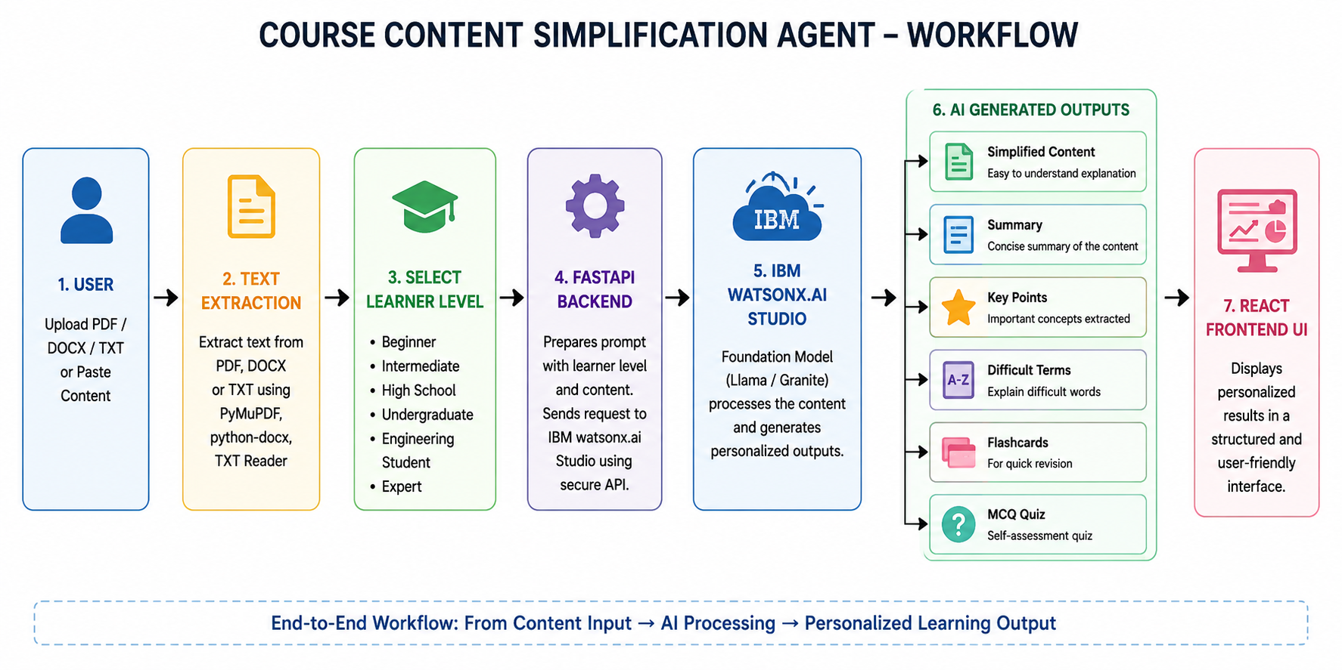
Workflow -

Slide 8
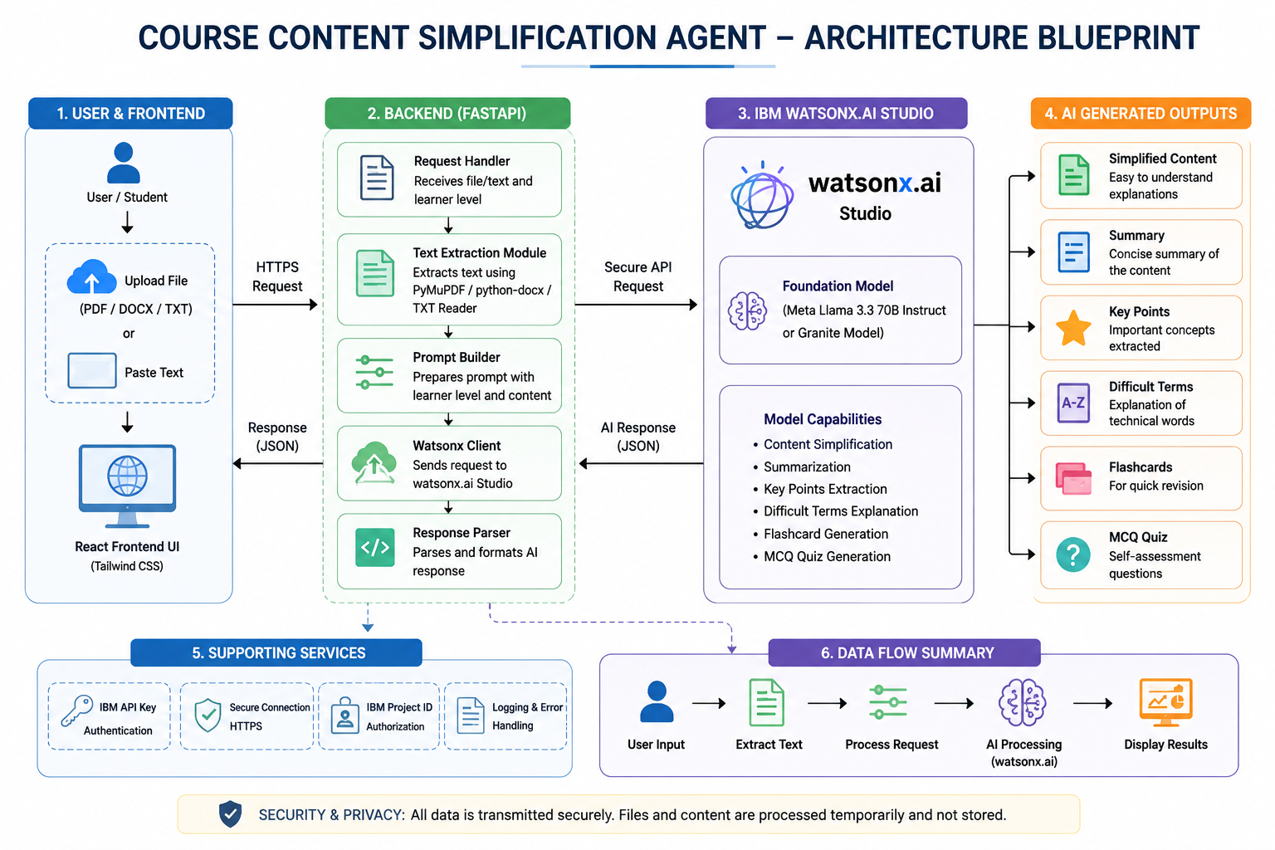
Architecture blueprint

Slide 9

Role of Agentic AI in the solution
Role of Agentic AI in Course Content Simplification Agent:
Agentic AI enables the Course Content Simplification Agent to function as an intelligent educational assistant rather than a traditional text summarizer. Using IBM watsonx.ai Studio and IBM Foundation Models, the system understands the complexity of academic content and adapts explanations according to the learner's knowledge level.
The AI autonomously performs multiple educational tasks including simplifying difficult concepts, generating summaries, identifying important points, explaining technical terminology, creating revision flashcards, and producing assessment quizzes. By understanding both the content and the learner's proficiency level, the system delivers personalized educational support that improves comprehension and encourages effective learning.
Overall, Agentic AI transforms static educational resources into dynamic, personalized learning material that enhances accessibility and promotes inclusive education.

Slide 10
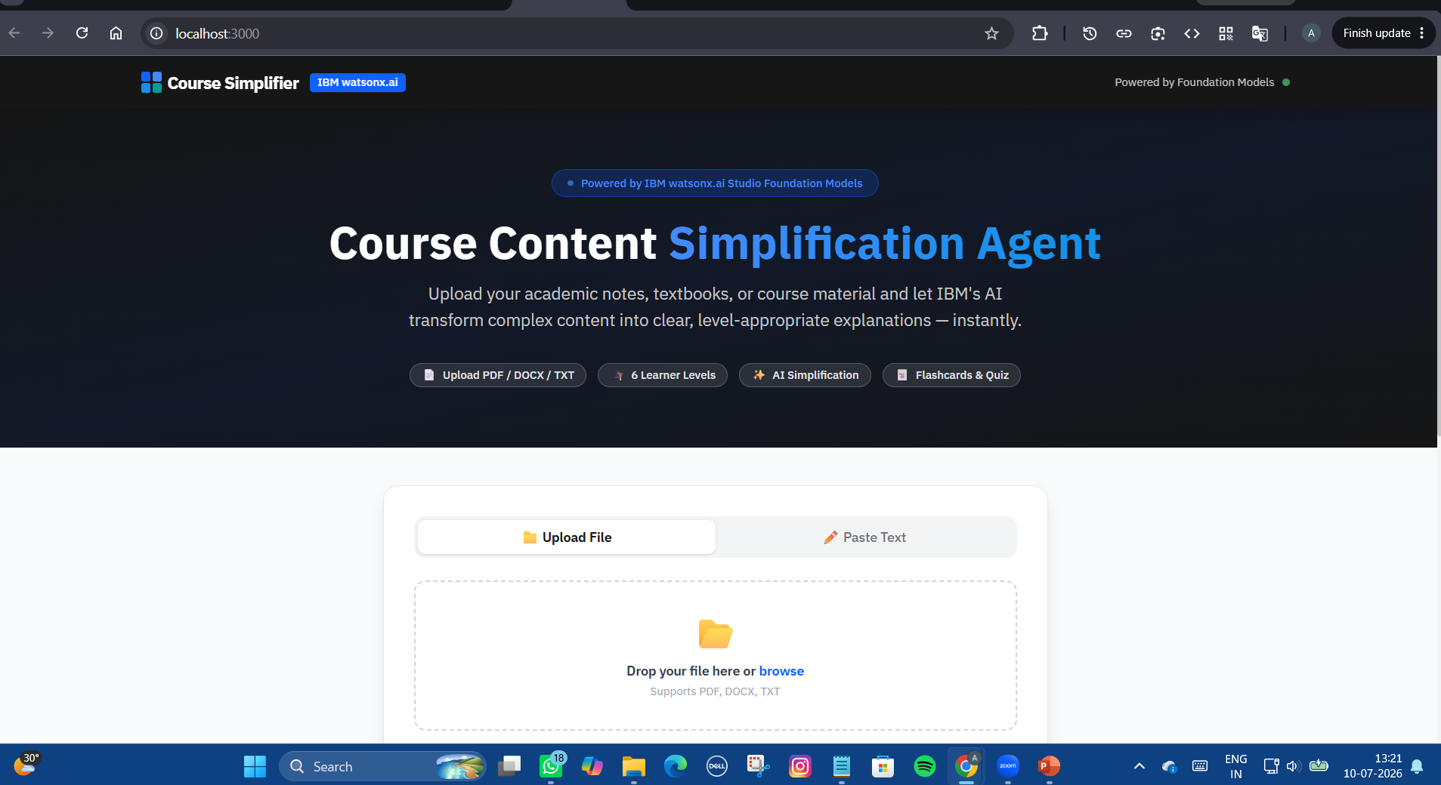
My Work

Slide 11
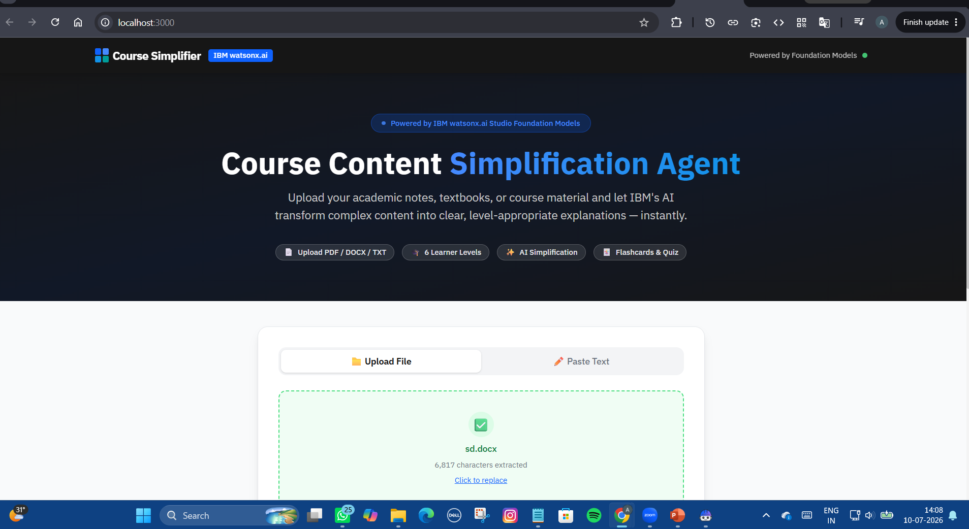
My Work

Slide 12
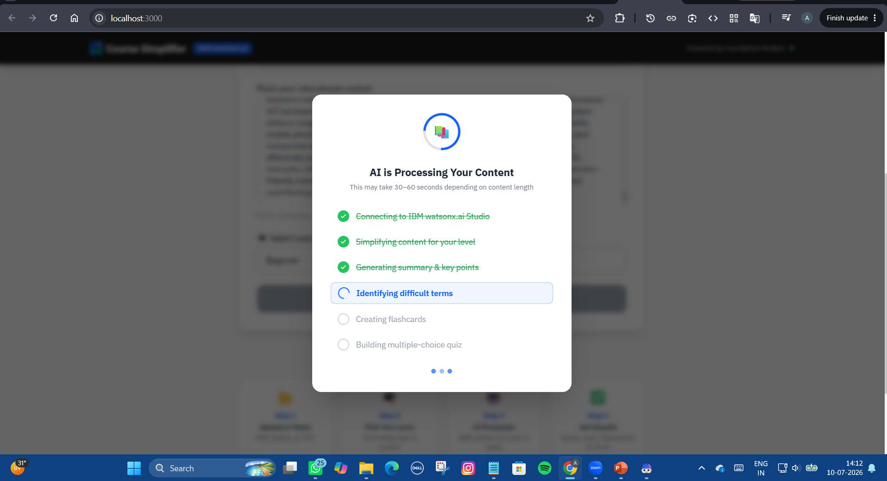
My Work

Slide 13
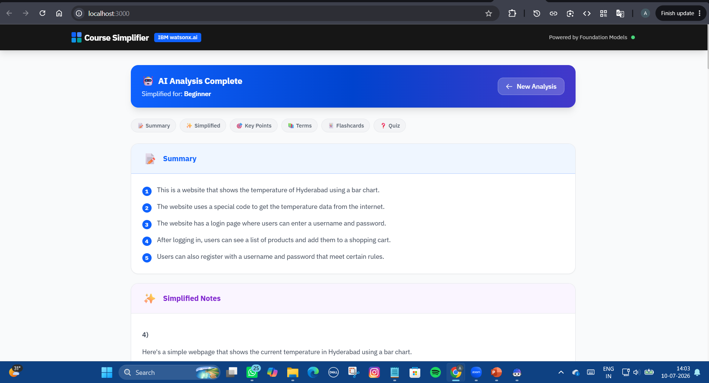
My Work

Slide 14
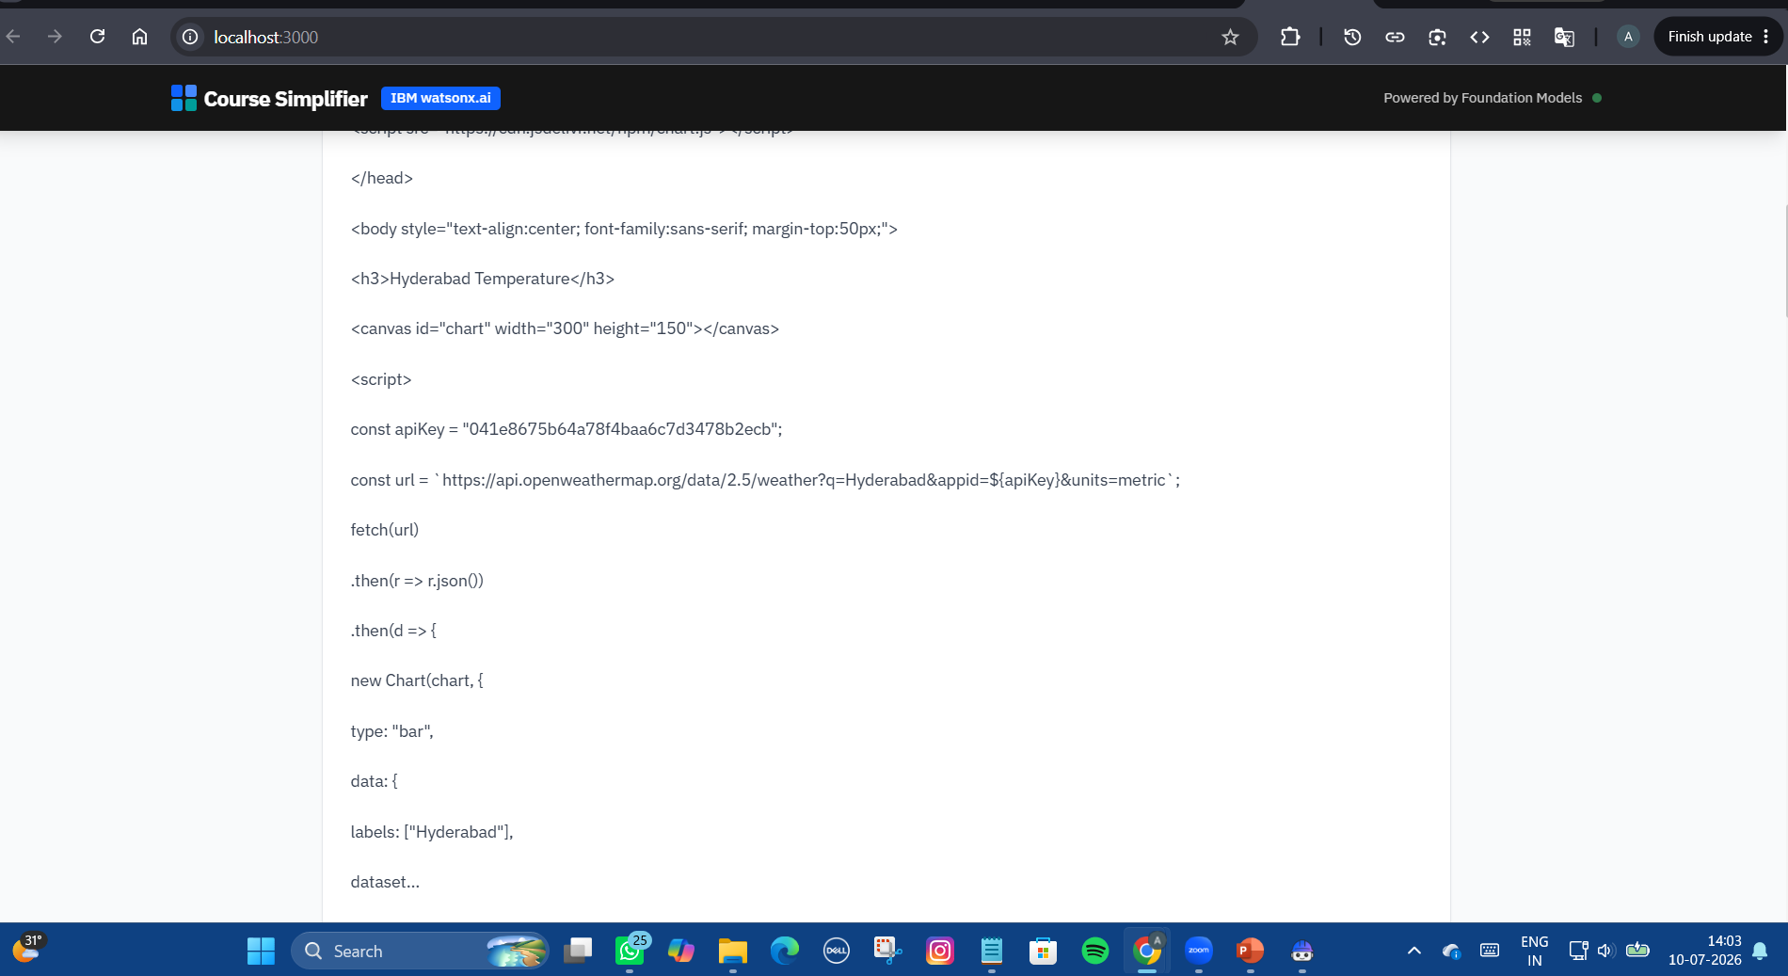
My Work

Slide 15
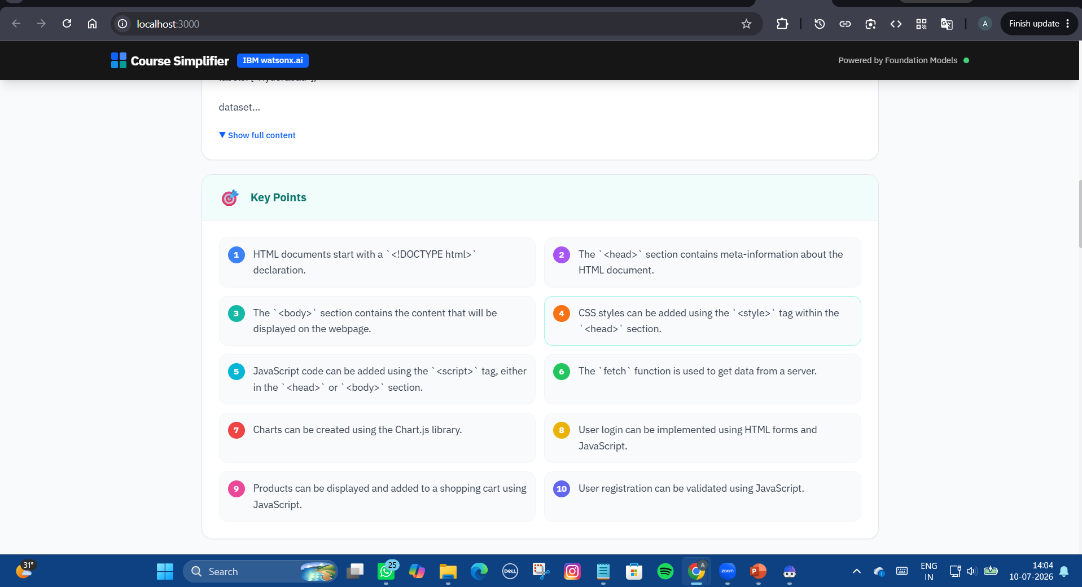
My Work

Slide 16
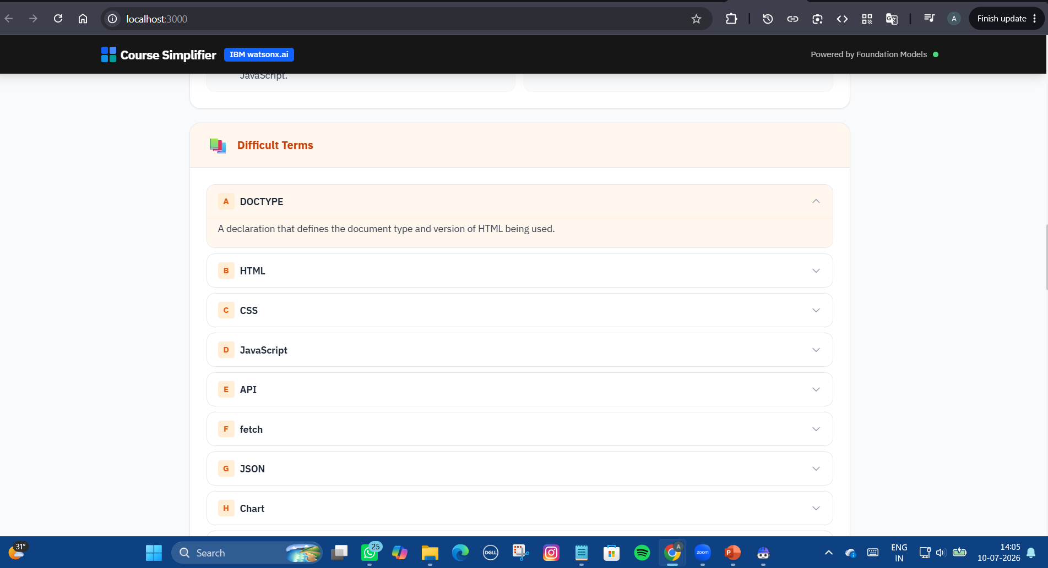
My Work

Slide 17
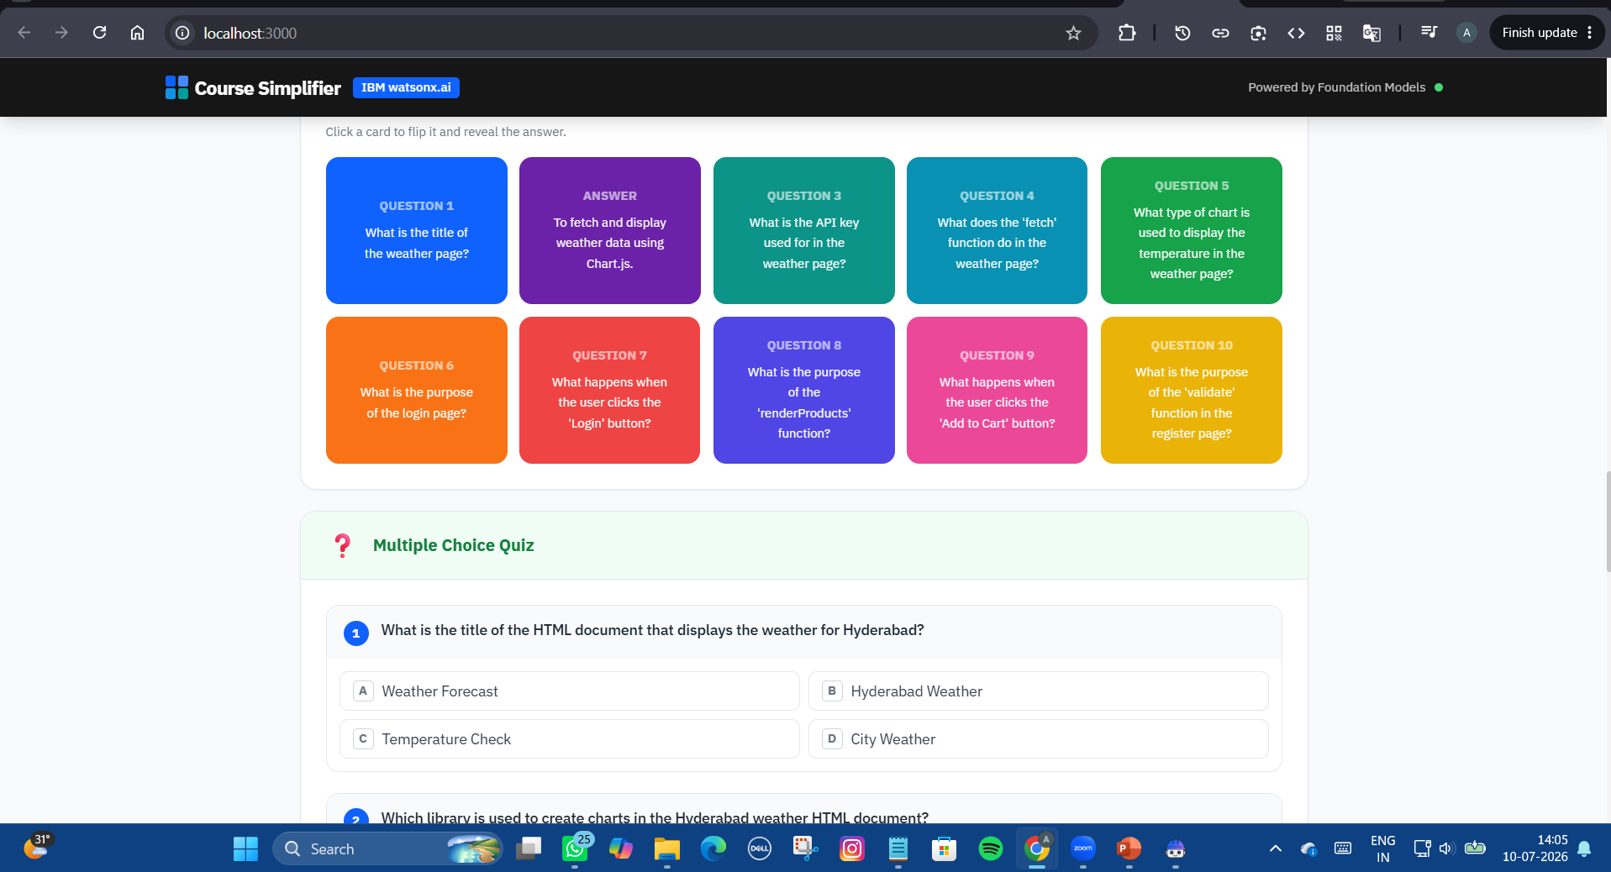
My Work

Slide 18
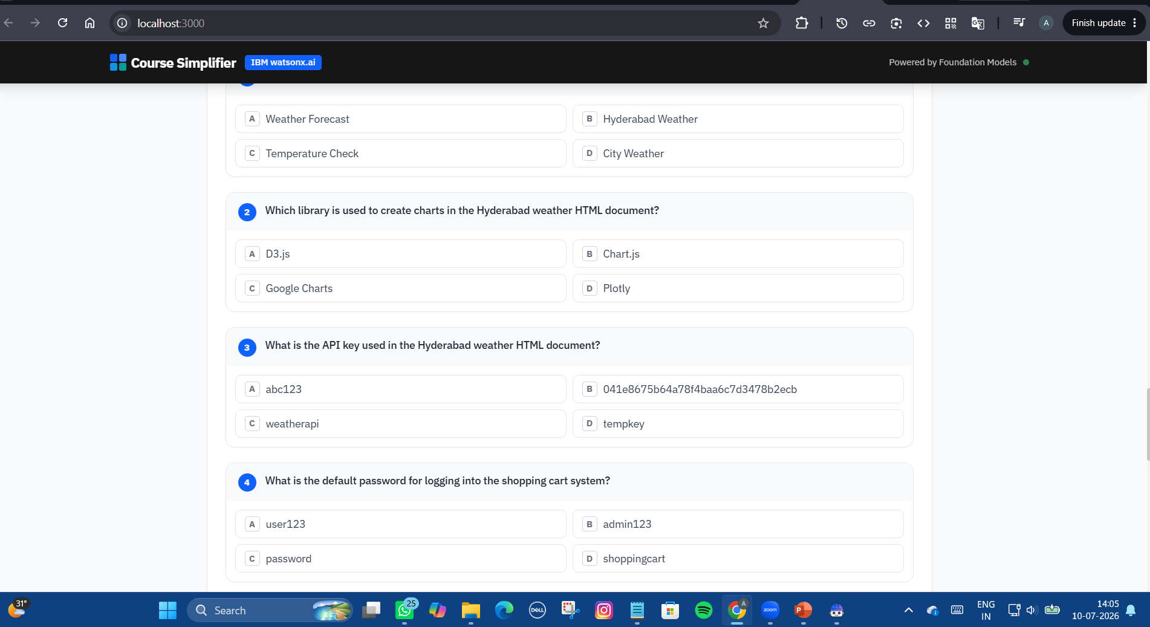
My Work

Slide 19
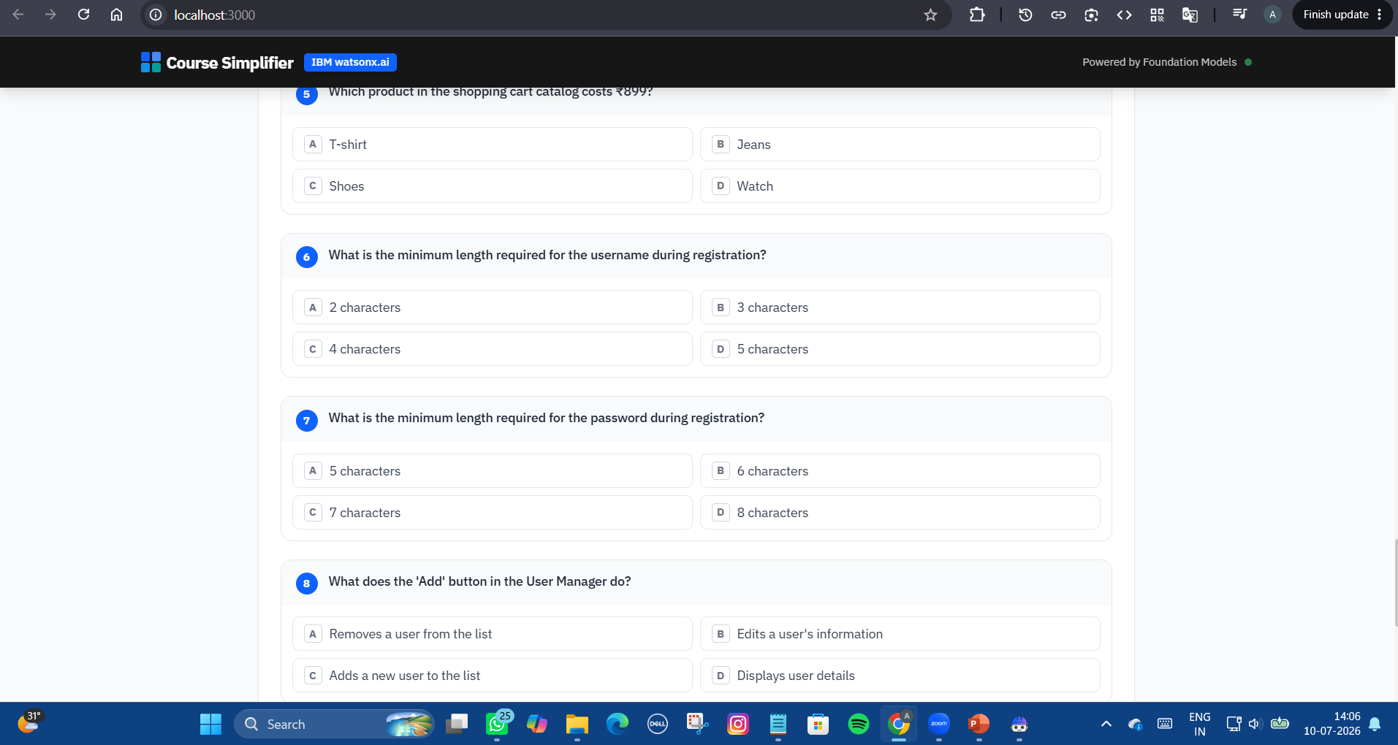
My Work

Slide 20
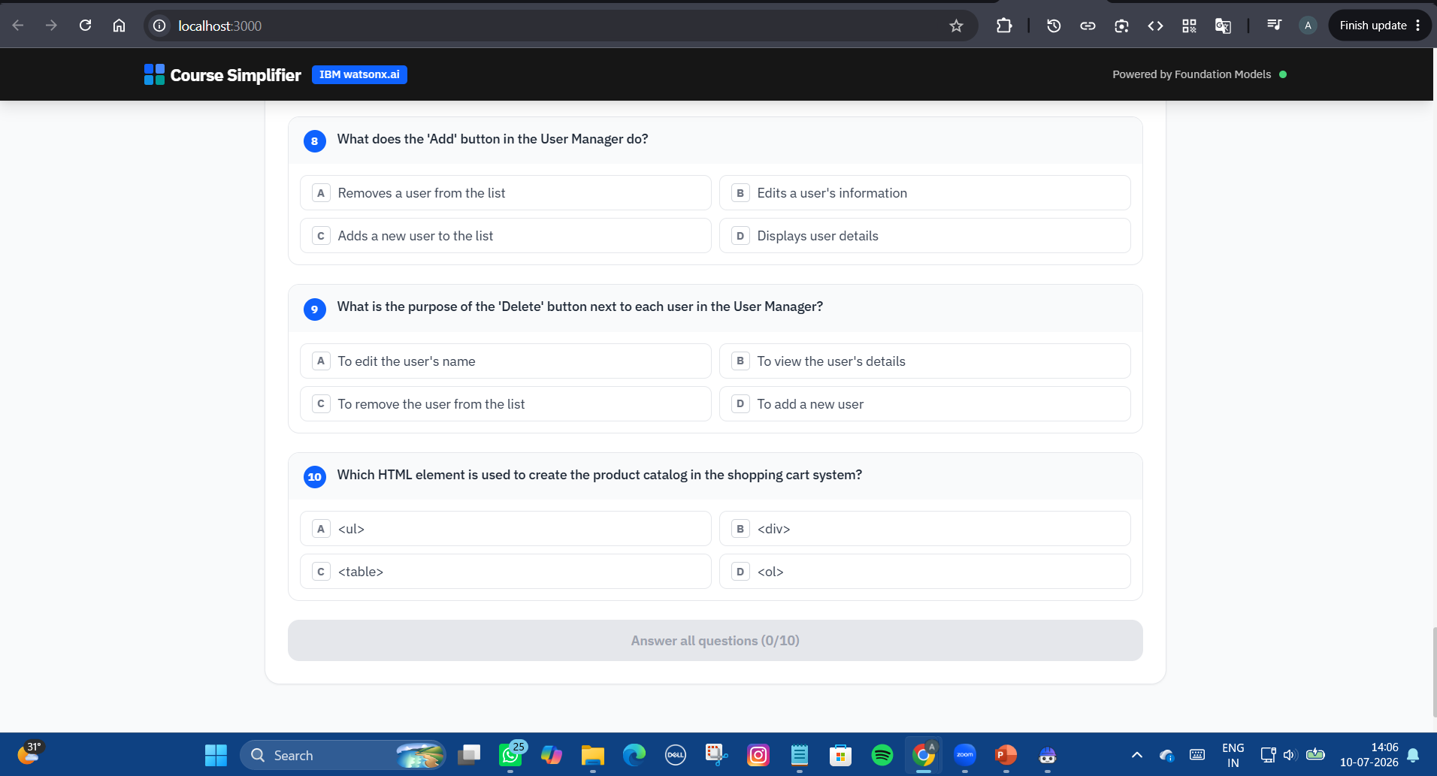
My Work

Slide 21
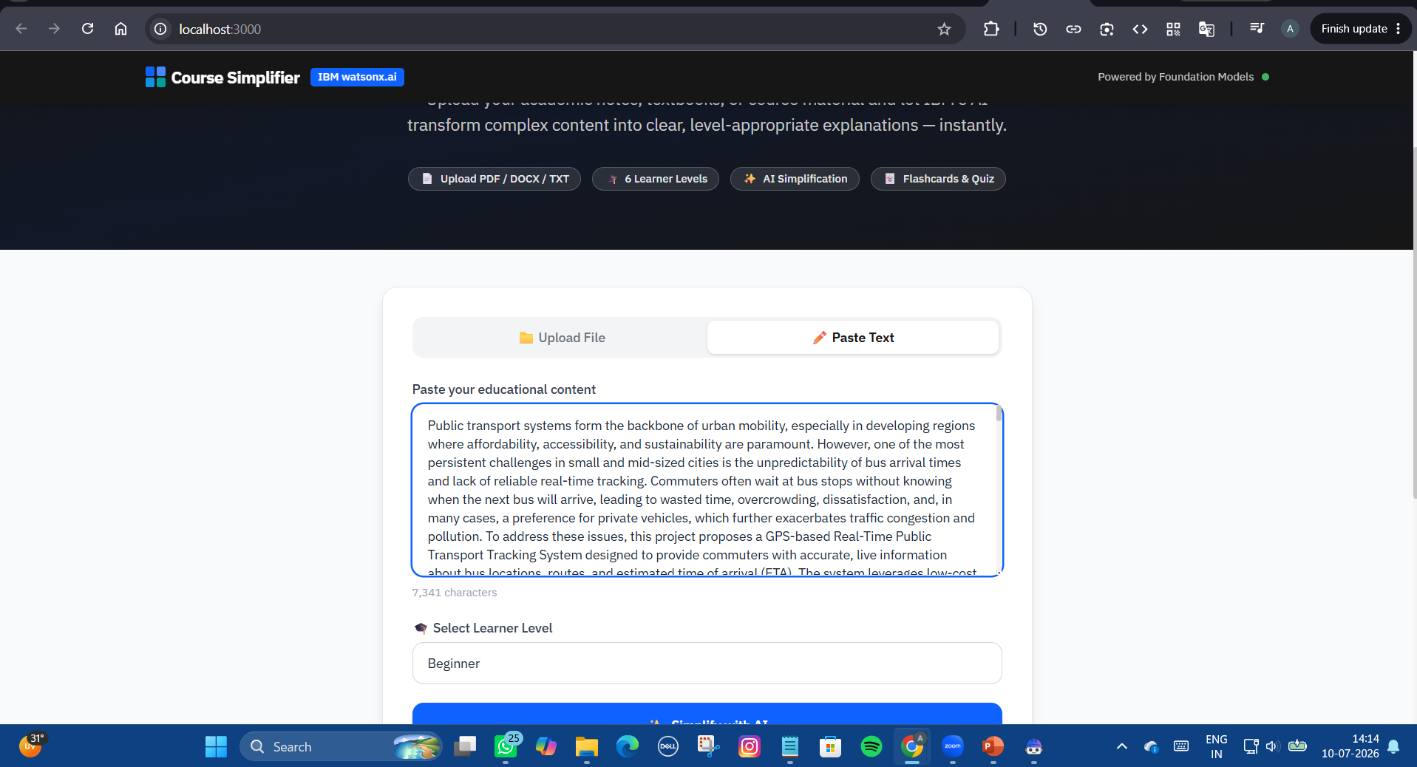
My Work

Slide 22
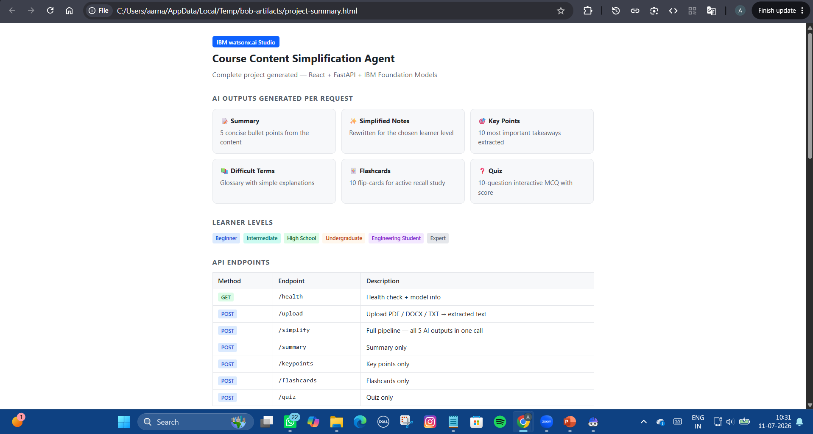
My Work

Slide 23
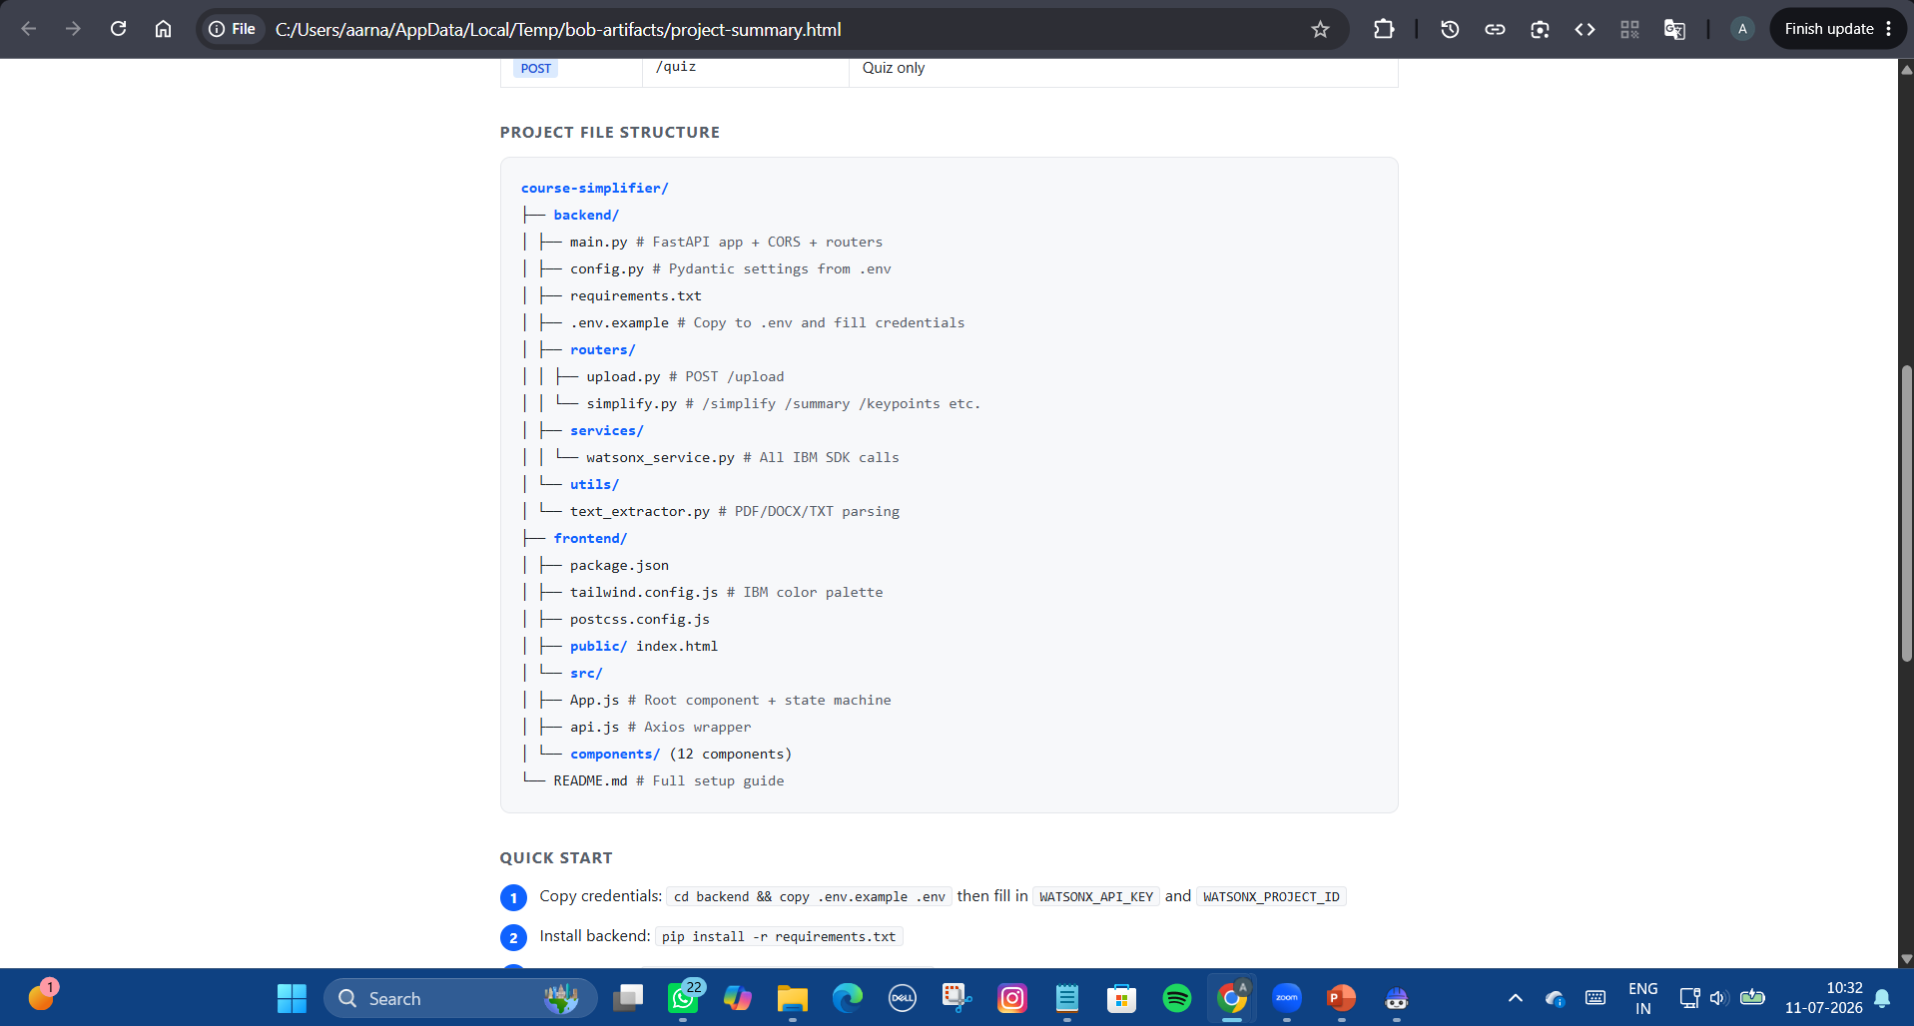
My Work

Slide 24
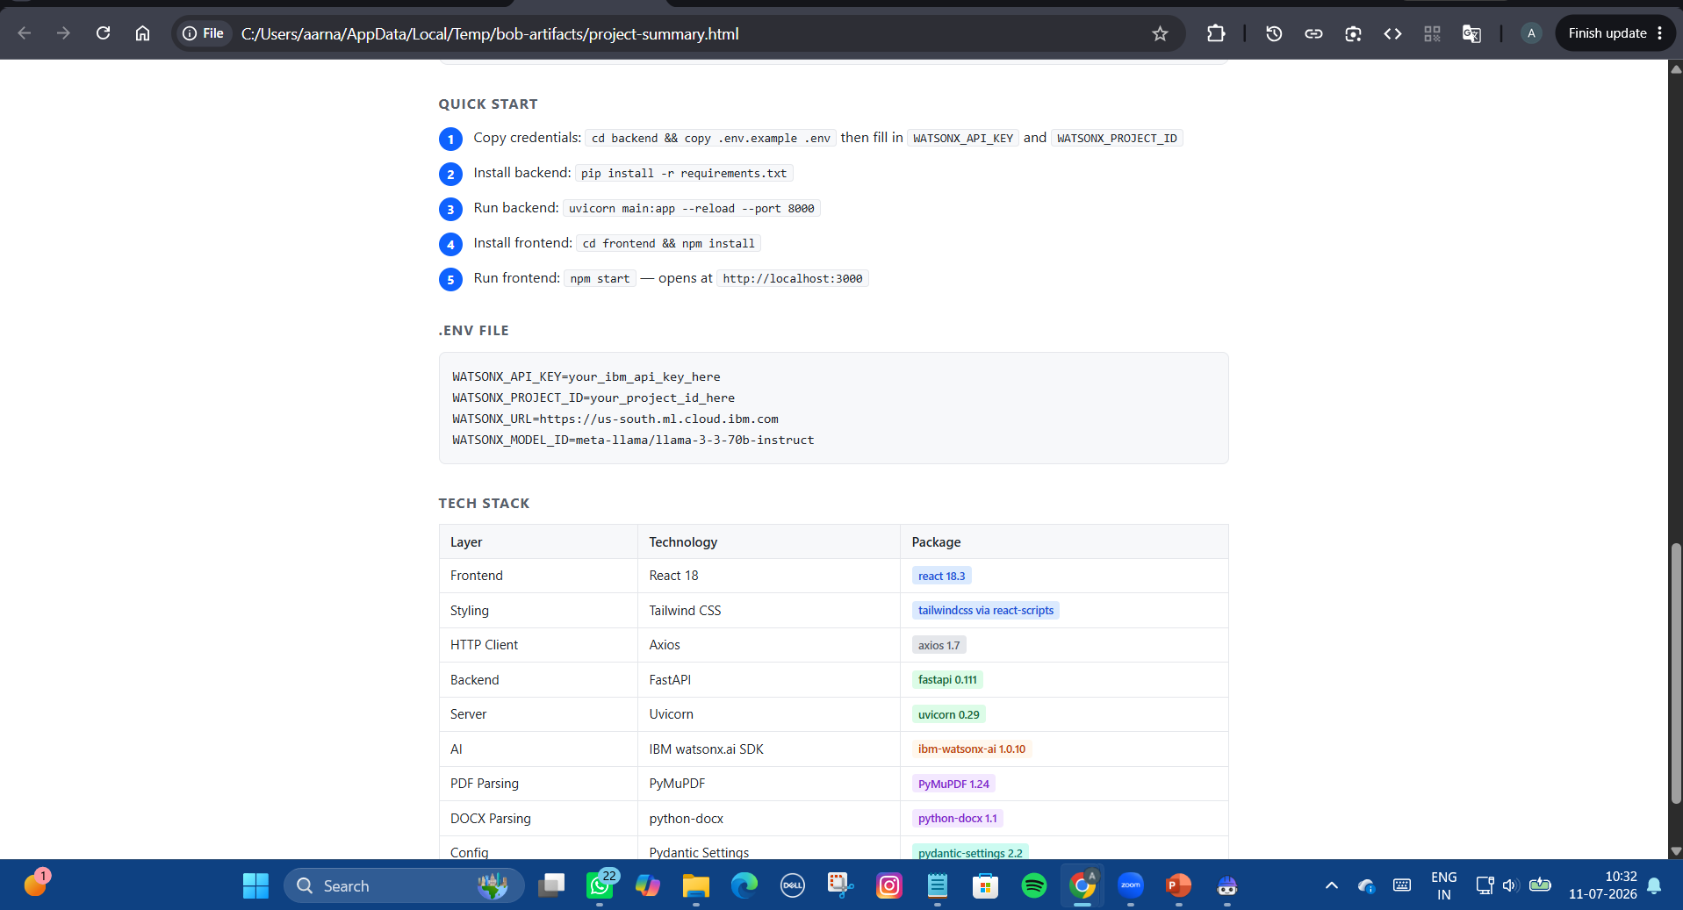
My Work

Slide 25
Novelty and Uniqueness
The proposed Course Content Simplification Agent introduces a personalized AI-driven learning experience by combining IBM watsonx.ai Studio with intelligent educational content generation.
Personalized Learning – Adapts educational content according to the learner's proficiency level.
Comprehensive Learning Support – Generates summaries, flashcards, quizzes, key points, and difficult term explanations from a single document.
Multi-Format Support – Accepts PDF, DOCX, TXT files, and direct text input.
AI-Based Content Simplification – Converts complex academic language into simple explanations without changing the original meaning.
Interactive Learning Experience – Helps students revise and self-assess using AI-generated study materials.
Scalable AI Solution – Built on IBM watsonx.ai Studio using Foundation Models for reliable and efficient educational assistance.
This makes the solution a smart, adaptive, and personalized AI learning assistant rather than a traditional content summarization tool.

Slide 26
Git Hub Link
· Please create public github repository (Enable Add README button while creating repository) with format –
Please test and Paste the working Github URL –
https://github.com/aarna2005/course-simplifier.git
Make sure you have Uploaded following three files into your github repository 1) app.json file , 2) yourproblemstatement.pdf file 3) your projectpresntation.pptx file 4)any other files
·

Slide 27
Future Scope
Multilingual Support – Extend the application to simplify educational content in multiple regional and international languages.
Voice-Based Learning – Integrate speech-to-text and text-to-speech features for interactive and accessible learning.
Personalized Learning Analytics – Track learner progress and recommend customized learning paths based on performance.
AI Tutor Assistant – Provide real-time doubt clarification and personalized guidance through an intelligent conversational assistant.
Mobile Application – Develop Android and iOS applications for convenient access to learning resources anytime and anywhere.
Visual Learning Support – Generate AI-based diagrams, flowcharts, and mind maps to enhance concept understanding.
LMS IOffline Learning – Enable access to previously processed educational content without requiring an internet connection.
ntegration – Integrate with Learning Management Systems such as Google Classroom, Moodle, and Microsoft Teams.

Slide 28
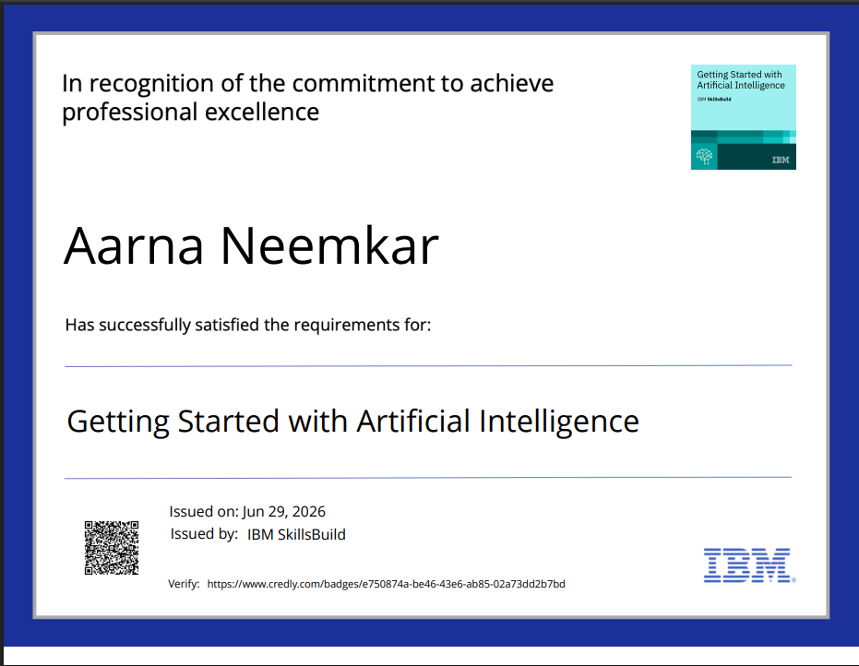
Certificates Earned:
Please add your credly certificate

Slide 29
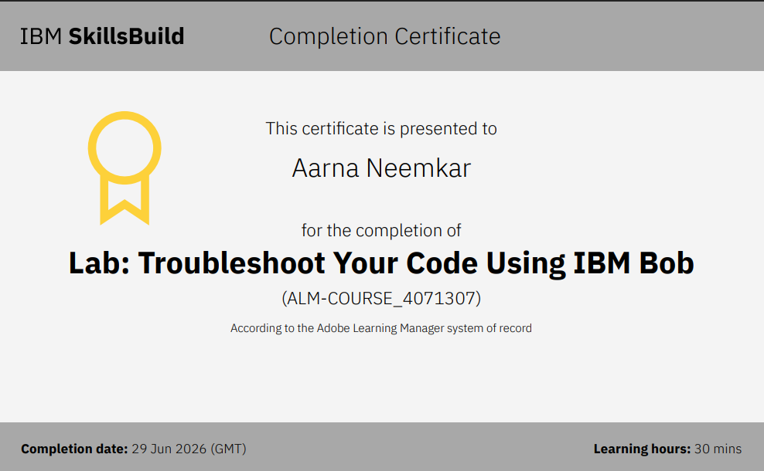
Certificates Earned:​
Add your IBM BOB Certificate

Slide 30


