Slide 1



SMART INDIA HACKATHON 2024
Problem Statement ID –1594
Problem Statement Title-Reducing pressure on cities Resources, Transportation and Logistics
Theme- Transportation and Logistics
PS Category- Software
Team ID-
Team Name- Crusaders

Slide 2
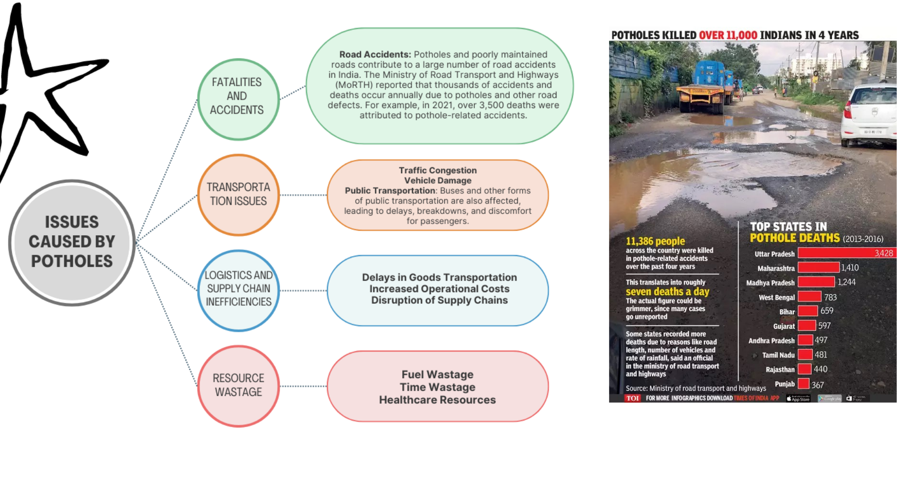
Problem Faced

Slide 3
Ideas to address the growing pressures on the city's resources, transport networks, and logistic infrastructure
Proposed Solution (Describe your Idea/Solution/Prototpe)
We are developing a platform that enables individuals to document and report potholes and damaged roads within their communities. Users will have the ability to upload photos and register complaints directly on the website. The uploaded photos will be accessible to both the general public and the concerned government authorities.
Our system will prioritize roads with a higher volume of complaints using sophisticated algorithms, prominently featuring them in the media section. This visibility will help exert pressure on relevant government authorities, encouraging them to address and repair these issues more swiftly.
By improving road conditions, our platform aims to enhance transportation and logistics efficiency. This will contribute to a reduction in traffic-related energy consumption, ultimately benefiting both the environment and the economy.
@SIH Idea submission- Template

Slide 4
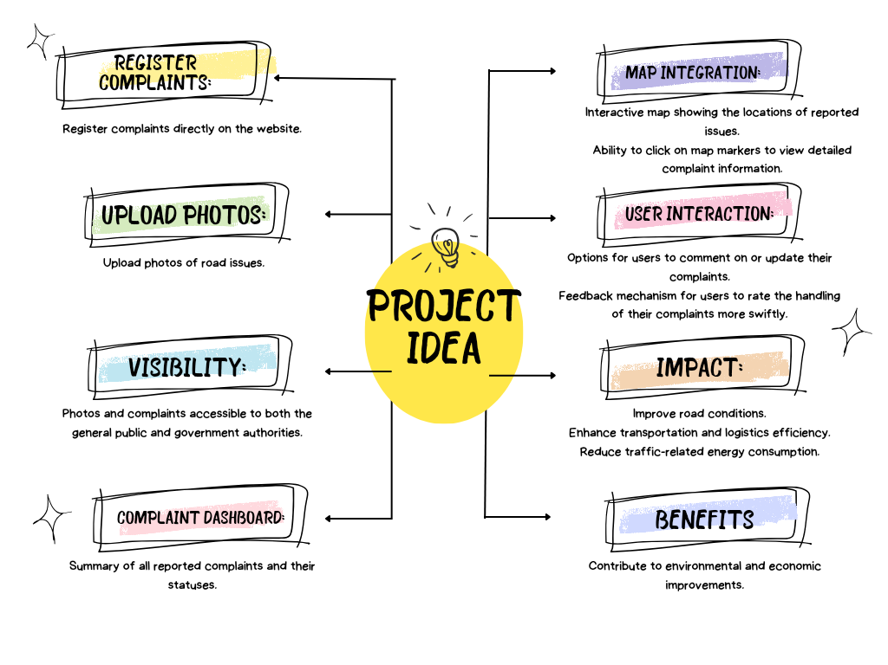

Slide 5
FEASIBILITY AND VIABILITY
Challenge: Handling user data, especially personal information and location data, poses significant privacy risks, including unauthorized access, data breaches, and non-compliance with regulations like GDPR.
Strategy:
Data Encryption: Implement strong encryption for data at rest and in transit to protect user information.
Access Control: Use role-based access control (RBAC) to limit who can access sensitive data.
Regular Audits and Compliance Checks: Conduct regular security audits and ensure compliance with data protection regulations. Employ legal counsel to stay aligned with international and local laws.
Challenge: Gaining a critical mass of users to contribute to and use the platform can be difficult, especially in areas with low internet penetration or among demographics less familiar with digital tools.
Strategy:
Marketing and Outreach Campaigns: Use targeted marketing campaigns to raise awareness, leveraging social media, community events, and partnerships with local influencers or organizations.
User Incentives: Offer incentives, such as rewards or recognition for frequent contributors, to encourage user engagement.
User Education: Provide tutorials, help centers, and customer support to educate users on how to effectively use the platform.
Challenge: Building and maintaining public trust is critical, especially when dealing with sensitive issues like government accountability and public infrastructure.
Strategy:
Transparency: Be transparent about how data is collected, used, and shared. Clearly communicate the platform’s purpose and the benefits to the community.
Community Engagement: Engage with the community through public forums, feedback loops, and user involvement in decision-making processes.
@SIH Idea submission- Template

Slide 6
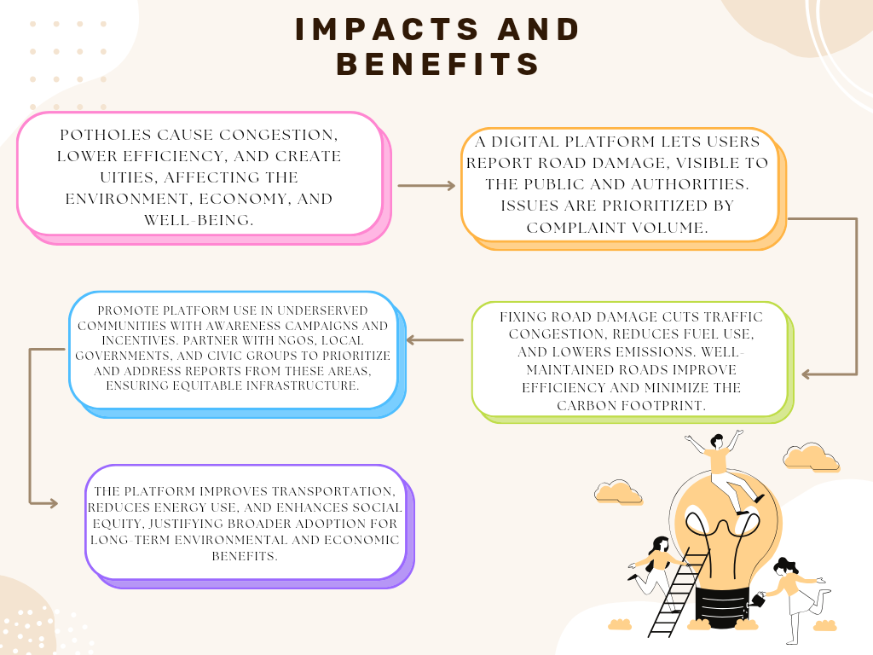

Slide 7
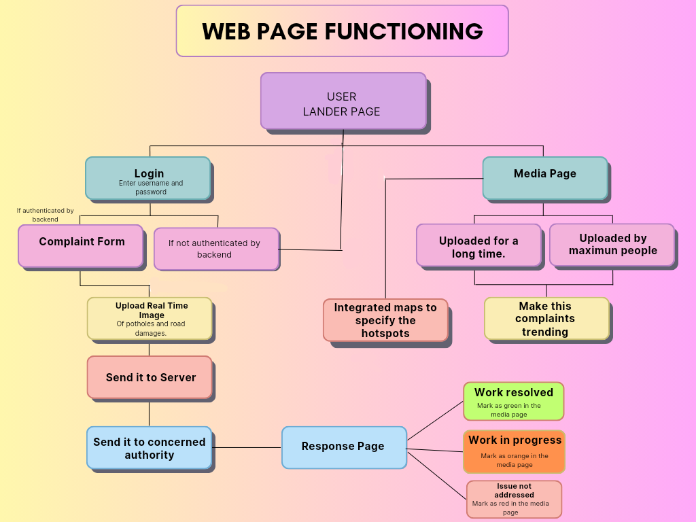

Slide 8
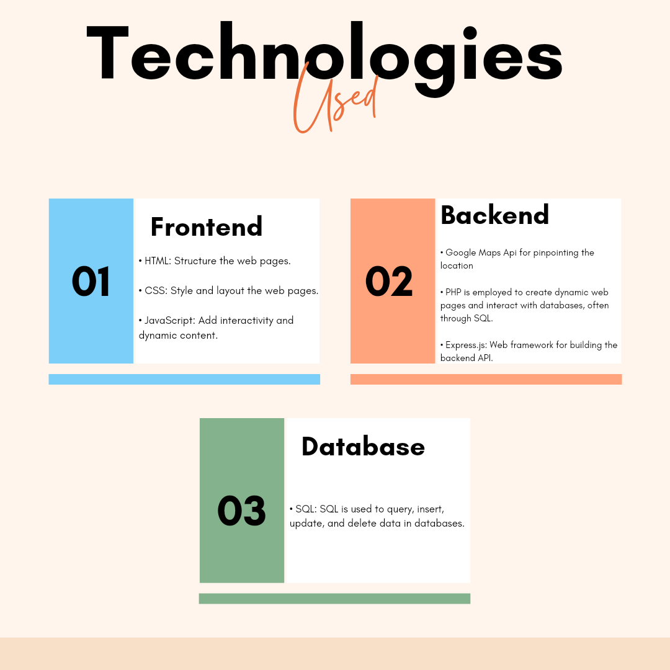

Slide 9
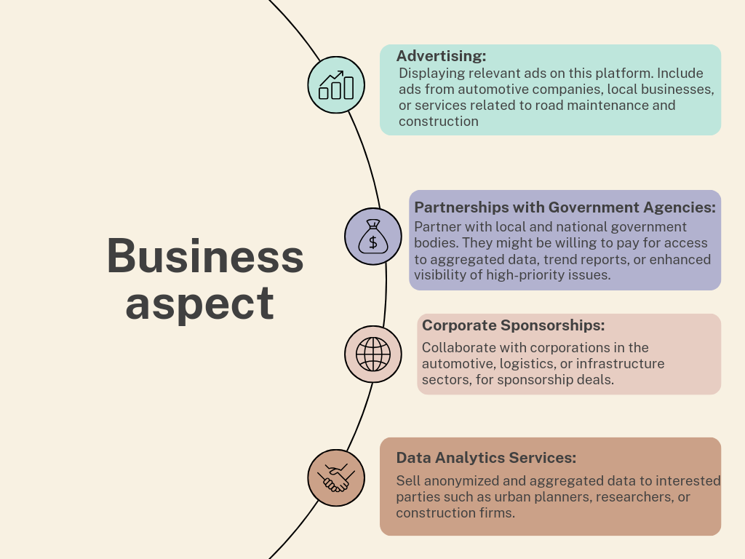

Slide 10
Problem: Determining which potholes require urgent attention can be challenging without clear, objective criteria.
Stereo Vision:
is a technique used to estimate the depth of objects in a scene by using two or more 2D images taken from slightly different viewpoints, similar to how human vision works. Here's a breakdown of how this method works:
Method Overview:
Capture Multiple Images: Take two or more images of the same scene from different angles or positions.
Find Corresponding Points: Identify the same points (features) in both images. These points must correspond to the same physical location in the scene.
Calculate Disparity: Measure the difference in the location of these corresponding points between the images, which is called disparity.
Estimate Depth: Use the disparity values to estimate the depth of each point in the scene. The larger the disparity, the closer the object is to the cameras; the smaller the disparity, the farther the object is.
IMPLEMENTATION:
OpenCV: A powerful library in computer vision and image processing that provides functions to implement stereo vision techniques.
cv2.StereoBM_create(): Creates a stereo block matcher, which is used for computing disparity maps.
cv2.findStereoCorrespondence(): Helps find corresponding points in stereo images and calculate disparity maps.

