Slide 1
Buffer Overflow and
Other Memory Corruption Attacks
CS 378
Vitaly Shmatikov
slide <number>

Slide 2
Reading Assignment
You MUST read Smashing the Stack for Fun and Profit to understand details of overflow exploits
  You will not be able to do the project without it!
Read Exploiting Format String Vulnerabilities
Read Blended Attacks by Chien and Szor to better understand buffer overflows and how they are used by Internet worms
Optional (but fun) reading: The Tao of Windows Buffer Overflow as taught by DilDog from the Cult of the Dead Cow
slide <number>

Slide 3

Morris Worm
Released in 1988 by Robert Morris
  Graduate student at Cornell,
  son of NSA chief scientist
  Convicted under Computer Fraud and Abuse Act, sentenced to 3 years of probation and 400 hours of community service
  Now a computer science professor at MIT
Morris claimed it was intended to harmlessly measure the Internet, but it created new copies as fast as it could and overloaded infected hosts
$10-100M worth of damage
slide <number>

Slide 4
Morris Worm and Buffer Overflow
We will look at the Morris worm in more detail when talking about worms and viruses
One of the worm’s propagation techniques was a buffer overflow attack against a vulnerable version of fingerd on VAX systems
  By sending special string to finger daemon, worm caused it to execute code creating a new worm copy
  Unable to determine remote OS version, worm also attacked fingerd on Suns running BSD, causing them to crash (instead of spawning a new copy)
slide <number>

Slide 5
Famous Buffer Overflow Attacks
Morris worm (1988): overflow in fingerd
  6,000 machines infected (10% of existing Internet)
CodeRed (2001): overflow in MS-IIS server
  300,000 machines infected in 14 hours
SQL Slammer (2003): overflow in MS-SQL server
  75,000 machines infected in 10 minutes (!!)
Sasser (2004): overflow in Windows LSASS
  Around 500,000 machines infected
Conficker (2008-09): overflow in Windows Server
  Around 10 million machines infected (estimates vary)
Responsible for user
authentication in Windows
slide <number>

Slide 6
Why Are We Insecure?
[Chen et al. 2005]
126 CERT security advisories (2000-2004)
Of these, 87 are memory corruption vulnerabilities
73 are in applications providing remote services
  13 in HTTP servers, 7 in database services, 6 in remote login services, 4 in mail services, 3 in FTP services
Most exploits involve illegitimate control transfers
  Jumps to injected attack code, return-to-libc, etc.
  Therefore, most defenses focus on control-flow security
But exploits can also target configurations, user data, decision-making values
slide <number>

Slide 7
Memory Exploits
Buffer is a data storage area inside computer memory (stack or heap)
  Intended to hold pre-defined amount of data
Memory-corruption attacks exploit unsafe memory operations to perform illegitimate memory writes
  Example: attacker supplies executable code as “data,” overwrites saved instruction pointer with its address
Attack can exploit any memory operation
  Pointer assignment, format strings, memory allocation, function pointers, calls to library routines
  Attacks need not involve injected code!
slide <number>

Slide 8
Stack Buffers
Suppose Web server contains this function
void func(char *str) {
char buf[126];
strcpy(buf,str);
}
When this function is invoked, a new frame with local variables is pushed onto the stack
Allocate local buffer
(126 bytes reserved on stack)
Copy argument into local buffer
Stack grows this way
buf
sfp
ret
addr
str
Frame of the
calling function
Top of
stack
Local variables
Pointer to
previous
frame
Arguments
Execute code
at this address
after func() finishes
slide <number>

Slide 9
What If Buffer is Overstuffed?
Memory pointed to by str is copied onto stack…
void func(char *str) {
char buf[126];
strcpy(buf,str);
}
If a string longer than 126 bytes is copied into buffer, it will overwrite adjacent stack locations
strcpy does NOT check whether the string
at *str contains fewer than 126 characters
buf
overflow
str
Frame of the
calling function
Top of
stack
This will be interpreted
as return address!
slide <number>

Slide 10
Executing Attack Code
Suppose buffer contains attacker-created string
  For example, *str points to a string received from the network as the URL
When function exits, code in the buffer will be
executed, giving attacker a shell
  Root shell if the victim program is setuid root
code
ret
str
Top of
stack
Frame of the
calling function
Attacker puts actual assembly
instructions into his input string, e.g.,
binary code of execve(“/bin/sh”)
In the overflow, a pointer back into the buffer
appears in the location where the program
expects to find return address
slide <number>

Slide 11
Stack Corruption (Redux)
int bar (int val1) {
int val2;
foo (a_function_pointer);
}
val1
val2
arguments (funcp)
return address
Saved Frame Pointer
pointer var (ptr)
buffer (buf)
String grows
Attacker-controlled memory
int foo (void (*funcp)()) {
char* ptr = point_to_an_array;
char buf[128];
gets (buf);
strncpy(ptr, buf, 8);
(*funcp)();
}
Most popular target
Stack grows
slide <number>

Slide 12
Attack #1: Return Address
args (funcp)
return address
SFP
pointer var (ptr)
buffer (buf)
② set stack pointers to return to a dangerous library function
Attack code
“/bin/sh”
①
system()
Change the return address to point to the attack code. After the function returns, control is transferred to the attack code.
… or return-to-libc: use existing instructions in the code segment such as system(), exec(), etc. as the attack code.
slide <number>

Slide 13
Basic Stack Code Injection
Executable attack code is stored on stack, inside the buffer containing attacker’s string
  Stack memory is supposed to contain only data, but…
For the basic stack-smashing attack, overflow portion of the buffer must contain correct address of attack code in the RET position
  The value in the RET position must point to the beginning of attack assembly code in the buffer
    Otherwise application will crash with segmentation violation
  Attacker must correctly guess in which stack position his buffer will be when the function is called
slide <number>

Slide 14
Cause: No Range Checking
strcpy does not check input size
  strcpy(buf, str) simply copies memory contents into buf starting from *str until “\0” is encountered, ignoring the size of area allocated to buf
Standard C library functions are all unsafe
  strcpy(char *dest, const char *src)
  strcat(char *dest, const char *src)
  gets(char *s)
  scanf(const char *format, …)
  printf(const char *format, …)
slide <number>

Slide 15
Does Range Checking Help?
strncpy(char *dest, const char *src, size_t n)
  If strncpy is used instead of strcpy, no more than n characters will be copied from *src to *dest
  Programmer has to supply the right value of n
Potential overflow in htpasswd.c (Apache 1.3):
… strcpy(record,user);
strcat(record,”:”);
strcat(record,cpw); …
Published “fix” (do you see the problem?):
… strncpy(record,user,MAX_STRING_LEN-1);
strcat(record,”:”);
strncat(record,cpw,MAX_STRING_LEN-1); …
Copies username (“user”) into buffer (“record”),
then appends “:” and hashed password (“cpw”)
slide <number>

Slide 16
Misuse of strncpy in htpasswd “Fix”
Published “fix” for Apache htpasswd overflow:
… strncpy(record,user,MAX_STRING_LEN-1);
strcat(record,”:”);
strncat(record,cpw,MAX_STRING_LEN-1); …
MAX_STRING_LEN bytes allocated for record buffer
contents of *user
:
contents of *cpw
Put up to MAX_STRING_LEN-1
characters into buffer
Put “:”
Again put up to MAX_STRING_LEN-1
characters into buffer
slide <number>

Slide 17
Attack #2: Pointer Variables
args (funcp)
return address
SFP
pointer var (ptr)
buffer (buf)
Attack code
Global Offset Table
Function pointer
Change a function pointer to point to the attack code
Any memory, even not in the stack, can be modified by the statement that stores a value into the compromised pointer
strcpy(buf, str);
*ptr = buf[0];
slide <number>

Slide 18
Off-By-One Overflow
Home-brewed range-checking string copy
void notSoSafeCopy(char *input) {
char buffer[512]; int i;
for (i=0; i<=512; i++)
buffer[i] = input[i];
}
void main(int argc, char *argv[]) {
if (argc==2)
notSoSafeCopy(argv[1]);
}
This will copy 513
characters into
buffer. Oops!
1-byte overflow: can’t change RET, but can change pointer to previous stack frame
  On little-endian architecture, make it point into buffer
  Caller’s RET will be read from buffer!
slide <number>

Slide 19
Attack #3: Frame Pointer
args (funcp)
return address
SFP
pointer var (ptr)
buffer (buf)
Fake return address
Fake SFP
Attack code
Arranged like a
real frame
Change the caller’s saved frame pointer to point to attack-controlled memory. Caller’s return address will be read from this memory.
slide <number>

Slide 20
Heap Overflow
Overflowing buffers on heap can change pointers that point to important data
  Sometimes can also transfer execution to attack code
    Example: December 2008 attack on XML parser in Internet Explorer 7 - see http://isc.sans.org/diary.html?storyid=5458
Illegitimate privilege elevation: if program with overflow has sysadm/root rights, attacker can use it to write into a normally inaccessible file
  Example: replace a filename pointer with a pointer into a memory location containing name of a system file
    Instead of temporary file, write into AUTOEXEC.BAT
slide <number>

Slide 21
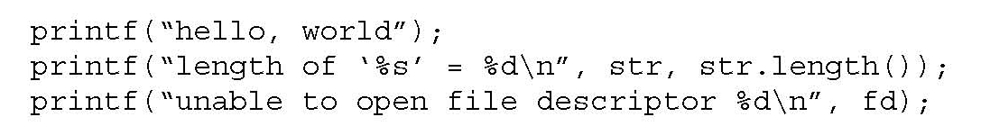
Variable Arguments in C
In C, can define a function with a variable number of arguments
  Example: void printf(const char* format, …)
Examples of usage:
Format specification encoded by
special % characters
%d,%i,%o,%u,%x,%X – integer argument
%s – string argument
%p – pointer argument (void *)
Several others
slide <number>

Slide 22
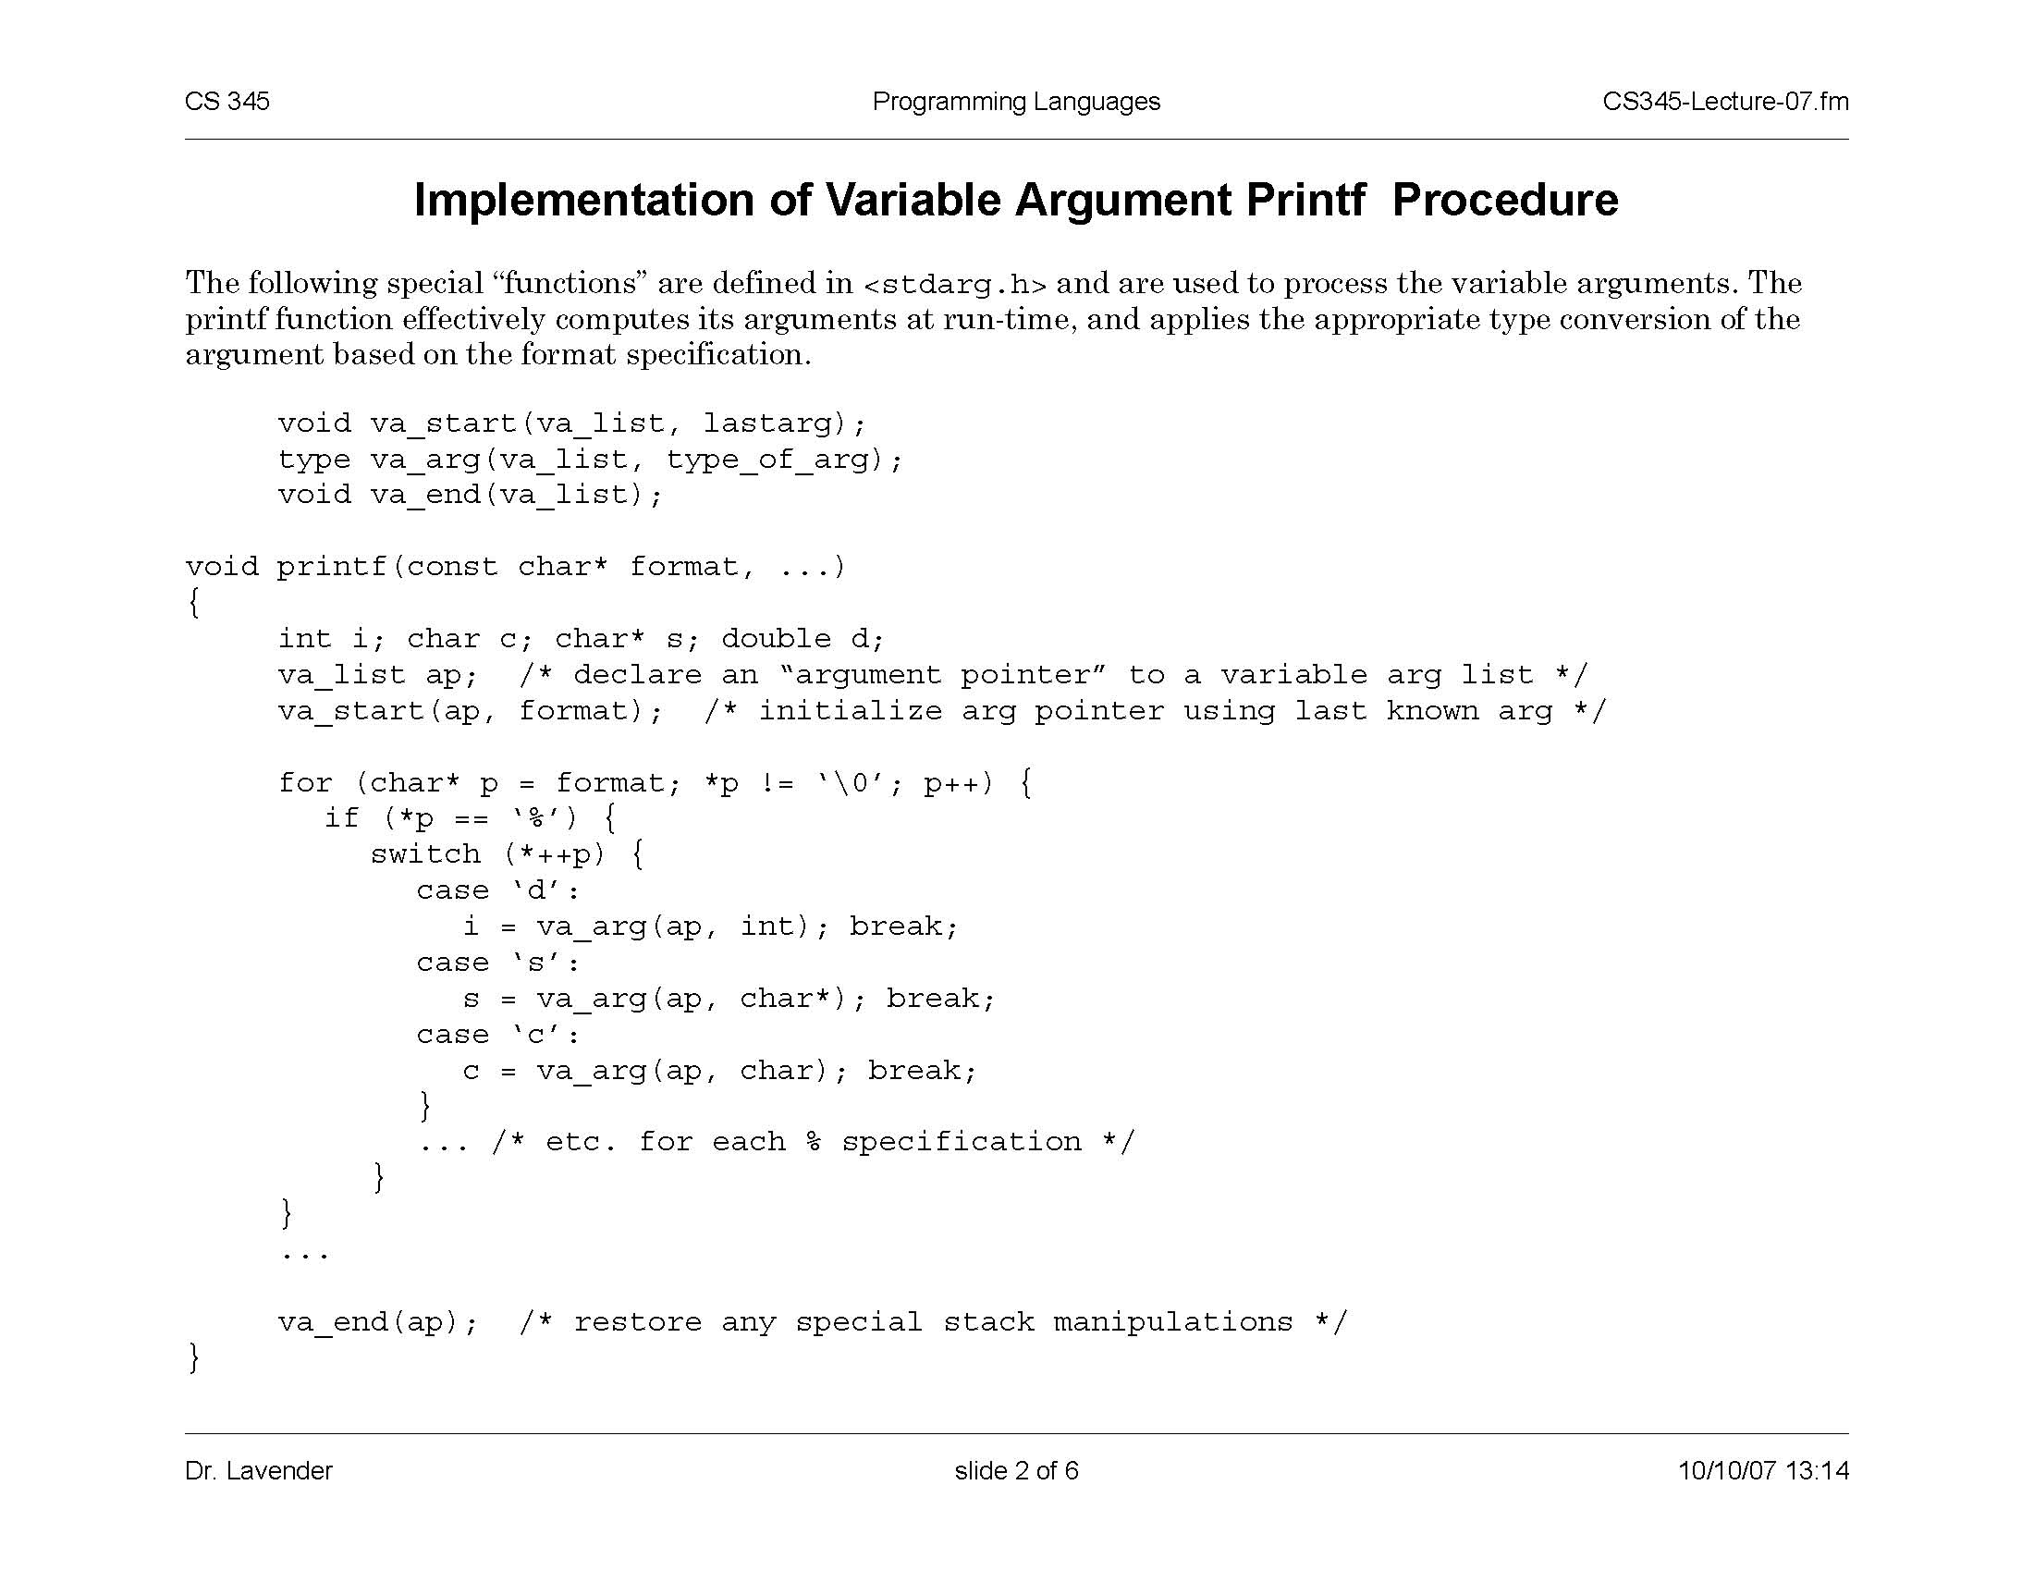
Implementation of Variable Args
Special functions va_start, va_arg, va_end compute arguments at run-time
printf has an internal
stack pointer
slide <number>

Slide 23
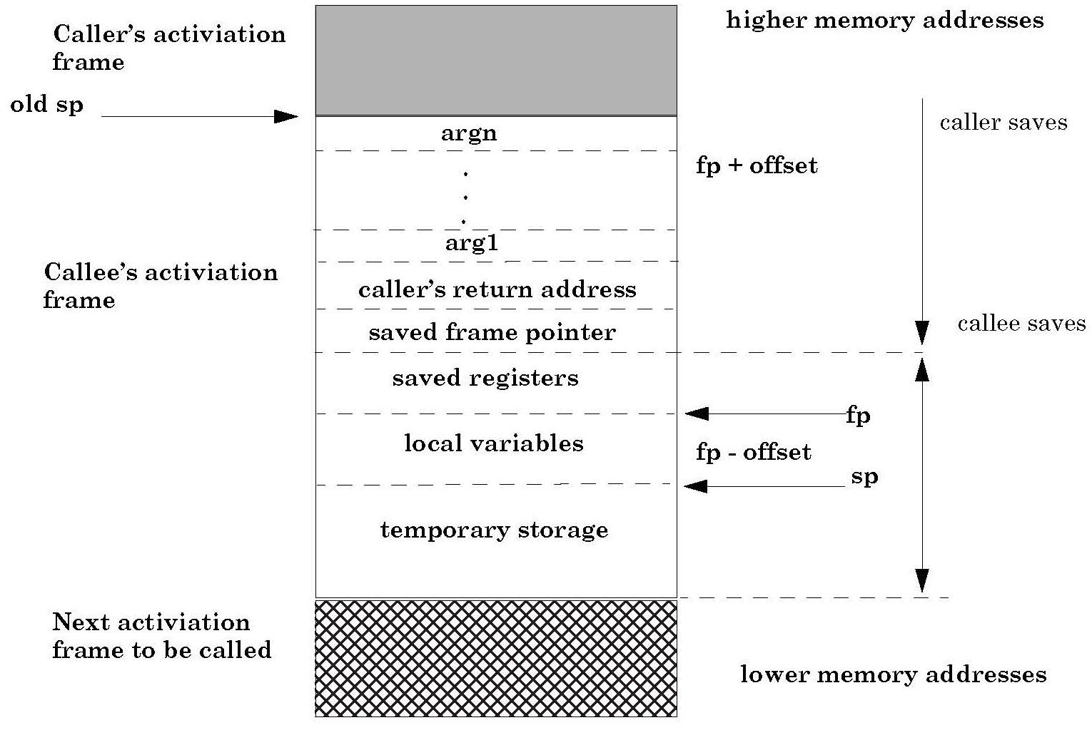
Frame with Variable Args
va_arg(ap,type)
retrieves next arg
from offset ap
va_start computes
location on the stack
past last statically
known argument
slide <number>

Slide 24
Format Strings in C
Proper use of printf format string:
… int foo=1234;
printf(“foo = %d in decimal, %X in hex”,foo,foo); …
    This will print
    foo = 1234 in decimal, 4D2 in hex
Sloppy use of printf format string:
… char buf[13]=“Hello, world!”;
printf(buf);
// should’ve used printf(“%s”, buf); …
    If the buffer contains a format symbol starting with %, location
    pointed to by printf’s internal stack pointer will be interpreted
    as an argument of printf. This can be exploited to move
    printf’s internal stack pointer! (how?)
slide <number>

Slide 25
Writing Stack with Format Strings
%n format symbol tells printf to write the number of characters that have been printed
… printf(“Overflow this!%n”,&myVar); …
    Argument of printf is interpeted as destination address
    This writes 14 into myVar (“Overflow this!” has 14 characters)
What if printf does not have an argument?
… char buf[16]=“Overflow this!%n”;
printf(buf); …
    Stack location pointed to by printf’s internal stack pointer will be interpreted as address into which the number of characters will be written!
slide <number>

Slide 26
Using %n to Mung Return Address
This portion contains
enough % symbols
to advance printf’s
internal stack pointer
Buffer with attacker-supplied
input string
“… attackString%n”, attack code
&RET
RET
Number of characters in
attackString must be
equal to … what?
Overwrite location under printf’s stack
pointer with RET address;
printf(buffer) will write the number of
characters in attackString into RET
Return
execution to
this address
C has a concise way of printing multiple symbols: %Mx will print exactly M bytes (taking them from the stack). If attackString contains enough “%Mx” so that its total length is equal to the most significant byte of the address of the attack code, this byte will be written into &RET.
Repeat three times (four “%n” in total) to write into &RET+1, &RET+2, &RET+3, thus replacing RET with the address of attack code.
See “Exploiting Format String Vulnerabilities” for details
slide <number>

Slide 27
Bad Format Strings in the Wild
Chen and Wagner study (2007)
  “Large-scale analysis of format string vulnerabilities in Debian Linux”
Analyzed a large fraction of the Debian Linux 3.1 distribution using CQual, a static taint analysis tool
  92 million lines of C and C++ code
  Objective: find “tainted” format strings (controlled by user, yet used in printf and similar functions)
Taint violations reported in 1533 packages
Estimated 85% are real format string bugs
  (why not 100%?)
slide <number>

Slide 28
Other Targets of Memory Exploits
Configuration parameters
  Example: directory names that confine remotely invoked programs to a portion of the file system
Pointers to names of system programs
  Example: replace the name of a harmless script with an interactive shell
  This is not the same as return-to-libc (why?)
Branch conditions in input validation code
slide <number>

Slide 29
Example: Web Server Security
CGI scripts are executables on Web server that can be executed by remote user via a special URL
  http://www.server.com/cgi-bin/SomeProgram
Don’t want remote users executing arbitrary programs with Web server’s privileges
  … especially if the Web server runs with root privileges
  Need to restrict which programs can be executed
CGI-BIN is the directory name which is always prepended to the name of the CGI script
  If CGI-BIN is /usr/local/httpd/cgi-bin, the above URL will execute /usr/local/httpd/cgi-bin/SomeProgram
slide <number>

Slide 30
Exploiting Null HTTP Heap Overflow
Null HTTPD had a heap overflow vulnerability
  When corrupted buffer is freed, an overflown value is copied to a location whose address is read from an overflown memory area
  This enables attacker to write an arbitrary value into a memory location of his choice
Standard exploit: write address of attack code into the table containing addresses of library functions
  Transfers control to attacker’s code next time the library function is called
Alternative: overwrite the value of CGI-BIN
slide <number>

Slide 31
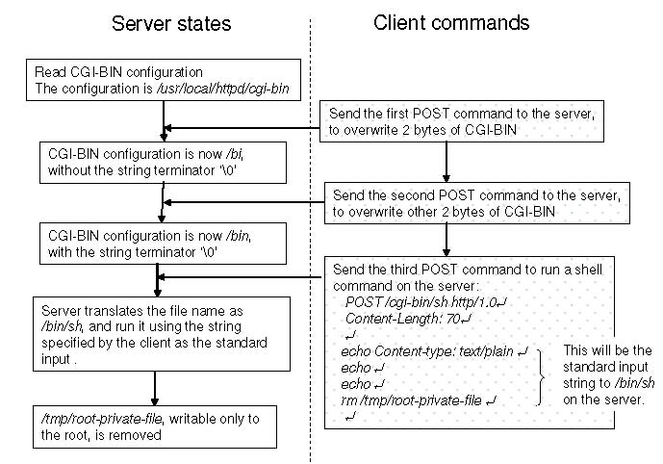
Null HTTP CGI-BIN Exploit
slide <number>

Slide 32
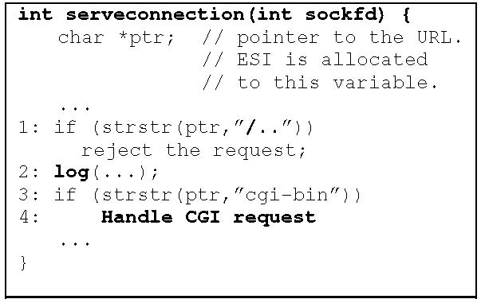
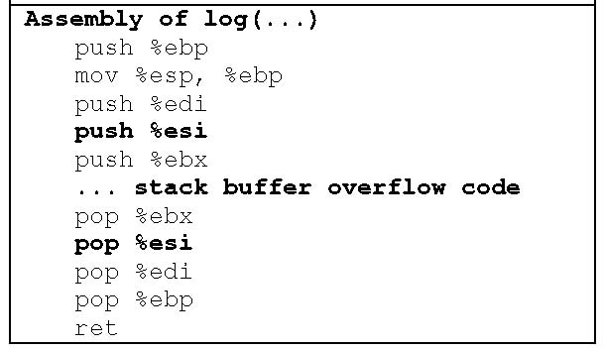
Another Web Server: GHTTPD
Check that URL doesn’t contain “/..”
Register containing pointer to URL
is pushed onto stack…
… overflown
At this point, overflown *ptr may point
to a string containing “/..”
… and read from stack
Value at *ptr changes after it was checked
but before it was used! (This is a TOCTTOU attack)
slide <number>

Slide 33
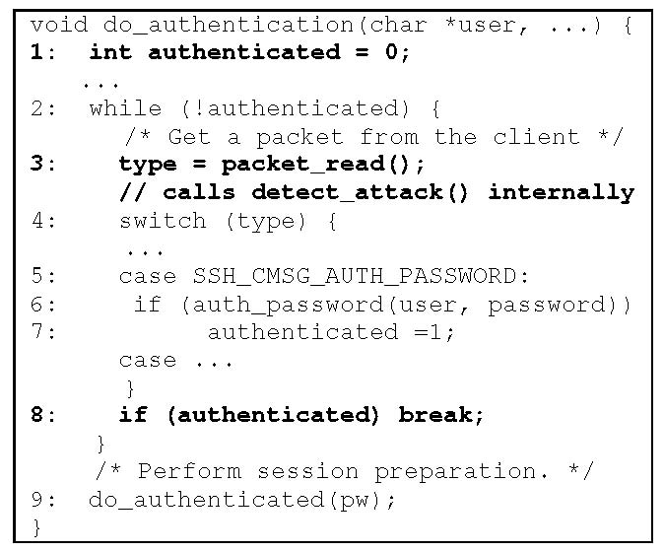
SSH Authentication Code
write 1 here
Loop until one of
the authentication
methods succeeds
detect_attack() prevents
checksum attack on SSH1…
…and also contains an
overflow bug which permits
the attacker to put any value
into any memory location
Break out of authentication
loop without authenticating
properly
slide <number>

Slide 34
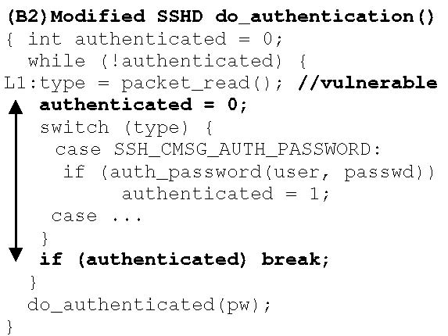
Reducing Lifetime of Critical Data
Reset flag here, right before
doing the checks
slide <number>

Slide 35
Two’s Complement
Binary representation of negative integers
Represent X (where X<0) as 2^{N}-|X|
  N is word size (e.g., 32 bits on x86 architecture)
1
0
0
0
0
…
0
1
2³¹-1
0
1
1
1
1
1
…
-1
1
1
1
1
1
1
…
2³¹ ??
-2
1
1
1
1
1
0
…
-2³¹
1
0
0
0
0
0
…
slide <number>

Slide 36
Integer Overflow
static int getpeername1(p, uap, compat) {
// In FreeBSD kernel, retrieves address of peer to which a socket is connected
…
struct sockaddr *sa;
…
len = MIN(len, sa->sa_len);
… copyout(sa, (caddr_t)uap->asa, (u_int)len);
…
}
Checks that “len” is not too big
Negative “len” will always pass this check…
… interpreted as a huge
unsigned integer here
Copies “len” bytes from
kernel memory to user space
… will copy up to 4G of
kernel memory
slide <number>

Slide 37


ActionScript Exploit
[Dowd]
ActionScript 3 is a scripting language for Flash
  Basically, JavaScript for Flash animations
  For performance, Flash 9 and higher compiles scripts into bytecode for ActionScript Virtual Machine (AVM2)
Flash plugins are installed on millions of browsers, thus a perfect target for attack
  Different Flash binaries are used for Internet Explorer and Firefox, but this turns out not to matter
Exploit published in April 2008
slide <number>

Slide 38
Processing SWF Scene Records (1)
Code that allocates memory
for scene records:
Supplied as part of SWF file from
potentially malicious website
call SWF_GetEncodedInteger ; Scene Count
mov edi, [ebp+arg_0]
mov [esi+4], eax
mov ecx, [ebx+8]
sub ecx, [ebx+4]
cmp eax, ecx
jg loc_30087BB4
…
push eax
call mem_Calloc
How much memory is neded to store scenes
Total size of the buffer
Offset into the buffer
Is there enough memory in the buffer?
(signed comparison)
Tell mem_Calloc how many bytes to allocate
Interprets its argument as unsigned integer
What if scene count is negative?
mem_Calloc fails (why?) and
returns NULL
slide <number>

Slide 39
Processing SWF Scene Records (2)
Scene records are copied as follows:
  Start with pointer P returned by allocator
  Loop through and copy scenes until count ≤ 0
  Copy frame count into P + offset, where offset is determined by scene count
    Frame count also comes from the SWF file
    It is a “short” (16-bit) value, but written as a 32-bit DWORD
Attacker gains the ability to write one short value into any location in memory (why?)
  … subject to some restrictions (see paper)
  But this is not enough to hijack control directly (why?)
slide <number>

Slide 40
ActionScript Virtual Machine (AVM2)
Register-based VM
  Bytecode instructions write and read from “registers”
“Registers”, operand stack, scope stack allocated on the same runtime stack as used by Flash itself
  “Registers” are mapped to locations on the stack and accessed by index (converted into memory offset)
  This is potentially dangerous (why?)
Malicious Flash script could hijack browser’s host
  Malicious bytecode can write into any location on the stack by supplying a fake register index
  This would be enough to take control (how?)
slide <number>

Slide 41
AVM2 Verifier
ActionScript code is verified before execution
All bytecodes must be valid
  Throw an exception if encountering an invalid bytecode
All register accesses correspond to valid locations on the stack to which registers are mapped
For every instruction, calculate the number of operands, ensure that operands of correct type will be on the stack when it is executed
All values are stored with correct type information
  Encoded in bottom 3 bits
slide <number>

Slide 42
Relevant Verifier Code
…
if(AS3_argmask[opCode] == 0xFF) {
… throw exception …
}
…
opcode_getArgs(…)
…
void opcode_getArgs(…) {
DWORD mask=AS3_argmask[opCode];
…
if(mask <=0) { … return … }
… *arg_dword1 = SWF_GetEncodedInteger(&ptr);
if(mask>1) *arg_dword2 = SWF_GetEncodedInteger(&ptr);
}
Invalid bytecode
Number of operands for each opcode
is defined in AS3_argmask array
Determine operands
slide <number>

Slide 43
Executing Invalid Opcodes
If interpreter encounters an invalid opcode, it silently skips it and continues executing
  Doesn’t really matter because this can’t happen
    Famous last words…
  AS3 code is executed only after it has been verified, and verifier throws an exception on invalid bytecode
But if we could somehow trick the verifier…
  Bytes after the opcode are treated as data (operands) by the verifier, but as executable code by interpreter
  This is an example of a TOCTTOU (time-of-check-to-time-of-use) vulnerability
slide <number>

Slide 44

Breaking AVM2 Verifier
slide <number>

Slide 45
Breaking AVM2 Verifier
Pick an invalid opcode
Use the ability to write into arbitrary memory to change the AS3_argmask of that opcode from 0xFF to something else
AVM2 verifier will treat it as normal opcode and skip subsequent bytes as operands
  How many? This is also determined by AS3_argmask!
AVM2 interpreter, however, will skip the invalid opcode and execute those bytes
Can now execute unverified ActionScript code
slide <number>

Slide 46
Further Complications
Can execute only a few unverified bytecodes at a time (why?)
  Use multiple “marker” opcodes with overwritten masks
Cannot directly overwrite saved EIP on the evaluation stack with the address of shellcode because 3 bits are clobbered by type information
  Stack contains a pointer to current bytecode (codePtr)
  Move it from one “register” to another, overwrite EIP
  Bytecode stream pointed to by codePtr contains a jump to the actual shellcode
Read the paper for more details
slide <number>

Slide 47
Buffer Overflow: Causes and Cures
Typical memory exploit involves code injection
  Put malicious code at a predictable location in memory, usually masquerading as data
  Trick vulnerable program into passing control to it
    Overwrite saved EIP, function callback pointer, etc.
Idea: prevent execution of untrusted code
  Make stack and other data areas non-executable
    Note: messes up useful functionality (e.g., ActionScript)
  Digitally sign all code
  Ensure that all control transfers are into a trusted, approved code image
slide <number>

Slide 48
W⊕X / DEP
Mark all writeable memory locations as non-executable
  Example: Microsoft’s Data Execution Prevention (DEP)
  This blocks (almost) all code injection exploits
Hardware support
  AMD “NX” bit, Intel “XD” bit (in post-2004 CPUs)
  Makes memory page non-executable
Widely deployed
  Windows (since XP SP2), Linux (via PaX patches), OpenBSD, OS X (since 10.5)
slide <number>

Slide 49
What Does W⊕X Not Prevent?
Can still corrupt stack …
  … or function pointers or critical data on the heap, but that’s not important right now
As long as “saved EIP” points into existing code, W⊕X protection will not block control transfer
This is the basis of return-to-libc exploits
  Overwrite saved EIP with address of any library routine, arrange stack to look like arguments
Does not look like a huge threat
  Attacker cannot execute arbitrary code
    … especially if system() is not available
slide <number>

Slide 50
return-to-libc on Steroids
Overwritten saved EIP need not point to the beginning of a library routine
Any existing instruction in the code image is fine
  Will execute the sequence starting from this instruction
What if instruction sequence contains RET?
  Execution will be transferred… to where?
  Read the word pointed to by stack pointer (ESP)
    Guess what? Its value is under attacker’s control! (why?)
  Use it as the new value for EIP
    Now control is transferred to an address of attacker’s choice!
  Increment ESP to point to the next word on the stack
slide <number>

Slide 51

Chaining RETs for Fun and Profit
[Shacham et al]
Can chain together sequences ending in RET
  Krahmer, “x86-64 buffer overflow exploits and the borrowed code chunks exploitation technique” (2005)
What is this good for?
Answer [Shacham et al.]: everything
  Turing-complete language
  Build “gadgets” for load-store, arithmetic,
  logic, control flow, system calls
  Attack can perform arbitrary computation
  using no injected code at all!
slide <number>

Slide 52
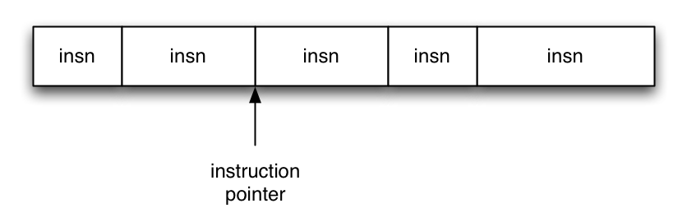
Ordinary Programming
Instruction pointer (EIP) determines which instruction to fetch and execute
Once processor has executed the instruction, it automatically increments EIP to next instruction
Control flow by changing value of EIP
slide <number>

Slide 53
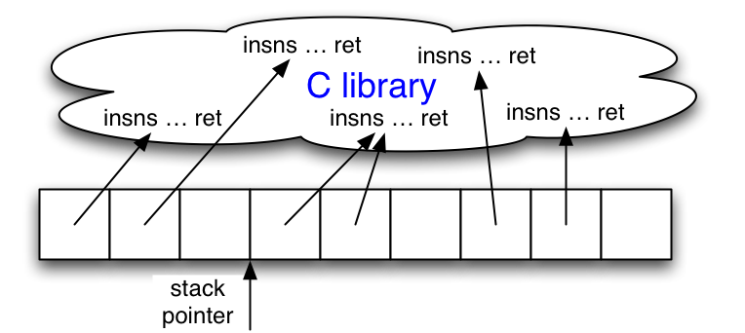
Return-Oriented Programming
Stack pointer (ESP) determines which instruction sequence to fetch and execute
Processor doesn’t automatically increment ESP
  But the RET at end of each instruction sequence does
slide <number>

Slide 54
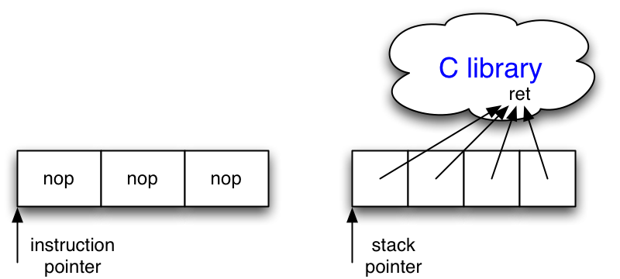
No-ops
No-op instruction does nothing but advance EIP
Return-oriented equivalent
  Point to return instruction
  Advances ESP
Useful in a NOP sled (what’s that?)
slide <number>

Slide 55
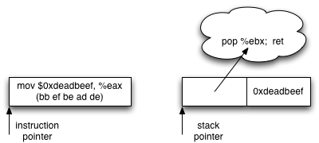
Immediate Constants
Instructions can encode constants
Return-oriented equivalent
  Store on the stack
  Pop into register to use
slide <number>

Slide 56
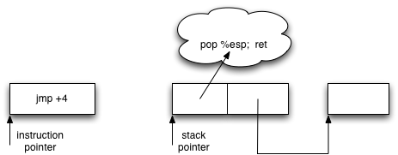
Control Flow
Ordinary programming
  (Conditionally) set EIP to new value
Return-oriented equivalent
  (Conditionally) set ESP to new value
slide <number>

Slide 57
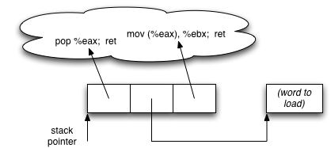
Gadgets: Multi-instruction Sequences
Sometimes more than one instruction sequence needed to encode logical unit
Example: load from memory into register
  Load address of source word into EAX
  Load memory at (EAX) into EBX
slide <number>

Slide 58
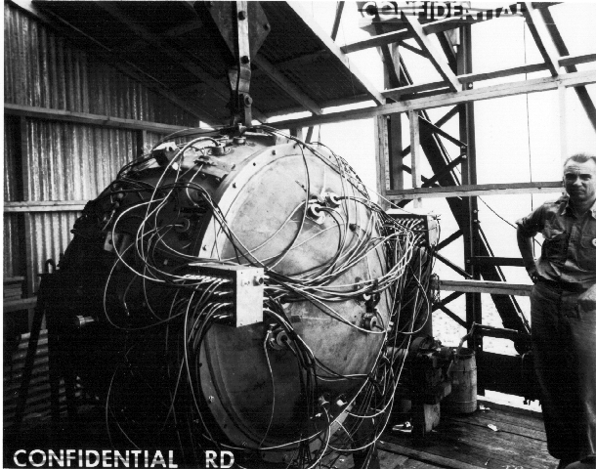
“The Gadget”: July 1945
slide <number>

Slide 59
Gadget Design
Testbed: libc-2.3.5.so, Fedora Core 4
Gadgets built from found code sequences:
  Load-store, arithmetic & logic, control flow, syscalls
Found code sequences are challenging to use!
  Short; perform a small unit of work
  No standard function prologue/epilogue
  Haphazard interface, not an ABI
  Some convenient instructions not always available
slide <number>

Slide 60
Conditional Jumps
cmp compares operands and sets a number of flags in the EFLAGS register
  Luckily, many other ops set EFLAGS as a side effect
jcc jumps when flags satisfy certain conditions
  But this causes a change in EIP… not useful (why?)
Need conditional change in stack pointer (ESP)
Strategy:
  Move flags to general-purpose register
  Compute either delta (if flag is 1) or 0 (if flag is 0)
  Perturb ESP by the computed delta
slide <number>

Slide 61

Phase 1: Perform Comparison
neg calculates two’s complement
  As a side effect, sets carry flag (CF) if the argument is nonzero
Use this to test for equality
sub is similar, use to test if one number is greater than another
slide <number>

Slide 62
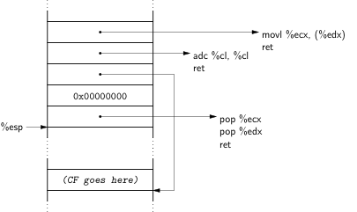
Phase 2: Store 1-or-0 to Memory
❹
❸
❶
❷
❶ Clear ECX
❷ EDX points to destination
❸ adc adds up its operands & the carry flag;
result will be equal to the carry flag (why?)
❹ Store result of adc into destination
slide <number>

Slide 63
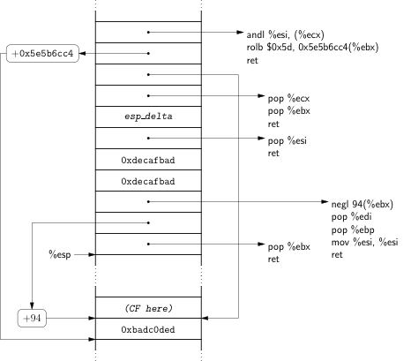
Phase 3: Compute Delta-or-Zero
Bitwise AND with delta
(in ESI)
Two’s-complement negation:
0 becomes 0…0;
1 becomes 1…1
slide <number>

Slide 64
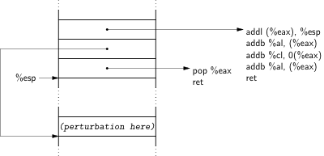
Phase 4: Perturb ESP by Delta
slide <number>

Slide 65
Finding Instruction Sequences
Any instruction sequence ending in RET is useful
Algorithmic problem: recover all sequences of valid instructions from libc that end in a RET
At each RET (C3 byte), look back:
  Are preceding i bytes a valid instruction?
  Recur from found instructions
Collect found instruction sequences in a trie
slide <number>

Slide 66
Unintended Instructions
Actual code from ecb_crypt()
c7
45
d4
01
00
00
00
f7
c7
07
00
00
00
0f
95
45
c3
movl $0x00000001, -44(%ebp)
add %dh, %bh
test $0x00000007, %edi
movl $0x0F000000, (%edi)
}
xchg %ebp, %eax
setnzb -61(%ebp)
}
inc %ebp
}
ret
slide <number>

Slide 67
Not Just x86
x86 architecture helps
  Register-memory with few registers ⇒ lots of memory accesses, multiple sequences operate on same register
  Instructions are variable-length, unaligned ⇒ multiple instruction sequences found in libc, instruction types not issued by compiler may be available
  Unstructured call/ret ABI ⇒ any sequence ending in a return is useful
… but can be done even on RISC architectures
… or even without returns (use jumps instead)
  See “Return-oriented programming without returns”
slide <number>

Slide 68
Other Issues with W⊕X / DEP
Some applications require executable stack
  Example: Lisp interpreters
Some applications are not linked with /NXcompat
  DEP disabled (e.g., popular browsers)
JVM makes all its memory RWX – readable, writable, executable (why?)
  Spray attack code over memory containing Java objects (how?), pass control to them
Return into a memory mapping routine, make page containing attack code writeable
slide <number>

Slide 69
Run-Time Checking: StackGuard
Embed “canaries” (stack cookies) in stack frames and verify their integrity prior to function return
  Any overflow of local variables will damage the canary
Choose random canary string on program start
  Attacker can’t guess what the value of canary will be
Terminator canary: “\0”, newline, linefeed, EOF
  String functions like strcpy won’t copy beyond “\0”
buf
canary
sfp
ret
addr
Frame of the
calling function
Top of
stack
Local variables
Pointer to
previous
frame
Return
execution to
this address
slide <number>

Slide 70
StackGuard Implementation
StackGuard requires code recompilation
Checking canary integrity prior to every function return causes a performance penalty
  For example, 8% for Apache Web server
StackGuard can be defeated
  A single memory write where the attacker controls both the value and the destination is sufficient
slide <number>

Slide 71
Defeating StackGuard
Suppose program contains strcpy(dst,buf) where attacker controls both dst and buf
  Example: dst is a local pointer variable
buf
dst
canary
sfp
RET
Return execution to
this address
BadPointer, attack code
&RET
canary
sfp
RET
Overwrite destination of strcpy with RET position
strcpy will copy
BadPointer here
slide <number>

Slide 72
ProPolice / SSP
[IBM, used in gcc 3.4.1; also MS compilers]
Rerrange stack layout (requires compiler mod)
args
No arrays or pointers
String
growth
return address
exception handler records
SFP
CANARY
Cannot overwrite any pointers
by overflowing an array
Arrays
Stack
growth
local variables
Ptrs, but no arrays
slide <number>

Slide 73
What Can Still Be Overwritten?
Other string buffers in the vulnerable function
Any data stored on the stack
  Exception handling records
  Pointers to virtual method tables
    C++: call to a member function passes as an argument this pointer to an object on the stack
    Stack overflow can overwrite this object’s vtable pointer and make it point into an attacker-controlled area
    When a virtual function is called (how?), control is transferred to attack code (why?)
    Do canaries help in this case?
    (Hint: when is the integrity of the canary checked?)
slide <number>

Slide 74
Litchfield’s Attack
Microsoft Windows 2003 server implements several defenses against stack overflow
  Random canary (with /GS option in the .NET compiler)
  When canary is damaged, exception handler is called
  Address of exception handler stored on stack above RET
Attack: smash the canary AND overwrite the pointer to the exception handler with the address of the attack code
  Attack code must be on heap and outside the module, or else Windows won’t execute the fake “handler”
  Similar exploit used by CodeRed worm
slide <number>

Slide 75
SafeSEH: Safe Exception Handling
Exception handler record must be on the stack of the current thread (why?)
Must point outside the stack (why?)
Must point to a valid handler
  Microsoft’s /SafeSEH linker option: header of the binary lists all valid handlers
Exception handler records must form a linked list, terminating in FinalExceptionHandler
  Windows Server 2008: SEH chain validation
  Address of FinalExceptionHandler is randomized (why?)
slide <number>

Slide 76
PointGuard
Attack: overflow a function pointer so that it points to attack code
Idea: encrypt all pointers while in memory
  Generate a random key when program is executed
  Each pointer is XORed with this key when loaded from memory to registers or stored back into memory
    Pointers cannot be overflown while in registers
Attacker cannot predict the target program’s key
  Even if pointer is overwritten, after XORing with key it will dereference to a “random” memory address
slide <number>

Slide 77
Normal Pointer Dereference
[Cowan]
CPU
1. Fetch pointer value
2. Access data referenced by pointer
Memory
Pointer
0x1234
Data
0x1234
CPU
2. Access attack code referenced
by corrupted pointer
1. Fetch pointer value
Memory
Corrupted pointer
0x1234
0x1340
Attack
code
Data
0x1234
0x1340
slide <number>

Slide 78
PointGuard Dereference
[Cowan]
CPU
1. Fetch pointer
value
0x1234
2. Access data referenced by pointer
Decrypt
Memory
Encrypted pointer
0x7239
Data
0x1234
Decrypts to
random value
CPU
2. Access random address;
segmentation fault and crash
1. Fetch pointer
value
0x9786
Decrypt
Memory
Corrupted pointer
0x7239
0x1340
Attack
code
Data
0x1234
0x1340
0x9786
slide <number>

Slide 79
PointGuard Issues
Must be very fast
  Pointer dereferences are very common
Compiler issues
  Must encrypt and decrypt only pointers
  If compiler “spills” registers, unencrypted pointer values end up in memory and can be overwritten there
Attacker should not be able to modify the key
  Store key in its own non-writable memory page
PG’d code doesn’t mix well with normal code
  What if PG’d code needs to pass a pointer to OS kernel?
slide <number>

Slide 80
Libsafe
Dynamically loaded library
Intercepts calls to strcpy(dest, src), other unsafe C library functions
  Checks if there is sufficient space in current stack frame |framePointer – dest| > strlen(src)
  If yes, does strcpy; else terminates application
top
of
stack
sfp
ret-addr
dest
src
buf
sfp
ret-addr
libsafe
main
slide <number>

Slide 81
Limitations of Libsafe
Protects frame pointer and return address from being overwritten by a stack overflow
Does not prevent sensitive local variables below the buffer from being overwritten
Does not prevent overflows on global and dynamically allocated buffers
slide <number>

