Slide 1
Google’s MapReduce
Functional Programming in the Real World

Slide 2
A Story
Once upon a time, there was a software company that had a problem…

Slide 3
Motivation
Large Scale Data Processing
Want to process lots of data ( > 1 TB)
  E.g., webpages, search logs, ad clicks, etc.
Want to parallelize across hundreds/thousands of CPUs
Want to make this easy for programmers
  Hide inter-node communication
  Mask node failures
  Automatic load balancing

Slide 4
Key Ideas
express computation as a map operation, followed by a fold
  Can do lots of common operations this way
map can easily be parallelized, since processed elements don’t depend on each other
if the folding function is commutative and associative, the fold operation can also be parallelized

Slide 5
MapReduce
Automatic parallelization & distribution
Fault-tolerant
Provides status and monitoring tools
Clean abstraction for programmers

Slide 6
Programming Model
Borrows from functional programming
Users implement two functions (special cases of their OCaml counterparts):
  A function to use with map:
  (in_key, in_value) ->
  (out_key, intermediate_value) list
  A function to use with fold (aka reduce):
  (out_key, intermediate_value list) ->
  out_value list

Slide 7
map
Records from the data source (lines out of files, rows of a database, etc) are fed into the map function as key*value pairs: e.g., (filename, line).
map() produces one or more intermediate values along with an output key from the input.

Slide 8
reduce
After the map phase is over, all the intermediate values for a given output key are combined together into a list
  The “shuffle”
reduce() combines those intermediate values into one or more final values for that same output key
(in practice, usually only one final value per key)

Slide 9
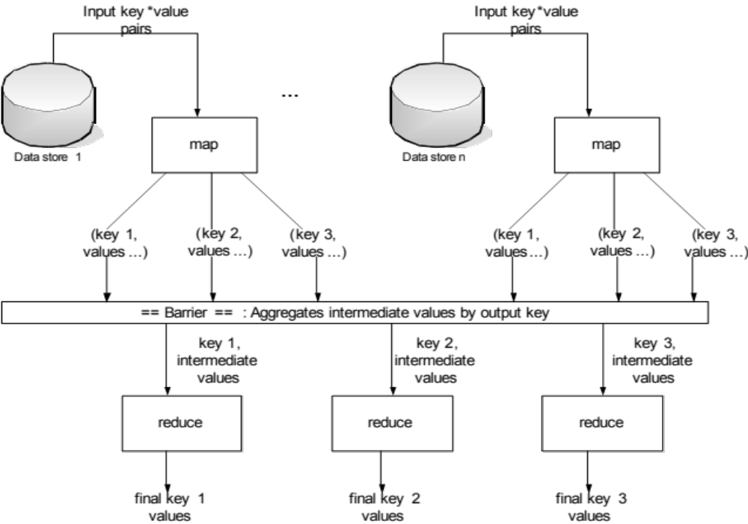

Slide 10
Parallelism
map() functions run in parallel, creating different intermediate values from different input data sets
reduce() functions also run in parallel, each working on a different output key
a single reduce() function can also be parallelized if it’s commutative and associative

Slide 11
Example: Count word occurrences
map(String input_key, String input_value):
// input_key: document name
// input_value: document contents
for each word w in input_value:
EmitIntermediate(w, "1");
reduce(String output_key, Iterator intermediate_values):
// output_key: a word
// output_values: a list of counts
int result = 0;
for each v in intermediate_values:
result += ParseInt(v);
Emit(AsString(result));

Slide 12
Example vs. Actual Source Code
Example is written in pseudo-code
Actual implementation is in C++, using a MapReduce library
Bindings for Python and Java exist via interfaces

Slide 13
Locality
Master program divvies up tasks based on location of data: tries to have map() tasks on same machine as physical file data, or at least same rack
map() task inputs are divided into 64 MB blocks: same size as Google File System chunks

Slide 14
Fault Tolerance
Master detects worker failures
  Re-executes completed & in-progress map() tasks
  Re-executes in-progress reduce() tasks
Master notices particular input key/values cause crashes in map(), and skips those values on re-execution.
  Effect: Can work around bugs in third-party libraries!

Slide 15
Optimizations
No reduce can start until map is complete:
  A single slow disk controller can rate-limit the whole process
Master redundantly executes “slow-moving” map tasks; uses results of first copy to finish

Slide 16
Optimizations
“Combiner” functions can run on same machine as a mapper
Causes a mini-reduce phase to occur before the real reduce phase, to save bandwidth

Slide 17
So what?
From the authors: “Inspired by similar primitives in LISP and other languages”
http://labs.google.com/papers/mapreduce-osdi04-slides/index-auto-0003.html
The point is this: programmers who only know Java/C/C++ would probably not have come up with this idea
Many other similar examples in industry

Slide 18
Remember
The next time you use google, think of how functional programming has inspired some of their key technical innovations

