Slide 1
A practical review of math and coding Coordinates & mapping
Andy Newman, Georgia Tech, 2022
Mildly adapted from presentation by Taka Ito, Georgia Tech in 2021

Slide 2
References
Ryan Abernathey’s Earth and Environmental Earth Science, https://earth-env-data-science.github.io/intro
MATLAB: m_map by Pawlowicz, R., 2020. "M_Map: A mapping package for MATLAB", version 1.4m, [Computer software], available online at http://www.eoas.ubc.ca/~rich/map.html
Python: Cartopy tutorial by Phil Elson who is the creator of Cartopy, https://github.com/SciTools/cartopy-tutorial
PyGMT: Tutorial for the Python adaptation of Generic Mapping Tools https://www.pygmt.org/latest/tutorials

Slide 3
Geospatial map projections and reference systems
Understand basic terminology
Determine what map projections are appropriate for your application
Some tutorials

Slide 4
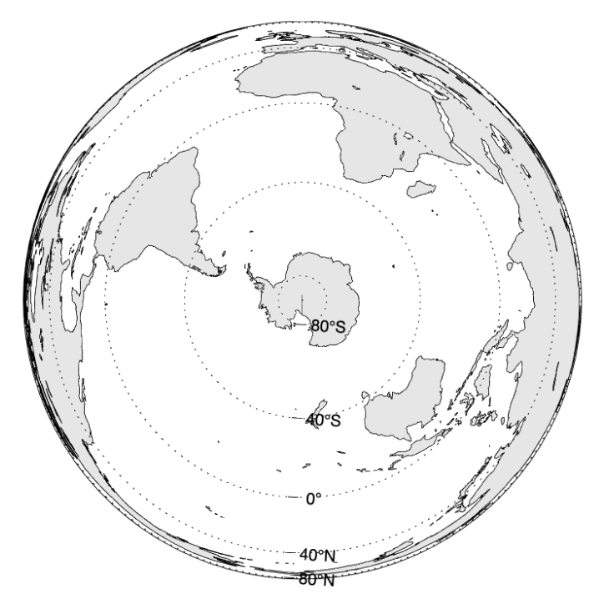
Projecting sphere onto a flat surface
Earth is 3D
Sphere
Media is 2D
Paper
Computer monitor
Azimuthal Equal-Area

Slide 5
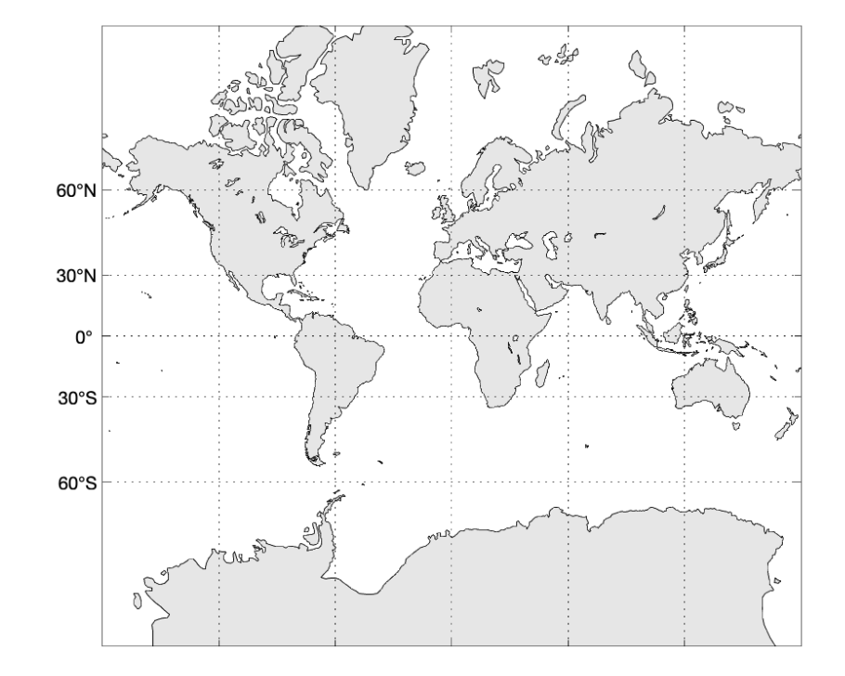
Projecting sphere onto a flat surface
Map projection means transformation of coordinates from (longitude, latitude) on the sphere to a location on a plane
Hard to avoid distortion when sphere is transformed into a flat surface
Mercator

Slide 6
Common metrics of distortion
Area
Distance
Shape
Direction
Scale
Mercator

Slide 7
Common metrics of distortion
Area
Distance
Shape
Direction
Scale
Azimuthal Equal-Area

Slide 8
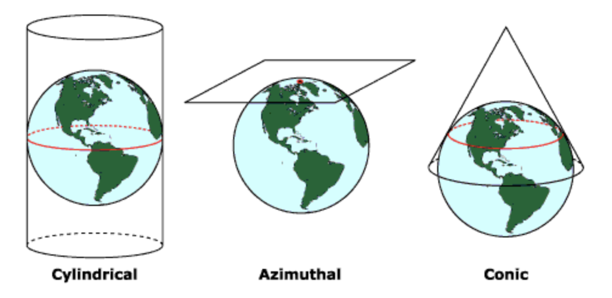
Projection by surface classification
Basic 3 types of projections

Slide 9
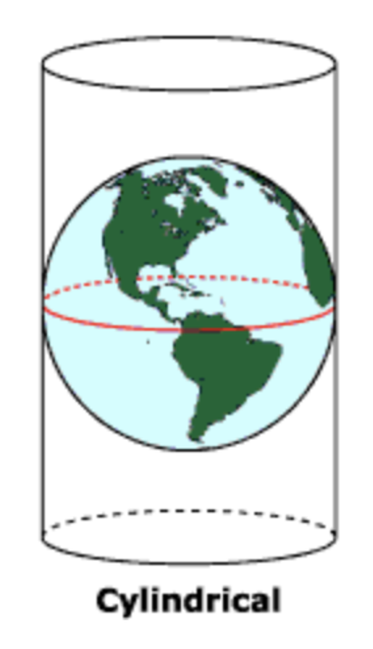
Cylindrical projection
Meridians and Parallels are straight and perpendicular
Mercator

Slide 10
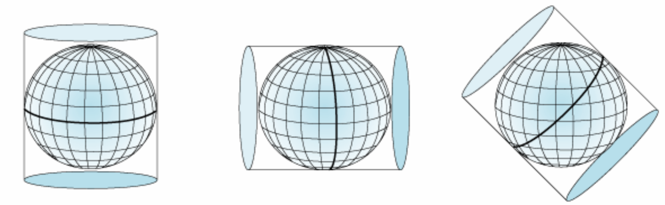
Cylindrical projection
Meridians and Parallels are straight and perpendicular
Oblique cylindrical
Transverse cylindrical
Mercator
Figure credit: arcgis.com
Mercator

Slide 11
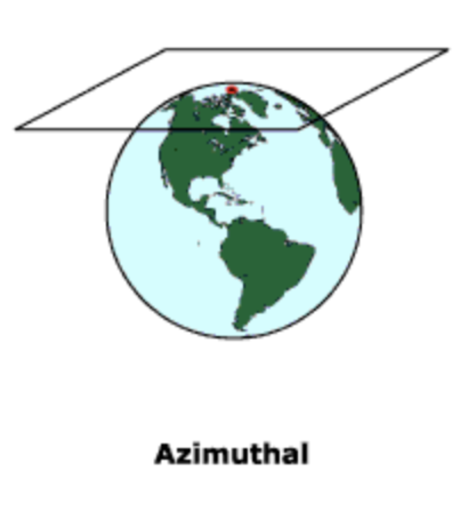
Azimuthal projection
Parallels are complete circles
Great circles from central point are straight lines
Azimuthal Equal-Area

Slide 12
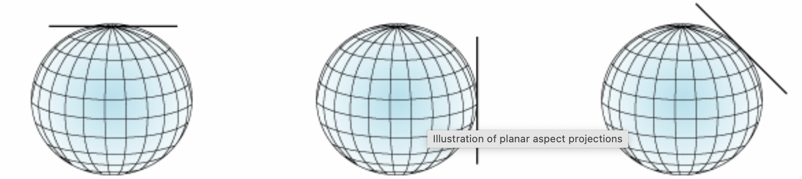
Azimuthal projection
Parallels are complete circles
Great circles from central point are straight lines
Polar
Equatorial
Oblique
Figure credit: arcgis.com
Azimuthal Equal-Area

Slide 13
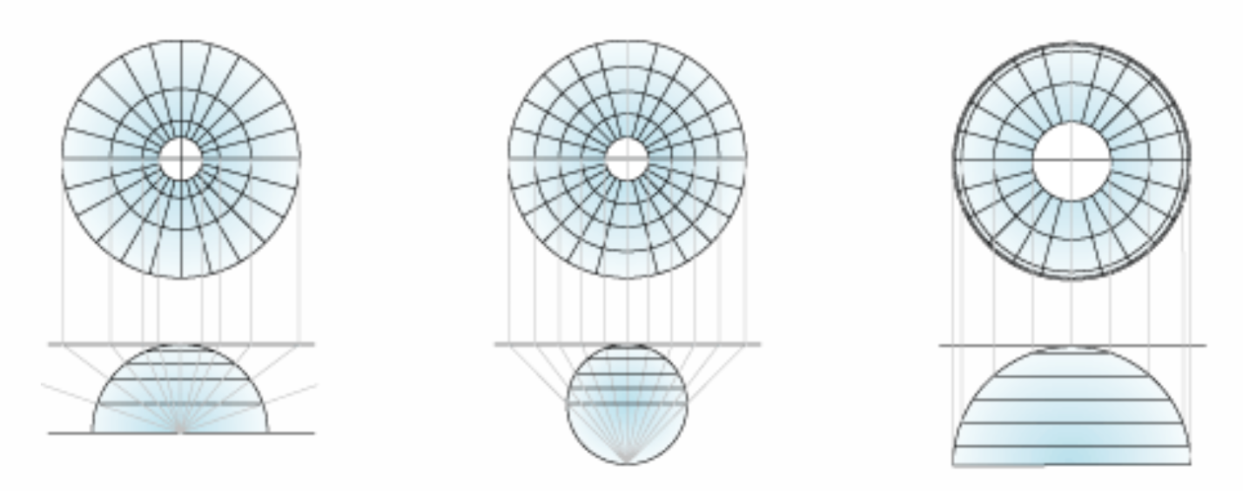
Azimuthal projection
Parallels are complete circles
Great circles from central point are straight lines
Gnomonic
Stereographic
Orthographic
Figure credit: arcgis.com
Azimuthal Equal-Area

Slide 14
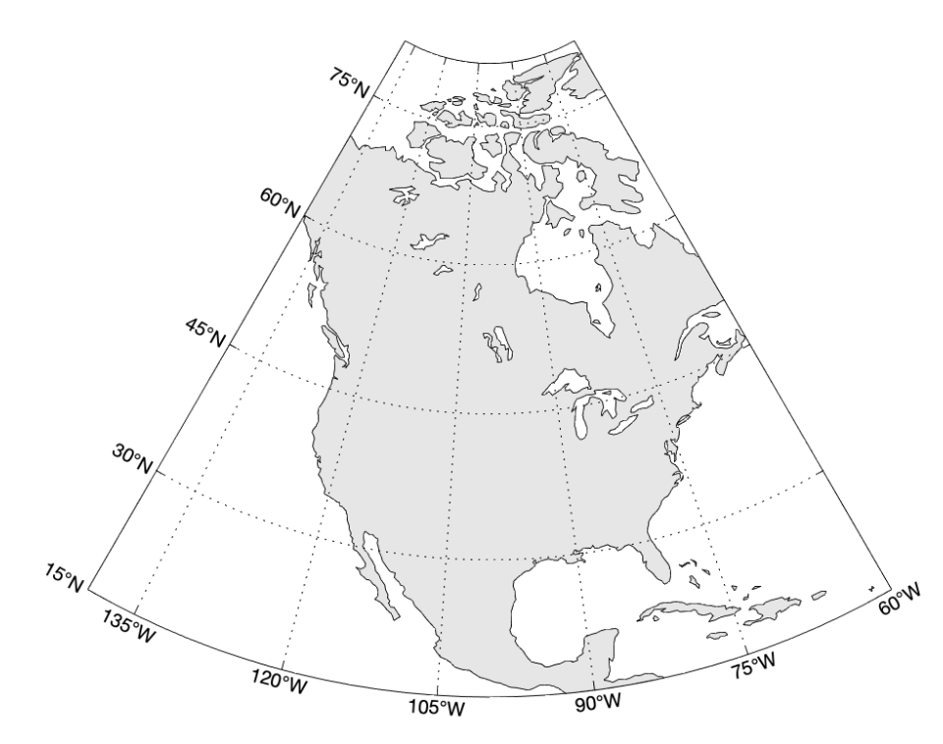
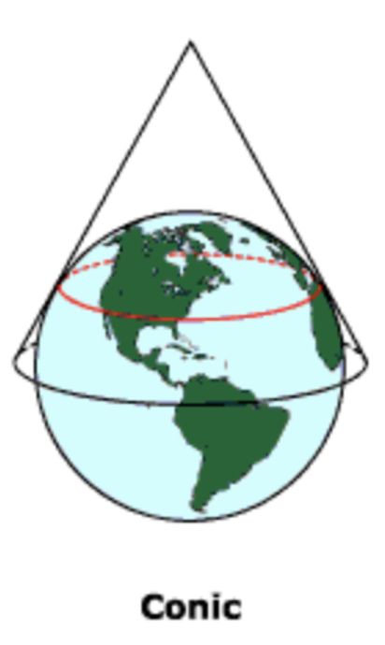
Conic projection
Meridians are straight equally-spaced lines
Parallels are circular arcs.
Albers Equal-Area Conic

Slide 15
Projections by conserved metrics
Within each of the 3 types, we can have different projections according to conserved metrics
Conformal (orthomorphic) maps preserve angles locally. Examples: Mercator and Stereographic. Google maps.
Equidistant maps preserve distance from a standard point or line. Examples: Azimuthal equidistant and Plate Carree
Equal-area maps preserves areas but the shape may be distorted. Examples: Albers Equal-Area Conic and Azimuthal Equal-Area

Slide 16
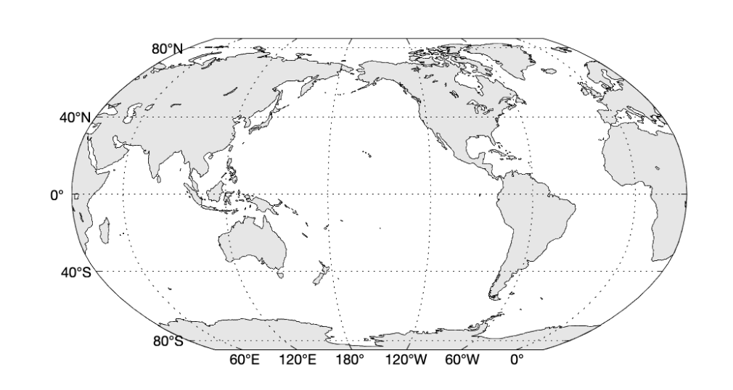
Projections: other non-preserving
Some projections try to strike some balance to minimize the distortion by not preserving any metrics. Usually, the polar regions get most distortions
Robinson: this is my go-to projection for global coverage
Robinson

Slide 17
Projection choices
Mapping choice depends on data coverage and extent (regional, global, polar, coastal, basin, etc)
Select projection approach (Azimuthal, Cylindrical or Conic)
Preserving metrics (Conformal, Equidistant, Equal-area)

Slide 18
Quick Intro to PyGMT
https://github.com/avnewman/pyGMT-Tutorial
Installation
Map Projections
Overlays
Shaded Relief and a couple non-geographic examples
More complex mixture

Slide 19
Coding procedure
Set up projection coordinate system
Display the data (plot, pcolor, contour, etc)
Display topographic features
Display grid lines etc

Slide 20
Some data example
Meteorological reanalysis (NCEP reanalysis)
Daily 2m air temperature for 2020
netCDF file = self-explaining data format. It contains the metadata together as a part of the dataset
2-minute resolution global topography ETOPO2v2

