Slide 1
Introduction to Deep Learning

Slide 2
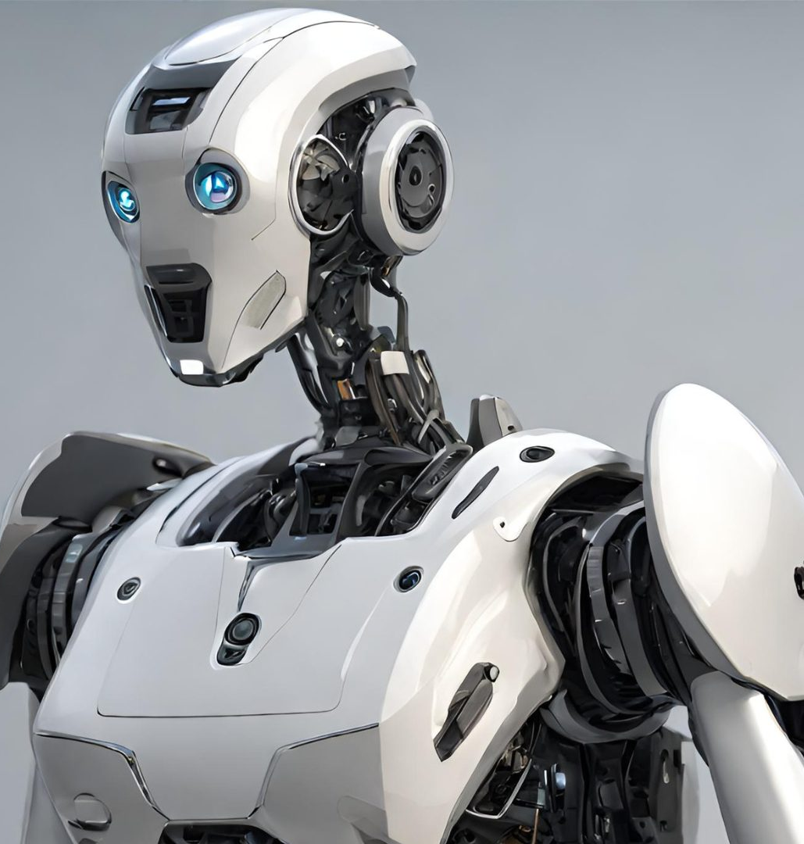
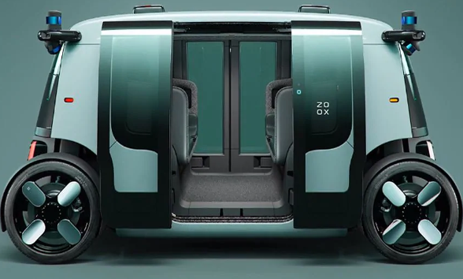
AI vs ML
AI
Machine Learning
Deep Learning
CNN, LSTM, autoencoder,
Transformers …
Logistic Regression,
Random Forest,
SVM, ANN

Slide 3
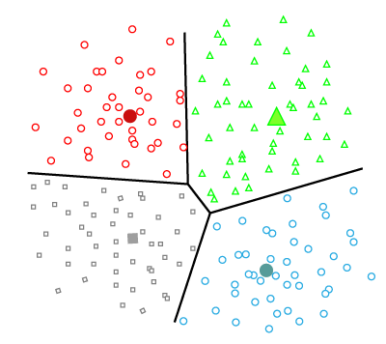
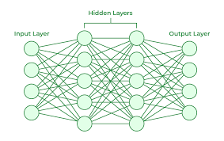
Types of Machine Learning
Unsupervised learning
Finds hidden/undetected patterns in data without labels and minimal human input, e.g.
principal component analysis, dimensionality reduction
clustering methods (k-means, hierarchical, self-organizing maps)
autoencoders
Supervised learning
Learning a function that maps an input to an output based on labled input-output pairs.
Regression
Decision trees and random forests
Support vector machines (SVM)
Artificial neural networks (ANN)

Slide 4
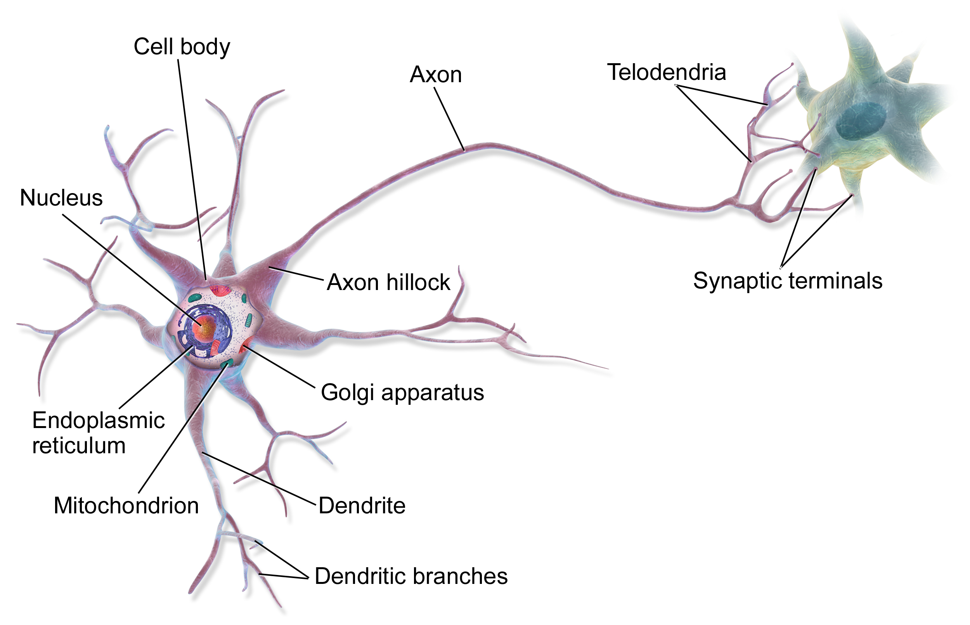
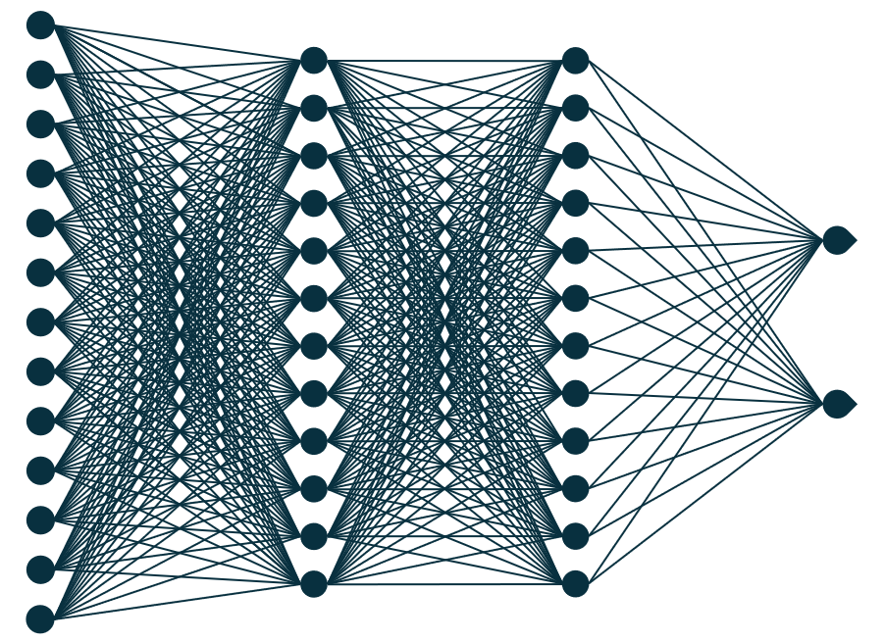
Artificial Neural Networks (ANNs)
Seeking inspiration from nature to develop innovative problem-solving methods
A biological neural network is a network of neurons connected by synapses.
Each neuron can be connected to many other neurons.
Connections between nodes act as artificial synapses
Intelligence emerges from the interconnection of multiple processors

Slide 5
















Artificial Neural Networks (ANNs)
Input
Hidden
Layer1
Hidden
Layer2
$$x_{1}$$
$$x_{1}$$
Output
$$x_{2}$$
$$x_{2}$$
$$Z_{1}$$
$$Z_{1}$$
$$x_{3}$$
$$x_{3}$$
$$Z_{2}$$
$$Z_{2}$$
$$Y_{1}$$
$$Y_{2}$$
$$Z_{n}$$
$$Z_{n}$$
$$x_{n}$$
$$x_{n}$$
Fully connected Deep Learning Network.

Slide 6
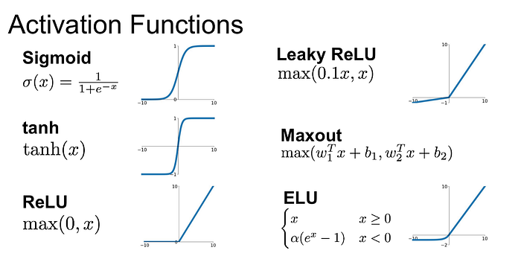


























Artificial Neural Networks (ANNs)
$$x_{1}$$
$$x_{1}$$
$$x_{2}$$
$$x_{2}$$
$$Z_{1}$$
$$x_{3}$$
$$x_{3}$$
$$Z_{2}$$
$$Y_{1}$$
$$Y_{2}$$
$$Z_{n}$$
$$x_{n}$$
$$x_{n}$$
$$x_{1}$$
In each node, incoming values are weighted, summed, added with a bias term, and passed through an activation function
$$w_{1}$$
$$b$$
+
$$x_{2}$$
$$w_{2}$$
$$w_{3}$$
$$Σ$$
$$f$$
$$O$$
$$Y_{1}$$
$$x_{3}$$
$$w_{n}$$
$$x_{n}$$
O$=f_{activation}(w_{1}x_{1}+w_{2}x_{2}+w_{3}x_{3}+…,w_{n}x_{n}+b)$

Slide 7












$$x_{1}$$
$$w_{1}$$
Activation functions
$$x_{2}$$
$$w_{2}$$
$$Σ$$
$$f$$
$$z$$
$$Y_{1}$$
$$w_{3}$$
$$x_{3}$$
$$w_{n}$$
$$x_{n}$$
The activation function in a neural network decides if a neuron should pass information to the next layer
The activation function adds nonlinearity, allowing neural networks to capture complex patterns; without it, they’d only perform linear computations.
https://medium.com/@shrutijadon/survey-on-activation-functions-for-deep-learning-9689331ba092

Slide 8
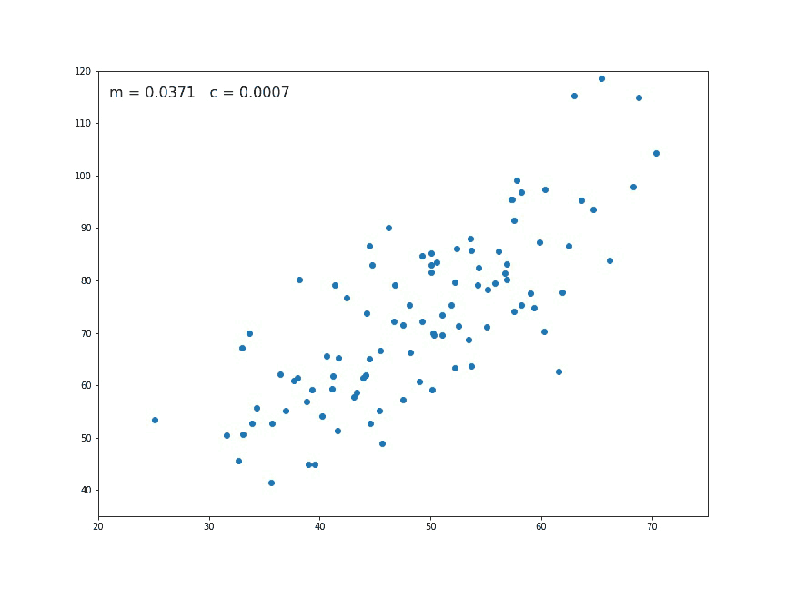
$$x_{1}$$
$$w_{1}$$
How do we train a network?
$$x_{2}$$
$$w_{2}$$
$$Σ$$
$$f$$
$$z$$
$$Y_{1}$$
$$w_{3}$$
$$x_{3}$$
$$w_{n}$$
$$x_{n}$$
Training the Network: Find the optimal weights w and biases b.
Activation Function: Apply a nonlinear function to capture complex patterns.
Objective: Adjust weights to produce the most accurate output, mapping inputs to desired outputs.
O$=f_{activation}(w_{1}x_{1}+w_{2}x_{2}+w_{3}x_{3}+…,w_{n}x_{n}+b)$
https://towardsdatascience.com/linear-regression-using-gradient-descent-97a6c8700931

Slide 9
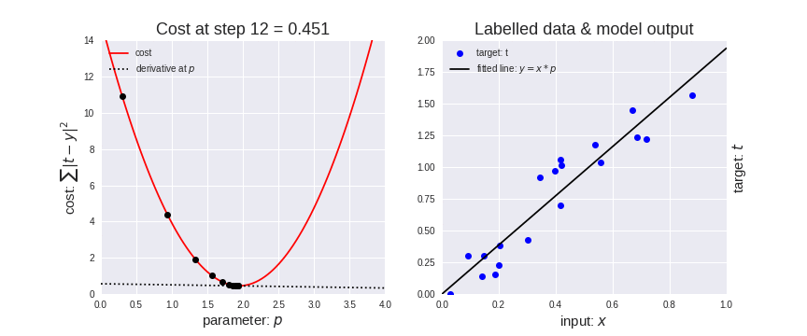

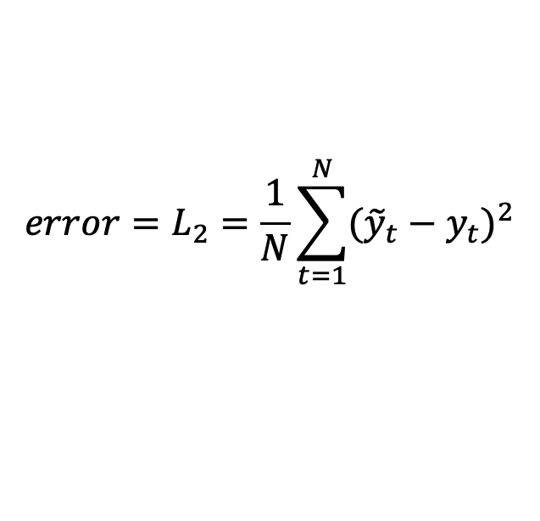
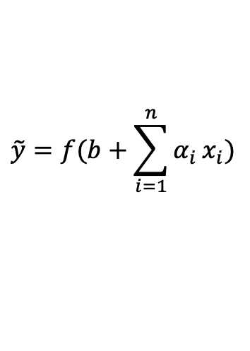
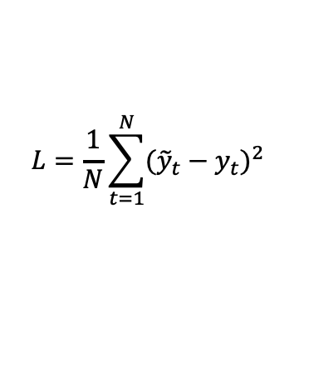
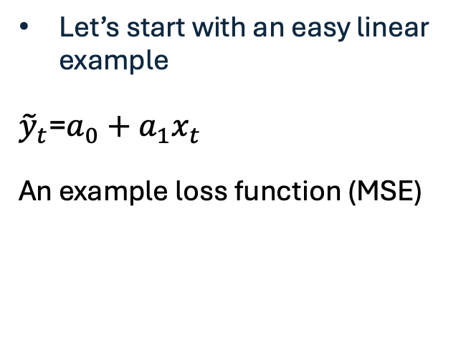

How do we define ‘optimal’ function?
$$Y=f(X)$$
$$\tilde{y}=f(b+\sum_{i=1}^{n}{α_{i}}x_{i})$$
Minimize the ‘loss’ to to help determine weights
$$error=L_{2}=\frac{1}{N}\sum_{t=1}^{N}{{({\tilde{y}}_{t}−y_{t})}^{2}}$$
Let’s start with an easy linear example
${\tilde{y}}_{t}$=$a_{0}+a_{1}x_{t}$
An example loss function (MSE)
Loss/cost
prediction
observation
$$L=\frac{1}{N}\sum_{t=1}^{N}{{({\tilde{y}}_{t}−y_{t})}^{2}}$$
$$a_{1}$$
https://chengjun.github.io/mybook/08-05-gradient-descent.html

Slide 10

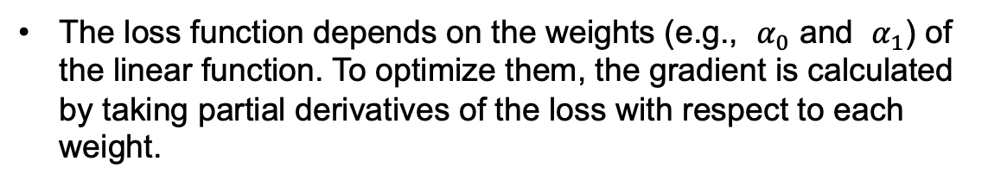
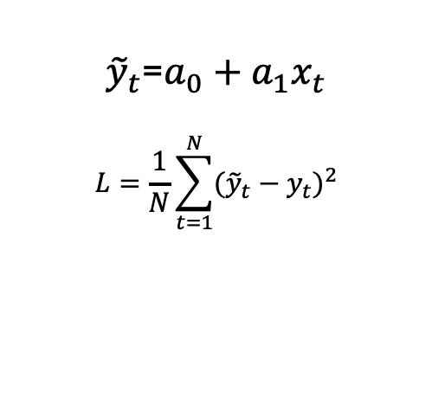



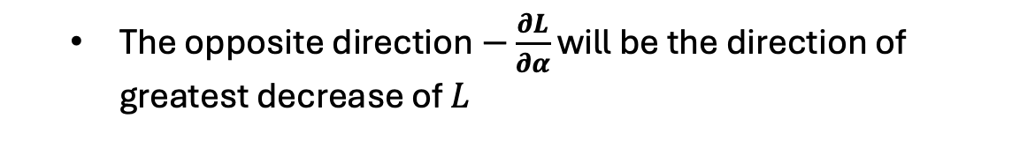

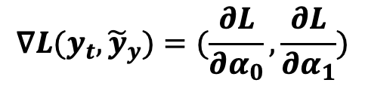




Gradient Descent Optimization:
${\tilde{y}}_{t}$=$a_{0}+a_{1}x_{t}$
$$L=\frac{1}{N}\sum_{t=1}^{N}{{({\tilde{y}}_{t}−y_{t})}^{2}}$$
$$L_{t+1}=L_{t}−λ\text{∇}L_{t+1}$$
The loss function depends on the weights (e.g., $α_{0}$​ and $α_{1}$) of the linear function. To optimize them, the gradient is calculated by taking partial derivatives of the loss with respect to each weight.
$$t_{1}$$
$$L=L(α_{0},α_{1})$$
$$\text{∇}L(y_{t},{\tilde{y}}_{y})=(\frac{∂L}{∂α_{0}},\frac{∂L}{∂α_{1}})$$
$$t_{2}$$
$$Loss$$
$$t_{3}$$
$$t_{4}$$
$$t_{5, ….T}$$
  The opposite direction$−\frac{∂L}{∂α}$ will be the direction of greatest decrease of $L$
$$Value of weight$$

Slide 11
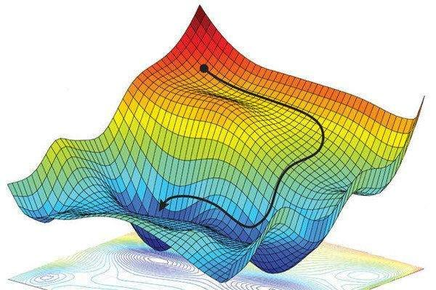






Gradient Descent Optimization:
Why ANN:
Automatic learning: An ANN learns directly from the data provided.
No need for assumptions: We don’t need to assume the best equation or functional form beforehand.
Captures complexity: The ANN can model complex relationships that might be difficult to define manually.
$$b_{2}$$
$$t_{2}$$
$${∇L(y}_{α},F\left(X_{α,}α_{1}\right)$$
$$t_{1}$$
$${∇L(y}_{α},F\left(X_{α,}α_{1}\right)$$
$$b_{1}$$
https://mohitmishra786687.medium.com/stochastic-gradient-descent-a-basic-explanation-cbddc63f08e0

Slide 12
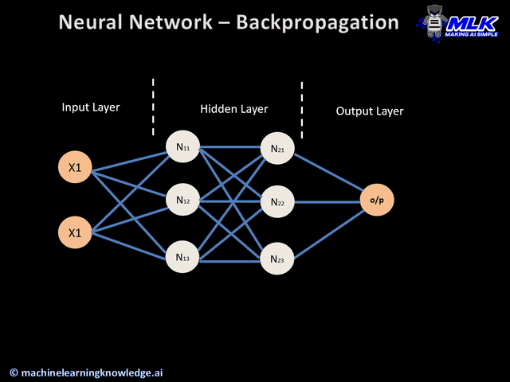
Backpropagation Technique
Step 1- Forward Pass: With frozen weights and biases, the ANN processes the input to make a prediction.
Step 2 - Calculate Error/Loss: Measure the error between the prediction and actual output.
Step 3 - Backward Pass: Adjust weights using gradient descent and backpropagation to minimize error.
Repeat
https://medium.com/analytics-vidhya/backpropagation-for-dummies-e069410fa585

Slide 13
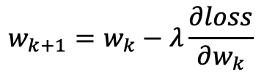

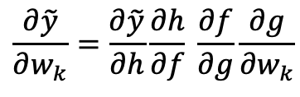
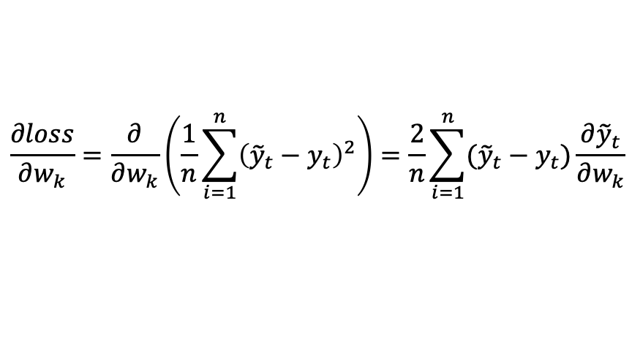
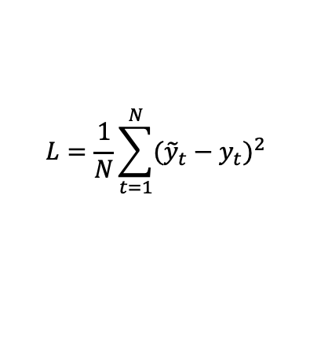
Backpropagation Technique
Chain rule used during the backpropagation process
$$L=\frac{1}{N}\sum_{t=1}^{N}{{({\tilde{y}}_{t}−y_{t})}^{2}}$$
$$w_{k+1}=w_{k}−λ\frac{∂loss}{∂w_{k}}$$
The method calculates the gradient of the loss function with respect to the neural network's weights.
$$\frac{∂loss}{∂w_{k}}=\frac{∂}{∂w_{k}}\left(\frac{1}{n}\sum_{i=1}^{n}{{\left({\tilde{y}}_{t}−y_{t}\right)}^{2}}\right)=\frac{2}{n}\sum_{i=1}^{n}{({\tilde{y}}_{t}−y_{t})\frac{∂{\tilde{y}}_{t}}{∂w_{k}}}$$
$$\tilde{y}=h(f\left(g\left(w_{k}x_{input}\right)\right))$$
$$\frac{∂\tilde{y}}{∂w_{k}}=\frac{∂\tilde{y}}{∂h}\frac{∂h}{∂f} \frac{∂f}{∂g}\frac{∂g}{∂w_{k}}$$

Slide 14
Developing DL Code!

Slide 15
Terminology
Designing an ANNs requires choices, including:
Architecture (number of nodes and layers)
Gradient Descent Algorithm (optimization strategy)
Learning Rate (step size in weight updates)
Activation Function (non-linearity applied at each node)
Batch Size (number of samples per training iteration)
Number of Epochs (iterations over the entire dataset)
Cross-Validation (evaluation and model selection), using k-fold approach.
Regularization (techniques to prevent overfitting)
Other Hyperparameters (e.g., initialization methods, momentum)
inputs
hidden
layer 1
hidden
layer 2
two outputs
each connection = a weight that must be “learned”

Slide 16
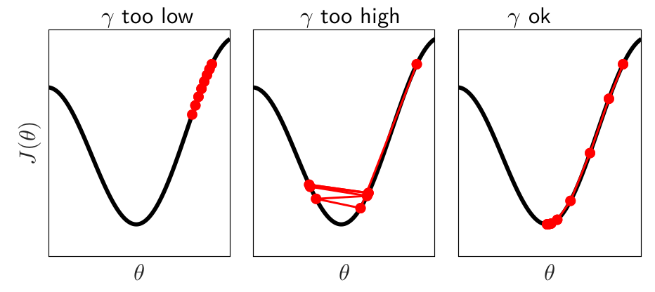
Gradient Descent and Learning rate
Identify the right learning rate.
A learning rate too large may cause the solution to skip between local minima.
A learning rate too small may get stuck in one local minimum, and also may take a longer to learn.
https://deeplearningmath.org/tricks-of-the-trade

Slide 17
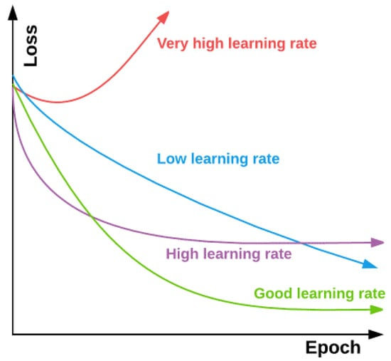
Gradient Descent and Learning rate
Identify the right learning rate.
A learning rate too large may cause the solution to skip between local minima.
A learning rate too small may get stuck in one local minimum, and also may take a longer to learn.
Apaydin et al, 2020, water

Slide 18
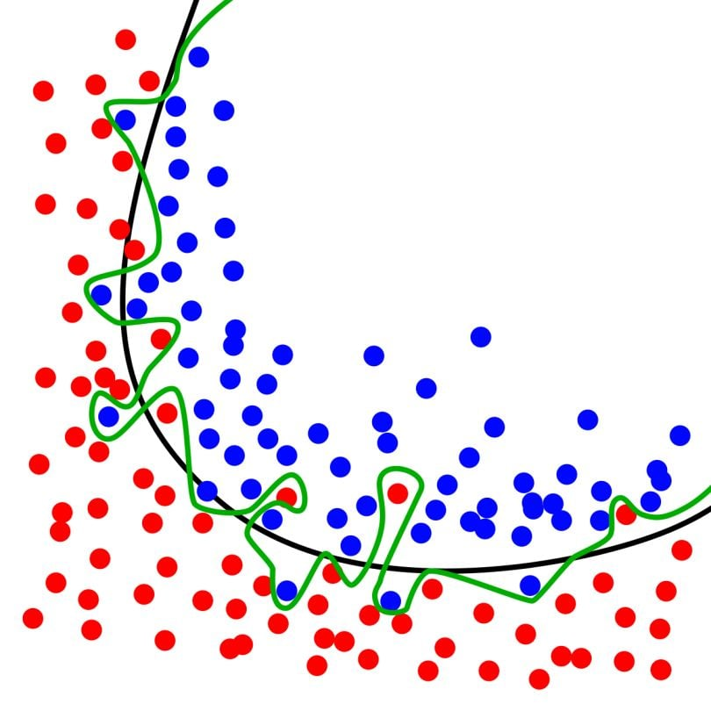
Overfitting!
Overfitting in ANNs:
Large numbers of weights in ANNs can lead to overfitting.
Common Solutions:
L1 & L2 Regularization
Drop-out
The black line fits well, while the green line overfits.
https://builtin.com/data-science/train-test-split

Slide 19
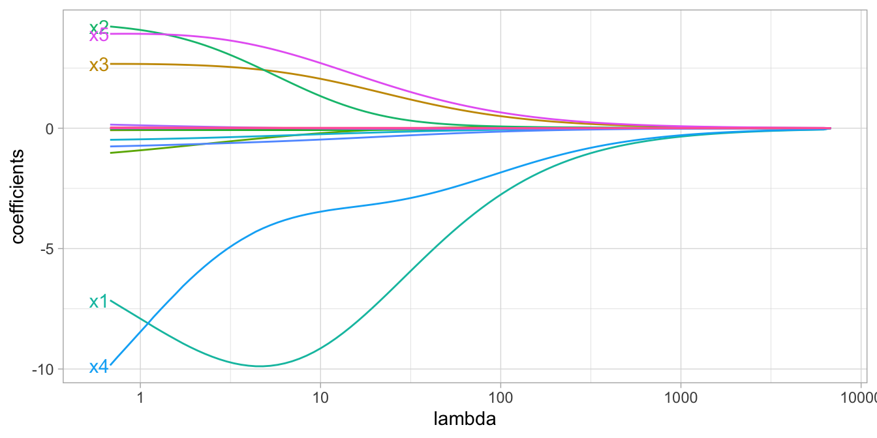
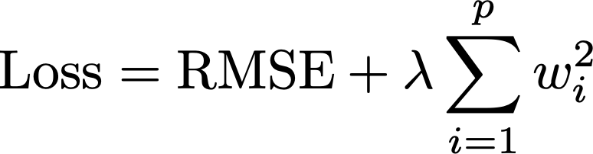
Overfitting!
Regularization (Ridge Regression): A technique to prevent overfitting by adding a penalty to the loss function, keeping weights small.
L2 Regularization
Ridge Parameter
will force coefficients to share importance

Slide 20
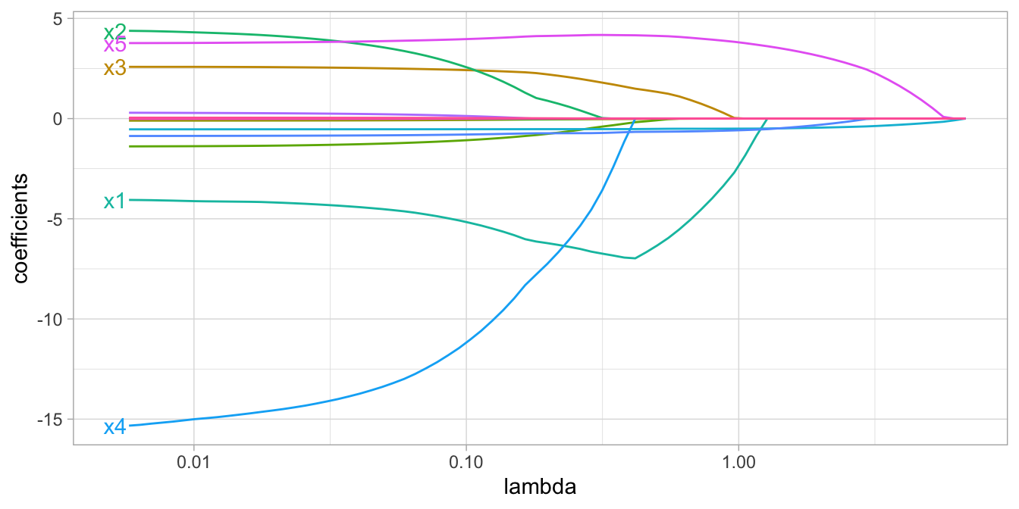
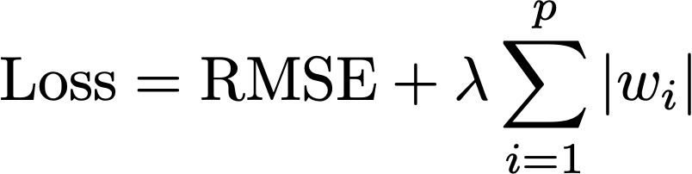
Overfitting!
Regularization (LASSO): A technique to prevent overfitting by penalizing large weights in the loss function, encouraging sparsity.
L1 Regularization
LASSO Parameter
/
0
/
0
/
0
/
0
/
0
/
0
will force some coefficients to zero

Slide 21
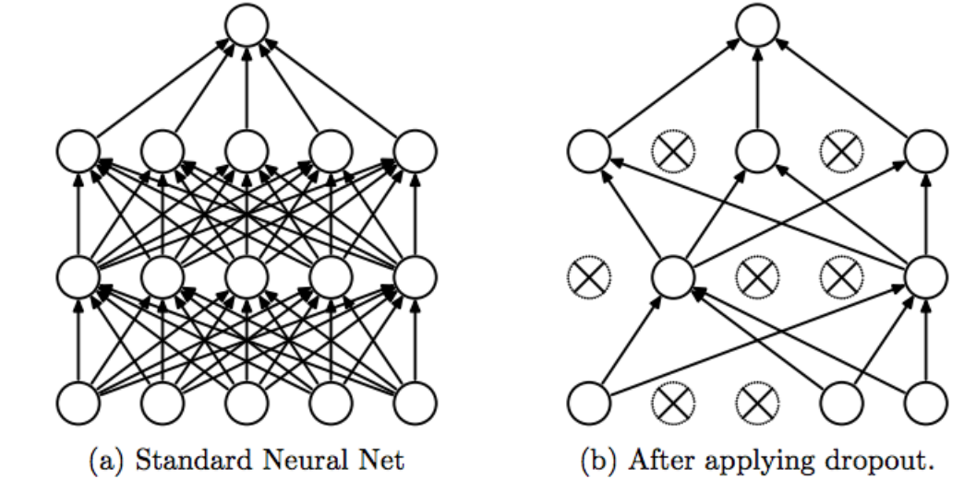
Overfitting!
During training (only training), dropout randomly deactivates nodes, forcing the ANN to learn more robust patterns and distribute responsibility across all nodes, reducing over-reliance on specific ones.
Testing then involves freezing the weights, and using the ANN as a predictor function.
Requires user to select dropout rate (typically 50-80%) and increases training epochs.
Apaydin et al, 2020, water

Slide 22
Convolutional Neural Networks

Slide 23
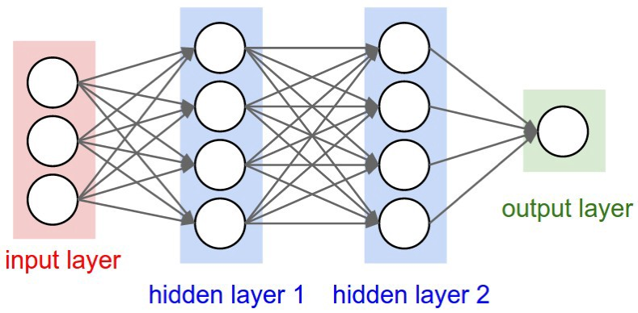

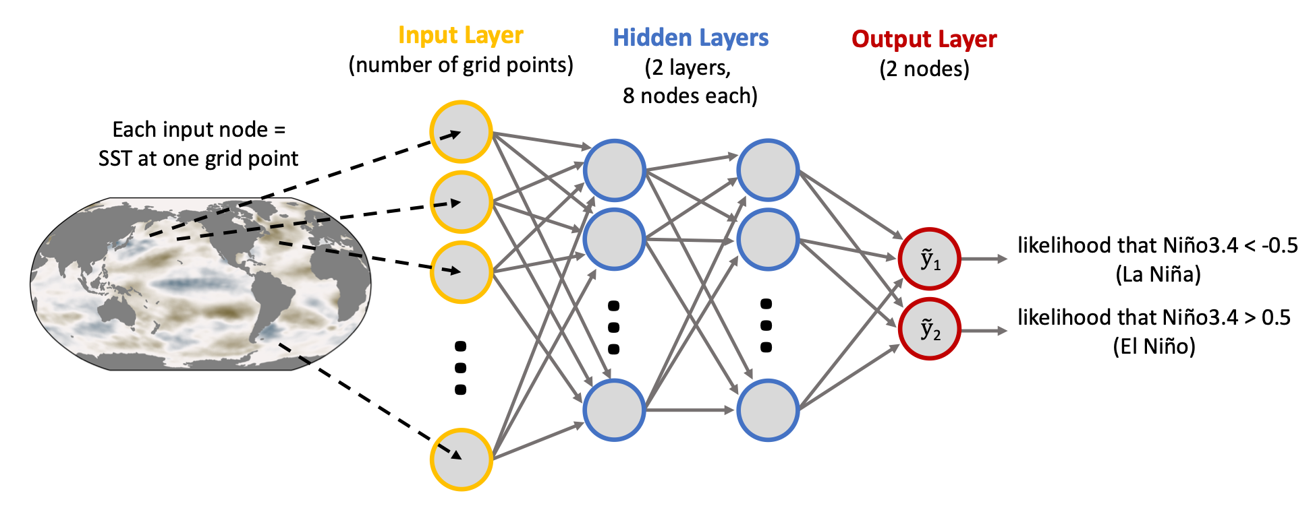
Convolutional NN
Convolutional Layer
Benefits:
maintain spatial info
fewer weights & biases (faster training and lower chance of overfitting)
Computer vision
Cat or Dog?
Earth System
Toms et al., JAMES (2020)

Slide 24
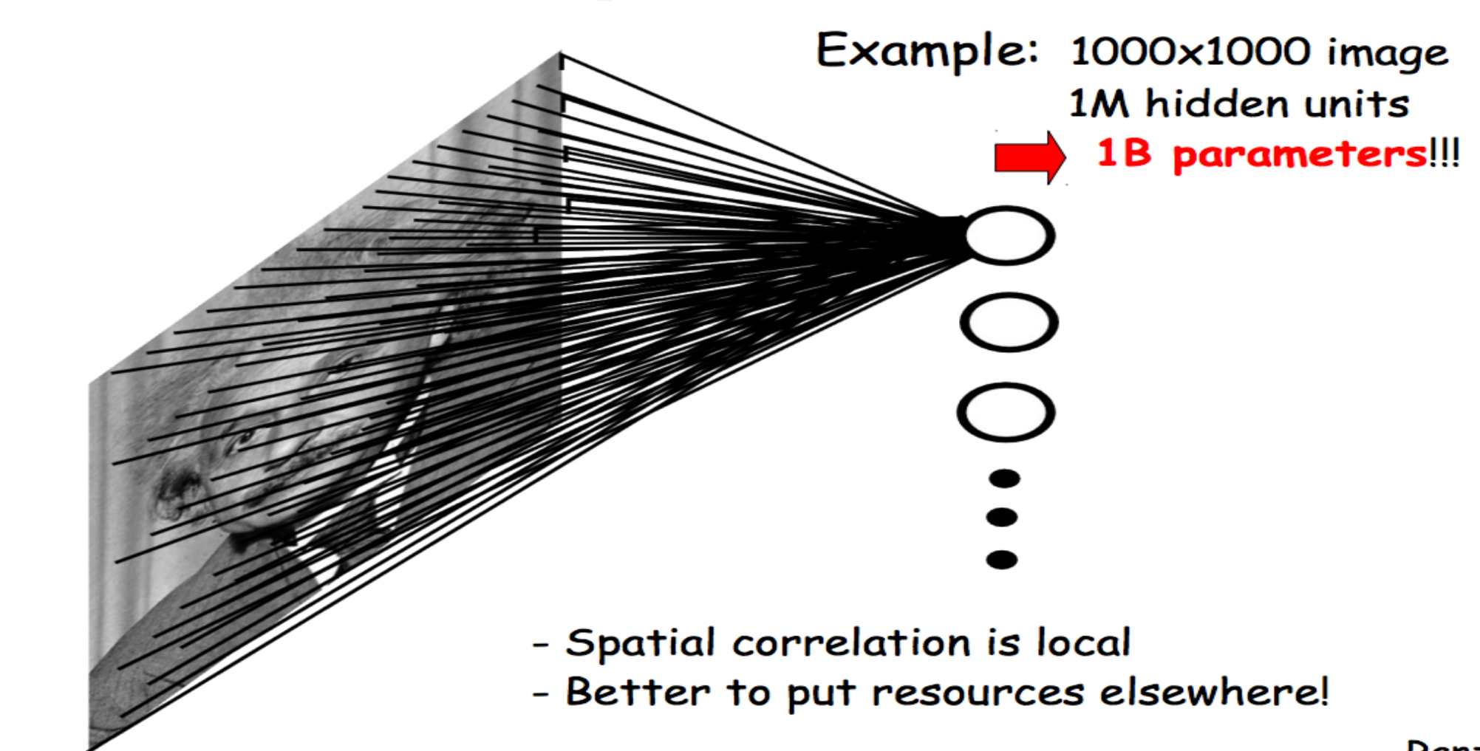








Convolutional NN
100x100 image size
1000 hidden units
10M parameters only in one layers
${z(i}_{x}×$ $i_{y})$
Hidden
Layer, n
Output
Flatten
$$Z_{1}$$
$n_{x}×$ $n_{y} input layer nodes$
$$Y_{1}$$
P (channel)
Feedforward Full Connected
$$Z_{2}$$
$$Y_{2}$$
P (channel)
$n_{x}×$ $n_{y} pixels$
$$Z_{n}$$

Slide 25

Convolutional NN
Instead of fully connected layers, use local shared weights
Input neurons
First hidden layer
Notes:
An image is dived by smaller subsets and our cortex is processing these subimages, basically patterns are preserved!

Slide 26
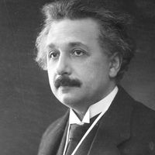




Convolutional NN
Instead of fully connected layers, use local shared weights
$n_{x}×$ $n_{y}weights$
Spatial, adjacent and ordering info is lost,
the data is flattened to 1D vector
$$Layers$$
$n_{x}×$ $n_{y}weights$
Spatial, adjacent and ordering preserved,
Data remains in 2D/3D setting in each layer, called feature maps
$$Feature map$$

Slide 27

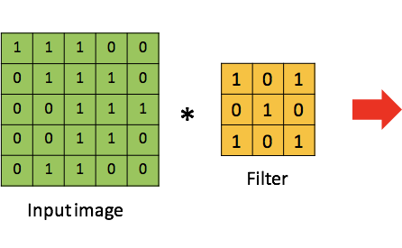

Convolutional NN
Convolving
Notes:
Weighting windows, kernel and filter

Slide 28
Convolutional NN
Input neurons
First hidden layer
Feature maps
Input neurons
First hidden layer
Input neurons
First hidden layer

Slide 29
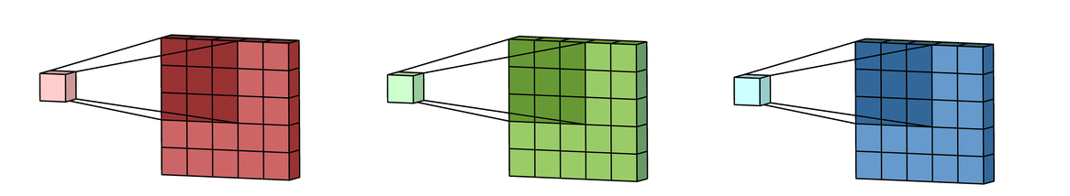
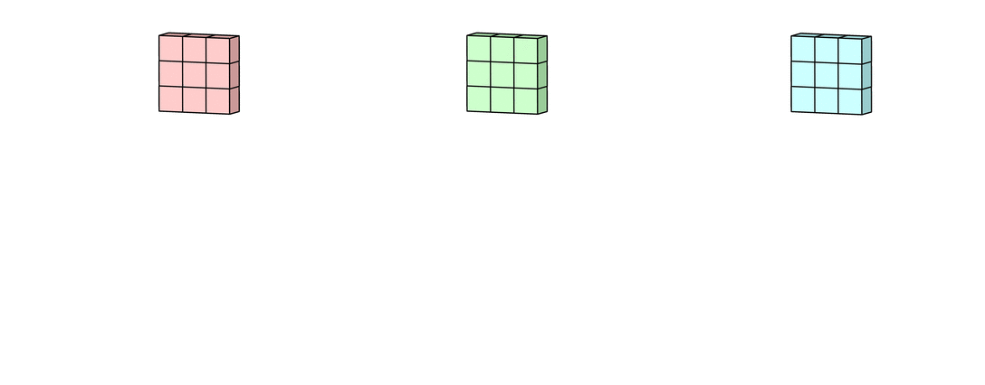
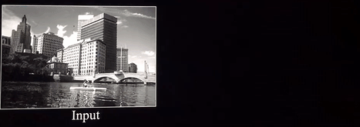
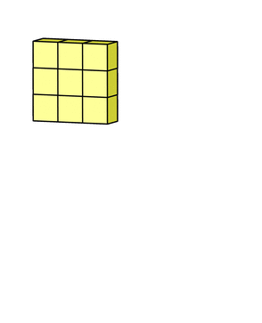
Convolutional NN
CNN layer for a single multi-channel kernel
Perform convolution across channels
Sum across channels
Add bias term
https://towardsdatascience.com/intuitively-understanding-convolutions-for-deep-learning-1f6f42faee1

Slide 30
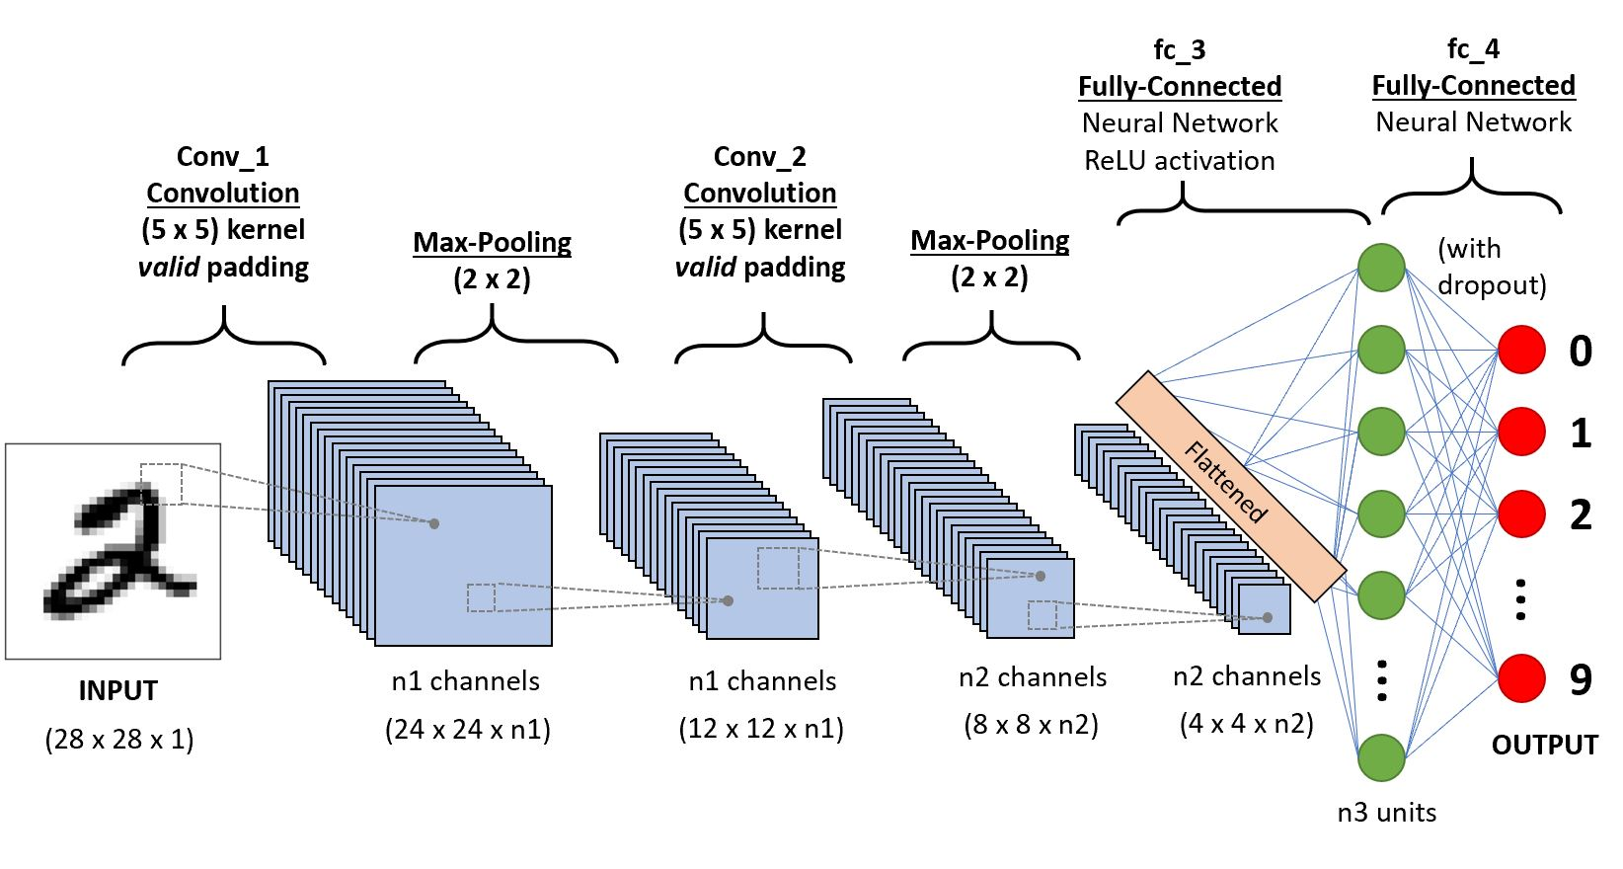
Convolutional NN
Connecting CNNs to Fully Connected Networks
Example courtesy of Imme Ebert-Uphoff
https://towardsdatascience.com/a-comprehensive-guide-to-convolutional-neural-networks-the-eli5-way-3bd2b1164a53
Notes:
The convolutional NN leans the weights for the filters to best extract patterns to maximize the accuracy of the model on traning data
Typlically multiple filters are tranined on each convolutional layer to extract various structure from the image. This increases feature map depth/channels
Padding make a dimensionality reduction, it leads to translation invariance, or pattern detection will be insensitive to location.

Slide 31
Convolutional NN
Common pattern for CNN
Input Image
Extract spatial features in feature maps
Convolution Layer
Integrate nonlinearity
Activation Function
Dimensionality reduction and location invariance
Pooling Layer
Full Connected
Prediction
Notes:
Common pattern of CNN

Slide 32
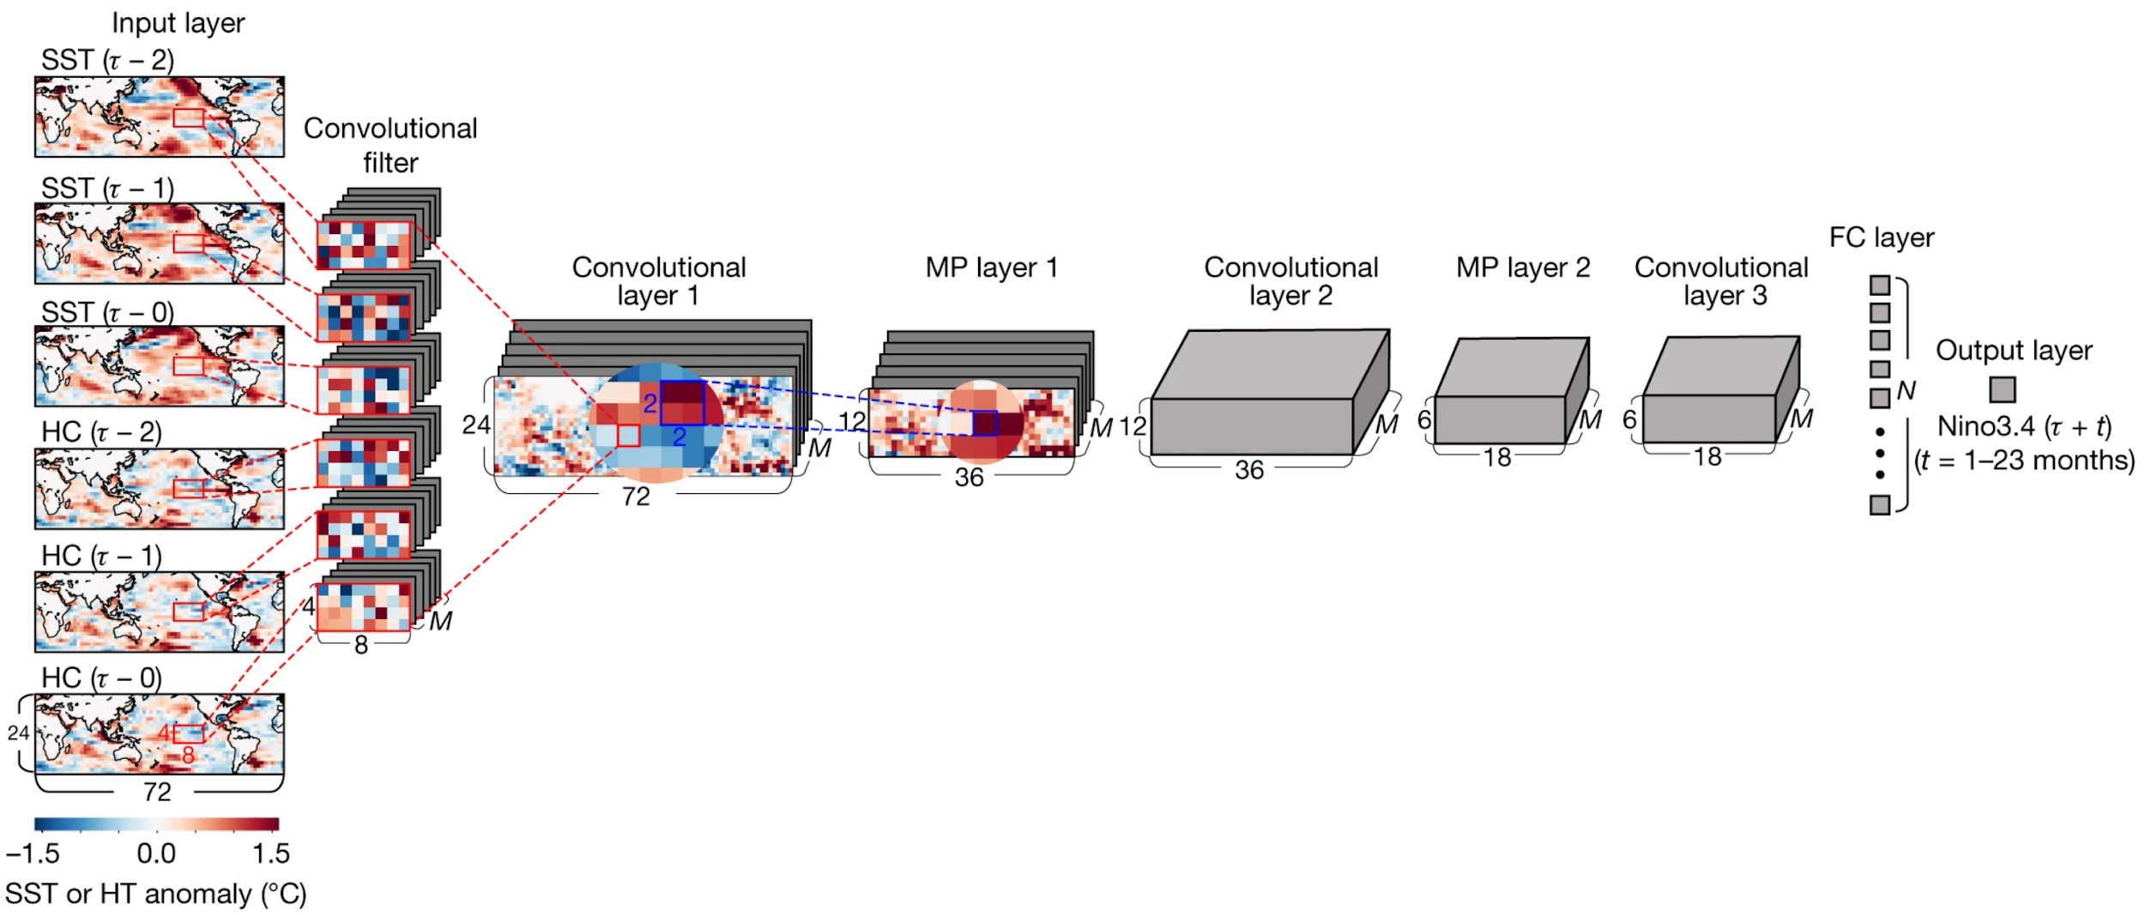
Convolutional NN
Seasonal ENSO prediction
Task: Predict Nino3.4 index __ months into the future using maps of the ocean state
Figure from Ham et al. (2019)

Slide 33
Developing CNN Code!

Slide 34
References:
Apaydin, H., Feizi, H., Sattari, M. T., Colak, M. S., Shamshirband, S., & Chau, K.-W. (2020). Comparative analysis of recurrent neural network architectures for reservoir inflow forecasting. Water, 12(5), 1500.
Barnes, E., et al.. Applied Machine Learning for Earth Scientists. Barnes Research Group, Department of Atmospheric Science, Colorado State University.
Chollet, F. (2018). Deep Learning with Python. Manning Publications.
Ham, Y.-G., Kim, J.-H., & Luo, J.-J. (2019). Deep learning for multi-year ENSO forecasts. Nature, 573(7775), 568–572
Toms, B. A., Barnes, E. A., & Hurrell, J. W. (2021). Assessing decadal predictability in an earth-system model using explainable neural networks. Geophysical Research Letters, 48(12), e2021GL093842
Pyrcz, M.J., 2024, Applied Geostatistics in Python: A Hands-on Guide with GeostatsPy, https://geostatsguy.github.io/GeostatsPyDemos_Book.

