Slide 1
Class12 – Fourier Analysis
Linear Algebra by Gilbert Strang, MIT open courseware 18.06, especially the video lectures, Chapter 10 https://ocw.mit.edu/courses/mathematics/18-06-linear-algebra-spring-2010/
https://mitmath.github.io/1806/
Data Driven Science & Engineering by Brunton and Kutz, Chapter 2
http://www.databookuw.com
This book also covers a range of machine learning topics relevant to EAS

Slide 2
Class12 – Fourier Analysis
Fourier Series
uses linear combination of cosine and sine waves to express any periodic function
Fourier Transform
decomposes functions of time (space) domain into frequency (wave number) domain
Fast Fourier Transform
is a computational algorithm to calculate Fourier Transform of discrete data very efficiently

Slide 3
Class12 – Fourier Analysis
Fourier Series for 2π periodic continuous function
2π periodic : f(x) = f(x+2π)
f(x) is a weighted, infinite sum of sine and cosine functions with increasing frequency
In practice, the infinite sum is often stopped (truncated) at a manageable level
Derivatives of f(x) become very easy to calculate

Slide 4
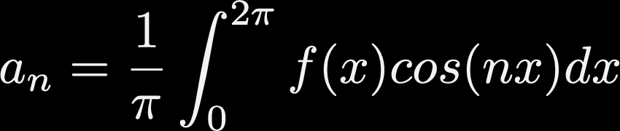


Class12 – Fourier Analysis
Fourier Series for 2π periodic continuous function
Formula for Fourier coefficients

Slide 5
Class12 – Fourier Analysis
Fourier Series for T periodic function
T periodic : f(x) = f(x+T).
Practically, your data does not have to be periodic as long as the signal of your interest is within T period.

Slide 6
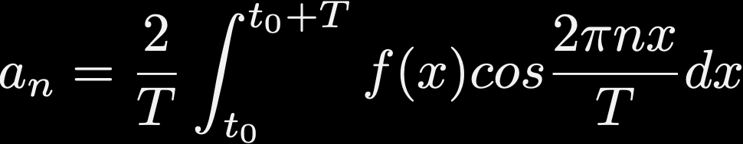
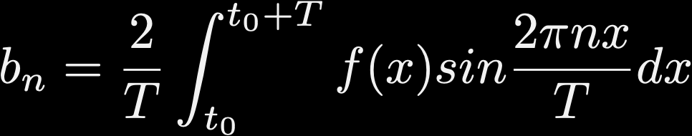
Class12 – Fourier Analysis
Fourier Series for T periodic function
Formula:

Slide 7
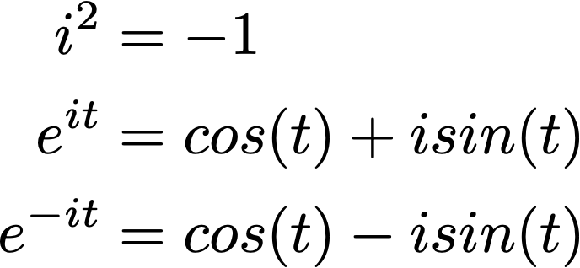
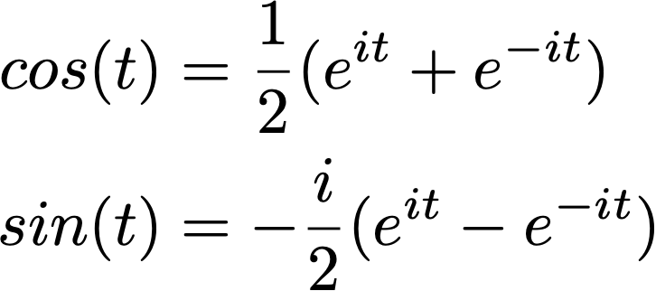
Class12 – Fourier Analysis
Euler’s formula
helps to re-write Fourier Series in a compact way

Slide 8
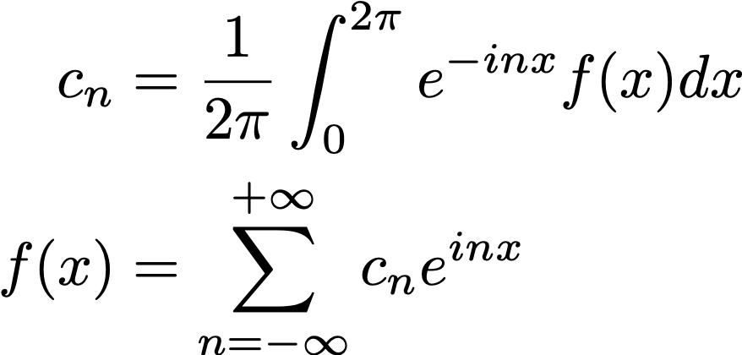
Class12 – Fourier Analysis
Euler’s formula
helps to re-write Fourier Series in a compact way
Complex Fourier Series

Slide 9
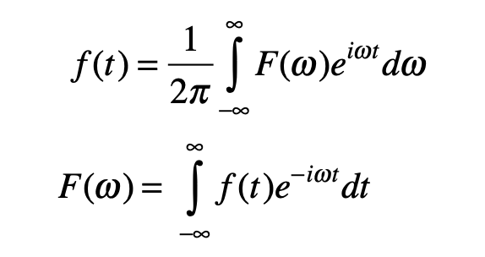
Class12 – Fourier Analysis
Fourier Transform (continuous)
Inverse Fourier Transform (to physical space)
Fourier Transform (to frequency space)

Slide 10

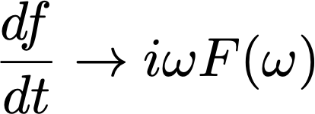

Class12 – Fourier Analysis
Fourier Transform (continuous)
Some notable properties
Derivatives (d/dt)
Linearity
Time shift

Slide 11
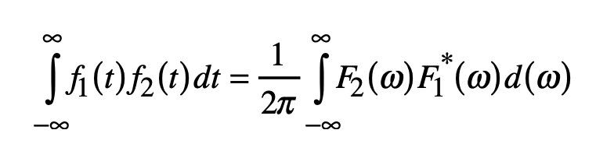
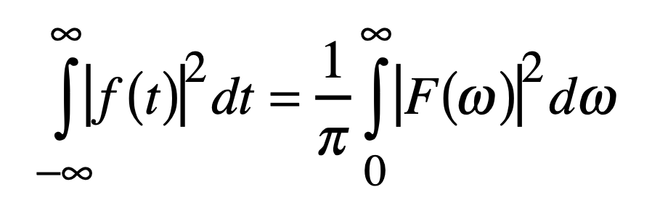
Class12 – Fourier Analysis
Parseval’s theorem
The second equation means that the square of time series integrated over time (~variance) is equal the square of Fourier transform integrated over the frequency. This motivates us to plot the square of Fourier transform as the variance contained in certain frequency range = Power Spectral Density

Slide 12
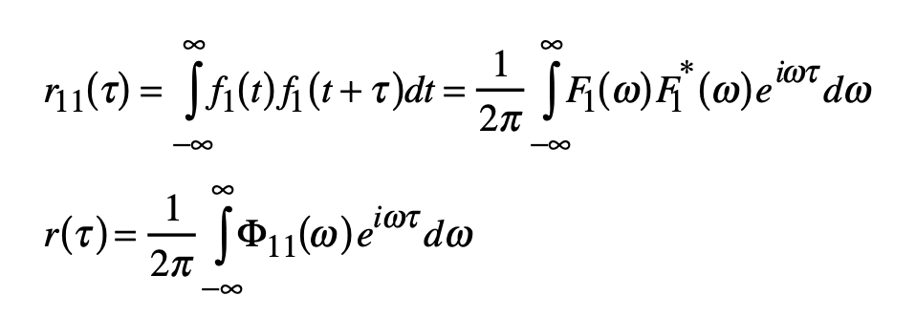
Class12 – Fourier Analysis
Autocorrelation and PSD
Autocorrelation is a correlation with itself with a time lag. (Complex-conjugate) square of Fourier transform is called power spectral density. They form Fourier transform pair.
For example, persistent signals show exponentially decaying positive autocorrelation and it has a bias towards low-frequency in its Fourier transform.

Slide 13
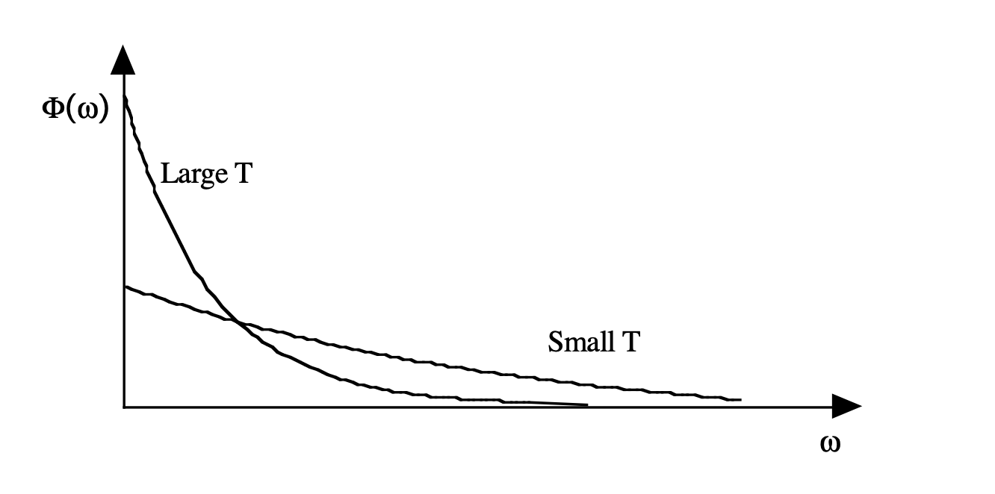
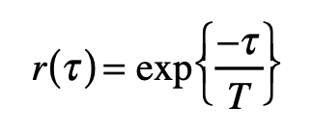
Class12 – Fourier Analysis
Autocorrelation and Spectral power
Autocorrelation is a correlation with itself with a time lag. Complex-conjugate square of Fourier transform is called spectral power density. They form Fourier transform pair.
For example, persistent signals show positive autocorrelation and it has a bias towards low-frequency in its Fourier transform.
Autocorrelation function: r(τ_{lag})

Slide 14
Class12 – Fourier Analysis
Discrete Fourier Transform (DFT)
You have discrete dataset: f = f(x) = [f₁ f₂ f₃ ･ ･ ･ f_{N}]
Rather than a continuous function like f(x), we normally work with discrete samples (vector). f(x), does not have to be periodic as we are only interested in the period within the data record.
How do we calculate Fourier coefficients?

Slide 15

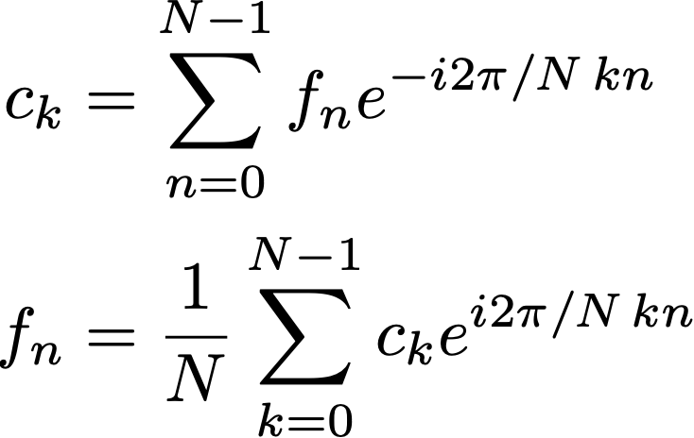
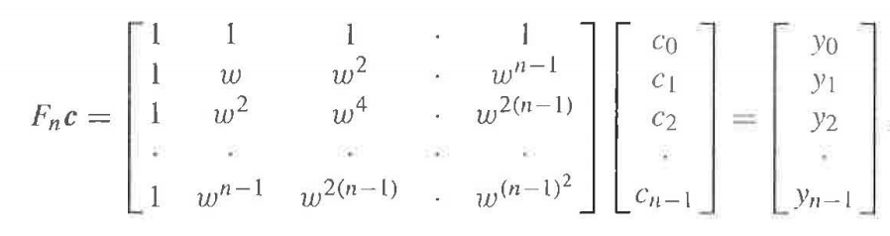
Class12 – Fourier Analysis
Discrete Fourier Transform (DFT)
Notice a recurring term
So we can write this in matrix-vector product (from Strang, ch. 10)

Slide 16
Class12 – Fourier Analysis
Fast Fourier Transform (FFT)
FFT operates the Fourier matrix (F) onto the data vector very efficiently. The data in physical space (time/space) is transformed into frequency space as Fourier coefficients. FFT algorithm is available in MATLAB (fft) and python (numpy.fft / scipy.fft)

Slide 17
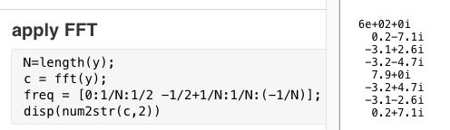
Class12 – Fourier Analysis
Let’s say we have a time series with N=8 samples (T=8 years)
We apply FFT to this time series. We get 8 Fourier coefficients.

Slide 18
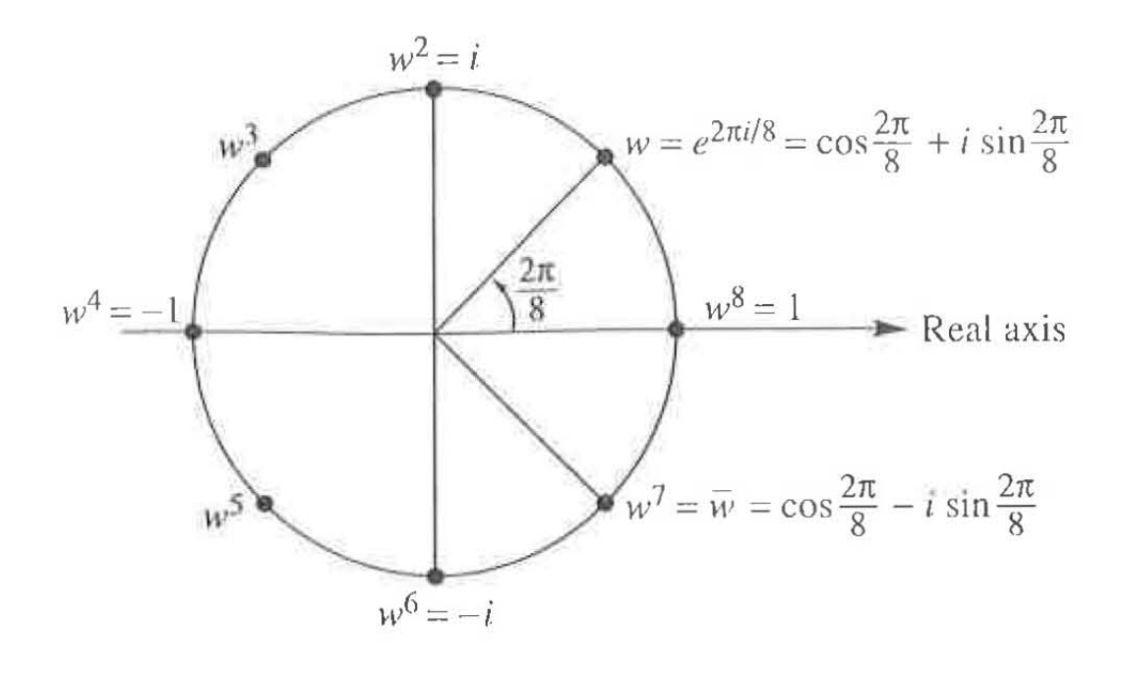
Class12 – Fourier Analysis
Let’s say we have a time series with N=8 samples (T=8 years).
We apply FFT to this time series. We get 8 Fourier coefficients.
The basic period is 8 (years), corresponding to the angular frequency of 2π/8 = π/4 (45°). Fourier coefficient is calculated for this increment: ω=[0, π/4, 2π/4, 3π/4, … 7π/4].
In terms of the frequencies, the second (π/4) and the last (7π/4) are the same because 7π/4=2π−π/4. Τhe highest frequency is the 4th component with the corresponding period of 2 years (Nyquiest frequency).

Slide 19
Continue to coding exercise

