Slide 1
A practical review of math and coding Class #4: Linear Algebra

Slide 2
Reference
Linear Algebra by Gilbert Strang, MIT open courseware 18.06, especially the video lectures https://ocw.mit.edu/courses/mathematics/18-06-linear-algebra-spring-2010/
https://mitmath.github.io/1806/

Slide 3
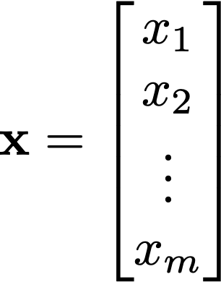
Vector
In physics, vector has a direction and magnitude, like velocity of a moving object.
In data analysis, a series of discrete data can be expressed as a vector (let’s say there are m data points, then you have a m-dimensional vector)
In computational model, model state can be expressed as a vector (e.g. chemical concentrations in box models, dynamic height in geophys fluid dynamics, with m being the number of grid points)

Slide 4
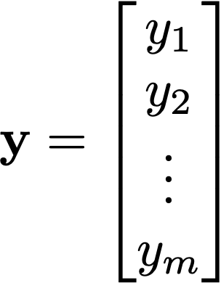
Vector
When there are more then two vectors, they can add together to form another vector
x + y
y
x

Slide 5
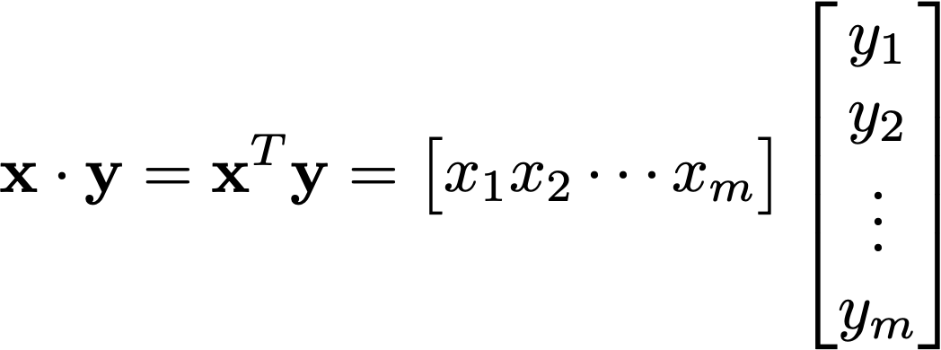

Vector
Vectors can multiply together: inner product produces a scalar
(remember “row times column”)
In a 2D example,
y
θ
x

Slide 6
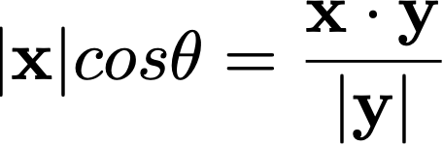
Vector
Vectors can multiply together: inner product produces a scalar
(remember “row times column”)
In a 2D example,
The projection of x onto y is:
y
θ
x

Slide 7
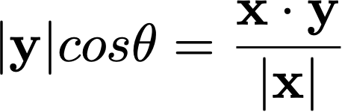
Vector
Vectors can multiply together: inner product produces a scalar
(remember “row times column”)
In a 2D example,
The projection of y onto x is:
y
θ
x

Slide 8

Vector
Vectors can multiply in a different way: cross product produces a vector
(remember “the right hand rule”)
x x y
y
θ
x

Slide 9
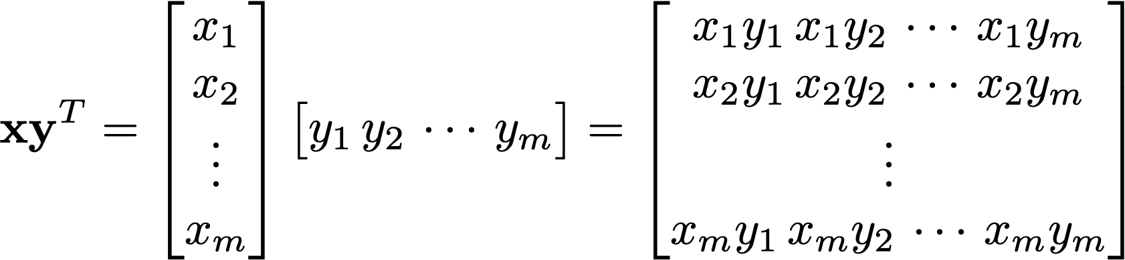
Vector
Vectors can multiply together in another different ways: outer product produces a matrix (again, remember “row times column”)

Slide 10
Inner product and (co)variance
In data analysis, vector can contain a collection of measurements (e.g. mean August temperature of Atlanta from last 140 years)

Slide 11
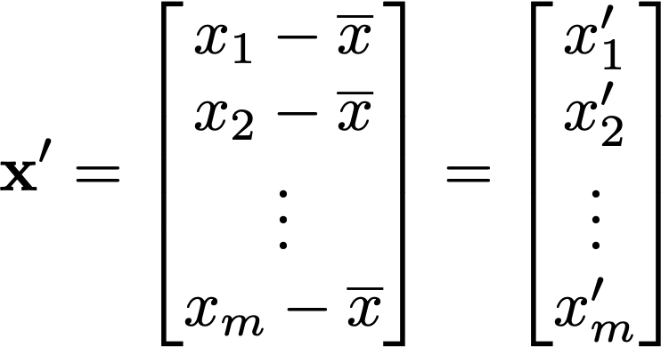
Inner product and (co)variance
Let’s subtract mean of x from all elements, so x becomes x’

Slide 12
Inner product and (co)variance
Inner product of x’ with itself the square of the ”length” of the x’ vector.
It is equal to the variance (σ² or σ_{xx}) of the data contained in vector x multiplied by N-1
The “length” |x’| is also called the L2 norm

Slide 13
Inner product and (co)variance
Inner product of x’ and y’ is:
the covariance of the data contained in vector x and y (multiplied by N-1)
(2) the projection of x onto y (multiplied by |y’|)
(3) Proportional to the correlation between x and y

Slide 14
Inner product and (co)variance
Inner product of x’ and y’ is:
the covariance of the data contained in vector x and y (multiplied by N-1)
(2) the projection of x onto y (multiplied by |y’|)

Slide 15

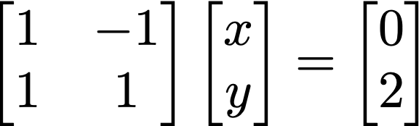
Matrix-vector product and
A (2 x 2) example
A
x
=
b

Slide 16


Matrix-vector product and
A (2 x 2) example
Matrix-vector product is essentially a collection of inner products, i.e. (rows) x (column)
A
x
=
b
The “row” point of view:
Inner products

Slide 17
Matrix-vector product and
A (2 x 2) example
y=x
A
x
=
b
The “row” point of view:
Intersection of two lines
y=-x+2
The problem Ax = b is solvable only if the two lines intersect at a point

Slide 18
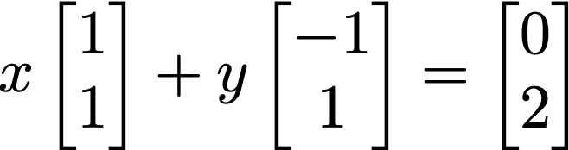
Matrix-vector product and
A (2 x 2) example
A
x
=
b
The “column” point of view:

Slide 19
Matrix-vector product and
A (2 x 2) example
A
x
=
b
The “column” point of view:

Slide 20
Matrix-vector product and
A (2 x 2) example
A
x
=
b
The “column” point of view:

Slide 21
Matrix-vector product and
A (2 x 2) example
A
x
=
b
The problem Ax = b is solvable only if b is in the “column space” of A.

Slide 22

Matrix-vector product and
Inverse matrix A⁻¹
IF the inverse matrix of A exists, we have
IF the determinant of the matrix A (detA or |A|) is not zero, the inverse exists.
For a 2x2 matrix, it is (ad-bc)

Slide 23
Matrix-vector product and
What are the examples of detA=0
One of the rows of A is all zero
Two rows of A are equal
One row of A is a multiple of another row
When determinant is zero, the matrix is singular (two lines are parallel to each other)

Slide 24
Matrix-vector product and
What are the examples of detA=0
One of the rows of A is all zero
Two rows of A are equal
One row of A is a multiple of another row
When determinant is zero, the matrix is singular (two column vectors point to the same direction)

Slide 25
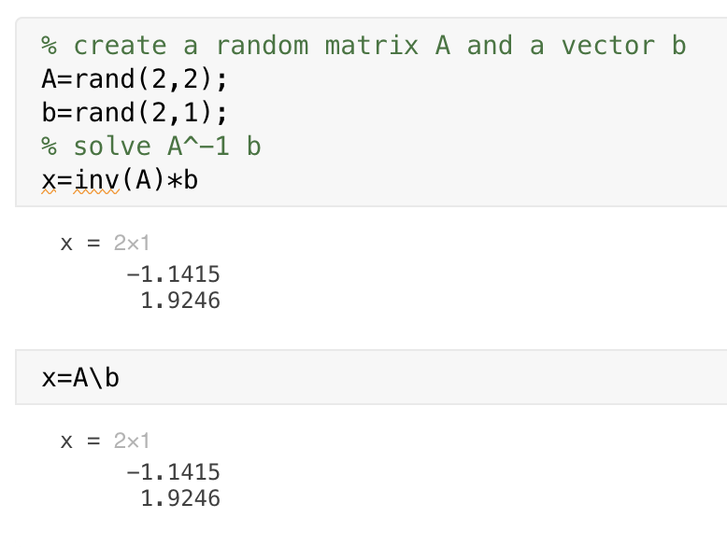
Matrix-vector product and
Inverse matrix A⁻¹
If inverse matrix of A exists, we have
In MATLAB it is inv function. Also the backslash operation “A\b” does it for you…
In Python, np.linalg.inv (or scipy.linalg.inv)

Slide 26
Matrix-vector product and
What if A is not a square matrix?

Slide 27
Matrix-vector product and
What if A is not a square matrix?
Let’s say there are too many (m) equations than (n) unknowns.
In this case, there is no unique solution x that can satisfy all equations in Ax = b in the exact sense

Slide 28
Matrix-vector product and
Consider A is (m x 2) matrix, x is (2 x 1) and b is (m x 1) and m is much larger than 2.
In this case, A x is unlikely equal to b in the exact sense.
However, we could look for the approximate solution x that minimizes the magnitude of the misfit |Ax - b| (aka least square method).

Slide 29
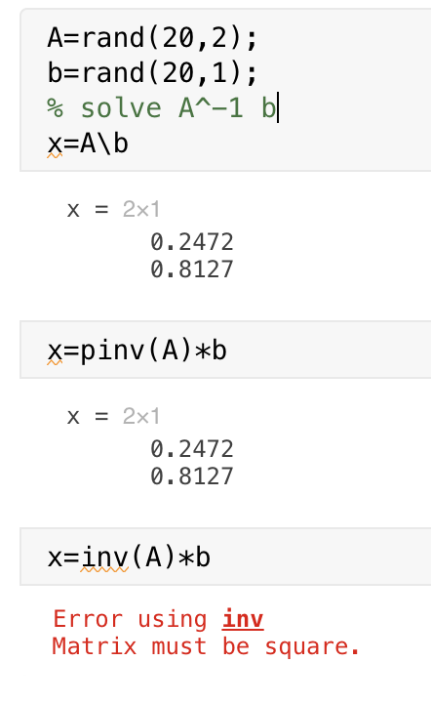
Matrix-vector product and
In MATLAB, ”backslash”(\) takes care of this problem.
It is also called pseudoinverse problem, and ”pinv” is the MATLAB function.
In python, it is available as numpy.linalg.pinv or scipy.linalg.pinv

Slide 30


Pseudoinverse of non-square matrix A
⬅ Solution to this equation does not exist because of non-square A
However, pseudoinverse provides a solution that minimizes the discrepancies between Ax and b
This is the pseudoinverse of A
The solution, x, is the best-fit solution to Ax = b in the “Least Square” sense!

Slide 31
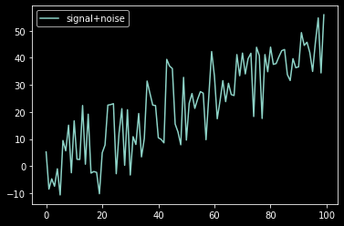
Linear regression
You have N paired dataset x_{i} and y_{i}
Find the linear relationship y = ax + b that best matches your dataset

Slide 32
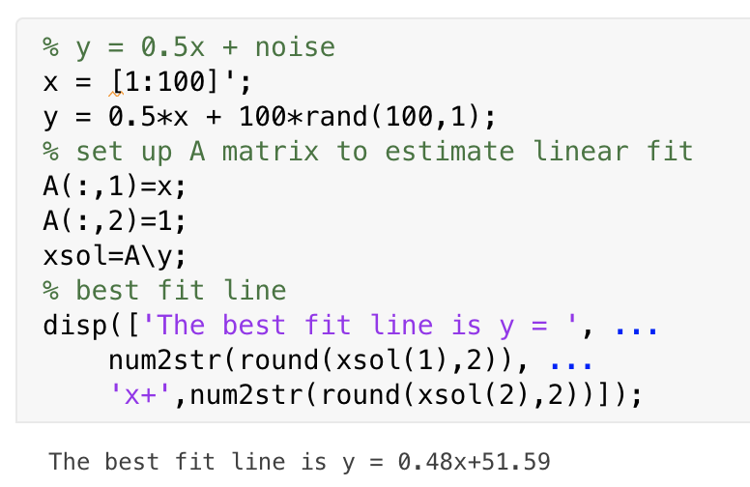
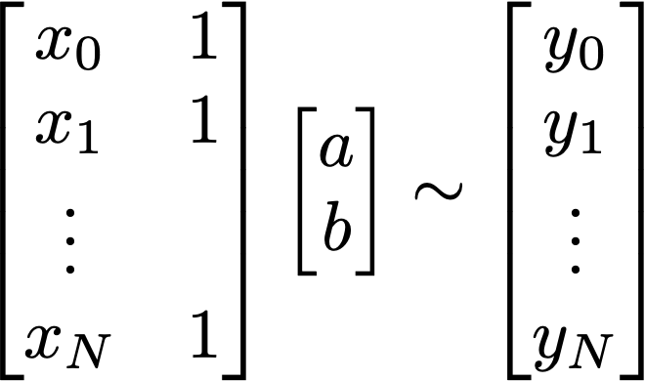
Linear regression in Ax = b form
A x ~ b

Slide 33
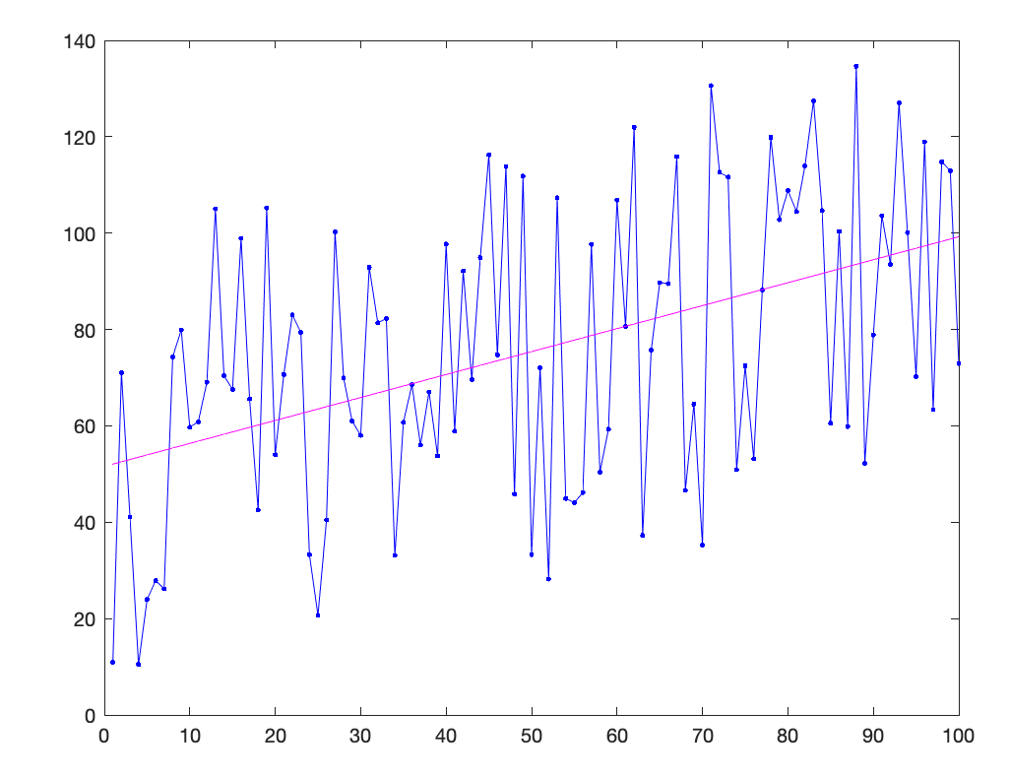
Linear regression in Ax = b form

Slide 34
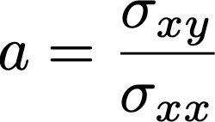
Regression coefficient a in y = ax + b
The linear coefficient (a) is called regression coefficient.
It is also said that ”y is regressed onto x”, and the regression coefficient measures the changes in y due to a unit increase in x.
It can also be shown that:
Covariance
=
Variance in x

Slide 35
Regression coefficient a in y = ax + b
Covariance
=
Variance in x
x : explanatory variable
y: explained variable
How much variance in y can be explained by the regression?

Slide 36
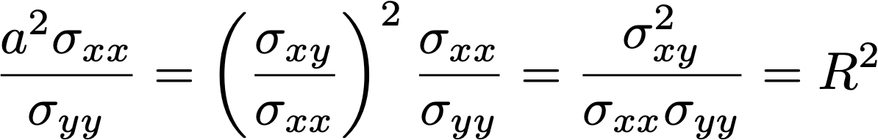
Regression coefficient a in y = ax + b
Covariance
=
Variance in x
x : explanatory variable
y: explained variable
How much variance in y can be explained by the regression?

Slide 37
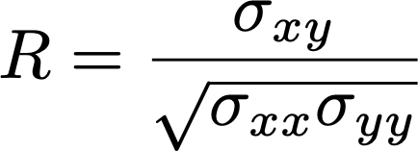
R² : coefficient of determination
R² measures the fraction of variance explained by the regression.
(correlation coefficient) =
R is called Pearson’s correlation, or simply, r-value. This quantifies a measure of the relationship between the two variable. It varies from -1 to +1. You can think of it as a unitless, normalized covariance.

Slide 38
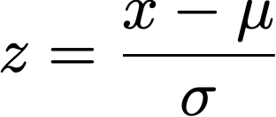
Standardization (z-transform)
Transforms the data so it has zero mean and 1 standard deviation.
This is useful when you want to evaluate the relationship between two variables
Covariance between the two standardized variables are equal to their correlation

Slide 39
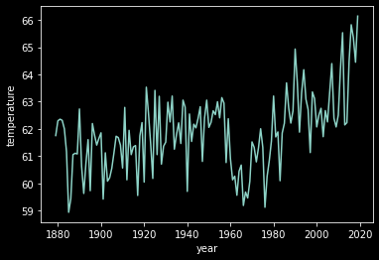
Application to Atlanta’s temperature data
Temperature of Atlanta appears to be warming up.
Let’s estimate the linear trend, which is a regression of temperature (y) onto time (x).

Slide 40
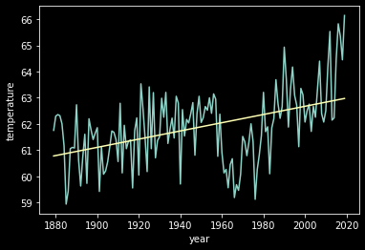
Application to Atlanta’s temperature data
Temperature of Atlanta appears to be warming up.
Let’s estimate the linear trend
y = ax + b
a = 0.016 °F/year
R² = 0.21

Slide 41
Application to Atlanta’s temperature data
Temperature of Atlanta appears to be warming up.
Let’s estimate the linear trend
y = ax + b
a = 0.016 °F/year
R² = 0.21
Linear trend explains 21% of the total variance in the data.

Slide 42
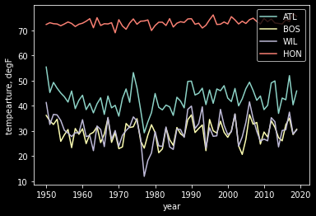
Comparing different cities (mean January temperature)

Slide 43
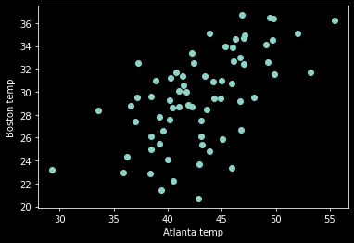
Comparing two cities (scatter plot)
R=0.6

Slide 44
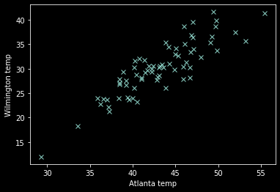
Comparing two cities (scatter plot)
R=0.87

Slide 45
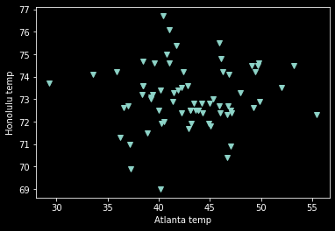
Comparing two cities
R=0.05

Slide 46
Covariance matrix
Data matrix: D
Temperature records from (M) cities are stored as row vector (M x N) matrix
We subtract mean value from each rows.
C = 1/N-1 * DD^{T}
can be calculated as np.cov(D) in python, cov(D) in MATLAB

Slide 47
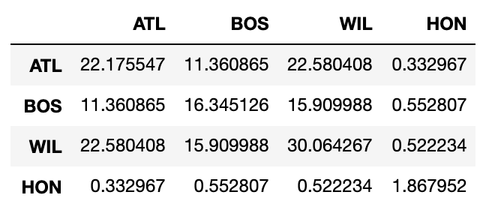
Covariance matrix
Covariance matrix: C for January temperature

Slide 48
Correlation matrix
Correlation matrix: R
Similar to covariance matrix but each element is divided by the product of standard deviation (z-transform)
This can be calculated as np.corrcoef(D) in python and corrcoef(D) in MATLAB

Slide 49
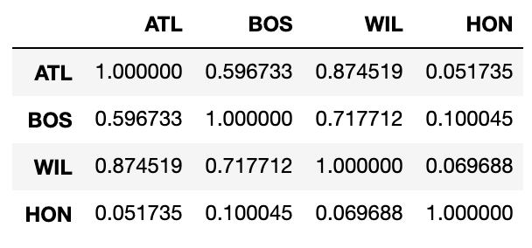
Correlation matrix
Correlation matrix: R for January temperature

