Slide 1
We may need to interpolate data when…
Comparing datasets that are defined in different grid system in space and/or in time
Data points are sparse and/or irregular, and it needs to be placed on regular grid before data analysis/interpretation
There is a data gap (missing data) that needs to be filled
Preparing inputs (e.g. boundary conditions) for a model that are continuous, smooth and without gaps

Slide 2

Interpolation as a linear operator
Mathematically,

Slide 3
Interpolation as a linear operator
Mathematically,
Output, e.g. estimated temperature on regular grid
Input, e.g. observed temperature on irregular grid

Slide 4
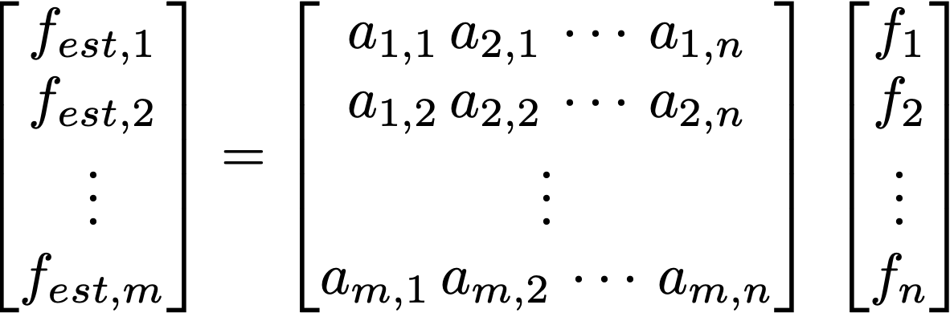
Interpolation as a linear operator
Mathematically,
Output, e.g. estimated temperature on regular grid
Input, e.g. observed temperature on irregular grid

Slide 5
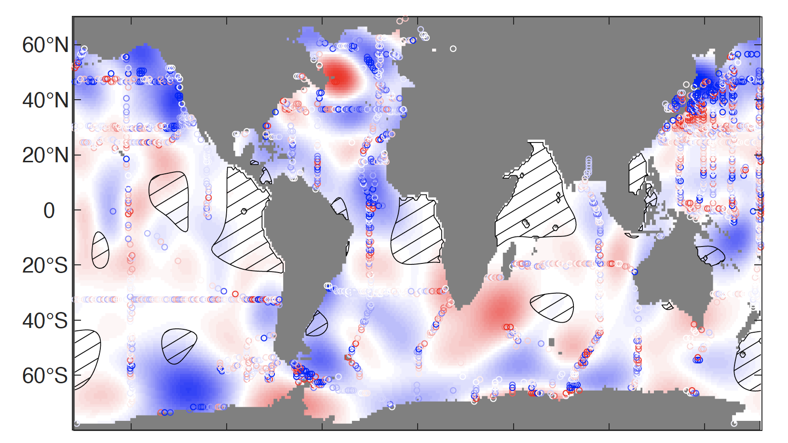
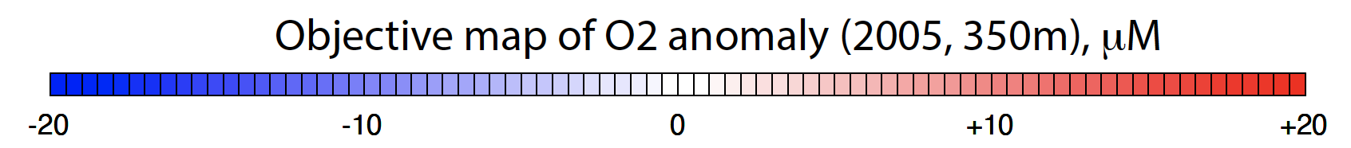
Objective mapping (optimal interpolation)
Objective mapping is a least square fit to the irregular, noisy observations, commonly used in meteorology and oceanography

Slide 6
Two dimensional interpolation
Input/output are in 2 dimensions: f(x,y)
Example: Input is a temperature on 2° x 2° longitude-latitude grid and the desired output is on 1° x 1° grid.
Bilinear interpolation → this is what I use for the first try. First, linearly interpolate in one direction, and then linearly interpolate again in the other direction
Other options would be nearest neighbor and cubic spline

Slide 7
Smoothing
Real data often contains noise.
For example, atmospheric data contains high-frequency weather events on top of slowly varying climate signals. Ocean data can contain the effects of tides, waves, eddies, seasonal cycles etc…
Sometimes, we want to remove the high-frequency “noises” so that we can focus on the slowly varying climate signals.
Smoothing (filtering) is almost necessary step in data analysis

Slide 8
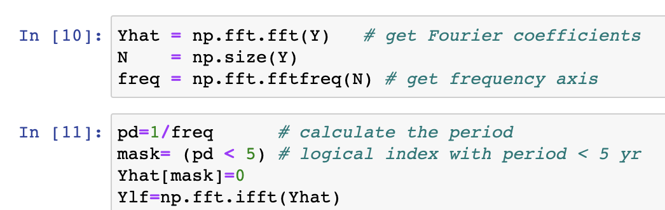
FFT filter
Fourier series → decomposes the data into linear combination of sine and cosine waves
Fast Fourier Transform (FFT) can be used to separate the data into different frequency domain, and ”truncate” the data to chop off certain frequency components

