Slide 1
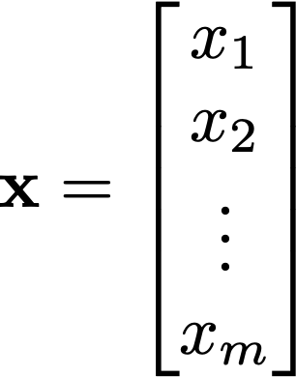
Vector
In physics, vector has a direction and magnitude, like velocity of a moving object.
In data analysis, a series of discrete data can be expressed as a vector (let’s say there are m data points, then you have a m-dimensional vector)
In computational model, model state can be expressed as a vector (e.g. chemical concentrations in box models, dynamic height in geophys fluid dynamics, with m being the number of grid points)

Slide 2
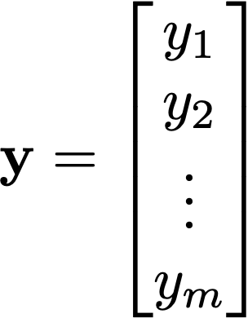
Vector
When there are more then two vectors, they can add together to form another vector
x + y
y
x

Slide 3
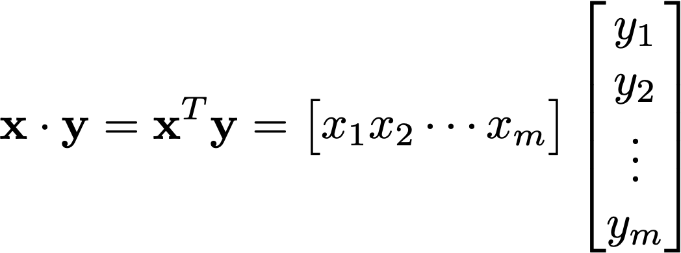

Vector
Vectors can multiply together: inner product produces a scalar
(remember “row times column”)
In a 2D example,
y
θ
x

Slide 4
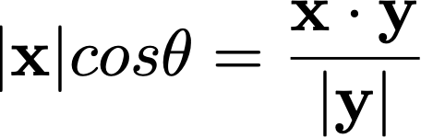
Vector
Vectors can multiply together: inner product produces a scalar
(remember “row times column”)
In a 2D example,
The projection of x onto y is:
y
θ
x

Slide 5
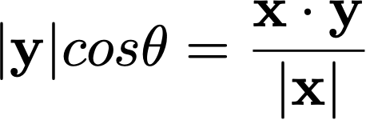
Vector
Vectors can multiply together: inner product produces a scalar
(remember “row times column”)
In a 2D example,
The projection of y onto x is:
y
θ
x

Slide 6

Vector
Vectors can multiply in a different way: cross product produces a vector
(remember “the right hand rule”)
x x y
y
θ
x

Slide 7
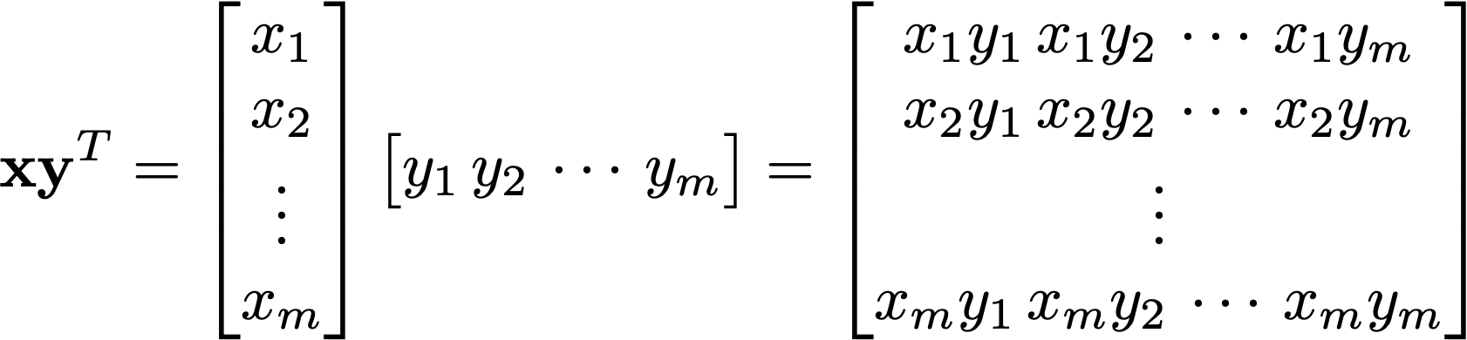
Vector
Vectors can multiply together in another different ways: outer product produces a matrix (again, remember “row times column”)

Slide 8
Inner product and (co)variance
In data analysis, vector can contain a collection of measurements (e.g. mean August temperature of Atlanta from last 140 years)

Slide 9
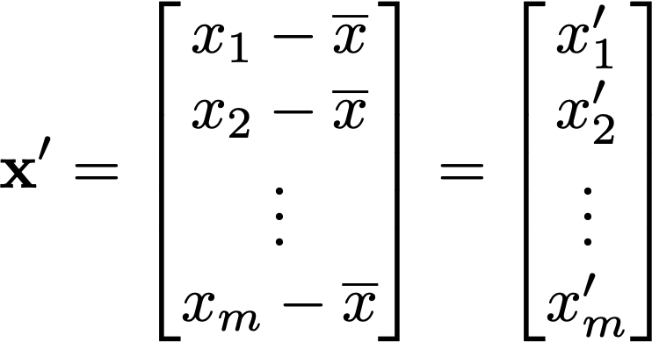
Inner product and (co)variance
Let’s subtract mean of x from all elements, so x becomes x’

Slide 10
Inner product and (co)variance
Inner product of x’ with itself the square of the ”length” of the x’ vector.
It is equal to the variance (σ² or σ_{xx}) of the data contained in vector x multiplied by N-1
The “length” |x’| is also called the L2 norm

Slide 11
Inner product and (co)variance
Inner product of x’ and y’ is:
the covariance of the data contained in vector x and y (multiplied by N-1)
(2) the projection of x onto y (multiplied by |y’|)
(3) Proportional to the correlation between x and y

Slide 12
Inner product and (co)variance
Inner product of x’ and y’ is:
the covariance of the data contained in vector x and y (multiplied by N-1)
(2) the projection of x onto y (multiplied by |y’|)

Slide 13

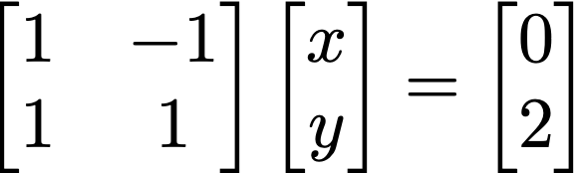


Matrix-vector product and
A (2 x 2) example
y=x
A
x
=
b
The “row” point of view:
Intersection of two lines
y=-x+2
The problem Ax = b is solvable only if the two lines intersect at a point

Slide 14

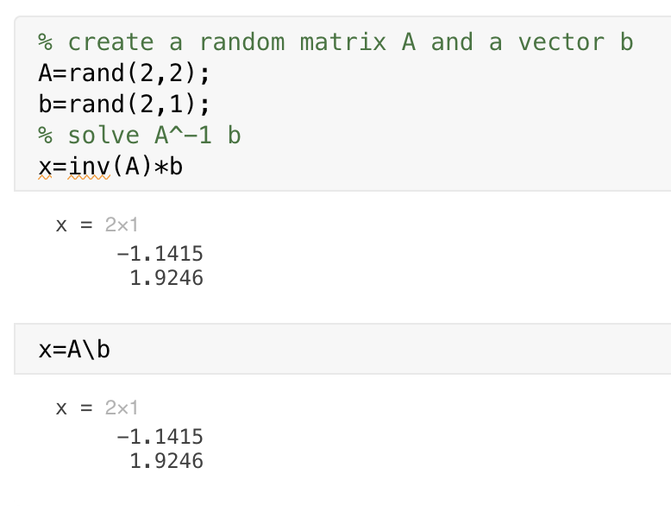
Matrix-vector product and
Inverse matrix A⁻¹
If inverse matrix of A exists, we have
In MATLAB it is inv function. Also the backslash operation “A\b” does it for you…
In Python, np.linalg.inv (or scipy.linalg.inv)

Slide 15
Matrix-vector product and
What if A is not a square matrix?
Let’s say there are too many (m) equations than (n) unknowns.
In this case, there is no unique solution x that can satisfy all equations in Ax = b in the exact sense

Slide 16
Matrix-vector product and
Consider A is (m x 2) matrix, x is (2 x 1) and b is (m x 1) and m is much larger than 2.
In this case, A x is unlikely equal to b in the exact sense.
However, we could look for the approximate solution x that minimizes the magnitude of the misfit |Ax - b| (aka least square method).

Slide 17


Pseudoinverse of non-square matrix A
⬅ Solution to this equation does not exist because of non-square A
However, pseudoinverse provides a solution that minimizes the discrepancies between Ax and b
This is the pseudoinverse of A
The solution, x, is the best-fit solution to Ax = b in the “Least Square” sense!

