Slide 1
Reproducing PowerSGD on Perlmutter
Low-rank gradient compression for data-parallel training
Paper: Vogels, Karimireddy & Jaggi, “PowerSGD: Practical Low-Rank Gradient Compression for Distributed Optimization”, NeurIPS 2019
Nayan Yadav
Deep Learning course project · November 2026
Notes:
We reproduced the main results of the PowerSGD paper on NERSC Perlmutter, using the authors' own research code, and checked which of its claims still hold on modern hardware.

Slide 2
The problem: communication in data-parallel training
Every training step, every GPU must exchange its entire gradient.
• Data parallelism: each GPU computes a gradient on its share of the batch; all GPUs then average their gradients (all-reduce) before updating the model.
• The message is the whole model: 43 MB per step for ResNet18 and 110 MB for the 3-layer LSTM used in the paper.
• As models and GPU counts grow, communication can dominate the time per step.
• Earlier compressors (sign-based, top-K) either lose accuracy or cannot be summed with all-reduce, so they scale poorly with more GPUs.
Reproducing PowerSGD on Perlmutter
2
Notes:
Data parallelism splits the batch across GPUs, but the gradients must be averaged after every step. The message is as large as the model, so communication grows with model size.

Slide 3
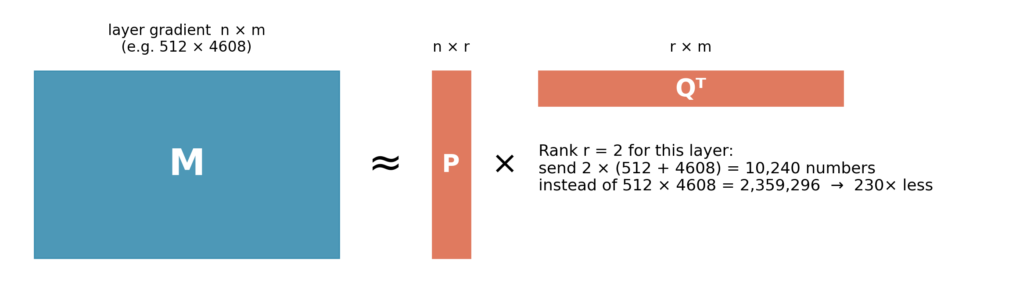
PowerSGD: send a low-rank approximation of each gradient
Approximate each layer's gradient matrix M by P·Qᵀ with small rank r (1, 2 or 4).
• One power-iteration step per layer: P = M·Q → all-reduce P → orthogonalize P → Q = Mᵀ·P → all-reduce Q.
• Warm start: reuse the previous step's Q, so a single cheap iteration is enough.
• Error feedback: remember what the compression missed and add it to the next gradient.
• Linear in M: the GPUs' P and Q can simply be summed with all-reduce.
Reproducing PowerSGD on Perlmutter
3
Notes:
Each layer's gradient is a matrix. PowerSGD runs one step of power iteration to find a rank-r approximation and only communicates the two thin factors. Warm start and error feedback keep it accurate; linearity lets it use all-reduce.

Slide 4
The paper's three claims
We tested all three with the authors' own code, matching Table 3 of the paper.
1
2
3
Same accuracy as SGD
100× or more less communication
Faster training
CIFAR-10: Rank 2 reaches 94.4% vs 94.3% for SGD.
WikiText-2: Rank 4 matches SGD's perplexity (91 vs 91).
136× less data with Rank 2 on ResNet18.
120× less with Rank 4 on the LSTM.
On 16 GPUs, time per batch drops by 23% (ResNet18, Rank 2) and 55% (LSTM, Rank 4).
Reproducing PowerSGD on Perlmutter
4
Notes:
These are the three claims we set out to check. Numbers are from Table 3 of the paper, 16 GPUs, ResNet18 on CIFAR-10 and an LSTM on WikiText-2.

Slide 5
Setup: same code and hyperparameters, very different hardware
Only the hardware changed; the algorithm, models and hyperparameters are the paper's.
 | Paper (2019) | Ours: Nayan Yadav's runs on NERSC Perlmutter (2026)
GPUs | 16× GTX Titan X (2 per node, 8 nodes) | 16× A100 (4 per node, 4 nodes)
Network | 10 Gbit/s Ethernet | NVLink within a node, Slingshot-11 between nodes
Software | PyTorch 1.1, NCCL | PyTorch 2.13, NCCL
Tasks | ResNet18 / CIFAR-10 (300 epochs), LSTM / WikiText-2 (90 epochs) | Same
Hyperparameters | Tuned for SGD, reused unchanged for PowerSGD | Identical
Repetitions | 3 seeds | 3 seeds per method: 24 runs
Compute used | Not reported | 36.9 GPU-hours (from Slurm accounting)
• Porting only: one GPU per process under Slurm; replaced two libraries that no longer exist (a CUDA bit-packing extension and the old torchtext/spaCy text pipeline); fixed the dataset download.
Reproducing PowerSGD on Perlmutter
5
Notes:
We ran the authors' research code unchanged except for porting. The big difference is the network: the paper's 10 Gbit/s Ethernet versus Perlmutter's NVLink and Slingshot.

Slide 6
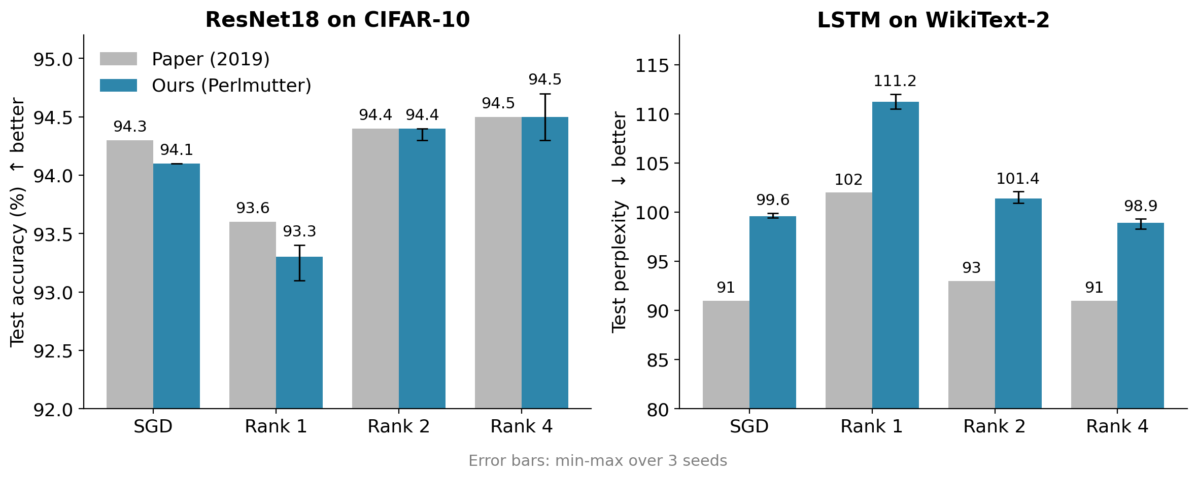
Claim 1: accuracy matches SGD ✓
CIFAR-10 is within 0.3 points of the paper; LSTM perplexity is 8-9 points higher for every method.
• Seeds agree closely (error bars = min-max of 3 runs), so the small differences are real but tiny.
Reproducing PowerSGD on Perlmutter
6
Notes:
Left: CIFAR-10 test accuracy. Rank 2 and Rank 4 hit the paper's numbers exactly. Right: the LSTM. All of our perplexities are higher than the paper's, including plain SGD, which points to a data difference rather than PowerSGD. The next slides show this.

Slide 7
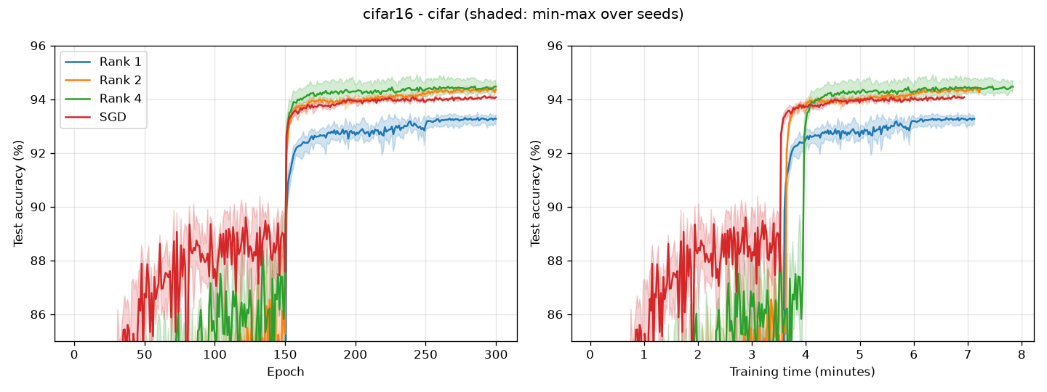
CIFAR-10 training curves
Rank 2 and Rank 4 track SGD; Rank 1 levels off about 1 point lower, as in the paper.
Jump at epoch 150 = learning-rate decay. Shaded = min-max over 3 seeds. Full run: ~8 minutes on 16 A100s (paper: ~45 minutes).
Reproducing PowerSGD on Perlmutter
7
Notes:
These are the counterpart of the paper's Figure 4. The jump at epoch 150 is the learning-rate decay. Training took about 8 minutes on 16 A100s versus about 45 minutes in the paper.

Slide 8
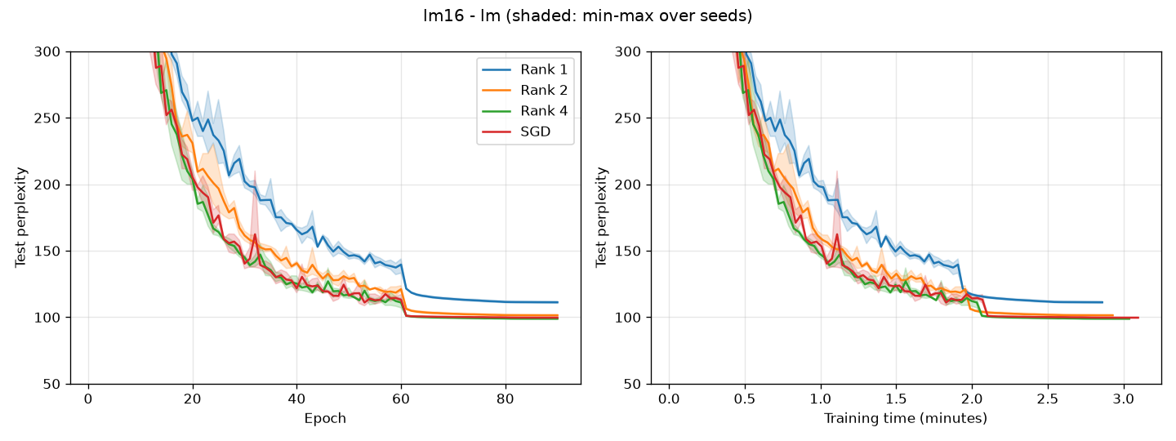
WikiText-2 LSTM training curves
Higher rank gives lower perplexity; Rank 4 ends level with SGD, as in the paper.
Drop at epoch 60 = learning-rate decay. Shaded = min-max over 3 seeds. Full run: ~3 minutes on 16 A100s.
Reproducing PowerSGD on Perlmutter
8
Notes:
Same ordering as the paper's Figure 4: Rank 1 is clearly worse, Rank 2 is close and Rank 4 matches SGD. The drop at epoch 60 is the learning-rate decay.

Slide 9
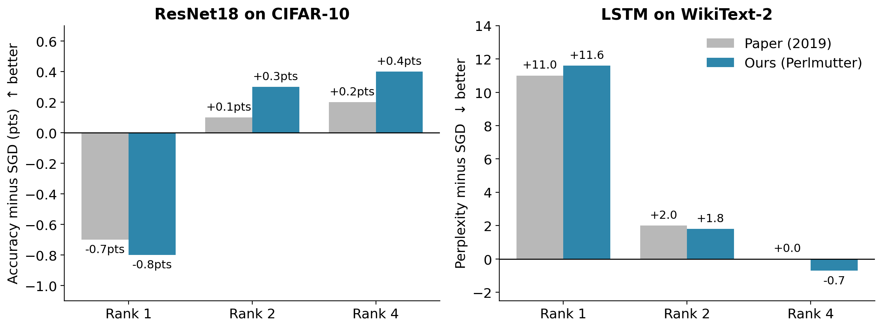
The key comparison: PowerSGD relative to SGD
Measured against SGD, our results match the paper almost exactly, LSTM included.
• The LSTM's +8-9 perplexity offset also affects SGD, so it comes from the data pipeline (the original spaCy tokenizer had to be replaced), not from PowerSGD.
Reproducing PowerSGD on Perlmutter
9
Notes:
The paper's claim is about PowerSGD compared with SGD, so this is the fair comparison. Our gaps match the paper's within half a point of accuracy and about one point of perplexity. The LSTM's constant offset cancels out because it also affects SGD.

Slide 10
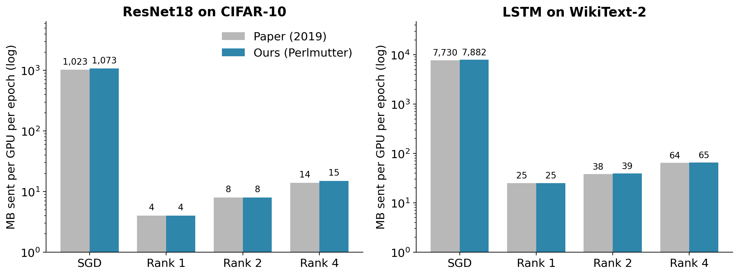
Claim 2: 100× or more less communication ✓
Data sent per epoch matches the paper for every method.
• ResNet18: Rank 2 sends 136× less than SGD. **LSTM: **Rank 1 sends 310× less, Rank 4 sends 120× less.
Reproducing PowerSGD on Perlmutter
10
Notes:
Log scale. Communication volume is a property of the algorithm and the model shapes, so it should match exactly, and it does. Rank 2 sends 136 times less than SGD on ResNet18.

Slide 11
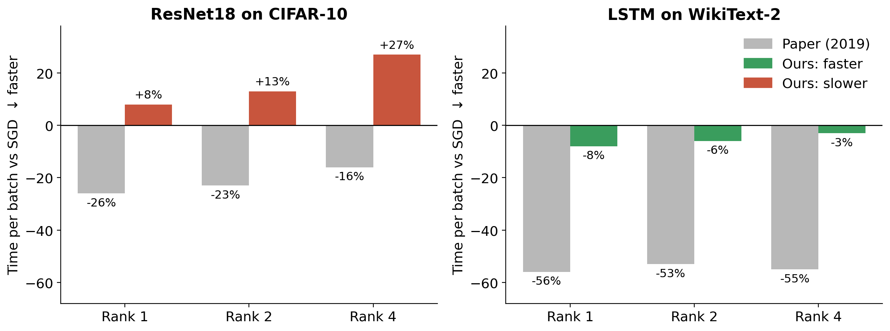
Claim 3: faster training ✗ on Perlmutter
On ResNet18, PowerSGD is slower than SGD; on the LSTM it saves only 3-8%.
• Paper: 16-26% faster (ResNet18) and 53-56% faster (LSTM). **Ours: **8-27% slower and 3-8% faster.
• Our ms per batch: ResNet18 SGD 26.2 → Rank 1/2/4: 28.3 / 29.6 / 33.2. LSTM SGD 28.8 → 26.5 / 27.1 / 28.1.
Reproducing PowerSGD on Perlmutter
11
Notes:
This is where our results differ from the paper. We compare the relative change against SGD on the same hardware, not raw milliseconds, since A100s are simply faster than Titan X GPUs.

Slide 12
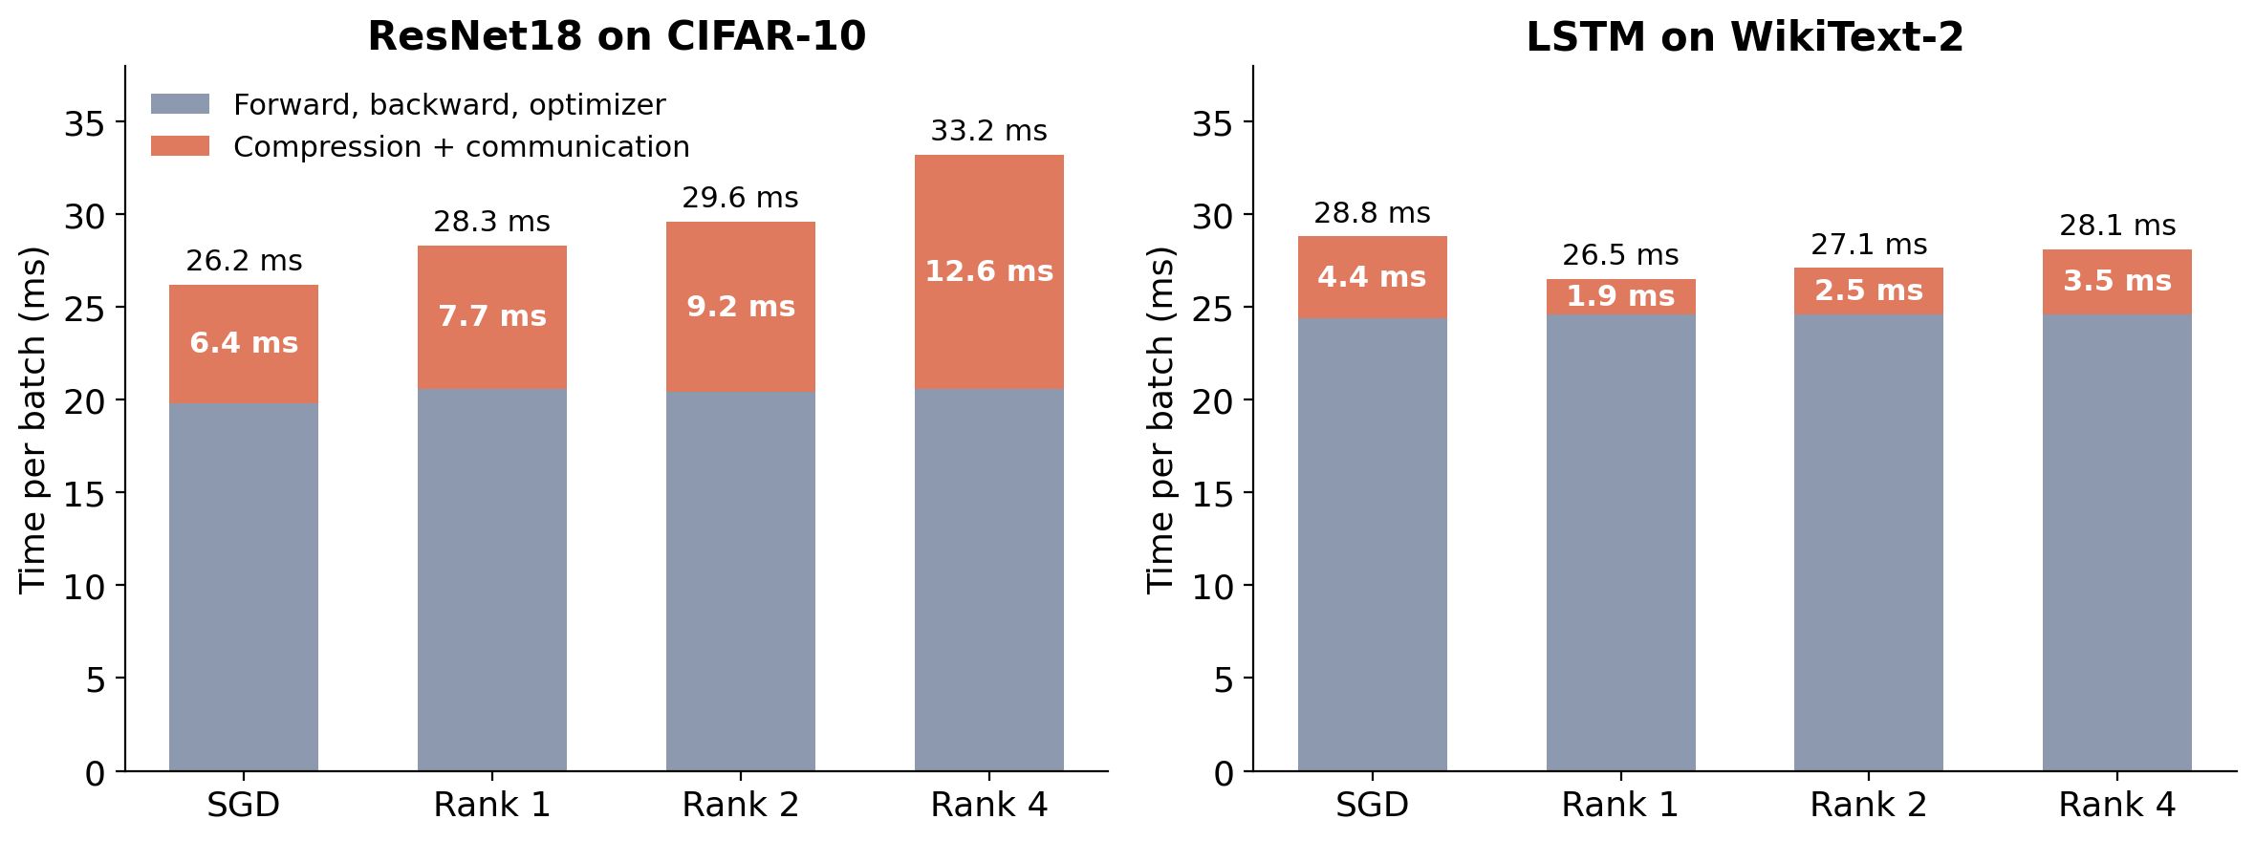
Why: communication is cheap on Perlmutter
There is little communication left to save, and compressing costs more than it saves.
• SGD's full all-reduce is only 6.4 of 26 ms (CIFAR-10) and 4.4 of 29 ms (LSTM): the most any compressor could save.
• PowerSGD's step takes longer (9.2 ms at Rank 2): many small per-layer matrix products and orthogonalizations, plus small all-reduces bound by latency, not bandwidth.
• The paper's 10 Gbit/s network is ~80× slower than Perlmutter's 4×200 Gbit/s links between nodes, so there communication dominated.
Reproducing PowerSGD on Perlmutter
12
Notes:
Breakdown of one training step. On CIFAR-10, SGD's whole gradient exchange is only 6.4 ms, about a quarter of the step, which caps any possible gain. PowerSGD's compression and communication take longer than that, because they are many small operations limited by latency rather than bandwidth.

Slide 13
Scorecard
Accuracy and compression are properties of the algorithm; speedup depends on the hardware.
Claim | Paper | Ours | Reproduced?
Accuracy on par with SGD (CIFAR-10) | Rank 2: 94.4% vs 94.3% | Rank 2: 94.4% vs 94.1% | ✓ Yes
LSTM: Rank 4 matches SGD | 91 vs 91 perplexity | 98.9 vs 99.6 perplexity | ✓ Yes (relative)
Quality improves with rank | Rank 1 < 2 < 4 | Rank 1 < 2 < 4 (both tasks) | ✓ Yes
Communication reduction | 136× (Rank 2, ResNet18) | Same MB per epoch | ✓ Yes
Speedup, ResNet18 | −23% per batch (Rank 2) | +13% per batch | ✗ No
Speedup, LSTM | −55% per batch (Rank 4) | −3% per batch | ✗ Mostly not
Reproducing PowerSGD on Perlmutter
13
Notes:
Summary of what reproduced. The algorithm behaves exactly as described; the wall-clock benefit depends on how expensive communication is relative to computation.

Slide 14
Takeaways and next steps
What we found
Next steps
• The paper's accuracy and compression results reproduce from the authors' code, with no retuning: 24/24 runs, 3 seeds each.
• Its speedups do not: on a fast interconnect, communication is too small a part of each step for compression to pay off on these models.
• Fair comparisons across hardware use changes relative to SGD, not raw times.
• nanoGPT and larger models: much bigger gradients, so communication matters more.
• Data vs tensor parallelism: where gradient compression applies, and where it does not.
• Low-precision gradients (fp32 → fp8): an alternative or complement to low-rank compression.
• Slow-network runs (Gloo backend, 1-16 GPUs) to recreate the paper's setting.
Reproducing PowerSGD on Perlmutter
14
Notes:
PowerSGD's speedup depends on the communication-to-compute ratio. Larger models such as GPT-style transformers send much bigger gradients, which is where we expect compression to pay off on modern hardware. That is the next part of the project.

Slide 15
Appendix: full Table 3 results
Nayan Yadav's Perlmutter runs: 16 GPUs, 3 seeds each, shown as mean [min, max].
Task | Method | Ours | Paper | MB/epoch ours | Paper | ms/batch ours | Paper
CIFAR-10 (acc.) | SGD | 94.1% [94.1, 94.1] | 94.3% | 1,073 | 1,023 | 26.2 | 312
 | Rank 1 | 93.3% [93.1, 93.4] | 93.6% | 4 | 4 | 28.3 | 229
 | Rank 2 | 94.4% [94.3, 94.4] | 94.4% | 8 | 8 | 29.6 | 239
 | Rank 4 | 94.5% [94.3, 94.7] | 94.5% | 15 | 14 | 33.2 | 260
WikiText-2 (ppl.) | SGD | 99.6 [99.4, 99.9] | 91 | 7,882 | 7,730 | 28.8 | 300
 | Rank 1 | 111.2 [110.5, 112.0] | 102 | 25 | 25 | 26.5 | 131
 | Rank 2 | 101.4 [100.9, 102.1] | 93 | 39 | 38 | 27.1 | 141
 | Rank 4 | 98.9 [98.3, 99.3] | 91 | 65 | 64 | 28.1 | 134
Raw ms/batch is not comparable across hardware (A100 vs Titan X); compare the change relative to SGD instead.
Reproducing PowerSGD on Perlmutter
15
Notes:
All numbers behind the charts. Generated with perlmutter/submit_paper.sh table3 and paper-code/analyze_results.py.

