Slide 1

Big Data Analytics Application In Healthcare
A Focus On Healthcare Patient Satisfaction
GROUP MEMBERS:
JAMIU AROGUNDADE - 240024714,
ELIJAH OLUSUNMADE - 230219645,
ESTHER CHUKWU - 240033587.

Slide 2
INTRODUCTION
Consumer Assessment of Healthcare Providers and Systems (CAHPS)
Purpose: To assess patient satisfaction at hospitals receiving Medicare and Medicaid payments.
Rating System: Hospitals are rated on a five-star scale (1 to 5 stars), 5 being the best and 1 the worst.
Benefits:
Historical Analysis: Track trends in patient satisfaction from 2016 to 2020.
Benchmarking: Compare performance against national averages and other health institutions.
Identifying Areas for Improvement: Pinpoint specific areas needing improvement based on patient feedbacks.
Benefits (Continued):
Policy and Decision Making: Guide the government to make Informed healthcare policies and accurate funding decisions.
Research Purposes: Facilitate studies on trends, correlations, and predictions.
Geographical Insights: Identify regional variations in satisfaction scores.
Performance Evaluation: Evaluate the impact of interventions on patient satisfaction.
Informed Patients: Enable potential patients to make informed healthcare decisions.
Notes:
References:
https://data.cms.gov/provider-data/archived-data/hospitals

Slide 3
INTRODUCTION
Data Analysis Processes
Data Collection: Gathering raw data from various sources. This data was obtained from Kaggle.
Data Preparation: Removing errors and inconsistencies.
Data Exploration: Understanding data characteristics and patterns.
Data Modeling: Applying statistical models, ML algorithms for deeper analysis and prediction.
Data Interpretation: Drawing conclusions and insights.
Data Visualization: Presenting data through charts and graphs.
Reporting: Summarizing findings for stakeholders. (As shown in Figure 1.)
Collection
Preparation
Exploration
Modelling
Interpretation
Visualizatiion
Reporting
Fig. 1: Data analysis process
Notes:
References:
Bryman, A. and Bell, E., 2015. Business Research Methods. 4th ed. Oxford: Oxford University Press.
McKinney, W., 2017. Python for Data Analysis. 2nd ed. Sebastopol: O'Reilly Media.
Provost, F. and Fawcett, T., 2013. Data Science for Business. 1st ed. Sebastopol: O'Reilly Media.
Mention the tools used and their purpose: Microsoft Azure, Power BI and ML in Jupyter Notebook

Slide 4
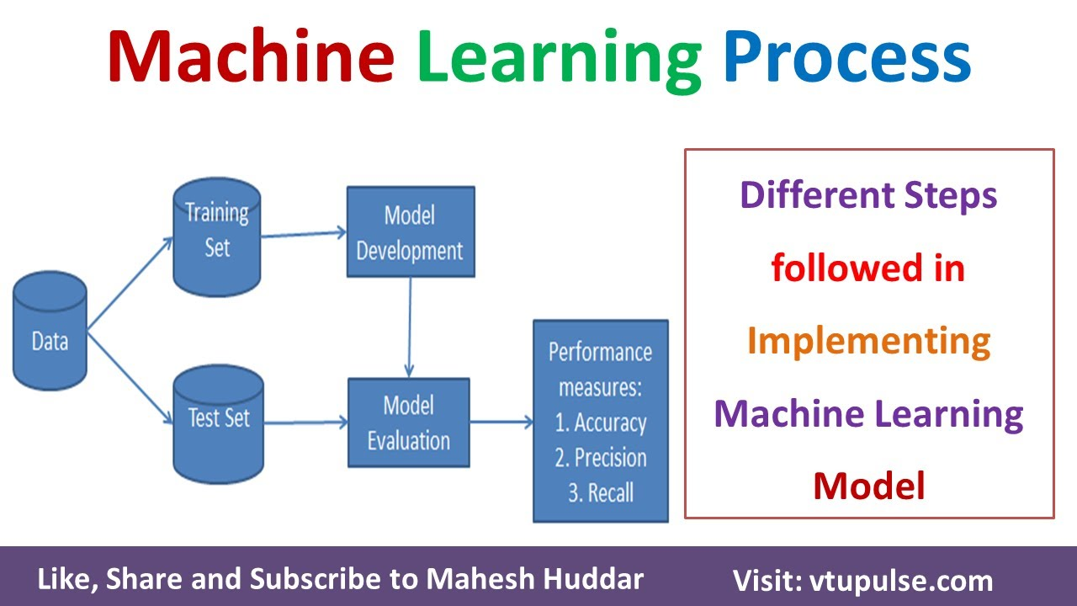
INTRODUCTION
Machine Learning In Data Analysis Process
Machine Learning (ML) transforms data analysis by automating and improving data processing, prediction, and interpretation.
It gifts the opportunity to unlock patterns and insights from large datasets that are often beyond human capability.
Machine Learning In Data Analysis Process:
Data Collection
Data preparation
Choosing the best-fit Model (e.g Regression, Classification)
Training and test the model
Model performance evaluation
Deployment and monitoring. (As shown in Fig 2)
Fig 2: ML Process
Notes:
References:
Bishop, C. M. (2006). Pattern Recognition and Machine Learning. Springer.
Murphy, K. P. (2012). Machine Learning: A Probabilistic Perspective. MIT.

Slide 5

Cloud Computing In Healthcare Patient Satisfaction
Esther Chukwu - 240033587
Cloud Computing is the on-demand delivery of IT resources including servers, storage, databases, networking, software, analytics, and intelligence over the internet (Cloud) to offer faster innovation, flexible resources and economies of scale.
The main types of cloud are: Public, Private and Hybrid cloud.
Public cloud solutions are the most prevalent IT infrastructures used today for computing and storage and they include:
Amazon Web Services (AWS) which offers a wide range of cloud services including computing power, storage options and networking.
Microsoft Azure Provides cloud services for building, testing, deploying and managing applications through Microsoft managed data centers
Google Cloud Platform (GCP) provides services including computing, data storage, data analytics and machine learning
Fig 2: ML Process
Fig 3.0: Cloud Services
Notes:
References:
Bryman, A. and Bell, E., 2015. Business Research Methods. 4th ed. Oxford: Oxford University Press.
McKinney, W., 2017. Python for Data Analysis. 2nd ed. Sebastopol: O'Reilly Media.
Provost, F. and Fawcett, T., 2013. Data Science for Business. 1st ed. Sebastopol: O'Reilly Media.

Slide 6

Microsoft Azure
Esther Chukwu - 240033587
Microsoft Azure provides cloud services for building, testing, deploying and managing applications through Microsoft-managed data Centers.
Why We chose Microsoft Azure over other Cloud Services:
Cost Efficiency and Optimization.
Hybrid Cloud Capacities
Infrastructure Management
High Security and Compliance.
Integration with other Microsoft products.
Scalable, Adaptable and easily Available.
Global Reach and Enterprise-Grade Solutions
Fig 3.1: Azure Logo

Slide 7
What We Did With Microsoft Azure
Esther Chukwu - 240033587
Benefits of Using Cloud Computing in our Project
Scalability: Easily handle large datasets
Collaboration: Seamless sharing and collaboration among team members
Cost-effective: Pay only for the services we used
Security: Robust security features to protect sensitive healthcare data.
We used Microsoft Azure cloud services to handle the Big Data involved in analyzing healthcare patient satisfaction.
Created Virtual Machines
Created Storage and Containers
Uploaded our dataset into the storage
Assigned appropriate permissions to my team

Slide 8
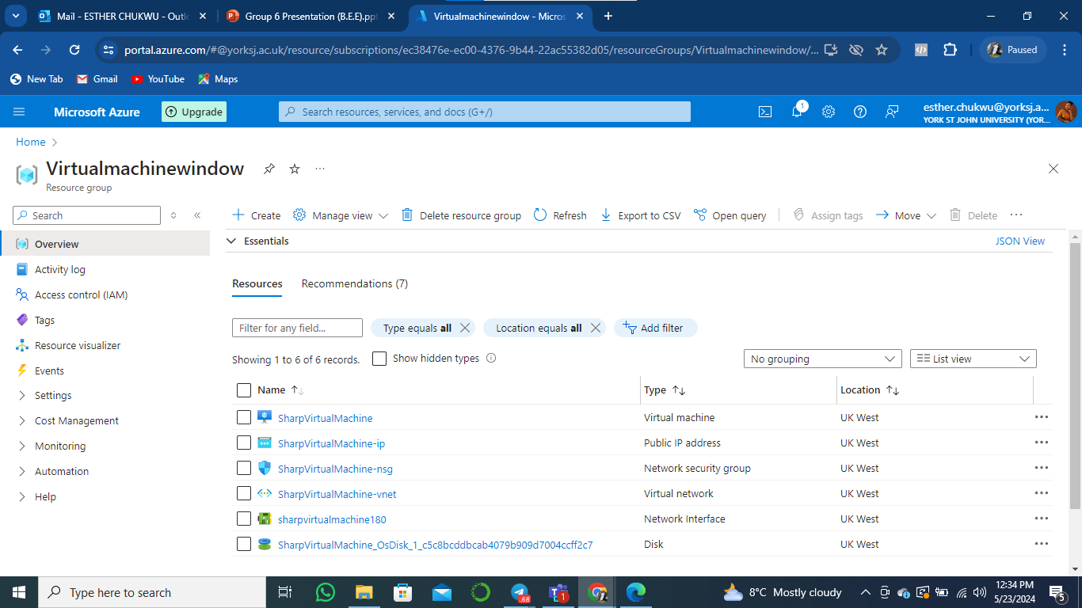
Creating Virtual Machine
Esther Chukwu - 240033587
Virtual Machines (VMS) are software-based emulations of physical computers.
We chose an appropriate VM configuration based on our computational needs.
Installed necessary software and tools for data analysis
Fig 3.2: Creating Azure Storage Account
Notes:
References:
Bryman, A. and Bell, E., 2015. Business Research Methods. 4th ed. Oxford: Oxford University Press.
McKinney, W., 2017. Python for Data Analysis. 2nd ed. Sebastopol: O'Reilly Media.
Provost, F. and Fawcett, T., 2013. Data Science for Business. 1st ed. Sebastopol: O'Reilly Media.

Slide 9
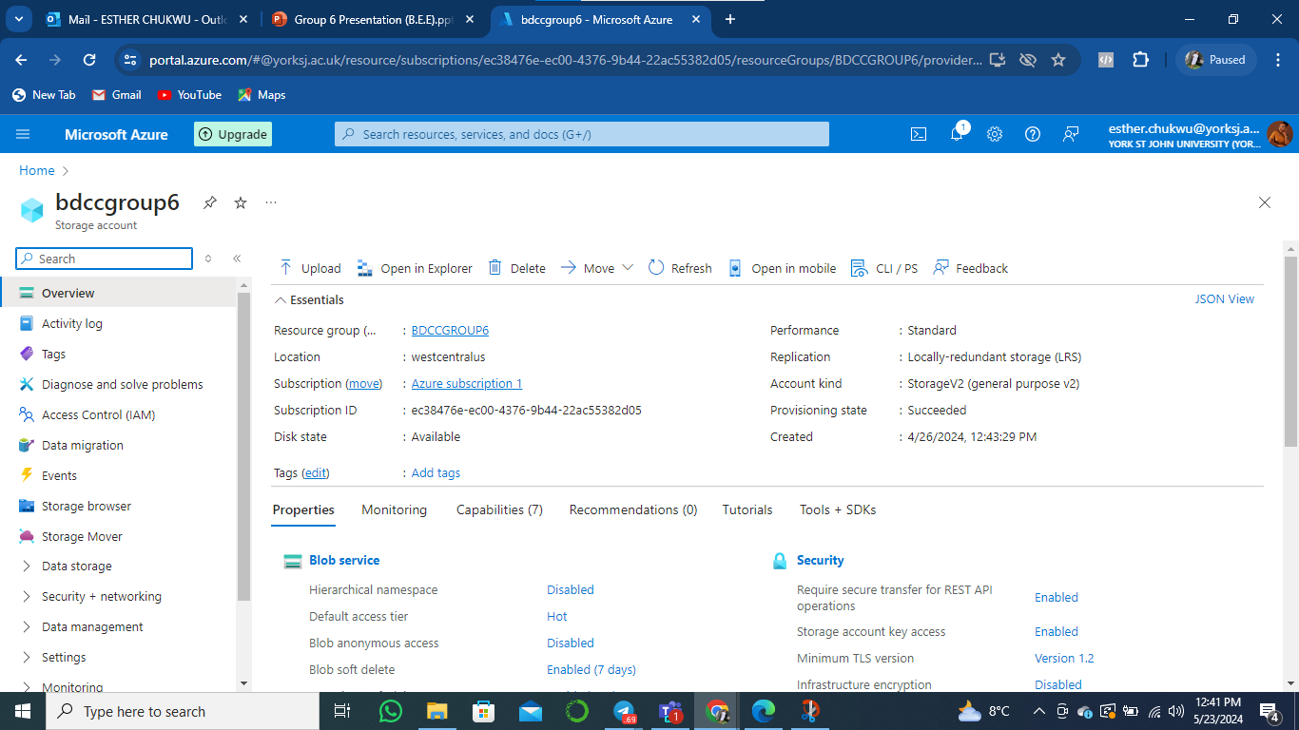
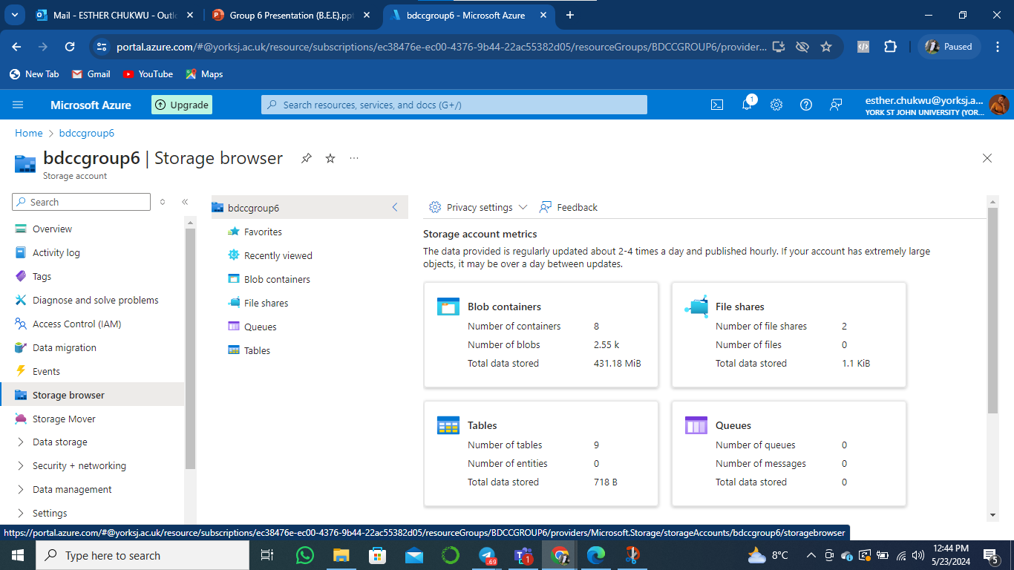
Creating Storage and Container
Esther Chukwu - 240033587
Storage: Cloud Storage allows us to store vast amounts of data securely.
Containers: Containers enclose an application and its dependencies and ensure it runs consistently across different environments.
We created storage accounts for our datasets
We set up containers to organize and manage data
Uploaded our healthcare dataset to the cloud storage we created.
Ensured data was organized and easily retrievable
Fig 3.3: Creating Azure Storage Account
Fig 3.4: Creating Azure Storage Account

Slide 10
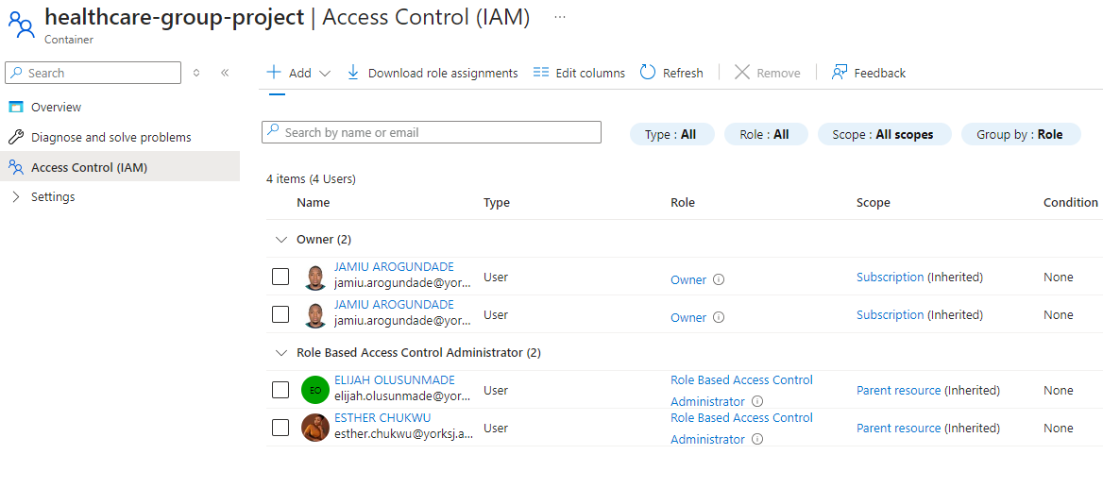
Assigning Appropriate Permissions
Esther Chukwu - 240033587
Ensuring the right permissions are set is crucial for data security and team collaboration.
I assigned read/write permissions to team members.
I managed access controls to ensure integrity and security.
Fig 3.5: Granting Security Access to the Storage Account
Notes:
References:
Bryman, A. and Bell, E., 2015. Business Research Methods. 4th ed. Oxford: Oxford University Press.
McKinney, W., 2017. Python for Data Analysis. 2nd ed. Sebastopol: O'Reilly Media.
Provost, F. and Fawcett, T., 2013. Data Science for Business. 1st ed. Sebastopol: O'Reilly Media.

Slide 11
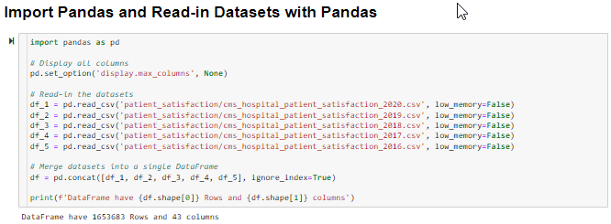
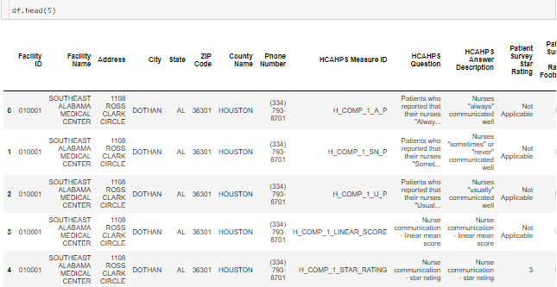
Data Collection
Jamiu Arogundade - 240024714
Fig 5: Importing datasets and storing in a dataframe.
Fig 6: Dataframe head.
Notes:
References:
Bryman, A. and Bell, E., 2015. Business Research Methods. 4th ed. Oxford: Oxford University Press.
McKinney, W., 2017. Python for Data Analysis. 2nd ed. Sebastopol: O'Reilly Media.
Provost, F. and Fawcett, T., 2013. Data Science for Business. 1st ed. Sebastopol: O'Reilly Media.

Slide 12
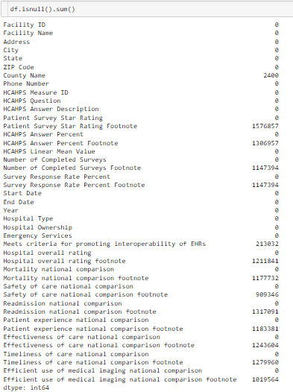
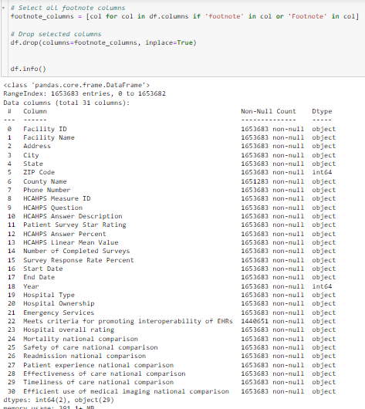
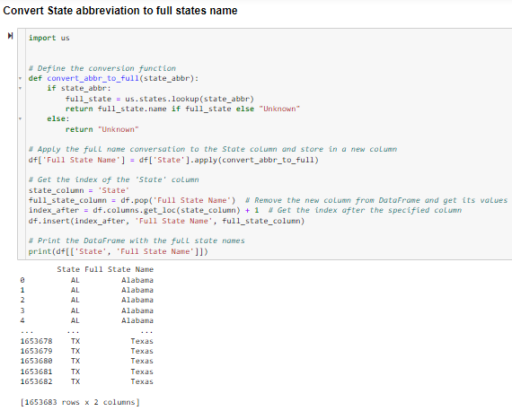
Data Cleaning and Preparation
Jamiu Arogundade - 240024714
Fig 6: Checking for NULL Values
Fig 7: After dropping the Footnotes Columns
Fig 8: New Column for State full name
Notes:
References:
Bryman, A. and Bell, E., 2015. Business Research Methods. 4th ed. Oxford: Oxford University Press.
McKinney, W., 2017. Python for Data Analysis. 2nd ed. Sebastopol: O'Reilly Media.
Provost, F. and Fawcett, T., 2013. Data Science for Business. 1st ed. Sebastopol: O'Reilly Media.

Slide 13
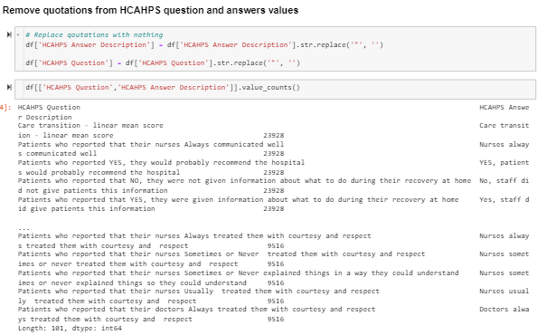
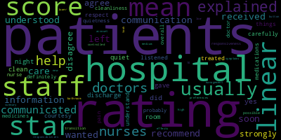
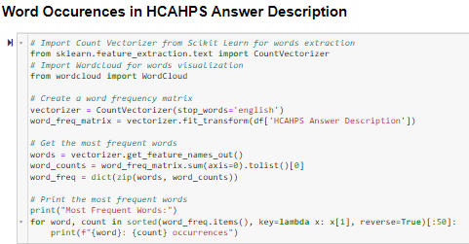
Data Cleaning and Preparation
Jamiu Arogundade - 240024714
Fig 9: Removing quotations from HCAHPS Question and Answer Columns
Fig 10: Counting Occurrence of words in the HCAHPS Answer Columns
Fig 11: Word Cloud for HCAHPS Answer Description Column
Notes:
References:
Bryman, A. and Bell, E., 2015. Business Research Methods. 4th ed. Oxford: Oxford University Press.
McKinney, W., 2017. Python for Data Analysis. 2nd ed. Sebastopol: O'Reilly Media.
Provost, F. and Fawcett, T., 2013. Data Science for Business. 1st ed. Sebastopol: O'Reilly Media.

Slide 14
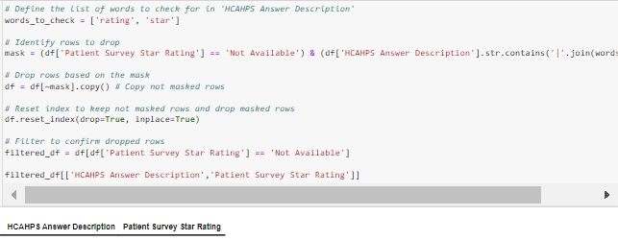
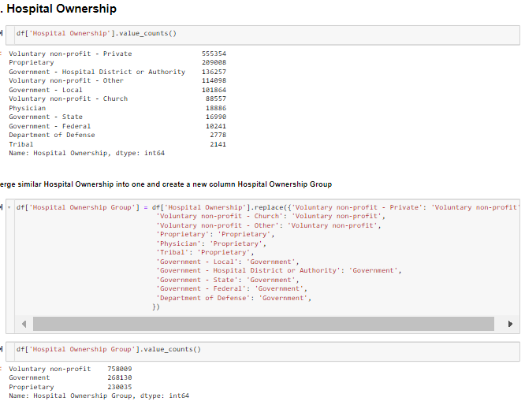
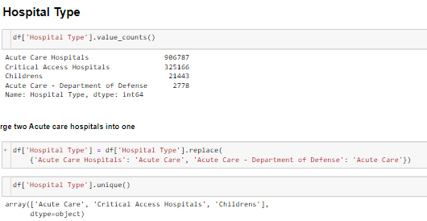
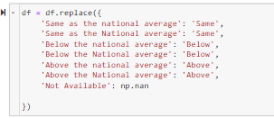
Data Cleaning and Preparation
Jamiu Arogundade - 240024714
Fig 12: Dropped rows with stop words in the HCAHPS Answer Columns
Fig 14: New column for Hospital Ownership Group
Fig 13: Merged Hospital Types
Fig 15: Renamed comparisons columns values for readability
Notes:
References:
Bryman, A. and Bell, E., 2015. Business Research Methods. 4th ed. Oxford: Oxford University Press.
McKinney, W., 2017. Python for Data Analysis. 2nd ed. Sebastopol: O'Reilly Media.
Provost, F. and Fawcett, T., 2013. Data Science for Business. 1st ed. Sebastopol: O'Reilly Media.

Slide 15

Sentiment Analysis with VADER
Jamiu Arogundade - 240024714
VADER (Valence Aware Dictionary and sEntiment Reasoner) is a lexicon and rule-based sentiment analysis tool that is specifically attuned to sentiments expressed in social media and works well on texts from other domains.
Hutto, C.J. & Gilbert, E.E. (2014). VADER: A Parsimonious Rule-based Model for Sentiment Analysis of Social Media Text. Eighth International Conference on Weblogs and Social Media (ICWSM-14). Ann Arbor, MI, June 2014.
Fig 16: https://realpython.com/python-nltk-sentiment-analysis/

Slide 16
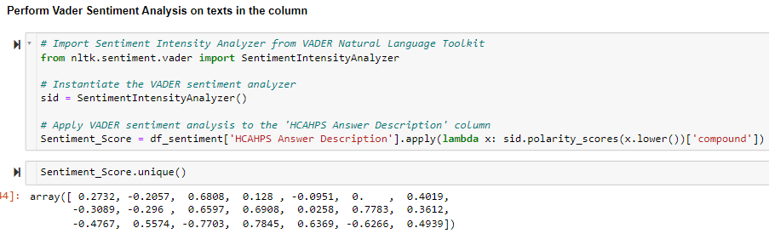
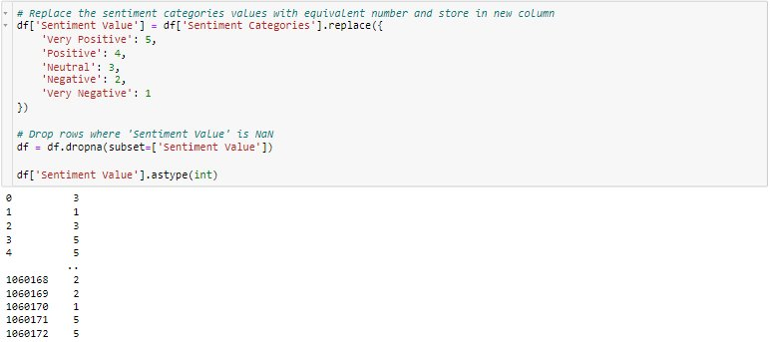
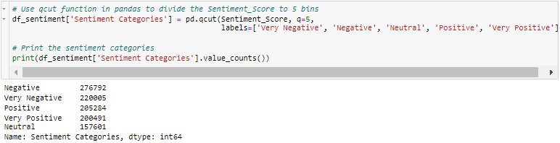
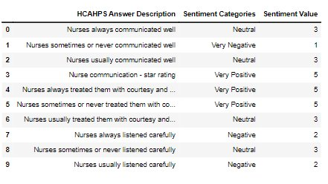
Jamiu Arogundade - 240024714
Sentiment Analysis with VADER
Fig 17: Calculating the sentiment scores.
Fig 19: New column for Sentiment Value.
Fig 18: New column for Sentiment Categories.
Fig 20: Top 10 Data frame for Sentiment Analysis.

Slide 17
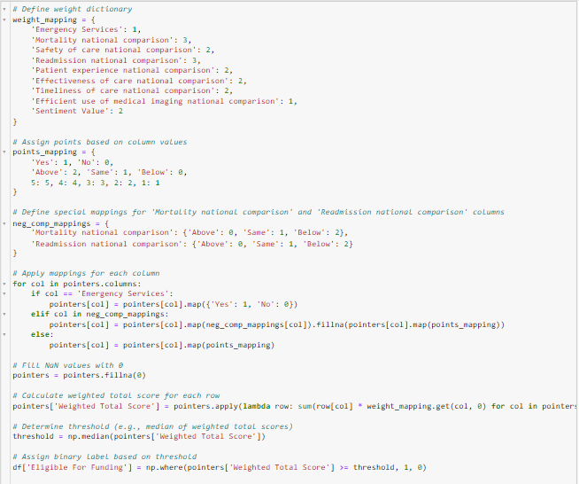
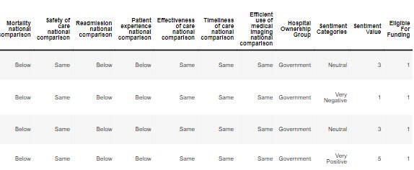

Jamiu Arogundade - 240024714
Setting Eligibility Criteria
Step 1: Set weight score to columns by their level of importance.
Step 2: Set point scores for values in the columns.
Step 3: Apply point scores to each columns
Step 4: Sum the point scores on each Pointers data frame rows and multiply with the column weighted score.
Step 5: Set threshold to the median of the weighted total point on each row.
Step 6: Set eligibility to 1 if weighted total score is greater than median and 0 if not.
Fig 21: Setting Eligibility Criteria​
Fig 23: Cleaned and prepared data frame
Fig 22: Eligible for funding values

Slide 18
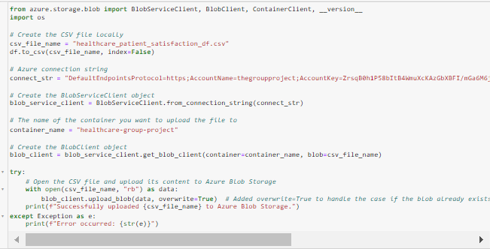
Jamiu Arogundade - 240024714
Exporting Cleaned and Processed Data to the Cloud Storage
Fig 25: Exporting Cleaned and processed data frame to the Azure Storage Blob

Slide 19
Microsoft Power BI
Elijah Olusunmade - 230219645
Introduction to Power BI: Microsoft Power BI is a powerful data visualization tool used for transforming raw data into meaningful insights (Microsoft, 2023).
Key Features:
Extensive Data Connectivity: Connects to various data sources like Excel, SQL databases, and cloud services (Microsoft, 2023).
Interactive Dashboards: Create appealing insights with dynamic and interactive dashboards (Sivarajah et al., 2022).
Advanced Analytics: Power BI can also Integrate with programming languages R and Python for advanced statistical analysis and machine learning (Smith & Taylor, 2021).
Benefits in Data Analysis:
Enhanced Decision Making: Empowers organizations to make data-driven decisions by visualizing key metrics (Sivarajah et al., 2022).
User-Friendly Interface: Intuitive design allows users with minimal technical skills to generate reports and insights (Smith & Taylor, 2021).
Scalability: Suitable for businesses of all sizes, providing scalable solutions as data needs grow (Microsoft, 2023).
Notes:
References:
Microsoft. (2023). Power BI Documentation. Retrieved from https://docs.microsoft.com/en-us/power-bi/
Sivarajah, U., Kamal, M. M., Irani, Z., & Weerakkody, V. (2022). Critical analysis of Big Data challenges and analytical methods. Journal of Business Research, 70, 263-286.
Smith, A., & Taylor, B. (2021). Data Science and Analytics with Power BI. International Journal of Data Analysis Techniques and Strategies, 13(4), 367-390.

Slide 20
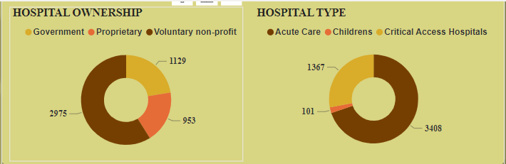

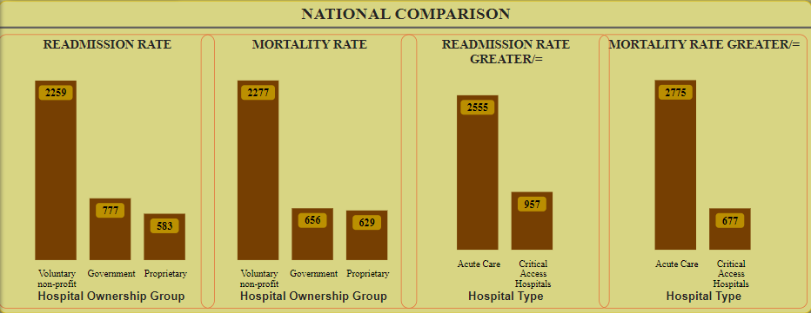

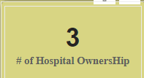
General Analysis Of The Healthcare Facilities
Elijah Olusunmade - 230219645
Fig 24 (Collection of pictures):
Gives the broad view of the healthcare facilities, highlighting the ownership groups, Hospital types, and their metric in line with National comparison.
Notes:
References:
Bryman, A. and Bell, E., 2015. Business Research Methods. 4th ed. Oxford: Oxford University Press.
McKinney, W., 2017. Python for Data Analysis. 2nd ed. Sebastopol: O'Reilly Media.
Provost, F. and Fawcett, T., 2013. Data Science for Business. 1st ed. Sebastopol: O'Reilly Media.

Slide 21
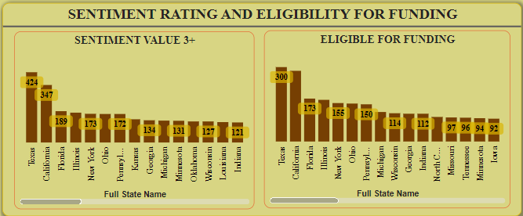
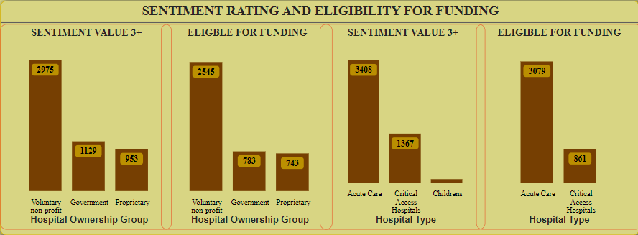
SENTIMENT AND RATING ANALYSIS OF HEALTHCARE FACILITIES
Elijah Olusunmade - 230219645
Fig 25 (collection of pictures):
An analysis of the sentiment and eligibility for funding of the healthcare facilities, highlighting the ownership groups, Hospital types, and state.
Notes:
References:
Bryman, A. and Bell, E., 2015. Business Research Methods. 4th ed. Oxford: Oxford University Press.
McKinney, W., 2017. Python for Data Analysis. 2nd ed. Sebastopol: O'Reilly Media.
Provost, F. and Fawcett, T., 2013. Data Science for Business. 1st ed. Sebastopol: O'Reilly Media.

Slide 22
Jamiu Arogundade - 240024714
Predictive Analysis With Classifier Algorithms
Machine Learning and Modelling
XGBoost
Decision Tree
K-Nearest Neighbor
XGBoost is an optimized distributed gradient boosting library designed to be highly efficient, flexible and portable. It implements machine learning algorithms under the Gradient Boosting framework.
A decision tree is a non-parametric supervised learning algorithm, which is utilized for both classification and regression tasks. It has a hierarchical, tree structure, which consists of a root node, branches, internal nodes and leaf nodes.
Scikit-learn: Machine Learning in Python, Pedregosa et al., JMLR 12, pp. 2825-2830, 2011.
The k-nearest neighbors (KNN) algorithm is a non-parametric, supervised learning classifier, which uses proximity to make classifications or predictions about the grouping of an individual data point.
Chen, Tianqi & Guestrin, Carlos. (2016). XGBoost: A Scalable Tree Boosting System. 785-794. 10.1145/2939672.2939785. ​
Scikit-learn: Machine Learning in Python, Pedregosa et al., JMLR 12, pp. 2825-2830, 2011.

Slide 23
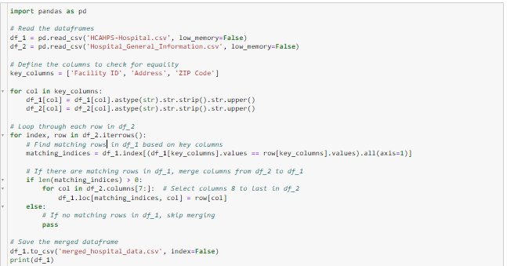
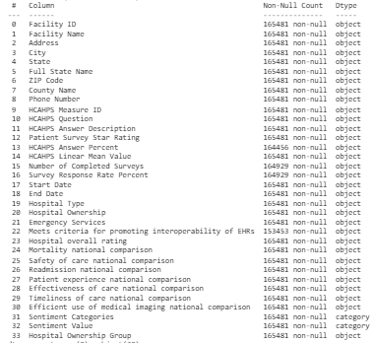
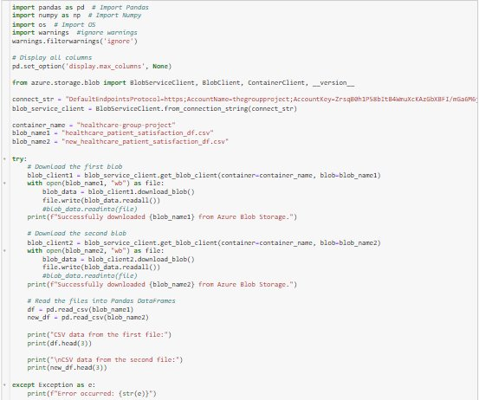
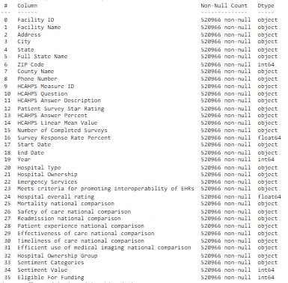
Jamiu Arogundade - 240024714
Preparing The New Dataset For Model Prediction
Fig 26: Imported new dataset for cleaning and processing
Fig 27: New dataset after cleaning, processing and exporting to cloud storage
Fig 27: Imported both datasets from cloud storage for modeling and prediction
Fig 29: Historical dataset after dropping NAN rows and ready for modeling

Slide 24
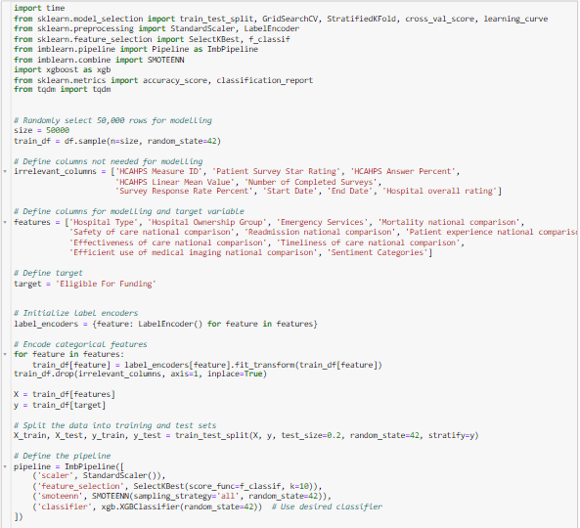
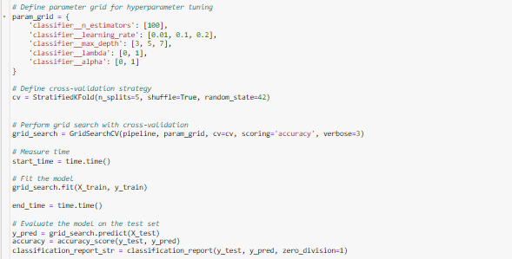
Jamiu Arogundade - 240024714
XGBoost Classification Algorithm
Fig 30 & 31: XGBoost Classification Modelling

Slide 25
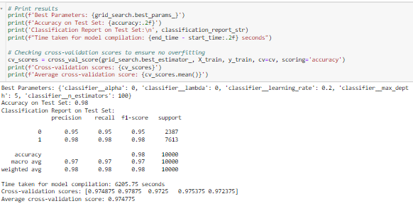
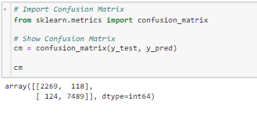
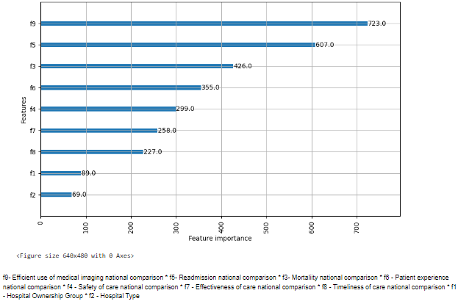
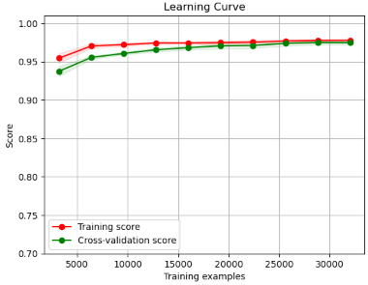
Jamiu Arogundade - 240024714
XGBoost Classification Algorithm
Fig 33: XGBoost Confusion Matrix
Fig 31: Classification Test Report
Fig 32: Classification learning curve
Fig 34: Features Importance

Slide 26
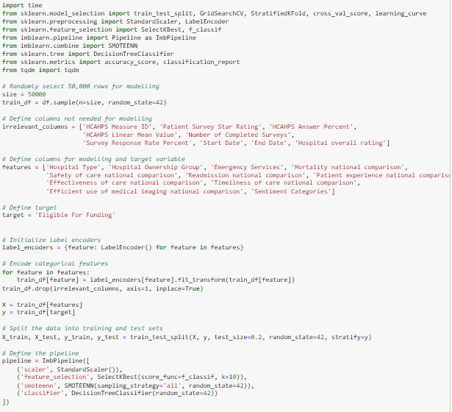
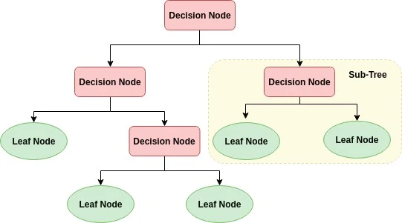
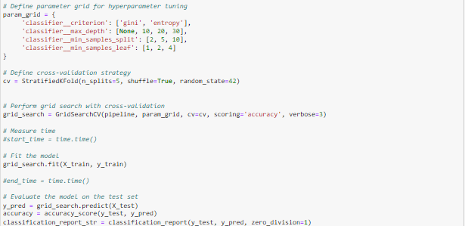
Jamiu Arogundade - 240024714
Decision Tree Classification Algorithm
Fig 35, 36, & 37: Decision Tree Classification Modeling

Slide 27
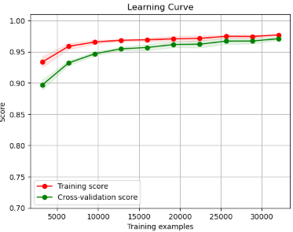
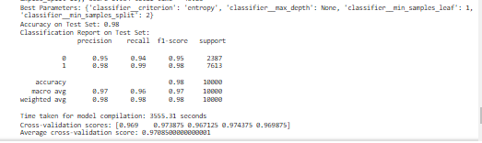
Jamiu Arogundade - 240024714
Decision Tree Classification Algorithm
Fig 38: Classification learning curve
Fig 39: Classification Report

Slide 28
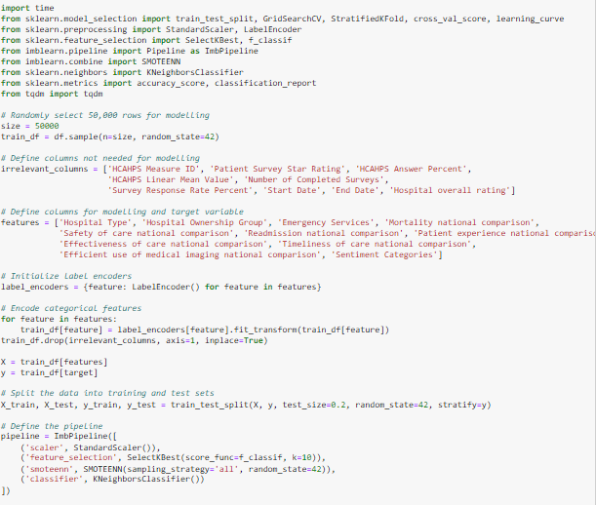
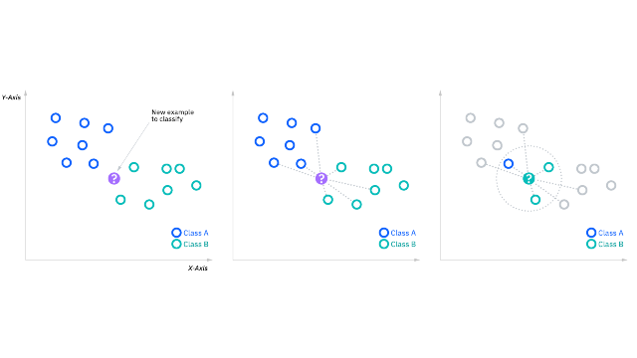
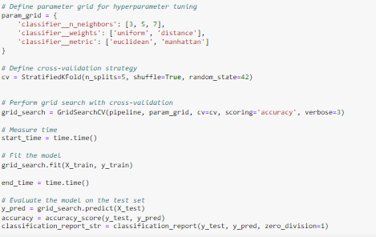
Jamiu Arogundade - 240024714
K-Nearest Neighbors Classification Algorithm
What is the k-nearest neighbors algorithm? | IBM
Fig 41, 42 & 43: K-Nearest Neighbors Classification Modeling

Slide 29
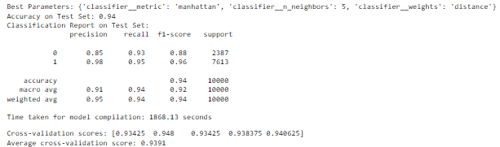
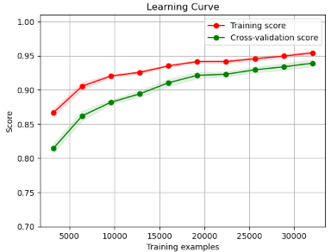
Jamiu Arogundade - 240024714
K-Nearest Neighbors Classification Algorithm
Fig 44: Classification Report
fig 45: Classification learning curve

Slide 30
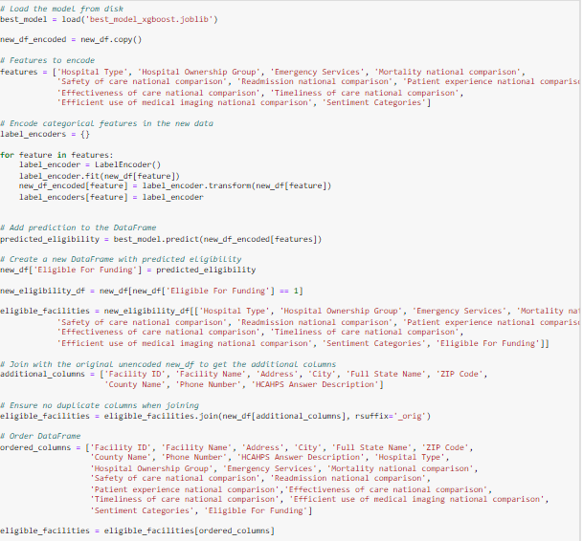

Jamiu Arogundade - 240024714
Predicting New Dataset with the Best Model: XGBoost
Fig 47: Predicting facilities Eligible for Funding on the new dataset with XGBoost classification algorithm
Fig 48: Eligible for funding distribution for Facilities

Slide 31
Conclusions
Patient sentiment analysis have a lot of objectives, a major one is to allowed the patients to make informed decisions about the services they receive and in what way the healthcare services can know which area to improve.
Also Based on these sentiments and the quality of the services rendered the government can know which healthcare facility to reimburse some percentage of expenses incurred.
The future of this research is to include the demography of patients involved in the survey and the health services directly and indirectly used, this could be useful in further analysis and prediction to know admission rate of healthcare facilities and in relation to their performance.

Slide 32
References
Microsoft. (2023). Power BI Documentation. Retrieved from https://docs.microsoft.com/en-us/power-bi/
Sivarajah, U., Kamal, M. M., Irani, Z., & Weerakkody, V. (2022). Critical analysis of Big Data challenges and analytical methods. Journal of Business Research, 70, 263-286.
Smith, A., & Taylor, B. (2021). Data Science and Analytics with Power BI. International Journal of Data Analysis Techniques and Strategies, 13(4), 367-390.
Hutto, C.J. & Gilbert, E.E. (2014). VADER: A Parsimonious Rule-based Model for Sentiment Analysis of Social Media Text. Eighth International Conference on Weblogs and Social Media (ICWSM-14). Ann Arbor, MI, June 2014.
Chen, Tianqi & Guestrin, Carlos. (2016). XGBoost: A Scalable Tree Boosting System. 785-794. 10.1145/2939672.2939785.
Scikit-learn: Machine Learning in Python, Pedregosa et al., JMLR 12, pp. 2825-2830, 2011
Bryman, A. and Bell, E., 2015. Business Research Methods. 4th ed. Oxford: Oxford University Press.
McKinney, W., 2017. Python for Data Analysis. 2nd ed. Sebastopol: O'Reilly Media.
Provost, F. and Fawcett, T., 2013. Data Science for Business. 1st ed. Sebastopol: O'Reilly Media.
Amazon Web Services, 2024. *What is Cloud Computing?* [online] Available at: <https://aws.amazon.com/what-is-cloud-computing/> [Accessed 23 May 2024].
Microsoft Azure, 2024. *What is Azure?* [online] Available at: <https://azure.microsoft.com/en-us/overview/what-is-azure/> [Accessed 23 May 2024].
Google Cloud, 2024. *Google Cloud Platform Overview* [online] Available at: <https://cloud.google.com/what-is-cloud> [Accessed 23 May 2024].
Microsoft Azure, 2024. *What is a Virtual Machine?* [online] Available at: <https://azure.microsoft.com/en-us/services/virtual-machines/> [Accessed 23 May 2024].
Amazon Web Services, 2024. *Cloud Storage* [online] Available at: <https://aws.amazon.com/products/storage/> [Accessed 23 May 2024].

