Slide 1
Object Oriented Software Engineering (OOSE)
22CS017
Agile Model

Slide 2
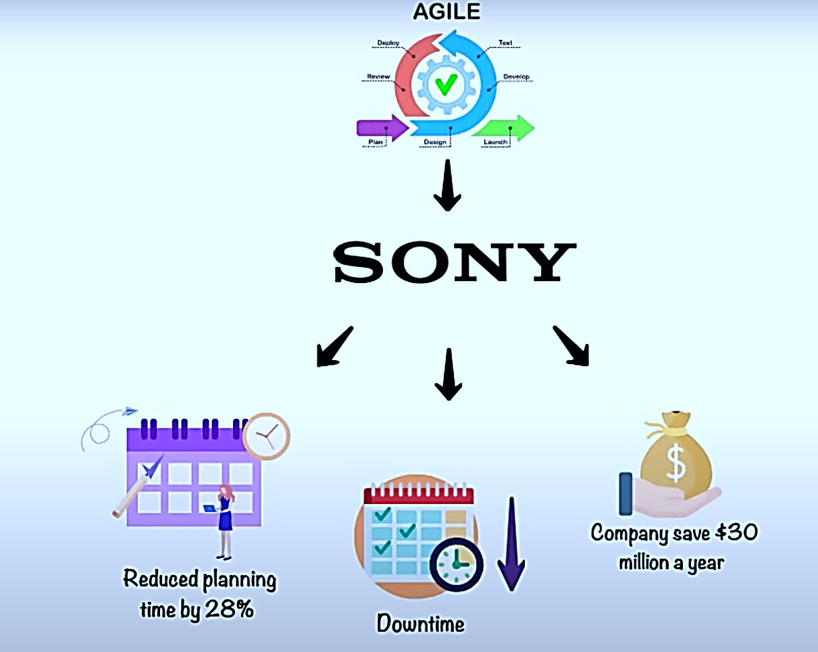

Slide 3
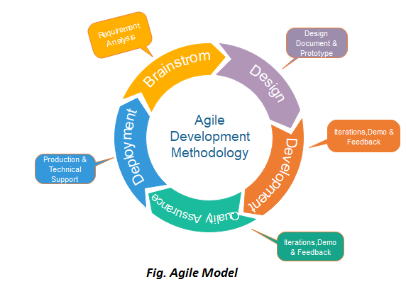
Agile Model
Agile is an iterative way of managing projects and developing software that makes it easier for teams to deliver value to their customers more quickly and effectively.
More focus on process adaptability and customer satisfaction through the timely delivery of working software.
The agile method splits the project into small iterations, and these iterations do not directly involve long-term planning.
Figure 1: Agile Development Methodology

Slide 4
Contd…
Agile was invented in the software industry but nowadays businesses in all industry sectors make use of it.
Agility is the ability of a business as a whole to respond quickly to changes, especially external changes. For example, by adapting business processes or changing customer experiences.

Slide 5
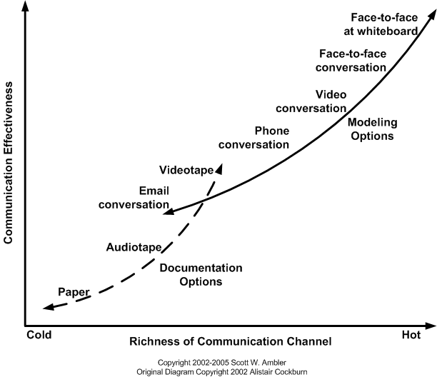
Effectiveness of Communication Modes
Figure 2: Communication Modes

Slide 6
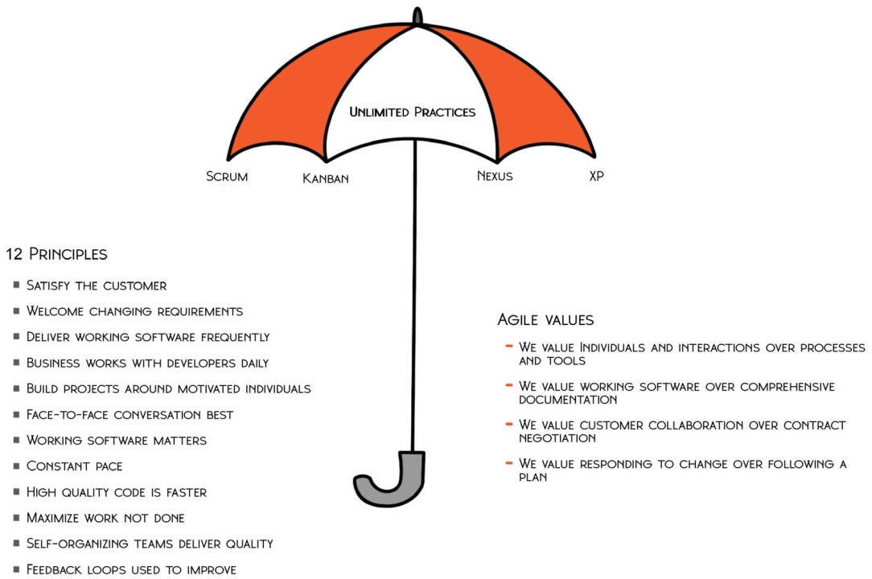
Agile Model
Agile is an umbrella term encompassing a variety of frameworks and approaches to value delivery in complex environments.
Figure 3: Agile Model

Slide 7
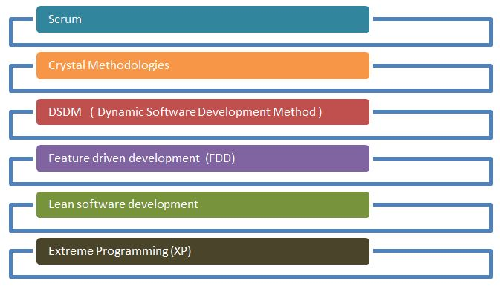
Agile Process Methodology
The agile process methodologies have been shown below:
Figure 4: Agile Process Methodology

Slide 8
Agile Principles
To make a process Agile, the following 12 principles need to be satisfied in the Agile Manifesto:
Customer Satisfaction: The customer needs to be satisfied with the quick delivery of the product.
Welcome Change: Even late in the development process, changing needs need to be addressed.
Deliver Frequently: Focus on a shorter timescale, and ensure products are delivered frequently.
Work Together: The business and development team need to work together through the course of the project.

Slide 9
Agile Principles (contd.)
Motivated Team: Team members must be motivated and trusted to complete the project successfully and on time.
Face-to-Face: Having face-to-face interactions is one of the most effective forms of communication.
Working Software: Working software is the primary measure of progress
Constant Pace: Agile promotes sustainable development.
Good Design: Continuous attention to technical excellence and good design

Slide 10
Agile Principles (contd.)
Simplicity: The amount of time where work isn’t being done needs to be reduced.
11. Self-Organization: These types of teams provide the best designs, requirements, and architectures.
12. Reflect and Adjust: Regularly, the team reflects on how to become more effective and adjusts accordingly.

Slide 11
Key Agile Concepts
User Stories: The team divides the work into functional units known as "user stories" in consultation with the client or product owner. Each user story must add something valuable to the final product.
Daily Meeting: The team meets every day at the same time to update everyone on the information necessary for coordination
Personas: When the project requires it, the team creates in-depth, fabricated biographies of hypothetical users of the intended product.
Team: A small group of individuals assigned to the same project or effort, almost all of whom work full-time, is referred to as a "team" in the Agile context.

Slide 12
Key Agile Concepts
Incremental Development: Agile teams prefer to use an incremental development strategy, which in an Agile setting means that each iteration of the product improves on the one before it by including user-visible functionality.
Iterative development: Agile projects intentionally permit "repeating" software development activities and the potential for "revisiting" the same work products, known as iterative development.
Milestone Retrospective: After a project has been running for a while, the team dedicates one to three days to examine the key moments.

Slide 13
Agile Development
Advantages:
Frequent Delivery
Face to face communication
Changes
Time
Disadvantages:
Less Documentation
Maintenance problem

Slide 14
Adaptive Software Development
Adaptive Software Development (ASD) is one of the earliest agile methodologies.
ASD is a development methodology that encourages continuous learning throughout the software development project.
ASD strongly advocates a software development process that is fun to be in as well as natural or organic. It focuses on human collaboration and self-organization
ASD is a method to build complex software and system.

Slide 15
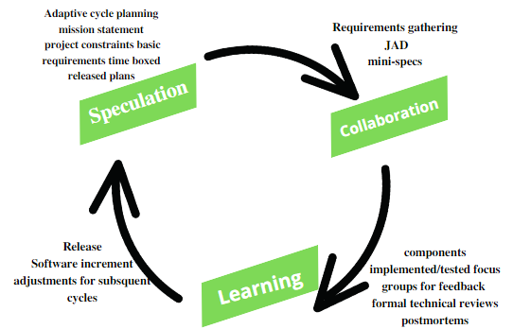
ASD Life Cycle
Figure 5: ASD Life Cycle

Slide 16
ASD Life Cycle - Speculation
Speculation phase carefully and intentionally removes the factor of planning that often brings with it lots of unnecessary baggage and tension.
This phase gives the teams full liberty to welcome and accept the outcomes without the fear of the unknown or uncertainty. It totally eliminates the toxic need to be right all the time, putting all the stakeholders at ease.
In the speculation phase:
A project mission statement is defined
Creation and sharing of the general idea of the goals to be achieved take place
Teams adopt the tools that would assist them in adapting and changing as per the requirements during the entire cycle of the project.

Slide 17
ASD Life Cycle - Speculation
Mostly, the speculation phase finds itself divided into two steps.
project initiation
adaptive planning
Project Initiation
The first step of initiation involves stuff that serves as the project’s foundation.
This includes project management information, mission statement and other
essential tools and information.

Slide 18
ASD Life Cycle - Speculation
2. Adaptive Planning:
In adaptive planning, different product features get assigned to the different teams as per their expertise and skills.
This requires the teams to decide:
Time box for the project
Number of development cycles
Amount of time each cycle would take as per the unanimously decided timebox
A theme and objective for the cycle
Assignment of components for each cycle
A task list for the project

Slide 19
ASD Life Cycle - Collaboration
It is in Collaboration phase that the actual development begins.
This phase is about group emergence.
It is about coming together of diverse experiences, knowledge, and skills.
This forms a collaborative environment where diversity serves as the building block for creativity and innovation during the entire development cycle.

Slide 20
ASD Life Cycle - Learning
The Learning part of the Lifecycle is vital for the success of the project.
Team has to enhance their knowledge constantly, using practices such as-
Technical Reviews
Project Retrospectives
Customer Focus Groups

Slide 21
SCRUM
The Scrum Guide defines scrum as:
“A framework within which people can address complex adaptive problems, while productively and creatively delivering products of the highest possible value.”
In simple terms, scrum is a lightweight agile project management framework that can be used to manage iterative and incremental projects of all types.
The concept here is to break large complex projects into smaller stages, reviewing and adapting along the way.

Slide 22
SCRUM (contd.)
With scrum you can:
Write fewer plans and do more in short iterations or cycles that we call sprints*
Work as one dedicated and committed team, instead of working on separate groups
Constantly deliver functioning products at the end of each sprint
Receive continuous feedback from your customers and improvise your product
*A sprint basically is a specified time period during which a scrum team produces a product.

Slide 23
People & Parts of Scrum Framework
The Scrum Framework is made of three distinct categories, which are:
Scrum Roles
Events in Scrum
Scrum Artifacts

Slide 24

Scrum Roles
Figure 6: Role of Scrum Team
Development Team (Scrum Team):
Motivate the team to achieve the goal.
It take input from others but when it comes to making major decisions, ultimately he/she is responsible.

Slide 25
Scrum Roles (contd.)
Scrum Master
Ensures that all the team members follow scrum’s theories, rules, and practices.
It makes sure the Scrum Team has whatever it needs to complete its work, like removing roadblocks that are holding up progress, organizing meetings, dealing with challenges and bottlenecks.
Product Owner
Working together to deliver products
Scrum development teams are given the freedom to organize themselves and manage their own work to maximize the team’s effectiveness and efficiency.

Slide 26
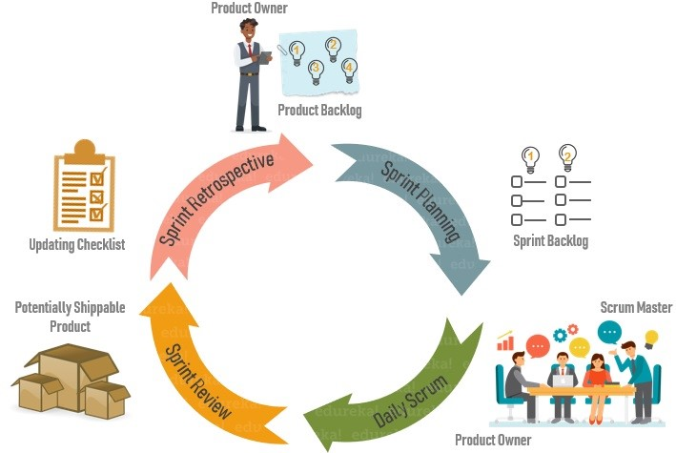
Events in Scrum

Slide 27
Events in Scrum (contd.)
Sprint Planning: It is a meeting where the work to be done during a sprint is mapped out and the team members are assigned the work necessary to achieve that goal.
Daily Scrum: Also known as a stand-up, it is a 15-minute daily meeting where the team has a chance to get on the same page and put together a strategy for the next 24 hours.
Sprint Review: During the sprint review, product owner explains what the planned work was and what was not completed during the Sprint.
Sprint Retrospective: During sprint retrospective, the team discusses what went right, what went wrong, and how to improve. They decide on how to fix the problems and create a plan for improvements to be enacted during the next sprint.

Slide 28
Scrum Artifacts
Artifacts are just physical records that provide project details when developing a product. Scrum Artifacts include:
Product Backlog: It is a simple document that outlines the list of tasks and every requirement that the final product needs. It is constantly evolving and is never complete. For each item in the product backlog, you should add some additional information like:
Description
Order based on priority
Estimate
Value to the business

Slide 29
Scrum Artifacts (contd.)
Sprint Backlog: It is the list of all items from the product backlog that need to be worked on during a sprint. Team members sign up for tasks based on their skills and priorities. It is a real-time picture of the work that the team currently plans to complete during the sprint.
Burndown Chart: It is a graphical representation of the amount of estimated remaining work.
Product Increment: The most important artifact is the product improvement, or in other words, the sum of product work completed during a Sprint, combined with all work completed during previous sprints.

Slide 30
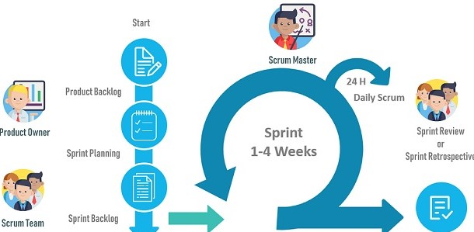
Scrum Framework
Figure 7: Scrum Framework

Slide 31
Scrum Framework (contd.)
Step 1:
Scrum process begins with a product owner. Product Owner creates a product backlog, a list of tasks and requirements the final product needs. The important part is that product backlog must be prioritized.
Step 2:
The scrum team gets together for sprint planning, which is when the team decides together what to work on first from the product backlog. This subset of items from the product backlog becomes the sprint backlog.

Slide 32
Scrum Framework (contd.)
Step 3:
During the sprint, the team meets to communicate progress and issues, this meeting is called the daily scrum. It is overseen by the scrum master who ensures that all the team members follow scrum’s theories, rules, and practices.
Step 4:
At the end of the sprint, the sprint review meeting is organized by the product owner. During the meeting, the development team demonstrates what they completed since the last sprint. Then the product owner gives information about what is remaining on the product backlog and estimated time to complete the project if needed.

Slide 33
Extreme Programming (XP)
Extreme programming (XP), introduced in 1996 lightweight, efficient, low-risk, flexible, predictable, scientific, and fun way to develop a software
It is the type of Agile Development we develop software with small team where the software requirements changes rapidly.
It provides values and principles to guide the team behavior

Slide 34
XP Values
1. Communication
XP emphasizes continuous and constant communication among the team members, managers and the customer.
The XP practices, such as unit testing, pair programming, simple designs, common metaphors, collective ownership and customer feedback focus on the value of communication.
2. Simplicity
XP believes in ‘it is better to do a simple thing today and pay a little more tomorrow to change it’ than ‘to do a more complicated thing today that may never be used anyway’.

Slide 35
XP Values (contd.)
3. Feedback
Every iteration commitment is taken seriously by delivering a working software.
The software is delivered early to the customer and a feedback is taken so that necessary changes can be made if needed.
4. Courage
To focus on only what is required
To communicate and accept feedback
To tell the truth about progress and estimates
To adapt to changes whenever they happen

Slide 36
XP Values (contd.)
5. Respect
Respect is a deep value, one that lies below the surface of the other four values. In Extreme Programming,
Everyone respects each other as a valued team member.
Everyone contributes value such as enthusiasm.
Developers respect the expertise of the customers and vice versa.
Management respects the right of the developers to accept the responsibility and receive authority over their own work.

Slide 37
Why is it called Extreme
Extreme Programming takes the effective principles and practices to extreme levels.
Code reviews are effective as the code is reviewed all the time.
Testing is effective as there is continuous regression and testing.
Design is effective as everybody needs to do refactoring daily.
Integration testing is important as integrate and test several times a day.
Short iterations are effective as the planning game for release planning and iteration planning.

Slide 38
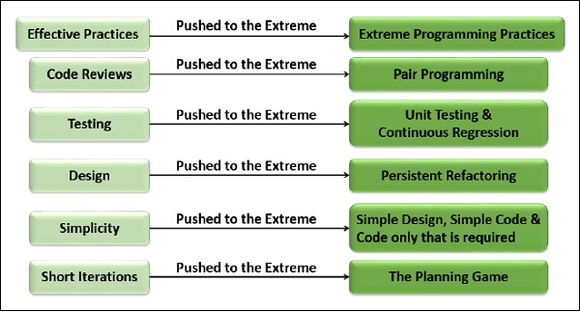
Why is it called Extreme
Figure 8: Extreme Programming

Slide 39
XP Practices
1. Planning Process
The first stage, is when the customer meets the development team and presents the requirements in the form of user stories to describe the desired result.
The team then estimates the stories and creates a release plan broken down into iterations needed to cover the required functionality part after part.
If one or more of the stories can’t be estimated, so-called spikes can be introduced which means that further research is needed.

Slide 40
XP Practices (contd.)
2. Small Releases
This practice suggests releasing the Minimum Value Product (MVP) quickly and further developing the product by making small and incremental updates.
An MVP, is the earliest version of a product that has only required features, enough to deliver the core value and verify it to early customers.
MVP is deployed to gather feedback and see whether the product is needed by users at all.
Small releases allow developers to frequently receive feedback, detect bugs early, and monitor how the product works in production.

Slide 41
XP Practices (contd.)
3. Metaphor
A Metaphor is an expression, often found in literature that describes a person or object by referring to something that is considered to have similar characteristics to that person or object.
For example, ‘The mind is an ocean’ and ‘the city is a jungle’ are both Metaphors.
You can think of metaphor as the architecture of the system to be built in a way that it is easily understandable by everyone involved in the development.
System metaphor stands for a simple design that has a set of certain qualities.
First, a design and its structure must be understandable to new people.
They should be able to start working on it without spending too much time examining specifications.

Slide 42
XP Practices (contd.)
4. Simple Design
The system should be designed as simply as possible at any given moment. Extra complexity is removed as soon as it is discovered.
The right design for the software at any given time is the one that −
Runs all the tests
Has no duplicated logic like parallel class hierarchies
States every intention important to the developers
Has the fewest possible classes and methods

Slide 43
XP Practices (contd.)
5. Testing
The developers continually write unit tests, which need to pass for the development to continue.
The customers write tests to verify that the features are implemented.
The tests are automated so that they become a part of the system and can be continuously run to ensure the working of the system.
The result is a system that is capable of accepting change.

Slide 44
XP Practices (contd.)
6. Refactoring
Refactoring is the process of restructuring code, while not changing its original functionality.
The goal of refactoring is to improve internal code by making many small changes without altering the code's external behavior.
The goal of this technique is to continuously improve code.
Refactoring is about removing redundancy, eliminating unnecessary functions, increasing code coherency, and at the same time decoupling elements. Keep your code clean and simple, so you can easily understand and modify it when required would be the advice of any XP team member.

Slide 45
XP Practices (contd.)
7. Pair Programming
This practice requires two programmers to work jointly on the same code.
While the first developer focuses on writing, the other one reviews code, suggests improvements, and fixes mistakes along the way.
Such teamwork results in high-quality software and faster knowledge sharing but takes about 15 percent more time.
In this regard, it’s more reasonable trying pair programming for long-term projects.

Slide 46
XP Practices (contd.)
8. Collective Ownership
This practice declares a whole team’s responsibility for the design of a system.
Each team member can review and update code.
Developers that have access to code won’t get into a situation in which they don’t know the right place to add a new feature.
The practice helps avoid code duplication.
The implementation of collective code ownership encourages the team to cooperate more and feel free to bring new ideas.

Slide 47
XP Practices (contd.)
9. Continuous Integration
Developers always keep the system fully integrated.
XP teams take iterative development to another level because they commit code multiple times a day, which is also called continuous delivery.
XP practitioners understand the importance of communication.
Programmers discuss which parts of the code can be re-used or shared.

Slide 48
XP Practices (contd.)
10. 40-Hour Work
Extreme Programming emphasizes on the limited number of hours of work per week for every team members, based on their sustainability, to a maximum of 40 hours a week.
If someone works for more time than that, it is considered as overtime. Overtime is allowed for at most one week.
This practice is to ensure that every team member be fresh, creative, careful and confident.

Slide 49
XP Practices (contd.)
11. On-Site Customer
Include a real, live user on the team, available full-time to answer the questions, resolve disputes and set small-scale priorities. This user may not have to spend 40 hours on this role only and can focus on other work too.
On-Site Customer – Advantages
Can give quick and knowledgeable answers to the real development questions.
Makes sure that what is developed is what is needed.
Functionality is prioritized correctly.

Slide 50
XP Practices (contd.)
12. Coding Standard
Developers write all code in accordance with the rules emphasizing-
Communication through the code.
The least amount of work possible.
Consistent with the “once and only once” rule (no duplicate code).
Voluntary adoption by the whole team.
These rules are necessary in Extreme Programming because all the developers −
Can change from one part of the system to another part of the system.
Swap partners a couple of times a day.
Refactor each other's code constantly.

Slide 51
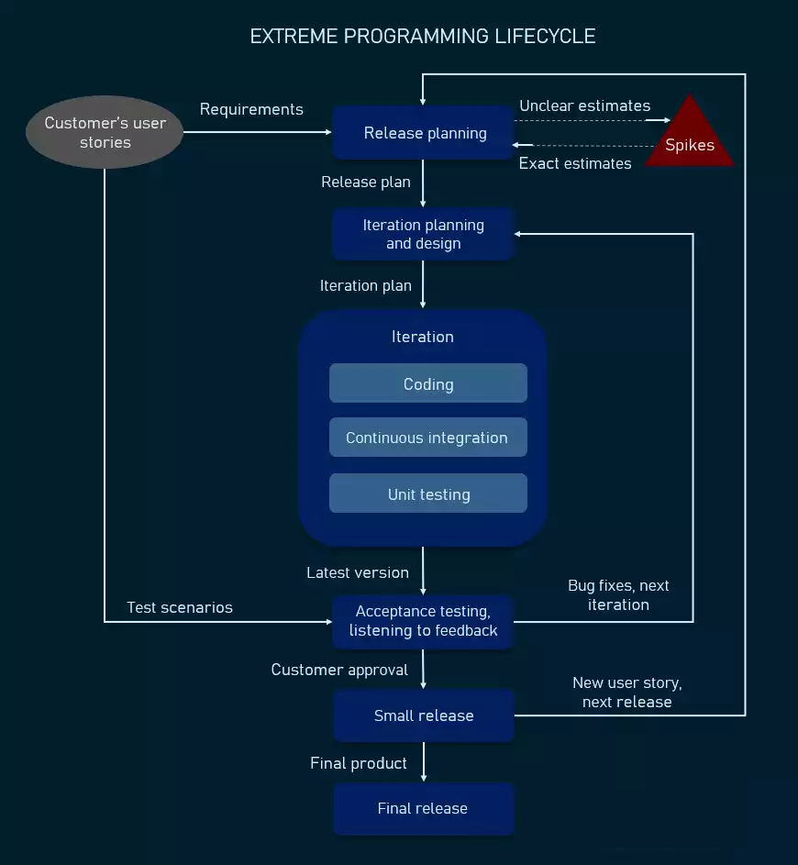
XP Lifecycle
Figure 9: Extreme Programming Life Cycle

Slide 52
XP Advantages
Continuous testing and refactoring practices help create stable well-performing systems with minimal debugging.
Simplicity value implies creating a clear, concise code that is easy to read and change in the future if needed.
Documentation is reduced as bulky requirements documents are substituted by user stories.
No or very little overtime is practiced.
Constant communication provides a high level of visibility and accountability and allows all team members to keep up with the project progress.

Slide 53
XP Advantages (contd.)
Pair programming has proven to result in higher-quality products with fewer bugs; most research participants also reported enjoying such collaboration more and feeling more confident about their job;
Customer engagement ensures their satisfaction as their participation in the development and testing process can directly influence the result, getting them exactly what they wanted.

Slide 54
XP Disadvantages
In many instances, the customer has no clear picture of the end result, which makes it almost unrealistic to accurately estimate scope, cost, and time;
Regular meetings with customers often take a great deal of time that could instead be spent on actual code writing;
Documentation can be scarce and lack clear requirements and specifications, leading to project scope creep;
The rapid transition from traditional methods of software development to extreme programming demands significant cultural and structural changes;
Pair programming takes more time and doesn’t always work right due to the human factor and character incompatibility;
XP works best with collocated teams and customers present in person to conduct face-to-face meetings, limiting its application with distributed teams;

Slide 55
Practice Questions
What do you mean by Agile or Agile Methodology or Agile Process?
What are different types of Agile Methodology?
What are the principles of Agile Testing?
Explain the difference between the traditional Waterfall model and the Agile model.
Explain Iterative and Incremental Development in Agile.
What are the obstacles to the Agile process?
Differentiate between Agile and Scrum
When should you use Waterfall over Scrum?
What is the right moment to use the agile model?

Slide 56
THANKS

