Slide 1

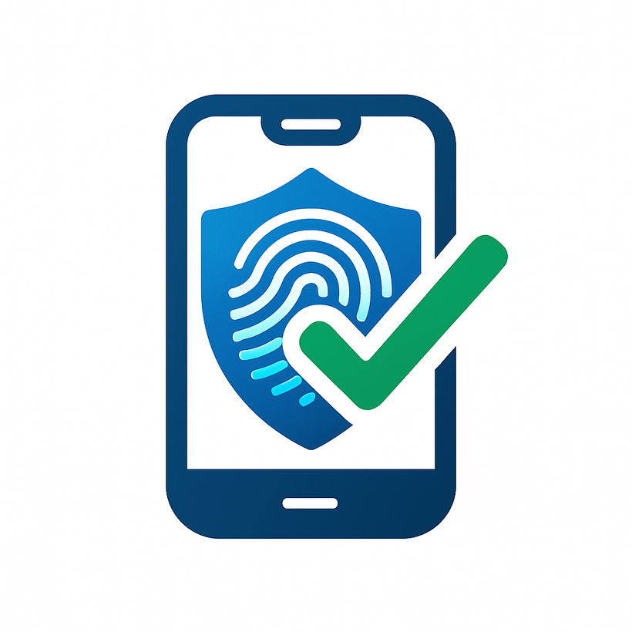



1/16
TRUEVOTE
Secure, Efficient, and User-Friendly Voting

Slide 2


OUR TEAM
2/16
1
AAROMAL A
ROLL NO:2
2
ABHIJITH R S
ROLL NO:4
3
DEERAJ P MENON
ROLL NO:31
4
HITHEK SIVA
ROLL NO:46
5
N NAVANEETH
ROLL NO:71

Slide 3
3/16
INTRODUCTION
PURPOSE: A digital voting system designed to manage voter, candidate, and polling data efficiently.
OBJECTIVE: To provide a secure, paperless, and user-friendly voting experience.
Key Features:
Admin control for data management.
Secure login system.
Real-time voting and results.
Data privacy and encryption.

Slide 4
4/16
KEY FEATURES OF TRUEVOTE
User-Friendly Interface: Easy navigation for voters and admins.
Secure Authentication: Admin login with trial-based access control
Data Management: Store and update voter, candidate, and poll data.
Real-Time Voting: Cast votes digitally with instant updates.
Privacy friendly Vote logger: Voter choices are securely loged
and analysed, ensuring anonymity.
Encryption: Protects data from unauthorized access.

Slide 5
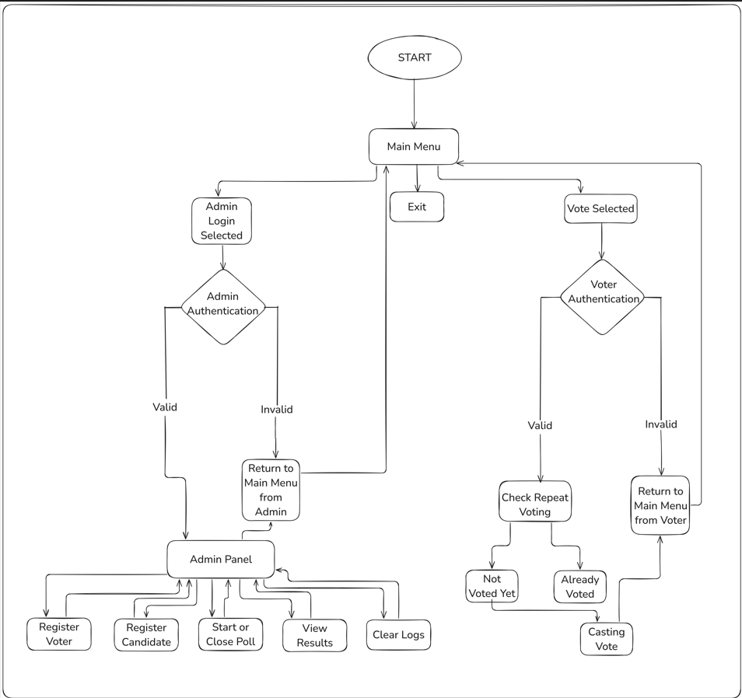
5/16
FLOW
CHART

Slide 6
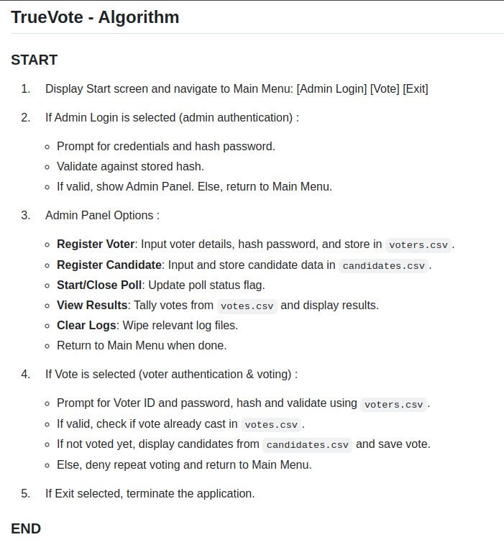
6/16
ALGORITHM

Slide 7
WHAT PROBLEM ARE WE SOLVING?
7/16
Ensuring one person, one vote with login & hash verification.
Preventing fraud with vote logs and admin-controlled poll status.
Enabling real-time result counting and auditability.
Providing a lightweight, open-source system for institutions, events, and communities.
Easy to customize and deploy for colleges, clubs, or small elections.

Slide 8
8/16
WHY IS NOT EVMS?
EVMs (Electronic Voting Machines) are hardware-limited:
Require physical presence at polling stations.
Expensive to manufacture, transport, and store.
No easy integration with identity verification or secure digital records.
Hard to audit EVM results in real-time without physical access.
Limited flexibility for low-budget or small-scale elections (e.g., schools, societies).

Slide 9
9/16
WHY IS THIS RELEVANT?
Growing need for remote, contactless voting in emergencies (e.g., pandemics).
Rising awareness about digital trust and transparency in governance.
Paper-based systems are time-consuming, error-prone, and expensive.
Governments worldwide are experimenting with digital voting pilots.

Slide 10
OOPS CONCEPTS INVOLVED
10/16
Inheritance: Used for creating classes like Voter, Candidate, and Admin.
Polymorphism: Function overloading, overriding, and operator overloading.
Abstract Classes: Defined pure virtual functions for flexibility.
Friend Functions: Access private data securely.
Constructors & Destructors: Manage object lifecycle.
File Handling: Store and retrieve data efficiently.
Vectors: Dynamic data storage for scalability.

Slide 11
11/16
SYSTEM ARCHITECTURE
Admin Module: Manages voters, candidates, and polls.
Voter Module: Allows voters to cast votes securely
Data Storage: Uses CSV files for candidate, voter, and poll data.
Security: Admin authentication and data encryption.

Slide 12
ADMIN MODULE FEATURES
12/16
Enroll Candidates: Add new candidates with ID, name party, and symbol.
Register Voters: Add voters with ID, name, gender, and DOB.
Update Data: Modify candidate or voter details.
Create Polls: Define polls with ID, name, date, and candidates.
Start/Stop Polls: Control polling with admin credentials.
Access Results: View poll results securely.

Slide 13
13/16
VOTER MODULE FEATURES
Login: Voters enter ID and password to access the system.
Cast Vote: Select candidates from a list and confirm the vote.
Privacy: Votes are anonymous and not stored with voter details.
Real-Time Updates: Votes are counted instantly.

Slide 14
14/16
SECURITY FEATURES
Admin/Voter Authentication: Login with unique id and password which are processed using hashing & salting.
Trial-Based Access: System locks after 5 failed login attempts.
Data Encryption: Protects stored data logs from unauthorized access using encryption.
Anonymity: Voter choices are never stored or tracked.
Backup & Recovery: Restore polling data in case of interruptions.

Slide 15
15/16
CONCLUSION
TrueVote is a secure, efficient, and user-friendly digital voting system.
Future Scope:
Integrate biometric authentication for voters.
Add support for multi-language interfaces.
Implement blockchain for enhanced security.
Develop a mobile app for wider accessibility.

Slide 16
16/16
THANK
you

