Slide 1




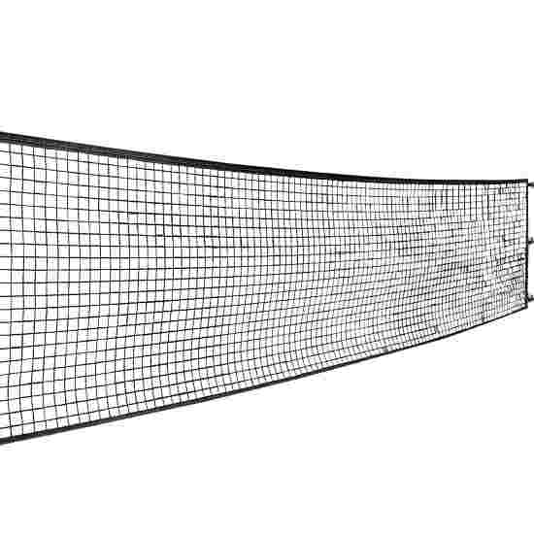
Primary
Header Font
Subtitle Font
Secondary
Text Font
Tertiary
Card
Button
Button
Button
ShuttleBell

Slide 2

Total Number of Players: (23/10/24)
6
Numbers
Join
Payment
Admin
Name
1.
2.
3.
4.
5.
6.

