Slide 1
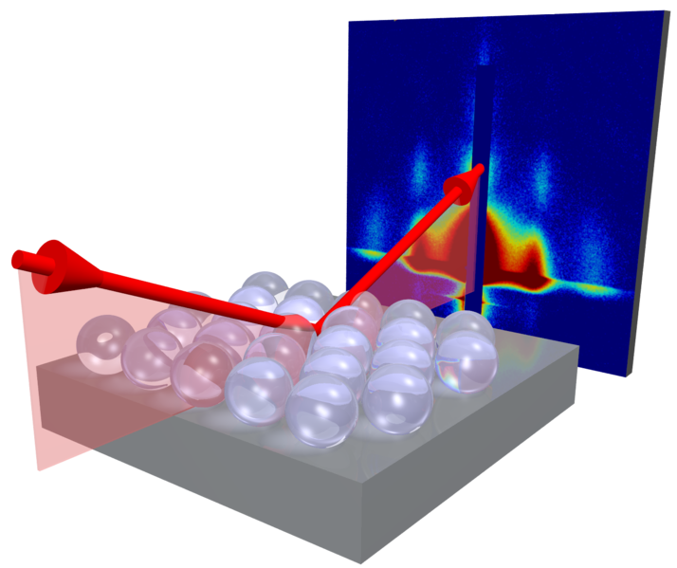
GISAXS Community Website

