Slide 1
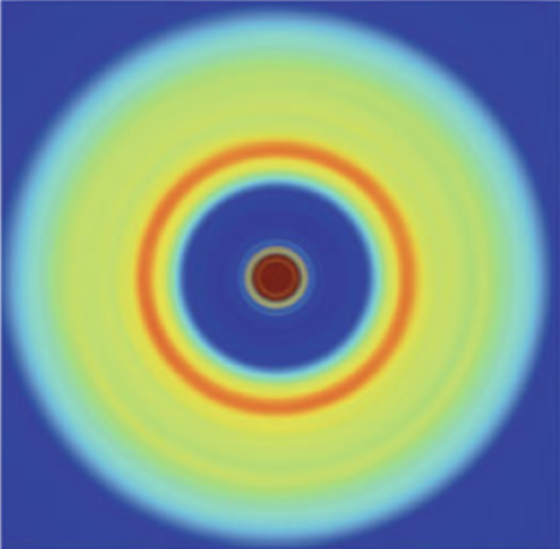
SAS
Tut rials.org

Slide 2
SAS
Tut rials.org

Slide 3
SAS
Tut rials.org

Slide 4
SAS
Tut rials.org

Slide 5
SAS
Tut rials.org

Slide 6
SAS
Tut rials.org

Slide 7
SAS
Tut rials.org

Slide 8
SAS
Tut rials.org

Slide 9
SAS
Tut rials.org

Slide 10
SAS
Tut rials.org

Slide 11
SAS
Tut rials.org

Slide 12
SAS
Tut rials.org

Slide 13
SAS
Tut rials.org

Slide 14
SAS
Tut rials.org

Slide 16
SAS
Tut rials.org

Slide 17
SAS
Tut rials.org

Slide 18
SAS
Tut rials.org

Slide 19
SAS
Tut rials.org

Slide 20
SAS
Tut rials.org

Slide 21
SAS
Tut rials.org

Slide 22
SAS
Tut rials.org

