Slide 1
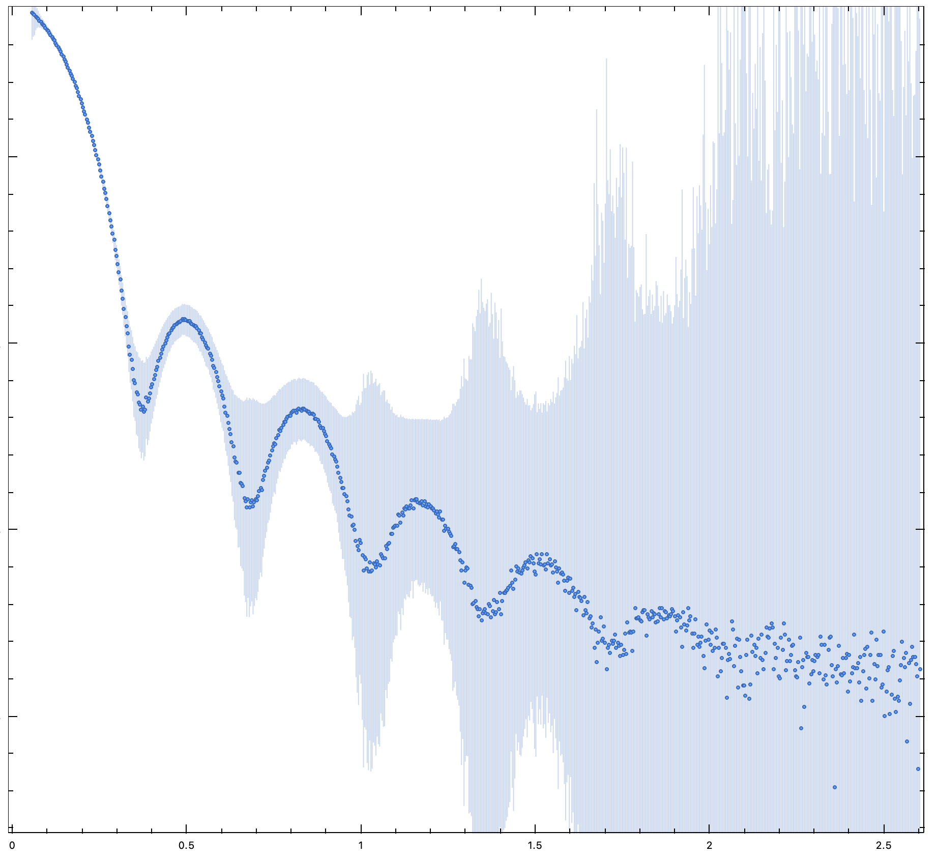
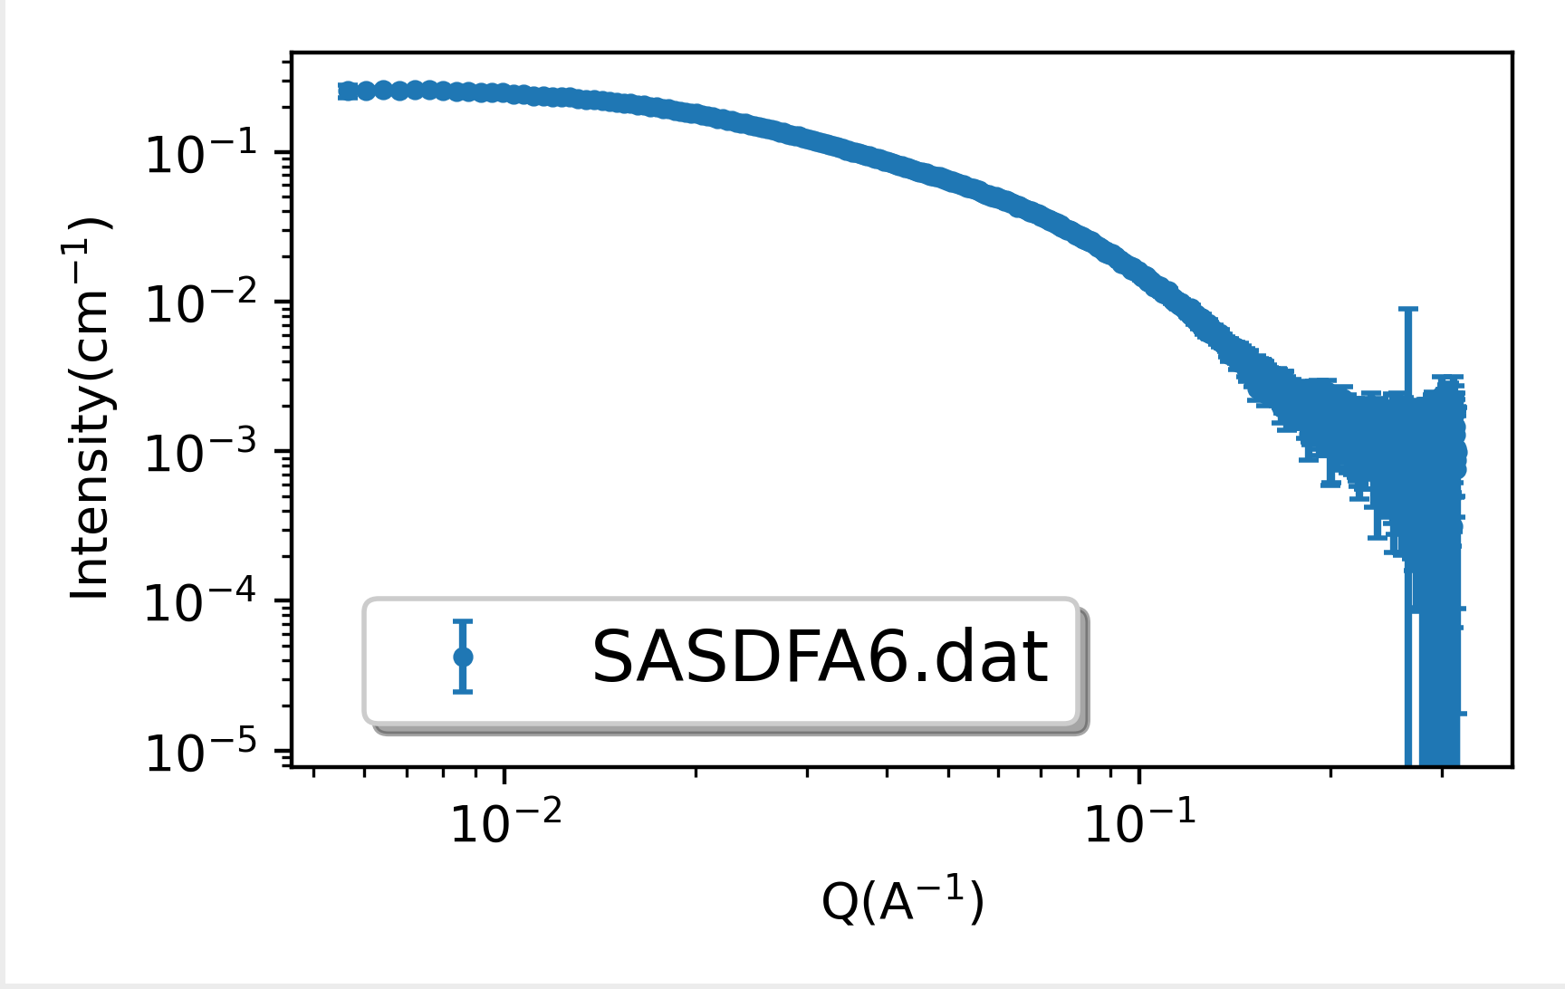
Dataset 1
Intensity
q, nm⁻¹
Dataset 2

