Slide 1
JAVA Threading Workshop
by Aaron Chen

Slide 2
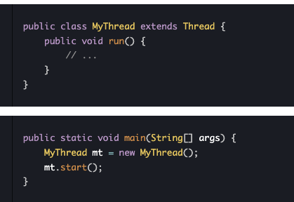
How to implement a thread in JAVA?
Extends Thread class
(not recommended)
Hard to integrate into modern framework
Separation of Concerns (Thread class shouldn’t care what to do)
single inheritance in JAVA

Slide 3
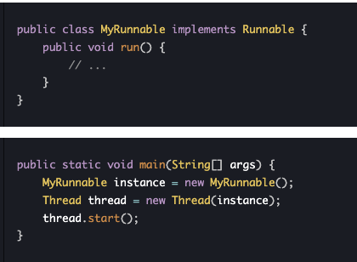
Implement Runnable

Slide 4
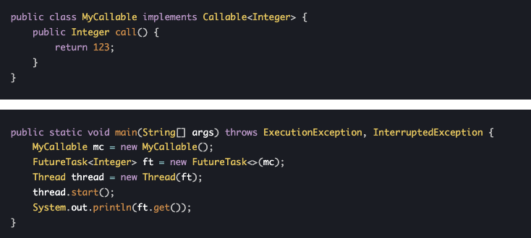
No return value? 🤔
Implement Callable and uses FutureTask to wrap

Slide 5
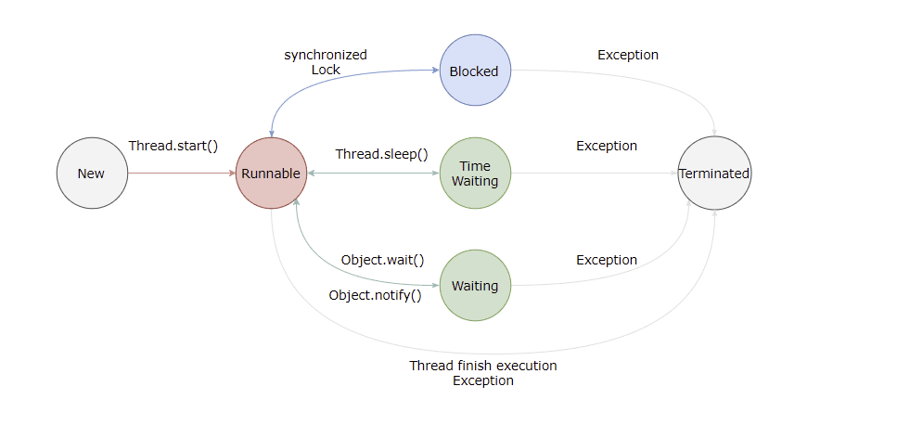
Lifecycle
New The thread object has been created (e.g. via new Thread(…)) but start() has not yet been called.
Runnable The thread is either actually running on the CPU or is ready to run as soon as it gets a time slice. (This covers both the OS “Running” and “Ready” states.)
Blocked The thread is waiting to acquire an intrinsic lock (i.e. synchronized). As soon as the lock is released by its holder, the thread will move back to the Runnable state.
Waiting The thread is waiting indefinitely until another thread explicitly wakes it up. It enters this state by calling one of:
Object.wait() without a timeout
Thread.join() without a timeout
LockSupport.park() It leaves this state when another thread calls Object.notify()/notifyAll(), when the joined thread terminates, or when unpark(...) is called.
Timed Waiting Similar to Waiting, but with an automatic timeout. Threads enter this state by calling:
Thread.sleep(...)
Object.wait(timeout)
Thread.join(timeout)
LockSupport.parkNanos(...) or parkUntil(...) After the specified time elapses, the thread automatically returns to Runnable.

Slide 6
Thread safety?
Check out the ThreadUnsafeCounter in the example
Atomicity Operations must execute as an indivisible unit. Example problem: count++ is actually read → modify → write; interleaving threads can “lose” updates.
Visibility Changes made by one thread must become visible to others in a timely manner. Mechanisms: volatile, synchronized, Lock (memory fences ensure that writes are flushed to Main Memory).
Ordering The JVM and CPU may reorder instructions for optimization, as long as single-thread semantics are preserved. Without a happens-before relationship (via volatile or locks), one thread’s writes can appear out of sequence to another.

Slide 7
JVM reordering
What It Is The JVM (and underlying CPU) may reorder independent memory and instruction operations to optimize throughput and resource utilization.
Where It Happens JIT Compiler: breaks and fuses code, reorders within methods. Runtime/CPU: out-of-order execution, register renaming, memory subsystem optimizations.
Thread-Local Reordering Reordering is always done per-thread and must preserve single-threaded semantics; you won’t see surprising behaviour unless you’re sharing data across threads without proper fences.
Java Memory Model (JMM) Defines a happens-before relationship that enforces ordering guarantees. Without a happens-before edge, writes by one thread might not be visible to another in program order.
Preventing Undesired Reordering final: used as immutable volatile: adds load/store fences before/after each access. synchronized/Lock: establishes acquire and release semantics.
Why It Matters In concurrent code, improper use of synchronization can allow reordering to produce stale or out-of-order results—always rely on the JMM’s fences rather than assumptions about instruction sequence.

Slide 8
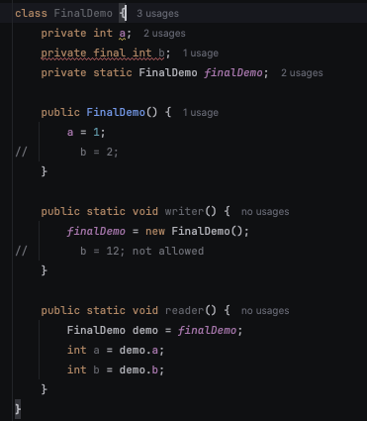
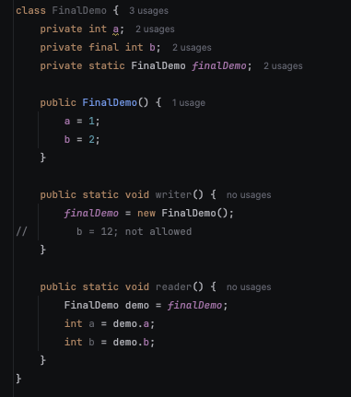
Keyword - final

Slide 9
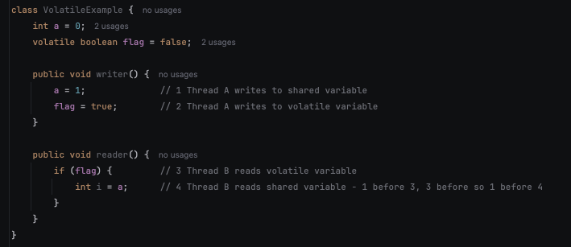
Keyword - volatile
Write -> immediately flush to the main memory
Read -> Force to read from main memory (not working memory/ Thread-local Cache)
adds load/store fences before/after each access

Slide 10
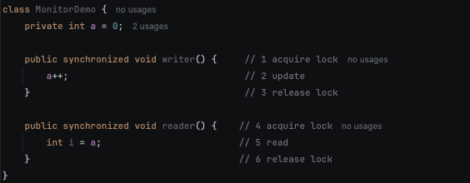
Keyword - synchronized
Ensure only one thread can access the resource at the same time
2 before 3, 3 before 4, 4 before 5, so 2 before 5, vice versa

Slide 11
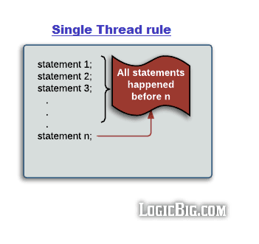
JMM – Java memory model (Happens - before)
Single Thread rule

Slide 12
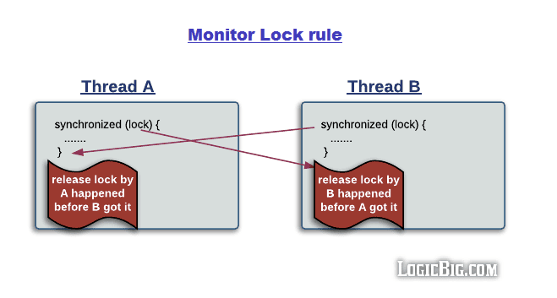
Monitor Lock rule

Slide 13
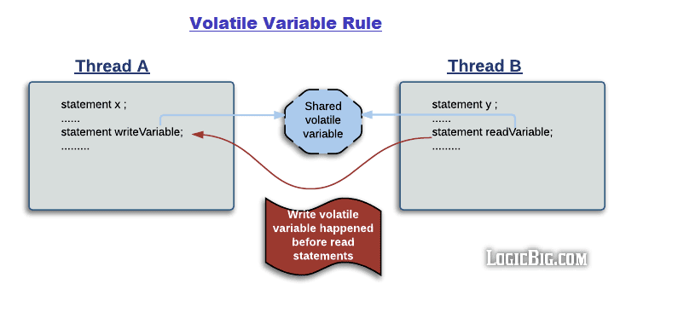
Volatile variable write before read

Slide 14
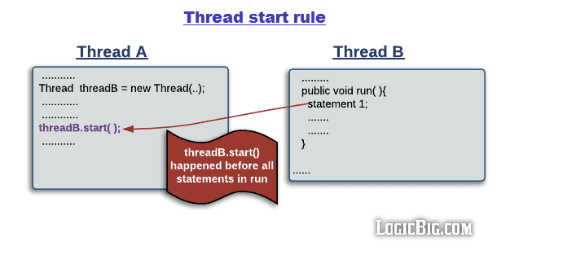
Start() method runs before all statement

Slide 15
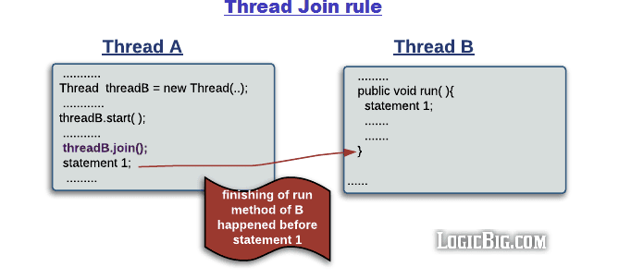
Join() will finish before continue

Slide 16
Transitivity
If a is before b and b is before c, a is before c

Slide 17
java.util.concurrent
Atomic Class : AtomicInteger, AtomicIntegerArray, AtomicReference, AtomicStampedReference etc…
Lock: ReentrantLock, ReentrantReadWriteLock etc…
Concurrent Collections: ConcurrentHashMap, CopyOnWriteArrayList, CopyOnWriteArraySet, etc..
Blocking Queue: ArrayBlockingQueue, LinkedBlockingQueue, etc..
None-Blocking Queue: ConcurrentLinkedQueue, LinkedTransferQueue, etc..
Tools: CountDownLatch, Semaphore, CyclicBarrier, etc

Slide 18
CAS (Compare and Swap)
Memory address of the target variable Expected value (what we think is currently stored) New value to write if the comparison succeeds If current value != expected, CAS fails → caller can retry (loop) or take alternative action
Lock-free algorithms - fewer context switches, better scalability
Reduces thread contention compared to synchronized/ReentrantLock
Spin-retry loops or higher-level utilities (e.g. AtomicInteger, ConcurrentLinkedQueue) build on CAS

Slide 19
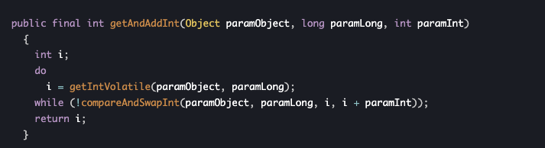
Atomic class - AtomicInteger
Provides lock-free, thread-safe operations on a single int value, based on CAS
Check out the AtomicCounter in the codebase
A-B-A problem, AtomicStampedReference to solve

Slide 20
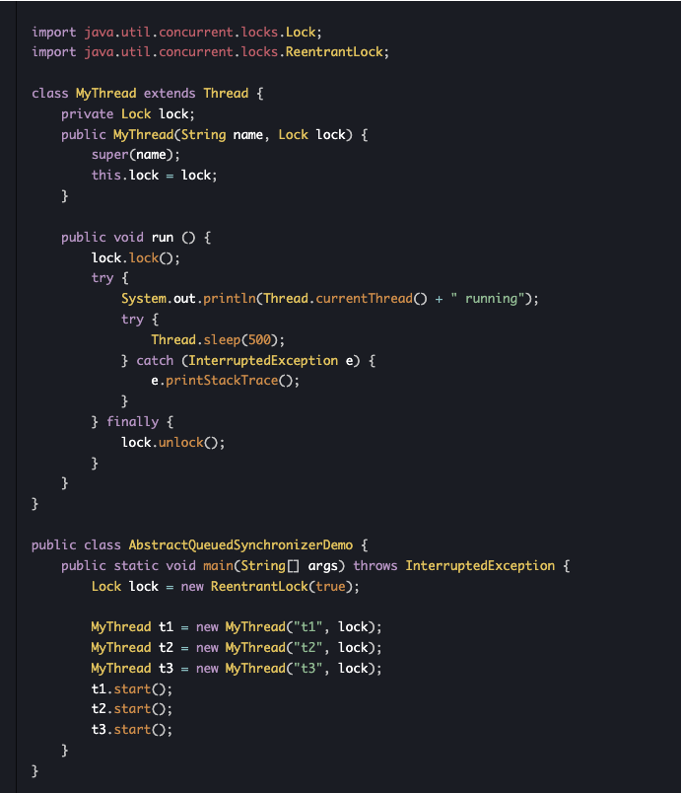
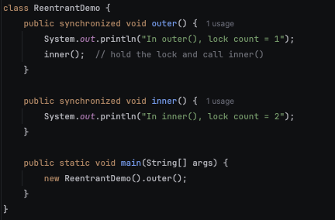
Lock - ReentrantLock
Implements the Lock interface from java.util.concurrent.locks
Offers explicit lock/unlock semantics instead of synchronized blocks
Reentrant: a thread holding the lock can re-acquire it any number of times
Can be either Fair/Unfair

Slide 21
Thread safe collections – Concurrent HashMap
A thread-safe, high-performance implementation of Map
Designed for concurrent read/write without global locking
CAS for Table Updates
size() is only an approximation
Iterators are weakly consistent
Example here multi thread updating it while multi thread reading it

Slide 22

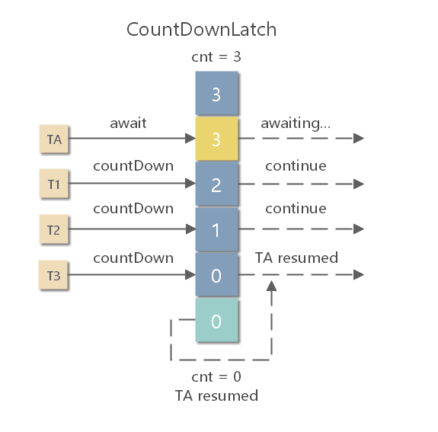
Tool - CountDownLatch
It is used to control one thread waiting for multiple threads.
CountDownLatch maintains a counter called count, which represents the number of events to wait for. The countDown() method decrements the counter, indicating that an event has occurred.
A thread calling the await() method will be blocked until the counter reaches zero, the waiting thread is interrupted, or the wait times out.
Example: OneTwoThreePrinterWithLatch in codebase

Slide 23
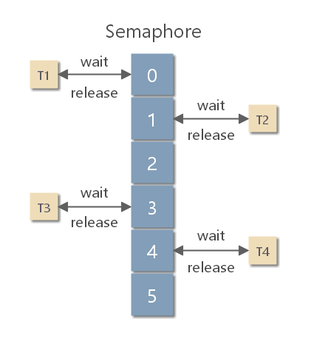
Tool - Semaphore
A Semaphore is used to control the number of concurrent accesses to a certain block of code.
A Semaphore manages a set of virtual permits, and the initial number of permits can be specified through its constructor. Each call to the acquire method attempts to obtain a permit; if none are available, the thread waits. The release method releases a permit back to the semaphore.
Use cases for Semaphore: A Semaphore can be used to implement a resource pool, such as a database connection pool. A Semaphore can be used to turn any kind of container into a bounded blocking container.
Example: OneTwoThreePrinterWithSemaphore in codebase

Slide 24
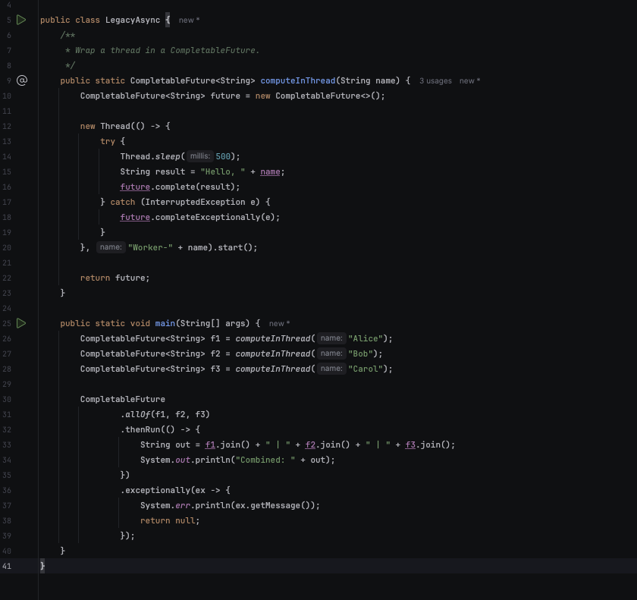
Legacy Async pattern
Wrap a thread into Completable Future

Slide 25
Code challenge: implement ABAB printer

