Slide 1
Federal Employee Workplace Satisfaction
An Analysis of Federal Employee Viewpoint Survey (FEVS) Data and Glassdoor/Indeed Reviews
Aaron Hollinger – Nashville Software School

Slide 2
Research Questions
FEVS Data
Which federal agencies exceeded or fell below the federal agency median?
Overall Satisfaction
Index Level
Are the FEVS indices correlated?
Glassdoor/Indeed Ratings
Which agencies received the most favorable Glassdoor/Indeed ratings?
Is there a correlation between Glassdoor and Indeed ratings?
FEVS and Glassdoor/Indeed Ratings
Is there a correlation between FEVS survey indices and Glassdoor/Indeed ratings?

Slide 3
Federal Agencies Included in Analysis
Department of Agriculture | Department of State | Nuclear Regulatory Commission
Department of Commerce | Department of the Interior | Office Of Personnel Management
Department of Education | Department of the Treasury | Small Business Administration
Department of Energy | Department of Transportation | Social Security Administration
Department of Homeland Security | Equal Employment Opportunity Commission | U.S. Agency for International Development
Department of Housing and Urban Development | Federal Energy Regulatory Commission | United States Department of the Air Force
Department of Justice | Federal Trade Commission | United States Department of the Army
Department of Labor | General Services Administration | United States Department of the Navy
Department of State | National Credit Union Administration
Department of the Interior | National Science Foundation

Slide 4
Overview of FEVS Data

Slide 5
FEVS Indices
My Work Experience
My Work Unit
My Organization
My Supervisor
Leadership
My Satisfaction
DEI
Employee Experience

Slide 6
Overall Satisfaction – Favorable Percentage

Slide 7
Median Favorable Percentage by Index

Slide 8
Favorable Percentage By Index - Top 2 / Bottom 2
Agency | My Work Experience
National Science Foundation | 83%
General Services Administration | 82%
Median | 72%
Department of Homeland Security | 63%
Social Security Administration | 57%
Agency | My Work Unit
Federal Trade Commission | 92%
Federal Energy Regulatory Commission | 87%
Median | 77%
Department of Homeland Security | 64%
Social Security Administration | 59%
Agency | My Organization
National Science Foundation | 85%
Federal Energy Regulatory Commission | 84%
Median | 71%
Department of Justice | 60%
Department of Homeland Security | 60%
Agency | My Supervisor
Federal Trade Commission | 93%
Federal Regulatory Commission | 92%
Median | 86%
Social Security Administration | 77%
Department of Justice | 77%

Slide 9
Favorable Percentage By Index - Top 2 / Bottom 2
Agency | Leadership
Federal Energy Regulatory Commission | 77%
General Services Administration | 76%
Median | 60%
Department of Justice | 49%
Social Security Administration | 49%
Agency | My Satisfaction
National Science Foundation | 77%
General Services Administration | 76%
Median | 61%
Department of Homeland Security | 50%
Social Security Administration | 47%
Agency | DEI
Federal Trade Commission | 89%
Federal Energy Regulatory Commission | 86%
Median | 78%
Department of Homeland Security | 67%
Social Security Administration | 66%
Agency | Employee Experience
Equal Employment Opportunity Commission | 85%
Federal Trade Commission | 84%
Median | 76%
Department of Homeland Security | 68%
Social Security Administration | 64%

Slide 10
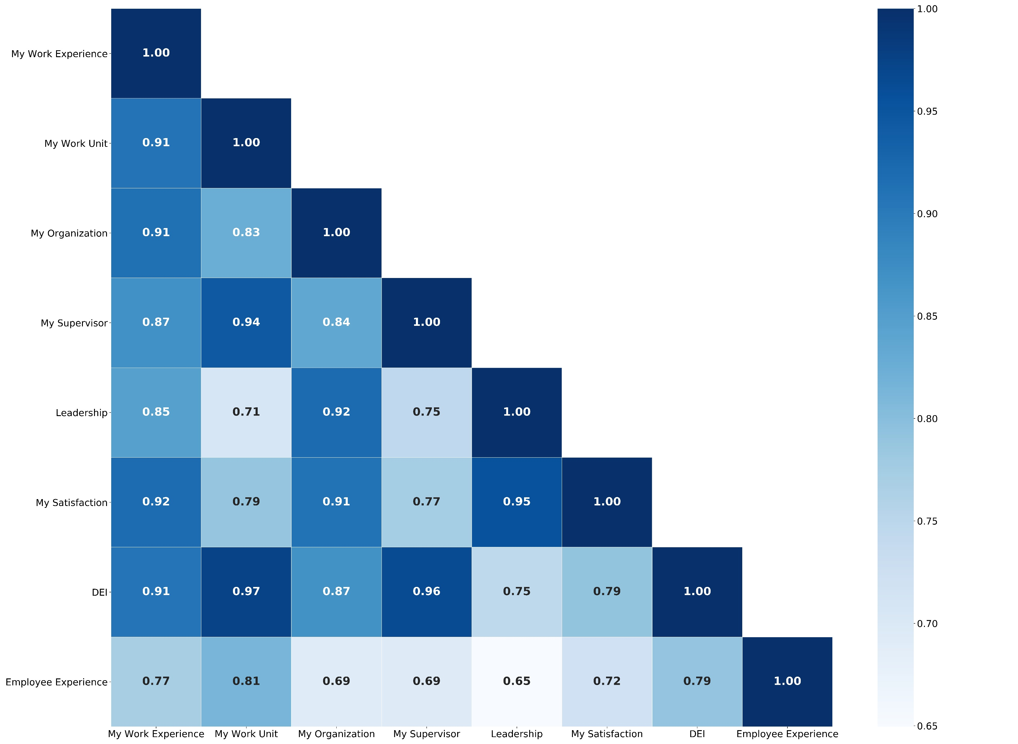
Correlation Between FEVS Indices

Slide 11
Glassdoor and Indeed Ratings

Slide 12
Online Reviews
Glassdoor | Indeed
Overall Rating | Overall Rating
Work-Life Balance | Work-Life Balance
Compensation & Benefits | Pay & Benefits
Senior Management | Management
Culture & Values | Culture
Career Opportunities | Job Security & Advancement
Rating Buckets
Five-point rating scale (1 to 5) converted to categorial variable: Strong: 4.0 or above Moderate: Below 4.0 and above 2.5. Weak: 2.5 or below

Slide 13
Glassdoor: Total Number of Strong Ratings - All Categories

Slide 14
Indeed: Total Number of Strong Ratings - All Categories

Slide 15
FEVS Indices and Glassdoor/Indeed Ratings

Slide 16
Correlation Between Indices and Online Ratings

Slide 17
Correlation with Work-Life Balance – Indeed – Top 3

Slide 18
Correlation with Work-Life Balance – Glassdoor – Top 3

Slide 19
Interactive Dashboard

Slide 20
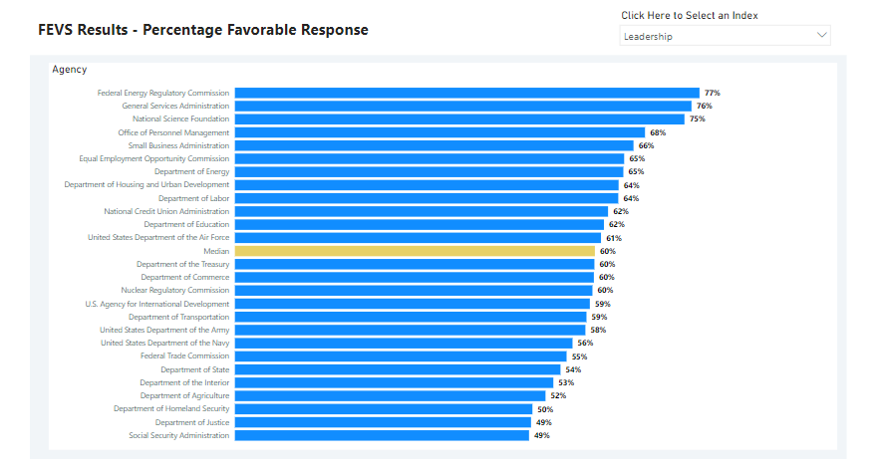

Slide 21
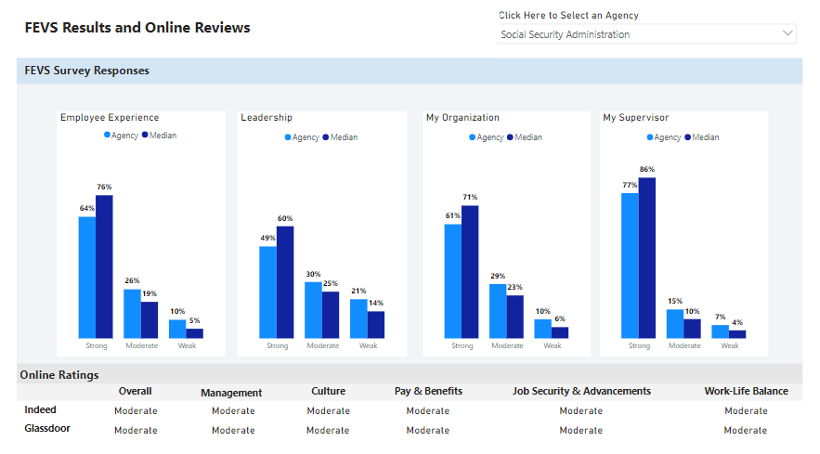

Slide 22
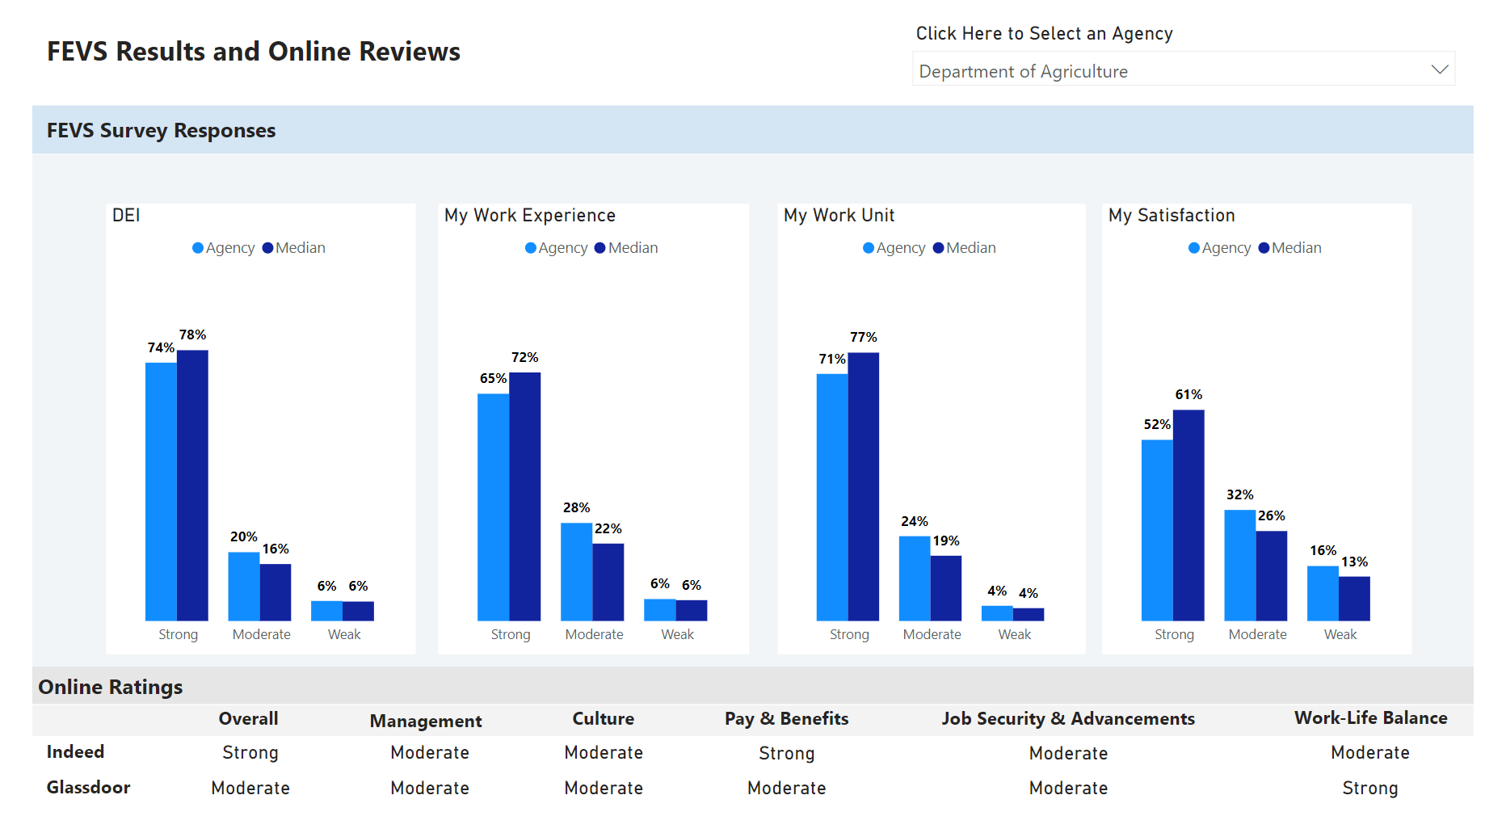

Slide 23
Key Takeaways – FEVS
My Supervisor was the highest rated index at all 26 agencies.
Leadership was the lowest rated index at 19 agencies.
Overall Satisfaction:
Highest: National Science Foundation and the Federal Energy Regulatory Commission.
Lowest: Department of Homeland Security and the Social Security Administration.

Slide 24
Key Takeaways – Glassdoor/Indeed
There was no significant correlation between ratings on Glassdoor and Indeed.
Strong Ratings – Six Categories:
Glassdoor: The Federal Energy Regulatory Commission.
Indeed: The U.S. Agency for International Development, the National Science Foundation, and the Federal Trade Commission.

Slide 25
Key Takeaways – FEVS and Online Ratings
Moderate correlation between FEVS indices and Indeed ratings – namely with the Work-Life Balance rating category.
In contrast, there was almost no correlation between FEVS Indices and Glassdoor ratings.

Slide 26
Sources
FEVS Data: https://www.opm.gov/fevs/
Glassdoor Reviews: https://www.glassdoor.com/
Indeed Reviews: https://www.indeed.com/

Slide 27
Thank you!

