Slide 1
Federal Employee Workplace Satisfaction
An Analysis of Federal Employee Viewpoint Survey (FEVS) Data and Glassdoor/Indeed Reviews
Aaron Hollinger – Nashville Software School

Slide 2
Research Questions
FEVS Data
Which federal agencies exceeded or fell below the federal agency median?
Overall Satisfaction
Index Level
Are the FEVS indices correlated?
Glassdoor/Indeed Ratings
Which agencies received the most favorable Glassdoor/Indeed ratings?
Is there a correlation between Glassdoor and Indeed ratings?
FEVS and Glassdoor/Indeed Ratings
Is there a correlation between FEVS survey indices and Glassdoor/Indeed ratings?

Slide 3
Federal Agencies Included in Analysis
Department of Agriculture | Department of State | Nuclear Regulatory Commission
Department of Commerce | Department of the Interior | Office Of Personnel Management
Department of Education | Department of the Treasury | Small Business Administration
Department of Energy | Department of Transportation | Social Security Administration
Department of Homeland Security | Equal Employment Opportunity Commission | U.S. Agency for International Development
Department of Housing and Urban Development | Federal Energy Regulatory Commission | United States Department of the Air Force
Department of Justice | Federal Trade Commission | United States Department of the Army
Department of Labor | General Services Administration | United States Department of the Navy
Department of State | National Credit Union Administration
Department of the Interior | National Science Foundation

Slide 4
Overview of FEVS Data

Slide 5
FEVS Indices
My Work Experience
My Work Unit
My Organization
My Supervisor
Leadership
My Satisfaction
DEI
Employee Experience

Slide 6
Overall Satisfaction – Favorable Percentage

Slide 7
Median Favorable Percentage by Index

Slide 8
Favorable Percentage By Index - Top 2 / Bottom 2
Agency | My Work Experience
National Science Foundation | 83%
General Services Administration | 82%
Median | 72%
Department of Homeland Security | 63%
Social Security Administration | 57%
Agency | My Work Unit
Federal Trade Commission | 92%
Federal Energy Regulatory Commission | 87%
Median | 77%
Department of Homeland Security | 64%
Social Security Administration | 59%
Agency | My Organization
National Science Foundation | 85%
Federal Energy Regulatory Commission | 84%
Median | 71%
Department of Justice | 60%
Department of Homeland Security | 60%
Agency | My Supervisor
Federal Trade Commission | 93%
Federal Regulatory Commission | 92%
Median | 86%
Social Security Administration | 77%
Department of Justice | 77%

Slide 9
Favorable Percentage By Index - Top 2 / Bottom 2
Agency | Leadership
Federal Energy Regulatory Commission | 77%
General Services Administration | 76%
Median | 60%
Department of Justice | 49%
Social Security Administration | 49%
Agency | My Satisfaction
National Science Foundation | 77%
General Services Administration | 76%
Median | 61%
Department of Homeland Security | 50%
Social Security Administration | 47%
Agency | DEI
Federal Trade Commission | 89%
Federal Energy Regulatory Commission | 86%
Median | 78%
Department of Homeland Security | 67%
Social Security Administration | 66%
Agency | Employee Experience
Equal Employment Opportunity Commission | 85%
Federal Trade Commission | 84%
Median | 76%
Department of Homeland Security | 68%
Social Security Administration | 64%

Slide 10
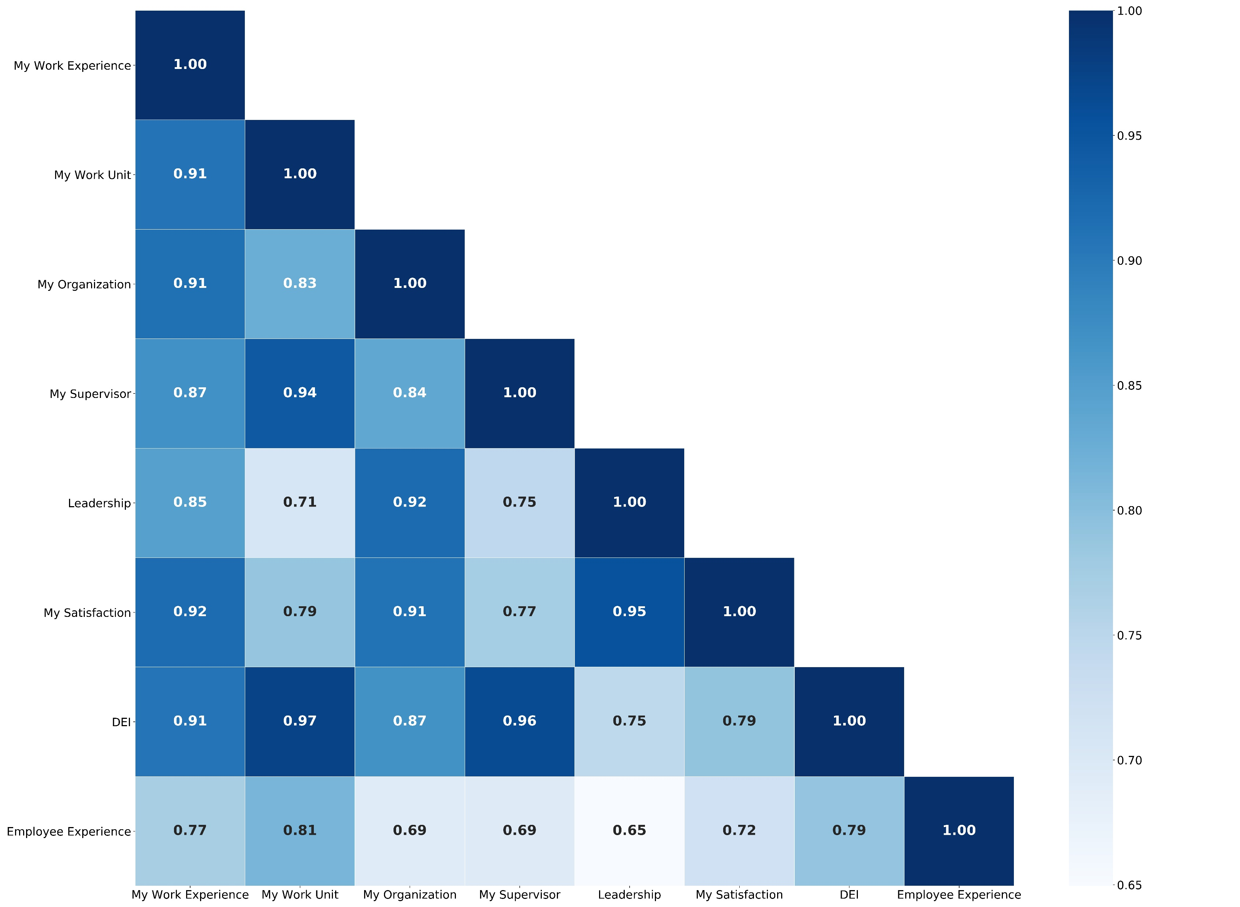
Correlation Between FEVS Indices

Slide 11
Glassdoor and Indeed Ratings

Slide 12
Online Reviews
Glassdoor | Indeed
Overall Rating | Overall Rating
Work-Life Balance | Work-Life Balance
Compensation & Benefits | Pay & Benefits
Senior Management | Management
Culture & Values | Culture
Career Opportunities | Job Security & Advancement
Rating Buckets
Five-point rating scale (1 to 5) converted to categorial variable: Strong: 4.0 or above Moderate: Below 4.0 and above 2.5. Weak: 2.5 or below

Slide 13
Glassdoor: Total Number of Strong Ratings - All Categories

Slide 14
Indeed: Total Number of Strong Ratings - All Categories

Slide 15
FEVS Indices and Glassdoor/Indeed Ratings

Slide 16
Correlation Between Indices and Online Ratings

Slide 17
Correlation with Work-Life Balance – Indeed – Top 3

Slide 18
Correlation with Work-Life Balance – Glassdoor – Top 3

Slide 19
Interactive Dashboard

Slide 20
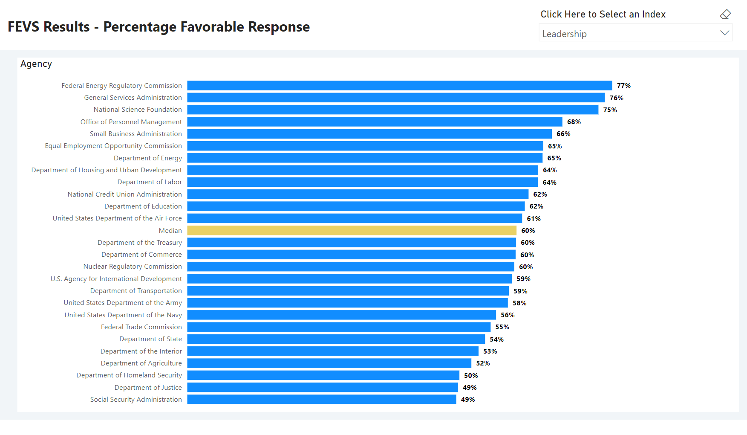

Slide 21
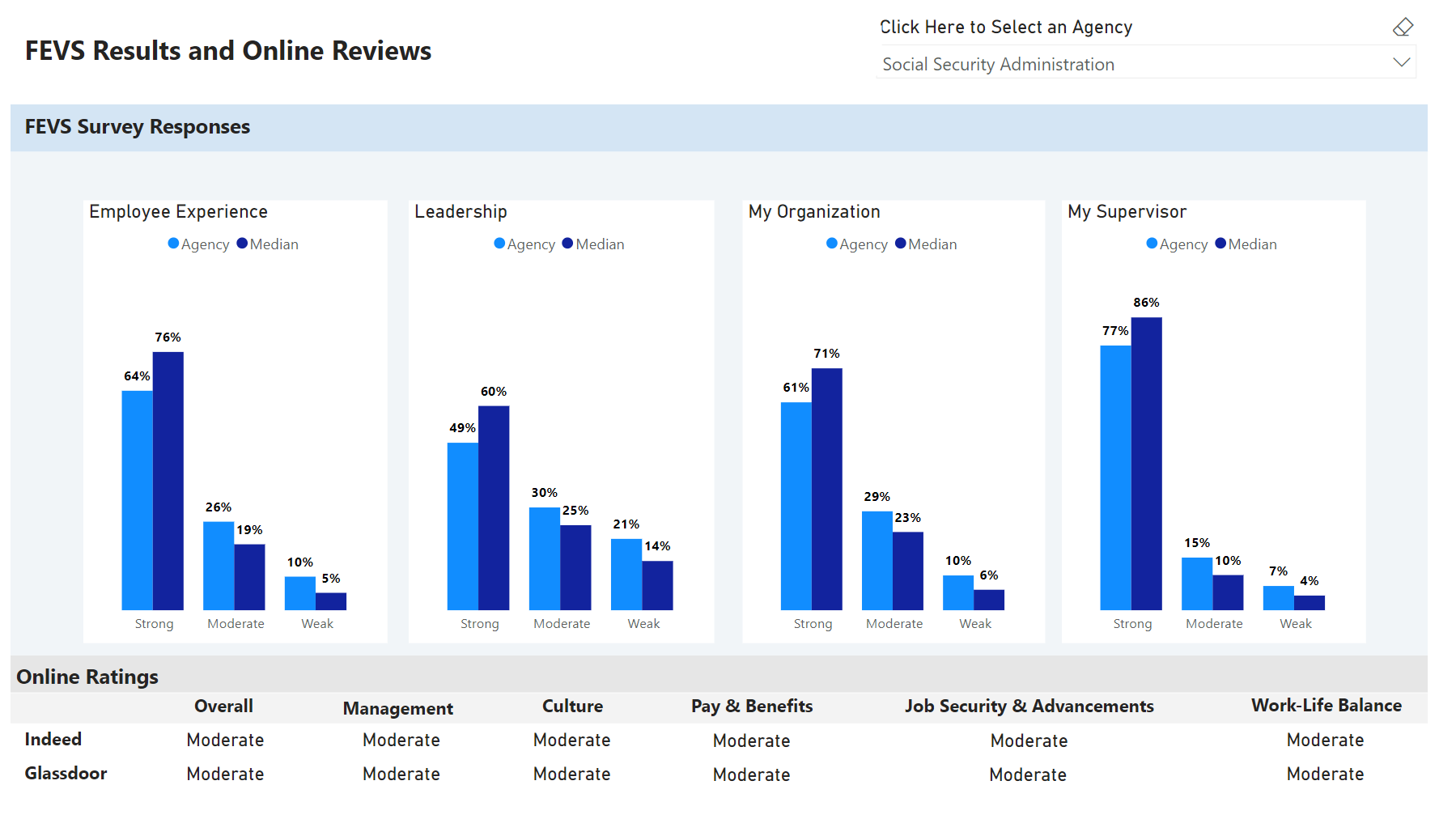

Slide 22
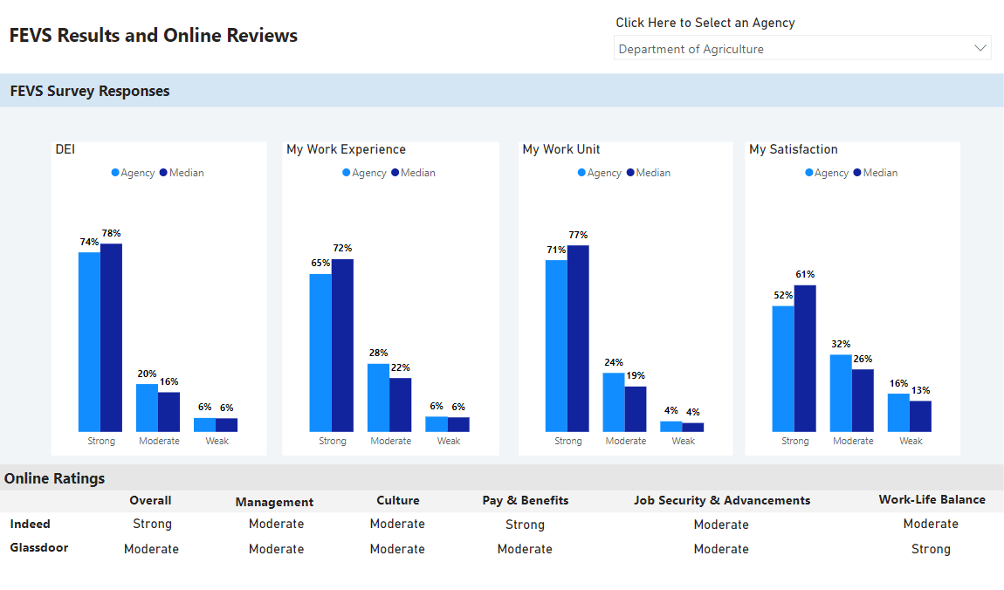

Slide 23
Key Takeaways – FEVS
My Supervisor was the highest rated index at all 26 agencies.
Leadership was the lowest rated index at 19 agencies.
Overall Satisfaction:
Highest: National Science Foundation and the Federal Energy Regulatory Commission.
Lowest: Department of Homeland Security and the Social Security Administration.

Slide 24
Key Takeaways – Glassdoor/Indeed
There was no significant correlation between ratings on Glassdoor and Indeed.
Strong ratings in all six categories:
Glassdoor: The Federal Energy Regulatory Commission.
Indeed: The U.S. Agency for International Development, the National Science Foundation, and the Federal Trade Commission.

Slide 25
Key Takeaways – FEVS and Online Ratings
There was a moderate positive correlation between several FEVS indices and Indeed rating categories.
Six correlations between FEVS indices and Indeed ratings exceeded .50.
There was no consistent correlation between FEVS Indices and Glassdoor rating categories.
Zero correlations between FEVS indices and Glassdoor ratings exceeded .50.

Slide 26
Sources
FEVS Data: https://www.opm.gov/fevs/
Glassdoor Reviews: https://www.glassdoor.com/
Indeed Reviews: https://www.indeed.com/

Slide 27
Thank you!

