Slide 1

ACLC COLLEGE
INFORMATION MANAGEMENT SYSTEM
Username:
Password:
LOGIN
EXIT

Slide 2
ACLC COLLEGE
INFORMATION MANAGEMENT SYSTEM
Login as
Administrator
Username:
Password:
User
LOGIN
EXIT

Slide 3
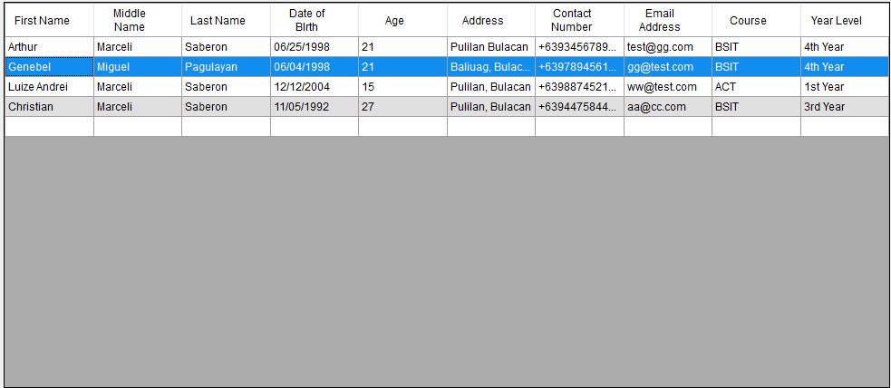
ACLC Information Management System
X
Search:
Manage
Export Report
Logout

Slide 4
ACLC Information Management System
X
Search:
Managing Records
X
Export Report
Logout
Search:
Add
Update
Delete

Slide 5
ACLC Information Management System
X
Search:
Adding New Record
X
Managing Records
X
Export Report
Logout
Search:
Browse
Add
First Name:
Update
Middle Name:
Last Name:
Delete
Birthday:
Address:
Contact Number:
Email Address:
Course:
Year Level:
Add

Slide 6
ACLC Information Management System
X
Search:
Updating Record
X
Managing Records
X
Export Report
Logout
Search:
Browse
Add
First Name:
Update
Middle Name:
Last Name:
Delete
Birthday:
Address:
Contact Number:
Email Address:
Course:
Year Level:
Update

Slide 7
ACLC Information Management System
X
Search:
Managing Records
X
Export Report
Logout
Search:
Add
Do you want to delete this record ?
Update
Delete
Yes
No

Slide 8
ACLC Information Management System
X
Search:
Export Report
Logout

