Slide 1
Food Delivery System
Phase 2: Implementation Core
BACSE202 Database Systems
Aaron Robertson 25BCE2640
Ark Khandelwal 25BCE2094
Priyansh Asati 25BDS0268
Ansh Kapoor 25BCE2281
Notes:
Source: Phase1/RELATIONAL_SCHEMA.md, Food-Delivery-System.pdf and BACSE202_Course_Project_Overview.pdf. Implementation and evidence: Phase2Database and Phase2App in the local DBS PROJECT folder. All sample people and orders are fictional. Team list retained from the supplied Phase 1 PDF. Local application uses FOOD_PROJECT on Oracle XE.

Slide 2
Phase 2 deliverables
Area | Implemented evidence | Marks
Table creation | Nine Oracle tables with constraints | 2
Data population | Fictional users, menus, orders and deliveries | 2
Front end | Black-and-white browser interface | 2
Business logic | Transactional Java service and workflow rules | 2
Initial connectivity | SELECT, INSERT and UPDATE through JDBC | 2
02
Notes:
Source: Phase1/RELATIONAL_SCHEMA.md, Food-Delivery-System.pdf and BACSE202_Course_Project_Overview.pdf. Implementation and evidence: Phase2Database and Phase2App in the local DBS PROJECT folder. All sample people and orders are fictional. The course overview assigns 2 marks to each of DDL, DML, front end, business logic and initial connectivity. The Phase 2 detail slide shows the first four rows; the stage-wise rubric includes initial connectivity.

Slide 3
Relations: accounts and restaurant catalog
Relation | Attributes and keys
APP_USER | user_id PK, full_name, email UQ, phone
CUSTOMER | user_id PK/FK, customer_since
DELIVERY_PARTNER | user_id PK/FK, transport_mode, availability_status
RESTAURANT | restaurant_id PK, restaurant_name, address_line, city, postal_code, contact_phone
MENU_ITEM | item_id PK, restaurant_id FK, item_name, category, current_price, is_available
03
Notes:
Source: Phase1/RELATIONAL_SCHEMA.md, Food-Delivery-System.pdf and BACSE202_Course_Project_Overview.pdf. Implementation and evidence: Phase2Database and Phase2App in the local DBS PROJECT folder. All sample people and orders are fictional. PK identifies a row. FK references its parent. UQ is a unique candidate key. Subtypes inherit the APP_USER identifier.

Slide 4
Relations: orders, payments and deliveries
Relation | Attributes and keys
FOOD_ORDER | order_id PK, customer_id FK, restaurant_id FK, ordered_at, order_status, dropoff_line, dropoff_city, dropoff_postal_code, delivery_fee
ORDER_ITEM | order_id PK/FK, item_id PK/FK, quantity, agreed_unit_price
PAYMENT | payment_id PK, order_id UQ/FK, payment_method, payment_amount, payment_status, paid_at
DELIVERY | order_id PK/FK, partner_id FK, assigned_at, picked_up_at, delivered_at
04
Notes:
Source: Phase1/RELATIONAL_SCHEMA.md, Food-Delivery-System.pdf and BACSE202_Course_Project_Overview.pdf. Implementation and evidence: Phase2Database and Phase2App in the local DBS PROJECT folder. All sample people and orders are fictional. ORDER_ITEM has composite PK(order_id,item_id). PAYMENT.order_id is unique. DELIVERY.order_id is a shared PK/FK. A missing row represents optional payment or delivery. Derived order totals are not stored in the normalized base tables.

Slide 5
Oracle DDL and constraints
ORDER_ITEM constraint example
CONSTRAINT pk_order_item PRIMARY KEY (order_id, item_id),
CONSTRAINT fk_line_order FOREIGN KEY (order_id)
REFERENCES food_order (order_id),
CONSTRAINT fk_line_item FOREIGN KEY (item_id)
REFERENCES menu_item (item_id),
CONSTRAINT ck_line_quantity CHECK (
quantity >= 1 AND quantity = TRUNC(quantity)
)
Keys protect identity and references. CHECK constraints protect allowed values.
05
Notes:
Source: Phase1/RELATIONAL_SCHEMA.md, Food-Delivery-System.pdf and BACSE202_Course_Project_Overview.pdf. Implementation and evidence: Phase2Database and Phase2App in the local DBS PROJECT folder. All sample people and orders are fictional. The complete script uses NUMBER, VARCHAR2, TIMESTAMP and named constraints. The fresh FOOD_PROJECT account has a 20 MB USERS quota and permissions to create tables and sequences. The setup prevents creation under SYS/SYSTEM and prevents rerunning in a schema with project tables.

Slide 6
Sample data in every relation
Relation | Rows after browser demonstration
APP_USER | 4
CUSTOMER | 3
DELIVERY_PARTNER | 2
RESTAURANT | 2
MENU_ITEM | 6
FOOD_ORDER | 5
ORDER_ITEM | 9
PAYMENT | 5
DELIVERY | 2
06
Notes:
Source: Phase1/RELATIONAL_SCHEMA.md, Food-Delivery-System.pdf and BACSE202_Course_Project_Overview.pdf. Implementation and evidence: Phase2Database and Phase2App in the local DBS PROJECT folder. All sample people and orders are fictional. Counts include the retained browser demonstration order 2005 and precede any later user modifications. Before that demo, FOOD_ORDER=4, ORDER_ITEM=7 and PAYMENT=4. All fixture data is fictional.

Slide 7
Order totals and historical prices
Order | Subtotal (INR) | Delivery fee (INR) | Total (INR)
1001 | 320.00 | 30.00 | 350.00
1002 | 160.00 | 20.00 | 180.00
1003 | 150.00 | 30.00 | 180.00
1004 | 140.00 | 20.00 | 160.00
2005 | 320.00 | 30.00 | 350.00
amount_due = SUM(quantity × agreed_unit_price) + delivery_fee
Current menu prices can change while the order keeps its agreed prices.
07
Notes:
Source: Phase1/RELATIONAL_SCHEMA.md, Food-Delivery-System.pdf and BACSE202_Course_Project_Overview.pdf. Implementation and evidence: Phase2Database and Phase2App in the local DBS PROJECT folder. All sample people and orders are fictional. Totals verified through Oracle queries. Order 2005 initially has status PLACED and payment PENDING. Seed orders have fees of 20 or 30; new browser orders use 30. The service test changes current menu price and confirms old order totals remain unchanged.

Slide 8
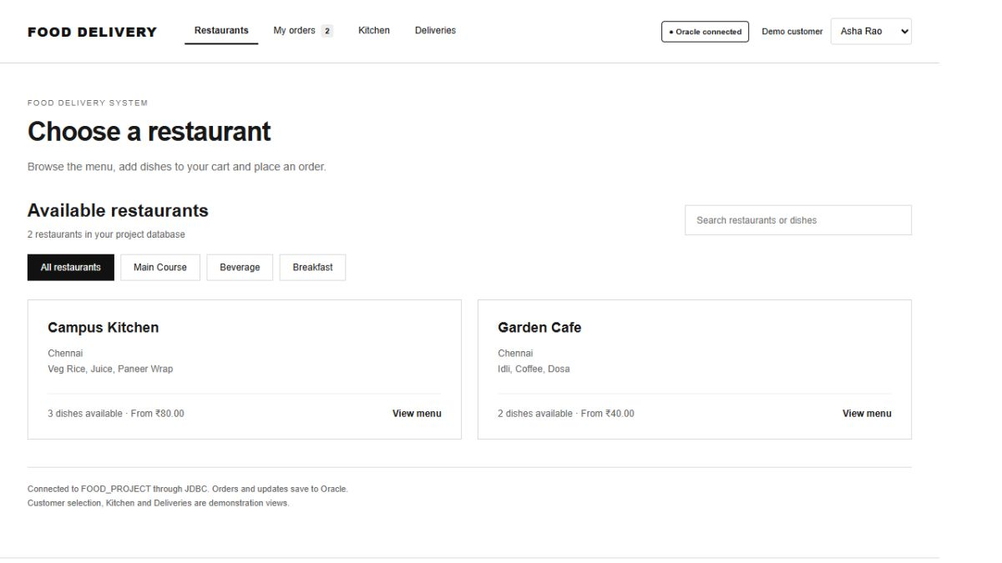
Front end: restaurant browsing
Restaurants and menu availability load from FOOD_PROJECT.
08
Notes:
Source: Phase1/RELATIONAL_SCHEMA.md, Food-Delivery-System.pdf and BACSE202_Course_Project_Overview.pdf. Implementation and evidence: Phase2Database and Phase2App in the local DBS PROJECT folder. All sample people and orders are fictional. The user requested a simple black-and-white layout with written food descriptions and no food photographs. Customer selection is a classroom demo control.

Slide 9
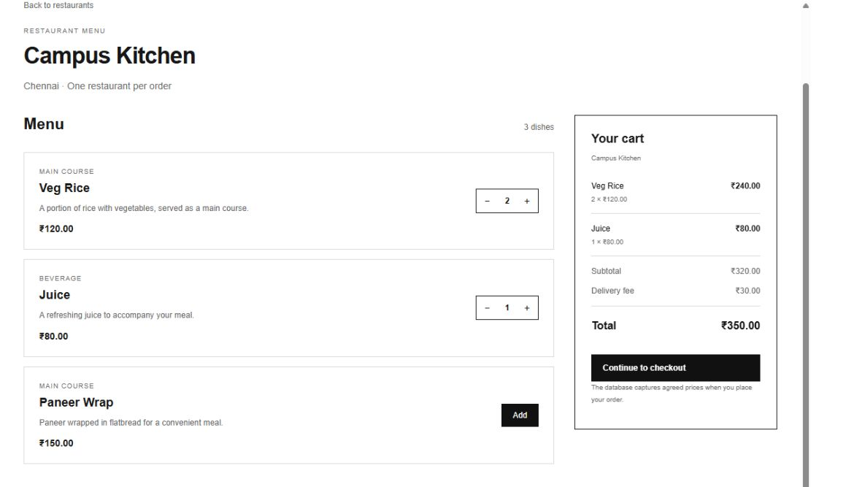
Front end: menu and cart
Two Veg Rice and one Juice total INR 350 with the delivery fee.
09
Notes:
Source: Phase1/RELATIONAL_SCHEMA.md, Food-Delivery-System.pdf and BACSE202_Course_Project_Overview.pdf. Implementation and evidence: Phase2Database and Phase2App in the local DBS PROJECT folder. All sample people and orders are fictional. Names, prices, categories and availability come from Oracle. Descriptions are frontend explanatory text for the fictional menu. The browser displays the total while the server reads and captures prices at checkout.

Slide 10
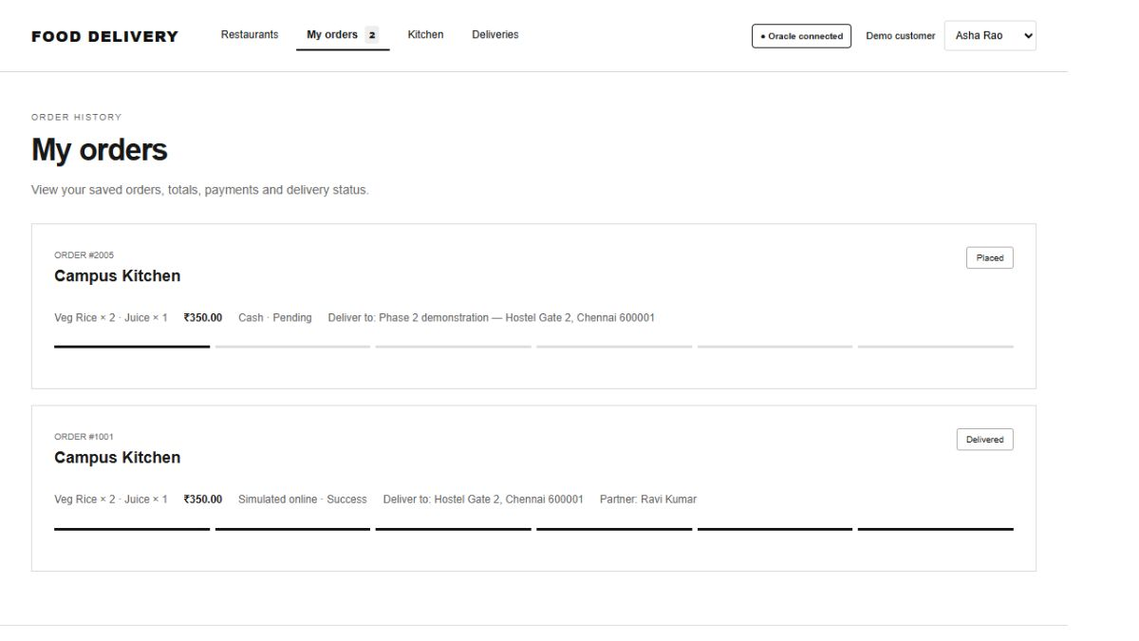
JDBC insertion and order history
The browser saved order 2005 and retrieved it from Oracle.
10
Notes:
Source: Phase1/RELATIONAL_SCHEMA.md, Food-Delivery-System.pdf and BACSE202_Course_Project_Overview.pdf. Implementation and evidence: Phase2Database and Phase2App in the local DBS PROJECT folder. All sample people and orders are fictional. Live browser test performed through http://127.0.0.1:8788. It inserted a header, two item rows and a pending cash payment. My orders showed the generated ID, destination and total. This is actual database evidence, not browser demo mode.

Slide 11
Connectivity and atomic checkout
Browser sends the customer, restaurant, cart and destination.
Java reads current availability and captures agreed item prices.
One transaction inserts FOOD_ORDER, ORDER_ITEM and PAYMENT.
The service commits on success and rolls back on failure.
The browser reloads the saved order through JDBC SELECT.
11
Notes:
Source: Phase1/RELATIONAL_SCHEMA.md, Food-Delivery-System.pdf and BACSE202_Course_Project_Overview.pdf. Implementation and evidence: Phase2Database and Phase2App in the local DBS PROJECT folder. All sample people and orders are fictional. Browser uses a loopback Java HTTP server. WebServer adapts requests to FoodService. FoodService connects with DriverManager and uses PreparedStatement. The Oracle password stays server-side in local private configuration.

Slide 12
Business logic behind the interface
Rule | Enforcement
One restaurant per order | Check each menu item against the order restaurant
Valid cart | Require items, availability and positive integer quantities
Historical integrity | Capture prices and destination when placing the order
Workflow transitions | Allow ordered preparation steps and early cancellation
Payment consistency | Require matching successful payment before delivery
Partner availability | Assign AVAILABLE partners and release after delivery
12
Notes:
Source: Phase1/RELATIONAL_SCHEMA.md, Food-Delivery-System.pdf and BACSE202_Course_Project_Overview.pdf. Implementation and evidence: Phase2Database and Phase2App in the local DBS PROJECT folder. All sample people and orders are fictional. These cross-table rules require the Java service. Declared PK/FK/CHECK constraints remain active in Oracle. Direct administrator SQL can bypass service-only rules.

Slide 13
Testing and Phase 3 work
46 JDBC checks passed
Tests cover rollback, invalid carts, keys, payment and delivery rules.
The browser demonstration saved and retrieved a real Oracle order.
Phase 3: complete remaining CRUD screens, broader testing and final report.
Demo roles and simulated payments remain within the stated scope.
13
Notes:
Source: Phase1/RELATIONAL_SCHEMA.md, Food-Delivery-System.pdf and BACSE202_Course_Project_Overview.pdf. Implementation and evidence: Phase2Database and Phase2App in the local DBS PROJECT folder. All sample people and orders are fictional. 46 checks passed against the fresh FOOD_PROJECT schema using the same copied FoodService and Phase2Test sources. The count comprises 37 checks for behavior/constraints and 9 checks confirming original table row counts after cleanup. Service tests complete cash and online workflows. Retained order 2005 was shown PLACED; later UI actions may change it.

