Slide 1
Motability SET Tech task
Aaron Southey | aaronsouthey.dev

Slide 2
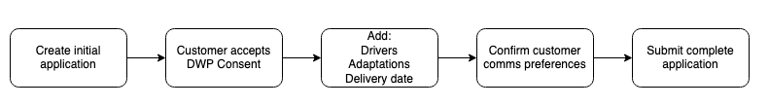
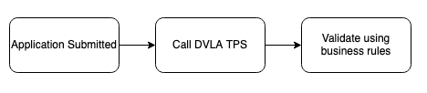
High level overview
The Application Submission Journey
The post-submission journey

Slide 3
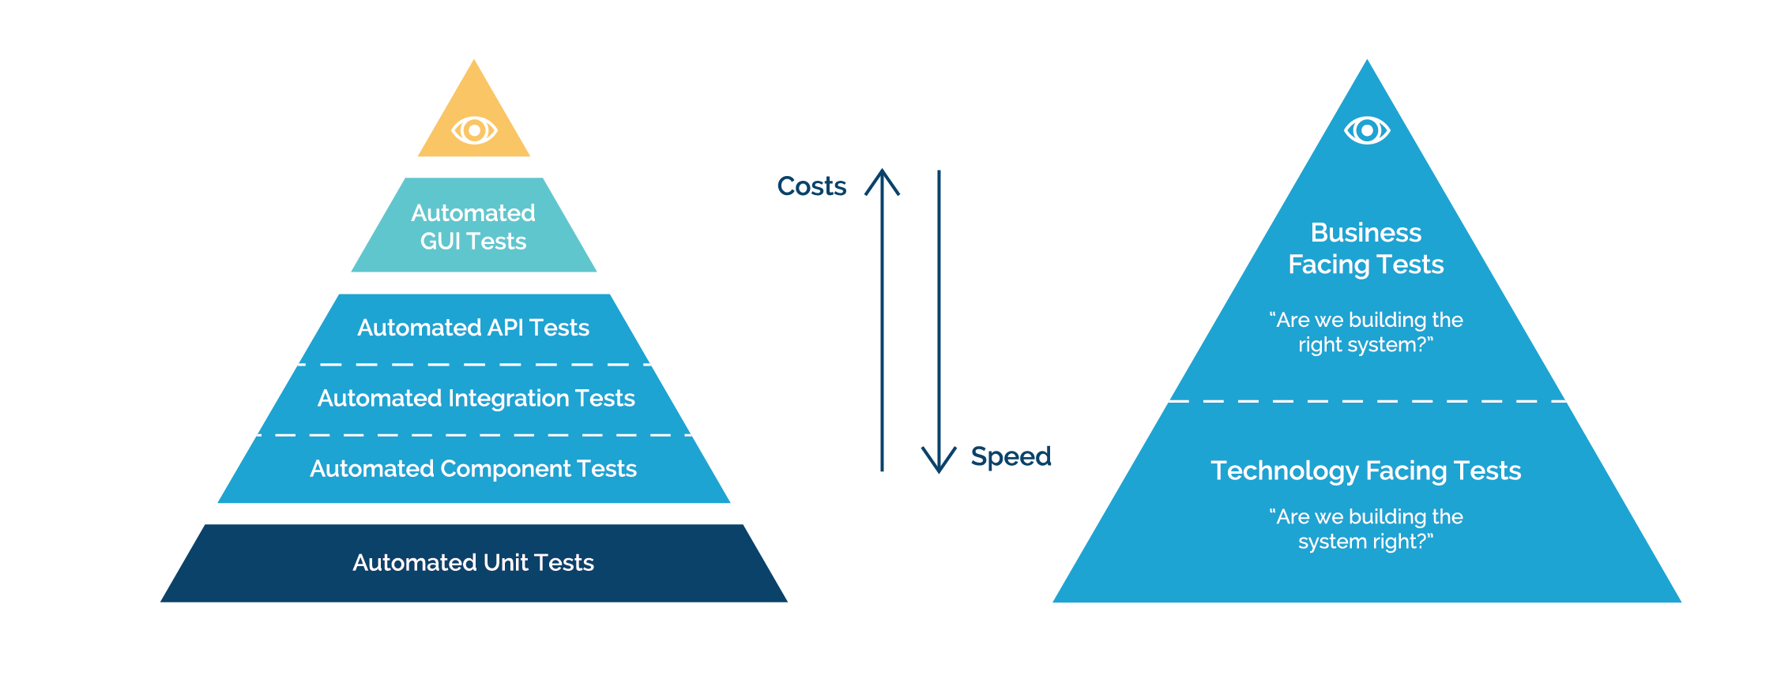
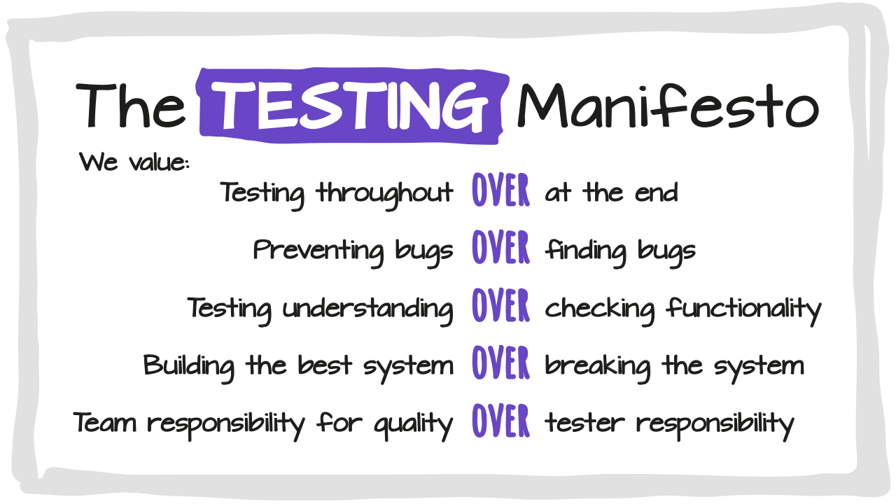
Test Strategy – The Approach
Confidence over Coverage
“Small Project” so it doesn’t require extensive testing types.
Simplicity is often the best approach, reduces potential test flake and overall maintenance requirements.
Focus on Eligability – these are the business-critical rules
Unit & Integration testing for pre merge
Fast following Smoke testing for post merge
Regression Schedules - API, UI E2E testing, focusing on the eligibility rules
Performance/Load/Scalability testing
Security testing
Usability & Accessibility

Slide 4
Eligibility Rules – Mapping Strategy
Eligibility Rule | Test Type(s) | Example Test
Driver with automatic licence cannot drive manual vehicle | Unit, Regression | it("should fail if auto licence driver selects manual vehicle")
At least one driver must have full licence | Integration, Regression | it("should pass if at least one driver is full licence")
Driver is disqualified | Smoke, Regression | it("should reject if any driver is disqualified")
≥4 endorsements in last 4 yrs (categories G/H/I) | Regression | it("should fail if driver has 4 endorsements in G/H/I")
≥2 endorsements in last 4 yrs (category G) | Regression | it("should fail if driver has 2 endorsements in G")
Any endorsement in last 4 yrs (category F) | Regression | it("should fail if driver has F category endorsement")
• Unit & integration tests validate rule logic and service contracts.
• Smoke & regression ensure rules hold under real flows.
• Non-functional checks validate SLA, resilience, and security.

Slide 5
Unit & Integration Testing
Unit Testing
Important for individual functionality (UI / API)
Scope: One function / component / module with external dependencies mocked
Good targets: • Pure functions (validation, formatting) • UI behaviour (button clicks, conditional rendering) • API branching logic
Examples: it(‘should only accept date type for `customer.dob`’, () => { … }) it(‘should submit the form on button click’, () => { … })
Integration Testing
Important for combined functionality across modules
Scope: Multiple modules / components interacting together with minimal mocks
Good targets: • Critical user journeys (form → API → persistence) • Error propagation (validation → HTTP 400 → UI message) • Service-to-service contracts (API ↔ DVLA TPS, etc.)
Example: it(‘saves customer with valid DOB and shows confirmation’, () => { … }) it(‘Should return a 4xx when invalid dob is submitted’, () => { … })

Slide 6
Smoke Testing
Run post-deployment as part of the release pipeline (test environment)
Focused on absolutely business-critical flows
Acts cross-project, validating each release against the latest build
Scope:
Minimal set of tests covering key application lifelines
Business critical only (not full regression)
Examples:
it(‘Should be able to submit the application successfully’, () => {…})
it(‘Should not pass eligibility checks if driver is disqualified’ () => {…})

Slide 7
Regression Testing
Ensures existing functionality still works after new changes
Runs on stable builds (Those that pass smoke testing)
Broader scope than smoke tests; covers core and edge cases
Regression focuses heavily on eligibility rule outcomes, as these are critical business rules
Helps prevent re-introduction of previously fixed bugs
Scope:
Full or partial test suite depending on risk/impact
Validates both business-critical and non-critical features, reducing silent bugs
Examples:
it('should create an application and save dealer + customer details', () => { … })
it('should submit application only after DWP consent is given', () => { … })
it('should fail if driver with automatic licence selects manual vehicle', () => { … })
it('should pass if at least one driver has a full licence', () => { … })
it('should reject application if any driver is disqualified', () => { … })

Slide 8
Non-functional testing
Ensures the system not only works functionally, but also meets quality attributes
Focus on performance, security, usability, and resilience of the OLA journey
Scope:
Performance & Load: • Application submission scales under peak dealership traffic • Eligibility API calls (e.g., DVLA) respond within SLA
Resilience & Reliability: • Graceful handling if TPS (DVLA) are slow or unavailable -> Critical! • Retry & failover mechanisms verified
Security: • System auth (Machine, user etc) • API endpoints protected against injection / unauthorised access
Usability & Accessibility: • Dealers can complete flow efficiently with minimal errors • UI meets accessibility guidelines
Examples:
it('should process `n` concurrent application submissions within SLA', () => { … })
it('should mask NINO in logs and error responses', () => { … })
it('should retry DVLA driver check if service times out', () => { … })
it('should meet WCAG AA accessibility standards on application form', () => { … })

Slide 9
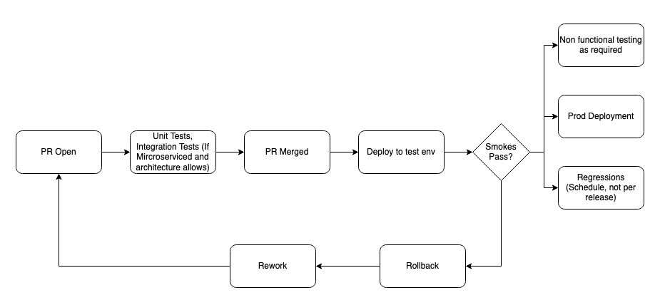
Other Considerations
Example Pipeline
Tooling: Consistent across stack (Jest, PyTest, Cypress, Playwright, OWASP ZAP, K6, Jmeter, Pactflow); clear env setup and data seeding
Reporting / Notifications: Unified test reports (coverage, e2e traces, security findings) with CI notifications to teams
Contracts / Testing: Consumer-driven contract tests for external APIs (DVLA/DWP); schema/versioning checks; backward compatibility verified

Slide 10
Thank You
Unit Testing
Important for individual functionality (UI / API)
Scope: One function / component / module with external dependencies mocked
Good targets: • Pure functions (validation, formatting) • UI behaviour (button clicks, conditional rendering) • API branching logic
Examples: it(‘should only accept date type for `customer.dob`’, () => { … }) it(‘should submit the form on button click’, () => { … })

