Slide 1
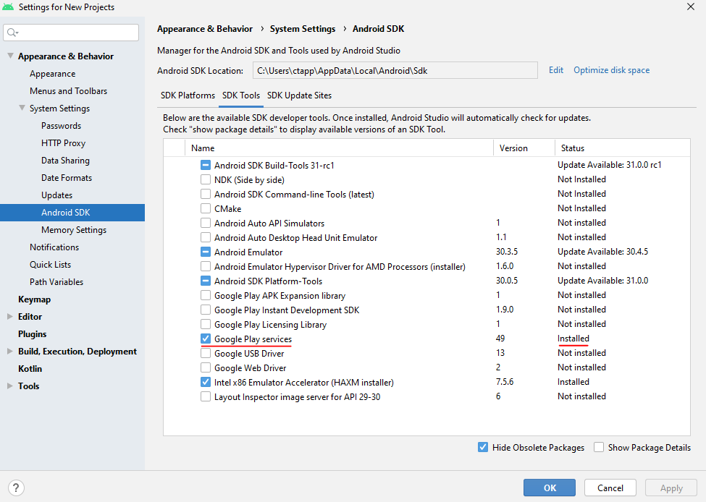
Creating a Firebase project (cont.)
First thing is to make sure you have Google play services installed
Tools->SDK Manager

Slide 2

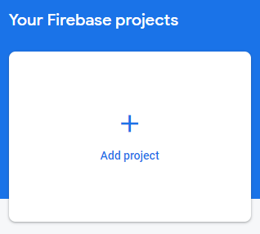
Creating a Firebase project (cont.)
Go to https://firebase.google.com
Sign in then click 'Go to the console' on the top right
Add a new project

Slide 3
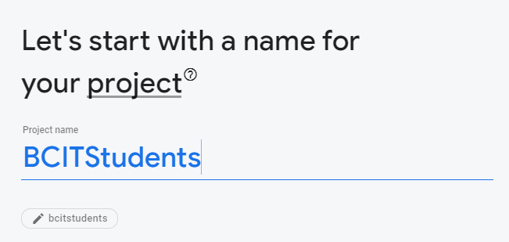

Creating a Firebase project (cont.)
Give your project a name such as BCITStudents
Then hit continue

Slide 4
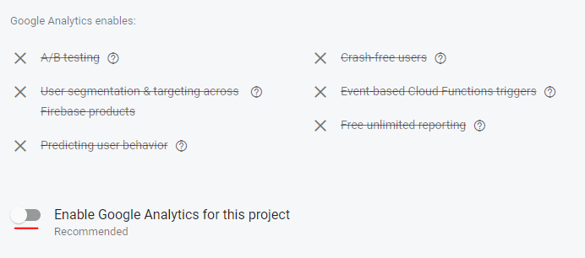

Creating a Firebase project (cont.)
Uncheck Enable Google Analytics for this project
Then click Create project

Slide 5
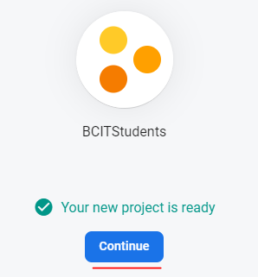
Creating a Firebase project (cont.)
When you project ready click continue
You will then be taken to the Project Overview page. Here you can check out many of the services Firebase has to offer

Slide 6
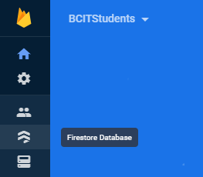
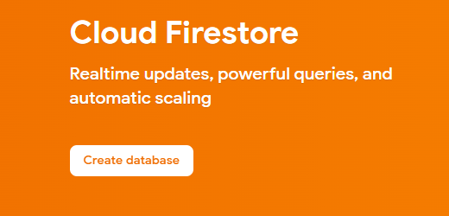
Setting up Cloud Firestore
Click on Firestore Database on the left
Then click Create Database

Slide 7
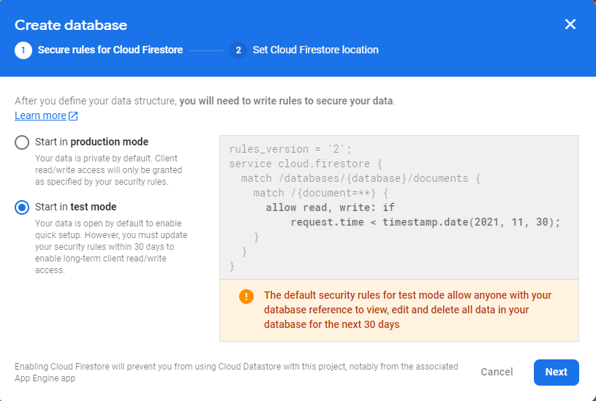
Setting up Cloud Firestore (cont.)
Choose Start in test mode
Here we are allowing read & write. This should be changed for production.

Slide 8
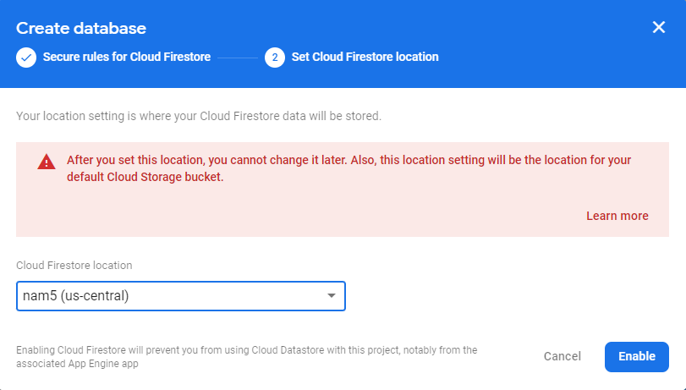
Setting up Cloud Firestore (cont.)
Choose a us-central location for your database

Slide 9
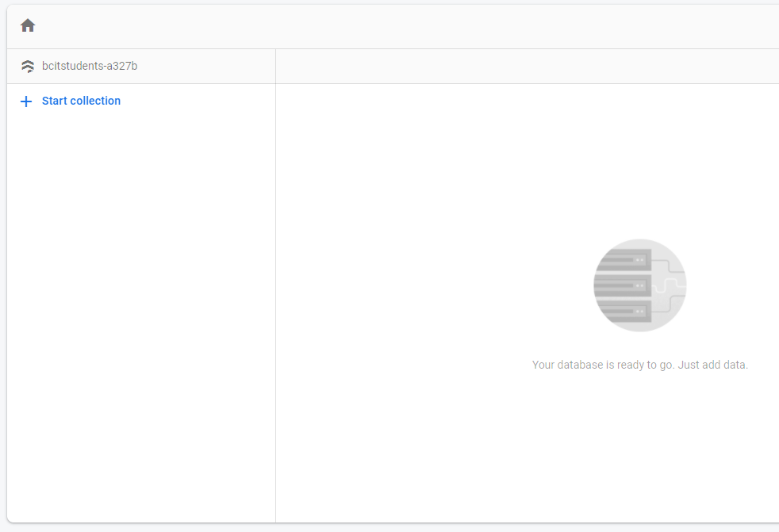
Setting up a Cloud Firestore (cont.)
That is it for the Firebase console for now, the data for you database is displayed here

Slide 10
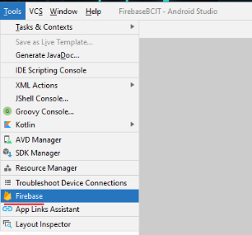
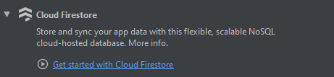
Connecting Firebase to app
Next step is to connect the database to our app, go to Tools->Firebase in Android Studio
Then click Get Started with Cloud Firestore

Slide 11

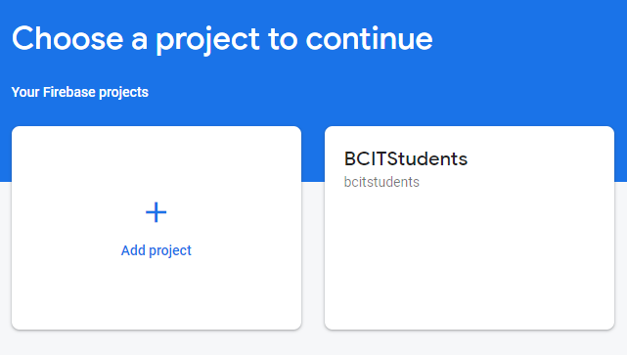
Connecting Firebase to app (cont.)
Click Connect to Firebase
(You may be prompted to build your project if you haven't yet. If so, click Connect to Firebase again once built)
Your browser will open and you will be prompted to select a project to continue
Choose your project!

Slide 12
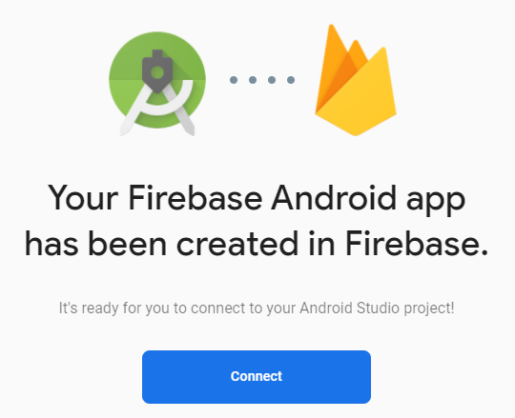
Connecting Firebase to app (cont.)
Hit Connect when prompted

Slide 13
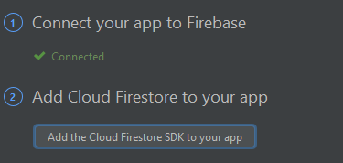
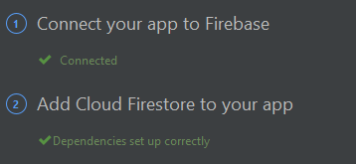
Adding Cloud Firestore to app
Next click on Add the Cloud Firestore SDK to your app
Android Studio will prompt that is making some changes, click Accept Changes
The app will then rebuild

Slide 14
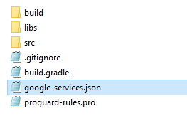
Adding Cloud Firestore to app (cont.)
Inside your app directory you will find a google-services.json file
It is not visible within android studio, only file system
google-services.json contains the credentials needed for accessing your Firebase account
When working with source control, you want to add this to your .gitignore file

Slide 15
Create a model class
The model class should be Person
firstName (String)
lastName (String)
location (String)
Create a constructor and pass through the variables above
Firebase requires java objects to have getters/setters, so add those too

Slide 16
Google Maps
There are different ways we can display a map in our app
MapView
MapFragment
The framework provides us with a template for the simplest and most modern way to place a map in an application
‘Google Maps Fragment’

Slide 17
Create a Google Maps Fragment (cont.)
The ‘Google Maps Fragment’ template provides us with a SupportMapFragment as a child Fragment
A MapFragment (or SupportMapFragment) manages all the lifecycle events needed to use a map in a app
If we used a MapView instead, we would need manage the lifecycle events

Slide 18
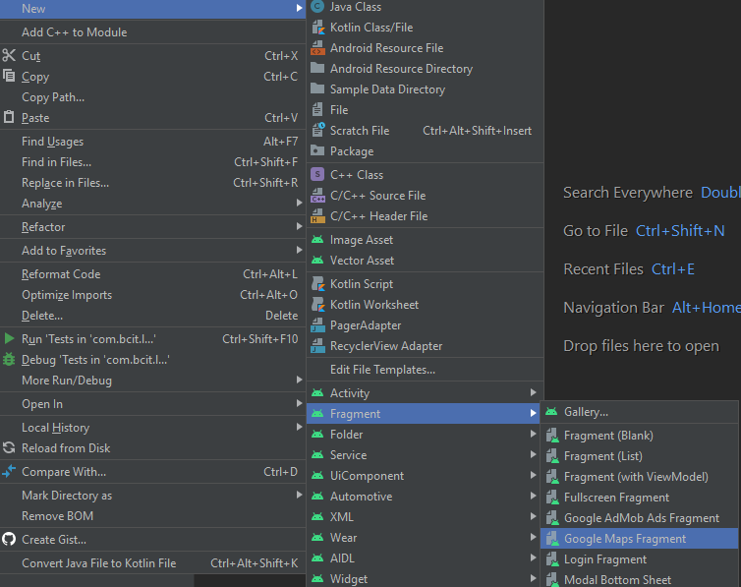
Create a Google Maps Fragment (cont.)

Slide 19
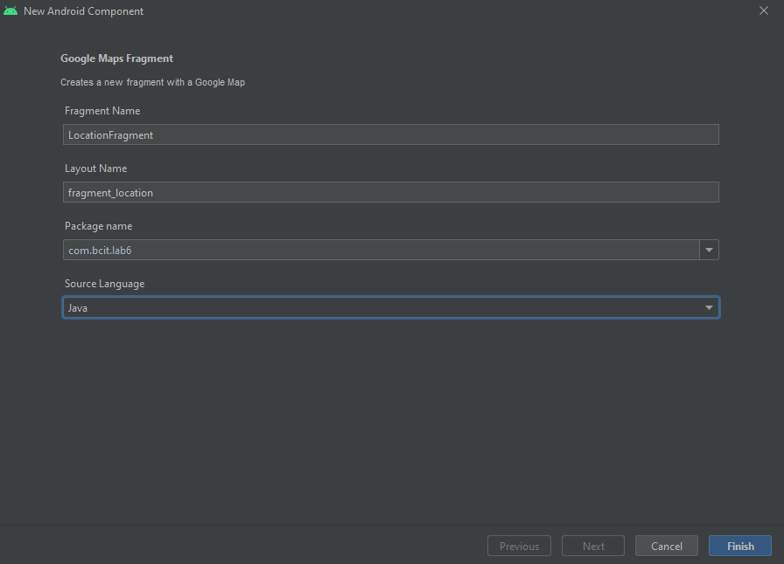
Create a Google Maps Fragment (cont.)

Slide 20
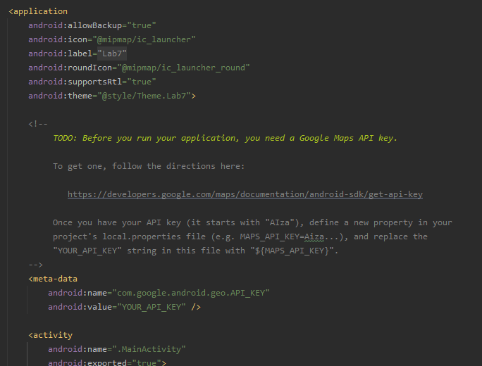
Create a Google Maps Fragment (cont.)
Look at your generated code in your manifest and follow the instructions

Slide 21
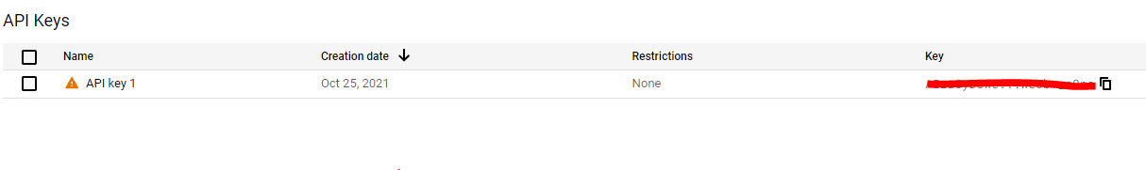
Create a Google Maps Fragment (cont.)
You will need to create a project in the Google Cloud Platform and enable the API Maps for Android
Follow the instruction in the file and create an API Key if one wasn't generated for you

Slide 22
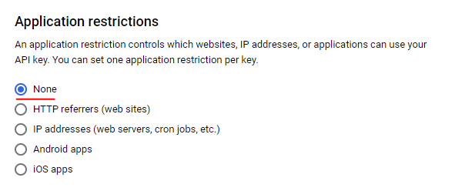
Create a Google Maps Fragment (cont.)
Make sure there are no restrictions with you API key

Slide 23
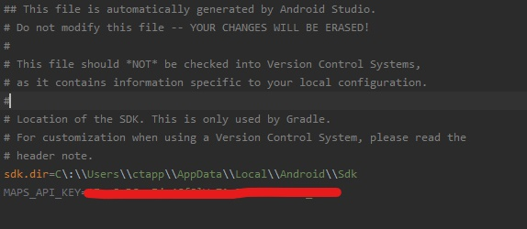

Create a Google Maps Fragment (cont.)
Update your local.properties and manifest

Slide 24
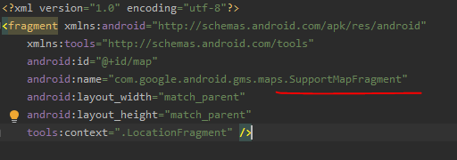
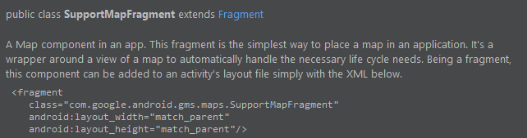
Create a Google Maps Fragment (cont.)
Look at the code of generated layout file and check out SupportMapFragment

Slide 25
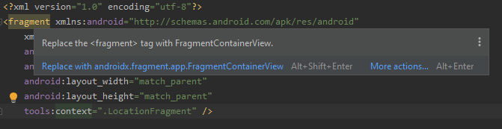
Create a Google Maps Fragment (cont.)
Also, if you are curious what the <fragment> tag is here, it is basically what FragmentContainerView used to be in older versions
You can replace it

Slide 26
Create a Google Maps Fragment (cont.)
Look at onViewCreated in your LocationFragment
LocationFragment uses a <fragment> (or FragmentContainerView) as it's parent layout
A fragment within a fragment!
Therefore, we use the helper function getChildFragmentManager to get a reference to the SupportMapFragment
Take some time to make sure you understand what is happening here ☺

Slide 27


Create a Google Maps Fragment (cont.)
The second part of onViewCreated
Sets a callback to be used for the MapFragment

Slide 28
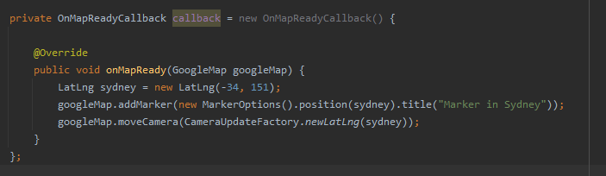
Create a Google Maps Fragment (cont.)
The callback itself, is created for us inside the our LocationFragment
Inside onMapReady is where we can add functionality to update our Map

Slide 29
Create a Google Maps Fragment (cont.)
You can see the default location is set to Sydney, Australia
A marker is added on the map to that location
For this lab, we want to be able to click on the map, and retrieve that location
Pro Tip: To zoom in/out on a map with your emulator:
Double click with your cursor and hold the second click. Now pan either up/down

Slide 30
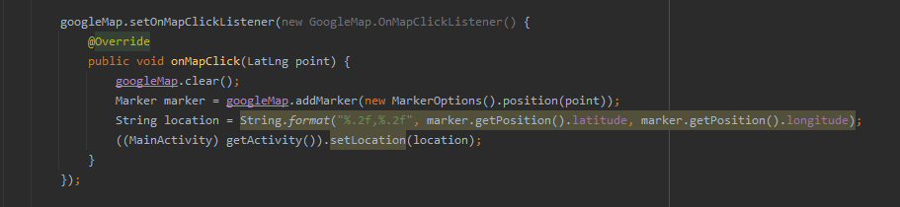
Create a Google Maps Fragment (cont.)
See if you can piece together what this code is doing below
This also assumes you have a function in MainActivity (setLocation)

Slide 31
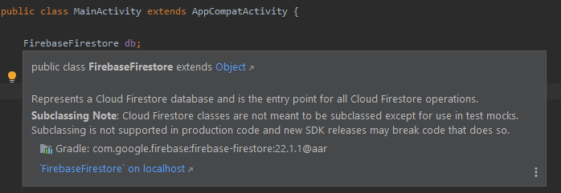
Writing to our database
Inside your MainActivity.java add an instance variable FirebaseFirestore
The entry point for all Cloud Firestore operations

Slide 32
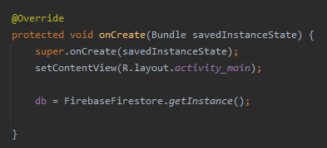
Writing to our database (cont.)
Let's access a FirebaseFirestore instance by assigning one to our variable

Slide 33
Writing to our database (cont.)
Next, create a function called AddPerson, this is what will get called when we click the Button
I will provide the code needed to add new data to the database, but you need to provide the data
From what we have so far, how can we get the firstname, lastname and location and fill it into our Person object?
code snippet on next slide

Slide 34
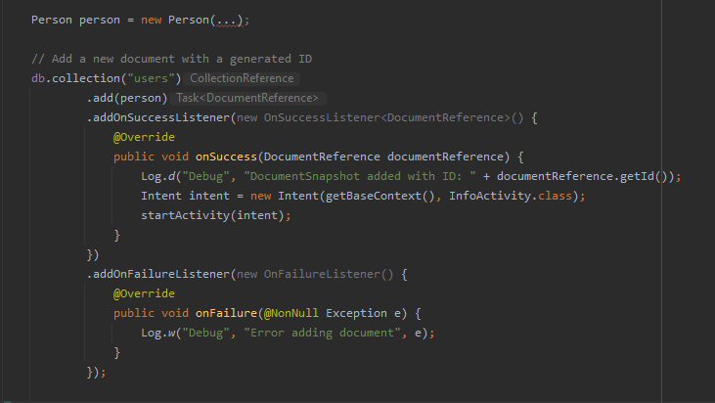
Writing to our database (cont.)

Slide 35
Reading from our database
Now that we can add people to our database, we need to get them in our InfoActivity, and update our RecyclerView.
I will provide you with most the code for retrieving the data, you just need to update your RecyclerView with it
Also make sure to create another instance for your FirebaseFirestore in InfoActivity

Slide 36
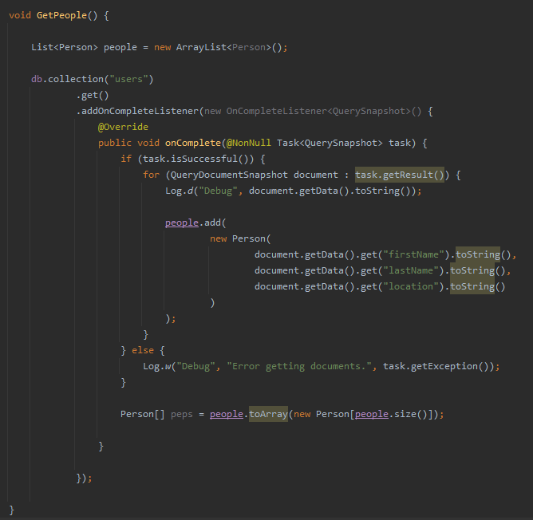

Slide 37
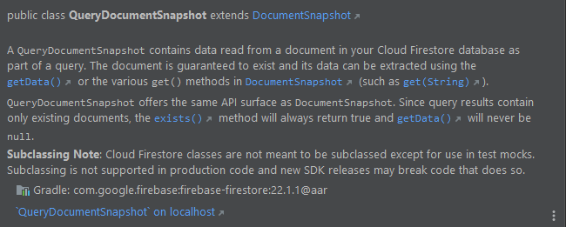
Reading from our database (cont.)
I assume most of you all have used Firebase databases before.
Make sure you understand the difference between a collection and a document
We read the data from our database by querying snapshots

Slide 38
Async
Notice that when we add and get data to our Firestore database it is done through a Task
Task: Represents an asynchronous operation
You will notice when you click the Button there is a delay before going to the InfoActivity
This is because we are waiting for the database to update, then let us know before we start the Intent

