Slide 1
農地作物現況調查影像辨識競賽 AI影像辨識教學

Slide 2
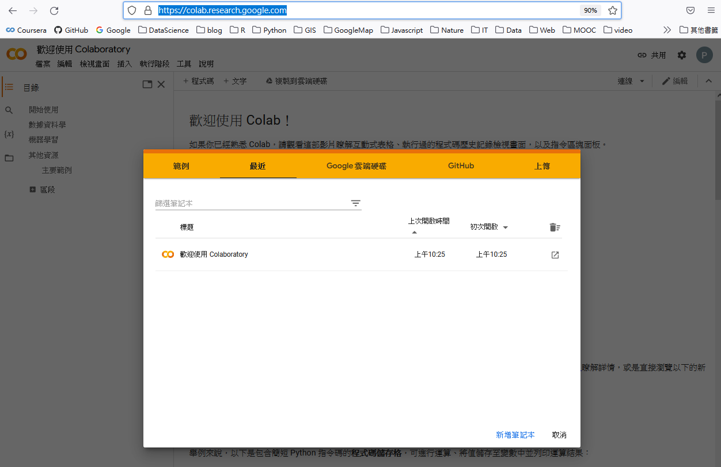
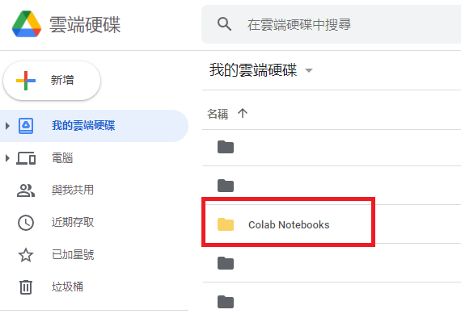
使用Google Colab
全名 Colaboratory
於瀏覽器中編寫及執行 Python 程式碼
https://colab.research.google.com/
雲端硬碟會自動新增Colab Notebooks資料夾

Slide 3
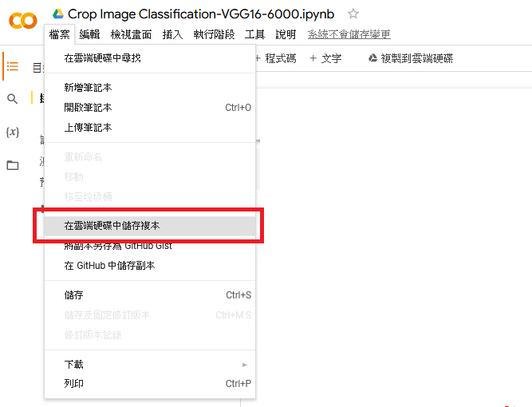
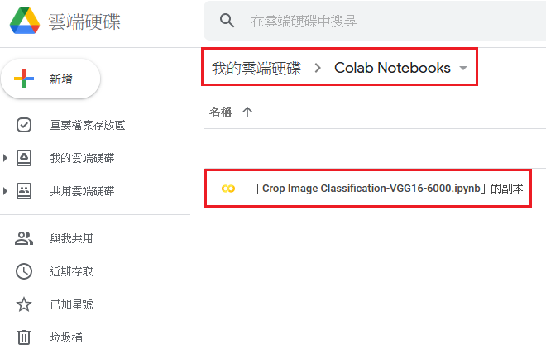
下載練習程式碼
https://colab.research.google.com/drive/1yDb_leUmzCQRI4J0ehN2Y-BTKFazTVnE

Slide 4
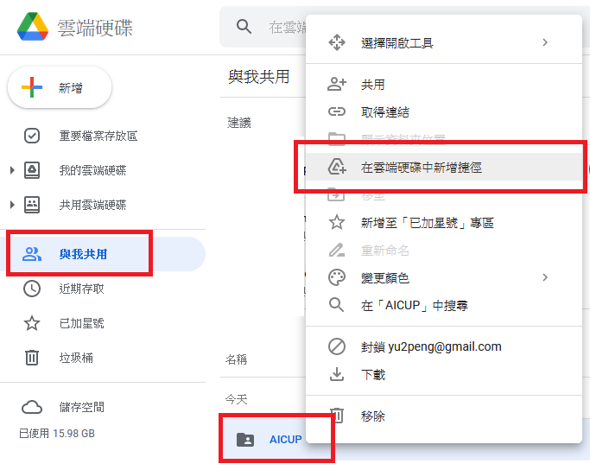
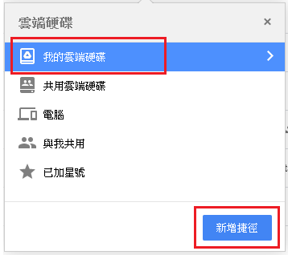
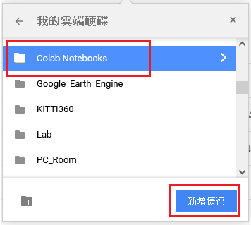
訓練及測試資料
於Google drive 使用共用資料
https://drive.google.com/drive/folders/10UHrE_F3fHUcaWVpKTBQiU8oxu_e9c-I
在個人的Google 雲端硬碟新增捷徑 (捷徑位置可自訂)

Slide 5
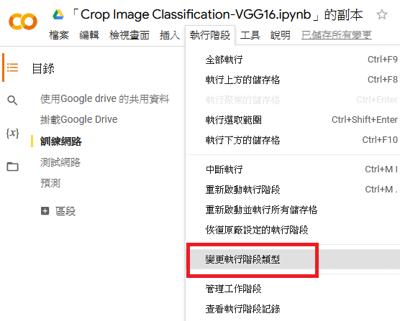
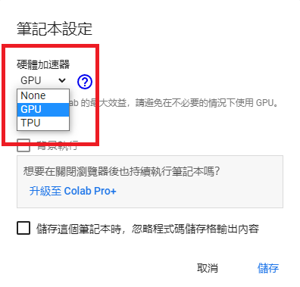
使用GPU

Slide 6
掛載 Google 雲端硬碟
測試連接Google drive
from google.colab import drive
drive.mount('/content/drive')
# !+指令: 使用linux 終端機指令, ls 檢視目錄與檔案狀態
!ls /content/drive/My\ Drive/Colab\ Notebooks/AICUP/

Slide 7
訓練網路
Step 1. 匯入Keras 與其它需要使用的模組
# TensorFlow 用於機器學習的開放原始碼平台
# Keras 可在tensorflow上執行的API
from tensorflow.keras.models import Sequential,Model
from tensorflow.keras.layers import Dense,Flatten,Conv2D,MaxPooling2D,Dropout
from tensorflow.keras import utils,optimizers
# NumPy 支援維度陣列與矩陣運算
import numpy as np
# OpenCV 進行影像處理
import cv2
# scikit-learn 機器學習模組, 使用sklearn.utils 程式中用來將訓練集隨機排序
from sklearn.utils import shuffle
# matplotlib 繪圖模組
import matplotlib.pyplot as plot
import os, math
from random import randint

Slide 8
訓練網路
Step 2. 讀取訓練資料
# 自訂函式
# 定義label: 0-corn, 1-garlic, 2-peanut, 3-pineapple, 4-rice, 5-bareland
def get_class_list():
crop_list = ['corn','garlic','peanut','pineapple','rice','bareland']
return crop_list
# 依label值[0-5]轉換為對應的類別名稱
def get_class(label_code):
classes = get_class_list();
return classes[label_code]

Slide 9
訓練網路
Step 2. 讀取訓練資料
# 自訂函式 - 取得影像及label值
def get_images(directory):
Images = []
Labels = []
label = 0
classes = get_class_list()
for folder in os.listdir(directory): # 影像分別儲存在以類別命名的資料夾.
label = classes.index(folder) # 依資料夾名稱轉換為label值
for img_file in os.listdir(os.path.join(directory, folder)):
# 用 OpenCV 模組讀取影像及縮放尺寸
image = cv2.imread(os.path.join(directory, folder, img_file))
image = cv2.resize(image,(224,224))
Images.append(image)
Labels.append(label)
return shuffle(Images,Labels) # 隨機排序

Slide 10
訓練網路
Step 2. 讀取訓練資料
train_dir = '/content/drive/My Drive/Colab Notebooks/AICUP
/crop image classification/train/'
# 取得訓練集影像及label
train_images, train_labels = get_images(train_dir)
# 資料轉成 numpy array
train_images = np.array(train_images)
train_labels = np.array(train_labels)
# 查看訓練資料組成, shape 檢視矩陣的維度
print("Shape of Images:",train_images.shape)
print("Shape of Labels:",train_labels.shape)
#Output
#Shape of Images: (6000, 224, 224, 3) #count, height, width, channels
#Shape of Labels: (6000,)

Slide 11
# 自訂函式 – 檢視資料影像及分類, num=顯示張數,隨機抽取
def plot_images(Images, Labels, Prediction, num=12):
if num > 30: num = 30 # 最多顯示30張, 避免輸出錯誤
row = math.ceil(num/6) # 每列顯示6張圖, 計算列數
fig, ax = plot.subplots(row, 6, figsize=(24, row*3)) # 建立子圖
pic = 1
for i in range(row):
for j in range(6):
if pic <= num:
idx = randint(0,len(Images)-1) # 隨機抽圖
ax[I,j].imshow(Images[idx]) # 繪圖
title = get_class(Labels[idx]) # 影像圖標題
if len(Prediction) > 0: # 若有預測值則顯示
title = "gt={},p={}".format(title, get_class(Prediction[idx]))
ax[i,j].set_title(title) # 設定子圖標題
ax[i,j].axis('off') # 不顯示刻度
pic += 1 # 張數
plot.show()
# 檢視訓練集影像內容
plot_images(train_images, train_labels)

Slide 12
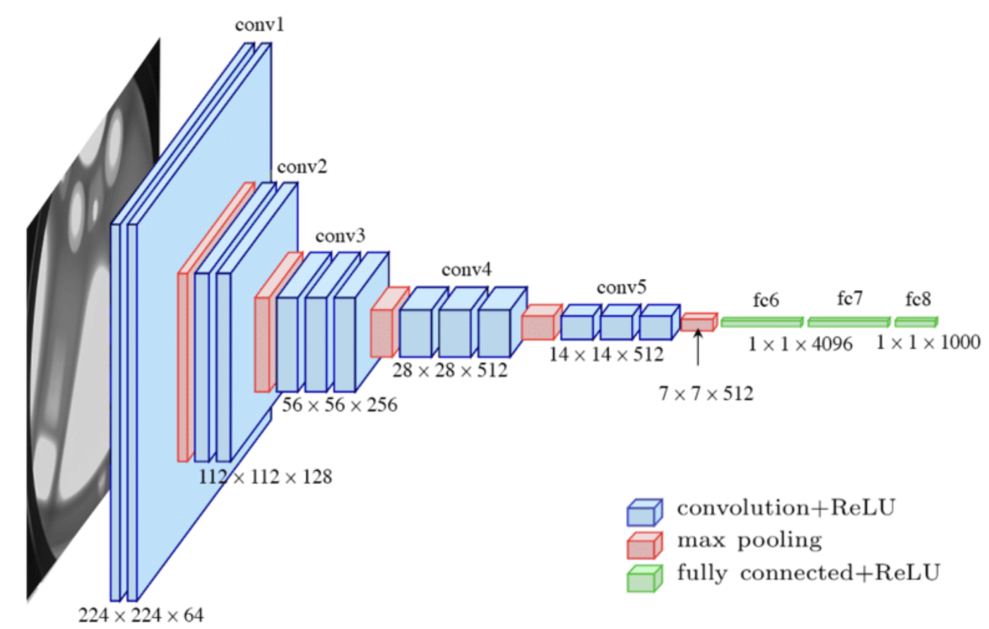
訓練網路
Step 3-1. 建構網路 – 定義網路模型 VGG16

Slide 13
訓練網路
Step 3-1. 建構網路 – 定義網路模型 VGG16
# Sequential: groups a linear stack of layers into a tf.keras.Model
# Conv2D: create a 2D convolution layer
# filter: the number of output filters in the convolution,
# kernel_size: specifying the height and width of the 2D convolution window,
# padding: “same” results in padding with zeros evenly to the left/right
or up/down of the input.
# input_shape: height, width, channels
# activation: Activation function to use.
# MaxPooling2D : Downsamples the input along its spatial dimensions (height and width)
by taking the maximum value over an input window
(of size defined by pool_size) for each channel of the input.
model = Sequential()
model.add(Conv2D(filters=64, kernel_size=(3,3), padding='same’,
input_shape=(224,224,3), activation='relu’))
model.add(Conv2D(filters=64, kernel_size=(3,3), padding='same', activation='relu’))
model.add(MaxPooling2D(pool_size=(2,2)))
….

Slide 14
訓練網路
Step 3-1. 建構網路 – 定義模型VGG16
….
model.add(Conv2D(filters=128, kernel_size=(3,3), padding='same', activation='relu'))
model.add(Conv2D(filters=128, kernel_size=(3,3), padding='same', activation='relu'))
model.add(MaxPooling2D(pool_size=(2,2)))
model.add(Conv2D(filters=256, kernel_size=(3,3), padding='same', activation='relu'))
model.add(Conv2D(filters=256, kernel_size=(3,3), padding='same', activation='relu'))
model.add(Conv2D(filters=256, kernel_size=(3,3), padding='same', activation='relu'))
model.add(MaxPooling2D(pool_size=(2,2)))
model.add(Conv2D(filters=512, kernel_size=(3,3), padding='same', activation='relu'))
model.add(Conv2D(filters=512, kernel_size=(3,3), padding='same', activation='relu'))
model.add(Conv2D(filters=512, kernel_size=(3,3), padding='same', activation='relu'))
model.add(MaxPooling2D(pool_size=(2,2)))
model.add(Conv2D(filters=512, kernel_size=(3,3), padding='same', activation='relu'))
model.add(Conv2D(filters=512, kernel_size=(3,3), padding='same', activation='relu'))
model.add(Conv2D(filters=512, kernel_size=(3,3), padding='same', activation='relu'))
model.add(MaxPooling2D(pool_size=(2,2)))
….

Slide 15
訓練網路
Step 3-1. 建構網路 – 定義模型VGG16
# Flatten: Flattens the input, e.g. input_shape (32,32,3) -> output_shape(3072,)
# Dense: create a fully connected network
# unit: dimensionality of the output space
# Dropout: randomly sets input units to 0 with a frequency of rate
….
model.add(Flatten())
model.add(Dense(units=4096, activation='relu'))
model.add(Dense(units=4096, activation='relu'))
model.add(Dropout(rate=0.5))
# output layer 的 units 為 類別數
model.add(Dense(units=6, activation='softmax'))

Slide 16
訓練網路
Step 3-2. 設定 loss function
# model.compile: configures the model for training.
# loss: loss function, when there are two or more label classes, you can use
# sparse_categorical_crossentropy: labels are provided as integers, or
# categorical_crossentropy: labels are provided as one-hot encoding
# optimizers: Adam, SGD, RMSprop, Adagrad ….
# learning_rate: how many updates of the weight via gradients
opt = optimizers.Adam(learning_rate=0.0001)
model.compile(loss='sparse_categorical_crossentropy',optimizer=opt,metrics=['accuracy'])
model.summary()

Slide 17
訓練網路
Step 3-3. 找出最佳的網路參數
# train_history: output is a History object, its History.history attribute is a record
of training loss values and metrics values at successive epochs.
# model.fit: trains the model.
# validation_split: fraction of the training data to be used as validation data.
# epochs: number of epochs to train the model, an epoch is an iteration over the
entire data provided.
# batch_size: number of samples per gradient update.
train_history = model.fit(x=train_images, y=train_labels, validation_split=0.2, epochs=20, batch_size=32)
# 儲存模型
model_dir = '/content/drive/My Drive/Colab Notebooks/'
model.save(model_dir)
# 之後若要載入已訓練好的模型
model = load_model(model_dir)

Slide 18
檢視訓練結果
def show_train_history(train_history, train, validation):
plot.plot(train_history.history[train])
plot.plot(train_history.history[validation])
plot.title('Train History')
plot.ylabel(train)
plot.xlabel('Epoch')
plot.legend(['train', 'validation'], loc='upper left')
plot.show()
# 將模型準確度繪圖
# model 訓練過程儲存在 train_history 變數
# accuracy, val_accuracy: key value of training accuracy and validation accuracy
respectively
show_train_history(train_history, 'accuracy', 'val_accuracy')
show_train_history(train_history, 'loss', 'val_loss')

Slide 19
測試網路
Step 1. 讀取測試資料
# 取得測試集影像及label 並轉成 numpy array
test_dir = ’/content/drive/My Drive/Colab Notebooks/AICUP
/crop image classification/test/'
test_images,test_labels = get_images(test_dir)
test_images = np.array(test_images)
test_labels = np.array(test_labels)
# 查看測試資料維度
print("Shape of Images:",test_images.shape)
print("Shape of Labels:",test_labels.shape)
#Output
#Shape of Images: (120, 224, 224, 3) #count, height, width, channels
#Shape of Labels: (120,)

Slide 20
測試網路
Step 2.評估測試集準確度
# 回傳測試集準確度
model.evaluate(test_images, test_labels)
# 應用模型於測試集之分類結果
prediction_prob = model.predict(test_images)
prediction = np.argmax(prediction_prob,axis=1)
# 顯示測試集影像並標示真值及預測值
print("gt:ground truth, p: prediction\n")
plot_images(test_images, test_labels, prediction, 18)

Slide 21
預測
# 取得影像
pred_dir = ’/content/drive/My Drive/Colab Notebooks/AICUP
/crop image classification/predict/'
pred_images=[]
for img_file in os.listdir(pred_dir):
image = cv2.imread(os.path.join(pred_dir,img_file))
image = cv2.resize(image,(224,224))
pred_images.append(image)
print(len(pred_images))
#Output
#25

Slide 22
顯示預測結果
row = 10
fig, ax = plot.subplots(row, 5, figsize=(24, 40))
i = 0 # 列數
pic1 = 0 # image圖 index
pic2 = 0 # bar 圖 index
while i < row:
# 第一列顯示影像
for j in range(5):
pred_image = np.array([pred_images[pic1]])
pred_prob = model.predict(pred_image)[0]
pred_label = np.argmax(pred_prob) # 回傳最大數值的位置(index)
pred_class = get_class(pred_label) # label 轉換為類別
ax[i,j].imshow(pred_images[pic1]) # 繪圖
ax[i,j].set_title(pred_class)
pic1+=1
# 第二列顯示預測的機率
i+=1
for j in range(5):
pred_image = np.array([pred_images[pic2]])
pred_prob = model.predict(pred_image)[0]
prob_value = pred_prob.reshape(6)
ax[i,j].bar(range(6),prob_value) # 各類別機率值繪圖
pic2+=1
i+=1

