Slide 1
Improving ML Applications in Shared Computing Environments
Aaron Harlap

Slide 2
Talk Outline
Background
Thesis statement
Three case studies

Slide 3
Iterative Convergent ML
Matrix Factorization, LDA, Neural Networks, etc…
Start with an initial guess
Iterate over training data improving solution
Converge to a “good” solution

Slide 4
Data-Parallel ML
Parameter server
READ, INC, CLOCK
Input data
(training data)
Parallel iterative
workers
Model parameters
(solution)

Slide 5
Shared Computing Environments
AWS, GCE, Azure, private clusters
Challenges:
Performance jitter
Heterogeneous resources
Transient resources
Limited network bandwidth

Slide 6
Thesis Statement
Improvements of 5x or more can be achieved for training ML models in shared computing environments by structuring software frameworks and work distribution to mitigate performance jitter, exploit transient resources, and address communication bandwidth limitations.

Slide 7
Three Case Studies
Addressing the straggler problem in iterative convergent ML
Flex-RR [SoCC’ 16]
Agile ML elasticity through tiered reliability in dynamic resource markets
Proteus [EuroSys’ 17]
Pipeline parallelism for DNN training
PipeDream [Under Submission]

Slide 8
Three Case Studies
Addressing the straggler problem in iterative convergent ML
Flex-RR [SoCC’ 16]
Agile ML elasticity through tiered reliability in dynamic resource markets
Proteus [EuroSys’ 17]
Pipeline parallelism for DNN training
PipeDream [Under submission]

Slide 9
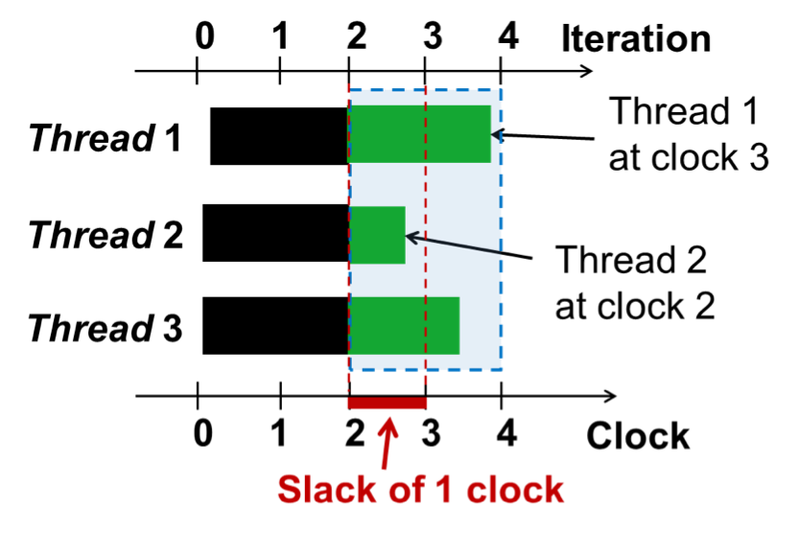
Parallelization Models
BSP: wait at each clock (barrier)
SSP: fastest <= slack + slowest
Increase in Slack bound lowers quality of work

Slide 10
Origin of Stragglers
One worker slower than others
Short Term Causes
Garbage collection, objective function computation (computing stopping criteria), resource contention
Long Term Causes
Load imbalance, heterogeneity of hardware

Slide 11
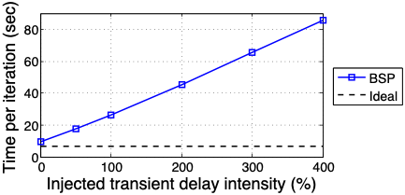
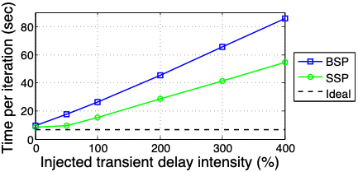
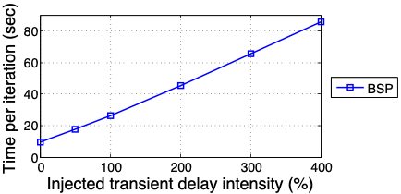
Effect of Stragglers
Emulating the effect of stragglers by injecting artificial stragglers

Slide 12
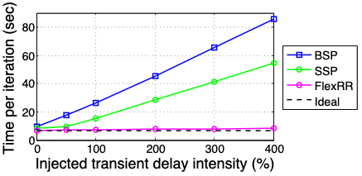
Quick Preview of our Results

Slide 13
New Approach: FlexRR
Initial Work Assignments
Rebalanced Work Assignments
Worker 1
Worker 2
Worker 3
Worker 4
Worker 1
Worker 2
Worker 3
Worker 4
FlexRR uses:
Flexible consistency bounds (SSP)
Temporary work re-assignment (RapidReassignment)

Slide 14
RR Design
Constraints:
Input data is too big fit all of it into memory
All - to - All communication / synchronization is expensive
Central arbiter can be a bottleneck
Solution: Helper Groups
Helpers: eligible to help - if they are ahead they help
Helpees: eligible to provide help to
Notes:
However there are several problems that need to be resolved in order to perform efficient work re-assignment, or as we call it , rapid reassignment. As you remember from earlier in the presentation every worker preloads the input data that it’s going to be working on into memory to avoid expensive disk reads. Thus the worker that is providing the help, will also need to have the appropriate data preloaded into memory in order to help efficiently. The workers will also need to coordinate amongst each other about who helps who, and make sure that all work is performed exactly once. While at small scale it’s possible to have all the workers load all the input data, and perform all-to-all communication, this will not be possible or efficient at larger scale.

Slide 15
Helper Groups
Helpers pre-load input data
Only 25% replication required
Avoids costly disk reads
Limited P2P Communication
Cheap messages - no overhead
Unique set of helpers & helpees
Provides waterfall effect
4 of each
Notes:
Since we are designing FlexRR for scalability we created the helper groups. Similarly to an overlay network, workers exchange progress reports and offloaded work with only a few other workers. Each worker has a unique set of helpers, who are eligible to provide help, and unique helpees, to whom the worker is eligible to help. The helpers pre-load in the input data of the worker they are eligible to help, thus avoiding having to read the input data from disk at run-time, greatly improving efficiency. The workers groups allow for limited P2P communication eliminating the need for a central arbiter, or for all - to - all communication, thus improving scalability. Our experiments showed that helper and helpee groups of size 4 provided the best performance.

Slide 16
RR Protocol
Ok
Fast
Slow
Driven by fast workers
Multicast to preset eligible helpees
No additional resources
Ignore
(I don’t need help)
I’m this far
I’m this far
I’m behind
(I need help)
Help with N-10 to N
(red work
Started Working
Notes:
This diagram demonstrates an example of the RR protocol. Every worker tracks his own progress, upon reaching a certain checkpoint in the iteration, the worker sends a progress report to the workers who it’s eligible to help. These workers then compare their own progress to the progress report that they received, if they find that they have behind by more than the preset threshold than they re-assign a small portion of their work to the faster worker. Once the faster worker begins helping with this work, it will send a notification to the the original owner, who will then have the option of sending over more work. All these reassignments are temporary, so in the next clock cycle, the original owner will once again be responsible for all its work.
We are not adding addition

Slide 17
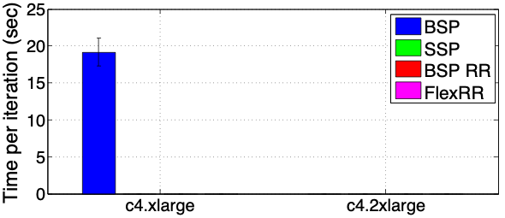
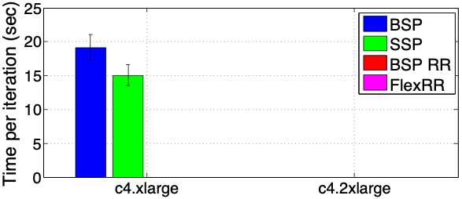
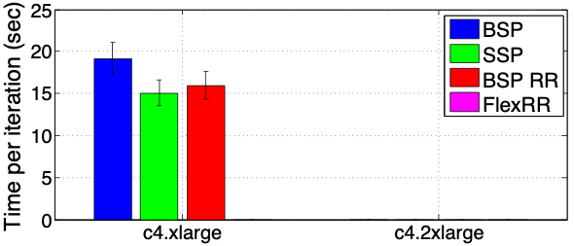
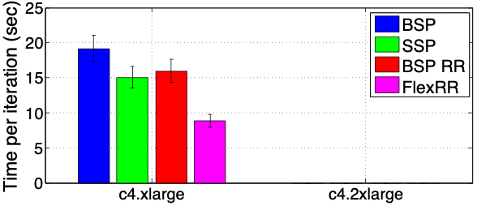
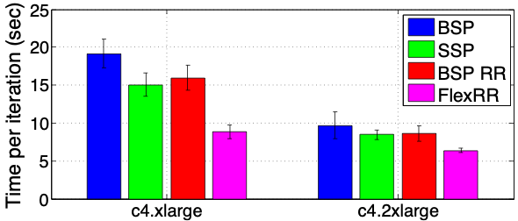
Significant Stragglers on EC2
Netflix (MF) workload (EC2 Clusters)
53% Improvement
Notes:
So now it’s time to examine at the effectiveness of FlexRR. This experiment consists of the two different classes of EC2 machines running the MF application. We show results for BSP, SSP with a slack of 1, RR w/o any slack, and FlexRR. The y-axis shows time per iteration, and x-axis shows the 2 different class of machines, with the c4.xlarge machines being the cheaper and slower of the two. On the lower class of machines FlexRR had an improvement of 53% and 39% on the higher class machines. The improvement on the c4.xlarge machines was greater because they experience more transient straggler effects.
Stress combination of SSP and RR is what is effective
Make sure to remind people what all the different acronyms mean.

Slide 18
Take-away Messages From FlexRR
Stragglers negatively impact ML training
Need to combine technique to address stragglers
Flexible synchronization (SSP)
Work re-assignment (RR)
Work published and presented at SoCC’ 16

Slide 19
Thesis Statement
Improvements of 5x or more can be achieved for training ML models in shared computing environments by structuring software frameworks and work distribution to mitigate performance jitter, exploit transient resources, and address communication bandwidth limitations.

Slide 20
Thesis Statement
Improvements of 5x or more can be achieved for training ML models in shared computing environments by structuring software frameworks and work distribution to mitigate performance jitter, exploit transient resources, and address communication bandwidth limitations.

Slide 21
Three Case Studies
Addressing the straggler problem in iterative convergent ML
Flex-RR [SoCC’ 16]
Agile ML elasticity through tiered reliability in dynamic resource markets
Proteus [EuroSys’ 17]
Pipeline parallelism for DNN training
PipeDream [Under submission]
Notes:
Describe in english

Slide 22
Dynamic Resource Availability
Revocable resources are common in clusters
Best effort resource that can be preempted
Yarn, Borg, Mesos, etc…
Adding the element of cost savings in clouds
Preemptible Instances in Google Compute Engine
Spot Instances in Amazon EC2
Notes:
First I want to provide some motivation for why we need elasticity in our systems. Many popular schedulers have such as Yarn and Messos have shown that they significantly improve their cluster utilization and ability to meet SLAs if they are able to revoke resources. The example that I am going to focus on in this talk is the Amazon EC2 spot market, where users can use cheaper resources with the risk of revocation, which we call eviction.

Slide 23
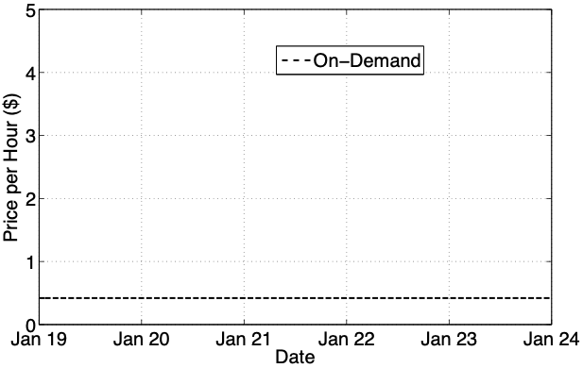
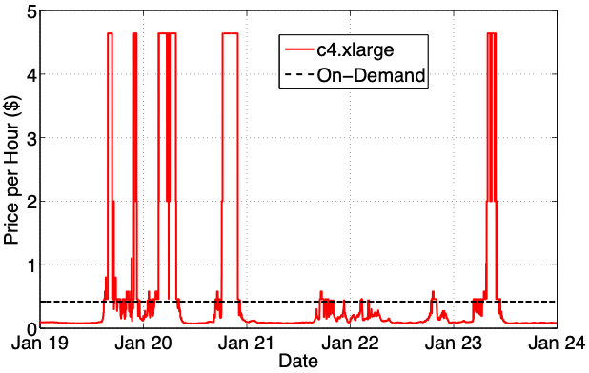
Transient Resources Often Cheaper
Often 75-85% cheaper to use Spot Instances
Low Cost
Notes:
what amazon calls the on-demand price
After red describe how cheap it is and explain spot market rules
after blue uncorrelated markets - move indecently
nickels on the dollar

Slide 24
Efficient use of transient resources
Support agile elasticity
Scale in and out efficiently and quickly
Handle bulk revocations/evictions efficiently
Don’t lose progress
Notes:
So now that we have seen just how much we can save the question becomes how do we do this. The answer is that we need systems that are able to perform efficient elasticity, handle losing large % of their resources efficiently, not lose forward progress, and preferably do all this with no overhead.
Mention this is for ML

Slide 25
AgileML: New Approach to Elasticity
Use tiers of reliable and un-reliable resources
Revocable resources are un-reliable (transient)
Maintain all state on reliable resources
E.g. Parameter Servers only on On-demand Instances
Spot Instances run workers only (initially)
3 architecture stages
Based on ratio of transient to reliable resources
Notes:
So we propose a new approach to achieving elasticity called TierML. TireML is a system that is designed to take advantage of tiers of reliability of its resources in order to achieve agile elasticity. It does so by running statefull processes only on reliable on-demand machines, and using unreliable spot machines to only run workers, which are stateless.

Slide 26
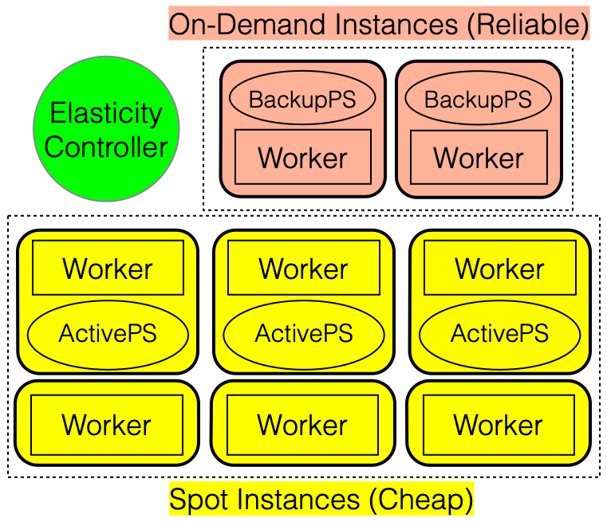
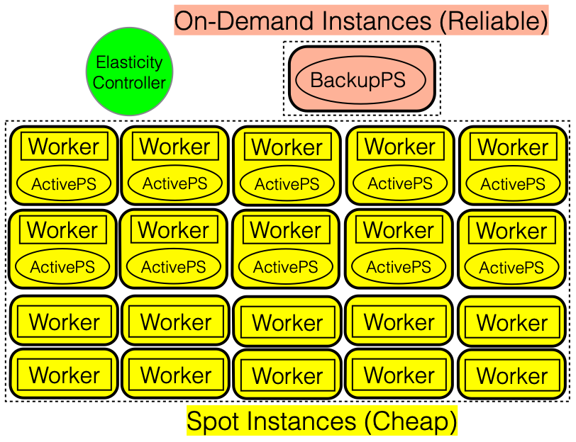
Building the Stages of Reliability
Stage #1
Stage #2
Stage #3
On-Demand Instances (Reliable)
Elasticity
Controller
ParamServ
ParamServ
Worker
Worker
Worker
Worker
Worker
Worker
Spot Instances (Cheap)
Transition between stages at run-time
Little/No overhead for transitions
Transitions based on ratios
Notes:
At the end
Shown you how to design an elastic PS ML system with low overhead, now I want to show you just how low that overhead is

Slide 27
Resource Manager for AgileML
Acquires resources for AgileML
Minimizes expected cost per work
Analyzes Resource Availability
EC2 Spot Market
Takes into account application characteristics
Scalability
Scale in/out overhead
Eviction overhead

Slide 28
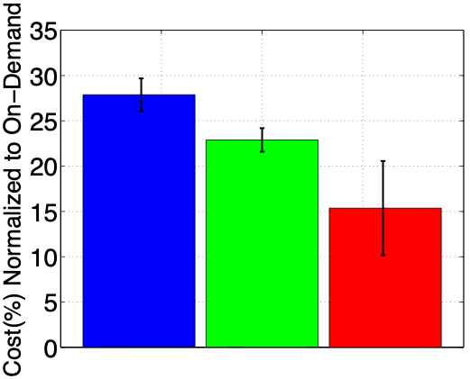
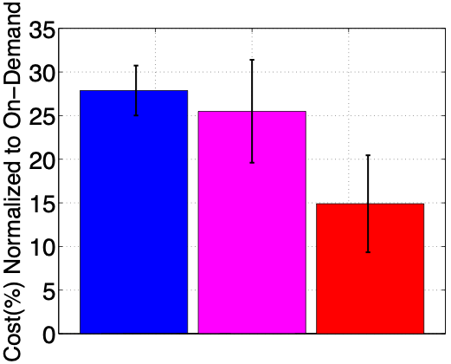
Need Elasticity and Smart Resource Manager
Proteus
BidBrain+
AgileML
Proteus
BidBrain+
AgileML
Standard
+CKPts
Standard
+AgileML
Standard
+CKPts
BidBrain
+CKPts

Slide 29
Take-away Messages From Proteus
Agile elastic ML system
Combined with RM for transient resources
Need agile elasticity & smart RM
85% cost savings
Published and presented at EuroSys’ 17

Slide 30
Thesis Statement
Improvements of 5x or more can be achieved for training ML models in shared computing environments by structuring software frameworks and work distribution to mitigate performance jitter, exploit transient resources, and address communication bandwidth limitations.

Slide 31
Thesis Statement
Improvements of 5x or more can be achieved for training ML models in shared computing environments by structuring software frameworks and work distribution to mitigate performance jitter, exploit transient resources, and address communication bandwidth limitations.

Slide 32
Three Case Studies
Addressing the straggler problem in iterative convergent ML
Flex-RR [SoCC’ 16]
Agile ML elasticity through tiered reliability in dynamic resource markets
Proteus [EuroSys’ 17]
Pipeline parallelism for DNN training
PipeDream [Under submission]

Slide 33
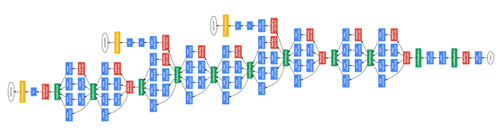


Example DNN
1000s

Slide 34


DNN Training - How Do They Learn
Forward Pass - Make a Prediction
Input
Output
Backward Pass - Update Solution Depending on Error
Notes:
EVALUATE!

Slide 35
Data-Parallel Training
Separate copy of model on each machine
Communicate updates to model parameters
various synchronization models can be used

Slide 36
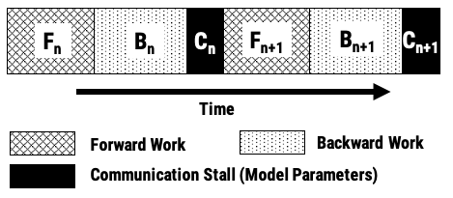
Data-Parallel Training

Slide 37
Data-Parallel Training

Slide 38
Data-Parallel Training

Slide 39
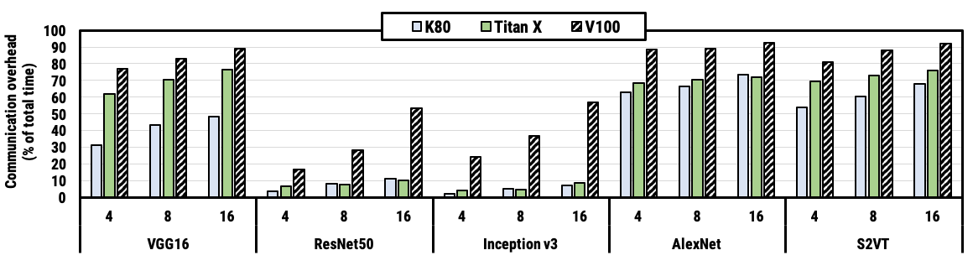
Overhead of Data Parallel Training
Significant communication overheads
Larger clusters increase communication overhead
Faster compute increases communication overhead
Notes:
Emphasize wall clock time

Slide 40
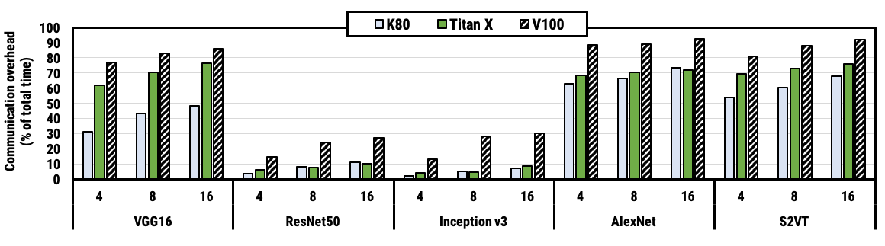
Overhead of Data Parallel Training
Notes:
Accelortors

Slide 41
New Approach: Pipeline Parallel
Assign layers to machines
communicate inter-layer activations
Machine 1
Machine 2
Machine 3
Machine 4

Slide 42

Naive Scheduling is Inefficient

Slide 43
Making Pipelining Possible
Need to work on multiple mini-batches simultaneously
Inter-batch parallelism
Same quality of work as data-parallel training
During backwards pass:
Need activations from forward pass
Need model parameters from forward pass
PipeDream:
Stashes activations & versions model parameters

Slide 44
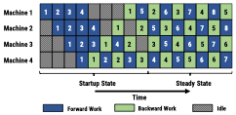
Alternate Forward / Backward Work

Slide 45
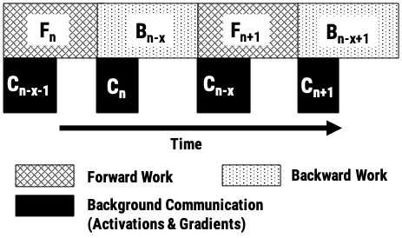
Overlaps Computation & Comm

Slide 46
Overlaps Computation & Comm

Slide 47
Simple Case of Straight Pipeline
Machine 1
Machine 2
Machine 3

Slide 48
Combine Data & Pipeline Parallel
Machine 2
Machine 1
Machine 4
Machine 3
Notes:
Complexity to partition: O(n^2 * k^2)

Slide 49
How to Split Layers
Measure forward and backward compute time
Compute communications time
GPU and Network Speed
Size of layer being cut
Notes:
Complexity: O(n^2 * k^2); n = number of layers, k = number of machines

Slide 50
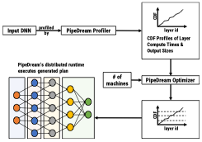
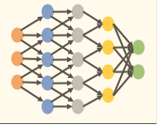
Putting it all Together

Slide 51
Putting it all Together

Slide 52
Putting it all Together

Slide 53
Putting it all Together

Slide 54

Evaluating PipeDream
Evaluated on seven DNN models
GNMT, VGG-16, Resnet-50, AWD-LM, …
Cluster Setups

Slide 55
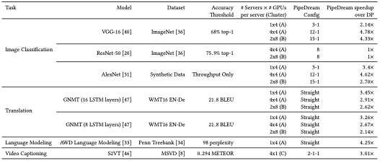
Summary of Results

Slide 56
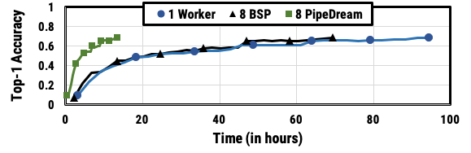
PipeDream 5x Better
VGG-16 on V100 GPUs (AWS p3.2xlarge)
PipeDream reduces communication by 95%
5x

Slide 57
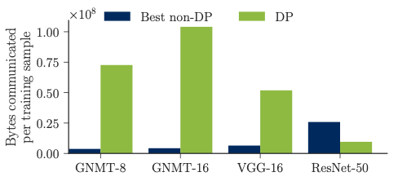
PipeDream Reduces Communication
PipeDream chooses DP only for Resnet-50

Slide 58
Take-away Messages From PipeDream
Combine pipeline-, data-, model- parallelism
Inter-batch parallelism
Reduces time to target accuracy by up to 5x
Reduces communication
Improves compute accelerator efficiency

Slide 59
Thesis Contributions
Addressing stragglers in iterative ML
Combined flexible synchronization and work re-assignment
Agile elastic ML system
Design a parameter server system for transient resources
Designed RM for batch workloads on EC2 spot market
Pipeline parallelism for DNN training
Designed a system that combines model parallelism, pipelining, and data-parallelism.

Slide 60
Thesis Statement
Improvements of 5x or more can be achieved for training ML models in shared computing environments by structuring software frameworks and work distribution to mitigate performance jitter, exploit transient resources, and address communication bandwidth limitations.

Slide 61
Thank You
My advisors: Greg Ganger & Phil Gibbons
My thesis committee:
Greg, Phil, Amar Phanishayee, Ameet Talwalkar
My Collaborators: Henggang Cui, Wei Dai, Jinliang Wei, Greg Ganger, Phillip Gibbons, Garth Gibson, Kevin Hsieh, Nandita Vijaykumar, Onur Mutlu, Alexey Tumanov, Andrew Chung, Deepak Narayanan, Amar Phanishayee, Vivek Seshadri.
Many others and you the listeners!

Slide 62
Thesis Contributions
Addressing stragglers in iterative ML
Combined flexible synchronization and work re-assignment
Agile elastic ML system
Design a parameter server system for transient resources
Designed RM for batch workloads on EC2 spot market
Pipeline parallelism for DNN training
Designed a system that combines model parallelism, pipelining, and data-parallelism.

Slide 63
Backup Slides

Slide 64
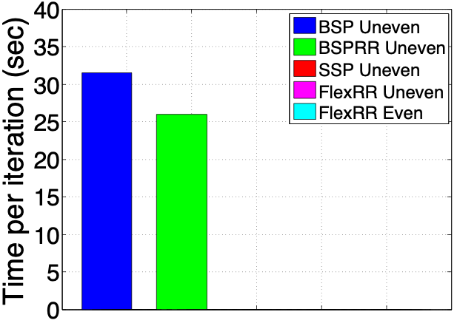
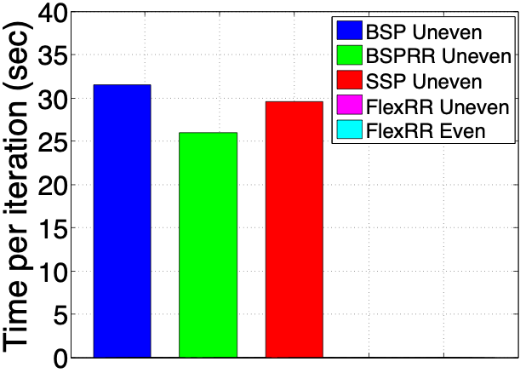
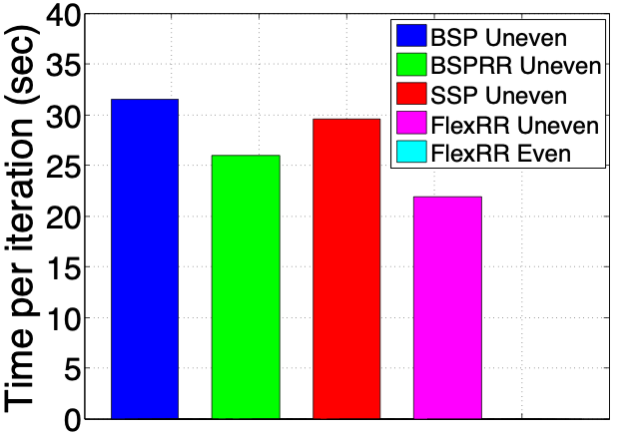
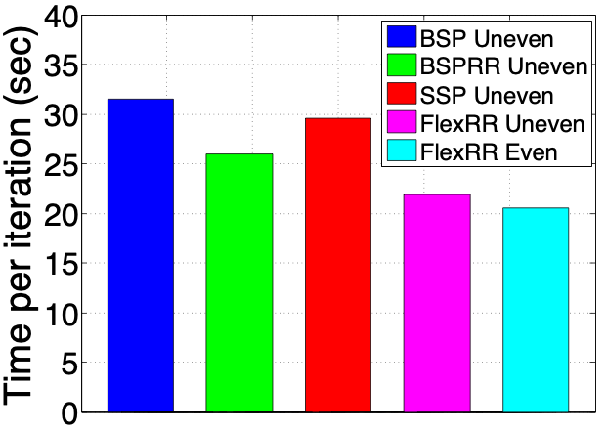
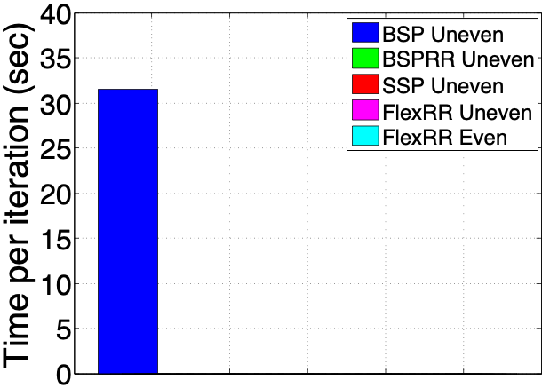
Long Term Stragglers
50% of machines given 75% of the workload
Notes:
While all the stragglers we have presented so far fall into the category of transient stragglers, this experiment shows long term stragglers. This experiment ran the MF application. To simulate long term stragglers half of the machines received 75% of the input data, while the ramming 50% were assigned 25% of the input data. We show results for running the uneven scenarios for BSP, SSP, RR on its own, FlexRR, and FlexRR where the input data is spread out evenly. Only FlexRR came close running at the speed of all work spread out evenly, while BSP experienced a 54% slowdown.
Emphasize that we re-assign work every iteration

Slide 65
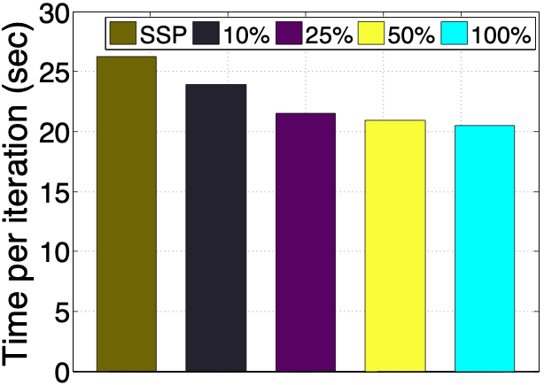
Works well w/ Partial Replication
Netflix workload
Replicate from the end input data / work assignment
Notes:
In all previous experiments worker replicated 100% of the input data belonging to the workers that they are eligible to help. This experiment demonstrates that it’s not necessary to replicate 100 percent of the data. In this experiment we replicated different amount of the input data, thus the helpers are only eligible to help with the portion that is replicated. These results demonstrate that replicating just 25% of the input data provides very similar results full replication.

Slide 66
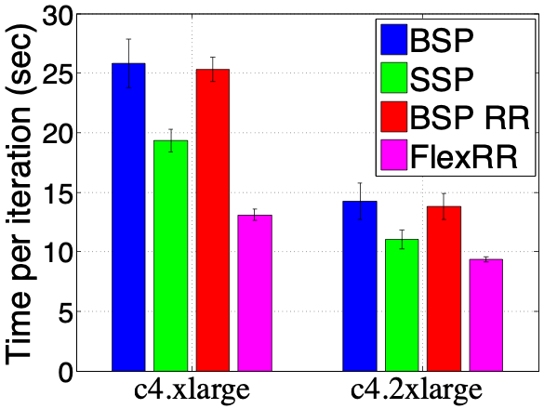
LDA Class Comparison

Slide 67
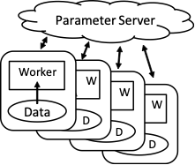
Parameter Servers are Great for Iterative ML
Parameter Servers shard solution state across machines
Traditional architecture has servers and workers on all machines
Used by IterStore, MXNet, Bosen …
Notes:
Efficient
This diagram shows the high level architecture of the traditional PS framework. The workers read in the data, and then concurrently read and update the solution state stored in the parameter server. Current architectures traditionally have workers running on all the machines, and shard the Parameter across all the machines also.
IterStore, Petuum, MxNet

Slide 68
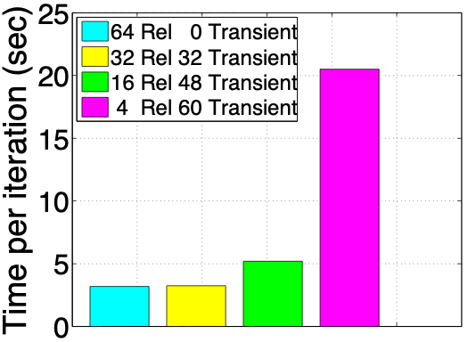
Stage #1 has a Weakness
ParamServs = Instances running server processes
64 c4.2x EC2 Machines
MF on Netflix Dataset
On-Demand Instances (Reliable)
Spot Instances (Cheap)
Costly
Cheaper
Cheap
Notes:
However is soon turned out that this new architecture had a problem, and this experiment here will demonstrate the problem to you. In this experiment we ran on a cluster of 64 ec2 machines and alternated how many of the machines we consider to ‘reliable’ red machines. the results are shown in time-per-iteration. The graph on the very right represents the traditional case where all machine are reliable so they would all be red. then we begin to decrease the number of red machine and substitute them for yellow machines. As you can see once the ratio becomes large 1-15 our performance is pretty terrible. However in order to save a good amount of money, we need this ratio to perform well. This problem happens become the servers running on the reliable resources become bottlenecked.

Slide 69
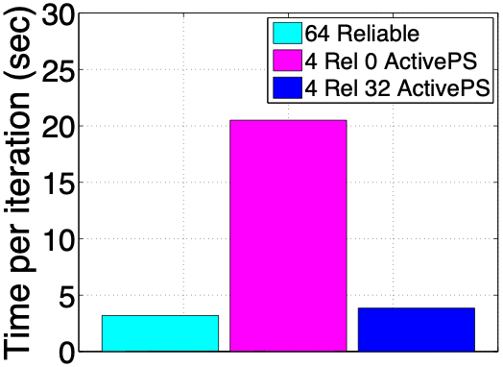
ActivePS Helps a Lot
64 c4.2x Machines
4 On-demand Machines
MF on Netflix Dataset
Costly
Cheap
Cheap
Notes:
It turns out that adding ActivePS to the architecture helps a lot. In this experiment with 64 machines the Y-axis is once agin time-per-iter. Once again the right bar represents the traditional PS case, and the bar on the left shows 4 red 60 yellow with no ActivePS running. Then for the 3 bars in the middle represent how setups with 4 red 60 yellow and different number of yellow machine running ActivePS. As you can see for ratios of 1-15 we are now getting much better results. Instead of 21 we are seeing results pretty close to traditional setup that has 64 reliable resources.

Slide 70
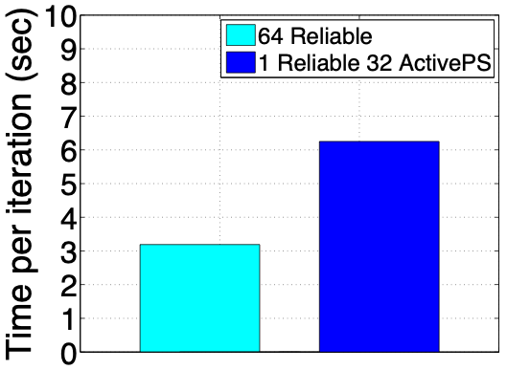
Becomes Slow at High Ratios
64 c4.2x EC2 Machines
1 Server
MF on Netflix Dataset
Costly
Cheap
Notes:
However there is still a problem with this architecture in some cases. This is an experimental result with 1 reliable and 63 unreliable resources. We have ActivePS running on 32 of the machines. You can see that our architecture is running almost twice as slow as the traditional architecture of treating all 64 machines as reliable.

Slide 71
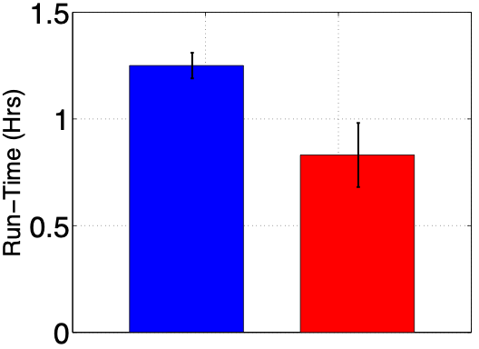
Proteus is also Faster
Proteus
(BidBrain+
AgileML)
Bid-on-demand
+ CKPts

Slide 72
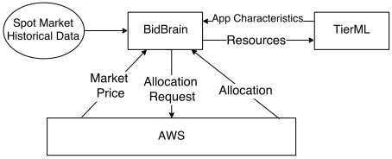
BidBrain TierML Implementation

Slide 73
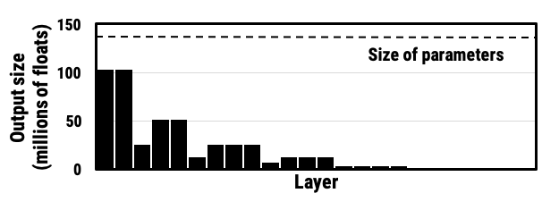
Layer Sizes

Slide 74
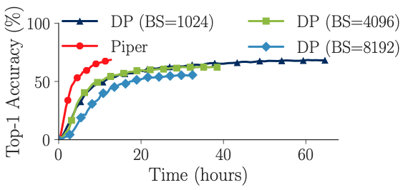
Large Batch Training

Slide 75
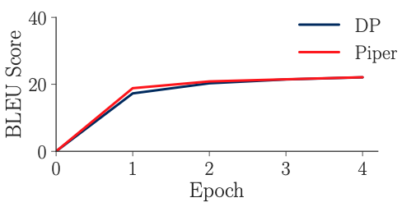
Accuracy vs Epoch

Slide 76
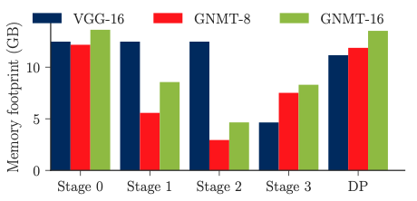
Memory Overheads

Slide 77
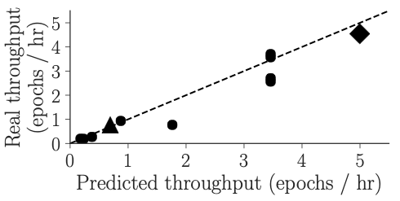
Optimizer

Slide 78
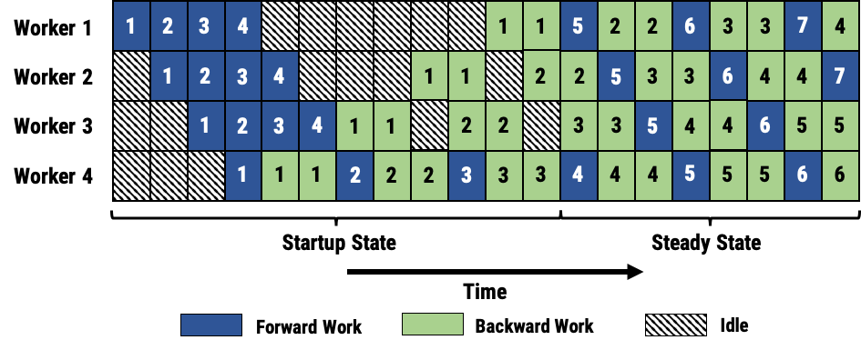
Longer Pipeline

Slide 79
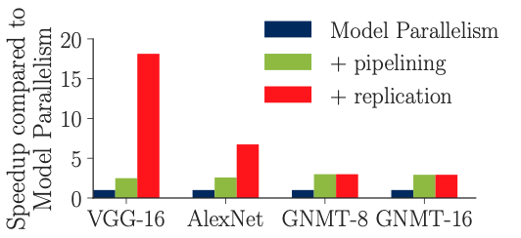
Pipelining and PipeDream are Faster
PipeDream = pipelining + replication
4 V100 GPUs on 1 Server (Azure)

