Slide 1
Proteus: agile ML elasticity through tiered reliability in dynamic resource markets
Aaron Harlap, Alexey Tumanov*,
Andrew Chung, Greg Ganger, Phil Gibbons
Notes:
So today I am going to be talking about agile elasticity in ML. How to achieve agile elasticity and how to take advantage of it.

Slide 2
Overview
Motivation for elasticity in ML
How to make Parameter Servers Elastic
AgileML
How to take advantage of Elasticity
BidBrain
Evaluations of cost benefits and runtime benefits of elasticity for ML
Notes:
I want to start this talk with a quick overview. First at the begging of this talk I am going to talk about some motivations for why we want elasticity. Then I am going to describe to you a component of our system called AgileML which modified the traditional parameter server architecture to make it efficiently elastic. Then I am going to describe a system called BidBrain which is designed to take advantage of elasticity by intelligently bidding on the Amazon EC2 spot market. Lastly at the end of this talk I will go over some evaluation results showing how valuable elasticity is.

Slide 3
Dynamic Resource Availability
Revocable resources are common in clusters
Best effort resource that can be preempted
Yarn, Borg, Mesos, etc…
Adding the element of cost savings in clouds
Preemptible Instances in Google Compute Engine
Spot Instances in Amazon EC2
Notes:
First I want to provide some motivation for why we need elasticity in our systems. Many popular schedulers have such as Yarn and Messos have shown that they significantly improve their cluster utilization and ability to meet SLAs if they are able to revoke resources. The example that I am going to focus on in this talk is the Amazon EC2 spot market, where users can use cheaper resources with the risk of revocation, which we call eviction.

Slide 4
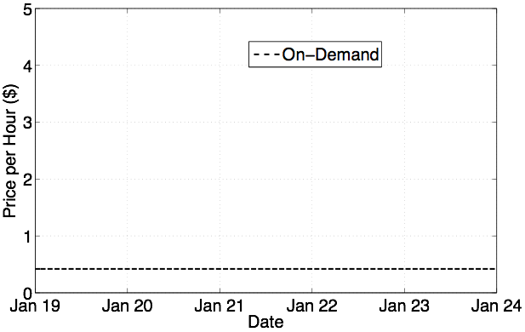
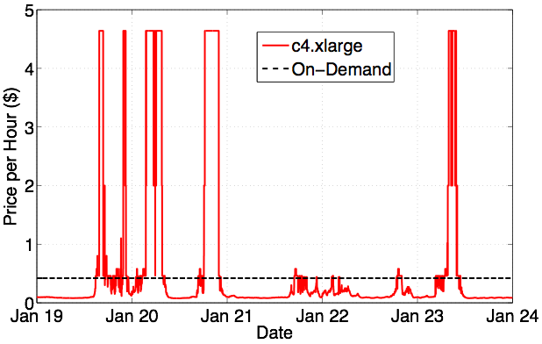
Big $$$ Saving
Often 75-85% cheaper to use Spot Instances
Low Cost
Notes:
what amazon calls the on-demand price
After red describe how cheap it is and explain spot market rules
after blue uncorrelated markets - move indecently
nickels on the dollar

Slide 5
How do you Save $$$
Support agile elasticity
Scale in and out efficiently and quickly
Handle bulk revocations/evictions efficiently
Don’t lose progress
Notes:
So now that we have seen just how much we can save the question becomes how do we do this. The answer is that we need systems that are able to perform efficient elasticity, handle losing large % of their resources efficiently, not lose forward progress, and preferably do all this with no overhead.
Mention this is for ML

Slide 6
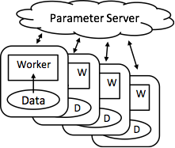
Parameter Servers are Great for Iterative ML
Parameter Servers shard solution state across machines
Traditional architecture has servers and workers on all machines
Used by IterStore, MXNet, Bosen …
Notes:
Efficient
This diagram shows the high level architecture of the traditional PS framework. The workers read in the data, and then concurrently read and update the solution state stored in the parameter server. Current architectures traditionally have workers running on all the machines, and shard the Parameter across all the machines also.
IterStore, Petuum, MxNet

Slide 7
AgileML: New Approach to Elasticity
Use tiers of reliable and un-reliable resources
Revocable resources are un-reliable (transient)
Maintain all state on reliable resources
E.g Parameter Servers only on On-demand Instances
Spot Instances run workers only (initially)
3 architecture stages
based on ratio of transient to reliable resources
Notes:
So we propose a new approach to achieving elasticity called TierML. TireML is a system that is designed to take advantage of tiers of reliability of its resources in order to achieve agile elasticity. It does so by running statefull processes only on reliable on-demand machines, and using unreliable spot machines to only run workers, which are stateless.

Slide 8
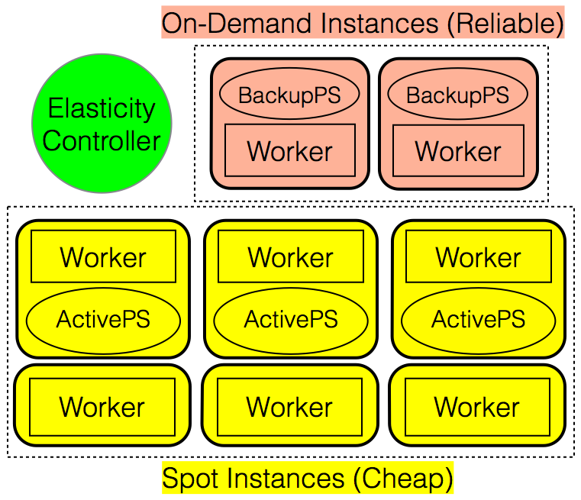
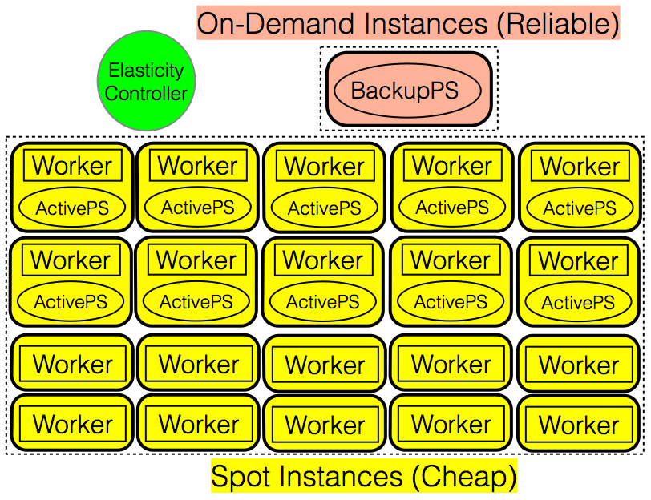
Building the Stages of Reliability
Stage #1
Stage #2
Stage #3
On-Demand Instances (Reliable)
Elasticity
Controller
ParamServ
ParamServ
Worker
Worker
Worker
Worker
Worker
Worker
Spot Instances (Cheap)
Transition between stages at run-time
Little/No overhead for transitions
Transitions based on ratios
Notes:
At the end
Shown you how to design an elastic PS ML system with low overhead, now I want to show you just how low that overhead is

Slide 9
So now we have Agile Elasticity
How do we take advantage of it?
Notes:
So not that we have build TierML, a system that performs agile elasticity, is able to use unreliable resources, and do these things at very little overhead, how do we take advantage of it?

Slide 10
Proteus Implementation
Spot Market
Historical Data
1
2
BidBrain
AgileML
6
3
4
5
Amazon EC2
1) Application Characteristics
3) Feed Spot Market
Price into BidBrian
5) AWS provides
resources to BidBrain
2) Feed Historic Spot
Market into BidBrian
4) BidBrain makes
allocation request
6) BidBrain provides
AgileML with resources
Notes:
Slow down for 4,5,6

Slide 11
Goal is to Minimize Cost Per Work
Computes expected cost of a set of resources
Computes expected work produced by a set of resources
Minimizes expected cost per work

Slide 12
Compute Expected Cost
Current Market Price
Historic Market Price
Bid Delta = Bid Price - Market Price
c4.2xlarge instance type in zone us-east-1a:
Bid Delta | Evicted within Hour | Expected Time to Eviction
$0.0005 | 55% | 42 Min
$0.01 | 5.5% | 738 Min
Notes:
This historic data is designed to provide BidBrain with an estimation about the reliability of resources depending on how much over the market price it decides to bid.
Mention Ideal Case
If you to take advantage of this free computing, you need a system like TierML that can handle evictions, now i will describe how midbrain decides how well the application will handle aggressive bidding

Slide 13
Compute Expected Work
AgileML provides this information to BidBrain
how long after startup do resources become productive
Scalability
Scale in/out overhead
Eviction overhead

Slide 14
Proteus Evaluation
AgileML vs Checkpointing
BidBrain vs Bid On-Demand Policy
Bid On-Demand Policy (standard)
Choose cheapest resource
Bid On-demand Price (user bid = on-demand price)
On eviction repeat

Slide 15
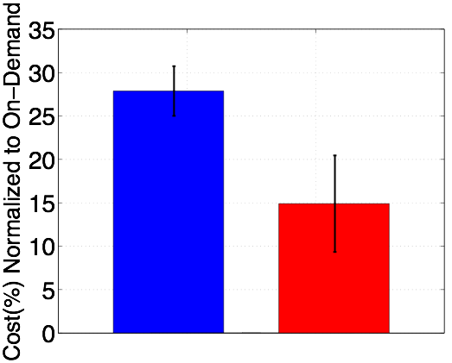
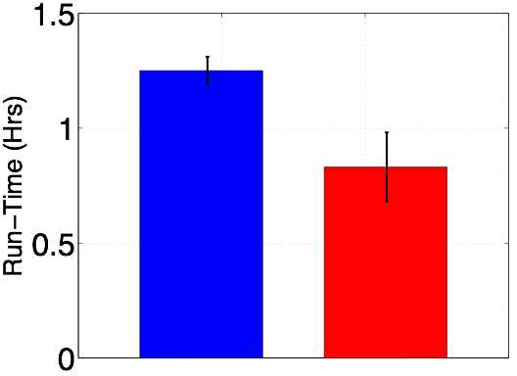
Proteus Saves Money and Time
Proteus
(BidBrain+
AgileML)
Proteus
(BidBrain+
AgileML)
Bid-on-demand
+ CKPts
Bid-on-demand
+ CKPts

Slide 16
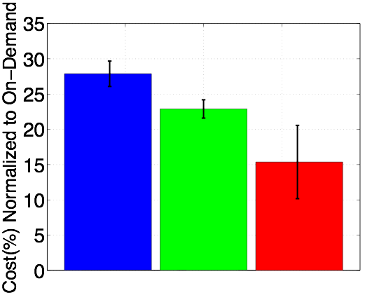
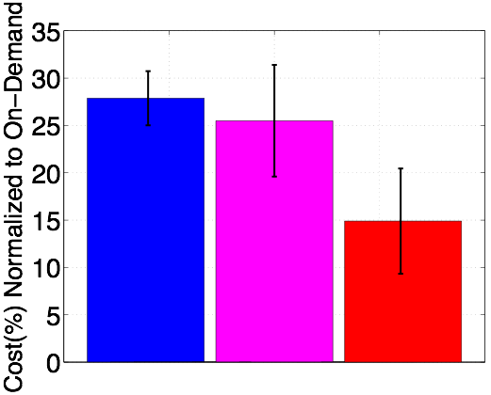
Need Elasticity and Smart Resource Manager
Proteus
BidBrain+
AgileML
Proteus
BidBrain+
AgileML
Standard
+CKPts
Standard
+AgileML
Standard
+CKPts
BidBrain
+CKPts

Slide 17
Summary
Proteus uses agile elastic ML system (AgileML) + smart bidding (BidBrain) take advantage of dynamic resource availability
~85% cost saving compared to on-demand resources!

